Slide 1
Chapter 5
ASSEMBLY PROGRAMING OF ARM7

Slide 2
INTRODUCTION
Assembly Language Programming (ALP) is an efficient way of using the instruction set of a processor.
Here coding is done in a symbolic language which is generally referred to as “mnemonics”.
These mnemonic are directly converted into machine language and are executed by the processor.
Assembler: Tool that does the translation from assembly language to machine language.
Means its process is one-to-one process such that, each mnemonic gets translated to only a specific machine code.

Slide 3
5.1 EMBEDDED PROGRAM DEVELOPMENT
ARM is an embedded processor and the code which is developed has finally to be 'burned' into its ROM.
Code has to be developed, and thoroughly tested and verified to be correct and working.
We need a host computer which is a PC, in which the development and testing of the code is done
PC runs on an x86 processor, but the program that we are working on is for another processor's Instruction Set Architecture (ISA), that is, ARM.
when the assembly process is complete, the binary code that is obtained is of a processor which is not the host computer (x86). So the conversion is termed as 'cross assembly'. If the source program is written in high level language, the translation is called `cross compiling'.

Slide 4
5.1 EMBEDDED PROGRAM DEVELOPMENT (CONTD..)
The host PC should have an IDE (Integrated Development Environment) which is a programming environment that has a code editor, cross compiler and assembler, debugger, simulator and graphical user interface (GUI).
The IDE has knowledge of the registers, instruction set, memory and
peripheral mapping of the embedded processor for which it is used.
IDE of 8051 cannot be used for ARM.
Our approach is to use assembly programming for the ARM core, and C
programming with peripherals

Slide 5
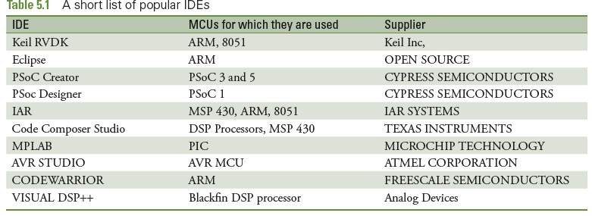
POPULAR IDES IN USE FOR VARIOUS PROCESSORS.

Slide 6
NOTE TO REMEMBER
When using the assembler, the results of the program are checked in registers
and/or memory.
When memory is being used, we may need to choose a specific processor, so that we can define the ROM and RAM spaces.
We have chosen NXP's LPC 214x series, which has ROM starting at address
Ox00000000 and RAM at Ox40000000.

Slide 7
5.1.1 FEATURES OF ARMV4T ISA
The version of ISA used for ARM7 is v4T (the character 'T' means that Thumb instructions are also included).
Feature are:
In general, all Instructions are of size 32 bits for ARM and 16 bits for
THUMB, though there are a few exceptions.
There is a barrel shifter in the ALU, as shown in Fig. 5.1. This means that one of the operands may be shifted/rotated. This is useful for simplifying some types of operations.
The use of the barrel shifter makes possible the combination of shift and ALU operations in a single instruction.
All operands of data processing instructions are in registers.

Slide 8
Only the load and store instructions access memory.
Most other processors use condition checking only with branch instructions. In contrast, here we find that many other instructions have conditions appended to it
There is a special technique for handling immediate instructions.
There are instructions to load/store data in multiple registers.
9.Arithmetic and logical instructions have a three operand format.

Slide 9
SOME POINTS TO NOTE BEFORE WE START
ASSEMBLY PROGRAMMING
The processor can opt to use the big endian or little endian format
In our discussion here, we choose the little endian format.
8-bit (byte), 16-bit(half word) and 32-bit(word) data sizes are possible.
Data alignment is necessary for efficiency.

Slide 10
5.1.2 ASSEMBLY LANGUAGE FORMAT
A line in assembly language has the following format.
Label SAM
Opcode Add
Operands R7,R6,R5
;comments
;add R6 and R5 & copy sum to R7
SAM is the label, ADD is the opcode, and R7, R6, R5 are the operands.
What is written after the semicolon is a comment.

Slide 11
5.2 ARM7 INSTRUCTION SET
The instructions can be classified into the following different types:
Data processing instructions
Load store instructions — single register, multiple register
Branch instructions
Status register access instructions
We will discuss only the first three types.

Slide 12
5.2.1 DATA PROCESSING INSTRUCTIONS
This set includes move, arithmetic, logical and compare instructions.
Lets start with the concept of the barrel shifter which is part of the ALU.
A barrel shifter is a unit which can shift and rotate operands by any
amount.
Figure shows that when there are two source operands in the ALU,
one of them may be shifted/rotated any number of times
Note that the maximum size of any register is 32 bits
so the barrel shifter operations are not needed for shift/rotations beyond 32 times.

Slide 13
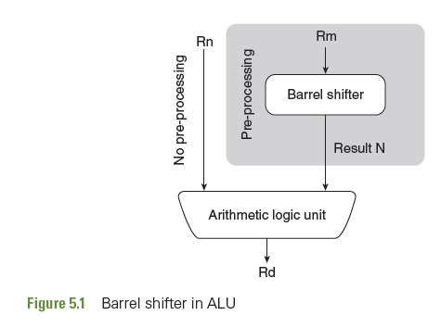

Slide 14
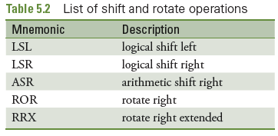

Slide 15
5.2.1.1 LOGICAL SHIFT LEFT (LSL #n)
When the shift amount is specified in the instruction, it is contained in a 5-bit field which may take any value from 0-31.
A logical shift left (LSL) takes the contents of the specified register and shifts it left.
A left shift by one bit position is equivalent to multiplication by 2.
For example, the effect of LSL #4 causes a multiplication by 2⁴, that is, by 16.
The least significant bits of the result are filled with zeros, and the high bits of the register are discarded.
The most significant discarded bit goes into the Carry flag.

Slide 16

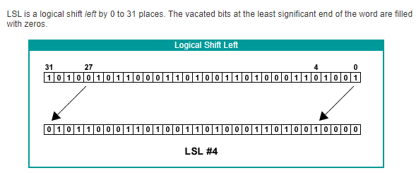

Slide 17
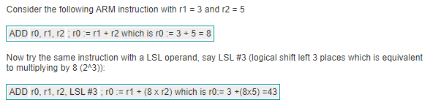
EXAMPLE

Slide 18

5.2.1.2 LOGICAL SHIFT RIGHT (LSR #n)
This is similar to LSL but the shifting is towards right.
Shifting right by each bit position is equivalent to a division by 2.
Thus, LSR #5 causes the data in the specified register to be divided by 32.

Slide 19
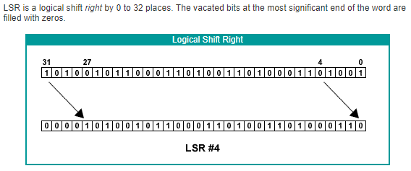

Slide 20
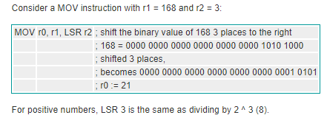

Slide 21

5.2.1.3 ARITHMETIC SHIFT RIGHT (ASR #n)
An arithmetic shift right (ASR) is similar to logical shift right, except that the high bits are filled with the MSB of the register instead of zeros.
This preserves the sign in 2's complement notation. Thus, sign extension is done on the data, along with it being divided by 2 for each shift.
Thus, ASR #4 causes a division by 16

Slide 22
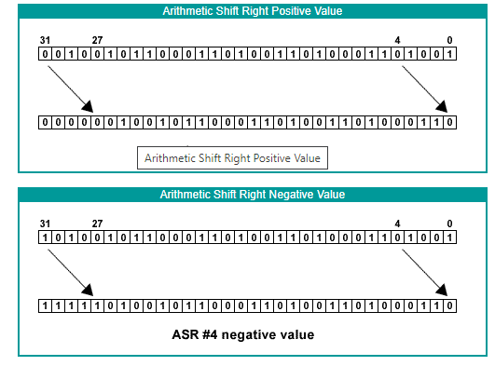

Slide 23
To show the difference between logical and arithmetic right shifts, consider A LSR and ASR where the value to be shifted is 112 and the shift is 3 places. To keep the mathematics simple, we will use 8-bit numbers.
The bit pattern for 112 is 0111 0000.
Performing LSR #3 transforms the bit pattern to be 0000 1110
Result is 14 : 14 to base 10
Performing ASR #3 again transforms the bit pattern to 0000 1110
Now what happens if the number is -112?
First create the 2's complement bit pattern for -112 by flipping the bit pattern of 112 and adding 1.
0111 0000 becomes (1000 1111 + 1) becomes 1001 0000
Now perform a LSR #3 operation on 1001 0000.

Slide 24
This shifts the bits 3 places to the right and fills in the vacated bits with 0s:
1001 0000 becomes 0001 0010 which is +18 to Base 10
Now instead perform an ASR #3 operation on 1001 0000.
This shifts the bits 3 places to the right and fills the vacated bits with copies of the most significant bit, i.e. 1's.
1001 0000 becomes 1111 0010 which is -14 to base 10.

Slide 25

5.2.1.4 ROTATE RIGHT (ROR #n)
Right shifting is done and the bits which overflow are reintroduced at the left end of the register.
The last bit shifted out, is put in the carry flag as well.
There is no 'rotate left' instruction, because left rotation by n
times can be achieved by rotating to the right (32 — n) times.
For example, rotating 4 times to the left is achieved by rotating 32 — 4 = 28 times to the right.

Slide 26
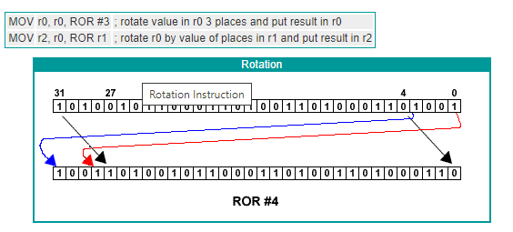

Slide 27
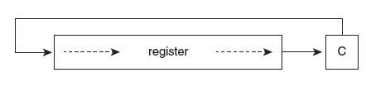
5.2.1.5 ROTATE RIGHT EXTENDED (RRX #n)
RRX is a ROR operation with a crucial difference.
It rotates the number to the right by one place but the original bit 31 is filled by the value of the Carry flag and the original bit 0 is moved into the Carry flag.
This allows a 33-bit rotation by using both the register and the carry flag.

Slide 28
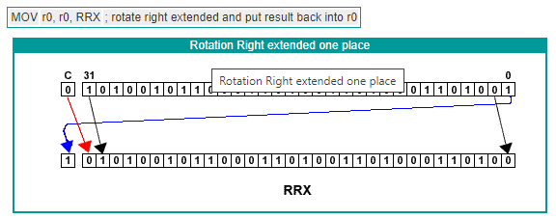

Slide 29
PROBLEMS
Find the results of the following operations given the contents of R1=0x0089EF32, R2=0x80456730, R3=0x8
1. LSL R1,#8 2. LSR R1,#12
ASR R2,R3
ROR R2,R3

Slide 30
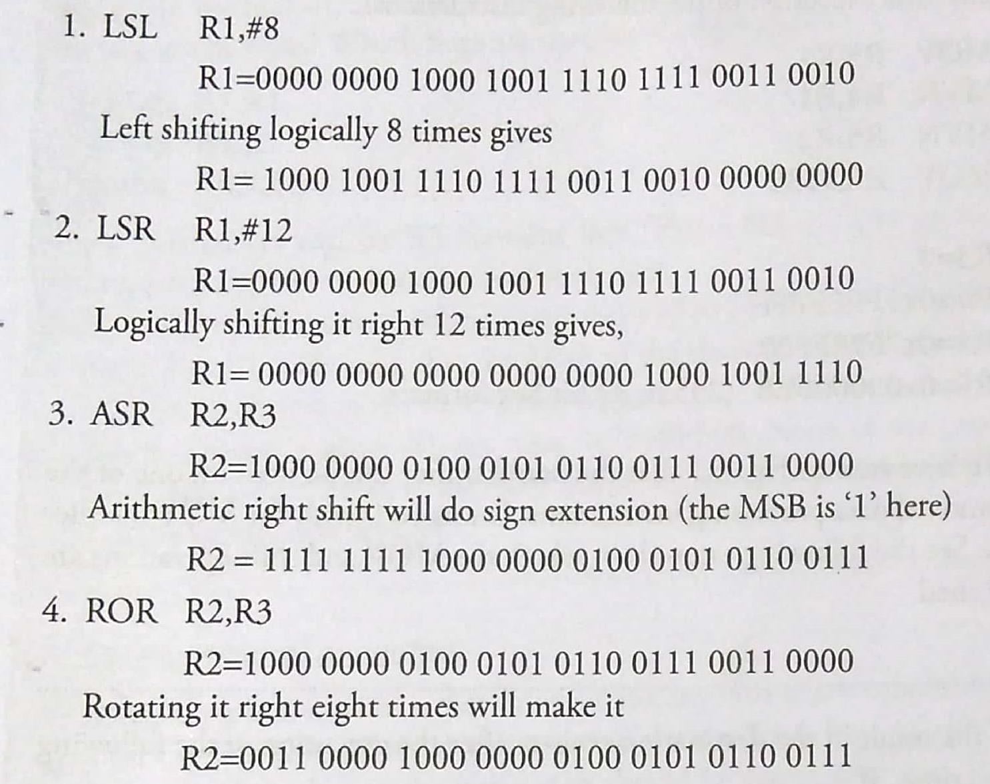
ANSWERS

Slide 31
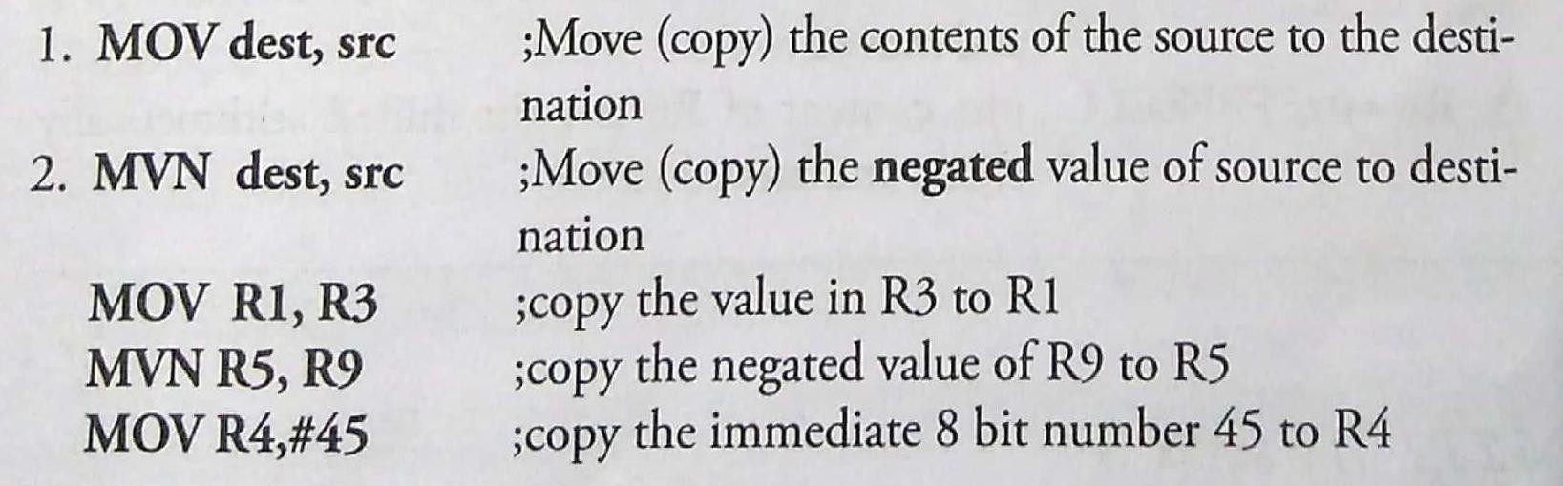
5.2.1.6 MOV Instruction (MOV, MVN)
The most frequently used instruction in any processor is the one that copies from a source to a destination.
In ARM, the `MOV' instruction does the copying of data to a destination register.
The simplest formats of the MOV instruction are as follows:

Slide 32
EXAMPLE 1
What is the content of the destination registers after the execution of the following instructions?
R1 = 0 R2 = 0x896700FF
MOV R3, R1
MVN R4, R1
MVN R5, R2
MOV R6, #235
SOLUTION
R3 = 0
R4 = 0xFFFFFFFF
R5 = 0x7698FF00
R6 = 0x000000EB (235 in 32-bit hexadecimal format)

Slide 33
EXAMPLE 2
Find the result in the destination register after the execution of the following instructions, if:
R6 = 0xFFEE1100 and R2 = 8
MOV R10, R6, LSR #2
MVN R9, R6, LSL #4
MOV R8, R6, ASR R2
Given:
FF EE 11 00
11111111 11101110 00010001 00000000
1) MOV R10, R6, LSR #2
Before:11111111 11101110 00010001 00000000
After LSR #2:R10=00111111 11111011 10000100 01000000= 0x3FFB8440
2) MVN R9, R6, LSL #4
Before: 11111111 11101110 00010001 00000000
After LSL #4: 11111110 11100001 00010000 00000000
Before NOT:11111110 11100001 00010000 00000000
After NOT:00000001 00011110 11101111 11111111
R9 = 0000 0001 00011 110 1110 1111 1111 1111= 0x011EEFFF
3) MOV R8, R6, ASR R2 (R2 = 8)
Before:11111111 11101110 00010001 00000000
After ASR #8:11111111 11111111 11101110 00010001
R8 = 1111 1111 11111111 11101110 00010001 = 0xFFFFEE11

Slide 34
5.2.1.7 THE SUFFIX ‘S’
For any data processing instruction to have the capability to update the conditional flags, it must be suffixed with the character 'S'.
If this suffix is not appended to the instruction, the updating of flags does not occur.
For example, the MOV instruction may be appended as MOVS.
Other instructions which we will see presently, may also be appended with the suffix S

Slide 35
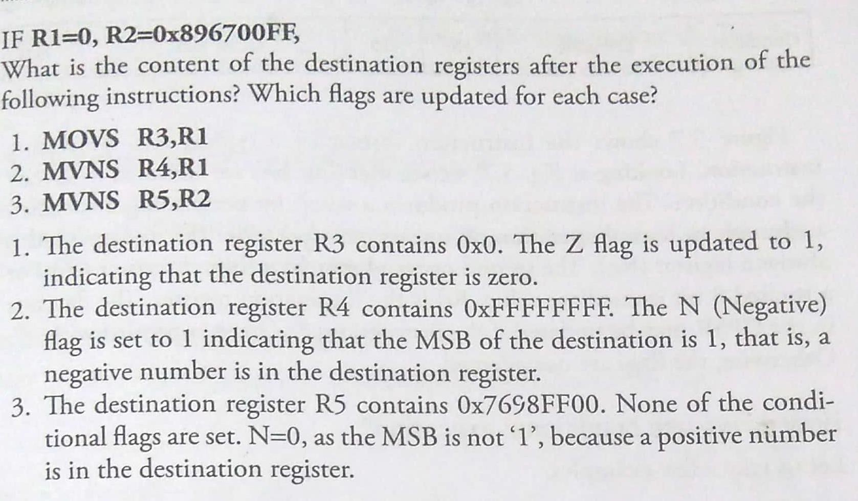

Slide 36
5.2.1.8 CONDITIONAL EXECUTION
One of ARM's special features is that it can execute any instruction conditionally.
The word conditionally implies that the state of the condition flags are checked before it is decided whether the instruction should be executed or not.
If the required condition is not met, the instruction becomes a NOP (No Operation).

Slide 37
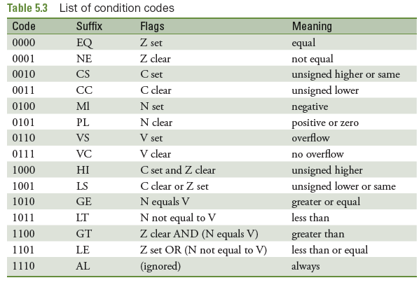
LIST OF CONDITION CODES and the FLAGS UPDATED CORRESPONDINGLY

Slide 38

Format of a Data Processing Instruction
Figure shows the instruction format of a typical data processing instruction.
Looking at Fig, we see that four bits are allocated to specify the condition.
The instruction produces a result by performing a specified arithmetic or logical operation on one or two operands. The first operand is always a register (Rn).
The second operand may be a shifted register (Rm) or a rotated 8 bit immediate value.
Rd is the destination register.
The flag bits in the CPSR may be updated if the instructions has been appended with ‘S'.
Otherwise, the flags are not affected.

Slide 39
How Do We Use Conditional Execution?
Let us take a few examples. MOVEQ R2,R4
The above instruction checks the flags associated with the condition `EQ:( equal). Referring to Table 5.3, we see that the Z flag should be set (Z=1), is the condition specified.
After this instruction is fetched and decoded, the condition (whether Z flag is set) is checked before this instruction comes to the execution stage. If found to be true, the execution of copying the content of R4 to R2 is done. But if Z=0, the instruction simply becomes an NOP, that is, it does not get executed.

Slide 40
MOVHI R5,R6
Before it is decided whether these instructions should be executed or not, the flags associated with the 'HI' condition is looked at. Table
5.3 shows that C=1 and Z=0 are the conditions.
If a previous instruction had updated the flags and these conditions are met, the MOVHI instruction gets executed — otherwise it becomes a NOR

Slide 41
What Are The Pros And Cons Of Such Conditional Execution (Which Is Not Done Inmost Other ISAs)?
The plus points (pros) are:
Most ISAs use conditions only with branch instructions. Here, conditions may be appended to any other instruction, and the condition evaluation hardware is shared for many instructions. The end result is that the effective number of instructions in the ISA becomes more than as seen directly. This is achieved without additional hardware.
Codes become dense and branching is avoided to a great extent
By avoiding branching (unless absolutely necessary), pipeline stalling is prevented

Slide 42
What Are The Pros And Cons Of Such Conditional Execution (Which Is Not Done Inmost Other ISAs)?
The minus points (cons) is:
When an instruction becomes a NOP, one cycle time is wasted.
This is because, even though execution of the instruction is not done, 'fetching and decoding' cannot be avoided.

Slide 43
5.2.1.9 ARITHMETIC AND LOGICAL INSTRUCTIONS
The general format is
<opcode>{cond}{S}Rd,Rn<Op2> where, Rd is the destination register, and Rn and Op2 are the source operands.

Slide 44
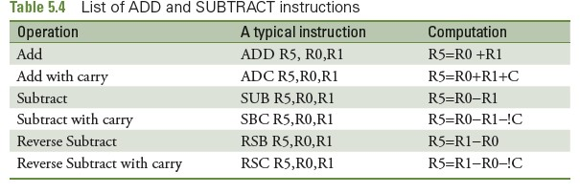
5.2.1.9 ADDITION AND SUBTRACTION
lists of addition and subtraction instructions of this ISA

Slide 45
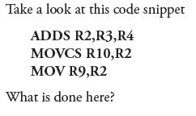
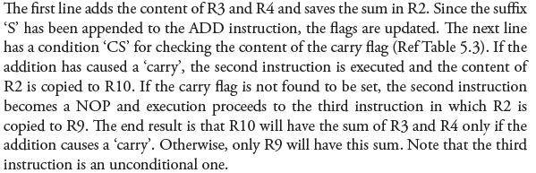

Slide 46
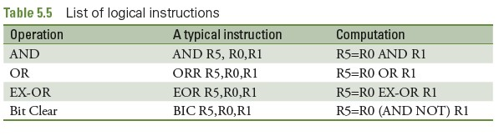

Slide 47
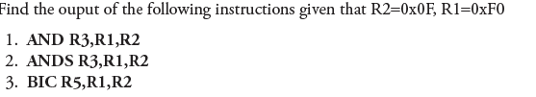
EXAMPLE

Slide 48
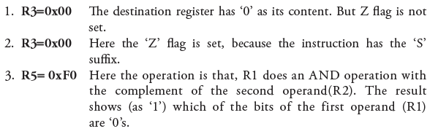
SOLUTION
BIC instruction Rd = Rn AND (NOT Operand2)

Slide 49
5.2.1.10 COMPARE Instruction
There are four instructions for comparison.
Table shows the list and the operations performed for each of them.
The important feature of these instructions is that they do
not produce a result — they only update the flags.
Thus, the `S' suffix is not needed for them.
The format for these instructions is
<opcode>{cond}Rn, Operand2

Slide 50
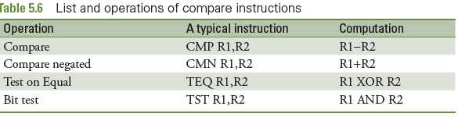
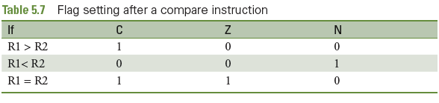

Slide 51
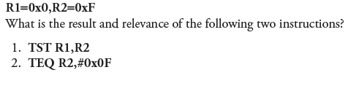
PROBLEM

Slide 52
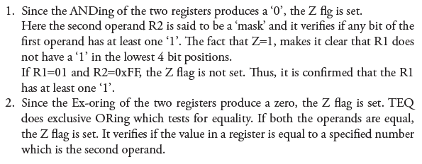
SOLUTION

Slide 53
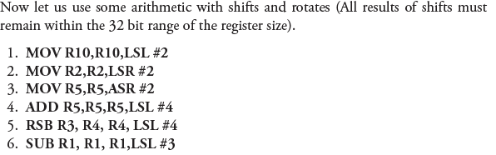
PROBLEM

Slide 54
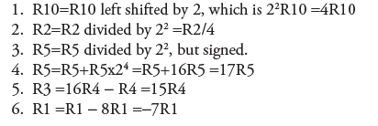
SOLUTION

Slide 55
PROBLEM

Slide 56
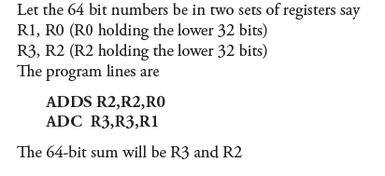
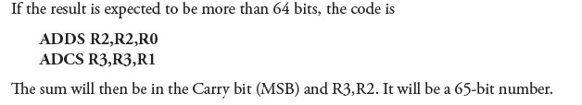

Slide 57
5.2.1.11 MULTIPLICATION
There are two basic multiplication instructions.
One is ‘Multiply’ and the other is ‘Multiply and Accumulate’
The word ‘Accumulate’ indicates ‘Addition’
Instruction format for the both is:
MUL{<cond>}{S} Rd, Rm, Rs MLA{<cond>}{S} Rd,Rm, Rs, Rn
;Rd = Rm * Rs
;Rd= (Rm * Rs) + Rn

Slide 58
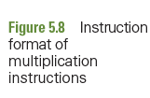
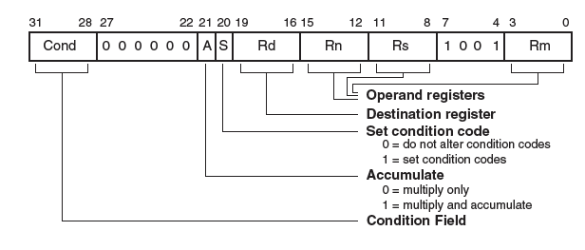

Slide 59
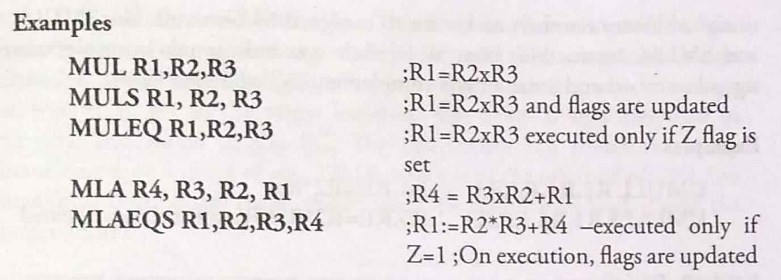
PROBLEM

Slide 60
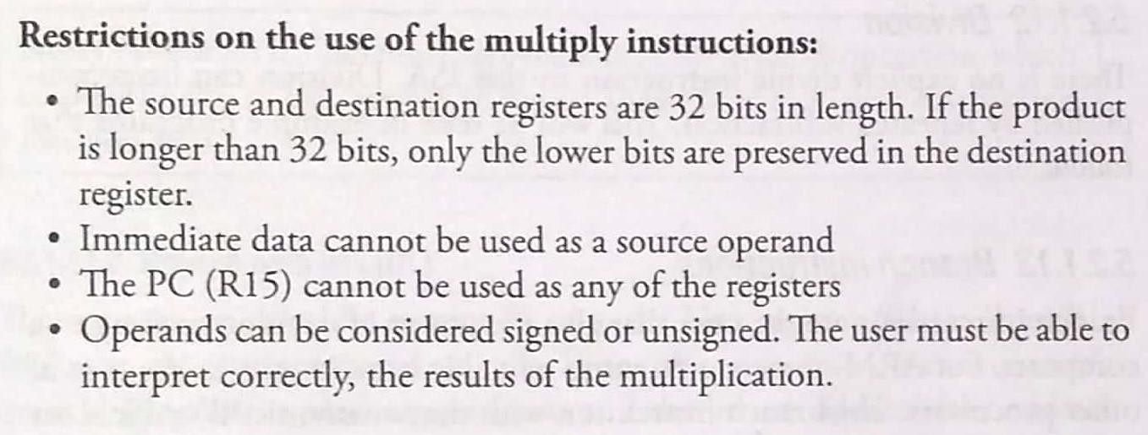

Slide 61
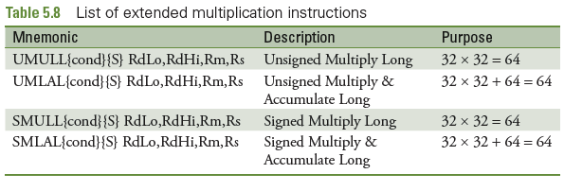

Slide 62
5.2.1.12 DIVISION
There is no explicit divide instruction in this ISA
Division can be accomplished by repeated subtraction i.e .
DIV MOV QUOTIENT,#0
LOOP3 SUBS DIVIDEND,DIVIDEND,DIVISOR
ADDPL QUOTIENT,QUOTIENT,#1
BPL LOOP3
ADDMI REMAINDER,DIVIDEND,DIVISOR
BX LR

Slide 63
5.2.1.13 BRANCH Instruction
Branch instructions are the ones that give the power of decision making to a computer.
For ARM, there are no jump or call instructions as in the case of other processors.
The branch instruction with the mnemonic 'B' suffices for all jumping operations and procedure calls.

Slide 64
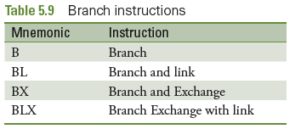
5.2.1.13.1 BRANCH (B)
The general format of a branch instruction is ‘B label'
'label' corresponds to the address of the target location.
Condition codes may be appended to make it a conditional branch instruction.
The assembler finds the target address with the use of the offset specified in the instruction.

Slide 65

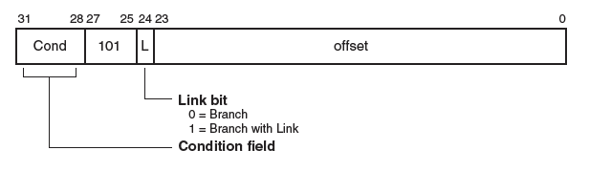

Slide 66
5.2.1.13.2 BRANCH With LINK (BL)
This instruction saves the current PC into the Link register (R14).
Thus, BL facilitates subroutine/procedure calls.
When this instruction is encountered, branching occurs to the target address and the 'return address' (the address to which control must come back after the procedure is ended), is saved in the link register.

Slide 67
5.2.1.13.3 BRANCH With LINK Exchange (BLX)
BLX in ARM BLX = Branch with Link and Exchange
It’s used for:
Function call (like BL)
Switching instruction set (ARM ↔ Thumb)
Syntax : BLX label
1. Branch
Jumps to target address (label or register)
2. Link
Stores return address in LR (R14) 3. Exchange
Switches instruction set depending on LSB of target address(0/1) or(ARM/Thumb mode)

