Slide 1
Unit -IV
Chapter-5
5.3Assembly language programming

Slide 2
5.3 Assembly language programming
Now we can start assembly programming using the Keil Microvision V assembler.
The step-by-step method of using this IDE for Assembly Language

Slide 3
5.3.1 Assembler Directives
For each assembler, there are 'directives'.
They are specific for an assembler and are non-executable statements, which means that they don't cause any `execution' by the processor.
Directives are related solely to the assembler.
We need a few directives of the Keil Assembler to get started in assembly programming.

Slide 4
5.3.1.1 AREA
The “AREA” directive instructs the assembler to assemble a new code or data section".
The above is a statement given in the user manual of Keil Microvi­sion.
It implies that the assembler understands two types of information —code and data.
Data is usually stored in R/W memory (RAM) while code is in Read only memory (ROM).
The assembler requires the names of these areas of code or data.

Slide 5
Typical statements that use the AREA directive are
AREA LINEAR, CODE, Read only
AREA NOTE, DATA, R/W
It is not mandatory to use the words 'Read Only' and `R/W' because by default, data is in R/W memory and code is in Read Only Memory.
Code is always in ROM, though data is also allowed to be stored there.
As a matter of fact, the R/W memory is volatile and is used only for intermediate storage of data in the course of instruction execution

Slide 6
5.3.1.2 ENTRY
The ENTRY directive marks the first instruction to be executed within an application.
Because an application cannot have more than one entry point, the ENTRY directive can appear in only one of the source modules.

Slide 7
5.3.1.3 END
This directive is the last line in an assembly module and it indicates that the assembler need not read beyondthat line.

Slide 8
5.3.1.4 DCB, DCW and DCD
The ARM processor has a word length of 32 bits, but it can handle data of 8 bits (byte) and 16 bits (half word) also.
The Keil assembler, however, uses the notations of byte, word and double word for 8 bits, 16 bits and 32 bits, respectively.
The directives used are DCB for data byte, DCW for data word and DCD for data double word.
The following lines show how these directives are used.
These directives are used by the assembler to store data in ROM.

Slide 9
Example
BAG DCB 0x32, 56, Ox7E
BAG DCW Ox2234, Ox ED37, Ox9067
BOG DCD Ox DE345678, ⁰x34009812
The first line says that three bytes are to be stored in contiguous loca­tions with labels, RAG, RAG+1, and RAG+2. Recollect that each address always corresponds to one byte of data. The second line indicates that 16 bit data is being stored in locations BAG, BAG+2 and BAG+4. The third line states that 32 bit data is to be stored in addresses with labels BOG and BOG+4.

Slide 10
5.3.1.5 equ
The EQU directive is for equating a label to a constant.
When the label is encountered by the assembler during the process of assembly, it is replaced by its actual value.
Examples of the usage of this directive are
RAPID EQU 65
STRT_ADDR EQU Ox84000000

Slide 11
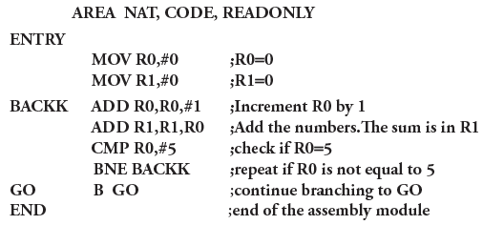

Slide 12
AREA ODD, CODE, READONLY
ENTRY
MOV R1,#1 ;R1=1
MOV R2,#9 ;R2=9, the counter
MOV R3,#1 ;R3=1
BACKK ADD R3,R3,#2 ;R3 has the odd numbers
ADD R1,R1,R3 ;R1 contains the final sum
SUBS R2,R2,#1 ;R2 is the counter for 10 numbers
BNE BACKK ;repeat the addition until R2=0
GO B GO
END

Slide 13
5.4 Accessing memory
We already know that ARM is a load-store architecture.
This means that only the load and store instructions access memory directly.
There are load/store instructions with single registers, as well as with multiple registers.

Slide 14
5.4.1 Single register data transfer
The word 'load' indicates that data from memory is to be moved to a register. `Store' means that data from a register is saved in memory
The format for a load/store instruction is
LDR/STR {<cond>}<Rd>, <addressing mode>
The operation of load/ store has a register Rd in which the data is placed. The `addressing mode' implies that an effective address is generated by address calculation.

Slide 15
Example
LDR R2, [R7] ; copy into R2, the content of memory, as pointed by R7
STR R2, [R7] ; store the content of R2, into the address pointed by R7
The address of the memory location for the load/store operation is placed in a register, called the base register. The address may be generated and put into the base register in various calculation formats using shifting, adding offsets, summing the contents of more registers etc.

Slide 16
Find the effective address of memory as specified by the following instructions
LDR R4, [R7, ROR #4]
STR R7, [R3, R4, LSL #2]
LDR R6, [R2, #4]
STR R8, [R1, R2, ASR #6]
LDR R1,[R7,R6]

Slide 17
The effective address is R7=R7 rotated right 4 times.
The effective address is R3=R3+R4 rotated left logically 2 times.
The effective address is R2=R2+4
The effective address is R1+R2 right shifted (arithmetically) 6 times
The effective address is R7=R7+R6

Slide 18
5.4.2 Loading/Storing data of different lengths
Data to be loaded or stored may be in bytes, half words (16 bits) or words (32 bits).
Data may be signed or unsigned, as well.
To make this explicit, the load and store instructions may be appended with the characters, B for byte, H for half word and S for signed.

Slide 19
Load/Store instructions
Instruction | Meaning
LDR | Load Word
LDRH | Load Half Word
LDRSH | Load Signed Half Word
LDRB | Load Byte
LDRSB | Load Signed Byte
STR | Store Word
STRH | Store Half Word
STRB | Store Byte

Slide 20
How is data accessed from memory with the following instructions, given that R7=0x00004400 and that memory contents are as given in Table (assume the little endian scheme)?
LDR R3, [R7]
LDRB R3,[R7]
LDRH R3, [R7]
LDRSH R3, [R7]
Address | Data
0x00004400 | 89
0x00004401 | E6
0x00004402 | F3
0x00004403 | 94

Slide 21
LDR R3, [R7]
This instruction pertains to a word (32 bits) of data to be loaded into the destination register. After the execution of the above instruction, R3=0x94F3E689.
LDRB R3, [R7]
After the execution of the above instruction, R3=0x00000089. This is because only a byte of the data will be taken from memory and so the lowest byte of the word (in the lowest address) pointed by R7, is loaded to R3.
LDRH R3, [R7]
After the execution of the above instruction, R3=0x0000E689. This is because the half word of the data will be taken from memory and the lower 16 bits of the word pointed by R7, is loaded to R3.
LDRSH R3, [R7]
After the execution of the above instruction, R3=OxFFFFE689. The lower half word of the data is OxE689. The instruction LDRSH considers this to be a 'signed halfword' and when loading it to a 32-bit register, the sign bit is extended to the upper 16 bits.

Slide 22

The content of registers, R6 and R3, and memory are as given below. R6= 0x40002200, R3=0x3498CE56
Address | Data
0x40002200 | 00
0x40002201 | 00
0x40002202 | 00
0x40002203 | 00
Show the content of memory after the execution of the following instructions
STRB R3, [R6]
STRH R3, [R6]
STR R3, [R6]

Slide 23
STRB R3, [R6]
STRH R3, [R6]
Address | Data
0x40002200 | 56
0x40002201 | 00
0x40002202 | 00
0x40002203 | 00
Address | Data
0x40002200 | 56
0x40002201 | CE
0x40002202 | 00
0x40002203 | 00
Address | Data
0x40002200 | 56
0x40002201 | CE
0x40002202 | 98
0x40002203 | 34
STR R3, [R6]

Slide 24
5.4.3 Pre Indexing, Post Indexing and Write Back
Consider the Instruction
STR R0, [R7,#2] and LDR R0,[R7,ROR #4]
In the first instruction, it calculates the effective address as R7=R7+2.
In the second instruction, it calculates the address as R7=R7 ROR #4.

Slide 25
What is the content of R7 after the execution of previous instruction?
The content of R7 remains the same as it was before the instruction execution.
Means the address calculation before, no change in R7

Slide 26
Write Back(!):
If it necessary to save the effective address into the base registers,
Instruction should have the concept of “ Write Back”.
Means the instruction need to have with the sign “ !”.
Write back instruction is:
STR R0, [R7,#2]! and LDR R0,[R7,ROR #4]!

Slide 27
Examples
What is the content of the base register R6 after the execution of each 0f the following instructions, given that R6=0x44001100 and R2 = 0x02.
LDR R2,[R6,#0x0056]!
STR R1,[R6,R2]!
LDR R3,[R6,LSL #4)

Slide 28
1 . LDR R2,[R6,#0x0056]! The effective address is calculated as R6= R6+0x0056 = Ox44001 156, because of write back, this number will be saved in R6 after instruction execution.
2. STR R1,[R6,R2]!
The effective address is calculated as R6=R6+R2 = Ox44001102 because of write back, this number will be saved in R6 after instruction execution.
3. LDR R3,[R6,LSL #4]
The effective address is calculated as R6=R6, LSL# 4. Because the instruction does not have the write back feature (!), after instruction execution, R6 will retain its previous content of Ox44001100.

Slide 29
5.4.4 Post Indexing
In this mode, the effective address calculation is done after the execution of the specific instruction.
Thus, write back is inherently implied.
Take the case of the instruction LDR R2, [R7], #2
Here the data pointed by the content of R7 is first copied to R2.
After that, the content of R7 (which is the base register) is changed to R7 +2.

Slide 30
5.4.5 Immediate mode of addressing
This is the mode when an immediate data is used as an operand.
Consider the instruction
MOV R1, #10 ; move data 10 to R1
ADD R4, R2, #3 ; Add 3 to the content of R2, and save the sum in R4
These instructions seems to be ok. But there is an unseen issues involved

Slide 31
What is the biggest constant that can be used in the immediate mode?
All instructions of ARM are to have same size 32 bits
If an immediate data is to be included, it must fit in the 32-Bit size allocated for a data processing instruction.
Means the larger sizes of constants cannot be used in immediate data.

Slide 32


The figure 5.10 shows the format of a typical data processing instructions of ARM.
If bit 25 is’0’ ,it is understood that the operand2 is a register.
If bit 25 is’1’,the operand2 is immediate data.
12bit space is allocated for operand2.

Slide 33
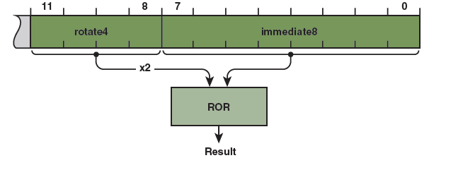

The 12bit space is arranged as a four bit rotate value and an eight bit immediate value as shown in figure 5.11.
The rotation bit field is only 4 bits .
Internally this rotation field is multiplied by 2,and thus becomes the case of an 8 bit number multiplied an even number of times to get a new number.
The operation must be done in a 32 bit space.

Slide 34

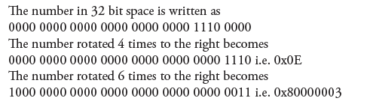

Slide 35
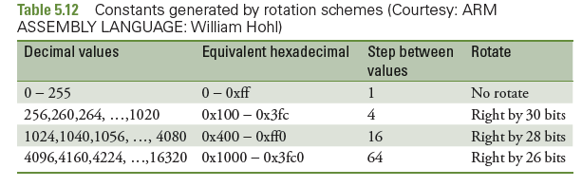

Slide 36
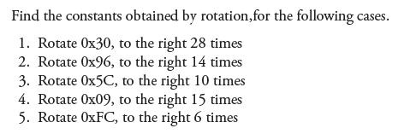

Slide 37

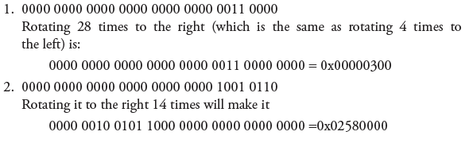


Slide 38
When we want larger constant, it is not possible to write it in an instruction like MOV R1, #n, where n is constant
Need to use the immediate mode in such a way that the constant that we need is obtained by the ARM rotation scheme
Not possible by programmer to find out exact 8-bit number which will produce a bigger size constant
So Assembler will come to an assistant here.
for that, a pseudo instruction is provided
The format is LDR Rd, =constant ; where Rd is destination register
ex: LDR R1, =0x44444444

Slide 39
But all constants are not obtainable by such a scheme.
Consider 0x77777777.
This constant cannot be generated in this way.
In such a case, the assembler is used to store the required constant in memory and take it from memory using the LDR instruction.
The area in memory where such constants are loaded is called a “literal pool”.
programmer need only write the pseudo instruction.
The assembler wil handle the matter in an efficient manner.
The sequence of actions that follow is highlighted below.
Take the case of needing a constant 0x77777777.
The pseudo instruction we write is
LDR R1 ,=0x77777777

Slide 40
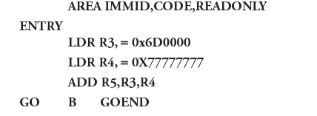

Slide 41
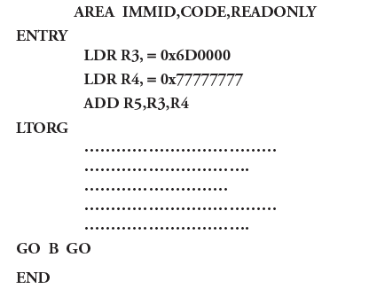
Space for literal pool is:
After the END directive, so that it can be stored in ROM in the space after the code.
If the program is large and the pseudo instruction for it is far away from the end of the program, the literal pool may be beyond the range of +/-4KB.
In such cases a directive LTORG(Origin of literal pool) is used.
This directive may be included in the program to specify where we want the literal pool to be.
Placing LTORG in this place gives a warning message ‘Literal pool in executable area’.

Slide 42
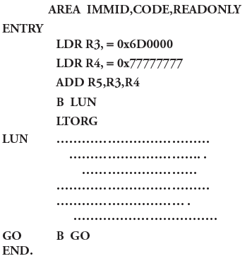
Literal pool are to be place in location in such a way that the processor does not consider them as instructions.
They are best placed after unconditional branch instructions.

Slide 43
5.4.6 Read Only and Read/Write Memory
We know that ROM is for code and RAM is for temporary storage of data.
It is important to realize that data in RAM is accessed using instructions of the processor
while data is placed in ROM using assembler directives like DCD, DCB etc.
From ROM data can be brought to RAM by fisrt loading it to registers using Load (LDR) instructions
Later store them using STR instructions

Slide 44
Block data transfer using multiple registers:
This ISA allows multiple registers to be loaded from contiguous memory locations, with the use of just one instructions.
Similarly ,the content of Multiple registers may be saved into consecutive locations in memory. Such instructions are referred to as multiple load/store instructions.
LDM {cond}address-mode Rn{!},reg-list{^}
Cond: is an optional condition
address-mode: specifies how the memory is sequenced.
Rn: is the base register for the load operation.
! : Specifies base register write back i.e the address in the base register is updated after the transfer.(if the base register is in the register list then no need to specify write back)
Reg-list: List of symbolic register names and register ranges enclosed in braces.There must be at least one register in the list.
^ :This is not to be used in the user/system mode. It is meant for use in the privileged mode.

Slide 45
Addressing modes of the multiple load/store instructions:
These modes indicates how to change the memory address after each word transfer.
The addressing modes are:
IA:Increment After
IB :Increment before
DA:Decrement After
DB:Decrement Before
Instructions are
LDMIA R7! {R0-R5}

Slide 46
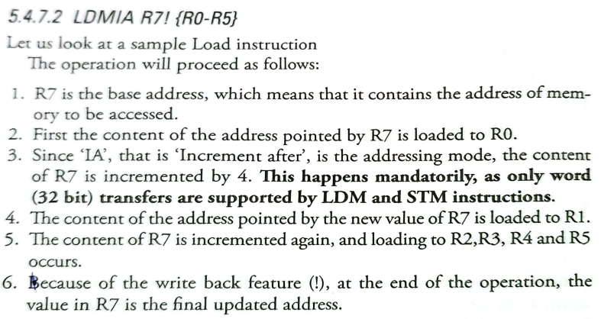

Slide 47
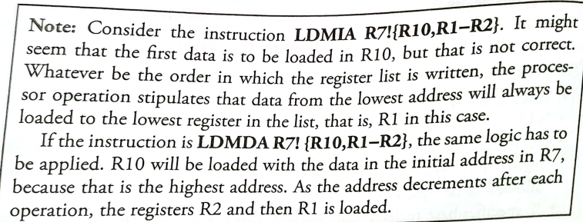

Slide 48
The STM instruction:
Syntax: STM{cond} address-mode Rn!, reg-list{^}
The operation is just the reverse of the LDM instruction.
Here the contents of the registers are stored in memory location indexed by the base register.
STMDB R1!,{R7,R2-R4} if R1=0X44400088
The base register is R1,It contains the number 0X44400088.Since the DB suffix is used, The R1 register is decremented by 4 and it contains the number 0X44400084.
The data in R7 is saved to this location.
The content of R1 is decremented by 4 and the data in R4 is save in this address.
These operation of decrementing the base register is repeated for storing the data in R3 and R2.
At the end of the execution of the instruction, the value in R1 is the final updated value because write back is stipulated.

Slide 49
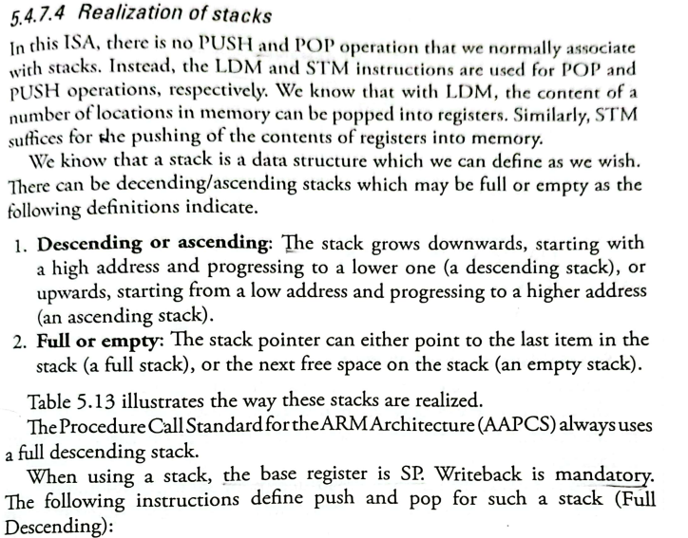

Slide 50
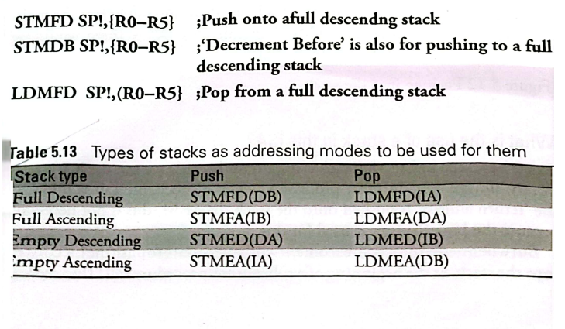
LDMIA SP!,{R0-R5} ;Increment after is also for popping from a full descending stack.
Before we use a stack, the stack pointer has to be initialized to the top of the stack to the topmost location in memory that we decide our stack to be.

Slide 51
What does this program do?
AREA FDSTCK,CODE,READONLY
ENTRY
LDR SP,=0X40000030
MOV R0,#5
MOV R1.#6
MOV R2,#7
STMDB SP!, {R0-R2}
LDMIA SP!, {R9,R4-R5}
GO B GO
END

Slide 52
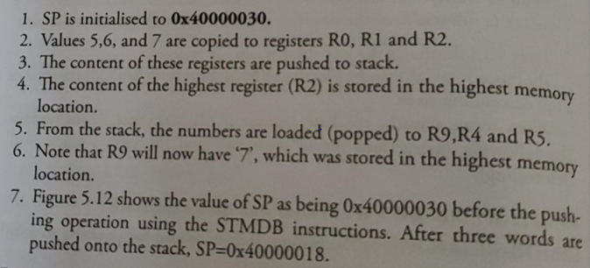

Slide 53
