Slide 1
Chapter 5
ASSEMBLY PROGRAMING OF ARM7

Slide 2
INTRODUCTION
Assembly Language Programming (ALP) is an efficient way of using the instruction set of a processor.
Here coding is done in a symbolic language which is generally referred to as “mnemonics”.
These mnemonic are directly converted into machine language and are executed by the processor.
Assembler: Tool that does the translation from assembly language to machine language.
Means its process is one-to-one process such that, each mnemonic gets translated to only a specific machine code.

Slide 3
5.1 EMBEDDED PROGRAM DEVELOPMENT
ARM is an embedded processor and the code which is developed has finally to be 'burned' into its ROM.
Code has to be developed, and thoroughly tested and verified to be correct and working.
We need a host computer which is a PC, in which the development and testing of the code is done
PC runs on an x86 processor, but the program that we are working on is for another processor's Instruction Set Architecture (ISA), that is, ARM.
when the assembly process is complete, the binary code that is obtained is of a processor which is not the host computer (x86). So the conversion is termed as 'cross assembly'. If the source program is written in high level language, the translation is called `cross compiling'.

Slide 4
5.1 EMBEDDED PROGRAM DEVELOPMENT (CONTD..)
The host PC should have an IDE (Integrated Development Environment) which is a programming environment that has a code editor, cross compiler and assembler, debugger, simulator and graphical user interface (GUI).
The IDE has knowledge of the registers, instruction set, memory and
peripheral mapping of the embedded processor for which it is used.
IDE of 8051 cannot be used for ARM.
Our approach is to use assembly programming for the ARM core, and C
programming with peripherals

Slide 5
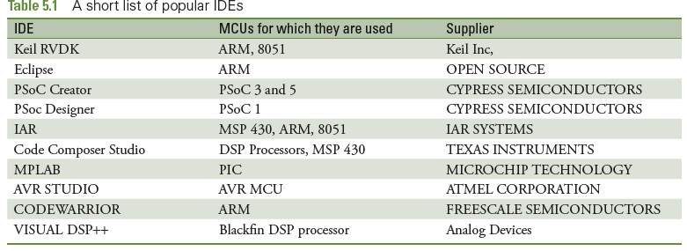
POPULAR IDES IN USE FOR VARIOUS PROCESSORS.

Slide 6
NOTE TO REMEMBER
When using the assembler, the results of the program are checked in registers
and/or memory.
When memory is being used, we may need to choose a specific processor, so that we can define the ROM and RAM spaces.
We have chosen NXP's LPC 214x series, which has ROM starting at address
Ox00000000 and RAM at Ox40000000.

Slide 7
5.1.1 FEATURES OF ARMV4T ISA
The version of ISA used for ARM7 is v4T (the character 'T' means that Thumb instructions are also included).
Feature are:
In general, all Instructions are of size 32 bits for ARM and 16 bits for
THUMB, though there are a few exceptions.
There is a barrel shifter in the ALU, as shown in Fig. 5.1. This means that one of the operands may be shifted/rotated. This is useful for simplifying some types of operations.
The use of the barrel shifter makes possible the combination of shift and ALU operations in a single instruction.
All operands of data processing instructions are in registers.

Slide 8
Only the load and store instructions access memory.
Most other processors use condition checking only with branch instructions. In contrast, here we find that many other instructions have conditions appended to it
There is a special technique for handling immediate instructions.
There are instructions to load/store data in multiple registers.
9.Arithmetic and logical instructions have a three operand format.

Slide 9
SOME POINTS TO NOTE BEFORE WE START
ASSEMBLY PROGRAMMING
The processor can opt to use the big endian or little endian format
In our discussion here, we choose the little endian format.
8-bit (byte), 16-bit(half word) and 32-bit(word) data sizes are possible.
Data alignment is necessary for efficiency.

Slide 10
5.1.2 ASSEMBLY LANGUAGE FORMAT
A line in assembly language has the following format.
Label SAM
Opcode Add
Operands R7,R6,R5
;comments
;add R6 and R5 & copy sum to R7
SAM is the label, ADD is the opcode, and R7, R6, R5 are the operands.
What is written after the semicolon is a comment.

Slide 11
5.2 ARM7 INSTRUCTION SET
The instructions can be classified into the following different types:
Data processing instructions
Load store instructions — single register, multiple register
Branch instructions
Status register access instructions
We will discuss only the first three types.

Slide 12
5.2.1 DATA PROCESSING INSTRUCTIONS
This set includes move, arithmetic, logical and compare instructions.
Lets start with the concept of the barrel shifter which is part of the ALU.
A barrel shifter is a unit which can shift and rotate operands by any
amount.
Figure shows that when there are two source operands in the ALU,
one of them may be shifted/rotated any number of times
Note that the maximum size of any register is 32 bits
so the barrel shifter operations are not needed for shift/rotations beyond 32 times.

Slide 13
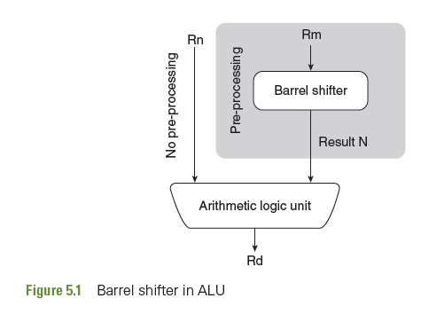

Slide 14
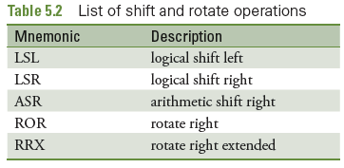

Slide 15
5.2.1.1 LOGICAL SHIFT LEFT (LSL #n)
When the shift amount is specified in the instruction, it is contained in a 5-bit field which may take any value from 0-31.
A logical shift left (LSL) takes the contents of the specified register and shifts it left.
A left shift by one bit position is equivalent to multiplication by 2.
For example, the effect of LSL #4 causes a multiplication by 2⁴, that is, by 16.
The least significant bits of the result are filled with zeros, and the high bits of the register are discarded.
The most significant discarded bit goes into the Carry flag.

Slide 16

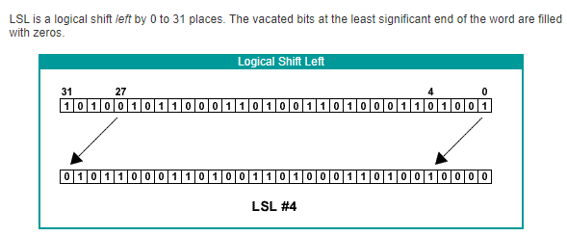

Slide 17
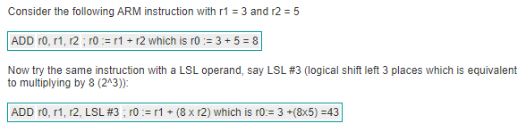
EXAMPLE

Slide 18

5.2.1.2 LOGICAL SHIFT RIGHT (LSR #n)
This is similar to LSL but the shifting is towards right.
Shifting right by each bit position is equivalent to a division by 2.
Thus, LSR #5 causes the data in the specified register to be divided by 32.

Slide 19
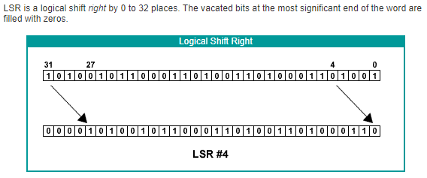

Slide 20
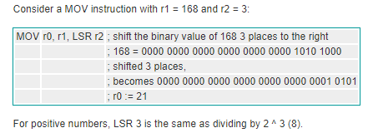

Slide 21

5.2.1.3 ARITHMETIC SHIFT RIGHT (ASR #n)
An arithmetic shift right (ASR) is similar to logical shift right, except that the high bits are filled with the MSB of the register instead of zeros.
This preserves the sign in 2's complement notation. Thus, sign extension is done on the data, along with it being divided by 2 for each shift.
Thus, ASR #4 causes a division by 16

Slide 22
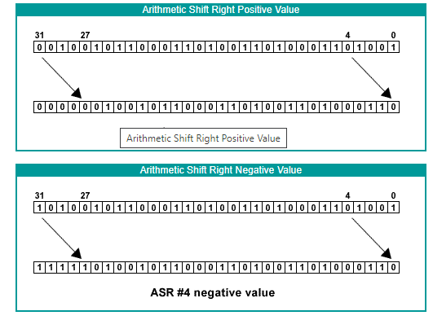

Slide 23
To show the difference between logical and arithmetic right shifts, consider A LSR and ASR where the value to be shifted is 112 and the shift is 3 places. To keep the mathematics simple, we will use 8-bit numbers.
The bit pattern for 112 is 0111 0000.
Performing LSR #3 transforms the bit pattern to be 0000 1110
Result is 14 : 14 to base 10
Performing ASR #3 again transforms the bit pattern to 0000 1110
Now what happens if the number is -112?
First create the 2's complement bit pattern for -112 by flipping the bit pattern of 112 and adding 1.
0111 0000 becomes (1000 1111 + 1) becomes 1001 0000
Now perform a LSR #3 operation on 1001 0000.

Slide 24
This shifts the bits 3 places to the right and fills in the vacated bits with 0s:
1001 0000 becomes 0001 0010 which is +18 to Base 10
Now instead perform an ASR #3 operation on 1001 0000.
This shifts the bits 3 places to the right and fills the vacated bits with copies of the most significant bit, i.e. 1's.
1001 0000 becomes 1111 0010 which is -14 to base 10.

Slide 25

5.2.1.4 ROTATE RIGHT (ROR #n)
Right shifting is done and the bits which overflow are reintroduced at the left end of the register.
The last bit shifted out, is put in the carry flag as well.
There is no 'rotate left' instruction, because left rotation by n
times can be achieved by rotating to the right (32 — n) times.
For example, rotating 4 times to the left is achieved by rotating 32 — 4 = 28 times to the right.

Slide 26
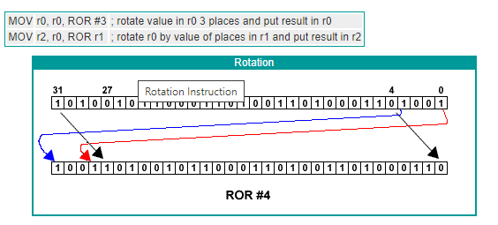

Slide 27
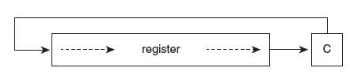
5.2.1.5 ROTATE RIGHT EXTENDED (RRX #n)
RRX is a ROR operation with a crucial difference.
It rotates the number to the right by one place but the original bit 31 is filled by the value of the Carry flag and the original bit 0 is moved into the Carry flag.
This allows a 33-bit rotation by using both the register and the carry flag.

Slide 28
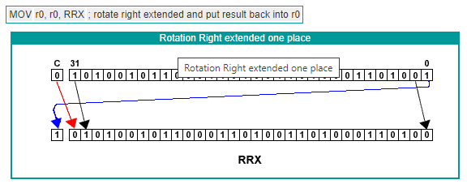

Slide 29
PROBLEMS
Find the results of the following operations given the contents of R1=0x0089EF32, R2=0x80456730, R3=0x8
1. LSL R1,#8 2. LSR R1,#12
ASR R2,R3
ROR R2,R3

Slide 30
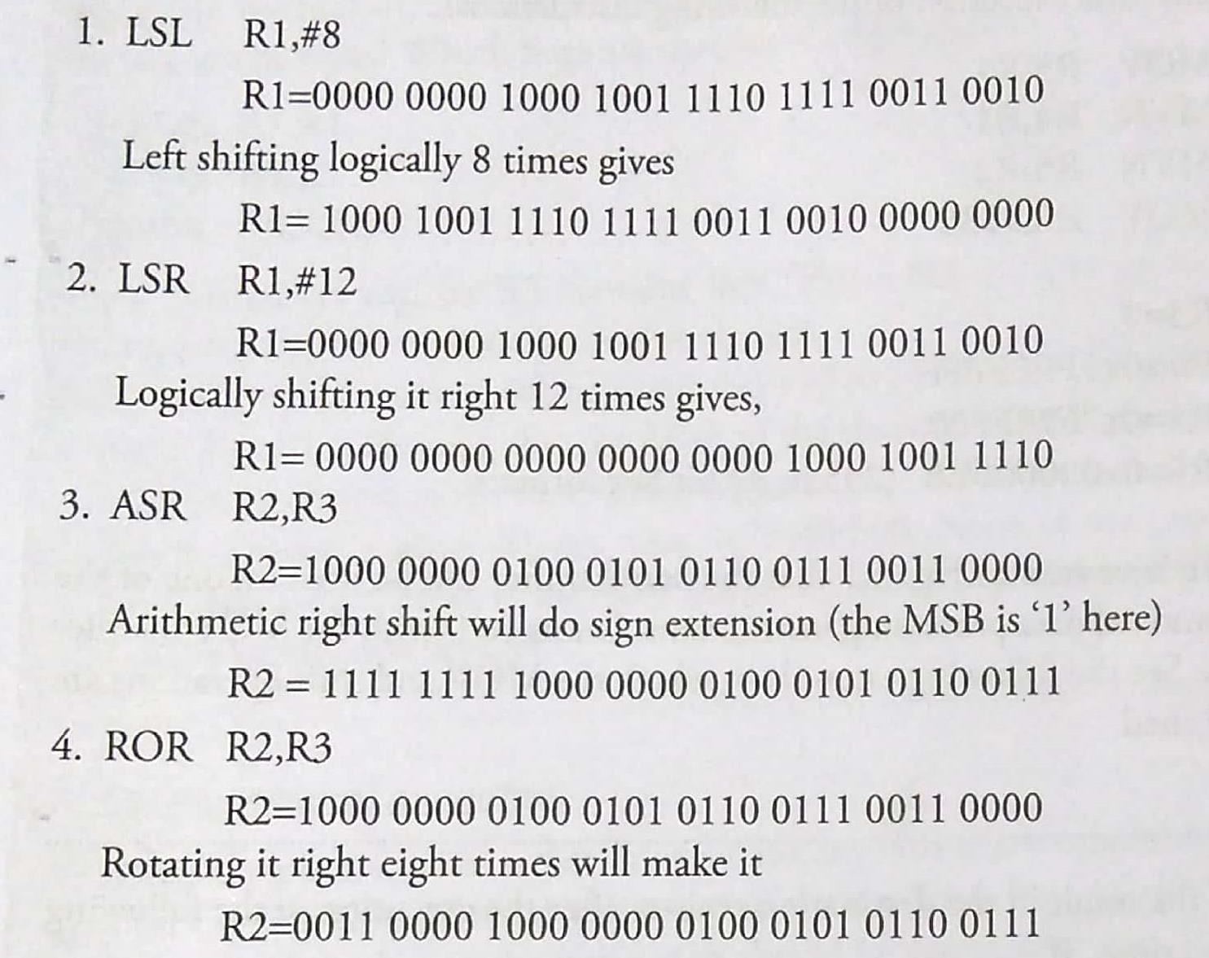
ANSWERS

Slide 31
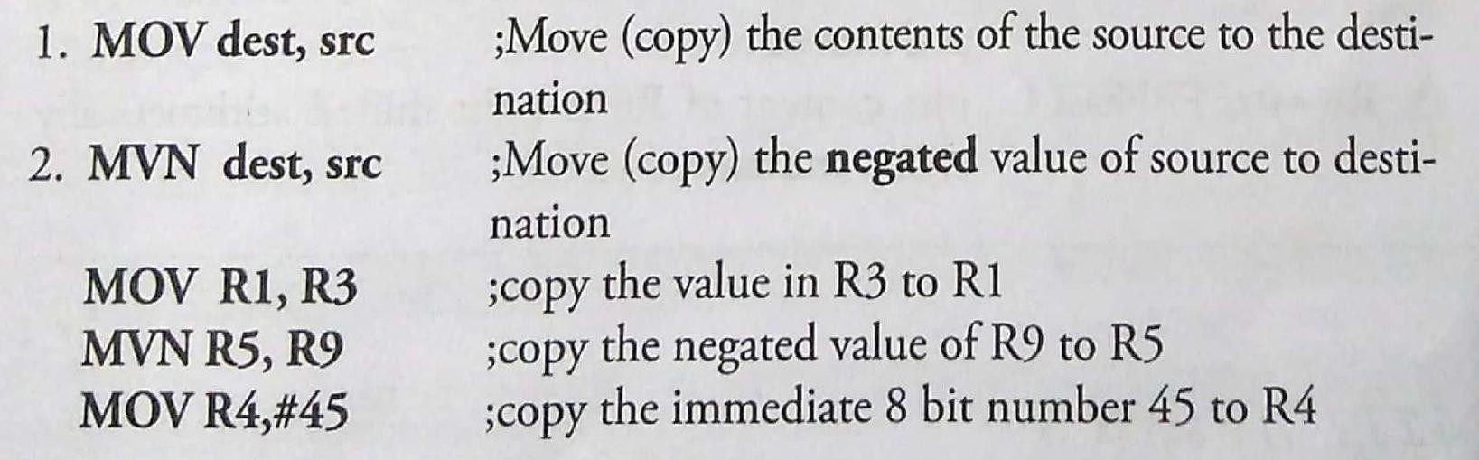
5.2.1.6 MOV Instruction (MOV, MVN)
The most frequently used instruction in any processor is the one that copies from a source to a destination.
In ARM, the `MOV' instruction does the copying of data to a destination register.
The simplest formats of the MOV instruction are as follows:

Slide 32
EXAMPLE 1
What is the content of the destination registers after the execution of the following instructions?
R1 = 0 R2 = 0x896700FF
MOV R3, R1
MVN R4, R1
MVN R5, R2
MOV R6, #235
SOLUTION
R3 = 0
R4 = 0xFFFFFFFF
R5 = 0x7698FF00
R6 = 0x000000EB (235 in 32-bit hexadecimal format)

Slide 33
EXAMPLE 2
Find the result in the destination register after the execution of the following instructions, if:
R6 = 0xFFEE1100 and R2 = 8
MOV R10, R6, LSR #2
MVN R9, R6, LSL #4
MOV R8, R6, ASR R2
Given:
FF EE 11 00
11111111 11101110 00010001 00000000
1) MOV R10, R6, LSR #2
Before:11111111 11101110 00010001 00000000
After LSR #2:R10=00111111 11111011 10000100 01000000= 0x3FFB8440
2) MVN R9, R6, LSL #4
Before: 11111111 11101110 00010001 00000000
After LSL #4: 11111110 11100001 00010000 00000000
Before NOT:11111110 11100001 00010000 00000000
After NOT:00000001 00011110 11101111 11111111
R9 = 0000 0001 00011 110 1110 1111 1111 1111= 0x011EEFFF
3) MOV R8, R6, ASR R2 (R2 = 8)
Before:11111111 11101110 00010001 00000000
After ASR #8:11111111 11111111 11101110 00010001
R8 = 1111 1111 11111111 11101110 00010001 = 0xFFFFEE11

Slide 34
5.2.1.7 THE SUFFIX ‘S’
For any data processing instruction to have the capability to update the conditional flags, it must be suffixed with the character 'S'.
If this suffix is not appended to the instruction, the updating of flags does not occur.
For example, the MOV instruction may be appended as MOVS.
Other instructions which we will see presently, may also be appended with the suffix S

Slide 35
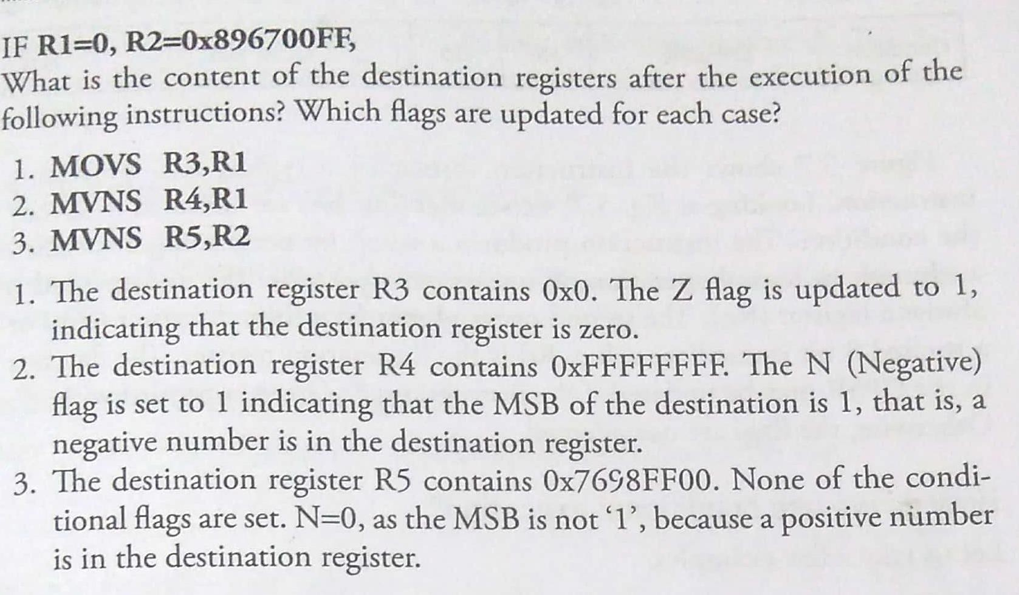

Slide 36
5.2.1.8 CONDITIONAL EXECUTION
One of ARM's special features is that it can execute any instruction conditionally.
The word conditionally implies that the state of the condition flags are checked before it is decided whether the instruction should be executed or not.
If the required condition is not met, the instruction becomes a NOP (No Operation).

Slide 37
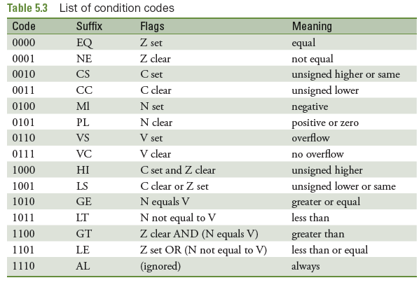
LIST OF CONDITION CODES and the FLAGS UPDATED CORRESPONDINGLY

Slide 38

Format of a Data Processing Instruction
Figure shows the instruction format of a typical data processing instruction.
Looking at Fig, we see that four bits are allocated to specify the condition.
The instruction produces a result by performing a specified arithmetic or logical operation on one or two operands. The first operand is always a register (Rn).
The second operand may be a shifted register (Rm) or a rotated 8 bit immediate value.
Rd is the destination register.
The flag bits in the CPSR may be updated if the instructions has been appended with ‘S'.
Otherwise, the flags are not affected.

Slide 39
How Do We Use Conditional Execution?
Let us take a few examples. MOVEQ R2,R4
The above instruction checks the flags associated with the condition `EQ:( equal). Referring to Table 5.3, we see that the Z flag should be set (Z=1), is the condition specified.
After this instruction is fetched and decoded, the condition (whether Z flag is set) is checked before this instruction comes to the execution stage. If found to be true, the execution of copying the content of R4 to R2 is done. But if Z=0, the instruction simply becomes an NOP, that is, it does not get executed.

Slide 40
MOVHI R5,R6
Before it is decided whether these instructions should be executed or not, the flags associated with the 'HI' condition is looked at. Table
5.3 shows that C=1 and Z=0 are the conditions.
If a previous instruction had updated the flags and these conditions are met, the MOVHI instruction gets executed — otherwise it becomes a NOR

Slide 41
What Are The Pros And Cons Of Such Conditional Execution (Which Is Not Done Inmost Other ISAs)?
The plus points (pros) are:
Most ISAs use conditions only with branch instructions. Here, conditions may be appended to any other instruction, and the condition evaluation hardware is shared for many instructions. The end result is that the effective number of instructions in the ISA becomes more than as seen directly. This is achieved without additional hardware.
Codes become dense and branching is avoided to a great extent
By avoiding branching (unless absolutely necessary), pipeline stalling is prevented

Slide 42
What Are The Pros And Cons Of Such Conditional Execution (Which Is Not Done Inmost Other ISAs)?
The minus points (cons) is:
When an instruction becomes a NOP, one cycle time is wasted.
This is because, even though execution of the instruction is not done, 'fetching and decoding' cannot be avoided.

Slide 43
5.2.1.9 ARITHMETIC AND LOGICAL INSTRUCTIONS
The general format is
<opcode>{cond}{S}Rd,Rn<Op2> where, Rd is the destination register, and Rn and Op2 are the source operands.

Slide 44
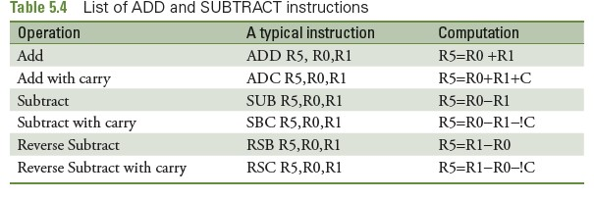
5.2.1.9 ADDITION AND SUBTRACTION
lists of addition and subtraction instructions of this ISA

Slide 45
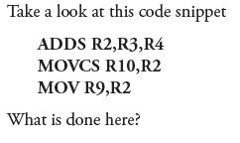
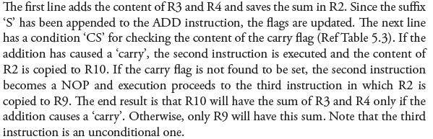

Slide 46
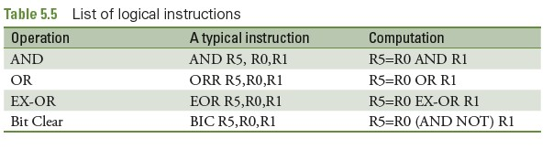

Slide 47
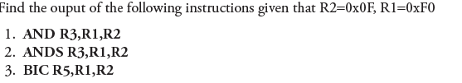
EXAMPLE

Slide 48
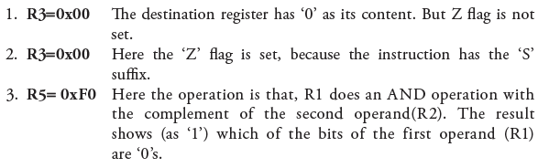
SOLUTION
BIC instruction Rd = Rn AND (NOT Operand2)

Slide 49
5.2.1.10 COMPARE Instruction
There are four instructions for comparison.
Table shows the list and the operations performed for each of them.
The important feature of these instructions is that they do
not produce a result — they only update the flags.
Thus, the `S' suffix is not needed for them.
The format for these instructions is
<opcode>{cond}Rn, Operand2

Slide 50
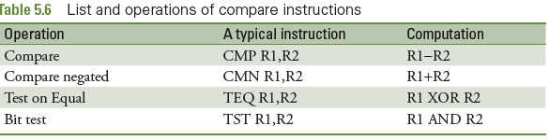
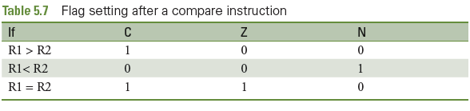

Slide 51
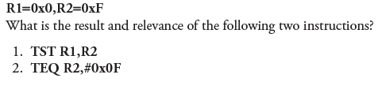
PROBLEM

Slide 52
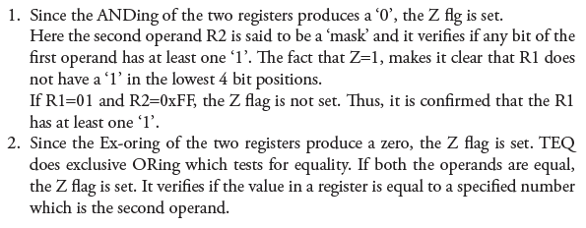
SOLUTION

Slide 53
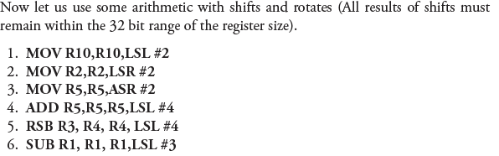
PROBLEM

Slide 54
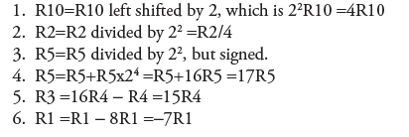
SOLUTION

Slide 55
PROBLEM

Slide 56
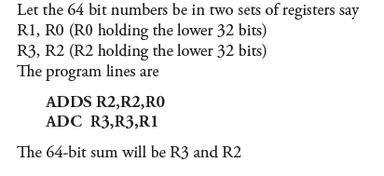
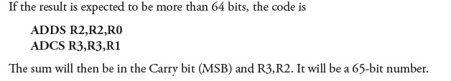

Slide 57
5.2.1.11 MULTIPLICATION
There are two basic multiplication instructions.
One is ‘Multiply’ and the other is ‘Multiply and Accumulate’
The word ‘Accumulate’ indicates ‘Addition’
Instruction format for the both is:
MUL{<cond>}{S} Rd, Rm, Rs MLA{<cond>}{S} Rd,Rm, Rs, Rn
;Rd = Rm * Rs
;Rd= (Rm * Rs) + Rn

Slide 58
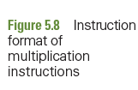
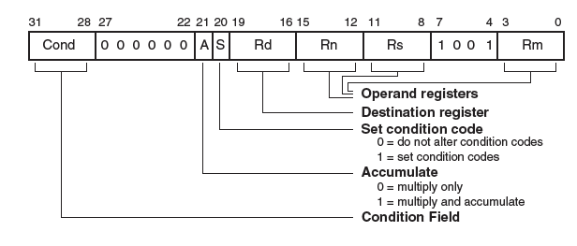

Slide 59
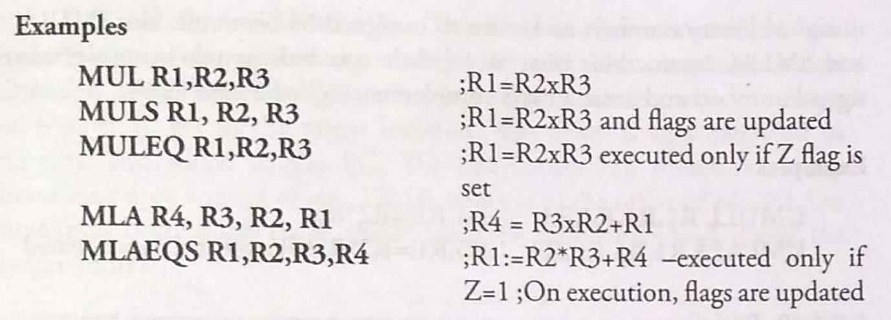
PROBLEM

Slide 60
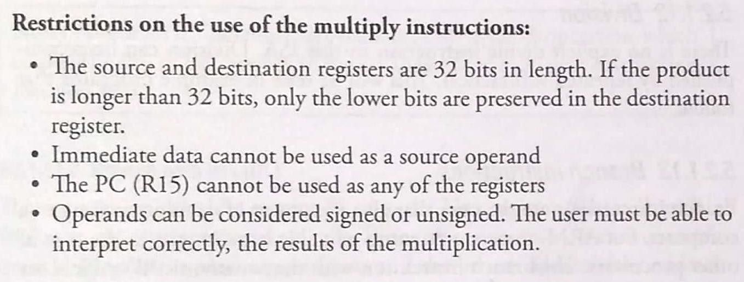

Slide 61
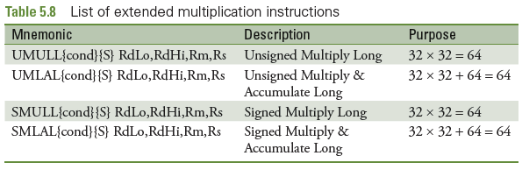

Slide 62
5.2.1.12 DIVISION
There is no explicit divide instruction in this ISA
Division can be accomplished by repeated subtraction i.e .
DIV MOV QUOTIENT,#0
LOOP3 SUBS DIVIDEND,DIVIDEND,DIVISOR
ADDPL QUOTIENT,QUOTIENT,#1
BPL LOOP3
ADDMI REMAINDER,DIVIDEND,DIVISOR
BX LR

Slide 63
5.2.1.13 BRANCH Instruction
Branch instructions are the ones that give the power of decision making to a computer.
For ARM, there are no jump or call instructions as in the case of other processors.
The branch instruction with the mnemonic 'B' suffices for all jumping operations and procedure calls.

Slide 64
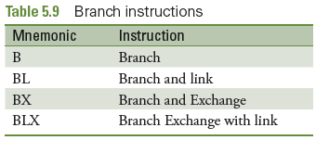
5.2.1.13.1 BRANCH (B)
The general format of a branch instruction is ‘B label'
'label' corresponds to the address of the target location.
Condition codes may be appended to make it a conditional branch instruction.
The assembler finds the target address with the use of the offset specified in the instruction.

Slide 65

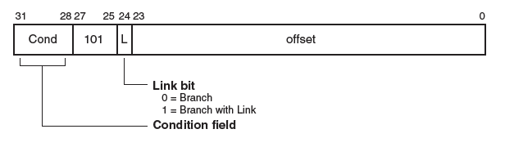

Slide 66
5.2.1.13.2 BRANCH With LINK (BL)
This instruction saves the current PC into the Link register (R14).
Thus, BL facilitates subroutine/procedure calls.
When this instruction is encountered, branching occurs to the target address and the 'return address' (the address to which control must come back after the procedure is ended), is saved in the link register.

Slide 67
5.2.1.13.3 BRANCH With LINK Exchange (BLX)
BLX in ARM BLX = Branch with Link and Exchange
It’s used for:
Function call (like BL)
Switching instruction set (ARM ↔ Thumb)
Syntax : BLX label
1. Branch
Jumps to target address (label or register)
2. Link
Stores return address in LR (R14) 3. Exchange
Switches instruction set depending on LSB of target address(0/1) or(ARM/Thumb mode)

Slide 68
Unit -IV
Chapter-5
Assembly language programming

Slide 69
5.3 Assembly language programming
Now we can start assembly programming using the Keil Microvision V assembler.
The step-by-step method of using this IDE for Assembly Language

Slide 70
5.3.1 Assembler Directives
For each assembler, there are 'directives'.
They are specific for an assembler and are non-executable statements, which means that they don't cause any `execution' by the processor.
Directives are related solely to the assembler.
We need a few directives of the Keil Assembler to get started in assembly programming.

Slide 71
5.3.1.1 AREA
The “AREA” directive instructs the assembler to assemble a new code or data section".
The above is a statement given in the user manual of Keil Microvi­sion.
It implies that the assembler understands two types of information —code and data.
Data is usually stored in R/W memory (RAM) while code is in Read only memory (ROM).
The assembler requires the names of these areas of code or data.

Slide 72
Typical statements that use the AREA directive are
AREA LINEAR, CODE, Read only
AREA NOTE, DATA, R/W
It is not mandatory to use the words 'Read Only' and `R/W' because by default, data is in R/W memory and code is in Read Only Memory.
Code is always in ROM, though data is also allowed to be stored there.
As a matter of fact, the R/W memory is volatile and is used only for intermediate storage of data in the course of instruction execution

Slide 73
5.3.1.2 ENTRY
The ENTRY directive marks the first instruction to be executed within an application.
Because an application cannot have more than one entry point, the ENTRY directive can appear in only one of the source modules.

Slide 74
5.3.1.3 END
This directive is the last line in an assembly module and it indicates that the assembler need not read beyondthat line.

Slide 75
5.3.1.4 DCB, DCW and DCD
The ARM processor has a word length of 32 bits, but it can handle data of 8 bits (byte) and 16 bits (half word) also.
The Keil assembler, however, uses the notations of byte, word and double word for 8 bits, 16 bits and 32 bits, respectively.
The directives used are DCB for data byte, DCW for data word and DCD for data double word.
The following lines show how these directives are used.
These directives are used by the assembler to store data in ROM.

Slide 76
Example
BAG DCB 0x32, 56, Ox7E
BAG DCW Ox2234, Ox ED37, Ox9067
BOG DCD Ox DE345678, ⁰x34009812
The first line says that three bytes are to be stored in contiguous loca­tions with labels, RAG, RAG+1, and RAG+2. Recollect that each address always corresponds to one byte of data. The second line indicates that 16 bit data is being stored in locations BAG, BAG+2 and BAG+4. The third line states that 32 bit data is to be stored in addresses with labels BOG and BOG+4.

Slide 77
5.3.1.5 equ
The EQU directive is for equating a label to a constant.
When the label is encountered by the assembler during the process of assembly, it is replaced by its actual value.
Examples of the usage of this directive are
RAPID EQU 65
STRT_ADDR EQU Ox84000000

Slide 78
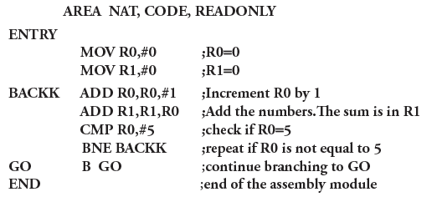

Slide 79
AREA ODD, CODE, READONLY
ENTRY
MOV R1,#1 ;R1=1
MOV R2,#9 ;R2=9, the counter
MOV R3,#1 ;R3=1
BACKK ADD R3,R3,#2 ;R3 has the odd numbers
ADD R1,R1,R3 ;R1 contains the final sum
SUBS R2,R2,#1 ;R2 is the counter for 10 numbers
BNE BACKK ;repeat the addition until R2=0
GO B GO
END

Slide 80
5.4 Accessing memory
We already know that ARM is a load-store architecture.
This means that only the load and store instructions access memory directly.
There are load/store instructions with single registers, as well as with multiple registers.

Slide 81
5.4.1 Single register data transfer
The word 'load' indicates that data from memory is to be moved to a register. `Store' means that data from a register is saved in memory
The format for a load/store instruction is
LDR/STR {<cond>}<Rd>, <addressing mode>
The operation of load/ store has a register Rd in which the data is placed. The `addressing mode' implies that an effective address is generated by address calculation.

Slide 82
Example
LDR R2, [R7] ; copy into R2, the content of memory, as pointed by R7
STR R2, [R7] ; store the content of R2, into the address pointed by R7
The address of the memory location for the load/store operation is placed in a register, called the base register. The address may be generated and put into the base register in various calculation formats using shifting, adding offsets, summing the contents of more registers etc.

Slide 83
Find the effective address of memory as specified by the following instructions
LDR R4, [R7, ROR #4]
STR R7, [R3, R4, LSL #2]
LDR R6, [R2, #4]
STR R8, [R1, R2, ASR #6]
LDR R1,[R7,R6]

Slide 84
The effective address is R7=R7 rotated right 4 times.
The effective address is R3=R3+R4 rotated left logically 2 times.
The effective address is R2=R2+4
The effective address is R1+R2 right shifted (arithmetically) 6 times
The effective address is R7=R7+R6

Slide 85
5.4.2 Loading/Storing data of different lengths
Data to be loaded or stored may be in bytes, half words (16 bits) or words (32 bits).
Data may be signed or unsigned, as well.
To make this explicit, the load and store instructions may be appended with the characters, B for byte, H for half word and S for signed.

Slide 86
Load/Store instructions
Instruction | Meaning
LDR | Load Word
LDRH | Load Half Word
LDRSH | Load Signed Half Word
LDRB | Load Byte
LDRSB | Load Signed Byte
STR | Store Word
STRH | Store Half Word
STRB | Store Byte

Slide 87
How is data accessed from memory with the following instructions, given that R7=0x00004400 and that memory contents are as given in Table (assume the little endian scheme)?
LDR R3, [R7]
LDRB R3,[R7]
LDRH R3, [R7]
LDRSH R3, [R7]
Address | Data
0x00004400 | 89
0x00004401 | E6
0x00004402 | F3
0x00004403 | 94

Slide 88
LDR R3, [R7]
This instruction pertains to a word (32 bits) of data to be loaded into the destination register. After the execution of the above instruction, R3=0x94F3E689.
LDRB R3, [R7]
After the execution of the above instruction, R3=0x00000089. This is because only a byte of the data will be taken from memory and so the lowest byte of the word (in the lowest address) pointed by R7, is loaded to R3.
LDRH R3, [R7]
After the execution of the above instruction, R3=0x0000E689. This is because the half word of the data will be taken from memory and the lower 16 bits of the word pointed by R7, is loaded to R3.
LDRSH R3, [R7]
After the execution of the above instruction, R3=OxFFFFE689. The lower half word of the data is OxE689. The instruction LDRSH considers this to be a 'signed halfword' and when loading it to a 32-bit register, the sign bit is extended to the upper 16 bits.

Slide 89

The content of registers, R6 and R3, and memory are as given below. R6= 0x40002200, R3=0x3498CE56
Address | Data
0x40002200 | 00
0x40002201 | 00
0x40002202 | 00
0x40002203 | 00
Show the content of memory after the execution of the following instructions
STRB R3, [R6]
STRH R3, [R6]
STR R3, [R6]

Slide 90
STRB R3, [R6]
STRH R3, [R6]
Address | Data
0x40002200 | 56
0x40002201 | 00
0x40002202 | 00
0x40002203 | 00
Address | Data
0x40002200 | 56
0x40002201 | CE
0x40002202 | 00
0x40002203 | 00
Address | Data
0x40002200 | 56
0x40002201 | CE
0x40002202 | 98
0x40002203 | 34
STR R3, [R6]

Slide 91
5.4.3 Pre Indexing, Post Indexing and Write Back
Consider the Instruction
STR R0, [R7,#2] and LDR R0,[R7,ROR #4]
In the first instruction, it calculates the effective address as R7=R7+2.
In the second instruction, it calculates the address as R7=R7 ROR #4.

Slide 92
What is the content of R7 after the execution of previous instruction?
The content of R7 remains the same as it was before the instruction execution.
Means the address calculation before, no change in R7

Slide 93
Write Back(!):
If it necessary to save the effective address into the base registers,
Instruction should have the concept of “ Write Back”.
Means the instruction need to have with the sign “ !”.
Write back instruction is:
STR R0, [R7,#2]! and LDR R0,[R7,ROR #4]!

Slide 94
Examples
What is the content of the base register R6 after the execution of each 0f the following instructions, given that R6=0x44001100 and R2 = 0x02.
LDR R2,[R6,#0x0056]!
STR R1,[R6,R2]!
LDR R3,[R6,LSL #4)

Slide 95
1 . LDR R2,[R6,#0x0056]! The effective address is calculated as R6= R6+0x0056 = Ox44001 156, because of write back, this number will be saved in R6 after instruction execution.
2. STR R1,[R6,R2]!
The effective address is calculated as R6=R6+R2 = Ox44001102 because of write back, this number will be saved in R6 after instruction execution.
3. LDR R3,[R6,LSL #4]
The effective address is calculated as R6=R6, LSL# 4. Because the instruction does not have the write back feature (!), after instruction execution, R6 will retain its previous content of Ox44001100.

Slide 96
5.4.4 Post Indexing
In this mode, the effective address calculation is done after the execution of the specific instruction.
Thus, write back is inherently implied.
Take the case of the instruction LDR R2, [R7], #2
Here the data pointed by the content of R7 is first copied to R2.
After that, the content of R7 (which is the base register) is changed to R7 +2.

Slide 97
5.4.5 Immediate mode of addressing
This is the mode when an immediate data is used as an operand.
Consider the instruction
MOV R1, #10 ; move data 10 to R1
ADD R4, R2, #3 ; Add 3 to the content of R2, and save the sum in R4
These instructions seems to be ok. But there is an unseen issues involved

Slide 98
What is the biggest constant that can be used in the immediate mode?
All instructions of ARM are to have same size 32 bits
If an immediate data is to be included, it must fit in the 32-Bit size allocated for a data processing instruction.
Means the larger sizes of constants cannot be used in immediate data.

Slide 99


The figure 5.10 shows the format of a typical data processing instructions of ARM.
If bit 25 is’0’ ,it is understood that the operand2 is a register.
If bit 25 is’1’,the operand2 is immediate data.
12bit space is allocated for operand2.

Slide 100
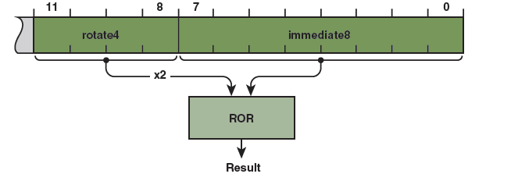

The 12bit space is arranged as a four bit rotate value and an eight bit immediate value as shown in figure 5.11.
The rotation bit field is only 4 bits .
Internally this rotation field is multiplied by 2,and thus becomes the case of an 8 bit number multiplied an even number of times to get a new number.
The operation must be done in a 32 bit space.

Slide 101

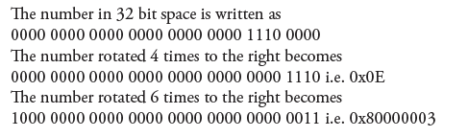

Slide 102
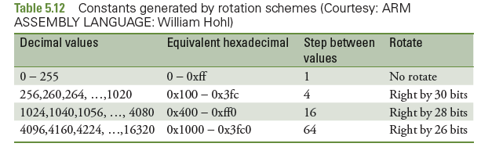

Slide 103
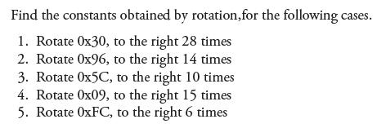

Slide 104

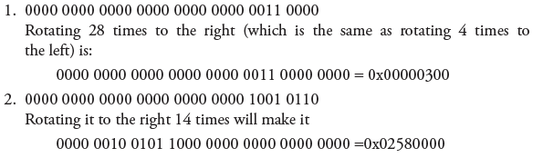


Slide 105
When we want larger constant, it is not possible to write it in an instruction like MOV R1, #n, where n is constant
Need to use the immediate mode in such a way that the constant that we need is obtained by the ARM rotation scheme
Not possible by programmer to find out exact 8-bit number which will produce a bigger size constant
So Assembler will come to an assistant here.
for that, a pseudo instruction is provided
The format is LDR Rd, =constant ; where Rd is destination register
ex: LDR R1, =0x44444444

Slide 106
But all constants are not obtainable by such a scheme.
Consider 0x77777777.
This constant cannot be generated in this way.
In such a case, the assembler is used to store the required constant in memory and take it from memory using the LDR instruction.
The area in memory where such constants are loaded is called a “literal pool”.
programmer need only write the pseudo instruction.
The assembler wil handle the matter in an efficient manner.
The sequence of actions that follow is highlighted below.
Take the case of needing a constant 0x77777777.
The pseudo instruction we write is
LDR R1 ,=0x77777777

Slide 107
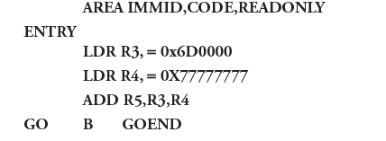

Slide 108
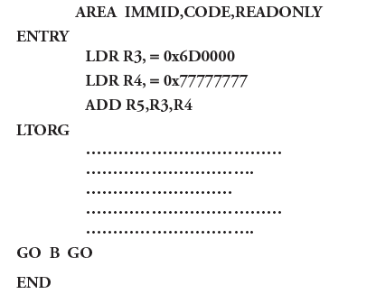
Space for literal pool is:
After the END directive, so that it can be stored in ROM in the space after the code.
If the program is large and the pseudo instruction for it is far away from the end of the program, the literal pool may be beyond the range of +/-4KB.
In such cases a directive LTORG(Origin of literal pool) is used.
This directive may be included in the program to specify where we want the literal pool to be.
Placing LTORG in this place gives a warning message ‘Literal pool in executable area’.

Slide 109
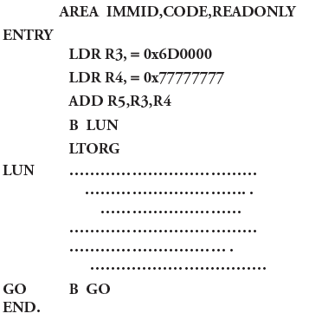
Literal pool are to be place in location in such a way that the processor does not consider them as instructions.
They are best placed after unconditional branch instructions.

Slide 110
5.4.6 Read Only and Read/Write Memory
We know that ROM is for code and RAM is for temporary storage of data.
It is important to realize that data in RAM is accessed using instructions of the processor
while data is placed in ROM using assembler directives like DCD, DCB etc.
From ROM data can be brought to RAM by fisrt loading it to registers using Load (LDR) instructions
Later store them using STR instructions

Slide 111
Block data transfer using multiple registers:
This ISA allows multiple registers to be loaded from contiguous memory locations, with the use of just one instructions.
Similarly ,the content of Multiple registers may be saved into consecutive locations in memory. Such instructions are referred to as multiple load/store instructions.
LDM {cond}address-mode Rn{!},reg-list{^}
Cond: is an optional condition
address-mode: specifies how the memory is sequenced.
Rn: is the base register for the load operation.
! : Specifies base register write back i.e the address in the base register is updated after the transfer.(if the base register is in the register list then no need to specify write back)
Reg-list: List of symbolic register names and register ranges enclosed in braces.There must be at least one register in the list.
^ :This is not to be used in the user/system mode. It is meant for use in the privileged mode.

Slide 112
Addressing modes of the multiple load/store instructions:
These modes indicates how to change the memory address after each word transfer.
The addressing modes are:
IA:Increment After
IB :Increment before
DA:Decrement After
DB:Decrement Before
Instructions are
LDMIA R7! {R0-R5}

Slide 113
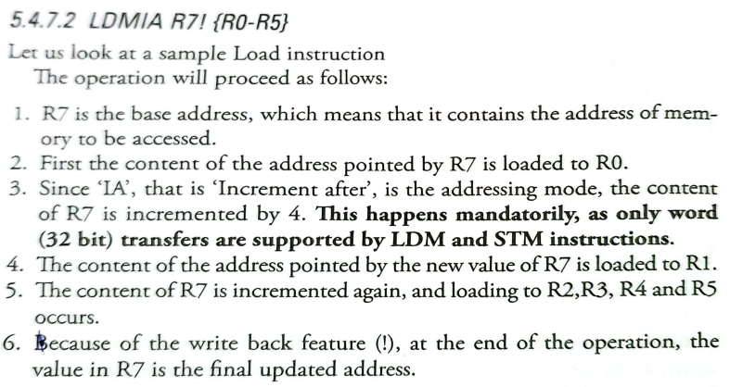

Slide 114
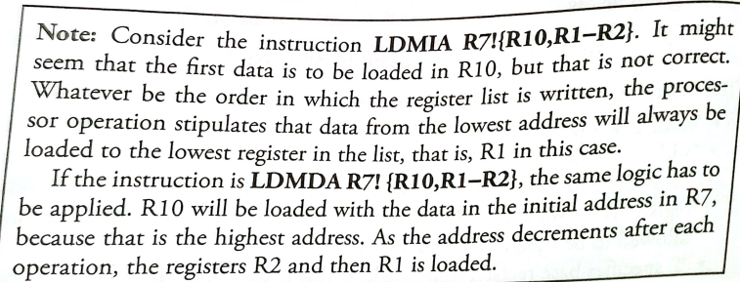

Slide 115
The STM instruction:
Syntax: STM{cond} address-mode Rn!, reg-list{^}
The operation is just the reverse of the LDM instruction.
Here the contents of the registers are stored in memory location indexed by the base register.
STMDB R1!,{R7,R2-R4} if R1=0X44400088
The base register is R1,It contains the number 0X44400088.Since the DB suffix is used, The R1 register is decremented by 4 and it contains the number 0X44400084.
The data in R7 is saved to this location.
The content of R1 is decremented by 4 and the data in R4 is save in this address.
These operation of decrementing the base register is repeated for storing the data in R3 and R2.
At the end of the execution of the instruction, the value in R1 is the final updated value because write back is stipulated.

Slide 116
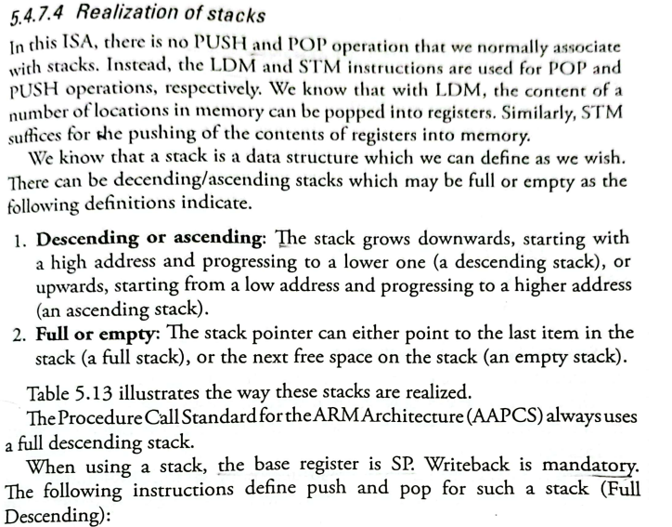

Slide 117
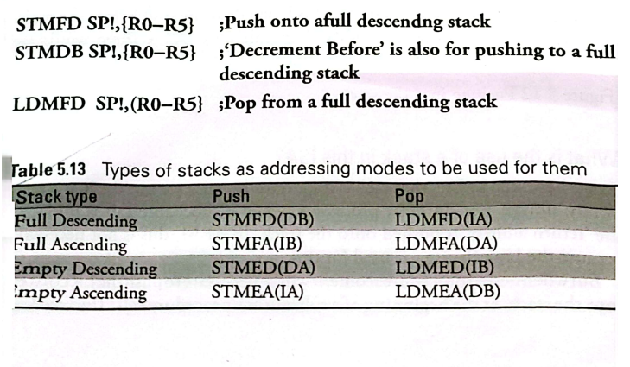
LDMIA SP!,{R0-R5} ;Increment after is also for popping from a full descending stack.
Before we use a stack, the stack pointer has to be initialized to the top of the stack to the topmost location in memory that we decide our stack to be.

Slide 118
What does this program do?
AREA FDSTCK,CODE,READONLY
ENTRY
LDR SP,=0X40000030
MOV R0,#5
MOV R1.#6
MOV R2,#7
STMDB SP!, {R0-R2}
LDMIA SP!, {R9,R4-R5}
GO B GO
END

Slide 119
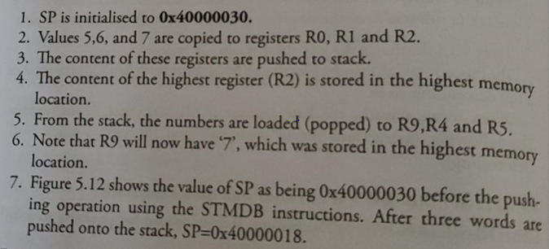

Slide 120


