Slide 1
JAVA SWINGS
UNIT-4

Slide 2
INTRODUCTION
Swing did not exist in the early days of Java. Rather, it was a response to deficiencies present in Java’s original GUI subsystem: the Abstract Window Toolkit.
The AWT defines a basic set of controls, windows, and dialog boxes that support a usable, but limited graphical interface.
One reason for the limited nature of the AWT is that it translates its various visual components into their corresponding, platform-specific equivalents, or peers. This means that the look and feel of a component is defined by the platform, not by Java. Because the AWT components use native code resources, they are referred to as heavyweight.

Slide 3
INTRODUCTION
The use of native peers led to several problems. First, because of variations between operating systems, a component might look, or even act, differently on different platforms.
Second, the look and feel of each component was fixed (because it is defined by the platform) and could not be (easily) changed. Third, the use of heavyweight components caused some frustrating restrictions. For example, a heavyweight component was always opaque.
Introduced in 1997, Swing was included as part of the Java Foundation Classes (JFC). Swing was initially available for use with Java 1.1 as a separate library. However, beginning with Java 1.2, Swing (and the rest of the JFC) was fully integrated into Java.

Slide 4
SWING FEATURES
Swing Components Are Lightweight
Consistent look across all platforms
Supports advanced UI features (transparency, layering)
More control over appearance and behavior
Swing Supports a Pluggable Look and Feel
Your program is the same
Only the style (colors, buttons, design) changes
A button can look:Like Windows style, macOS style Or a custom modern style (Nimbus). But it still works the same when you click it

Slide 5
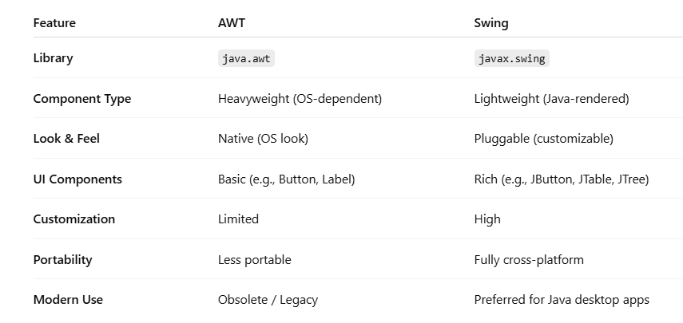
AWT VS SWING

Slide 6
MVC CONNECTION
In general, a visual component is a composite of three distinct aspects:
The way that the component looks when rendered on the screen
The way that the component reacts to the user
The state information associated with the component
In MVC terminology, the model corresponds to the state information associated with the component. The view determines how the component is displayed on the screen, including any aspects of the view that are affected by the current state of the model. The controller determines how the component reacts to the user.
For example, when the user clicks a check box, the controller reacts by changing the model to reflect the user’s choice (checked or unchecked). This then results in the view being updated. By separating a component into a model, a view, and a controller, the specific implementation of each can be changed without affecting the other two.

Slide 7
MVC CONNECTION
Swing uses a modified version of MVC that combines the view and the controller into a single logical entity called the UI delegate. For this reason, Swing’s approach is called either the Model-Delegate architecture or the Separable Model architecture.

Slide 8
CONTAINERS AND COMPONENTS
A Swing GUI consists of two key items: components and containers.
A component is an independent visual control, such as a push button or slider. A container holds a group of components. Thus, a container is a special type of component that is designed to hold other components.
All Swing GUIs will have at least one container. Because containers are components, a container can also hold other containers. This enables Swing to define what is called a containment hierarchy, at the top of which must be a top-level container.

Slide 9
CONTAINERS AND COMPONENTS
In general, Swing components are derived from the JComponent class. JComponent provides the functionality that is common to all components. JComponent inherits the AWT classes Container and Component.
Swing defines two types of containers. The first are top-level containers: JFrame, JApplet, JWindow, and JDialog. These containers do not inherit JComponent. They do, however, inherit the AWT classes Component and Container.
The one most commonly used for applications is JFrame.
Lightweight containers do inherit JComponent. An example of a lightweight container is JPanel, which is a general-purpose container. Lightweight containers are often used to organize and manage groups of related components because a lightweight container can be contained within another container.

Slide 10
SIMPLE CODE
import javax.swing.*;
public class HelloSwing {
public static void main(String[] args) {
JFrame frame = new JFrame("My First Swing App");
frame.setSize(300, 200);
frame.setDefaultCloseOperation(JFrame.EXIT_ON_CLOSE);
frame.setLayout(null);
JLabel label = new JLabel("Hello, Swing!");
frame.add(label); frame.setVisible(true);
}}

Slide 11
EVENT HANDLING
Event handling is the mechanism that controls the event and decides what should happen if an event occurs. In Java Swing, when a user interacts with a GUI component (like a button), an event is generated, and it's handled by event listeners.

Slide 12
SIMPLE JAVA CODE
import javax.swing.*;
import java.awt.event.*;
public class ButtonExample {
public static void main(String[] args) {
JFrame frame = new JFrame("Button Event Example");
JButton button = new JButton("Click Me"); button.setBounds(100, 100, 140, 40);
button.addActionListener(new ActionListener() {
public void actionPerformed(ActionEvent e) {
System.out.println("Button was clicked!"); } });
frame.add(button); frame.setSize(300, 300);frame.setLayout(null); frame.setVisible(true);
frame.setDefaultCloseOperation(JFrame.EXIT_ON_CLOSE); }}

Slide 13
QUESTIONS
Create a GUI with a button labeled "Click Me". Each time it's clicked, increment a counter and display the total number of clicks in a label.
Create a form with a JTextField and a JButton. When the button is clicked, display the text entered in the console.
Create a GUI with two JTextFields, a JButton, and a JLabel. When the button is clicked, show the sum of the numbers entered in the label.
Make a button that toggles its label between "ON" and "OFF" every time it's clicked.

Slide 14
JFRAME
Two constructors
JFrame frame = new JFrame();
JFrame frame = new JFrame(String str);
Common methods
frame.setSize(int width, int height);
frame.setTitle(String title);
frame.setVisible(boolean b);
frame.setDefaultCloseOperation(JFrame.EXIT_ON_CLOSE);
frame.add(Component c);
frame.setLayout(LayoutManager lm);

Slide 15
JLABEL
JLabel can be used to display text and/or an icon. It is a passive component in that it does not respond to user input. JLabel defines several constructors. Here are three of them:
JLabel(Icon icon)
JLabel(String str)
JLabel(String str, Icon icon, int align)
Here, str and icon are the text and icon used for the label. The align argument specifies the horizontal alignment of the text and/or icon within the dimensions of the label. It must be one of the following values: LEFT, RIGHT, CENTER, LEADING, or TRAILING. These constants are defined in the SwingConstants interface, along with several others used by the Swing classes.

Slide 16
package temp;
import javax.swing.*;
import java.awt.*;
public class JLabelExample {
public static void main(String[] args) {
// Create a JFrame to display the JLabel components
JFrame frame = new JFrame("JLabel Constructor Example");
frame.setSize(400, 300);
// Panel to hold the labels
JPanel panel = new JPanel();
frame.add(panel);
// JLabel(Icon icon) constructor example
ImageIcon icon = new ImageIcon("/home/student/sun.jpg");
JLabel labelWithIcon = new JLabel(icon);
panel.add(labelWithIcon);
// JLabel(String str) constructor example
JLabel labelWithText = new JLabel("This is a text label");
panel.add(labelWithText);
// JLabel(String str, Icon icon, int align) constructor example
JLabel labelWithTextAndIcon = new JLabel("Label with text and icon", icon, SwingConstants.CENTER);
panel.add(labelWithTextAndIcon);
panel.setLayout(new GridLayout(3,1));
// Make the frame visible
frame.setVisible(true); } }

Slide 17
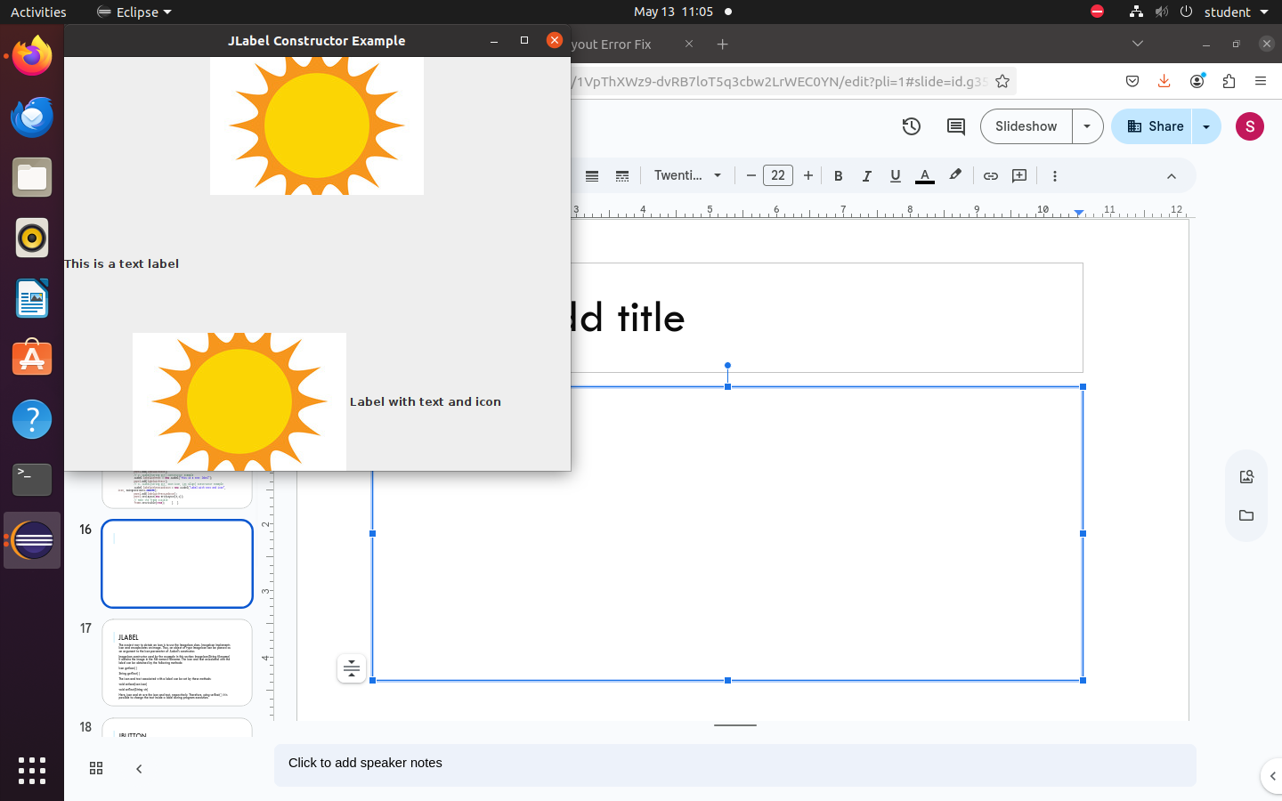
OUTPUT

Slide 18
JLABEL
The easiest way to obtain an icon is to use the ImageIcon class. ImageIcon implements Icon and encapsulates an image. Thus, an object of type ImageIcon can be passed as an argument to the Icon parameter of JLabel’s constructor.
ImageIcon constructor used by the example in this section: ImageIcon(String filename) It obtains the image in the file named filename. The icon and text associated with the label can be obtained by the following methods:
Icon getIcon( )
String getText( )
The icon and text associated with a label can be set by these methods:
void setIcon(Icon icon)
void setText(String str)
Here, icon and str are the icon and text, respectively. Therefore, using setText( ) it is possible to change the text inside a label during program execution.

Slide 19
package temp;
import javax.swing.*;
import java.awt.*;
public class JLabelExample2 {
public static void main(String[] args) {
// Create a new JLabel
JLabel label = new JLabel();
// Set text and icon for the label
label.setText("Welcome to Java!");
ImageIcon icon = new ImageIcon("/home/student/sun.jpg");
label.setIcon(icon);
// Get the text and icon associated with the label
String labelText = label.getText(); // Get the text from the label
Icon labelIcon = label.getIcon(); // Get the icon from the label
// Print out the label's text and icon
System.out.println("Label Text: " + labelText);
System.out.println("Label Icon: " + labelIcon);
// Set up the frame to display the label
JFrame frame = new JFrame("Label Example");
frame.setSize(300, 200);
frame.setLayout(new FlowLayout());
frame.add(label);
frame.setVisible(true); }
}

Slide 20
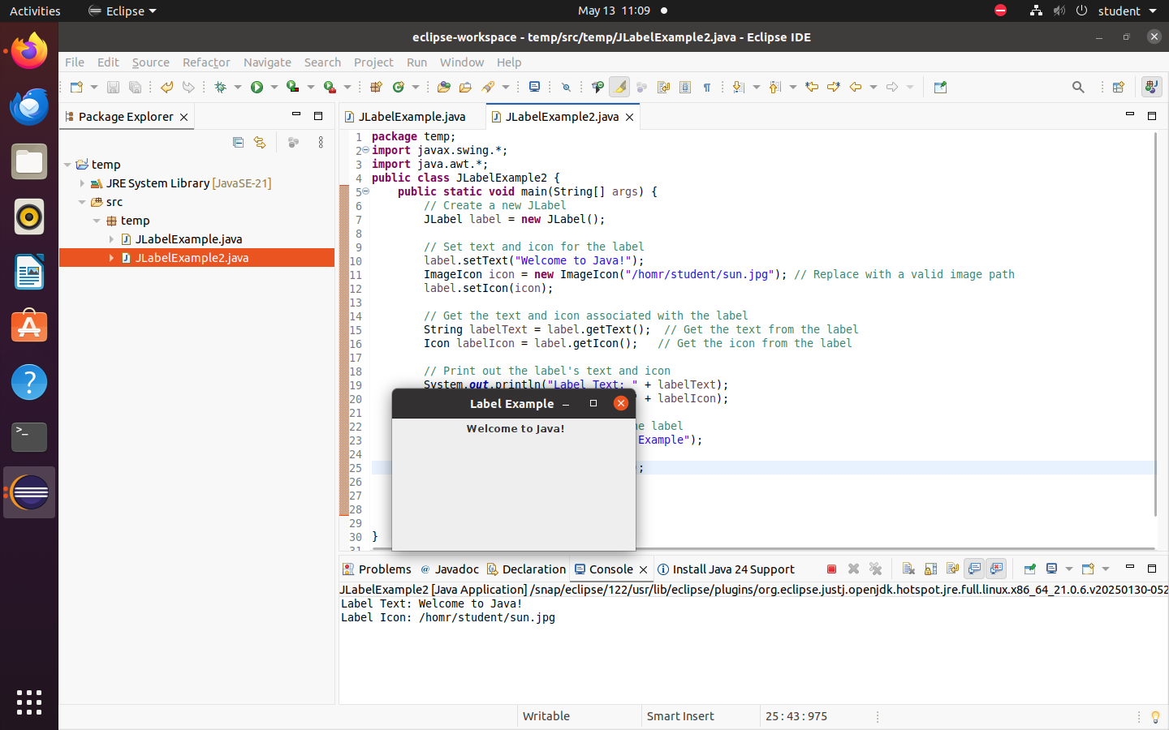

Slide 21
JTEXTFIELD
Constructors
JTextField()
JTextField(int columns)
JTextField(String text)
JTextField(String text, int columns)
Common methods
void setText(String text);
String getText();

Slide 22
import javax.swing.*;
import java.awt.*;
public class TextFieldDemo {
public static void main(String[] args) {
JFrame frame = new JFrame("JTextField Constructors");
frame.setLayout(new FlowLayout());
// Empty text field
JTextField tf1 = new JTextField();
// Text field with columns
JTextField tf2 = new JTextField(15);
// Text field with initial text
JTextField tf3 = new JTextField("Hello");
// Text field with text + columns
JTextField tf4 = new JTextField("Welcome", 20);
frame.add(tf1); frame.add(tf2); frame.add(tf3); frame.add(tf4);
frame.setSize(400, 200); frame.setDefaultCloseOperation(JFrame.EXIT_ON_CLOSE);
frame.setVisible(true); }}

Slide 23
JBUTTON
The JButton class provides the functionality of a push button.
JButton allows an icon, a string, or both to be associated with the push button. Three of its constructors are shown here:
JButton(Icon icon)
JButton(String str)
JButton(String str, Icon icon)
Here, str and icon are the string and icon used for the button.

Slide 24
package temp;
import javax.swing.*;
import java.awt.*;
public class JButtonExample {
public static void main(String[] args) {
// Create a JFrame to display the buttons
JFrame frame = new JFrame("JButton Example");
frame.setSize(400, 200);
frame.setLayout(new FlowLayout());
// Create a button with just text
JButton buttonText = new JButton("Click Me!");
ImageIcon icon = new ImageIcon("/home/student/sun.jpg");
// Create a button with just an icon
JButton buttonIcon = new JButton(icon);
// Create a button with both text and an icon
JButton buttonTextIcon = new JButton("Click Here!", icon);
// Add the buttons to the frame
frame.add(buttonText);
frame.add(buttonIcon);
frame.add(buttonTextIcon);
// Display the frame
frame.setVisible(true);
} }

Slide 25
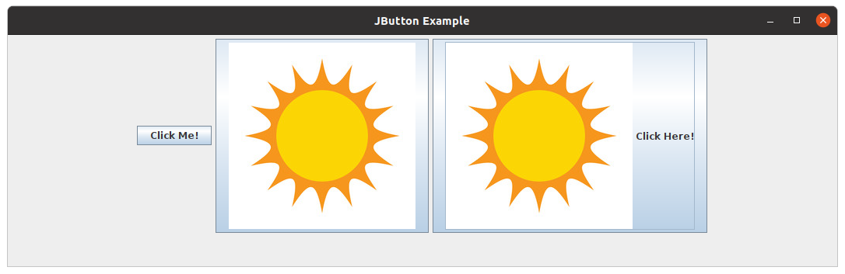
OUTPUT

Slide 26
JBUTTON
When the button is pressed, an ActionEvent is generated. Using the ActionEvent object passed to the actionPerformed( ) method of the registered ActionListener, you can obtain the action command string associated with the button.
By default, this is the string displayed inside the button. However, you can set the action command by calling setActionCommand( ) on the button. You can obtain the action command by calling getActionCommand( ) on the event object. It is declared like this:
String getActionCommand( )
The action command identifies the button. Thus, when using two or more buttons within the same application, the action command gives you an easy way to determine which button was pressed.

Slide 27
package temp;
import javax.swing.*;
import java.awt.event.*;
import java.awt.*;
public class JButtonExample2 implements ActionListener{
private JButton button1;
private JButton button2;
public static void main(String[] args) {
// Create an instance of the class and call the setup method
JButtonExample2 example = new JButtonExample2();
example.setupUI();
}
public void setupUI() {
JFrame frame = new JFrame("ActionCommand Example");frame.setSize(300, 200);
button1 = new JButton("Button 1"); button2 = new JButton("Button 2");
button1.setActionCommand("button1Clicked");
button2.setActionCommand("button2Clicked");
button1.addActionListener(this);button2.addActionListener(this);
frame.setLayout(new FlowLayout());
frame.add(button1);frame.add(button2);frame.setVisible(true); }
public void actionPerformed(ActionEvent e) {
String command = e.getActionCommand();
System.out.println("Action Command: " + command);
if (command.equals("button1Clicked")) {
System.out.println("Button 1 was clicked!");
} else if (command.equals("button2Clicked")) {
System.out.println("Button 2 was clicked!");
} } }

Slide 28
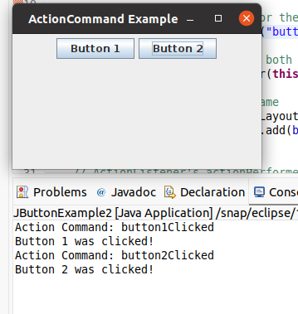
OUTPUT

Slide 29
JTOGGLEBUTTON
A useful variation on the push button is called a toggle button. A toggle button looks just like a push button, but it acts differently because it has two states: pushed and released.
That is, when you press a toggle button, it stays pressed rather than popping back up as a regular push button does.
When you press the toggle button a second time, it releases (pops up). Therefore, each time a toggle button is pushed, it toggles between its two states. The constructor is:
JToggleButton(String str) This creates a toggle button that contains the text passed in str. By default, the button is in the off position. Other constructors enable you to create toggle buttons that contain images, or images and text.

Slide 30
JTOGGLEBUTTON
The easiest way to determine a toggle button’s state is by calling the isSelected( ) method (inherited from AbstractButton) on the button that generated the event. It is shown here:
boolean isSelected( )
It returns true if the button is selected and false otherwise

Slide 31
package temp;
import javax.swing.*;
import java.awt.event.*;
import java.awt.*;
public class JToggleButtonExample implements ActionListener{
private JToggleButton toggleButton;
public static void main(String[] args) {
JToggleButtonExample example = new JToggleButtonExample();
example.setupUI();
}
public void setupUI() {
JFrame frame = new JFrame("JToggleButton Example");
frame.setSize(300, 200);
toggleButton = new JToggleButton("Toggle Me");
toggleButton.addActionListener(this);
frame.add(toggleButton); frame.setVisible(true);
}
public void actionPerformed(ActionEvent ae)
{
if (toggleButton.isSelected()) {
System.out.println("The button is selected.");
} else {
System.out.println("The button is not selected."); } }
}

Slide 32
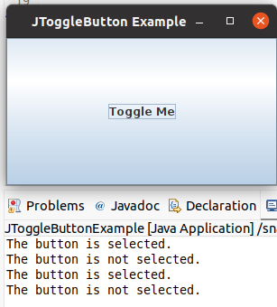
OUTPUT

Slide 33
CHECKBOXES
The JCheckBox class provides the functionality of a check box. Its immediate superclass is JToggleButton, which provides support for two-state buttons, as just described. JCheckBox defines several constructors.
JCheckBox(String str)
It creates a check box that has the text specified by str as a label. Other constructors let you specify the initial selection state of the button and specify an icon.
When the user selects or deselects a check box, an ItemEvent is generated. You can obtain a reference to the JCheckBox that generated the event by calling getItem( ) on the ItemEvent passed to the itemStateChanged( ) method defined by ItemListener. The easiest way to determine the selected state of a check box is to call isSelected( ) on the JCheckBox instance.

Slide 34
package temp;
import javax.swing.*;
import java.awt.event.*;
import java.awt.*;
public class JCheckBoxExample implements ItemListener{
private JCheckBox checkBox;
public static void main(String[] args) {
JCheckBoxExample example = new JCheckBoxExample();
example.setupUI();
}
public void setupUI() {
JFrame frame = new JFrame("JCheckBox Example");
frame.setSize(300, 200);
checkBox = new JCheckBox("Check Me");
checkBox.addItemListener(this);
frame.add(checkBox);
frame.setVisible(true);
}
public void itemStateChanged(ItemEvent e) {
String itemText = checkBox.getText();
if (checkBox.isSelected()) {
System.out.println(itemText + " is selected.");
} else {
System.out.println(itemText + " is not selected.");
} }}

Slide 35
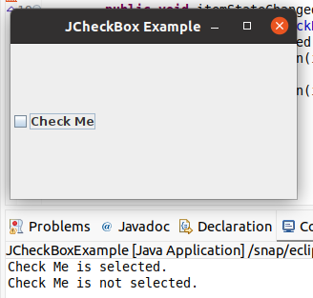
OUTPUT

Slide 36
RADIOBUTTONS
Radio buttons are a group of mutually exclusive buttons, in which only one button can be selected at any one time. They are supported by the JRadioButton class, which extends JToggleButton. JRadioButton provides several constructors. The one used in the example is shown here:
JRadioButton(String str)
Here, str is the label for the button. Other constructors let you specify the initial selection state of the button and specify an icon

Slide 37
RADIOBUTTONS
In order for their mutually exclusive nature to be activated, radio buttons must be configured into a group. Only one of the buttons in the group can be selected at any time.
For example, if a user presses a radio button that is in a group, any previously selected button in that group is automatically deselected.
A button group is created by the ButtonGroup class. Its default constructor is invoked for this purpose.
Elements are then added to the button group via the following method:
void add(AbstractButton ab)
Here, ab is a reference to the button to be added to the group.

Slide 38
RADIOBUTTONS
A JRadioButton generates action events, item events, and change events each time the button selection changes. Most often, it is the action event that is handled, which means that you will normally implement the ActionListener interface and define actionPerformed( ).
Inside this method, you can use a number of different ways to determine which button was selected. First, you can check its action command by calling getActionCommand( ).
Second, you can call getSource( ) on the ActionEvent object and check that reference against the buttons.
Third, you can check each radio button to find out which one is currently selected by calling isSelected( ) on each button.

Slide 39
package temp;
import javax.swing.*;
import java.awt.event.*;
import java.awt.*;
public class JRadioButtonExample implements ActionListener{
private JRadioButton radioButton1; private JRadioButton radioButton2;
public static void main(String[] args) {
JRadioButtonExample example = new JRadioButtonExample();
example.setupUI(); }
public void setupUI() {
JFrame frame = new JFrame("JRadioButton Example");frame.setSize(300, 200);
radioButton1 = new JRadioButton("Option 1"); radioButton2 = new JRadioButton("Option 2");
radioButton1.setActionCommand("Option 1 Selected");
radioButton2.setActionCommand("Option 2 Selected");
ButtonGroup group = new ButtonGroup(); group.add(radioButton1);group.add(radioButton2);
radioButton1.addActionListener(this); radioButton2.addActionListener(this);
frame.setLayout(new FlowLayout());
frame.add(radioButton1);frame.add(radioButton2); frame.setVisible(true); }
public void actionPerformed(ActionEvent e) {
Object source = e.getSource();
if (source == radioButton1) {
System.out.println(radioButton1.getActionCommand() + " - Selected: " + radioButton1.isSelected()); } else if (source == radioButton2) {
System.out.println(radioButton2.getActionCommand() + " - Selected: " + radioButton2.isSelected()); } }}

Slide 40
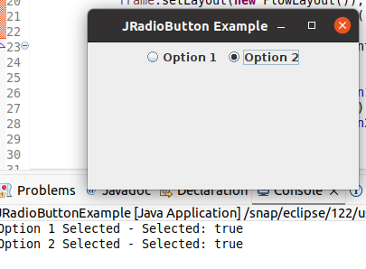
OUTPUT

Slide 41
JTABBEDPANE
JTabbedPane encapsulates a tabbed pane. It manages a set of components by linking them with tabs. Selecting a tab causes the component associated with that tab to come to the forefront. Tabbed panes are very common in the modern GUI.
JTabbedPane defines three constructors. We will use its default constructor, which creates an empty control with the tabs positioned across the top of the pane. The other two constructors let you specify the location of the tabs, which can be along any of the four sides.
Tabs are added by calling addTab( ). Here is one of its forms:
void addTab(String name, Component comp)
Here, name is the name for the tab, and comp is the component that should be added to the tab.

Slide 42
JTABBEDPANE
The general procedure to use a tabbed pane is outlined here:
Create an instance of JTabbedPane.
Add each tab by calling addTab( ).
Add the tabbed pane to the content pane.

Slide 43
package temp;
import javax.swing.*;
import java.awt.*;
import java.awt.event.ActionEvent;
import java.awt.event.ActionListener;
public class JTabbedPaneExample implements ActionListener{
private JFrame frame;
private JTabbedPane tabbedPane;
public static void main(String[] args)
{JTabbedPaneExample jt=new JTabbedPaneExample(); jt.setupUI(); }
public void setupUI() {
frame = new JFrame("JTabbedPane Example");frame.setSize(400, 300);
tabbedPane = new JTabbedPane();
JPanel panel1 = new JPanel();JPanel panel2 = new JPanel();
JButton button1 = new JButton("Click me (Tab 1)");
JButton button2 = new JButton("Click me (Tab 2)");
button1.addActionListener(this); button2.addActionListener(this);
panel1.add(button1);panel2.add(button2);
tabbedPane.addTab("Tab 1", panel1);tabbedPane.addTab("Tab 2", panel2);
frame.add(tabbedPane, BorderLayout.CENTER);
frame.setVisible(true); }
public void actionPerformed(ActionEvent e)
{ if (e.getActionCommand().equals("Click me (Tab 1)")) {
JOptionPane.showMessageDialog(frame, "Button 1 in Tab 1 clicked!");} else if (e.getActionCommand().equals("Click me (Tab 2)")) {
JOptionPane.showMessageDialog(frame, "Button 2 in Tab 2 clicked!")}}}

Slide 44
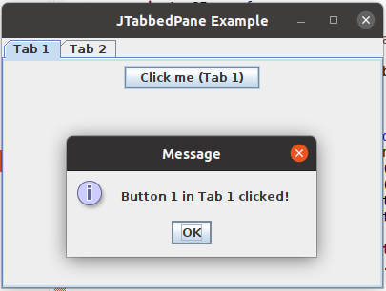
OUTPUT

Slide 45
JSCROLLPANE
JScrollPane is a lightweight container that automatically handles the scrolling of another component. The component being scrolled can be either an individual component, such as a table, or a group of components contained within another lightweight container, such as a JPanel.
In either case, if the object being scrolled is larger than the viewable area, horizontal and/or vertical scroll bars are automatically provided, and the component can be scrolled through the pane.
Because JScrollPane automates scrolling, it usually eliminates the need to manage individual scroll bars.

Slide 46
JSCROLLPANE
The viewable area of a scroll pane is called the viewport. It is a window in which the component being scrolled is displayed. Thus, the viewport displays the visible portion of the component being scrolled. The scroll bars scroll the component through the viewport. In its default behavior, a JScrollPane will dynamically add or remove a scroll bar as needed.
JScrollPane defines several constructors. The one used in this chapter is shown here:
JScrollPane(Component comp)
Scroll bars are automatically displayed when the content of the pane exceeds the dimensions of the viewport.

Slide 47
JSCROLLPANE
Here are the steps to follow to use a scroll pane:
Create the component to be scrolled.
Create an instance of JScrollPane, passing to it the object to scroll.
Add the scroll pane to the content pane.

Slide 48
package temp;
import javax.swing.*;
import java.awt.*;
public class JScrollPaneExample {
private JTextArea textArea;
public static void main(String[] args) {
JScrollPaneExample js=new JScrollPaneExample();
js.setupUI(); }
public void setupUI()
{ JFrame frame = new JFrame("JScrollPane Example");
frame.setSize(400, 300);
JTextArea textArea = new JTextArea(10, 30); // 10 rows, 30 cols
textArea.setText("This is a simple example of JScrollPane with JTextArea.\nYou can scroll when the text overflows.\nTry adding more text!");
JScrollPane scrollPane = new JScrollPane(textArea);
scrollPane.setHorizontalScrollBarPolicy(JScrollPane.HORIZONTAL_SCROLLBAR_ALWAYS); scrollPane.setVerticalScrollBarPolicy(JScrollPane.VERTICAL_SCROLLBAR_ALWAYS); frame.add(scrollPane, BorderLayout.CENTER);
frame.setVisible(true); }}

Slide 49
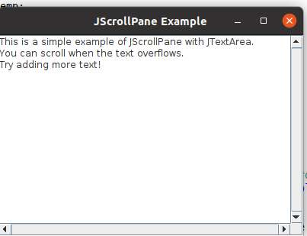
OUTPUT

Slide 50
JLIST
In Swing, the basic list class is called JList. It supports the selection of one or more items from a list. Although the list often consists of strings, it is possible to create a list of just about any object that can be displayed.
beginning with JDK 7, JList was made generic and is now declared like this: class JList Here, E represents the type of the items in the list. JList provides several constructors. The one used here is
JList(E[ ] items)
This creates a JList that contains the items in the array specified by items

Slide 51
JLIST
A JList generates a ListSelectionEvent when the user makes or changes a selection. This event is also generated when the user deselects an item. It is handled by implementing ListSelectionListener. This listener specifies only one method, called valueChanged( ), which is shown here:
void valueChanged(ListSelectionEvent le)
Here, le is a reference to the event. Although ListSelectionEvent does provide some methods of its own, normally you will interrogate the JList object itself to determine what has occurred. Both ListSelectionEvent and ListSelectionListener are packaged in javax.swing.event.

Slide 52
JLIST
By default, a JList allows the user to select multiple ranges of items within the list, but you can change this behavior by calling setSelectionMode( ), which is defined by JList. It is shown here:
void setSelectionMode(int mode)
Here, mode specifies the selection mode.
You can obtain the index of the first item selected, which will also be the index of the only selected item when using single-selection mode, by calling getSelectedIndex( ), shown here:
int getSelectedIndex( )
Indexing begins at zero.

Slide 53
JLIST
Instead of obtaining the index of a selection, you can obtain the value associated with the selection by calling getSelectedValue( ):
E getSelectedValue( )
It returns a reference to the first selected value. If no value has been selected, it returns null.

Slide 54
package temp;
import javax.swing.*;
import javax.swing.event.ListSelectionEvent;
import javax.swing.event.ListSelectionListener;
import java.awt.*;
public class JListExample implements ListSelectionListener {
private JFrame frame; private JList<String> list;
public static void main(String[] args) {
JListExample jl=new JListExample(); jl.createAndShowGUI(); }
public void createAndShowGUI() {
frame = new JFrame("JList Example with ListSelectionListener");
frame.setSize(400, 300);
String[] items = {"Apple", "Banana", "Cherry", "Date", "Elderberry", "Fig", "Grape"}; list = new JList<>(items);
list.setSelectionMode(ListSelectionModel.SINGLE_SELECTION);
list.addListSelectionListener(this);
JScrollPane scrollPane = new JScrollPane(list);
frame.add(scrollPane, BorderLayout.CENTER); frame.setVisible(true); }
public void valueChanged(ListSelectionEvent le) {
if (!le.getValueIsAdjusting()) {
int selectedIndex = list.getSelectedIndex();
String selectedItem = list.getSelectedValue();
if (selectedIndex != -1) {
JOptionPane.showMessageDialog(frame,
"Selected Item: " + selectedItem + "\nIndex: " + selectedIndex); } } }}

Slide 55
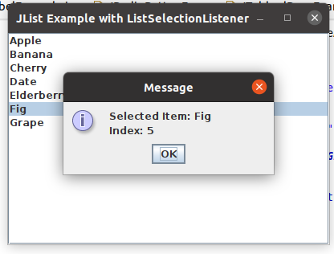
OUTPUT

Slide 56
JCOMBOBOX
Swing provides a combo box (a combination of a text field and a drop-down list) through the JComboBox class. A combo box normally displays one entry, but it will also display a drop down list that allows a user to select a different entry. You can also create a combo box that lets the user enter a selection into the text field.
Beginning with JDK 7, JComboBox was made generic and is now declared like this:
class JComboBox
Here, E represents the type of the items in the combo box. The JComboBox constructor used by the example is shown here:
JComboBox(E[ ] items)
Here, items is an array that initializes the combo box. Other constructors are available.

Slide 57
JCOMBOBOX
In addition to passing an array of items to be displayed in the drop-down list, items can be dynamically added to the list of choices via the addItem( ) method, shown here:
void addItem(E obj)
Here, obj is the object to be added to the combo box. This method must be used only with mutable combo boxes. One way to obtain the item selected in the list is to call getSelectedItem( ) on the combo box. It is shown here: Object getSelectedItem( )
You will need to cast the returned value into the type of object stored in the list.

Slide 58
package temp;
import javax.swing.*;
import java.awt.event.*;
public class JComboBoxExample implements ActionListener{
private JComboBox<String> comboBox; private JLabel label;
public JComboBoxExample() {
JFrame frame = new JFrame("JComboBox Example"); frame.setSize(300, 150);
String[] languages = { "Java", "Python", "C++", "JavaScript" };
comboBox = new JComboBox<>(languages);JButton button = new JButton("Show Selected"); button.addActionListener(this);label = new JLabel("Selected: ");
JPanel panel = new JPanel(); panel.add(comboBox);panel.add(button);panel.add(label); frame.add(panel);frame.setVisible(true); }
public void actionPerformed(ActionEvent e) {
String selected = (String) comboBox.getSelectedItem();label.setText("Selected: " + selected); }
public static void main(String[] args) { new JComboBoxExample(); }}

Slide 59
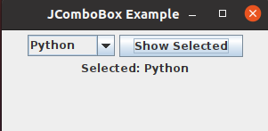
OUTPUT

