Slide 1
SERVLETS

Slide 2
Static vs Dynamic content
In the early days, web pages were only static. User sends request and receives response from server.
With advent of World Wide Web, people used dynamic content for the betterment of lives like updation of bank balance after transactions, ticket booking, weather updates, news headlines, etc.,
Common Gateway Interface (CGI) was the first solution for the same. Helps accept user input, query database and return response on web browser.
It can be programmed in C, C++, VBScript, TCL, Python, Icon, AppleScript, Perl, etc.,

Slide 3
Disadvantages of CGI
Lack of scalability and reduced speed.
Platform dependent
Consumes lot of server side resources in multi-server situation
Difficult for beginners to program modules in this environment
Sharing resources is not available
Alternatives are FastCGI, mod_perl,NSAPI, ISAPI, Java servlets

Slide 4
Java Servlets
Server-side program that services HTTP requests and returns results as HTTP Responses.
Lifecycle similar to that of applet and runs inside JVM at the web server.
Module written in Java and runs in a server application. Used with HTTP.
Executes all requests; shares resources; can be ported to other platforms that support Java.

Slide 5
Java Servlets
Servlet is a technology which is used to create a web application.
Servlet is an API that provides many interfaces and classes including documentation.
Servlet is an interface that must be implemented for creating any Servlet.
Servlet is a class that extends the capabilities of the servers and responds to the incoming requests. It can respond to any requests.
Servlet is a web component that is deployed on the server to create a dynamic web page.

Slide 6
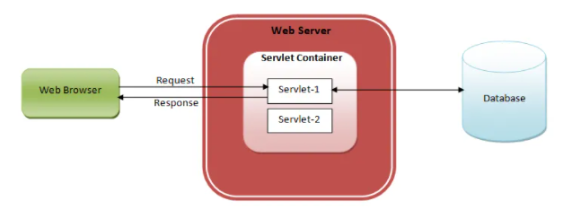
Java Servlets

Slide 7
Java Servlets
Efficient with automated threading model wherein each request is handled by a lightweight thread.
Platform-independent. They run using a set of standard interfaces and a JVM.
If JVM exists for platform A, servlet validated on platform B,C, etc., will run successfully on A.
Servlets provide an object oriented and extensible middle tier for Web server based applications.
Web servers cannot communicate with databases. So, Servlets extend the functionality of web servers and deliver information to clients’ browser.

Slide 8
Servlet Clients & Container
Servlet clients are not necessarily written in Java. Servlets are used in middle tier of distributed application systems. Servlets can in turn be clients to other services, written in some other language.
Servlet container provides runtime environment in which the servlet executes. Servlet engine manages lifecycle of servlet from its creation to destruction.
Servlets are supported by servers like Apache, Netscape, Microsoft IIS, etc.,
Servlet works behind the scene and displays its results on web browser after processing.

Slide 9
Why Servlets?
Loaded into memory once and run from memory thereafter
Spawned as a thread. Portable across multiple web servers and platforms.
Simple to design and implement. Tightly integrated with web server.
Services client requests efficiently. Runs within the secure scope of JVM. Complies with Servlet API.
Robust, scalable and secure CGI replacement. Provides database access using native and ODBC DB drivers. Supported by several web browsers.
Gives code protection when on server-side.

Slide 10
What can servlets do?
Servlet is actually a piece of code executed at the Web Server in response to HTTP Request from clients’ browser. They perform the following:
Process and / or store data submitted by HTML form.
Can provide dynamic content like returning database query results to client.
Can manage state information on top of stateless HTTP. Can handle multiple requests concurrently and these requests can be synchronized to support systems allowing collaboration between people.
Can forward requests to other servers / servlets.
Can be used to balance load among several servers that mirror same content. Can maintain and track sessions. Servlets clean up session when session is terminated (log off / time out). Can pass data by themselves
Can be used to serve as HTTP as middle tier between any kind of thin client and large enterprise services being made available via EJB’s

Slide 11
Request-Response Paradigm
Servlets are based on request-response paradigm where requests are accepted and responses are generated. Servlets work with web server software.
Step 1 : Client i.e. web browser sends the request to the web server.
Step 2 : Web server receives the request and sends it to the servlet container. Servlet container is also called web container or servlet engine. It is responsible for handling the life of a servlet.
Step 3 : Servlet container understands the request’s URL and calls the particular servlet. Actually, it creates a thread for execution of that servlet. If there are multiple requests for the same servlet, then for each request, one thread will be created.
Step 4 : Servlet processes the request object and prepares response object after interacting with the database or performing any other operations and sends the response object back to the web server.
Step 5 : Then web server sends the response back to the client

Slide 12

Servlet Interface
Servlets implement Servlet Interface.
service() has two arguments - Request and Response to encapsulate data sent by client, provide access to parameters and allow Servlets to report status.

Slide 13
Servlet Example
The servlet example can be created by three ways:
By implementing Servlet interface,
By inheriting GenericServlet class, (or)
By inheriting HttpServlet class
The most widely used approach is by extending HttpServlet because it provides http request specific method such as doGet(), doPost(), doHead() etc.

Slide 14
Servlet Lifecycle
Load
Instantiate
Initialize
Service request
Destroy
Garbage collection

Slide 15
First 3 Steps
Servlet engine first locates the servlet class with the help of URL. Servlet class can be in local system / remote system / any system connected in network
Servlet engine loads servlet class into JVM. Once loaded, servlet engine instantiates instance of servlet class and calls init method. This method is invoked when server starts; servlet is requested or at the request of server administrator.

Slide 16
Constructor vs init()
In JDK1.0, constructors for Servlets were incapable of accepting arguments. So, servlet does not understand its own environment.
Java does not permit interfaces to have constructors. Hence, we use init()
Even if constructor is used, it cannot access ServletConfig object or throw Servlet

Slide 17
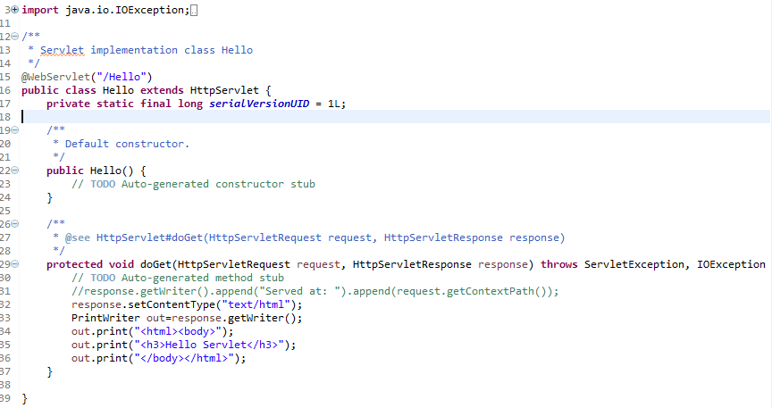
Simple Example

Slide 18
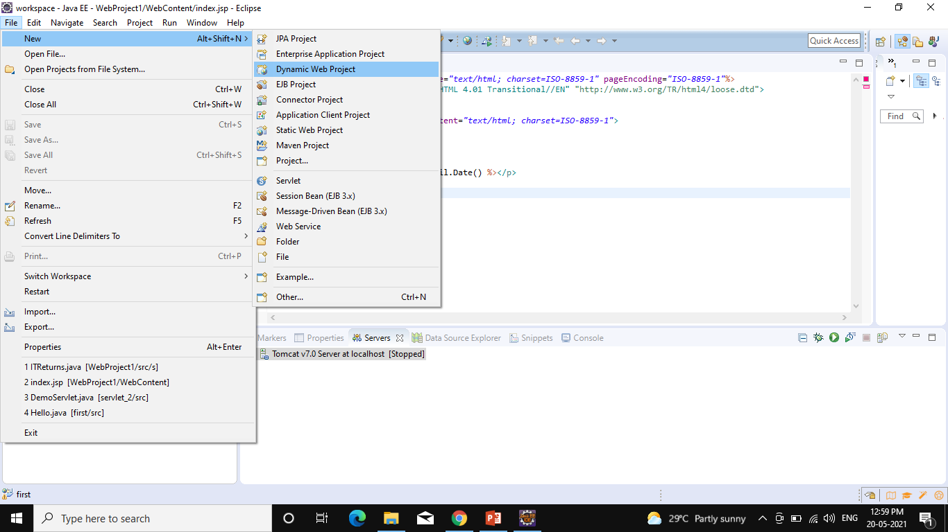
Running Servlet in Eclipse
Create the dynamic web project: For creating a dynamic web project click on File Menu -> New -> Project..-> Web -> dynamic web project -> write your project name e.g. first -> Finish.

Slide 19
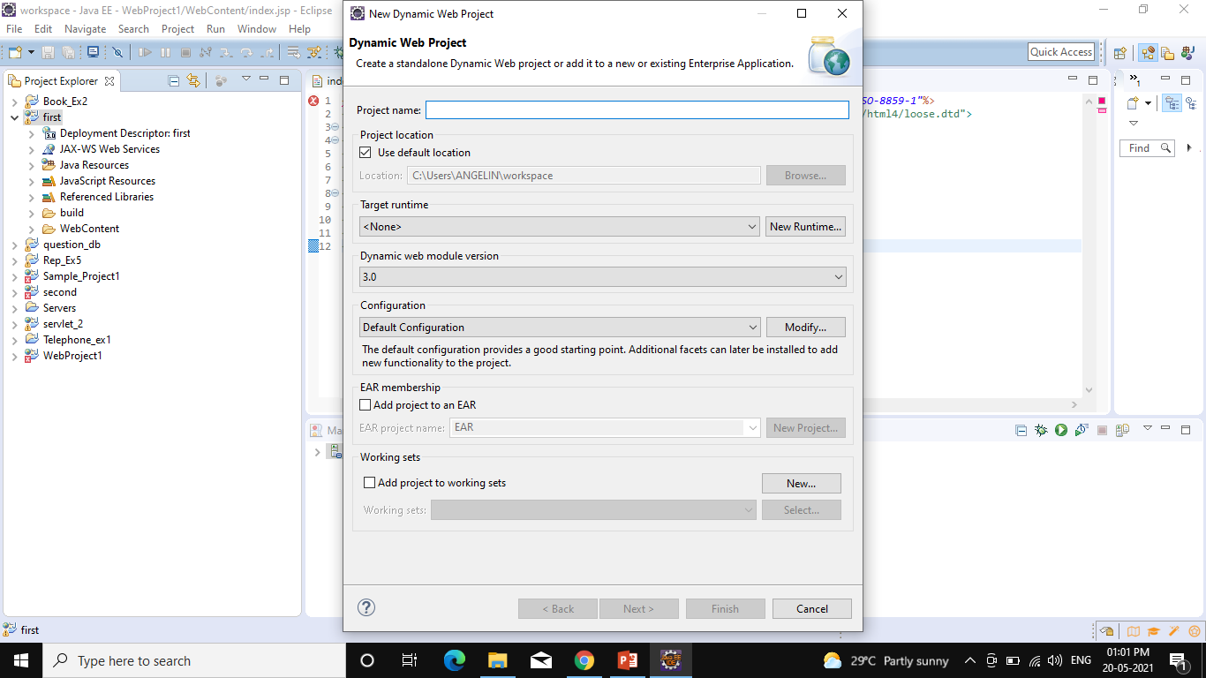
Running Servlet in Eclipse

Slide 20
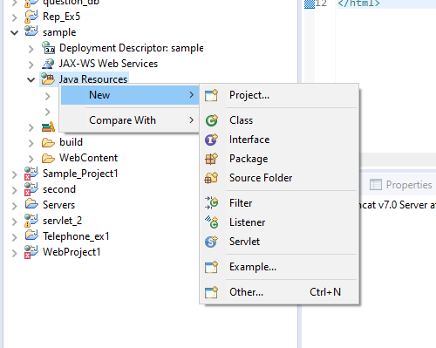
Running Servlet in Eclipse
Create the servlet in eclipse IDE: For creating a servlet, explore the project by clicking the + icon -> explore the Java Resources -> right click on src -> New -> servlet -> write your servlet name e.g. Hello -> uncheck all the checkboxes except doGet() -> next -> Finish.

Slide 21
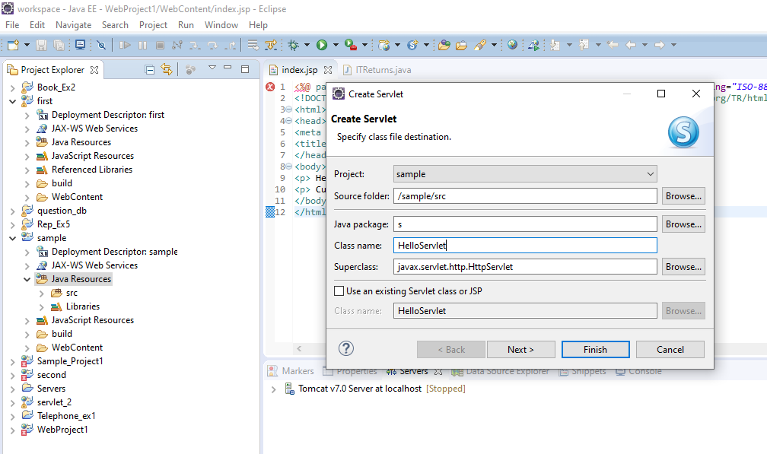
Running Servlet in Eclipse

Slide 22
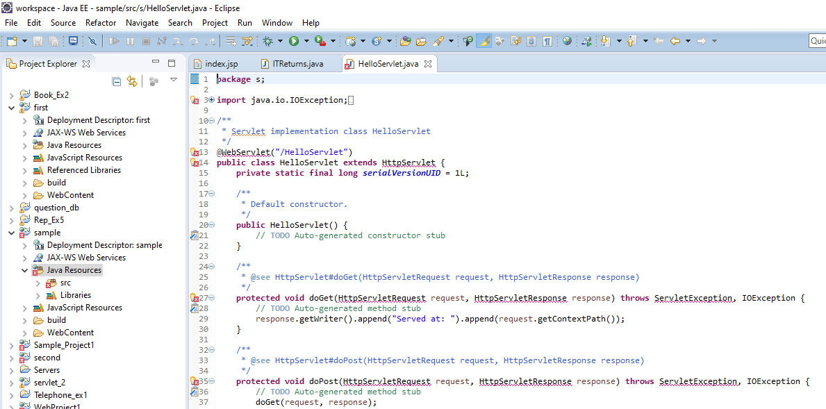
Running Servlet in Eclipse

Slide 23
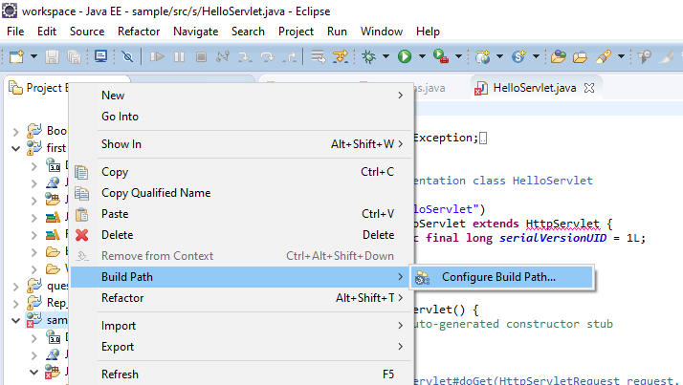
Running Servlet in Eclipse
Add jar file to eclipse: For adding a jar file, right click on your project -> Build Path -> Configure Build Path -> click on Libraries tab in Java Build Path -> click on Add External JARs button -> select the servlet-api.jar file under tomcat/lib -> ok.

Slide 24
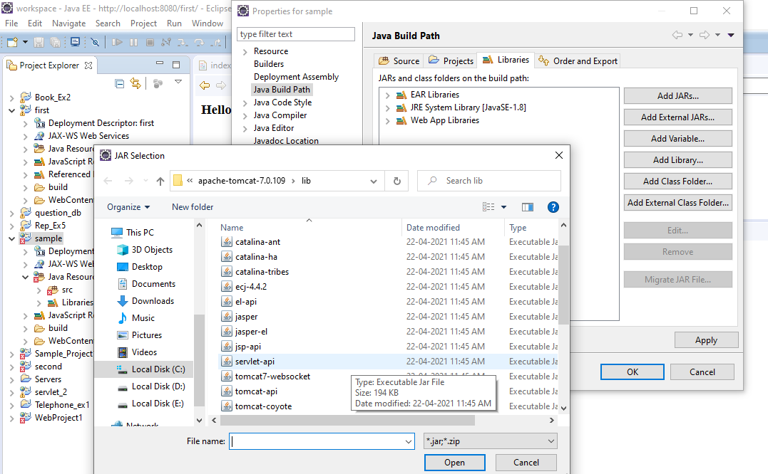

Slide 25
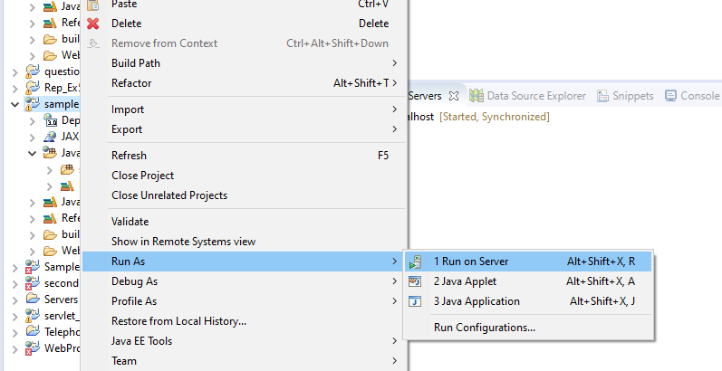
Running Servlet in Eclipse
Start the server and deploy the project: For starting the server and deploying the project in one step, Right click on your project -> Run As -> Run on Server -> choose tomcat server -> next -> addAll -> finish.

Slide 26
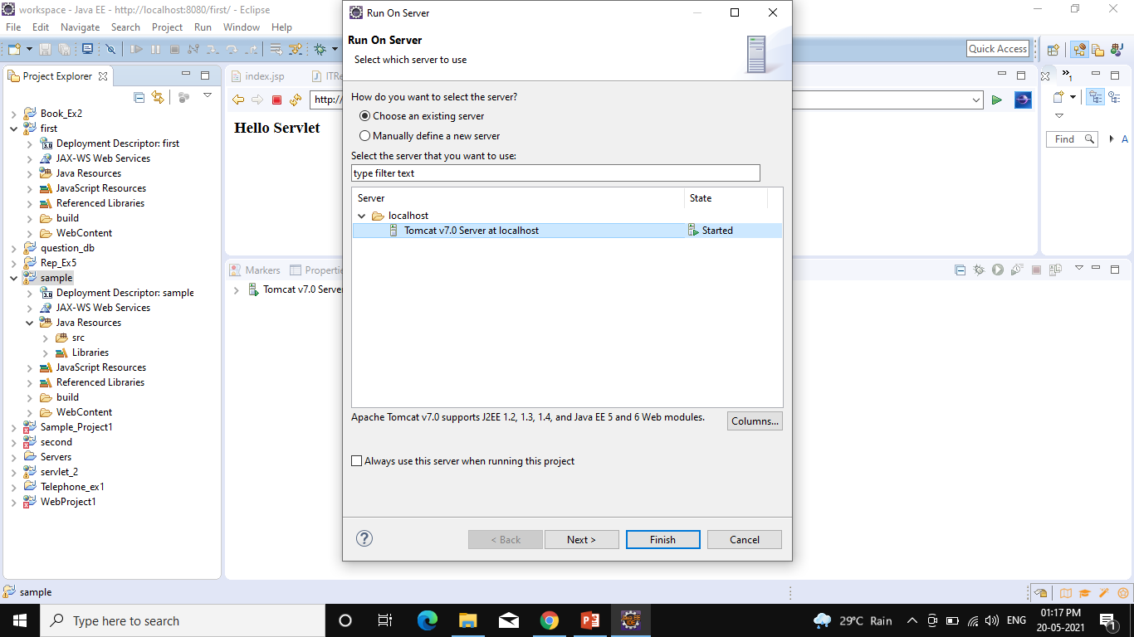

Slide 27
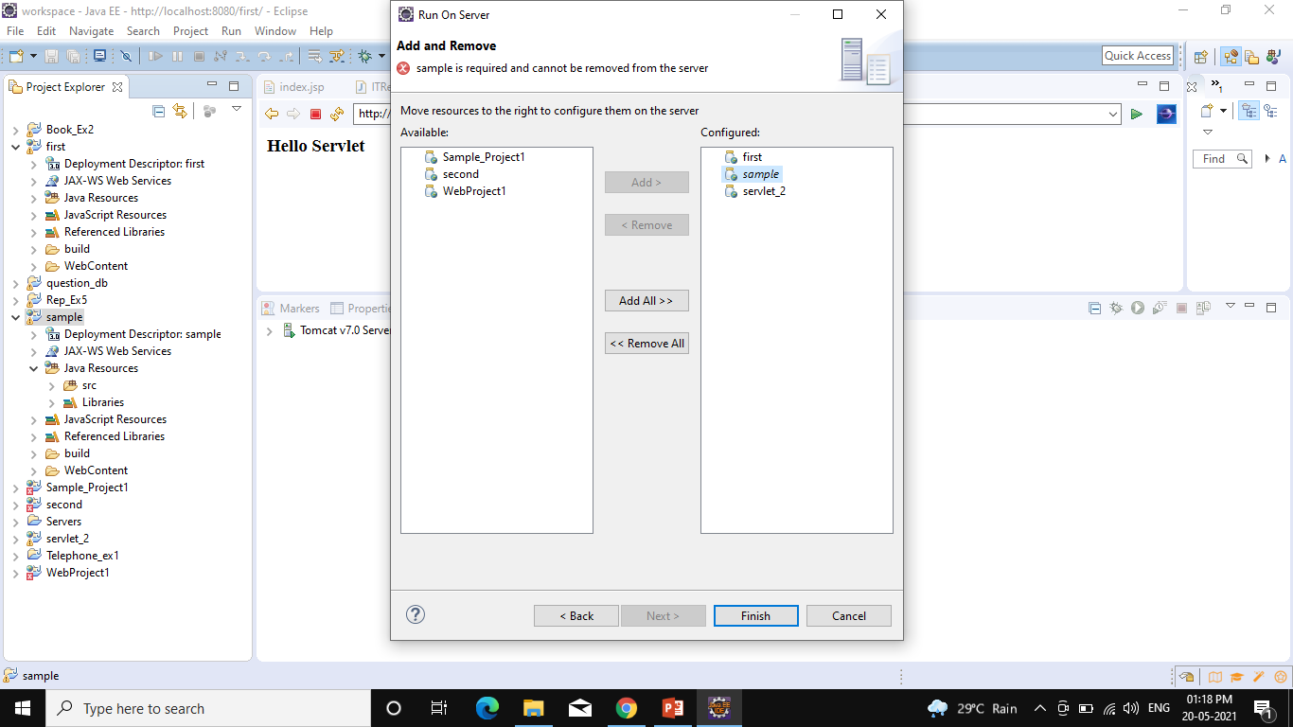

Slide 28
