Slide 1
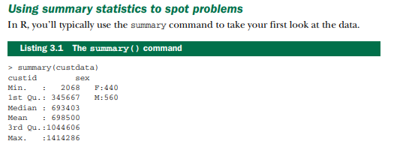
Using summary statistics to spot problems
use the summary command

Slide 2
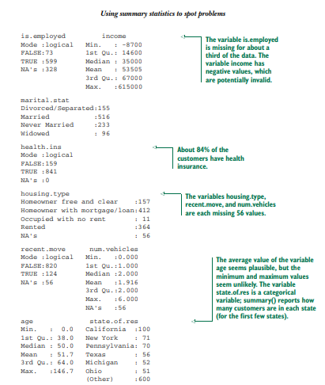
Summary statistics(Contd..)

Slide 3
Typical problems revealed by data summaries
At this stage, you’re looking for several common issues:
Missing values
Invalid values and outliers
Data ranges that are too wide or too narrow.
Units

Slide 4
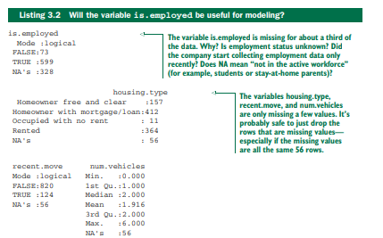
MISSING VALUES

Slide 5
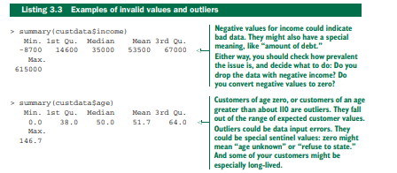
INVALID VALUES AND OUTLIERS

Slide 6

Data Range

Slide 7
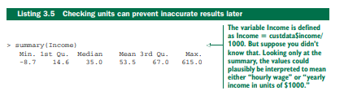
Units

Slide 8
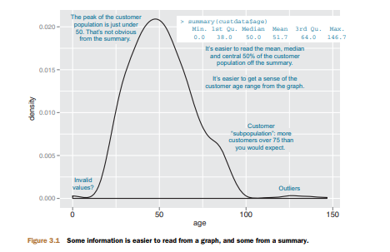
Spotting problems using graphics and visualization
spot plenty of problems just by looking over the data summaries.
For other properties of the data, pictures are better than text.

Slide 9
Graphics and visualization
A graphic should display as much information as it can, with the lowest possible cognitive strain to the viewer.
Strive for clarity. Make the data stand out. Specific tips for increasing clarity include – Avoid too many superimposed elements, such as too many curves in the same graphing space
– Find the right aspect ratio and scaling to properly bring out the details of the data. – Avoid having the data all skewed to one side or the other of your graph.
Visualization is an iterative process. Its purpose is to answer questions about the data

Slide 10
ggplot2
we use ggplot2 to demonstrate the visualizations and graphics; of course, other R visualization packages can produce similar graphics
Graphs in ggplot2 can only be defined on data frames. The variables in a graph—the x variable, the y variable, the variables that define the color or the size of the points—are called aesthetics, and are declared by using the aes function.
The ggplot() function declares the graph object. The arguments to ggplot() can include the data frame of interest and the aesthetics.
The ggplot() function doesn’t of itself produce a visualization; visualizations are produced by layers.

Slide 11
Visually checking distributions for a single variable
The visualizations in this section help you answer questions like these:
What is the peak value of the distribution?
How many peaks are there in the distribution (unimodality versus bimodality)?
How normal (or lognormal) is the data?
How much does the data vary?
Is it concentrated in a certain interval or in a certain category?

Slide 12
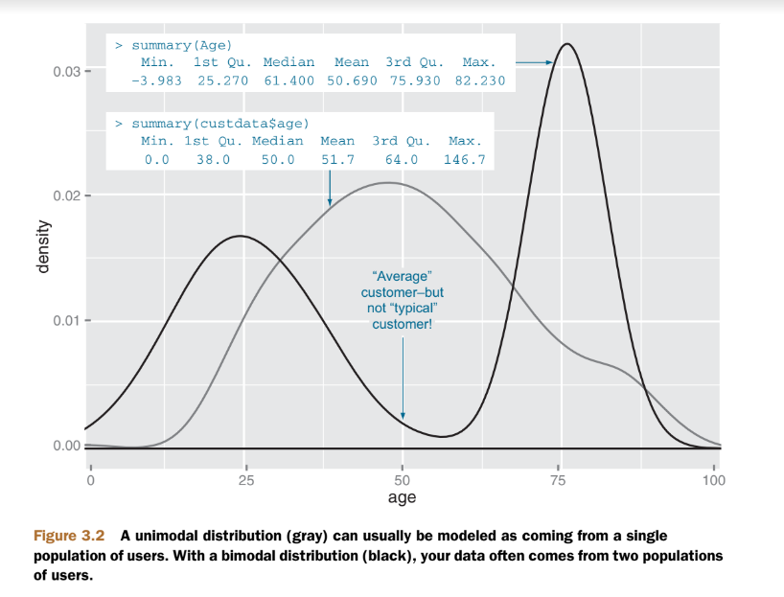
Unimodal distribution and Bimodal Distribution

Slide 13
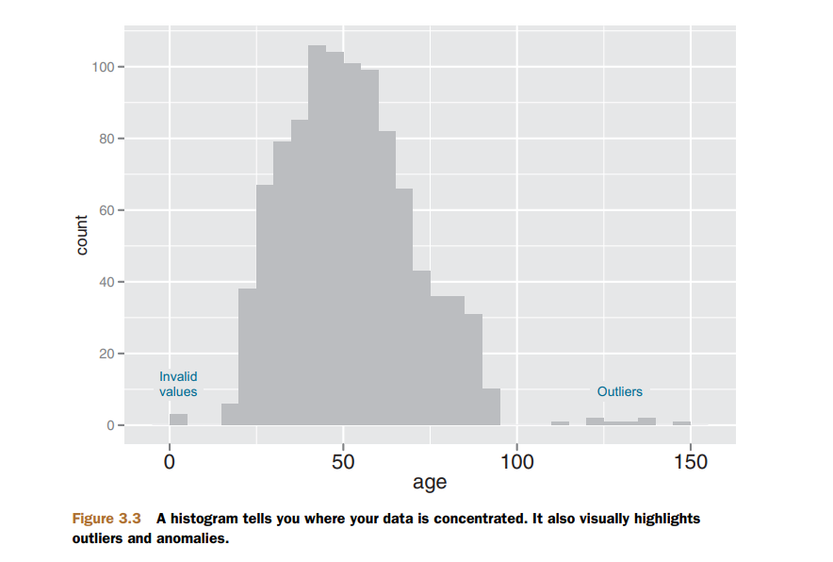
HISTOGRAMS
A basic histogram bins a variable into fixed-width buckets and returns the number of data points that falls into each bucket.

Slide 14
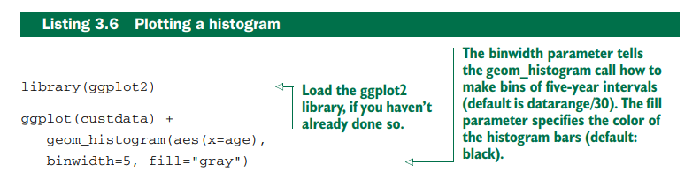
Plotting a Histogram

Slide 15
DENSITY PLOTS
density plot as a “continuous histogram” of a variable, except the area under the density plot is equal to 1.
A point on a density plot corresponds to the fraction of data (or the percentage of data, divided by 100) that takes on a particular value.

Slide 16
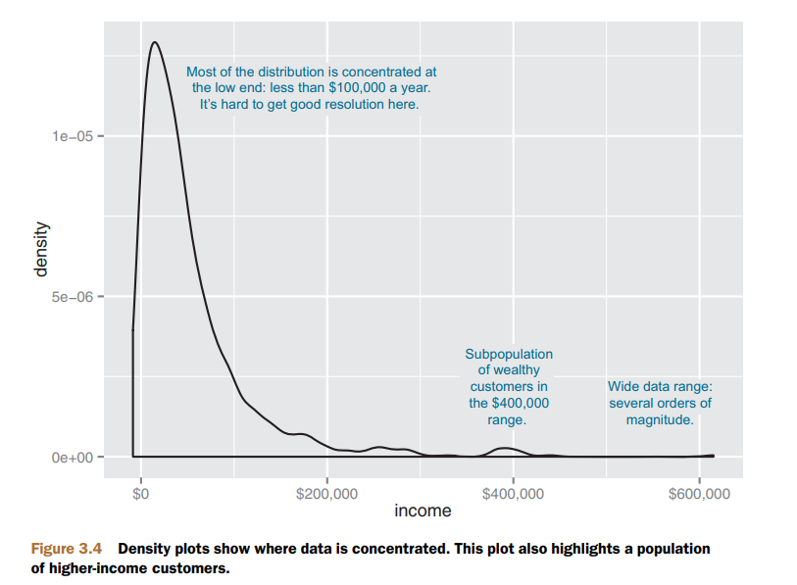
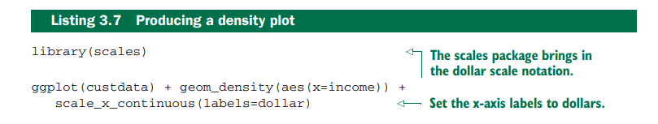
Producing a Density Plot

Slide 17
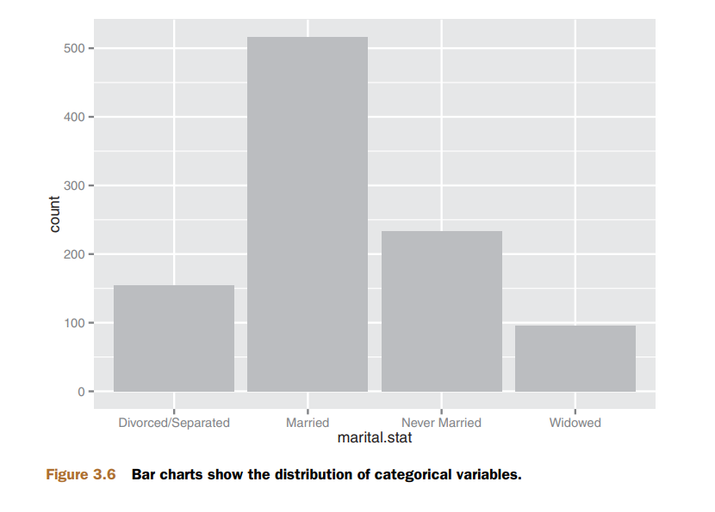
BAR CHARTS
A bar chart is a histogram for discrete data: it records the frequency of every value of a categorical variable
ggplot(custdata) + geom_bar(aes(x=marital.stat), fill="gray")

Slide 18
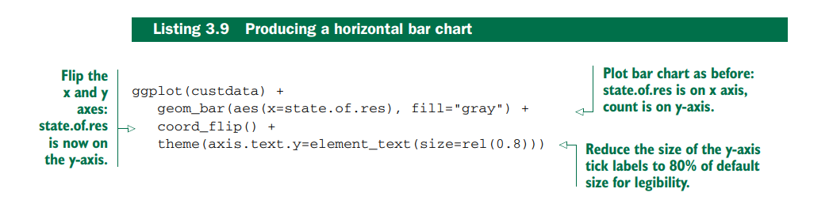
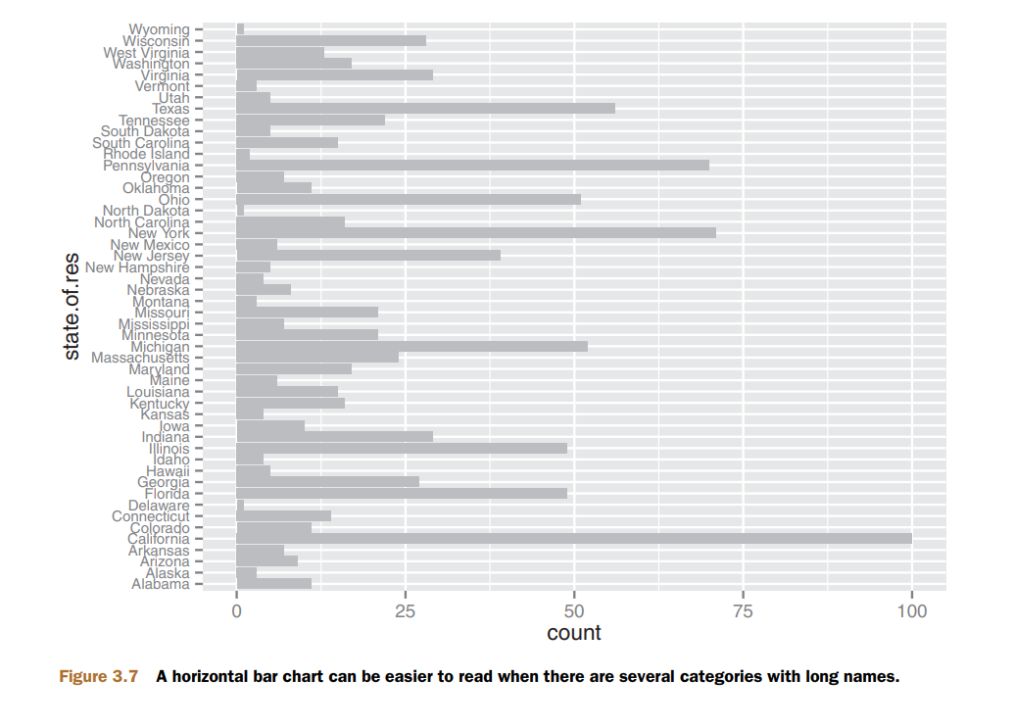
Horizontal Bar Chart

Slide 19
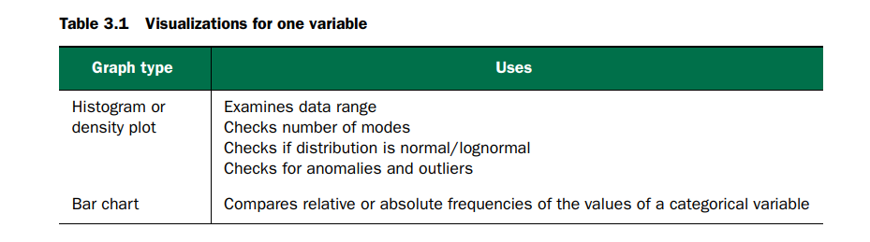
Visualizations for Single Variable

Slide 20
Visually checking relationships between two variables
In addition to examining variables in isolation, Find the relationship between two variables.
For example, you might want to answer questions like these:
Is there a relationship between the two inputs age and income in my data?
What kind of relationship, and how strong?
Is there a relationship between the input marital status and the output health insurance? How strong?

Slide 21
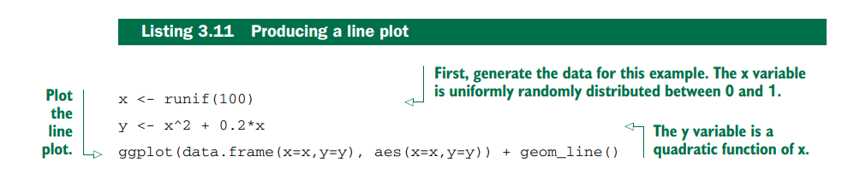
LINE PLOTS
First, let’s consider the relationship between two continuous variables.
Line plots work best when the relationship between two variables is relatively clean: each x value has a unique (or nearly unique) y value, as in figure ,plot figure with geom_line.

Slide 22
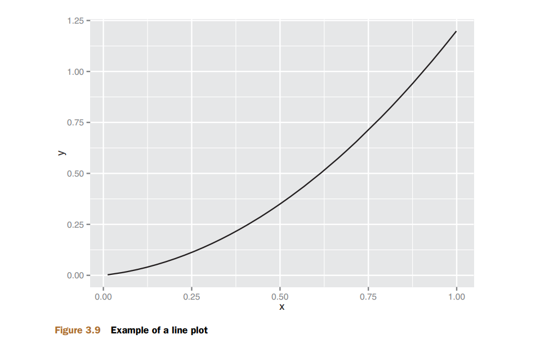
Line Plot
When the data is not so cleanly related, line plots aren’t as useful; then use the scatter plot instead

Slide 23
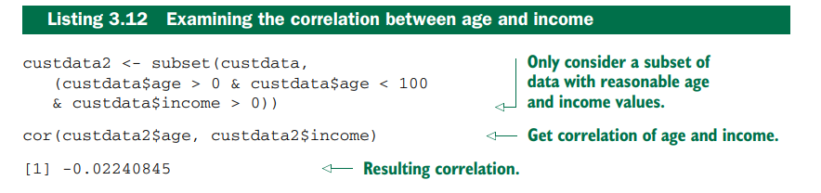
SCATTER PLOTS AND SMOOTHING CURVES
a relationship between age and health insurance, and also a relationship between income and health insurance. But what is the relationship between age and income? If they track each other perfectly, then you might not want to use both variables in a model for health insurance.
The appropriate summary statistic is the correlation, which we compute on a safe subset of our data.

Slide 24
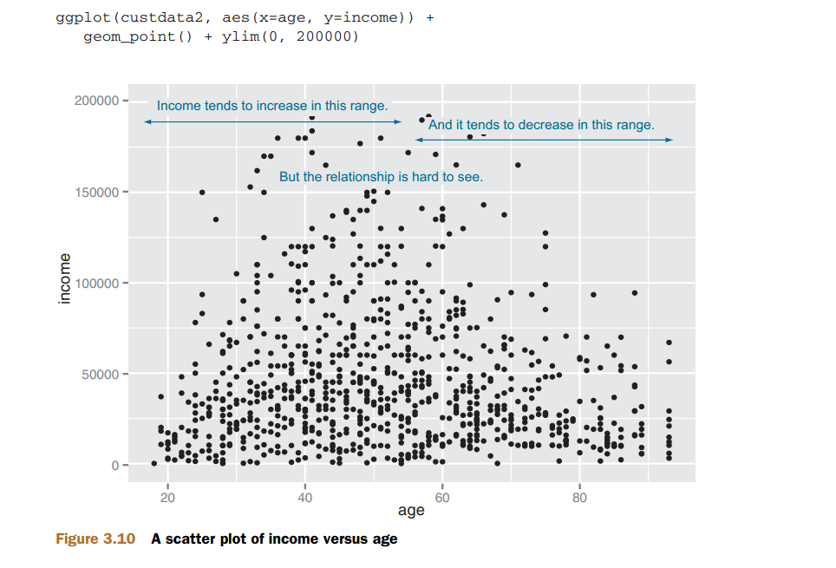
Scatter Plot

Slide 25
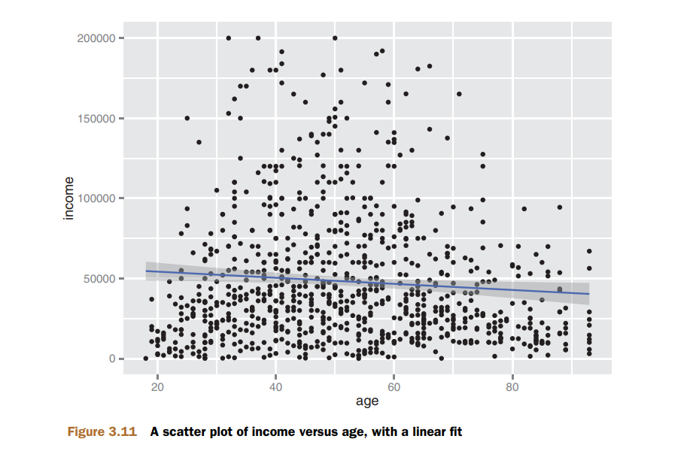
Scatter Plot
The relationship between age and income isn’t easy to see. You can try to make the relationship clearer by also plotting a linear fit through the data, as shown in figure. using the stat_smooth layer:
ggplot(custdata2, aes(x=age, y=income)) + geom_point() + stat_smooth(method="lm") + ylim(0, 200000)

Slide 26
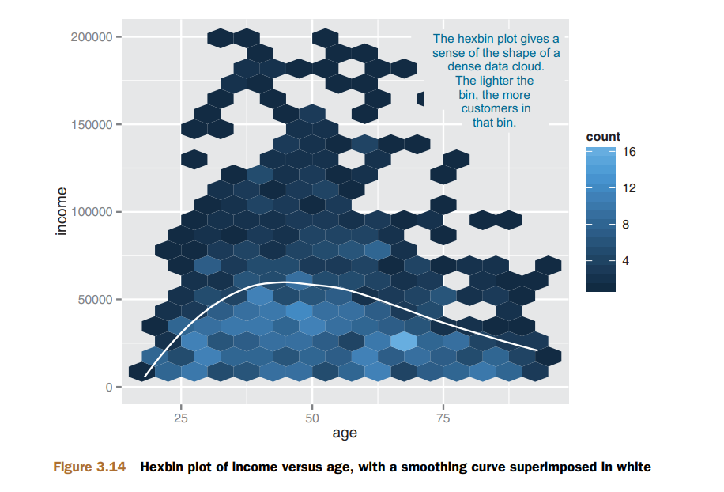
HEXBIN PLOTS
A hexbin plot is like a two-dimensional histogram. The data is divided into bins, and the number of data points in each bin is represented by color or shading

Slide 27
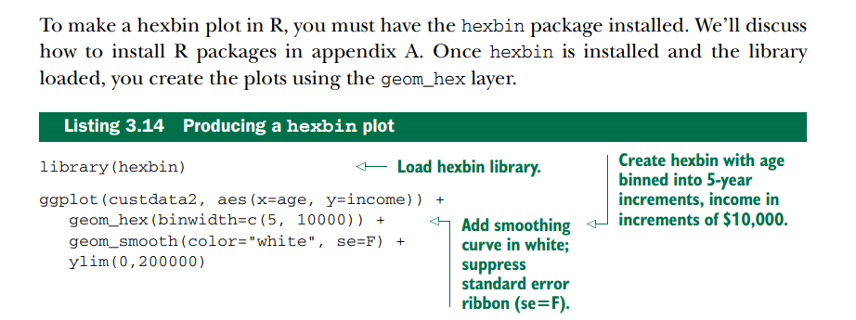
HEXBIN PLOTS

Slide 28
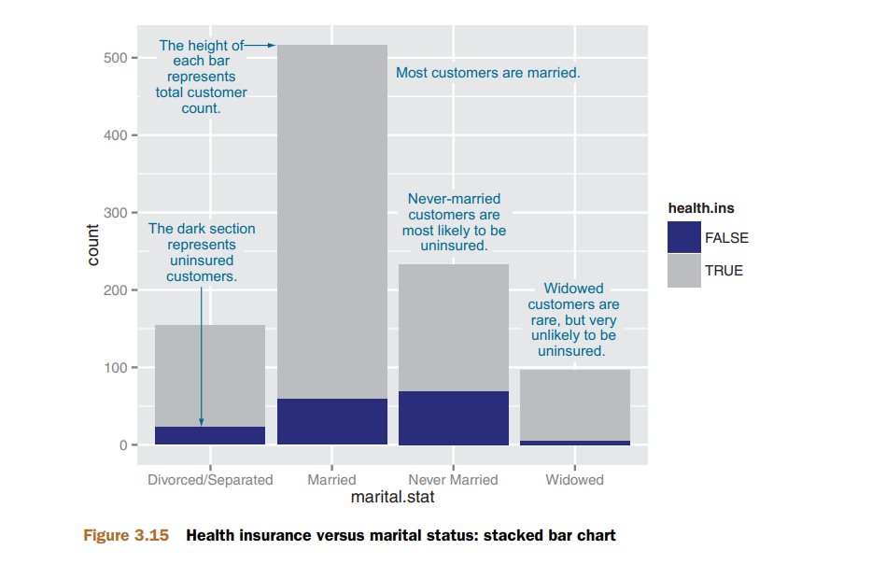
BAR CHARTS FOR TWO CATEGORICAL VARIABLES
Example: the relationship between marital status and the probability of health insurance coverage.

Slide 29
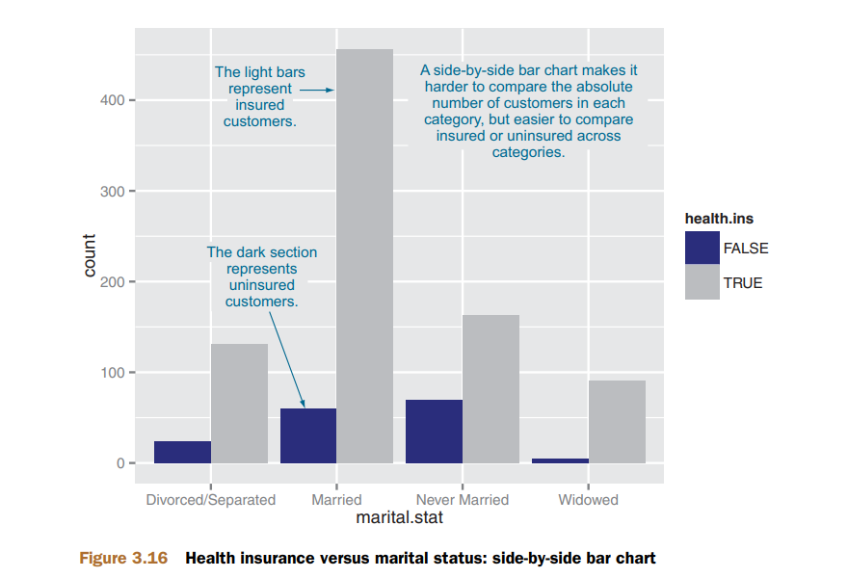
BAR CHARTS FOR TWO CATEGORICAL VARIABLES

Slide 30
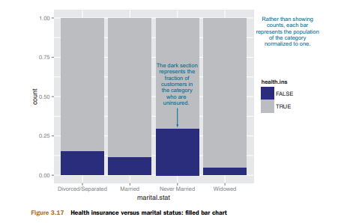
Filled Bar Chart

Slide 31
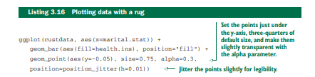
Filled Bar with Rug Chart
To get a simultaneous sense of both the population in each category and the ratio of insured to uninsured, you can add what’s called a rug to the filled bar chart.
A rug is a series of ticks or points on the x-axis, one tick per datum. The rug is dense where you have a lot of data, and sparse where you have little data. This is shown in figure Generate this graph by adding a geom_point layer to the graph

Slide 32
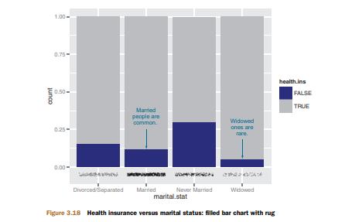
Filled Bar with Rug Chart

Slide 33
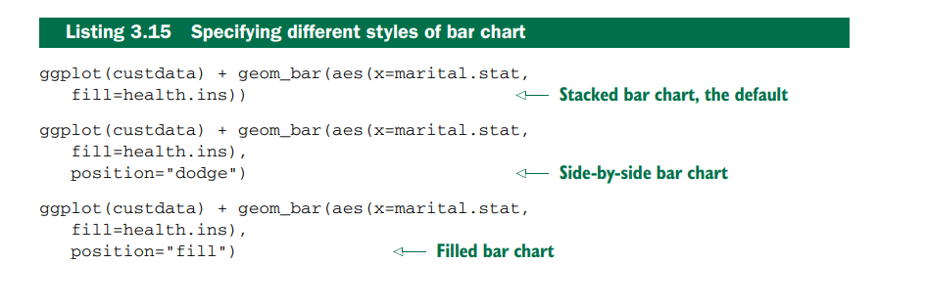
Different Styles of Bar Chart

Slide 34
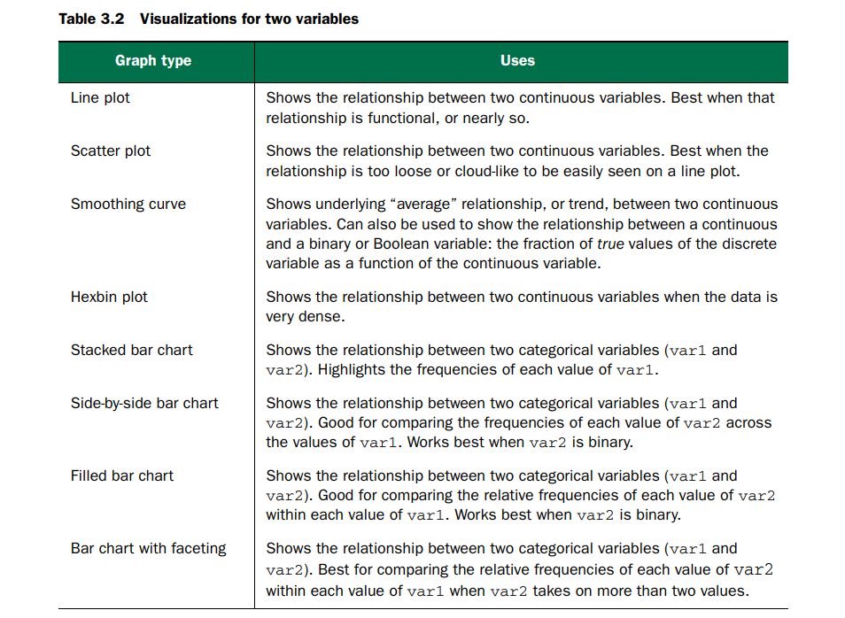
Visualizations for Two variables

Slide 35
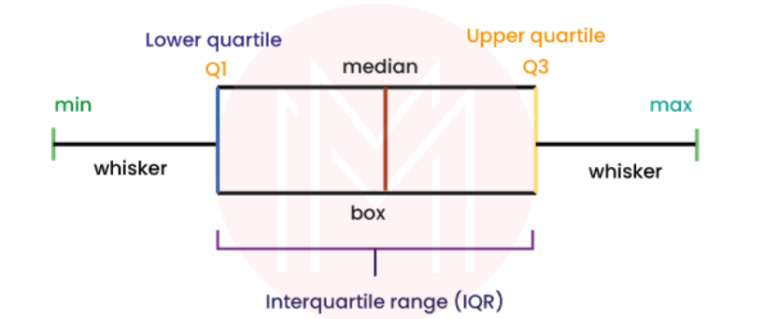
Other Graphs
A Box and Whisker Plot, also known simply as a Boxplot, is a graphical representation of data distribution through its quartiles.
The graph is presented in the form of a rectangle with lines emanating from both the top and the bottom.
These lines, called "whiskers," depict the variability outside the upper and lower quartiles.

Slide 36
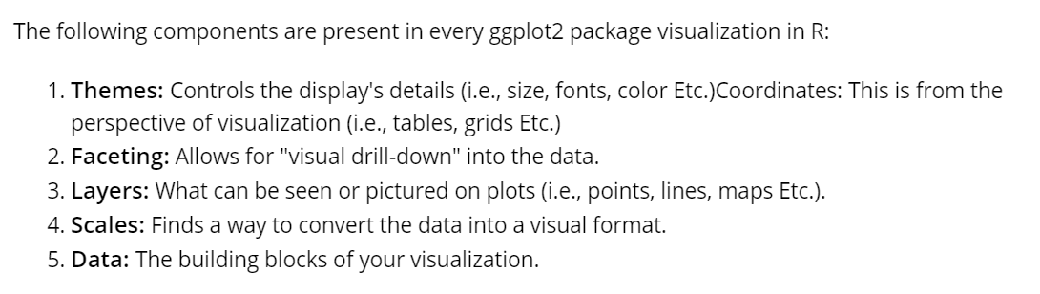
What are the ggplot2 library's key components or grammar?

Slide 37
Summary
Take the time to examine your data before diving into the modeling.
The summary command helps you spot issues with data range, units, data type, and missing or invalid values.
Visualization additionally gives you a sense of data distribution and relationships among variables.
Visualization is an iterative process and helps answer questions about the data.
Time spent here is time not wasted during the modeling process.

Slide 38
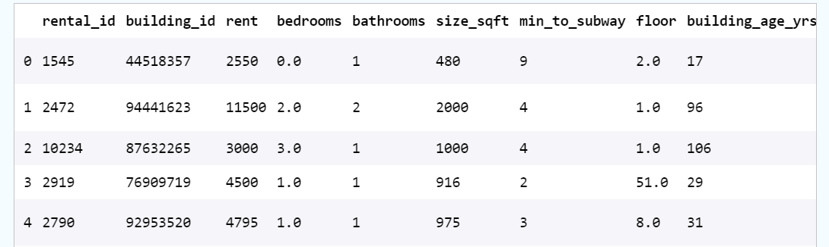
Data Set

Slide 39
Analytics Example
Univariate analysis
What is the typical price of a rental in New York City?
What proportion of NYC rentals have a gym?
Quantitative variables
Box plots (or violin plots) and histograms are common choices for visually summarizing a quantitative variable. These plots are useful because they simultaneously communicate information about minimum and maximum values, central location, and spread.

Slide 40
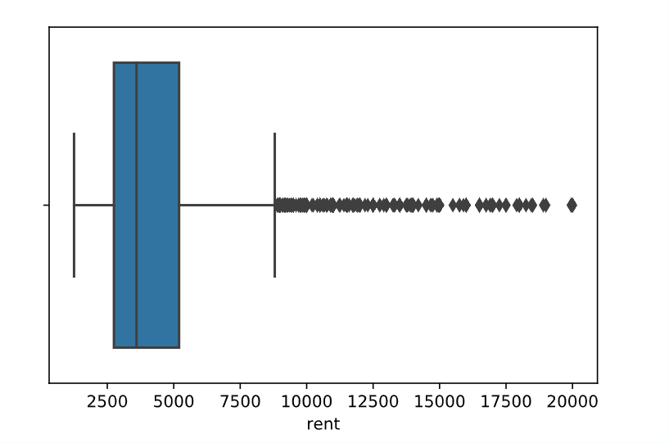
Analytics Example(Contd..)
For example, suppose we are interested in learning more about the price of apartments in NYC. A good starting place is to plot a box plot of the rent variable. We could plot a boxplot of rent as follows:

Slide 41
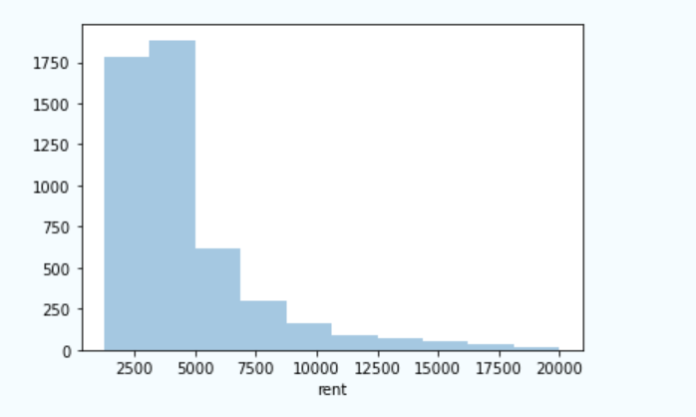
Analytics Example(Contd..)
We can see that most rental prices fall within a range of $2500-$5000; however, there are many outliers, particularly on the high end.
For more detail, we can also plot a histogram of the rent variable.
The histogram highlights the long right-handed tail for rental prices.

Slide 42
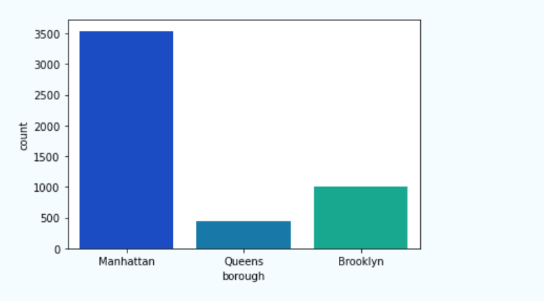
Analytics Example(Contd..)-Categorical variables
For example, suppose we want to know how many apartments are available in each borough. We can visually represent that information as follows:

Slide 43
Analytics Example(Contd..)-Bivariate analysis
In the relationship between two variables in a dataset.
For example:
Do apartments in different boroughs tend to cost different amounts?
What is the relationship between the area of an apartment and how much it costs?

Slide 44
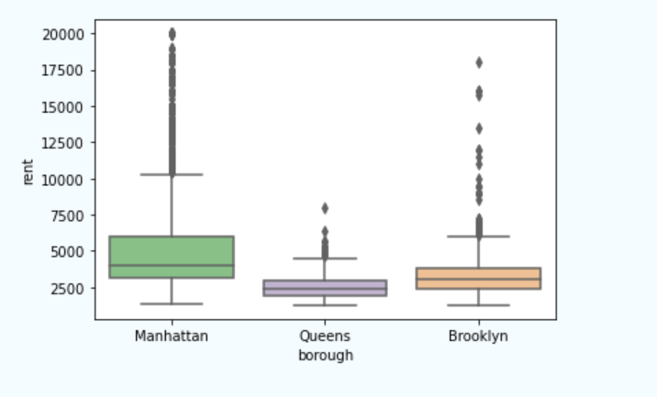
Analytics Example(Contd..)-One quantitative variable and one categorical variable
This plot indicates that rental prices in Manhattan tend to be higher and have more variation than rental prices in other boroughs.

Slide 45
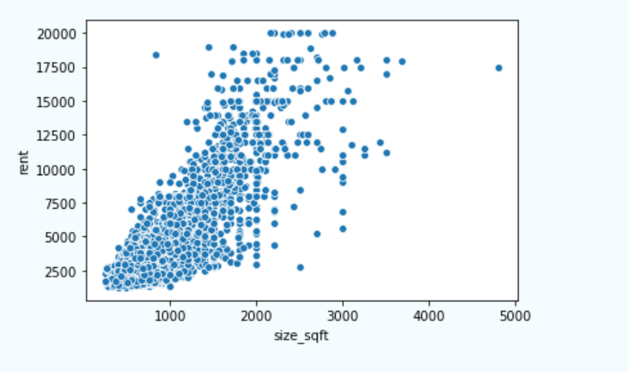
Analytics Example(Contd..)-Two quantitative variables
Explore the relationship between rent and size_sqft.
create a scatter plot of these two variables:

Slide 46
Managing Data
This chapter covers
Fixing data quality problems
Organizing your data for the modeling process

Slide 47
4.1 Cleaning data
Converting continuous variables to discrete;
normalization and rescaling;
and logarithmic transformations.

Slide 48
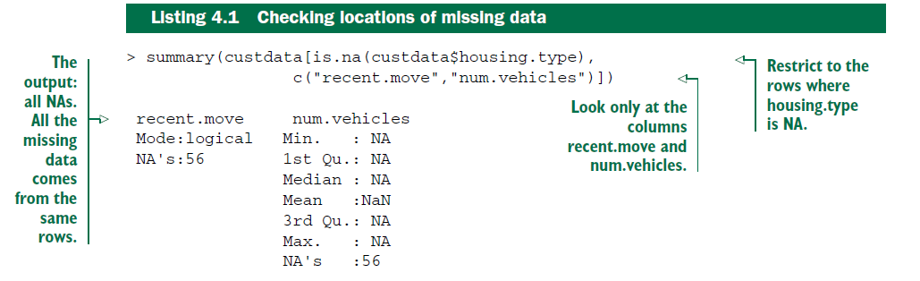
4.1.1 Treating missing values (NAs)
Fundamentally, there are two things you can do with these variables: drop the rows with missing values, or convert the missing values to a meaningful value.
TO DROP OR NOT TO DROP?

Slide 49
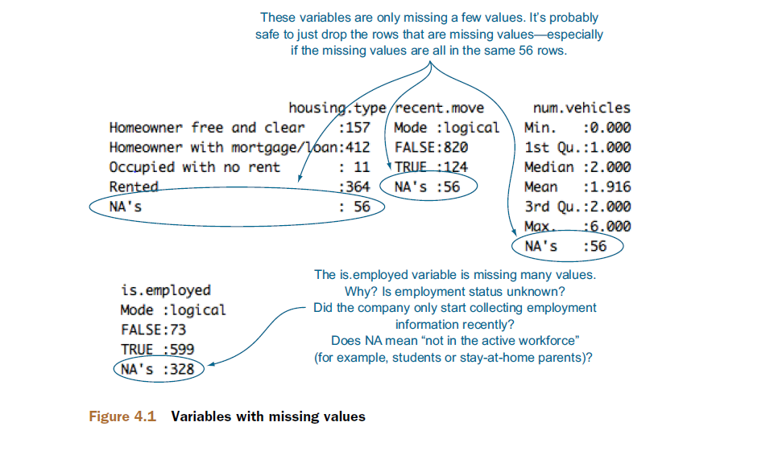
4.1.1 Treating missing values (NAs)
TO DROP OR NOT TO DROP?

Slide 50
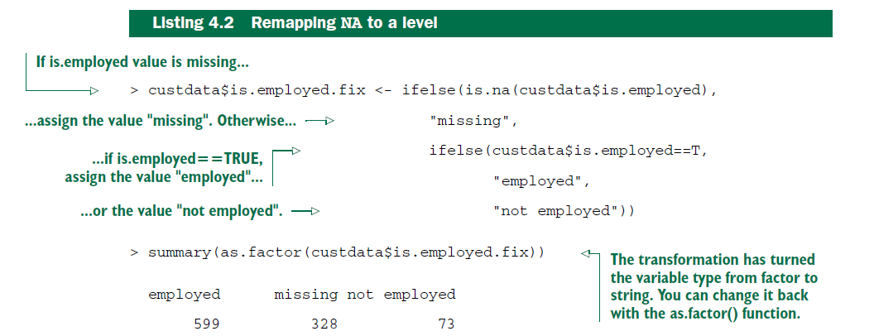
4.1.1 Treating missing values (NAs)
MISSING DATA IN CATEGORICAL VARIABLES
The most straightforward solution is just to create a new category for the variable, called missing.

Slide 51
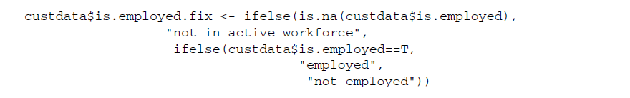
4.1.1 Treating missing values (NAs)
MISSING DATA IN CATEGORICAL VARIABLES

Slide 52
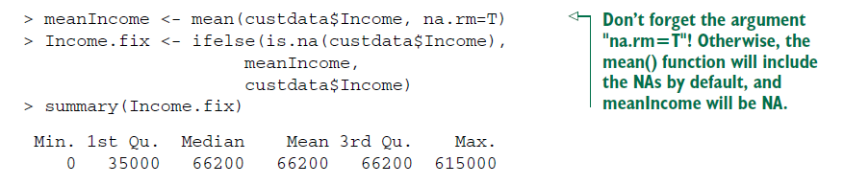
4.1.1 Treating missing values (NAs)
MISSING VALUES IN NUMERIC DATA
> summary(custdata$Income)
Min. 1st Qu. Median Mean 3rd Qu. Max. NA’s
0 25000 45000 66200 82000 615000 328
WHEN VALUES ARE MISSING RANDOMLY

Slide 53
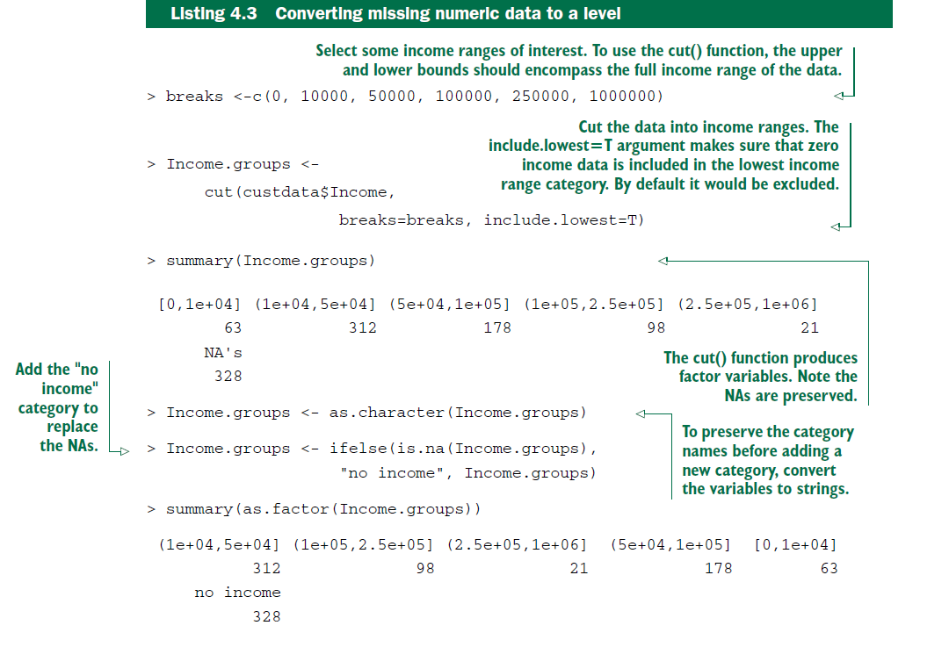
4.1.1 Treating missing values (NAs)
WHEN VALUES ARE MISSING SYSTEMATICALLY

Slide 54
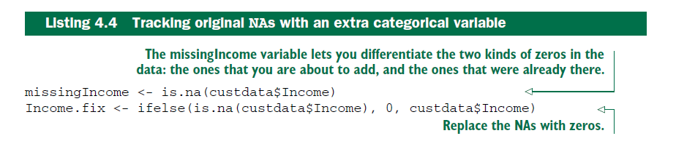
4.1.1 Treating missing values (NAs)

Slide 55
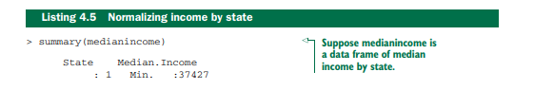
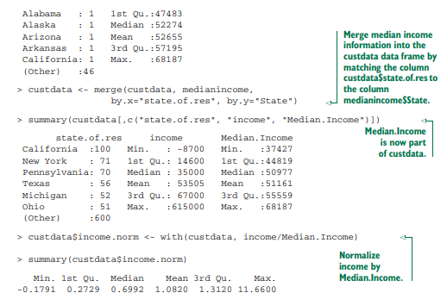
4.1.2 Data transformations
The purpose of data transformation is to make data easier to model—and easier to understand.

Slide 56
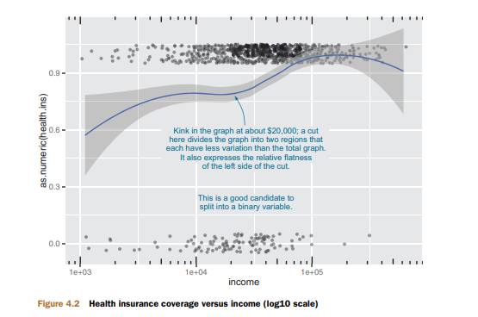
4.1.2 Data transformations
CONVERTING CONTINUOUS VARIABLES TO DISCRETE
Discretizing continuous variables is useful when the relationship between input and output isn’t linear, but you’re using a modeling technique that assumes it is, like regression

Slide 57
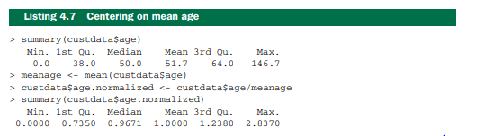
4.1.2 Data transformations
NORMALIZATION AND RESCALING
Normalization is useful when absolute quantities are less meaningful than relative ones

Slide 58
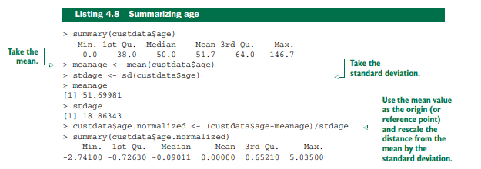
4.1.2 Data transformations

Slide 59
4.3 Summary
data quality that is as good as you can make it. You’ve fixed problems with missing data and performed any needed transformations. You’re ready to go on to the modeling stage
Remember, though, that data science is an iterative process. You may discover during the modeling process that you have to do additional data cleaning or transformation. You may have to go back even further and collect different types of data.

