Slide 1

Department of Information Science & Engineering
Term: 10th Sep 2025 – 31st Dec 2025
Semester: 5
Subject Code: IS53 Credits: 4:0:0
Subject Name: Computer Networks

Slide 2
UNIT 3
NETWORK Layer

Slide 3
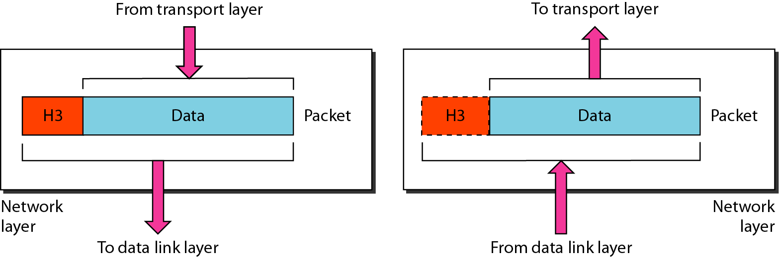
NETWORK LAYER
Data link layer operates on the same network(link)
Network layer operates on different networks(links)
Responsible for source to destination delivery
The network layer is responsible for the
delivery of individual packets from
the source host to the destination host.

Slide 4
Responsibilities / Functions / Services of Network Layer
Source to destination delivery
Logical addressing
Packetizing
Routing and Forwarding
Other services
  Error Control , Flow control
  Congestion control, Quality of service
  Security

Slide 5
PACKET SWITCHING
Datagram Approach – Connection less service
Virtual Circuit Approach – Connection Oriented service
    Setup Phase (Request packet & ACK packet)
    Data Transfer Phase
    Tear down / Termination phase

Slide 6
NETWORK-LAYER PERFORMANCE
Delay
  Transmission delay
  Propagation delay
  Processing delay
  Queuing delay
  Total delay – Sum of the above
Throughput
Packet loss
Congestion

Slide 7
DELAY
Transmission delay: Delay_{tr} = (Packet length) / (Transmission rate)
Propagation delay: Delay_{pg} = (Distance) / (Propagation speed)
Processing delay: Delay_{pr} = Time required to process a packet in a router or a destination host
Queuing delay: Delay_{qu} = The time a packet waits in input and output queues in a router
Total delay: Sum of the above
Total delay = (n+1) (Delay_{tr} + Delay_{pg} + Delay_{pr}) + (n) (Delay_{qu})

Slide 8
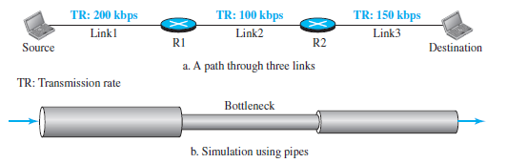
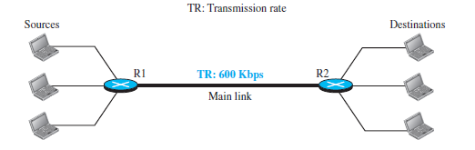
THROUGHPUT
Throughput = minimum {TR1, TR2, . . . TRn}.
Effect of throughput in shared links

Slide 9
Congestion Control
Congestion:
  the load on the network is greater than the capacity of the network
Congestion control:
  the mechanisms to control the congestion and keep the load below the capacity
Congestion happens in any system that involves waiting
Congestion occurs because routers and switches have queues/buffers that hold the packets before and after processing

Slide 10
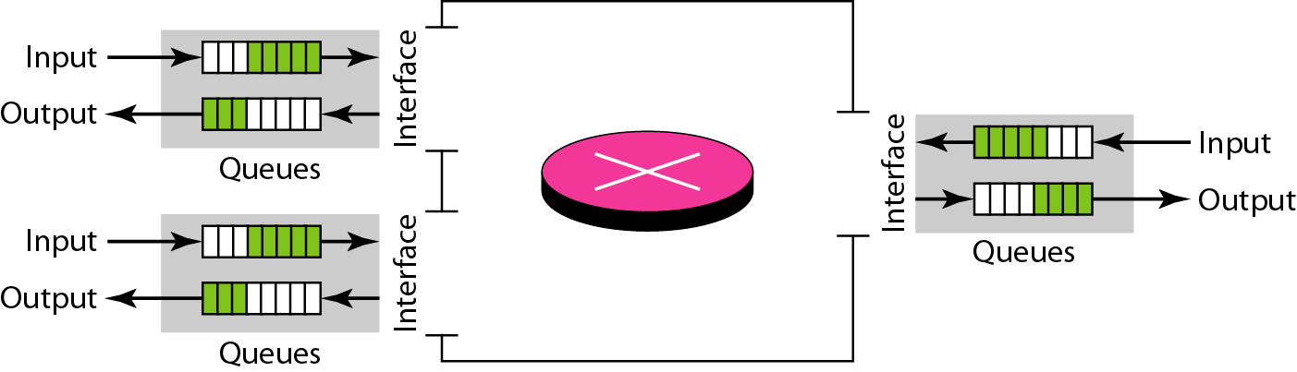
Congestion Control
Two Issues
The rate of packet arrival > packet processing rate → affects input queue
The packet departure rate < packet processing rate → affects output queue

Slide 11
Congestion control involves two factors that measure the performance of a network - Delay and throughput
Delay is composed of propagation delay and processing delay
Throughput: the number of packets passing through the network in a unit of time

Slide 12
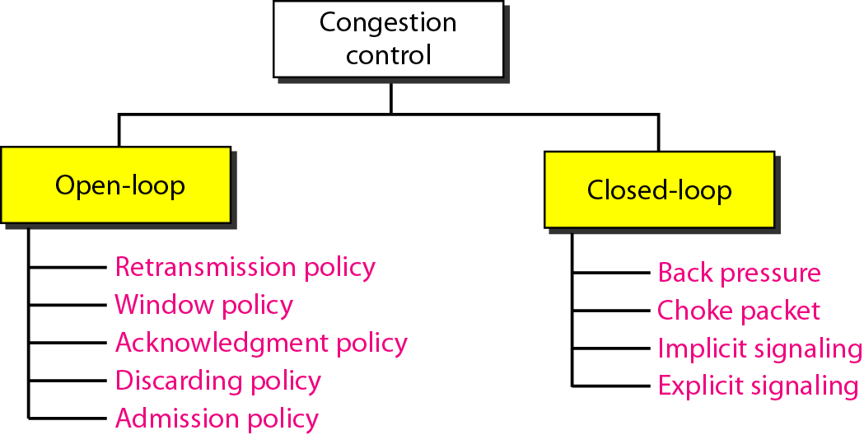
Congestion Control
Congestion control refers to techniques and mechanisms that can either prevent congestion or remove congestion.
Two broad categories: open-loop congestion control (prevention) and closed-loop congestion control (removal).

Slide 13
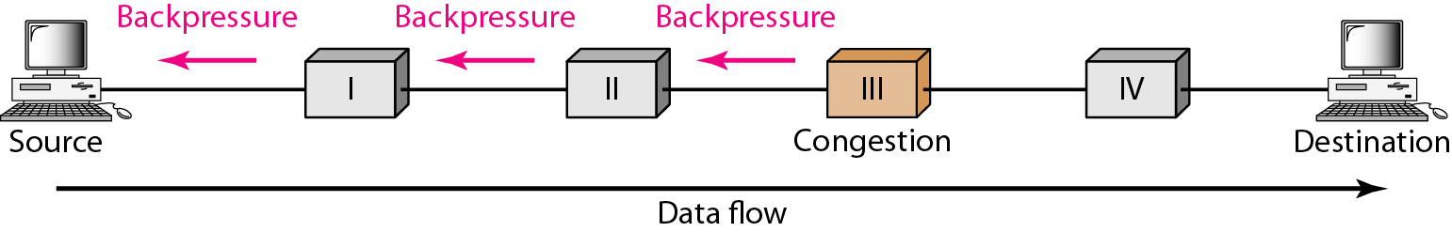
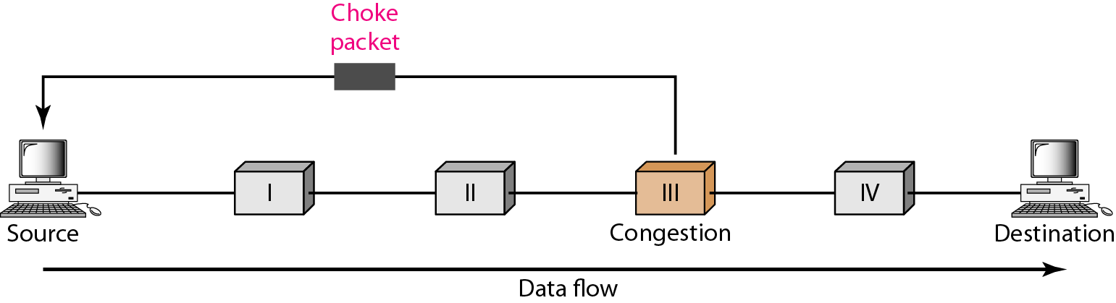
Back pressure
Choke Packet

Slide 14

IPv4 ADDRESSES

Slide 15
IPv4 ADDRESSES
An IPv4 address is a 32-bit address that uniquely and universally defines the connection of a device (for example, a computer or a router) to the Internet.
An IPv4 address is 32 bits long
The IPv4 addresses are unique and universal
The address space of IPv4 is 2³² or 4,294,967,296 (4 billion+)

Slide 16
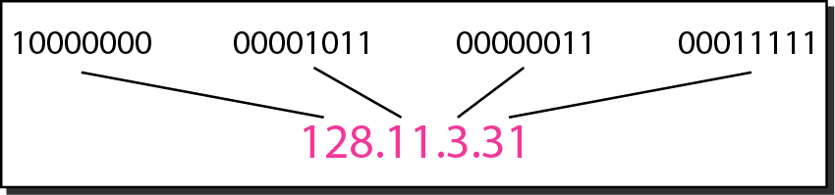
IPv4 ADDRESS NOTATION
Binary Notation :
Address is displayed as 32 bits.
Referred to as 32-bit address or 4-byte address
Example: 01110101 10010101 00011101 00000010
Dotted Decimal Notation :
More compact and easier to read
Example: 117.149.29.2

Slide 17
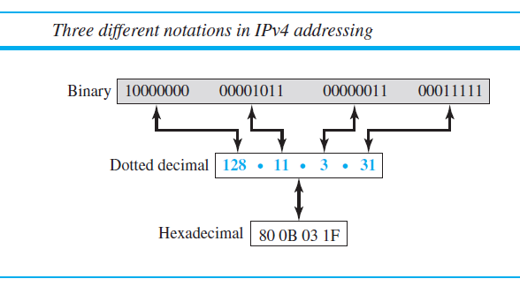
IPv4 ADDRESS NOTATION
Hexadecimal Notation :
8 hexadecimal digits
Example: 80 0B 03 1F

Slide 18
Example 1
Change the following IPv4 addresses from binary notation to dotted-decimal notation.
Solution
We replace each group of 8 bits with its equivalent decimal number and add dots for separation.

Slide 19
Example 2
Change the following IPv4 addresses from dotted-decimal notation to binary notation.
Solution
We replace each decimal number with its binary equivalent

Slide 20
Example 3
Find the error, if any, in the following IPv4 addresses.
Solution
a. There must be no leading zero (045).
b. There can be no more than four numbers.
c. Each number needs to be less than or equal to 255.
d. A mixture of binary notation and dotted-decimal
notation is not allowed.

Slide 21
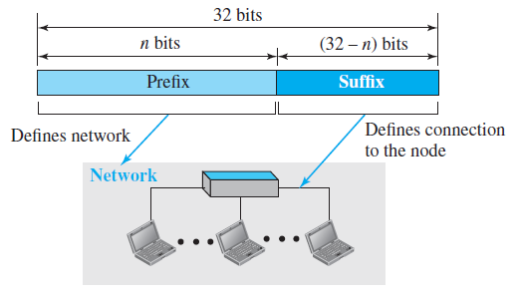
HIERARCHY IN ADDRESSING

Slide 22

IPv4 CLASSFUL ADDRESSING
In classful addressing, the address space is divided into five classes: A, B, C, D, and E.
Each IP address consists of 4 bytes, defining three fields :
      Class Type
      NetID (network identifier)
      HostID (host identifier)

Slide 23
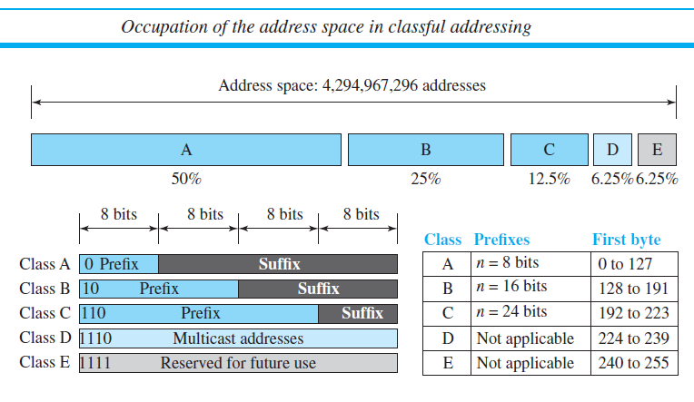
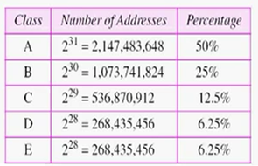

Slide 24
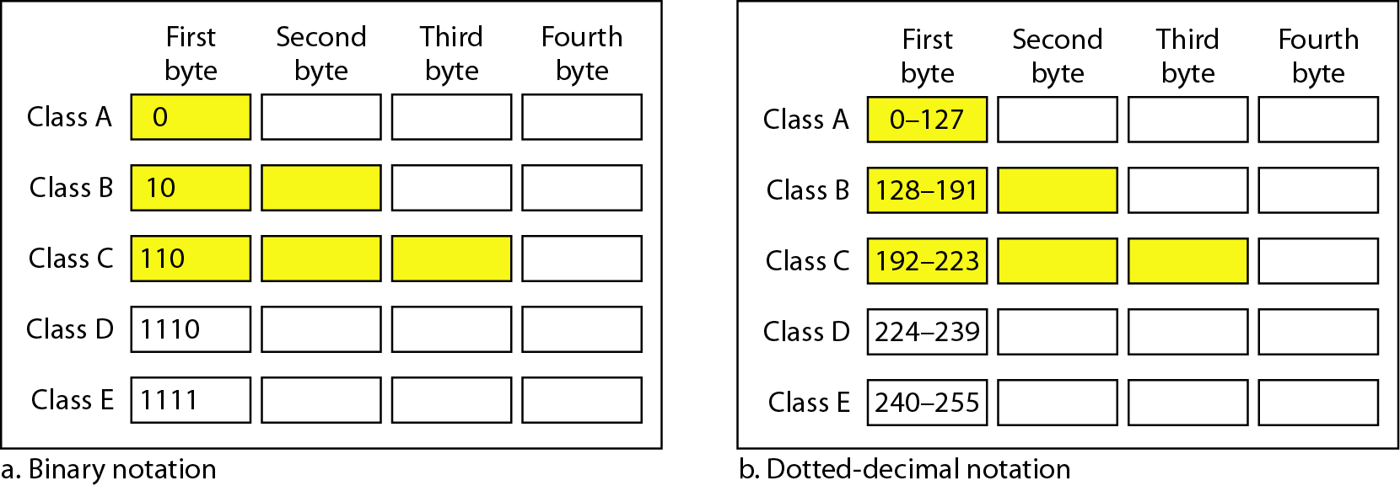
Finding the classes in binary and dotted-decimal notation

Slide 25
Example 4
Find the class of each address.
a. 00000001 00001011 00001011 11101111
b. 11000001 10000011 00011011 11111111
c. 14.23.120.8
d. 252.5.15.111
Solution
a. The first bit is 0. This is a class A address.
b. The first 2 bits are 1; the third bit is 0. This is a class C
address.
c. The first byte is 14; the class is A.
d. The first byte is 252; the class is E.

Slide 26
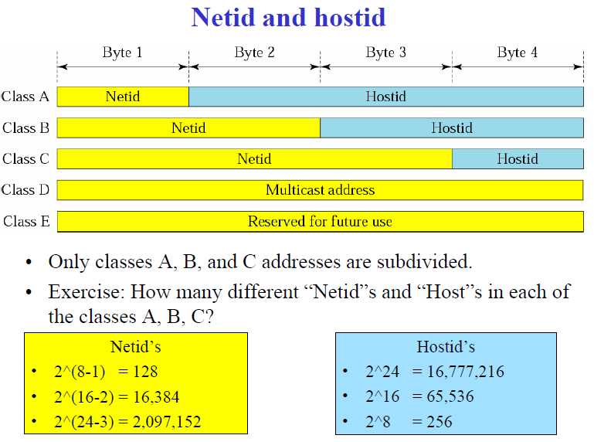

Slide 27
Number of blocks and block size in classful IPv4 addressing

Slide 28
Class A address: designed for large organizations with a large number of attached hosts or routers. (wasted & not used)
Class B address: designed for midsize organizations with ten of thousands of attached hosts or routers( too large for many organizations)
Class C address: designed for small organizations with a small number of attached hosts or routers.(too small for many organizations)
Class D address: designed for multicasting (waste of addresses)
Class E address: reserved for future use (waste of addresses)

Slide 29
Subnetting
Address Depletion
Supernetting

Slide 30

Note
Classful addressing, which is almost obsolete, is replaced with classless addressing.

Slide 31
CLASSLESS ADDRESSING
Serves as the solution for address depletion but does not remove it
No classes but the address are still granted in blocks
The size of the block( the number of addresses) varies based on the nature and size of the entity.
      Household: 2 addresses
      Large organization: thousands of addresses.
      ISP: thousands or hundreds of thousands based on the number of customers it may serve.

Slide 32
CLASSLESS ADDRESSING
Restriction
Internet authorities impose three restrictions on classless address blocks:
The addresses in a block must be contiguous, one after another.
2. The number of addresses in a block must be a power of 2 (1, 2, 4, 8, ... ).
3. The first address must be evenly divisible by the number of addresses.

Slide 33
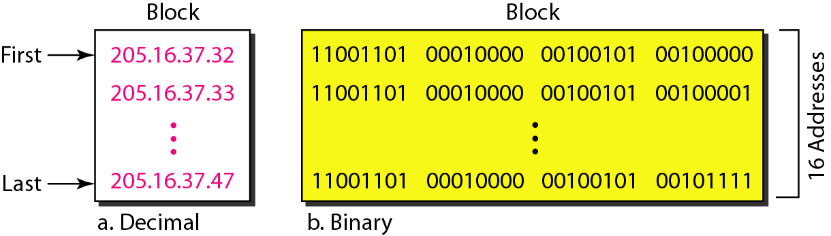
Classless Address Block – Example
The restrictions are applied to this block:
The addresses are contiguous.
The number of addresses is a power of 2 (2⁴=16)
The first address is divisible by 16. The first address, when converted to a decimal number is 3,440,387,360 which when divided by 16 results in 215,024,210.

Slide 34
MASK - CLASSLESS ADDRESSING
Mask: 32- bit
    The n leftmost bits are 1s
    32-n rightmost bits are 0s
Prefix length – slash notation
In CIDR, n has a value from 0 to 32 and used to show the mask in the form /n.
One of the address and the /n notation define the whole address block:
    First address
    Last address
    Number of address

Slide 35
Note
In IPv4 classless addressing, a block of
addresses can be defined as
x.y.z.t /n
in which x.y.z.t defines one of the addresses and the /n defines the mask.
Example: 172.31.1.2 / 25

Slide 36
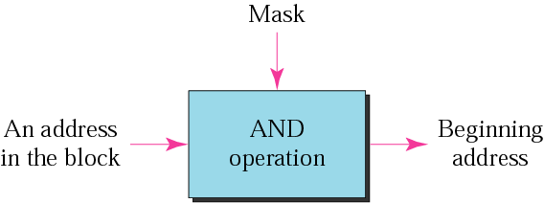
Note
The first address in the block can be found by setting the rightmost
32 − n bits to 0s.
The first address in the block can be found by AND - ing the given address with the mask.

Slide 37
Example 6
A block of addresses is granted to a small organization. We know that one of the addresses is 205.16.37.39/28. What is the first address in the block?
Solution
The binary representation of the given address is
11001101 00010000 00100101 00100111
If we set 32−28 rightmost bits to 0, we get
11001101 00010000 00100101 0010000
or
205.16.37.32/28
This is the one shown in the classless address block example.

Slide 38
Note
The last address in the block can be found by setting the rightmost
32 − n bits to 1s.
The last address in the block can be found by OR - ing the given address with the complement of the mask.

Slide 39
Example 7
A block of addresses is granted to a small organization. We know that one of the addresses is 205.16.37.39/28. What is the last address in the block?
Solution
The binary representation of the given address is
11001101 00010000 00100101 00100111
If we set 32 − 28 rightmost bits to 1, we get
11001101 00010000 00100101 00101111
or
205.16.37.47/28
This is the one shown in the classless address block example.

Slide 40
Note
The number of addresses in the block can be found by using the formula
2^{32−n}.

Slide 41
Example
A block of addresses is granted to a small organization. We know that one of the addresses is 205.16.37.39/28. Find the number of addresses in the block ?
Solution
The value of n is 28, which means that number
of addresses is 2 ³²⁻²⁸ or 16.

Slide 42
Example – with mask ANDing , ORing
A block of addresses is granted to a small organization. We know that one of the addresses is 205.16.37.39/28.
Find
a. The first address
b. The last address
c. The number of addresses.

Slide 43
Example (continued)
Solution
a. The first address can be found by ANDing the given
addresses with the mask. ANDing here is done bit by
bit. The result of ANDing 2 bits is 1 if both bits are 1s;
the result is 0 otherwise.

Slide 44
Example (continued)
b. The last address can be found by ORing the given
addresses with the complement of the mask. ORing
here is done bit by bit. The result of ORing 2 bits is 0 if
both bits are 0s; the result is 1 otherwise. The
complement of a number is found by changing each 1
to 0 and each 0 to 1.

Slide 45
Example (continued)
c. The number of addresses can be found by
complementing the mask, interpreting it as a decimal
number, and adding 1 to it.

Slide 46
NETWORK ADDRESS
A very important concept in IP addressing is the network address.
When an organization is given a block of addresses, the first address in the block is normally treated as a special address.
The first address is called the network address and defines the organization network.
Not assigned to any hosts or devices
The network address represents the organization
to the rest of the world.

Slide 47
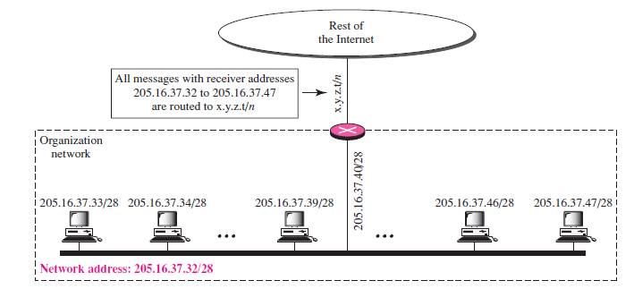

Slide 48
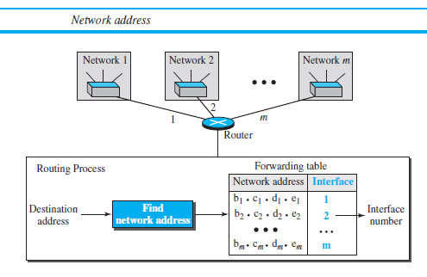

Slide 49
Example
Given the following classful address, find the network address?
a. 132.6.17.85
b. 23.56.7.91
Solution
a. The class is B. The first 2 bytes defines the netid. We can find the network address by replacing the hostid bytes (17.85) with 0s. 132.6.0.0.
b. The class is A. Only the first byte defines the netid. We can find the network address by replacing the hostid bytes (56.7.91) with 0s. 23.0.0.0.

Slide 50
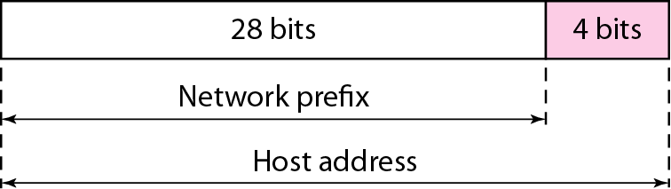
Hierarchy in Classless Addressing
Two Level Hierarchy – No Subnetting

Slide 51
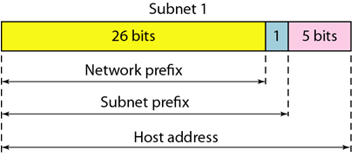
Hierarchy in Classless Addressing
Three Level Hierarchy – Subnetting
More Levels of Hierarchy – Subnets within subnet

Slide 52
DESIGNING SUBNETS
The subnetworks in a network should be carefully designed to enable the routing of packets.
Lets assume -
    Total number of addresses granted to the organization is N,
    Prefix length is n,
    Assigned number of addresses to each subnetwork is N_{sub},
    Prefix length for each subnetwork is n_{sub}.

Slide 53
DESIGNING SUBNETS
Key requirements – Steps to follow
The addresses in a block must be contiguous, one after another.
2. The number of addresses in a block must be a power of 2 (1, 2, 4, 8, ... ).
3. Prefix length for each subnet is calculated using the formula:
n_{sub} = 32 − log₂N_{sub}
4. The first address must be evenly divisible by the number of addresses.

Slide 54
Example 11
Suppose an organization is given the block 17.12.14.0/26, which contains 64 address. The organization has three offices and needs to divide the address into three subblocks of 32, 16 and 16 address. Design the configuration of the subnetted network.
Solution:
Subnet 1: 17.12.14.0/27 to 17.12.14.31/27
Subnet 2: 17.12.14.32/28 to 17.12.14.47/28
Subnet 3: 17.12.14.48/28 to 17.12.14.63/28

Slide 55
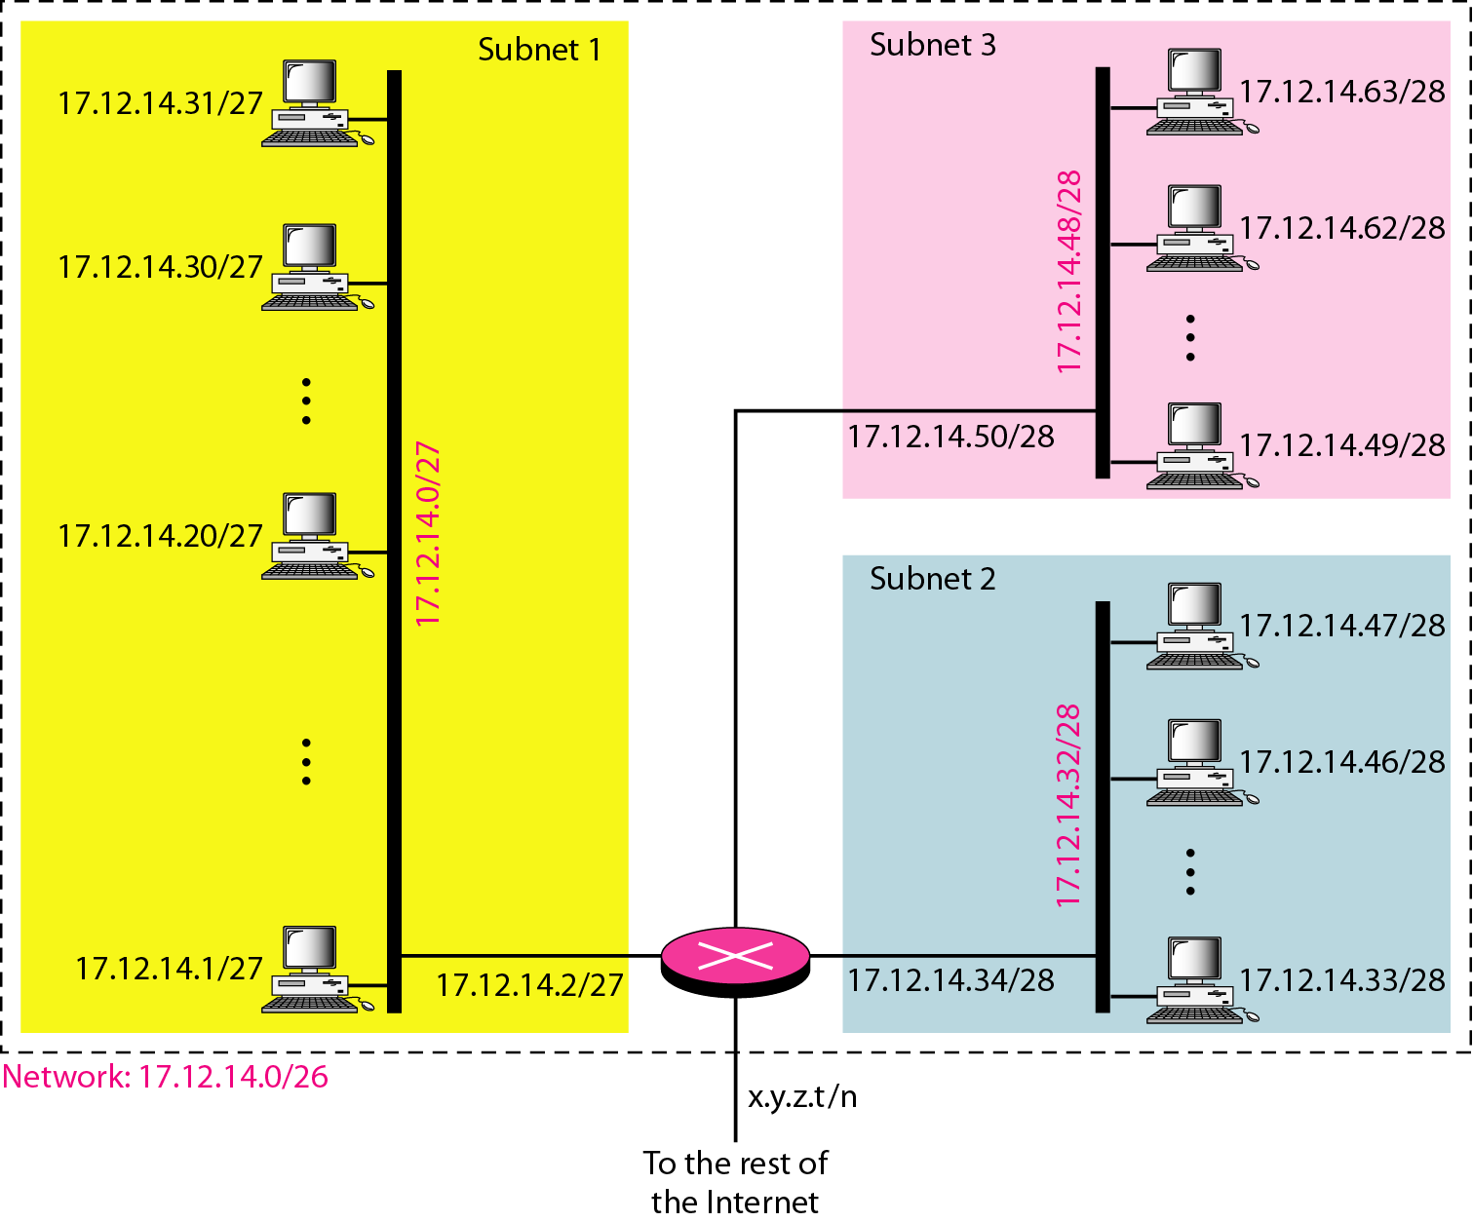
Example 11 (continued)

Slide 56
Example 12 - Address Allocation
An ISP is granted a block of addresses starting with 190.100.0.0/16 (65,536 addresses). The ISP needs to distribute these addresses to three groups of customers as follows:
a. The first group has 64 customers; each needs 256
addresses.
b. The second group has 128 customers; each needs 128
addresses.
c. The third group has 128 customers; each needs 64
addresses.
Design the subblocks and find out how many addresses are still available after these allocations.

Slide 57
Example 12 (continued)
Group 1
For this group, each customer needs 256 addresses. This means that 8 (log₂ 256) bits are needed to define each host. The prefix length is then 32 − 8 = 24. The addresses are

Slide 58
Example 12 (continued)
Group 2
For this group, each customer needs 128 addresses. This means that 7 (log₂ 128) bits are needed to define each host. The prefix length is then 32 − 7 = 25. The addresses are

Slide 59
Example 12 (continued)
Group 3
For this group, each customer needs 64 addresses. This means that 6 (log₂ 64) bits are needed to each host. The prefix length is then 32 − 6 = 26. The addresses are
Number of granted addresses to the ISP: 65,536
Number of allocated addresses by the ISP: 40,960
Number of available addresses: 24,576

Slide 60
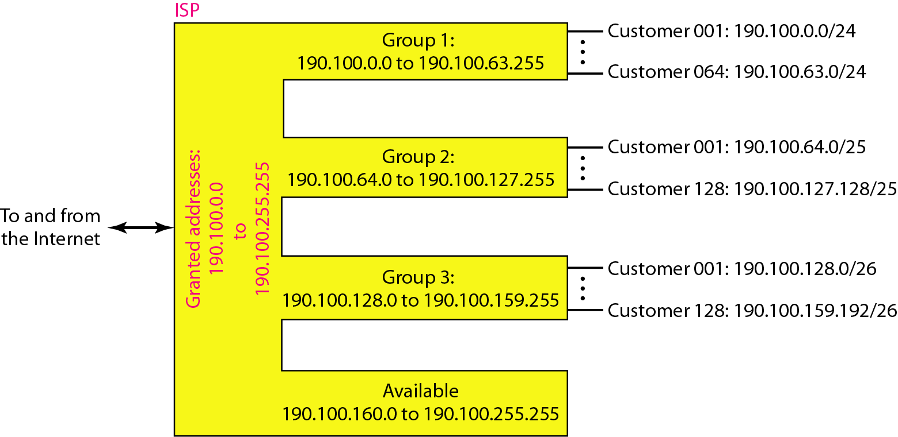
Example 12 (continued)

Slide 61
Address Allocation – Problem 1
An organization is granted the block 211.17.180.0/24. The administrator wants to create 32 subnets.
a. Find the subnet mask.
b. Find the number of addresses in each subnet.
c. Find the first and last addresses in subnet 1.
d. Find the first and last addresses in subnet 32.
Design the subblocks.

Slide 62
Address Allocation - Problem 2
An organization is granted a block of addresses with the beginning address 14.24.74.0/24. The organization needs to have 3 subblocks of addresses to use in its three subnets: one subblock of 10 addresses, one subblock of 60 addresses, and one subblock of 120 addresses. Design the subblocks.

Slide 63
Address Allocation - Problem 3
An ISP is granted a block of addresses starting with 150.80.0.0/16. The ISP wants to distribute these blocks to 2600 customers as follows.
a. The first group has 200 medium-size businesses; each needs 16 addresses.
b. The second group has 400 small businesses; each needs 8 addresses.
c. The third group has 2000 households; each needs 4 addresses.
Design the subblocks and give the slash notation for each subblock. Find out how many addresses are still available after these allocations.

Slide 64
Address Allocation - Problem 4
An ISP is granted a block of addresses starting with 150.80.0.0/16. The ISP wants to distribute these blocks to 2600 customers as follows.
a. The first group has 200 medium-size businesses; each needs 128 addresses.
b. The second group has 400 small businesses; each needs 16 addresses.
c. The third group has 2000 households; each needs 4 addresses.
Design the subblocks and give the slash notation for each subblock. Find out how many addresses are still available after these allocations.

Slide 65
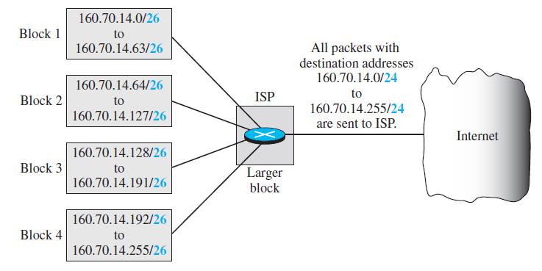
ADDRESSES AGGREGATION

Slide 66
ADDRESSES AGGREGATION
_{Group1}
_{Group2}
_{Group3}
Group1: 190.100.0.0/18 to 190.100.63.255/18
Group2: 190.100.64.0/18 to 190.100.127.255/18
Group3: 190.100.128.0/19 to 190.100.159.255/19
Final: 190.100.0.0/16 to 190.100.255.255/16

Slide 67
SPECIAL ADDRESSES
This-host Address
    0.0.0.0/32 (Only address in the block) - It is used when-ever a host needs to send an IP datagram but it does not know its own address to use as the source address.
Limited-broadcast Address
    255.255.255.255/32 (Only address in the block) - It is used whenever a router or a host needs to send a datagram to all devices in a network. The routers in the network, however, block the packet having this address as the destination; the packet cannot travel outside the network.

Slide 68
SPECIAL ADDRESSES
Loopback Address
    The block 127.0.0.0/8 - A packet with one of the addresses in this block as the destination address never leaves the host; it will remain in the host.
Private Addresses
    Four blocks are assigned as private addresses: 10.0.0.0/8, 172.16.0.0/12, 192.168.0.0/16, and 169.254.0.0/16.
Multicast Addresses
    The block 224.0.0.0/4 is reserved for multicast addresses

Slide 69
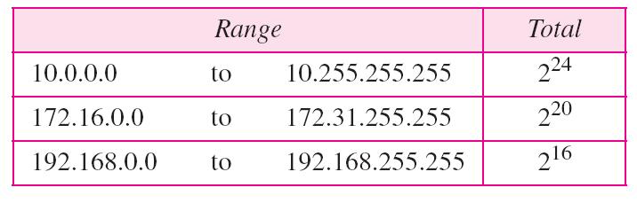
Network Address Translation
Addresses for private networks

Slide 70
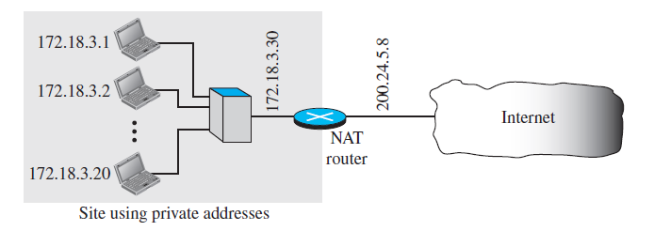
NAT implementation

Slide 71
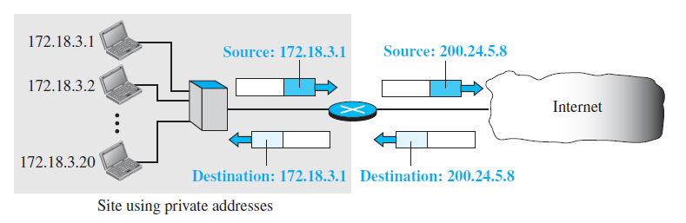
Addresses in a NAT

Slide 72
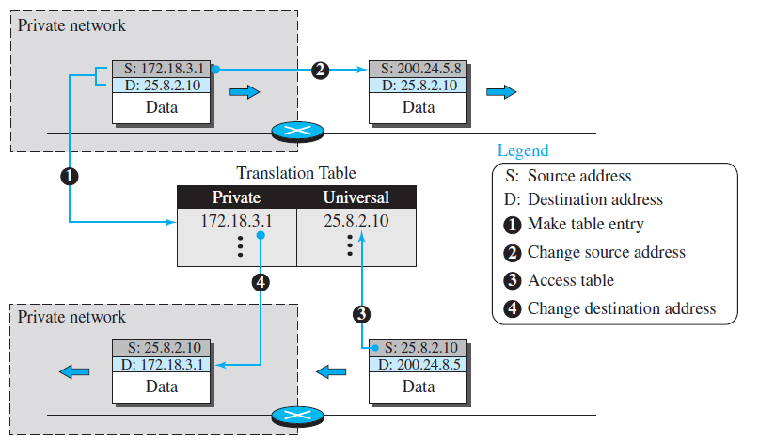
NAT address translation Using One IP Address

Slide 73
NAT address translation Using
    One IP Address
    Using a Pool of IP Addresses
    Using Both IP Addresses and Port Addresses
Using Both IP Addresses and Port Addresses -
Five-column translation table

