Slide 1
POLLUTION

Slide 2
DEFINITION OF POLLUTION
When Harmful Substances Contaminate the Environment it is Called Pollution.
Pollution refers to the very bad condition of environment in terms of quantity and quality .

Slide 3
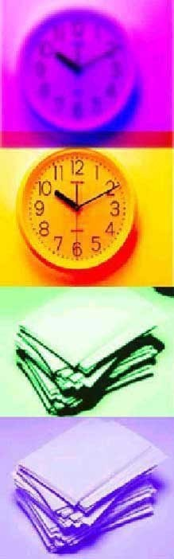
Types of Pollution
There are Five types of Pollution
Air Pollution
Water Pollution
Noise Pollution
Land Pollution
Radio Active Pollution

Slide 4
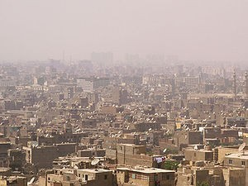

What is Atmosphere
Atmosphere is the life blanket of Earth.
It is therefore essential that we know more about the atmosphere and the ways in which it is Polluted.

Slide 5
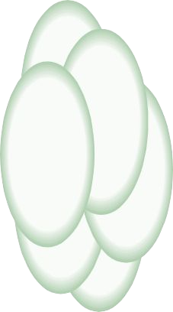
Causes of Air Pollution
Major sources of Air Pollution
- Industries
-Automobiles and Domestic fuels
-High Proportion of undesirable
gases, such as sulphur dioxide and carbon monoxide

Slide 6

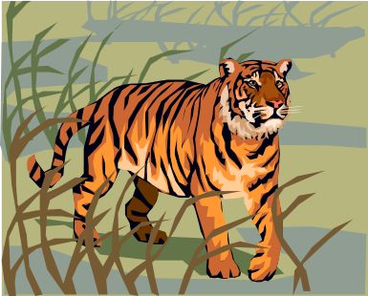
Effects of Air Pollution
Air Pollution affects???
Human health
Animals
Plants
The atmosphere as a whole

Slide 7
How to Avoid Air Pollution
Yes, we can avoid pollution As Follows
Use natural Gases, like lpg autos Do not Burst Crackers
Use less Amount of Fuel for Vehicles Avoid using and use electric stoves (bio gas)

Slide 8

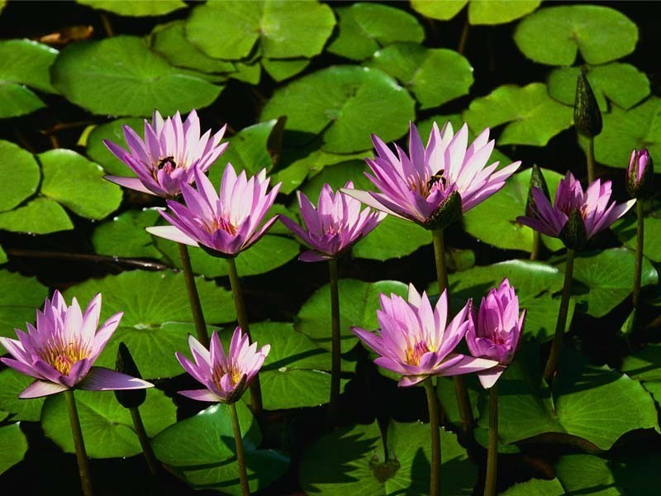
Water God’s Valuable Gift

Slide 9
Definition of Water Pollution
The Contamination of water with undesirable substances which make it unfit for usage is termed water Pollution.

Slide 10
Causes of Water Pollution
About 40% of Deaths worldwide are caused by Water Pollution.
Water Pollution is Caused by organsic and inorganic industrial wastes and affluents discharged into rivers.
Noise also causes anxiety stress reacation and fright.

Slide 11
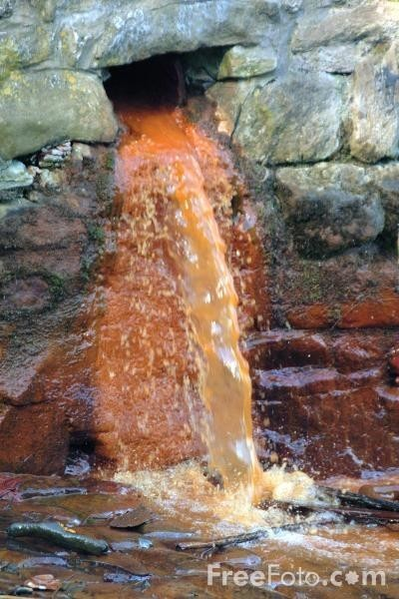
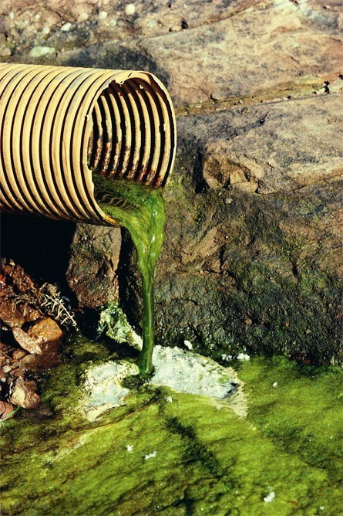
Water Pollution Pictures

Slide 12
Effects of Water Pollution
Diseases like Cholera
Malaria
Typhoid (spread during the rainy season )
Aquatic life gets destroyed

Slide 13
How to Avoid Water Pollution
Rivers should not be used for washing clothes or bathing animals in.
Harvesting of Rainwater to meet water requirements.
Dams &embankments must be created.
The rivers must not be contaminated.
In sacred river like Ganga the dead bodies shouldn’t thrown.

Slide 14
Definition of Land Pollution
One fourth of area is covered by land is Called Land.
Land is a earth which is occupied by people for shelter,occuption etc..,

Slide 15

Causes of Land Pollution
We can classify major sources that lead to land
following Categories
Mining and quarrying
Sewage waste
Household Garbage
Industrial Waste

Slide 16
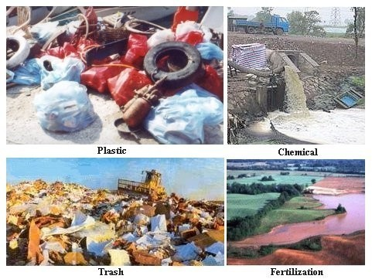
Land pollution pictures

Slide 17
Effects of Land Pollution
The Land Cannot be construct house
Man cannot be farming
Ground water will gets Affected
House hold Garbage like putting Plastics

Slide 18
Prevention of Land Pollution
More and more land should be brought under farming
Trees should be planted everywhere.
Waste matter should be disposed immediately
Avoid drilling the Land for more underground water.
Avoid using more fertilizers and Pesticides.

Slide 19

Dam is a solid barrier constructed at a suitable location across a river valley to store flowing water.
Dam
Storage of water is utilized for following objectives:
Hydropower
Irrigation
Water for domestic consumption
For drought and flood control
Other additional utilization is to develop fisheries.

Slide 20
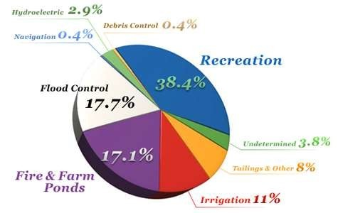
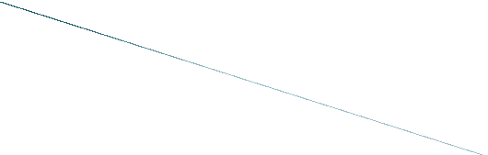


Slide 21
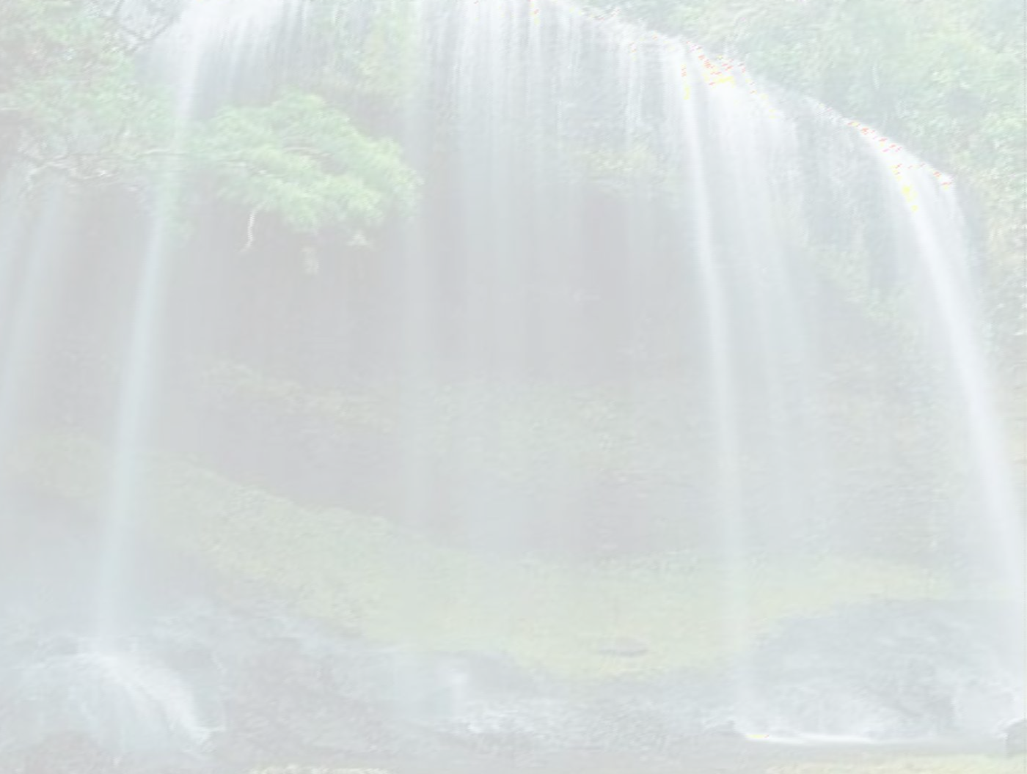
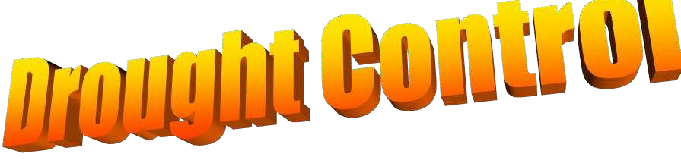








Slide 22
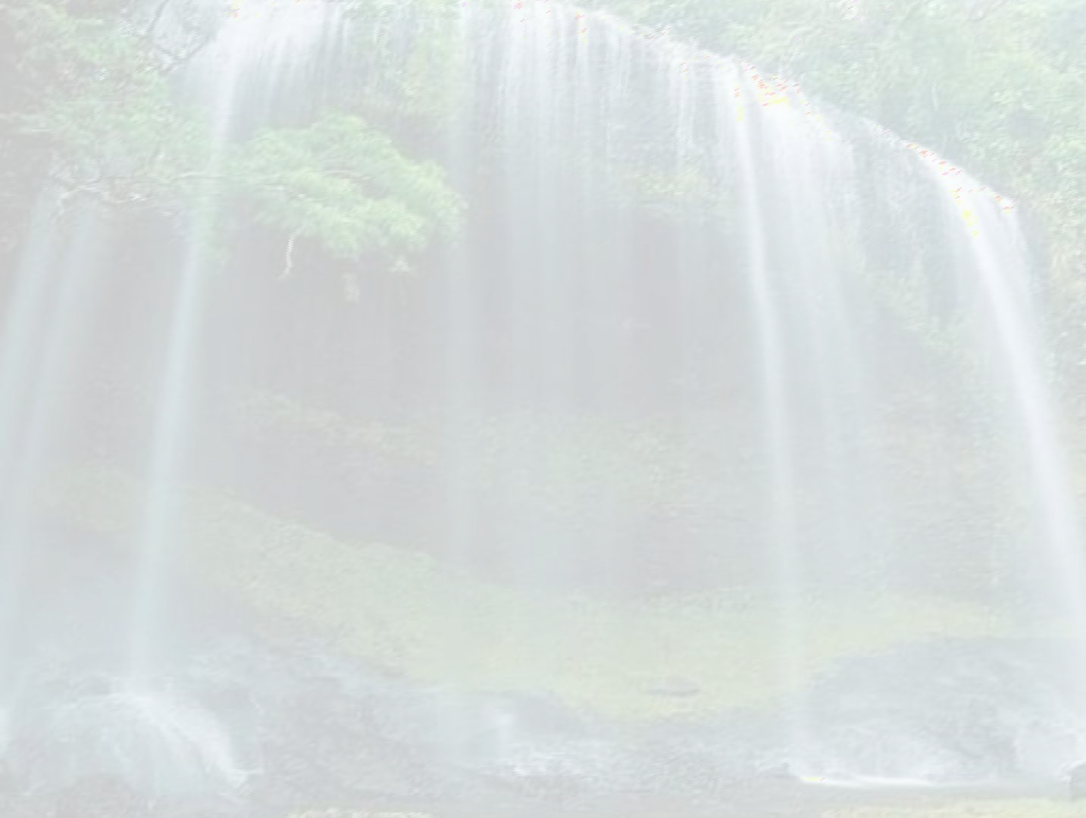

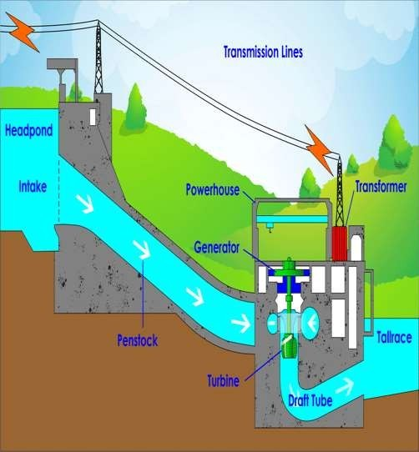
The most prominent use of large dams is for hydroelectric power generation, combined with a hydropower plant. Compared to other renewable sources, hydropower produces the most cost-efficient energy at costs as low as 2 US¢/kWh.

Slide 23
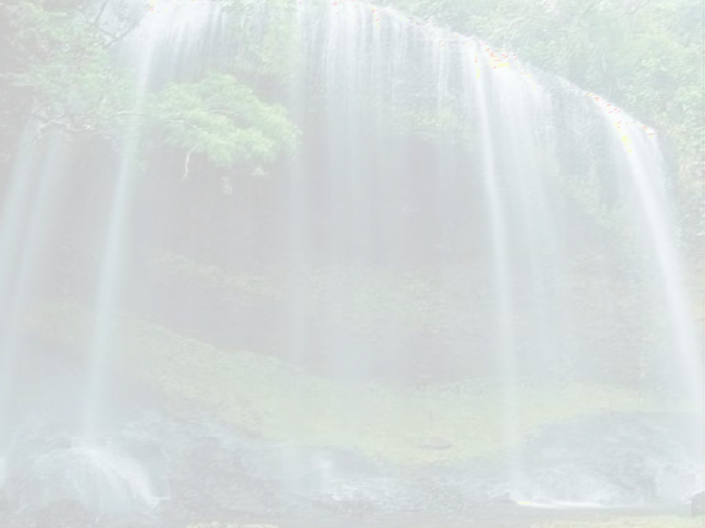

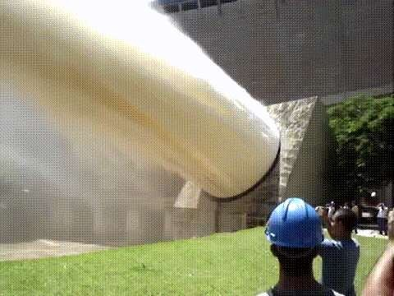
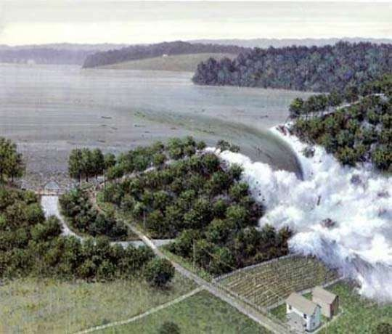
Water stored in a reservoir is used to irrigate agricultural crops. It is estimated that 30- 40% of irrigated lands worldwide, which contribute 12- 16% of global food production, rely on dams.

Slide 24

□ Especially in urban areas, reservoir storage capacities are used to supply drinking water or water for industrial purposes.

Slide 25


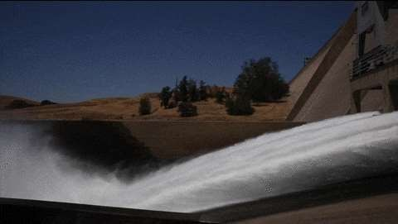
As a positive side effect, dam structures often offer flood protection by regulating water discharge and balancing runoff differences.

Slide 26



The navigability of a water system enabled through the regulation by the dam may provide an impetus for trade and development. Inland navigation is the most cost effective and least polluting means of transportation.

Slide 27

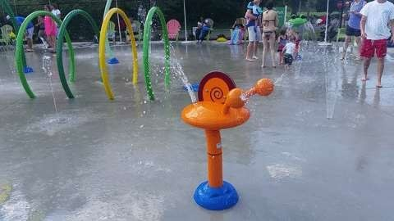
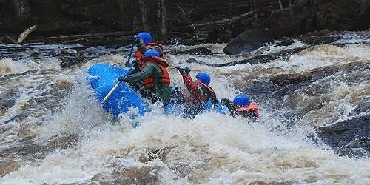
Finally, the lakes created through water storage can additionally serve recreational and touristic purposes.

Slide 28


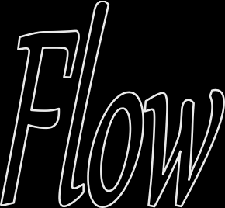

“60% of total stream flow is regulated by dams and reservoirs for flood control” (Jiles and Spencer, 1995).
This is due to flood peaks being reduced, and the uniformity in base flow being increased throughout.

Slide 29

DISADVANTAGES
Dams have endangered some species of fish
Reservoirs can foster diseases if not properly maintained
Reservoir water can evaporate significantly, Some researchers believe that reservoirs can cause earthquakes

Slide 30

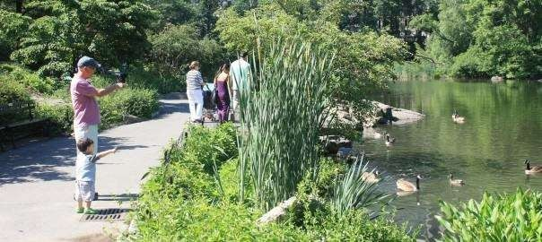

Slide 31


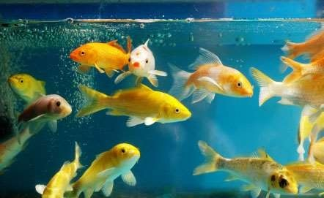

Slide 32


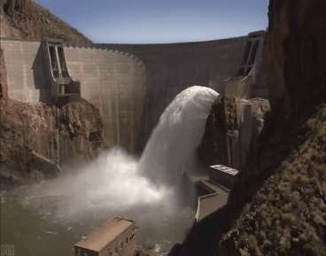
when a dam fails it can be catastrophic.
As recently as recently as 2004 the Big Bay Dam in Mississippi broke destroying nearly fifty homes. It is a major concern in civil engineering to see that dams are safe from hazards such as landslides and earthquakes.

Slide 33
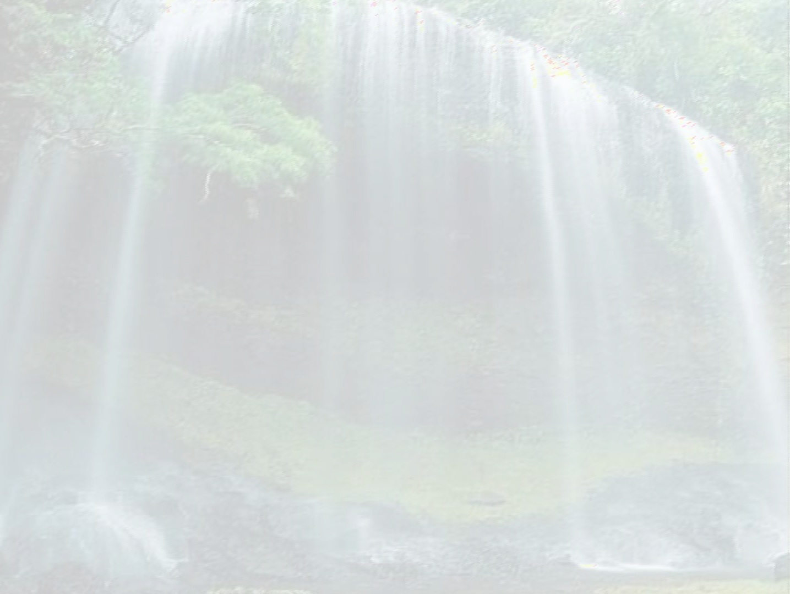


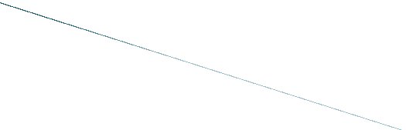

Dams are very costly projects,so their construction in seismic areas needs careful study to ensure their safety.when earth quakes occurs,a dam is subjected to two forces are due to the dam and due to reservoir water.

Slide 34
Solid Waste
Solid Waste in general can be defined as ‘As a material which has negligible value to the producer and there is no direct consumption of the generated waste’.
It is generated due to various activities that can be residual and commercial, agricultural, etc.
In a nutshell “ Solid waste can be regarded as refuse or waste from any kind of source”. But any refuse or waste can be economic resource to others.

Slide 35
Basic terms related to solid waste
Ash : the non-combustible solid by-products of incineration or other burning process.
Bulky waste: large wastes such as appliances, furniture, and trees and branches, that cannot be handled by normal MSW processing methods.
Co-disposal: the disposal of different types of waste in one area of a landfill or dump. For instance, sewage sludges may be disposed of with regular solid wastes.

Slide 36
Biodegradable material : any organic material that can be broken down by microorganisms into simpler, more stable com-pounds. Most organic wastes (e.g., food, paper) are biodegradable.
Compost : the material resulting from com posting. Compost, also called humus, is a soil conditioner and in some instances is used as a fertilizer.
Composting : biological decomposition of solid organic materials by bacteria, fungi, and other organisms into a soil-like product.

Slide 37
Disposal : the final handling of solid waste, following collection, processing, or incineration. Disposal most often means placement of wastes in a dump or a landfill.
Environmental impact assessment (EIA) : an evaluation designed to identify and predict the impact of an action or a project on the environment and human health and
well-being. Can include risk assessment as a component, along with economic and land use assessment.

Slide 38
9. Environmental risk assessment (EnRA) : an evaluation of the interactions of agents, humans, and ecological resources. Comprised of human health risk assessment and ecological risk assessment, typically evaluating the probabilities and magnitudes of harm that could come from environmental contaminants.

Slide 39
Garbage : in everyday usage, refuse in general. Some MSWM manuals use garbage to mean "food wastes," although this usage is not common.
Landfilling : the final disposal of solid waste by placing it in a controlled fashion in a place intended to be permanent. The Source Book uses this term for both controlled dumps and sanitary landfills.

Slide 40
Leachate : liquid that has seeped through a landfill or a compost pile and has accumulated bacteria and other possibly harmful dissolved or suspended materials.
MSW : municipal solid waste.
MSWM : municipal solid waste management.

Slide 41
Putrescible : subject to decomposition or decay. Usually used in reference to food wastes and other organic wastes that decay quickly.
Refuse : all kinds of wastes in solid state excepting excreta from residential, commercial and industrial area.

Slide 42
Refuse-derived fuel (RDF) : fuel produced from MSW that has undergone processing. Processing can include separation of recyclables and non-combustible materials, shredding, size reduction, and pelletizing.
Rubbish : a general term for solid waste. Sometimes used to exclude food wastes and ashes.

Slide 43
19. Waste-to-energy (WTE) plant : a facility that uses solid waste materials (processed or raw) to produce energy. WTE plants include incinerators that produce steam for district heating or industrial use, or that generate electricity; they also include facilities that convert landfill gas to electricity.

Slide 44
Kinds of Wastes
Solid wastes: domestic, commercial and industrial wastes especially common as co-disposal of wastes
Examples: plastics, containers, bottles,
cans, papers, scrap iron, and other trash
Liquid Wastes: wastes in liquid form
Examples:
domestic washings, chemicals, oils,
waste water from ponds, manufacturing

Slide 45
Classification of Wastes according to their Properties
Bio-degradable
can be degraded (paper, wood, fruits and others)
Non-biodegradable
cannot be degraded (plastics, bottles, old machines, cans, containers and others)

Slide 46
Classification of Wastes according to
their Effects on Human Health and the Environment
Hazardous wastes
waste that is reactive, toxic, corrosive, or otherwise dangerous to living things and/or the environment. Many industrial by-products are hazardous.
Non-hazardous
Substances safe to use commercially, industrially, agriculturally, or economically.

Slide 47
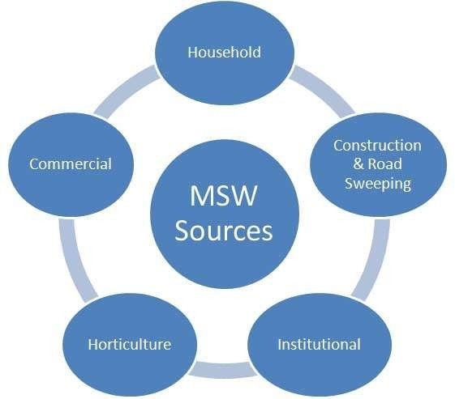
From where these comes???

Slide 48
Effects of waste if not managed wisely
Affects our health
Affects our socio-economic conditions
Affects our coastal and marine environment
Affects our climate

Slide 49
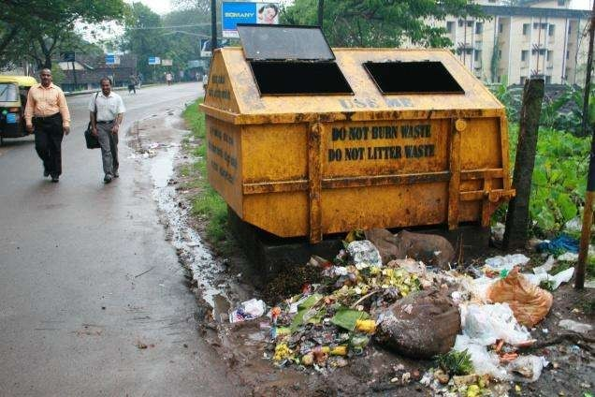
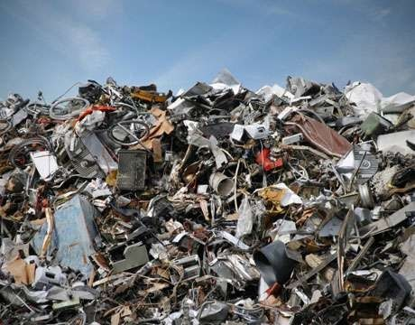
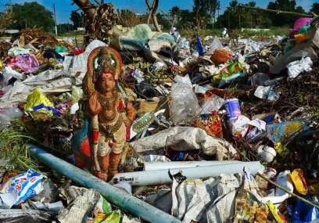
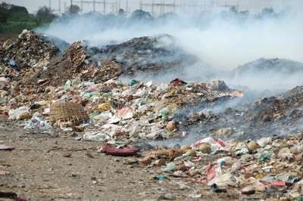

Slide 50
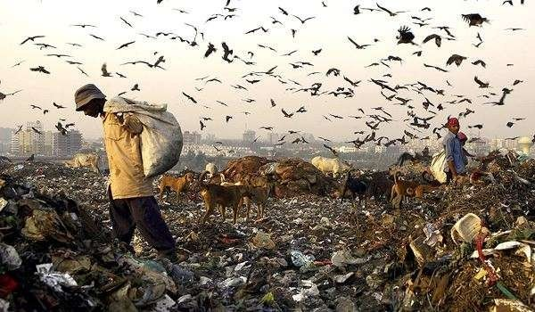
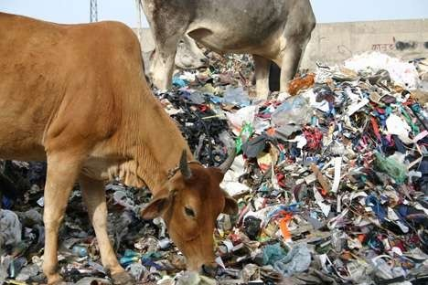

Slide 51
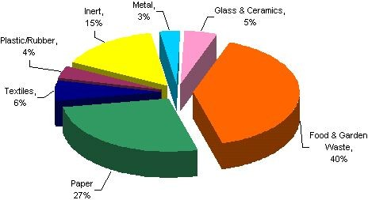

Slide 52
SOLID WASTE MANAGEMENT
Solid Waste Management is defined as the discipline associated with control of generation, storage, collection, transport or transfer, processing and disposal of solid waste materials.
Solid waste management includes planning, administrative, financial, engineering and legal functions in the process of solving problems arising from waste materials.
The primary goal of solid waste management is reducing and eliminating adverse impacts of waste materials on human health and environment to support economic development and superior quality of life.

Slide 53
Solid waste collection and transport
Factors considered:
Types of Containers:
  Depend on:
    characteristics of SW collected
      E.g. Large storage containers (Domestic SW: flats/apartment)
      Containers at curbs
      Large containers on a roller (Commercial/Industrial)
Collection frequency
Space available for the placement of containers

Slide 54
Container Locations:
  side/rear of house
  alleys
  special enclosures (apartment/condos)
  Basement (apts. in foreign countries)/ newer complexes
Public Health:
- relates to on-time collection to avoid the spread of diseases by vectors, etc.
iv) Aesthetics:
- must be pleasing to the eye (containers must be clean, shielded from public’s view).
iii)

Slide 55
v) Collection of SW
60-80 percent of total SWM costs.
Malaysia (other developing nations) - labor and capital intensive.
Major problems:
  Poor building layouts - e.g. squatters
  Road congestion - time cost, leachate, transport costs.
  Physical infrastructure
  Old containers used (leaky/ damaged)
  Absence of systematic methods (especially at apartments, markets with large wst. volume).

Slide 56
Collections were made by:
Municipal/ District Council
Private firm under contract to municipal
Private firm contract with private residents

Slide 57
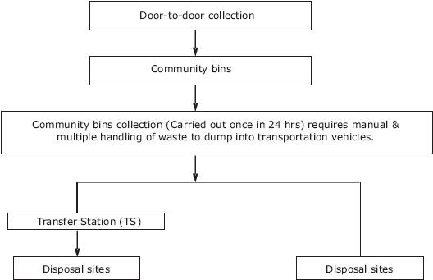

Slide 58
Types of collection
Municipal Collection Services:
Residential:
  Curb (Kerb-side)
  Alley
  Set out and set back
  Backyard collection

Slide 59
Curb (Kerb-side)
House owner is responsible for placing solid waste containers at the curb on scheduled day.
The work man come, collect and empty the container and put back at the curb.
House owner is required to take back the empty containers from the curb to his house.
Quickest/ economical
Crew: 1 driver + 1 or 2 collectors
No need to enter property

Slide 60
Set-out, set back
Collectors have to enter property
Set out crew carries full containers from resident storage location to curb/ alley before collection vehicle arrives.
Collection crew load their refuse into vehicle
Set-back crew return the container to storage area.

Slide 61
Alley service
□ The containers are placed at the alley line from where they are picked up by workmen from refuse vehicles who deposit back the empty container.

Slide 62
Backyard service
The workers with the vehicles carry a bin, wheel
– barrow or sack or cloth to the yard and empty the solid waste container in it.
The bin is taken to solid waste vehicles where it is emptied.

Slide 63
Commercial-Industrial Collection Services:
Large movable and stationary containers
Large stationary compactors (to form bales)

Slide 64
Collection Frequency:
residential areas :everyday/ once in 2 days
communal/ commercial : daily
food waste - max. period should not exceed
:
  the normal time for the accumulation of waste to fill a container
  the time for fresh garbage to putrefy and emit fouls odor
  the length of fly-breeding cycle ( < 7 days).

Slide 65
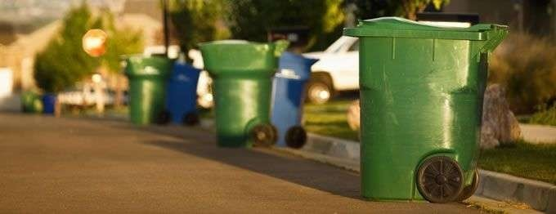
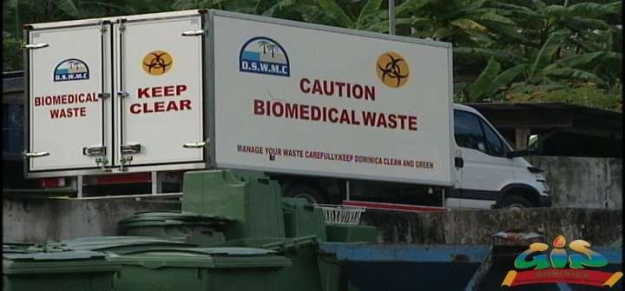

Slide 66
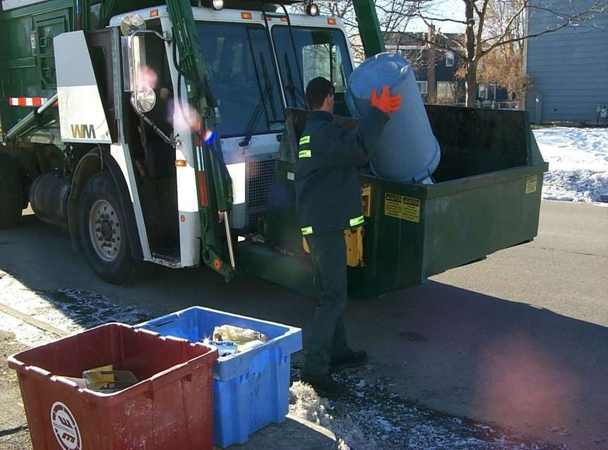

Slide 67
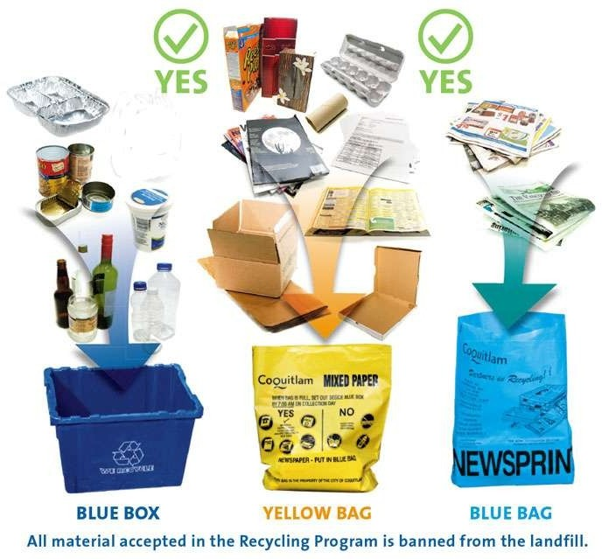

Slide 68
Treatment and disposal of solid waste
Several methods are used for treatment and disposal. These are:
Composting
Incineration
Landfilling
Pyrolysis
Recycling

Slide 69
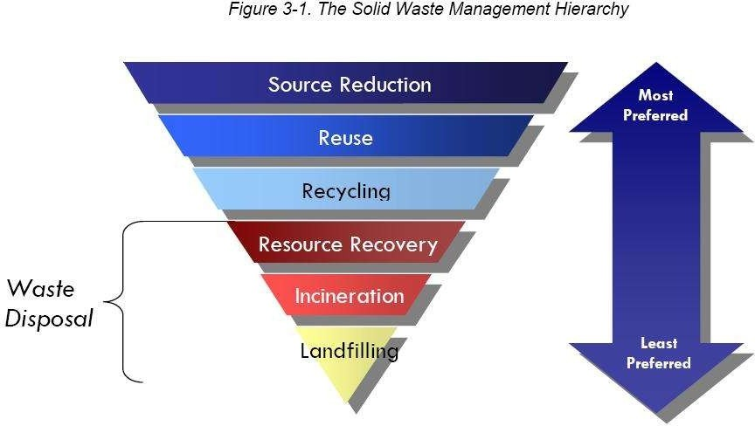

Slide 70
Composting
It is a process in which organic matter of solid waste is decomposed and converted to humus and mineral compounds.
Compost is the end product of composting, which used as fertilizer.
Three methods of composting:
  composting by trenching
  open windrow composting
  mechanical composting

Slide 71
Composting by trenching
Trenches 3 - 12 m long, 2 – 3 m wide and 1- 2 m deep with spacing 2 m.
Dry wastes are filled up in 15 cm. On top of each layer 5 cm thick sandwiching layer of animal dung is sprayed in semi liquid form.
Biological action starts in 2- 3 days and decomposition starts.
Solid waste stabilize in 4- 6 months and changed into brown colored odorless powdery form known as humus.

Slide 72
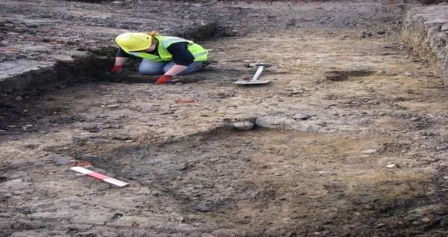
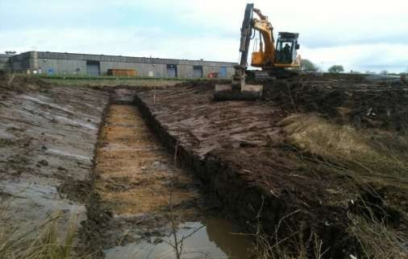

Slide 73
Open window composting
Large materials like broken glass, stone, plastic articles are removed.
Remaining solid wastes is dumped on ground in form of piles of 0.6 – 1 m height.
The width and length of piles are kept 1- 2 m and 6 m respectively.
Moisture content maintained at 60%.
Temp. increases in side pile.
After pile for turned for cooling and aeration to avoid anaerobic decomposition.
The complete process may take 4- 6 week.

Slide 74
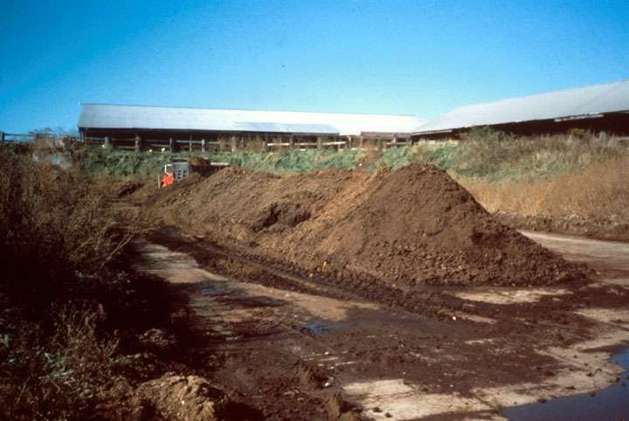

Slide 75
Mechanical composting
It requires small area compare to trenching and open windrow composting.
The stabilization of waste takes 3- 6 days.
The operation involved are
reception of refuse
segregation shredding stabilization marketing the humus

Slide 76
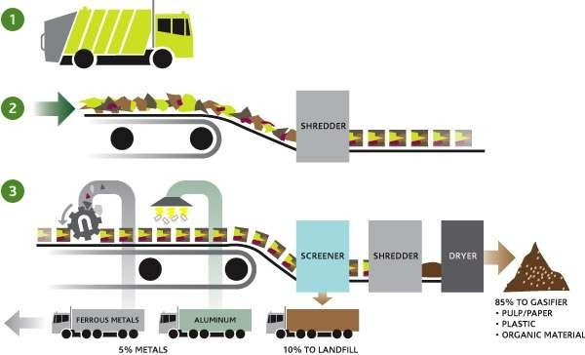

Slide 77
Incineration
Incineration is a waste treatment process that involves the combustion of organic substances contained in waste materials.
Incineration and other high temperature waste treatment systems are described as "thermal treatment".
Incineration of waste materials converts the waste into ash, flue gas, and heat.
Incinerators are used for this process.

Slide 78
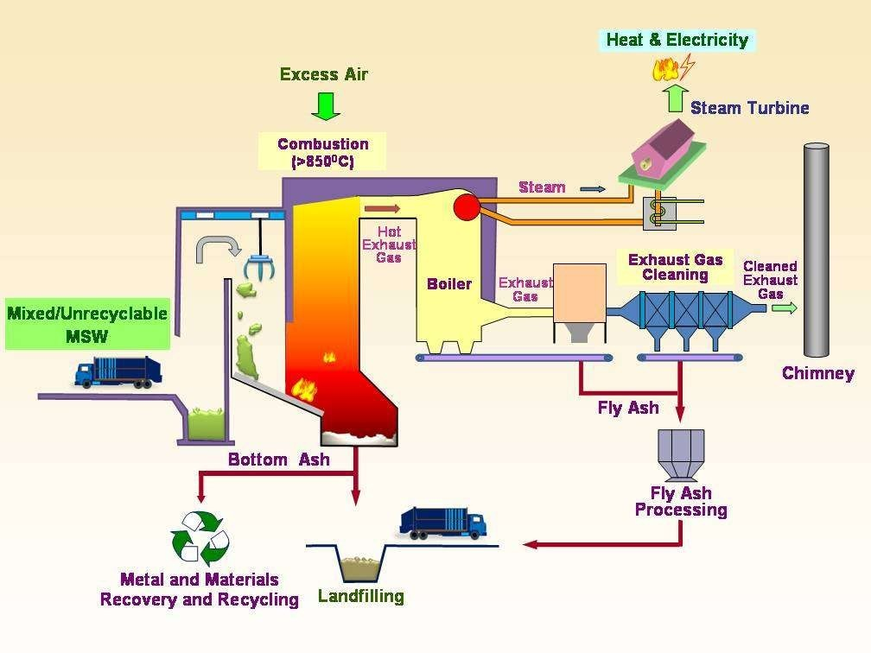

Slide 79
Important points regarding incineration
Supplying of solid waste should be continuous.
Waste should be proper mixed with fuel for complete combustion.
Temp. should not less than 670 ˚C.

Slide 80
Advantages
Most hygienic method.
Complete destruction of pathogens.
No odor trouble.
Heat generated may be used for steam power.
Clinkers produced may be used for road construction.
Less space required.
Adverse weather condition has no effect.

Slide 81
Disadvantages
Large initial expense.
Care and attention required otherwise incomplete combustion will increase air pollution.
Residues required to be disposed which require money.
Large no of vehicles required for transportation.

Slide 82
Landfilling
A landfill site is a site for the disposal
of waste materials by burial and is the oldest form of waste treatment.
Historically, landfills have been the most common methods of organized waste disposal and remain so in many places around the world.
The dumping is done with layers of 1- 2 m.
The layer is covered with soil of 20 cm thickness.

Slide 83
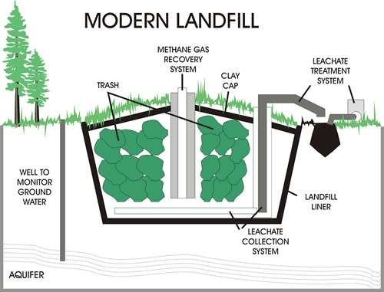

Slide 84
Advantages
Simple method.
No costly plant required.
No residues or by products need to be disposed.
Separation not required.
Unused land can be used.
Methane gas can be used ass fuel.

Slide 85
Disadvantages
Large land required.
Proper dumping site may not be available.
Odor problem.
Use of insecticides required.
Leachate should be collected regularly.
Methane gas should be collected properly.
Green house gas problem.

Slide 86
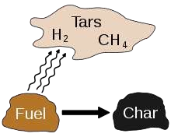
Pyrolysis
Heating of the solid waste at very high temp. in absence of air.
Carried out at temp. between 500 ˚C – 1000
˚C.
Gas, liquid and chars are the by products.

Slide 87
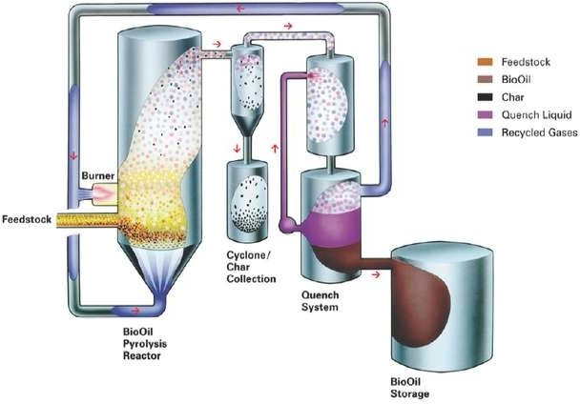

Slide 88
Recycling
Recycling is processing used materials into new products .
It reduce the consumption of fresh raw materials, reduce energy usage, reduce air pollution
(from incineration) and water pollution (from landfilling).
Recycling is a key component of modern waste reduction and is the third component of the "Reduce, Reuse, Recycle" waste hierarchy.

Slide 89
Recyclable materials include many kinds of glass, paper, metal, plastic, textiles, and electronics.
Although similar in effect, the composting or other reuse of biodegradable waste – such
as food or garden waste – is not typically considered recycling.
Materials to be recycled are either brought to a collection centre or picked up from the curbside, then sorted, cleaned, and reprocessed into new materials.

Slide 90
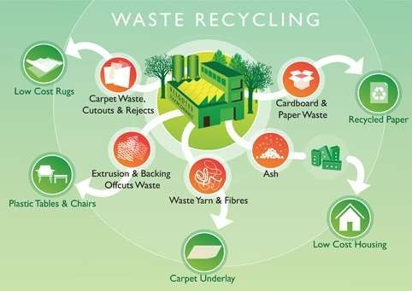

Slide 91

