Slide 1
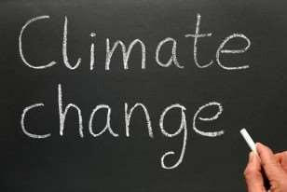



Slide 2
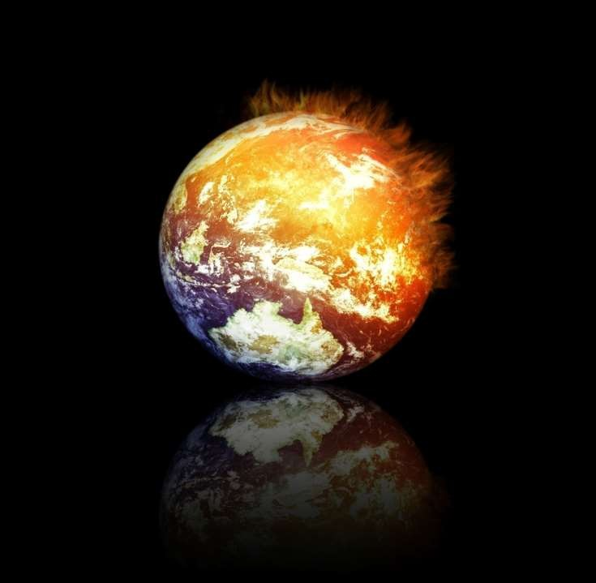



Slide 3
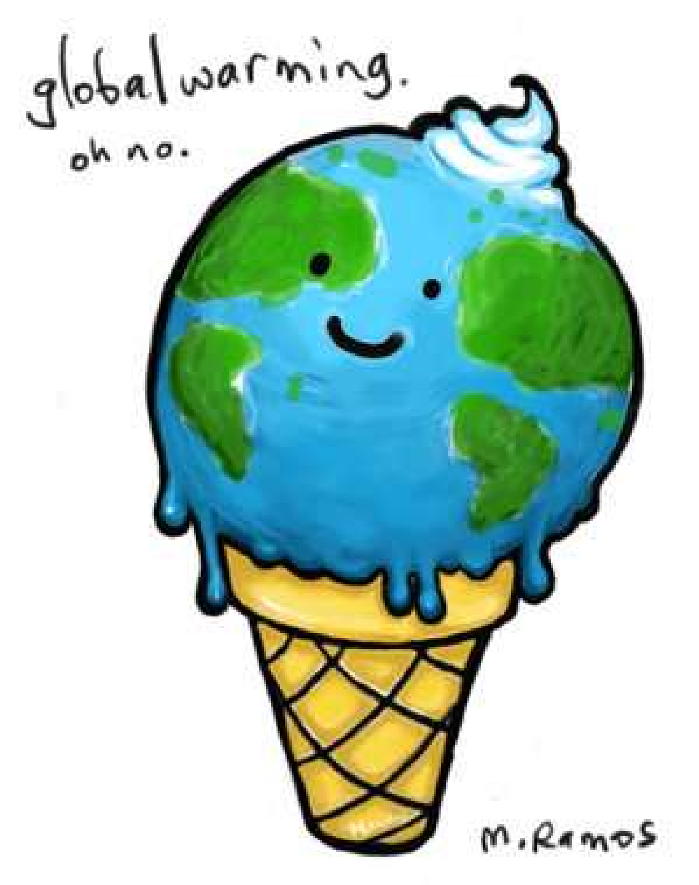
GLOBAL
WARMING is an increase in the earth's average atmospheric temperature that causes corresponding changes in climate and that may result from the greenhouse effect.

Slide 4
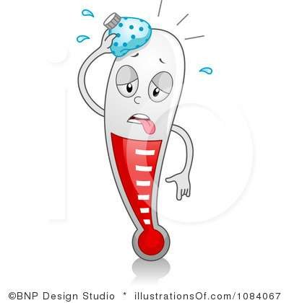
MORE ABOUT GLOBAL WARMING
A gradual increase in the overall temperature of the earth's atmosphere generally attributed to the greenhouse effect caused by increased levels carbon dioxide, CFCs, and other pollutants.
Since the early 20th century, Earth's mean surface temperature has increased by about 0.8 °C (1.4 °F), with about two-thirds of the increase occurring since 1980.
Warming of the climate system is unequivocal, and scientists are 95-100% certain that it is primarily caused by increasing concentrations of greenhouse gases produced by human activities such as the burning of fossil fuels and deforestation.

Slide 5

Causes of Global Warming
Global warming is primarily a problem of too much carbon dioxide (CO2) in the atmosphere—which acts as a blanket, trapping heat and warming the planet.
As we burn fossil fuels like coal, oil and natural gas for energy or cut down and burn forests to create pastures and plantations, carbon accumulates and overloads our atmosphere.
Certain waste management and agricultural practices aggravate the problem by releasing other potent global warming gases, such as methane and nitrous oxide.

Slide 6
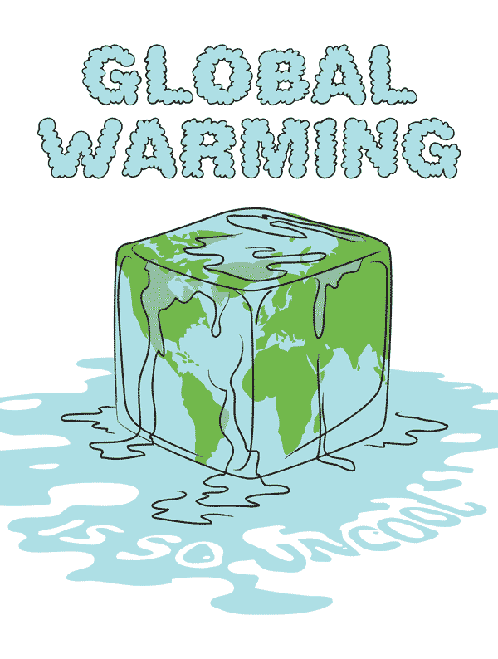
Cont….
The major greenhouse gases are water vapor, which causes
about 36–70% of the greenhouse effect; carbon dioxide (CO₂), which causes 9–26%; methane (CH₄), which causes 4–9%;and ozone (O₃), which causes 3-7%. Clouds also affect the radiation balance.
Human activity since the Industrial Revolution has increased the amount of greenhouse gases in the atmosphere, leading to increased radiative forcing from CO₂, methane, tropospheric ozone, CFCs and nitrous oxide.

Slide 7

Effects of global warming
Sea level rise is accelerating. The planet's temperature is rising.
The number of large wildfires is growing.
Dangerous heat waves are becoming more common.
Extreme storm events are increasing in many areas. More severe droughts are occurring in others.
These are having significant and harmful effects on our health, our environment, and our communities.

Slide 8

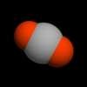
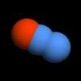
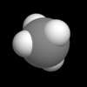
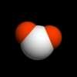

Methane
Carbon dioxide
Nitrous oxide
Water
Sulfur hexafluoride

Slide 9
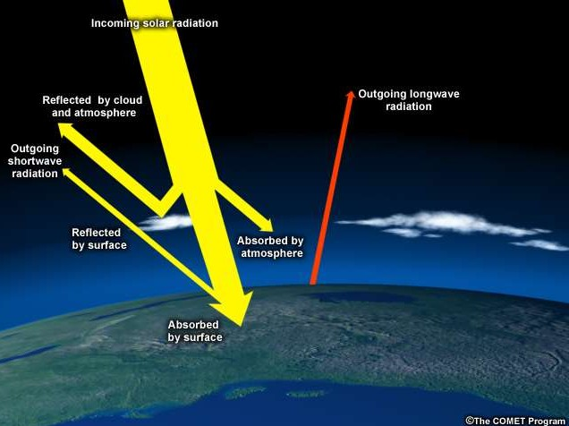
“Greenhouse effect”
heat
Earth’s surface absorbs heat from the sun and then re- radiates it back into the atmosphere and to space.

Slide 10
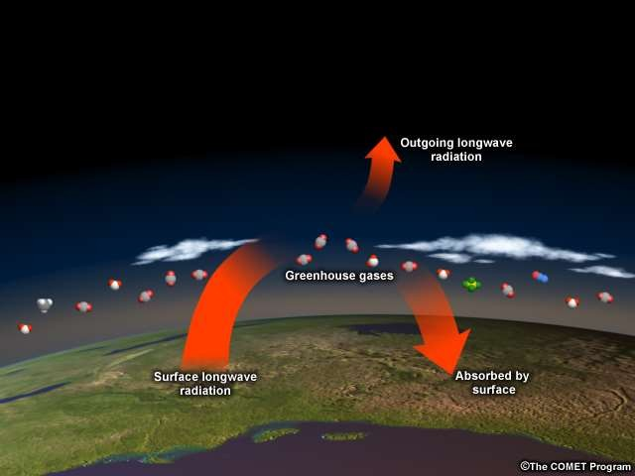
Increasing greenhouse gases trap more heat
Much of this heat is absorbed by greenhouse gases, which then send the heat back to the surface, to other greenhouse gas molecules, or out to space. Though only 1% of atmospheric gases are greenhouse gases, they are extremely powerful heat trappers.
By burning fossil fuels faster and faster, humans are effectively
piling on more blankets, heating the planet
so much and so quickly that it’s hard for Mother Nature and human societies to adapt.

Slide 11

How to reduce Global Warming?
Produce more fuel-efficient vehicles
Reduce vehicle use
Improve energy-efficiency in buildings
Develop carbon capture and storage processes
Triple nuclear power
Increase solar power
Decrease deforestation/plant forests

Slide 12
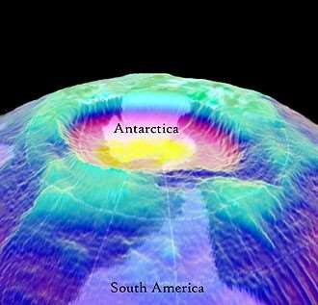


Slide 13
The ozone layer in the upper atmosphere absorbs the sun’s ultraviolet radiation, preventing it from reaching the earth’s surface.
This layer in the atmosphere protects life on earth from the dangerous UV radiation from the sun.
In the 1970s, scientists discovered that chemicals called chlorofluorocarbons or CFCs, which were used as refrigerants and aerosol spray propellants, posed a threat to the ozone layer.
The destruction of the ozone layer is seen to cause increased cases of skin cancer and cataracts.
It also causes damage to certain crops and to plankton, thus affecting natures food chains and food webs. This in turn causes an increase in carbon dioxide due to the decrease in vegetation.

Slide 14
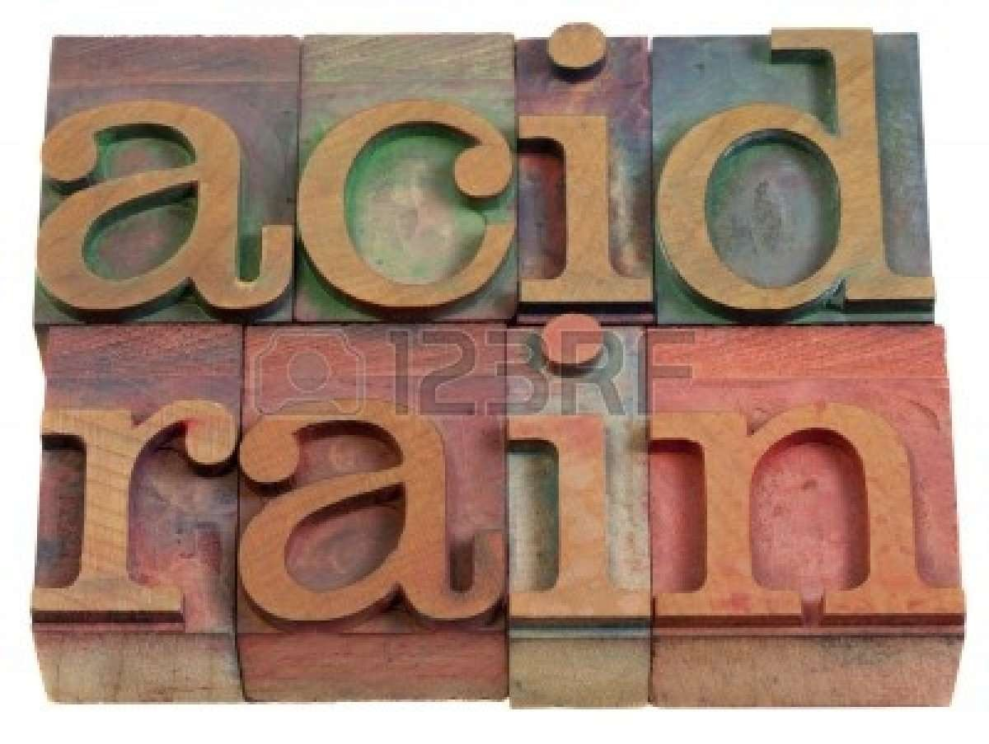

Slide 15



What is acid rain?
ACID RAIN is a rain or
any other precipitation
form of
that is
usually acidic i.e. it has low pH. Acid rain is caused by emissions of
sulfhur nitrogen react molecules
dioxide oxide, with
in
and which water
the
atmosphere to produce acids.

Slide 16

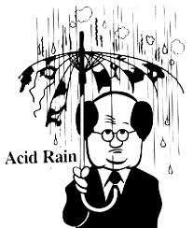
Causes of Acid Rain
The primary cause of acid rain is the emission of harmful gases and emissions by industrial power plants and factories, and to some extent, cars as well.
Burning of fossil fuels lead to emission of gases that give oxides of sulfur and nitrogen.
Burning of gasoline and diesel in cars build the amount of acidified water droplets in the atmosphere.

Slide 17

Effects of Acid Rain
The effects of acid rain are unhealthy and harmful. Buildings, national monuments and bridges tend to deteriorate faster.
The biggest reason to find satisfactory solutions for acid rains is the damage to natural ecosystems. This rain will affect the plants, trees, rivers, lakes, soil and land wherever it may fall on.
Animals and plants that live in such areas are severely affected. Their food sources get diminished, they may develop unhealthy diseases or mutations, or they may even die in extreme cases.

Slide 18

EFFECT ON HUMANS
The pollutants that cause acid rain—sulfur dioxide and nitrogen oxides damage human health.
These gases interact in the atmosphere to form fine sulfate and nitrate particles that can be transported long distances by winds and inhaled deep into people's lungs. When we breathe in air pollution, these very fine particulates can easily enter our body, where they can cause breathing problems (asthma), bronchitis and over time even cause skin cancer.

Slide 19

Solutions for acid rain
Understand acid deposition's causes and effects
To solve the acid rain problem, people need to understand how acid rain damages the environment. They also need to understand what changes could be made to the air pollution sources that cause the problem.
Use Low Sulfur Coal
The amount of sulfur oxides emitted by a power plant can be reduced by burning coal with a very low percentage of sulfur present.
Use Scrubbers
Scrubbers remove 80-95 percent of the sulfur oxides. Certain types do not remove nitrogen oxides. They are costly to retrofit to existing power plants. They increase the electric generating costs by 10-15 %.

Slide 20
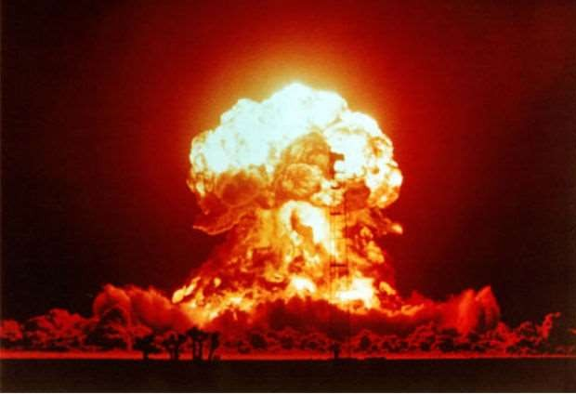

Slide 21


What are Nuclear Disasters?
Nuclear energy is generated by the process of molecular fission, molcular fusion and molecular decay. Uncontrolled formation of such energy leads to nuclear disasters.
These disasters significantly affect the population and its effects are observed for years.

Slide 22

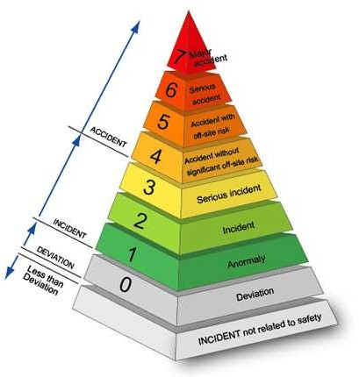
Effects on Environment
A single nuclear accident can cause loss of life, long term illness and destruction of property o a large scale.
Radioactivity leads to cancer, genetic disorders and death in the affected area for decades.
It thus affects all forms of
life for generation to come.

Slide 23
Air Pollution Control Acts
1948:-Factories Act and Amendment in 1987.
1981:-Air(Prevention and Control of Pollution)Act.
1982:-Air(Prevention and Control of Pollution)Rules.
1982:-Atomic Energy Act.
1987:-Air(Prevention Pollution)Amendment Act.
1988:-Motor Vehicle Act.
and Control of
3 December 2018

Slide 24
The Air (Prevention and Control of Pollution) Act, 1981
The Air(Prevention and Control of Pollution)Act, 1981 is a central Act of Parliament, which provides for the prevention and control of air pollution and maintaining the good quality of air.
It also provided for the establishment of the Central and State Boards for the Prevention and Control of Air Pollution.
It is applicable to whole of India except Jammu and Kashmir.
3 December 2018

Slide 25
Objective
To provide for the prevention, control and abatement of air pollution.
To provide for the establishment of central and state board with a view to implement the Act.
To confer on the boards the power to implement the provisions of the Act and assign to the boards functions relating to pollution.
3 December 2018

Slide 26
Definition Under the Air Act
 “Air Pollutant” means any solid, liquid or gaseous substance(including noise) present in the atmosphere in such concentration as may be or tend
to be injurious to
human beings or other plants or
living
or
creatures or
property
environment.(Sec.2(a))
 “Air Pollutant” means
the presence in the
atmosphere of any air.(Sec.(b))
“Board” means the Central and State Board.(Sec.2(f))
“Member” means a member of the Central Board or a State Board, as the case may be, and includes the
7 Chairman thereof.(Sec.2(l))
3 December 2018

Slide 27
Central Pollution Control Board
 Central Pollution Control Board constituted under sec.3 of the Water Prevention and Control Act,1974 was authorized to exercise the powers and performs the functions for the prevention and control of air pollution.(CPCB) of India is a statutory organisation under the Ministry of Environment, Forest and Climate Change. It serves as a field formation and provide technical and financial services.
8
3 December 2018

Slide 28
The functions of Central Board under the Air Act
The main functions of the Central Board, as specified in Section 16 of the Act, shall be:-
Advise the Central Government on any matter concerning the improvement of the quality of air and the prevention, control of abatement of air pollution.
Plan and cause to be executed a nation-wide programme for the prevention and control of air pollution.
Coordinate the activities of the State Boards and resolve dispute among them.
Provide technical assistance and guidance to the State
Boards.
Collect, compile and publish technical and statistical data
relating to air pollution and measures devised for its
⁹effective prevention and control.
3 December 2018

Slide 29
The functions of State Boards under the Air Act
The functions of the State Board, as specified in
Sec.17,shall be:-
To advise the State Government on any matter concerning the prevention, control or abatement of air pollution.
To collaborate with the Central Board in organising the training of persons engaged or to be engaged in programmes relating to prevention and control of air pollution and to provide mass education programmer relating thereof.
To advise the State Government with respect to the suitability of any premises or location for carrying on any industry which is likely to cause air pollution.
To provide various standards for the emissions of different
industrial plants with regard to quantify and composition of
¹e¹mission of air pollutant into the atmospher³e^{D}.^{ecember 2018}

Slide 30
Penalties
The persons managing industry are to be penalized if they produce emissions of air pollutants in excess of the standards laid down by the State Board.
Whoever is founded to be work against the clauses of the Act or any order or direction issued is punishable with Rs.10,000 in case of three months and if in case offence is continue then extra Rs.5000 is charged for everyday.
12
3 December 2018

Slide 31
The Water (Prevention and Control of Pollution) Act, 1974
The Federal Water Pollution Control Act of 1948 was the first major U.S. law to address water pollution. Growing public awareness and concern for controlling water pollution led to sweeping amendments in 1972. As amended in 1972, the law became commonly known as the Clean Water Act (CWA).
The need for legislating the act was felt in the year 1962, it was the same year when independent India fought its first war with china. A committee was set up in 1962 to draw a draft enactment for the prevention of water pollution.

Slide 32
Introduction
The Water Act was enacted by Parliament Act, 1974 purpose to provide for the prevention of control of water pollution and the maintaining or restoring of wholesomeness of water. As on day, it is applicable in all the states of India.

Slide 33
OBJECTIVES
The water(prevention and pollution control) act 1974, provides for following:
Prevention and control of water pollution
Maintaining or restoring the wholesomeness of water; and
Establishment of board for prevention and control of water pollution
An act to provide for the levy and collection of a cess on water consumed by persons carrying on certain industries and by local authorities, with a view to augment the resources of the central board and the state boards for the prevention and control of water pollution constituted under the water (prevention and control of pollution) act, 1974.

Slide 34
Functions of Central Board (sec. 16)
The Central Board may establish or recognize a laboratory or laboratories to enable the Central Board to perform its functions under this section efficiently.
The Central Board may-
  delegate any of its functions under this Act generally or specially to any of the committees appointed by it;
  do such other things and perform such other acts as it may think necessary for the proper discharge of its functions and generally for the purpose of carrying into effect the purposes Of this Act.

Slide 35
Functions of the State Board
Functions of a State Board has been prescribed in section 17
But the state pollution board have confined themselves only to grant consents to the industries.
After the legislation of Environment (Protection) Act, 1986 wherein the Standards for Effluent has been prescribed in the EP Rules, the Boards merely mentioned those rules in the conditions of the consent.
More so Boards are issuing consent with the condition “Zero Discharge” without
ensuring whether this condition could be met or complied by the Industry.

