Slide 1
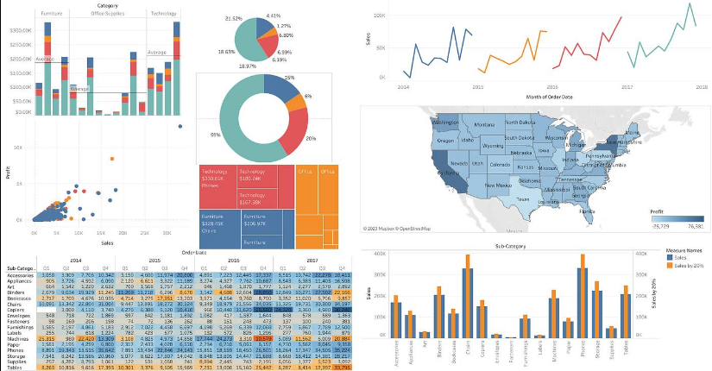
Tableau
Tableau, it is a Business Intelligence (BI) and data visualization tool used to convert raw data into interactive charts, dashboards, and reports.

Slide 2
Key features of Tableau
Feature | Description
Data Visualization | Creates graphs, charts, maps, and plots
Dashboard | Combines multiple visualizations into one interactive screen
Data Connection | Connects to Excel, CSV, SQL databases, cloud data, etc.
Drag and Drop | Most visualizations can be created without coding
Interactive Analysis | Filters, drill-downs, and interactive charts
Data Blending | Combines data from different sources
Real-time Analysis | Can work with live database connections
Sharing | Dashboards can be published and shared with others

Slide 3
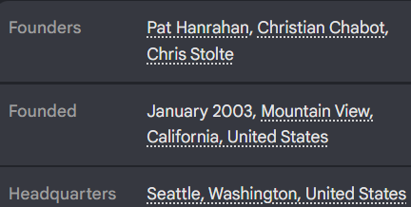
Tableau Software is an American interactive data visualization software company focused on business intelligence. It was founded in 2003 in Mountain View, California and is headquartered in Seattle, Washington.

Slide 4
Main Tableau products
Tableau Desktop – Used to create visualizations and dashboards.
Tableau Cloud – Cloud-based platform for publishing and sharing dashboards.
Tableau Server – Tableau platform deployed within an organization's infrastructure.
Tableau Public – Free platform for creating and publicly sharing visualizations.
Tableau Prep – Used for cleaning and preparing data.

Slide 5
Experiment -1
Exploring and Visualizing Sales Data. Import a sample sales dataset into Tableau. Create a dashboard that includes the following visualizations:
A bar chart showing total sales by product category.
A line chart showing monthly sales trends over the past year.
A geographic map showing sales distribution by region.
Use a dual-axis chart or side-by-side bar charts to compare sales and return rates across regions.

Slide 6
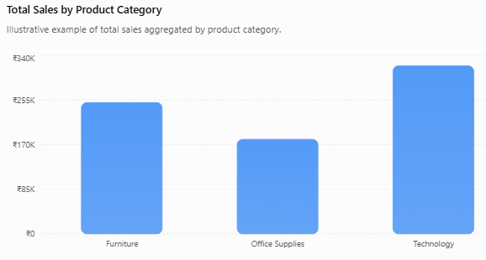
Experiment-1 Solution: a)A bar chart showing total sales by product category.
Step 1: Open Tableau
Open Tableau Desktop or Tableau Public.
Click Connect to Data.
Select Microsoft Excel if your sales dataset is in Excel.
Browse and select your sales dataset.
Drag the required sheet/table into the data area.
Step 2: Open a worksheet
Click Sheet 1 at the bottom.
You will see the Data pane on the left.
Identify:
  Category → Dimension
  Sales → Measure
Step 3: Place Category on Columns
Drag Category from the Data pane.
Drop it onto the Columns shelf.
Step 4: Place Sales on Rows
Drag Sales from the Data pane.
Drop it onto the Rows shelf.
Tableau automatically calculates SUM(Sales).
The resulting visualization will be a bar chart showing total sales for each category.

Slide 7
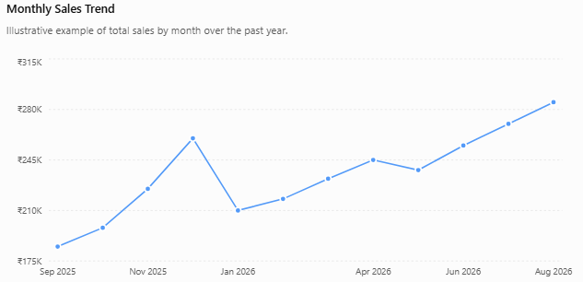
b) A line chart showing monthly sales trends over the past year.
Verify the fields
In the Data pane on the left:
Order Date should have a calendar/date icon.
Sales should be a numeric measure.
Tableau normally identifies Sales as SUM(Sales) automatically.
If Order Date is not recognized as a date:
Right-click Order Date → Change Data Type → Date.
2. Create the monthly sales trend
Drag:
Order Date → Columns
Then:
Sales → Rows
Initially, Tableau may display sales by year, quarter, or another date level.
3. Change Order Date to Month
Click the drop-down arrow on the Order Date pill on the Columns shelf.
Select:
Month
Prefer the continuous Month option if you want a continuous time-series line.
The view should now contain:
Jan → Feb → Mar → ... → Dec
with total sales plotted for each month.
4. Change the chart type to Line
On the Marks card:
Click the chart-type drop-down.
Select Line.

Slide 8
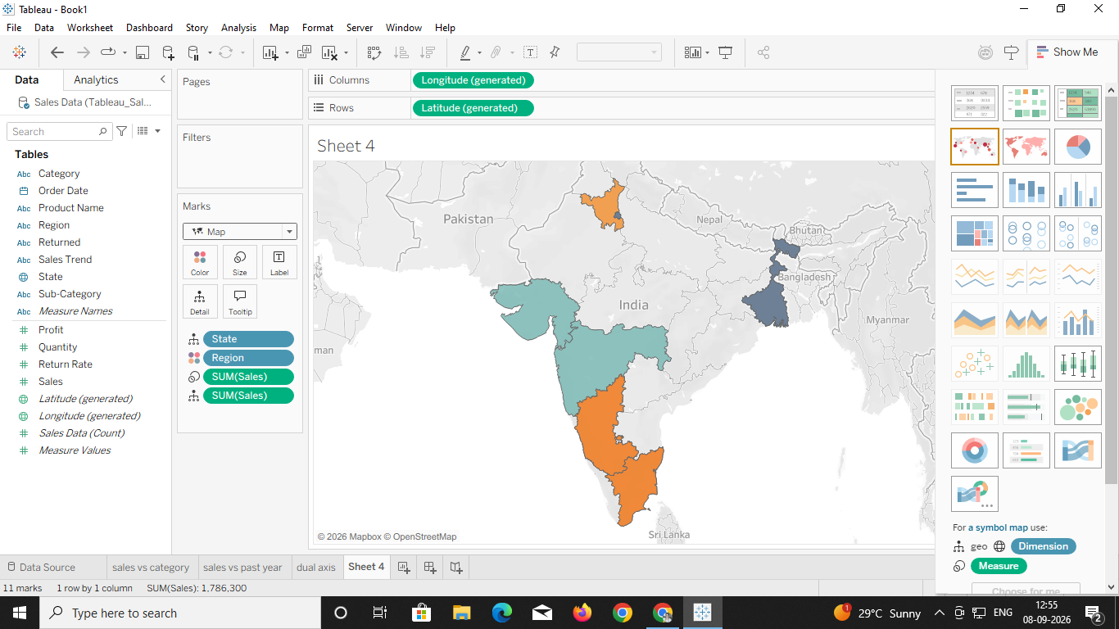
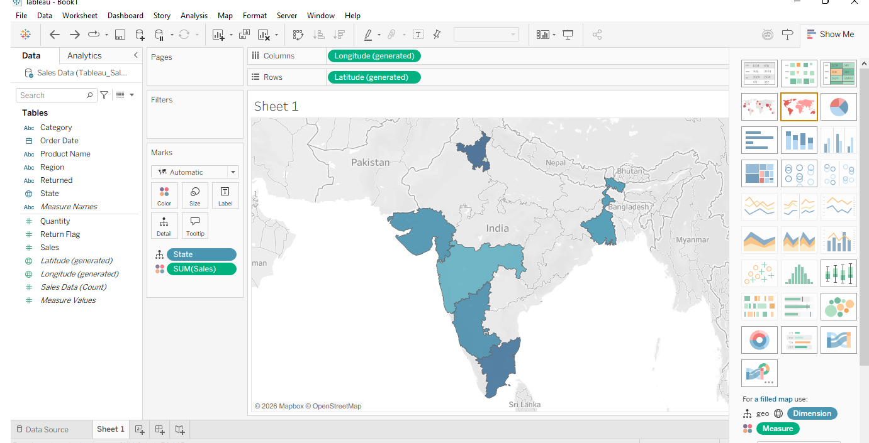
c) A geographic map showing sales distribution by region.

Slide 9
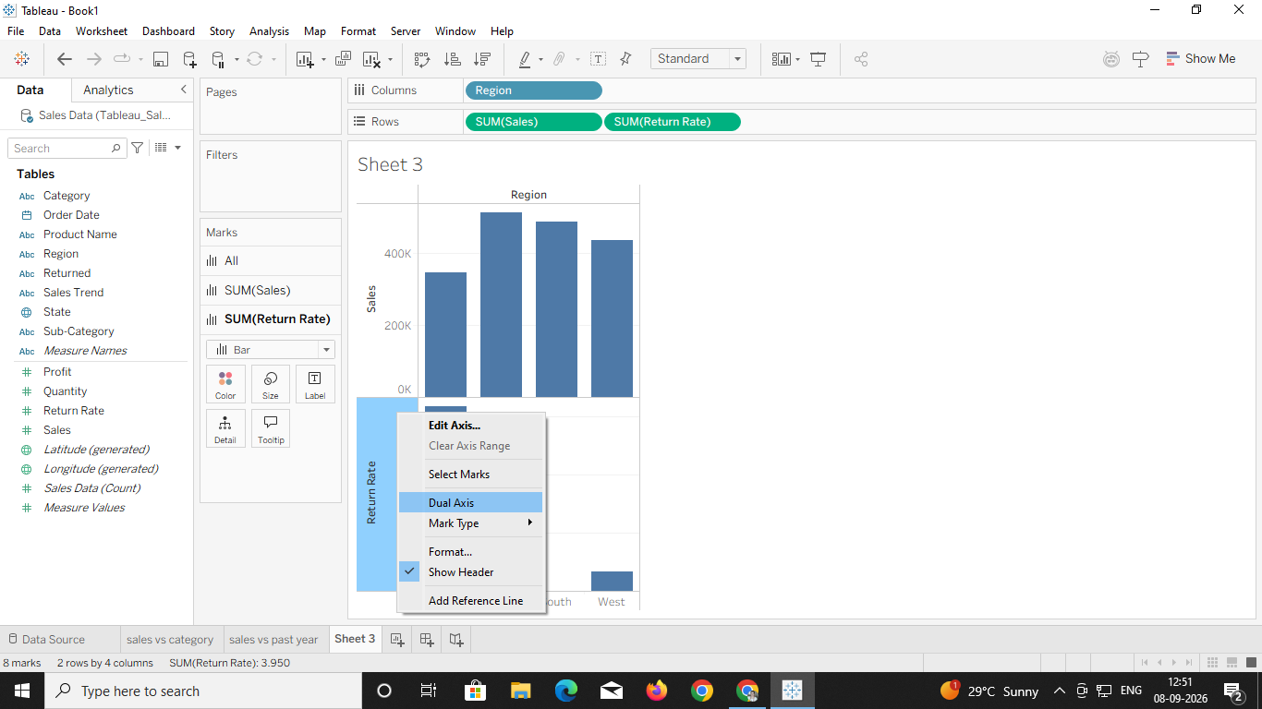
d) Use a dual-axis chart or side-by-side bar charts to compare sales and return rates across regions.

Slide 10
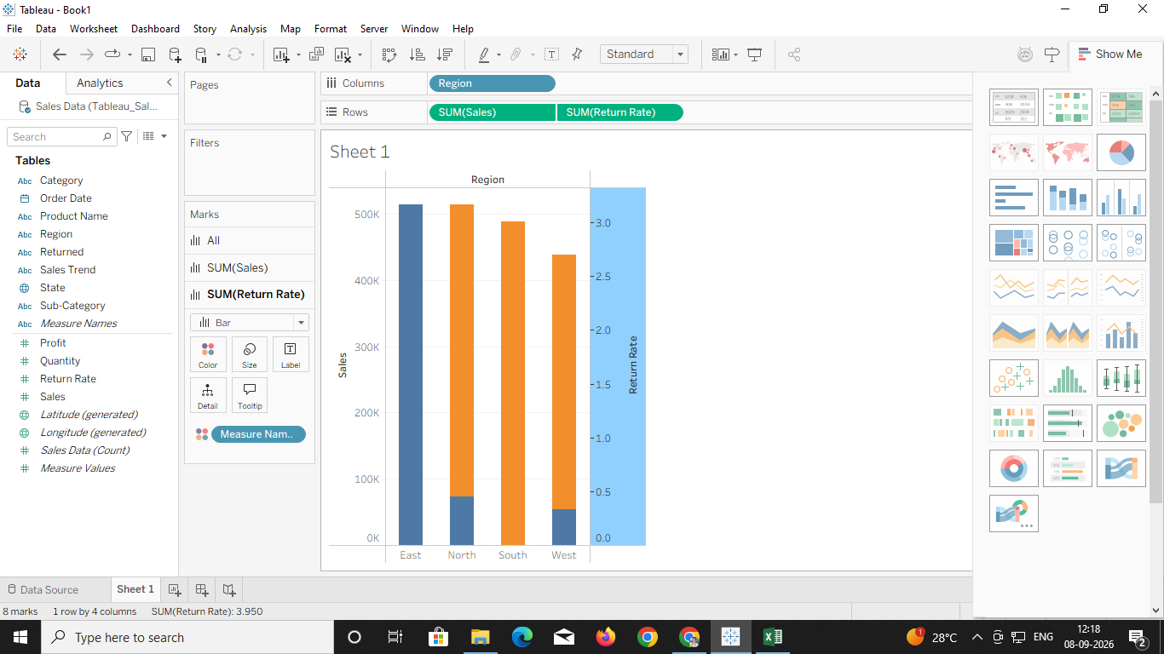
Right click on the graph and select dual axis option. Both the graph can be visualized in dual axis

Slide 11
5. To show only the past 12 months:
Drag Order Date to the Filters shelf.
Select Relative Date.
Choose Months.
Select Last → 12 → Months.
Click Apply → OK.
6.Add data labels
To display the sales value for each month:
Click Label on the Marks card.
Check Show mark labels.
The sales amount will appear near each point on the line.
7.Format the sales valuesF
If the values are large:
Right-click the Sales axis.
Select Format.
Under Numbers, select an appropriate number format.
You can use currency formatting if your sales data represents monetary values.
For example:
₹185,000 → ₹185K
8. Add a meaningful title
Double-click the chart title and change it to:
Monthly Sales Trends – Past 12 Months
A good chart should clearly communicate:
X-axis: Month
Y-axis: Total Sales
Line: Monthly sales movement
9. Tooltip
Click Tooltip on the Marks card and include:
Month
Total Sales
Category
Region
For example:
Month: June 2026
Total Sales: ₹255,000
You can also add a trend line:
Analytics → Trend Line → Linear
This helps identify whether sales are generally increasing or decreasing.

Slide 12
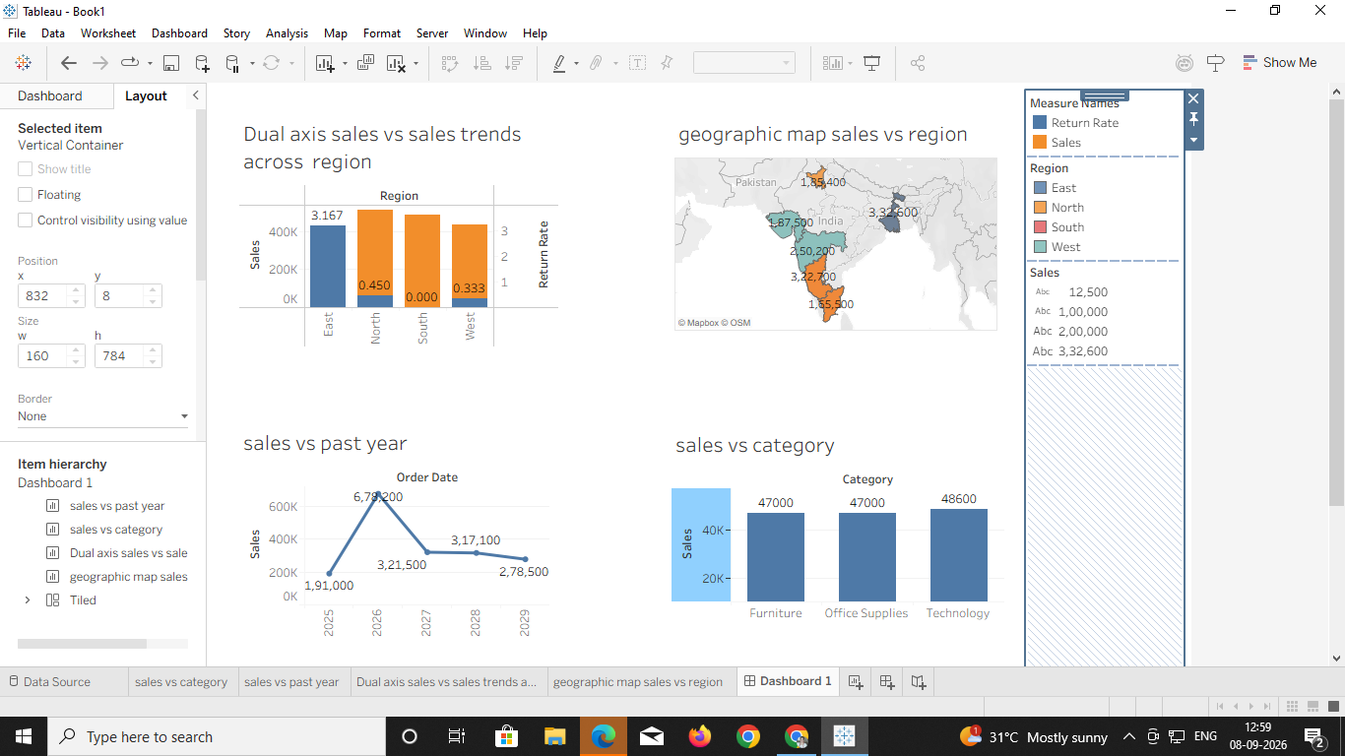
Dashboard

Slide 13
Experiment -2
Using a dataset on customer purchases, create a dashboard with the following advanced visualizations:
A scatter plot showing the relationship between customer age and total spending.
A heat map illustrating product sales intensity by store location.
A dual-axis chart comparing sales and profit margins over time.
Create a bar chart or treemap showing total sales revenue by product and region.

Slide 14
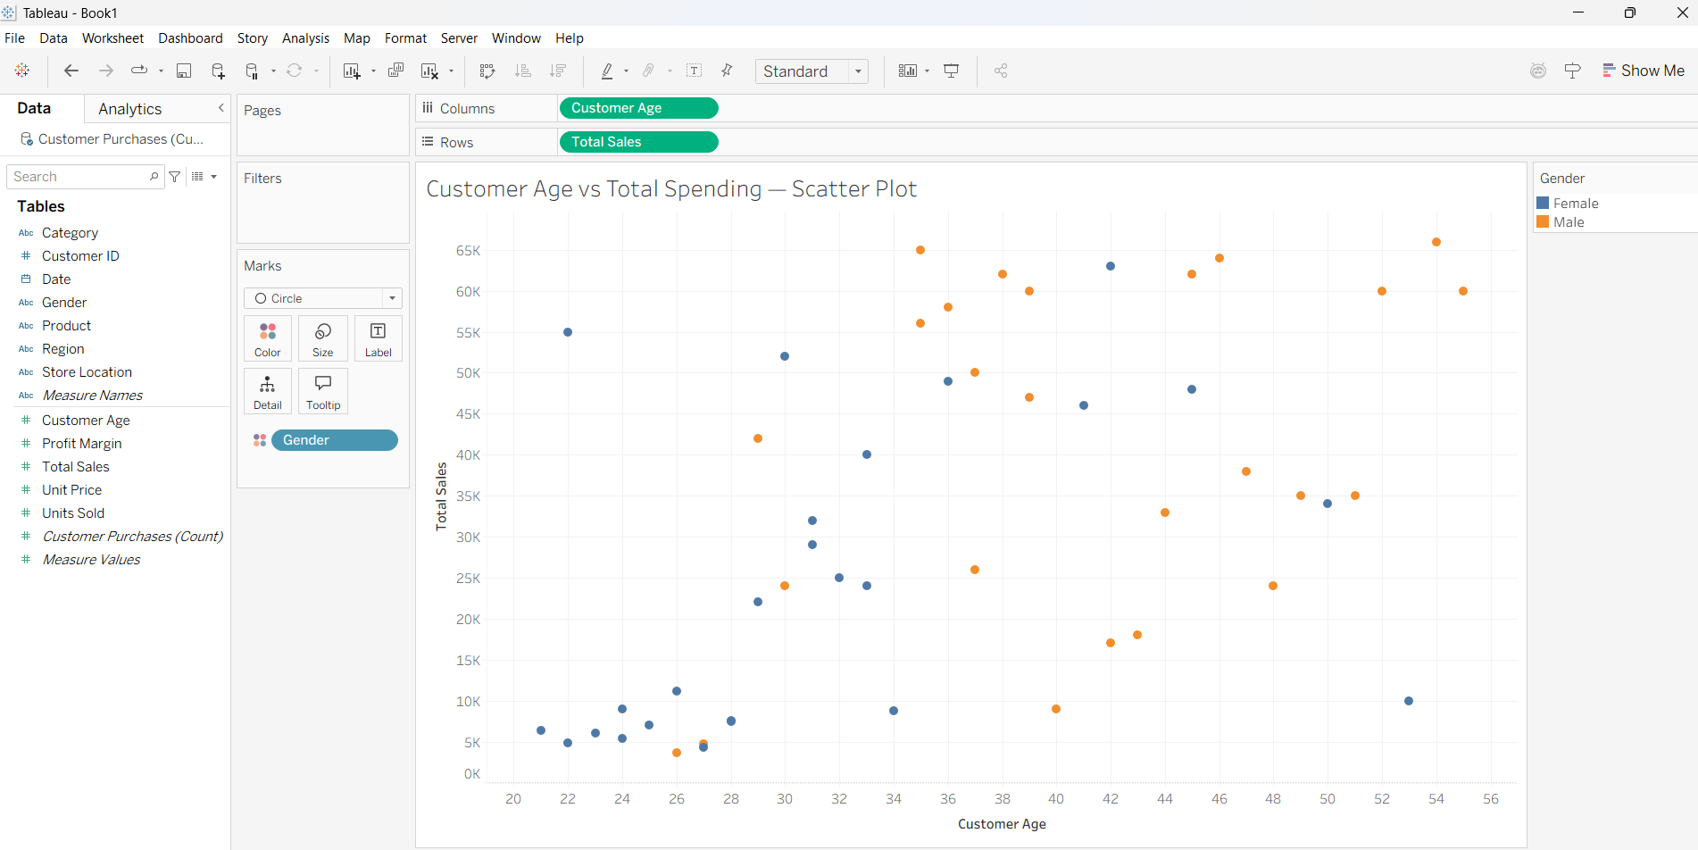
A scatter plot showing the relationship between customer age and total spending.
Customer Age vs Total Spending — Scatter Plot
Columns: Customer_Age
Rows: Total_Sales
Marks: Circle
Details: Customer_ID
Color: Gender

Slide 15
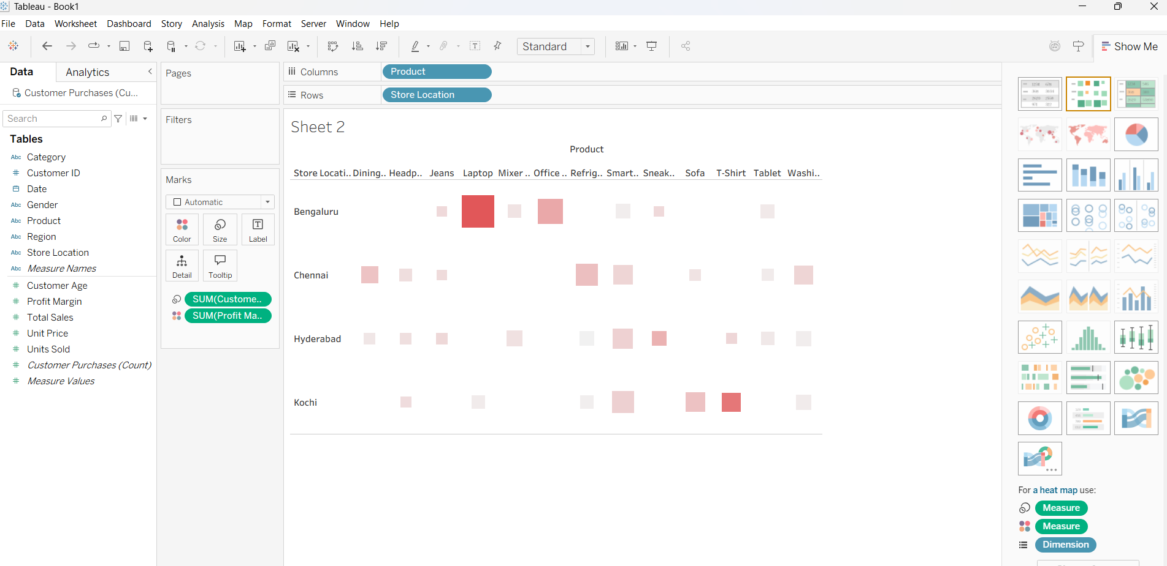
b) A heat map illustrating product sales intensity by store location.
Product Sales Intensity by Store Location — Heat Map
Rows: Store_Location
Columns: Product
Color: SUM(Total_Sales)
Label: SUM(Total_Sales)
Marks: Square

Slide 16
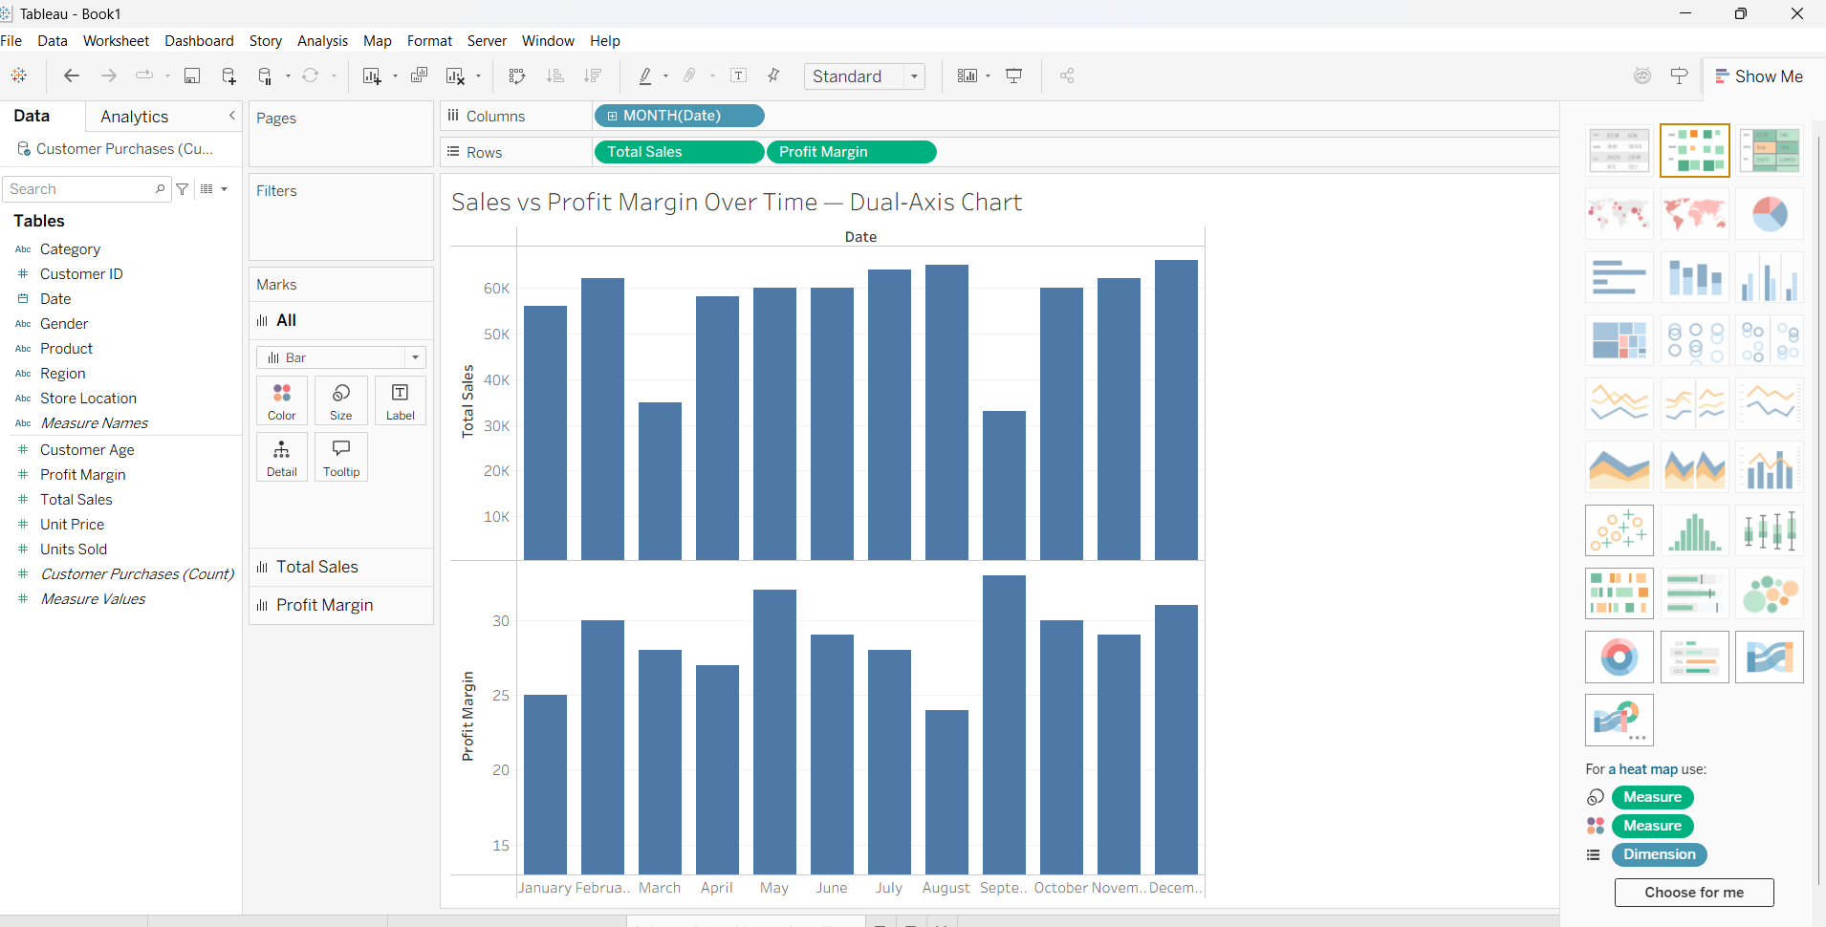
c) A dual-axis chart comparing sales and profit margins over time.
Sales vs Profit Margin Over Time — Dual-Axis Chart
Columns: MONTH(Date)
First measure:
Rows: SUM(Total_Sales)
Second measure:
Drag AVG(Profit_Margin) onto the same axis and select:
Right Click on bottom graph select dual axis. It will merge both the graphs

Slide 17
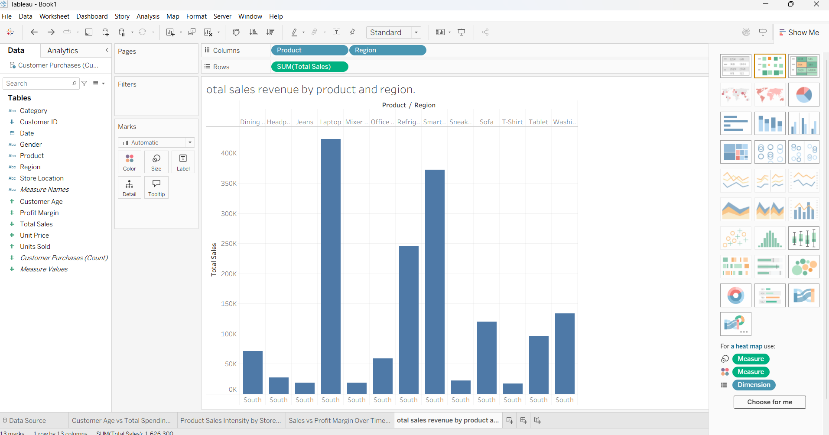
d) Create a bar chart or treemap showing total sales revenue by product and region.
Marks → Treemap
Product → Label
Region → Detail
SUM(Total_Sales) → Size
SUM(Total_Sales) → Color
Alternatively, create a horizontal bar chart using:
Rows: Product
Columns: SUM(Total_Sales)
Color: Region

Slide 18
d) Treemap
OR
Drag Category to the Label or Marks card.
Drag Sub-Category to Label.
Drag Sales to Size.
Drag Profit to Color.
Select the required fields.
Click Show Me → Treemap.
Drag Category to Detail.
Drag Sub-Category to Label.
Drag Sales to Size.
Drag Profit to Color.
Change the Marks type to Treemap.

Slide 19
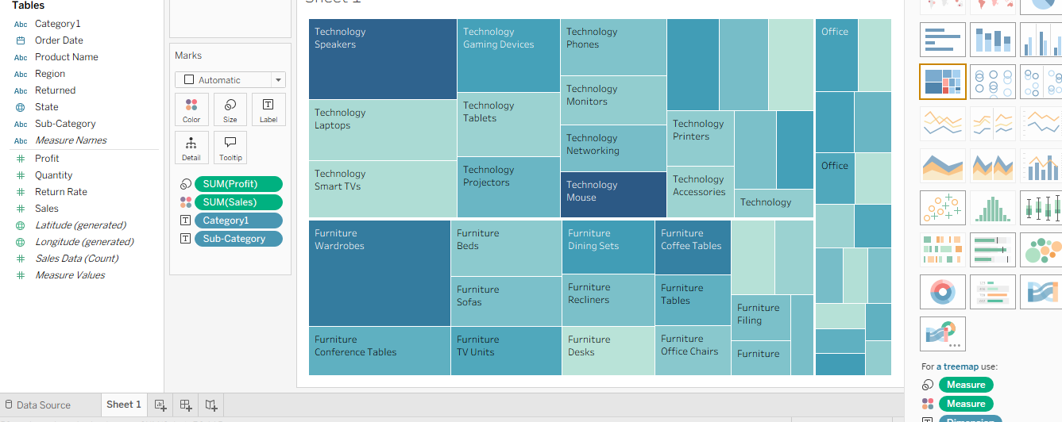
Treemap

Slide 20
Experiment -3
3.Analysing Sales Performance: Create various visualizations to analyze the sales performance.
Create a line chart to show sales trends over time.
Create a bar chart to compare sales across different regions.
Use a pie chart to display the distribution of sales among different product categories.
Create a dashboard combining these visualizations to provide an overall view of sales performance.

Slide 21
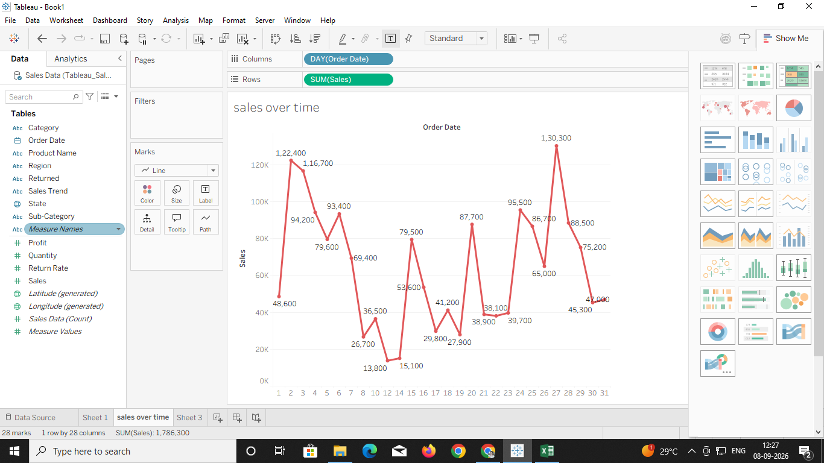
Create a line chart to show sales trends over time.

Slide 22
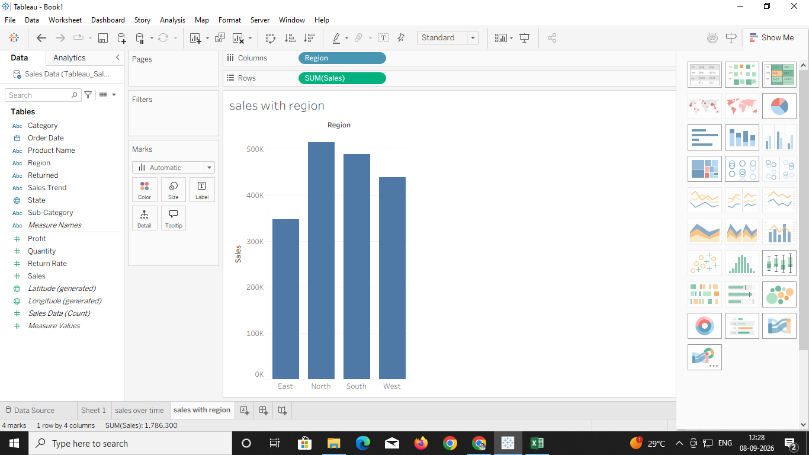
b.Create a bar chart to compare sales across different regions.

Slide 23
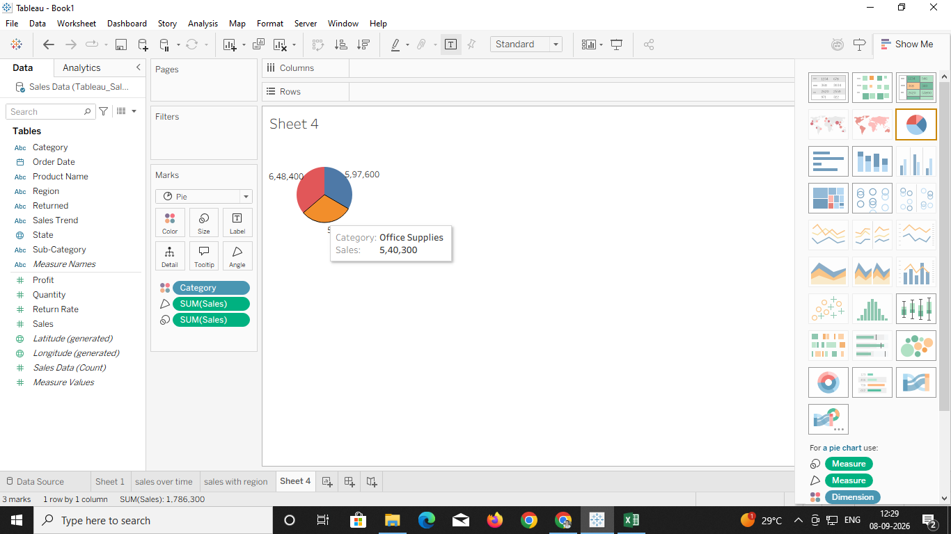
C. Use a pie chart to display the distribution of sales among different product categories.

Slide 24
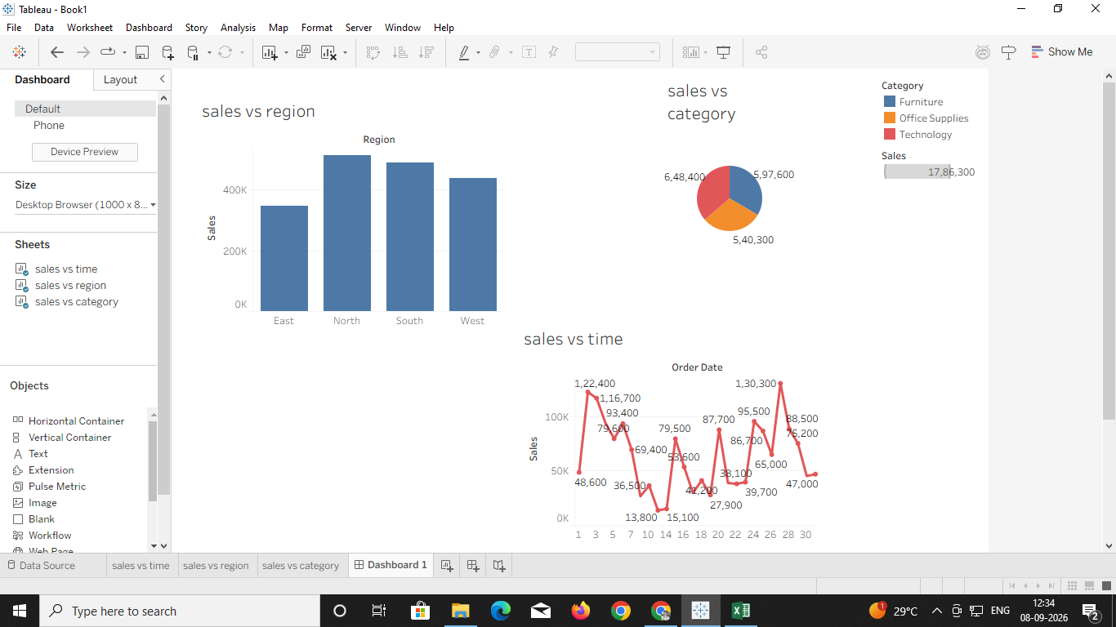
D. Create a dashboard combining these visualizations to provide an overall view of sales performance.

Slide 25
END

