Slide 1
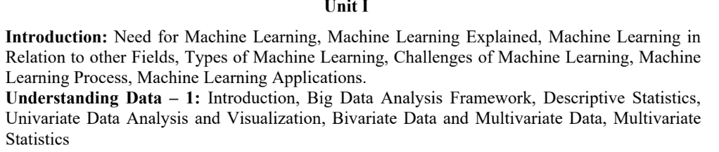
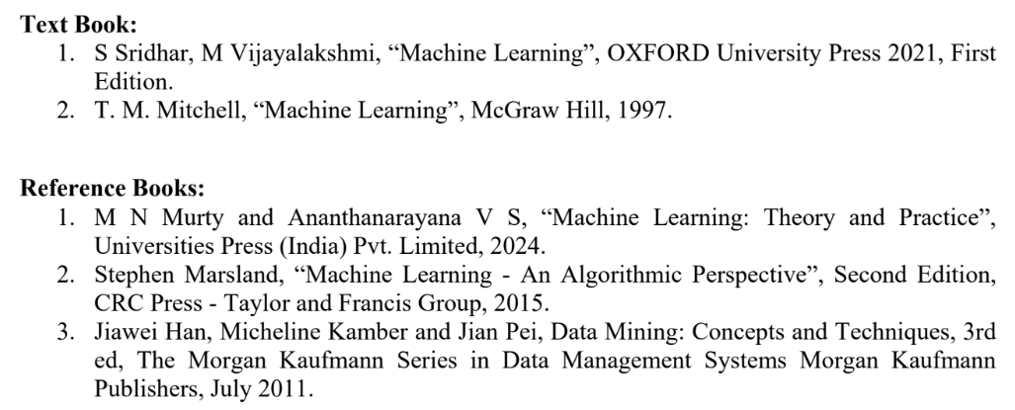
Machine Learning-IS51

Slide 2
Topics to be covered
Introduction:
1,1 Need for Machine Learning
1.2 Machine Learning Explained
1.3 Machine Learning in Relation to other Fields
1.4 Types of Machine Learning
1.5 Challenges of Machine Learning
1.6 Machine Learning Process
1.7 Machine Learning Applications
Understanding Data – 1:
Introduction
2.3 Big Data Analysis Framework
2.4 Descriptive Statistics
2.5 Univariate Data Analysis and Visualization
2.6 Bivariate Data and Multivariate Data
2.7 Multivariate Statistics

Slide 3
1.1 Need for Machine Learning
Business organizations generate large amounts of data every day.
Earlier, this data was not fully used because it was stored in different systems and was difficult to combine.
There was also a lack of advanced software tools to analyze the data and find useful information.
Today, organizations use modern technologies such as Machine Learning to analyze data and make better decisions.

Slide 4
1.1 Cont’d
Why is Machine Learning Becoming Popular?
Machine Learning (ML) has become popular mainly because of three major reasons:
Huge Amount of Data
  Companies such as Facebook, Twitter, and YouTube generate massive amounts of data.
  Data is growing very rapidly, approximately doubling every year.
  ML helps computers analyze this large amount of data.
Lower Storage and Hardware Cost
  The cost of storing data has decreased significantly.
  Computer hardware has also become cheaper and more powerful.
  Therefore, organizations can easily collect, store, process, and transmit data.
Availability of Advanced Algorithms
  Many powerful ML algorithms are now available.
  Deep Learning has further increased the capabilities of ML.
  These algorithms can solve complex real-world problems.

Slide 5
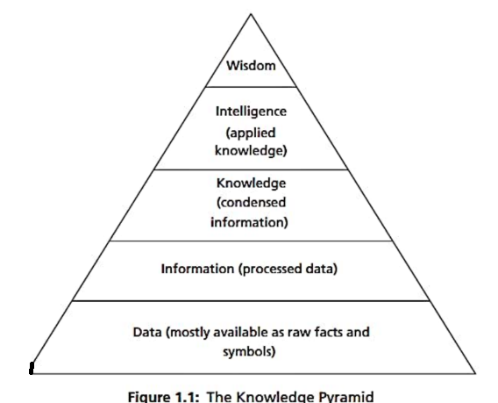
The Knowledge Pyramid explains how raw data becomes useful for decision-making.
Data → Information → Knowledge → Intelligence → Wisdom
Data: Raw facts, numbers, symbols, or text.
Example: 100, 150, 200 sales records.
Information: Processed data that reveals patterns or relationships.
Example: Product A has the highest sales.
Knowledge: Useful conclusions obtained from information.
Example: Product A has been consistently popular over the last year.
Intelligence: Applying knowledge to take appropriate action.
Example: Increase production of Product A.
Wisdom: Ability to make mature and effective decisions based on experience and understanding.
1.1 Cont’d

Slide 6
1.1 Cont’d
Why Do We Need Machine Learning?
Organizations collect large amounts of historical data.
Machine Learning helps to:
Analyze large datasets
Identify hidden patterns and trends
Make better decisions
Predict future outcomes
Design new products
Improve business processes
Develop effective Decision Support Systems
Machine Learning converts large amounts of data into Machine Learning converts large amounts of data into useful insights that help organizations make better decisions.
Simple example:
Sales Data → Sales Pattern → Product Knowledge → Production Decision → Better Business Outcome

Slide 7
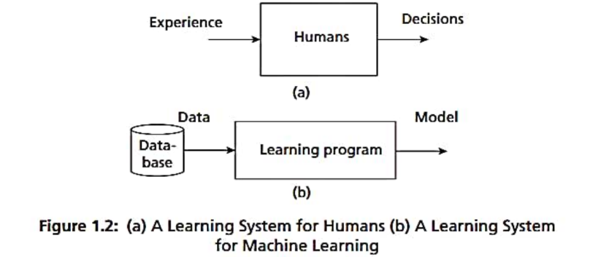
1.2 Machine Learning Explained
ML is a part of AI. Machine learning is the field of study that gives computers the ability to learn without being explicitly programmed.

Slide 8
1.2 Cont’d
Conventional Programming | Machine Learning
Rules are manually written | Patterns are learned from data
Programmer defines the logic | Algorithm learns the logic
Input + Rules → Output | Data + Examples → Model
Difficult for highly complex problems | Suitable for complex data-driven problems
Does not automatically learn | Can learn and improve from data
Example: Calculator program | Example: Spam detection

Slide 9
Limitations of Conventional Programming
1.2 Cont’d
Conventional programming works well when rules are clearly defined.
However, it becomes difficult for complex real-world problems such as:
Puzzles
Games
Image Recognition
Natural Language Processing
Autonomous systems
It is difficult to manually write rules for every possible situation.
Complex problems may have too many possible conditions.
Human-designed rules may not handle unknown situations effectively.

Slide 10
Early Artificial Intelligence – Rule-Based Approach
1.2 Cont’d
The early approach of AI was to create general-purpose rules manually.
Understand the problem.
Obtain knowledge from human experts.
Convert expert knowledge into rules.
Represent rules using logic and reasoning.
Implement the rules in a computer program.
Use the program to make decisions.
Expert Knowledge → Rules → Program → Decision

Slide 11
1.2 Cont’d
Expert Systems
An Expert System is an AI system that uses the knowledge of human experts to solve problems in a specific domain.
Main components:
Knowledge Base – stores expert knowledge and rules.
Inference Engine – applies rules to available information.
User Interface – allows users to interact with the system.
Example: MYCIN
MYCIN was an early expert system for medical diagnosis.
It used knowledge obtained from doctors.
The system applied predefined rules to assist in diagnosing infections and recommending antibiotics.
Limitations of Expert Systems
Although expert systems were useful, they had several limitations:
They depended heavily on human experts.
Rules had to be manually created and updated.
Difficult to handle new or unexpected situations.
Difficult to scale when the number of rules becomes very large.
They did not truly learn from data.
Hence, they had limitations in demonstrating genuine intelligence.
Human must provide the rules → System follows the rules

Slide 12
Shift Towards Machine Learning
1.2 Cont’d
Because rule-based systems had limitations, AI gradually shifted toward a data-driven approach.
Instead of manually writing all the rules:
Collect relevant data.
Give the data to a machine learning algorithm.
The algorithm identifies patterns and relationships.
A model is automatically developed.
The model can make predictions on new/unseen data.
Data → Learning Algorithm → Model → Prediction

Slide 13
1.2 Cont’d
Machine Learning (ML) has become popular mainly because of three major reasons:
Huge Amount of Data
  Companies such as Facebook, Twitter, and YouTube generate massive amounts of data.
  Data is growing very rapidly, approximately doubling every year.
  ML helps computers analyze this large amount of data.
Lower Storage and Hardware Cost
  The cost of storing data has decreased significantly.
  Computer hardware has also become cheaper and more powerful.
  Therefore, organizations can easily collect, store, process, and transmit data.
Availability of Advanced Algorithms
  Many powerful ML algorithms are now available.
  Deep Learning has further increased the capabilities of ML.
  These algorithms can solve complex real-world problems.

Slide 14
Machine Learning Process
1.2 Cont’d
1. Data Collection
First, relevant data is collected.
The quality and quantity of data are important for learning.
2. Abstraction
The collected data is analyzed to identify important concepts and patterns.
These concepts help the system understand objects or situations.
Example: From many images of elephants, the system learns the concept of what an elephant looks like.
3. Generalization
The learned concepts are converted into useful knowledge for making decisions.
The system identifies patterns, ranks possible concepts, and develops heuristics.
Heuristics are practical rules of thumb learned from experience.
Example: From past experiences, a person learns to recognize situations that may indicate danger.
4. Evaluation and Correction
Learned rules or heuristics may sometimes produce incorrect results.
Evaluation measures are used to check how well the model performs.
If performance is poor, the model is corrected or improved.
Data Collection → Abstraction → Generalization → Evaluation → Improved Model

Slide 15
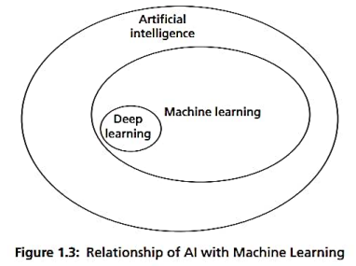
1.3 Machine learning in relation to other field
Machine learning is an important branch of AI.
Machine learning is the subbranch of AI, whose aim is to extract the patterns for prediction.
The aim of AI is to develop intelligent agents. An agent can be a robot, humans, or any autonomous systems.
Deep learning is a subbranch of machine learning. In deep learning, the models are constructed using neural network technology. Many neurons form a network connected with the activation functions that trigger further neurons to perform tasks.
Machine learning starts with data. Therefore, data science and machine learning are interlinked.

Slide 16
Data science deals with gathering of data for analysis It is a broad field that includes:
1. Big Data
Big Data is a specialization within data science focused on managing data with three primary characteristics:
Volume: Large quantities of data created by major tech platforms (e.g., social media and video sites).
Variety: Diverse formats and media types, including images and video files.
Velocity: The rapid rate at which information is generated and processed.
It powers machine learning tasks like translation and image recognition, and drives advancements in deep learning (which builds models using neural networks).
1.3 Cont’d
2. Data Mining
Originating from business needs, data mining focuses on uncovering hidden insights within datasets that might otherwise be overlooked. While often conflated with machine learning, they differ in purpose:
Data Mining: Focused on discovering hidden patterns in existing data.
Machine Learning: Focused on using data patterns to make predictions.
3. Data Analytics
Data analytics transforms raw data into actionable knowledge. A key subtype, Predictive Analytics, relies on machine learning algorithms to forecast future outcomes.
4. Pattern Recognition
An engineering domain that uses machine learning algorithms to identify features, analyze structures, and classify patterns. It can be understood as a specific practical application of machine learning.

Slide 17
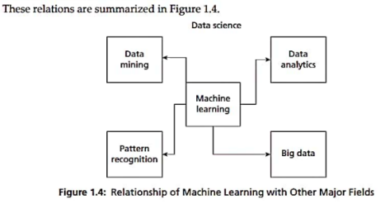
1.3 Cont’d

Slide 18
Machine Learning and Statistics
1.3 Cont’d
Statistics:
A mathematical branch with strong, rigorous theoretical foundations. It relies on hypothesis testing and experiments to validate data relationships.
Math-heavy, using complex equations and strict assumptions tailored to specific datasets. Requires deep statistical knowledge.
Machine Learning:
A computational approach focused on learning directly from data with fewer underlying assumptions.
Requires less formal statistical background but relies heavily on software tools to automate the learning process.
“Many views consider Machine Learning as the modern, automated evolution of "old Statistics".

Slide 19
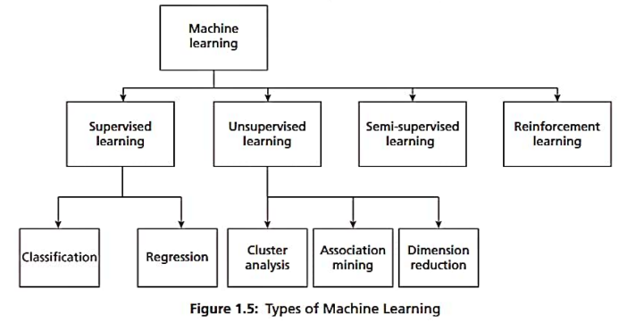
1.4 Types of Machine Learning

Slide 20
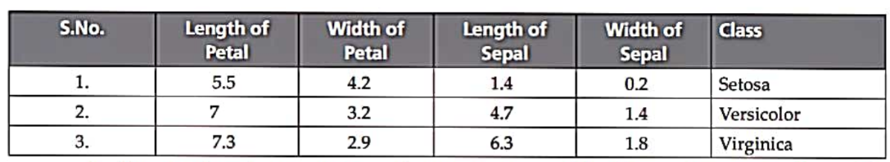
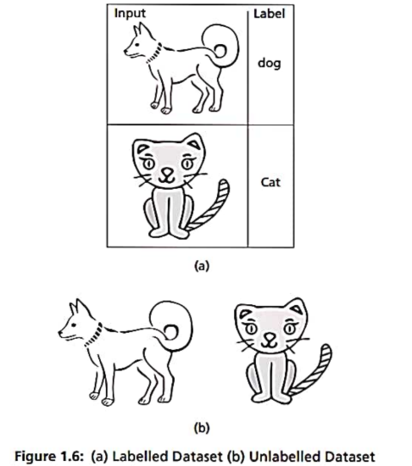
Dataset
Labelled and Unlabelled Data

Slide 21
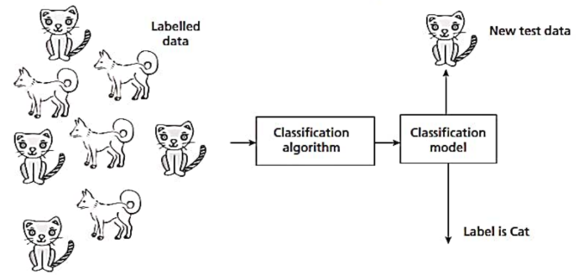
Supervised learning:
classification :
Some of the key algorithms of classification are:
Decision Tree
Random Forest
Support Vector Machines
Naïve Bayes
Artificial Neural Network and Deep Learning networks like CNN

Slide 22
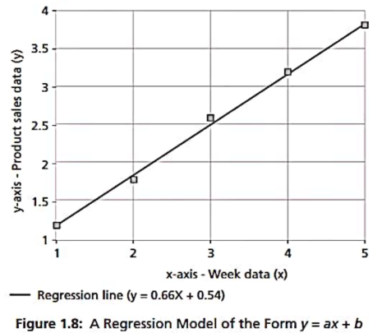
Regression Models
Regression models predict continuous variables (such as product sales or product price).
The regression model takes input x and generates a model in the form of a fitted line of the form y = f(x).
Here, x is the independent variable that may be one or more attributes and y is the dependent variable.

Slide 23
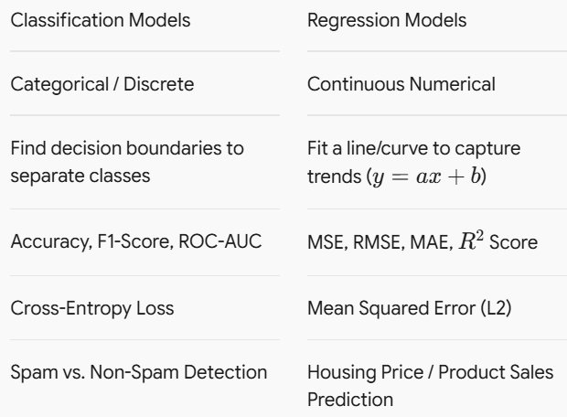
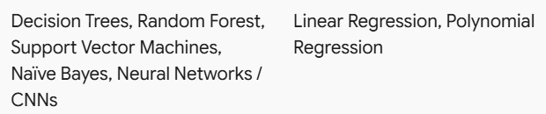
Comparison

Slide 24
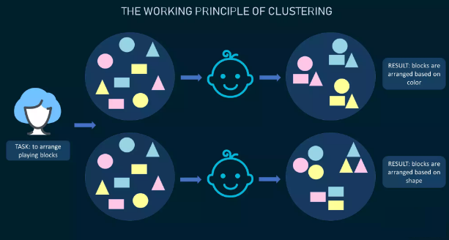
Unsupervised Learning
A machine learning model tries to find any similarities, differences, patterns, and structure in data by itself. No prior human intervention is needed.
Example:Anomaly detection, Customer and market segmentation, recommender system
Clustering
Association

Slide 25
Unsupervised Learning
Operates without a supervisor, teacher, or target labels.
Relies on finding inherent patterns, structures, and grouping principles directly from unlabelled data.
Key algorithmic families include Cluster Analysis and Dimensionality Reduction.
Applications:
Image Processing: Segmentation of Regions of Interest (ROI) in images.
Medical Imaging: Automated detection of abnormal growths or tumors.
Bioinformatics: Pattern matching and signature clustering in gene databases.
Computer Vision Example: Grouping mixed image sets (e.g., separating images of cats and dogs) into distinct clusters based purely on visual attributes.

Slide 26
Cluster Analysis :
Cluster analysis is an unsupervised learning technique that groups unlabelled data into disjoint clusters based purely on feature attributes.
Ensures high intra-cluster similarity (objects within a group share common traits) and high inter-cluster variation (objects across groups differ significantly).
Ensures high intra-cluster similarity (objects within a group share common traits) and high inter-cluster variation (objects across groups differ significantly).
Automatically separates the dataset into distinct clusters (e.g., Cluster 1: Cats, Cluster 2: Dogs).

Slide 27
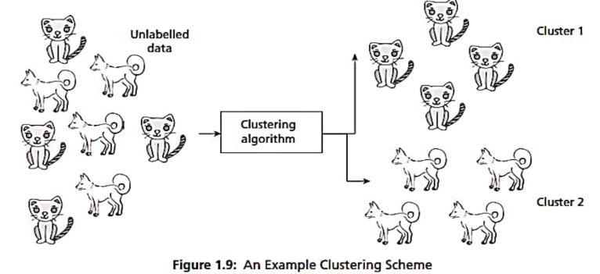
Some of the clustering algorithms are
k-means algorithm:
A centroid-based partition technique that iteratively assigns data points to k pre-specified clusters by minimizing within-cluster variance (Euclidean distance).
Hierarchical algorithms: Structure-based approaches that build a nested tree of clusters (dendrogram) using either a bottom-up. (agglomerative) or top-down (divisive) strategy.

Slide 28
Dimensionality Reduction
Dimensionality reduction algorithms fall under unsupervised learning.
Accepts high-dimensional data as input and transforms it into a lower-dimensional space.
Shrinks the dataset feature count while preserving its overall structure and generality (mitigating the "curse of dimensionality").
Reducing input dimensions significantly lowers training time, memory consumption, and algorithmic complexity.
Noise removal before feeding data into predictive models.
Common Techniques includes Principal Component Analysis (PCA), Linear Discriminant Analysis (LDA).

Slide 29
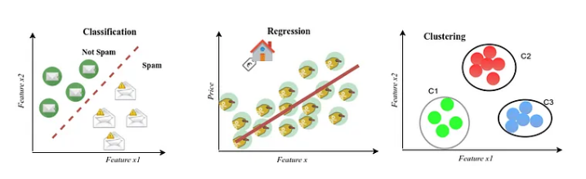

Slide 30
Metric | Formula | Meaning | Better Value
Accuracy | TP+TNTP+TN+FP+FN\frac{TP+TN}{TP+TN+FP+FN} | Percentage of correctly classified samples | Higher
Precision | TPTP+FP\frac{TP}{TP+FP} | Of all predicted positives, how many are actually positive | Higher
Recall / Sensitivity | TPTP+FN\frac{TP}{TP+FN} | Of all actual positives, how many are correctly detected | Higher
Specificity | TNTN+FP\frac{TN}{TN+FP} | Of all actual negatives, how many are correctly identified | Higher
F1-score | 2Precision×RecallPrecision+Recall2\frac{Precision\times Recall}{Precision+Recall} | Balance between Precision and Recall | Higher
ROC-AUC | Area under ROC curve | Ability to distinguish between classes across thresholds | Higher
measuring machine learning models
SUPERVISED Learning
Classification Metrics

Slide 31
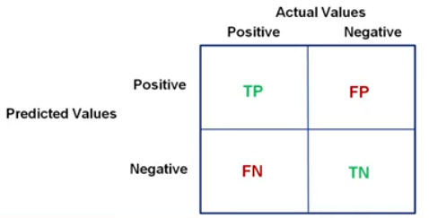
What is Confusion matrix?

Slide 32
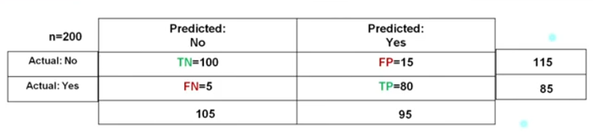
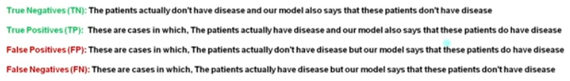
confusion matrix for binary classification problems

Slide 33
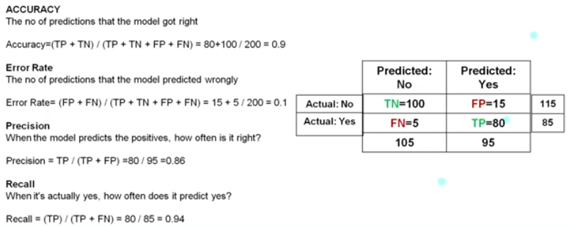
Performance measures

Slide 34
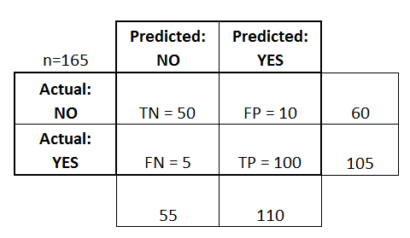
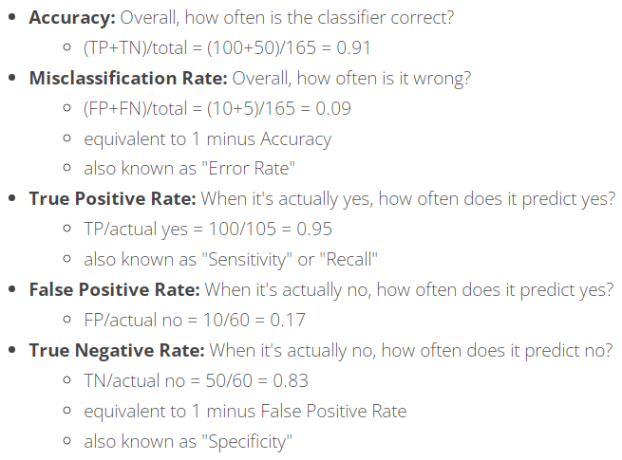
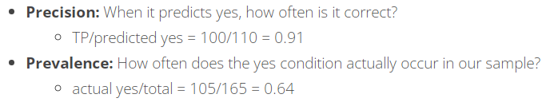
Example

Slide 35
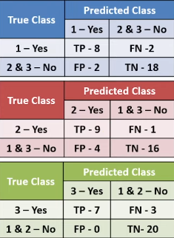
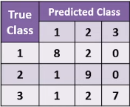
confusion matrix for
multiclass classification

Slide 36
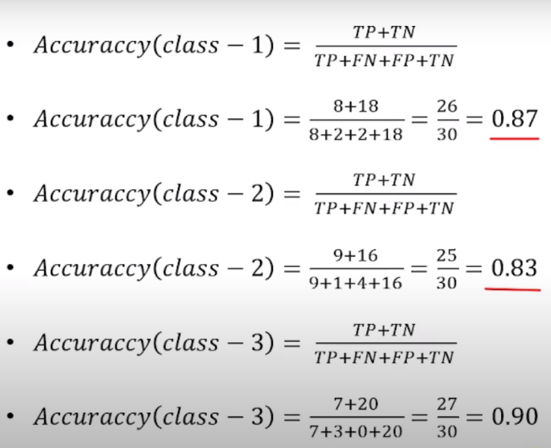

Slide 37
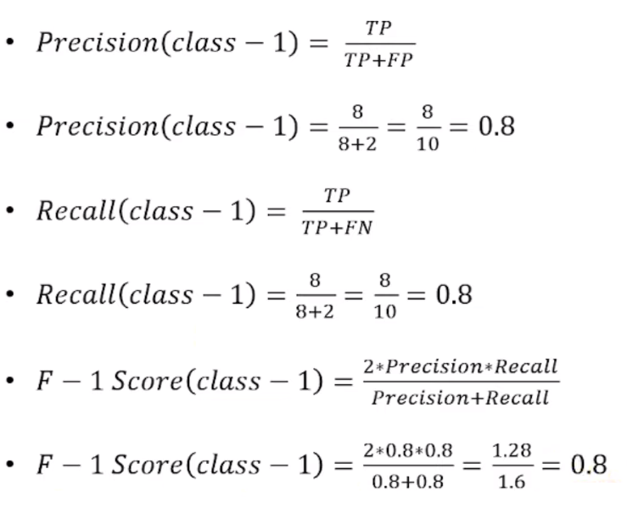

Slide 38
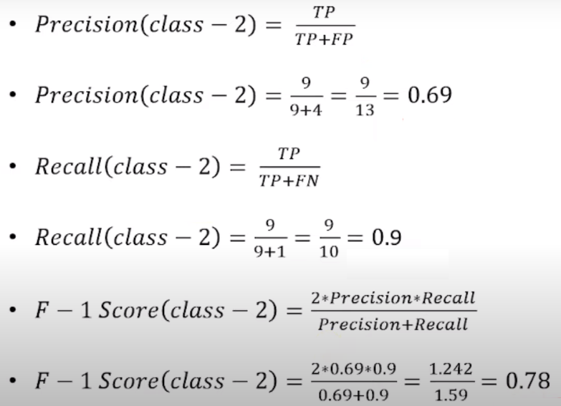

Slide 39
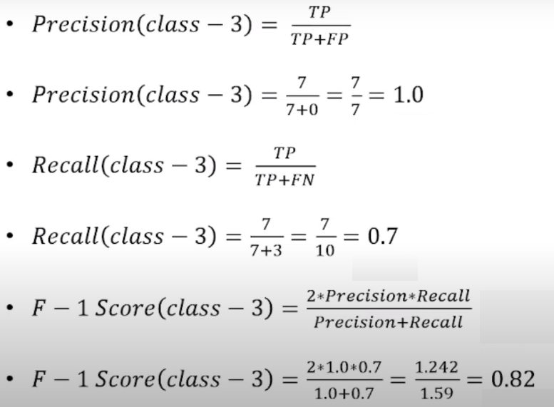

Slide 40
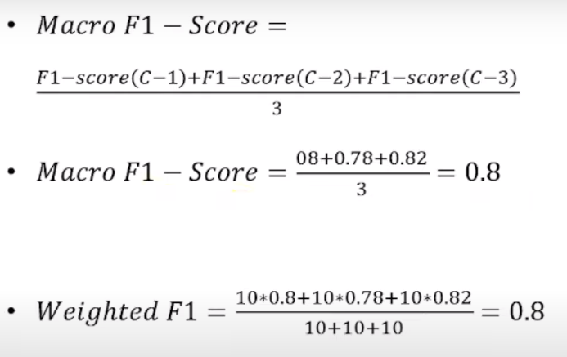
weighed F1=
(number of class-1 samples(i.e 10)*F1-score(C-1)+
number of class-2 samples(i.e 10)*F1-score(C-2)+
number of class-3 samples(i.e 10)*F1-score(C-3)) / total number of samples of all classes(i.e 10+10+10)

Slide 41
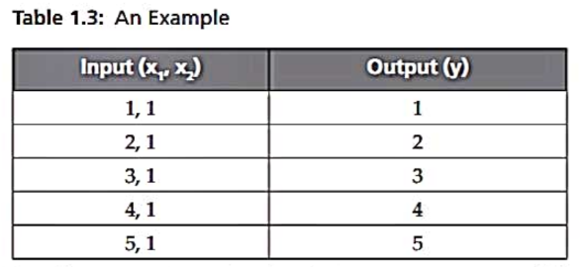
1.5 Challenges of Machine Learning
Computers are better than humans at fast computation and repetitive tasks, and they can perform complex activities such as chess and Go. Humans, however, are generally better at recognition and understanding tasks. Deep learning has reduced this gap by enabling machines to recognize faces and patterns efficiently. Nevertheless, machine learning systems depend heavily on large amounts of high-quality data, making data quality and availability major challenges in building effective models.
Problems
  Machine learning works well with well-posed problems, where the problem specifications and required information are clearly defined.
  Ill-posed problems occur when the available data is insufficient to determine a unique solution.
  In the given example, the same data can be explained by different functions such as multiplication, division, or squaring.
  Therefore, additional examples or data are needed to identify the correct model.
  Puzzles, games, scientific computing, and real-world problems can become ill-posed when their specifications or information are incomplete.

Slide 42
2. Huge Data
Machine learning requires large amounts of high-quality data.
Data should be accurate and free from problems such as missing or incorrect values.
Collecting and maintaining quality data is a major challenge.
3. High Computing Power
Big Data and complex ML tasks require high computational resources.
GPUs and TPUs are often used to speed up machine learning computations.
Increasing algorithm complexity also increases time and computational requirements.
4. Complexity of Algorithms
Choosing, designing, implementing, and evaluating suitable ML algorithms can be challenging.
Different algorithms may need to be compared to identify an appropriate solution.
Algorithm selection and optimization are important challenges for ML professionals.
5. Bias–Variance Tradeoff
Bias and variance are important sources of model error.
Overfitting: The model performs very well on training data but poorly on test data, resulting in poor generalization.
Underfitting: The model performs poorly even on training data but may generalize reasonably well.
Finding the right balance between bias and variance is a major challenge in machine learning.

Slide 43
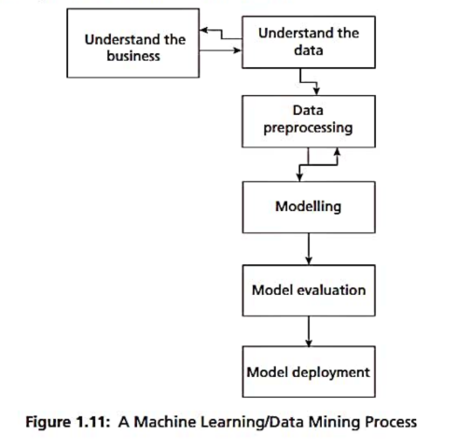
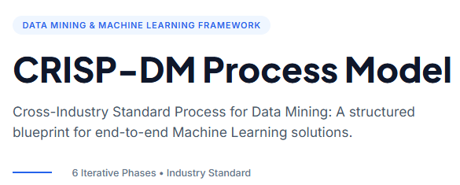
1.6 Machine Learning Process

Slide 44
Understand the Business: Defines project objectives and requirements from a business perspective, converting them into a machine learning problem definition.
Understand the Data: Involves initial data collection, exploring data characteristics, identifying quality issues, and discovering first insights.
Data Preprocessing: Cleans raw data, handles missing values, normalizes features, and transforms datasets into the final format required for modeling.
Modelling: Selects and applies various machine learning algorithms to the prepared data and tunes model parameters for optimal performance.
Model Evaluation: Assesses the model against business metrics and key performance indicators (KPIs) to ensure it meets original business goals before deployment.
Model Deployment: Integrates the validated model into a live production environment so end-users or systems can make data-driven decisions.

Slide 45
1.7 Machine Learning Applications
Sentiment Analysis: An application of natural language processing (NLP) that converts words in documents into sentiments such as happy, sad, and angry, often captured by emoticons. It is used to automatically assign star ratings (e.g., five stars or one star) to movie or product reviews.
Recommendation Systems: Systems based on machine learning that enable personalized purchases. Examples include Amazon suggesting related books or books bought by people with similar tastes, and Netflix suggesting shows or movies based on user taste.
Voice Assistants: Products such as Amazon Alexa, Microsoft Cortana, Apple Siri, and Google Assistant that process speech commands to perform tasks.
Navigation & Mapping Technologies: Technologies such as Google Maps and Uber that locate and navigate the shortest paths to reduce travel time.

Slide 46
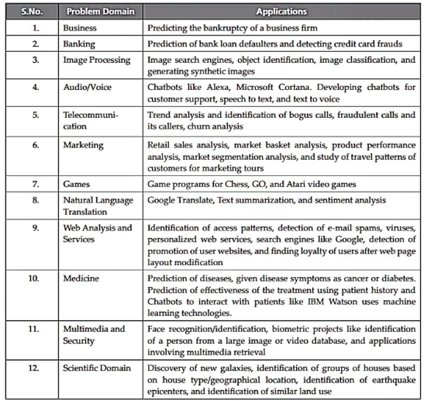

Slide 47
Understanding Data – 1: Introduction
2.3 Big Data Analysis Framework
Difference Between Data Analytics and Data Analysis
Data Analytics: A general, broader concept that covers the complete cycle of data management, including data collection, preprocessing, and analysis. It focuses more on the future and aids in making predictions.
Data Analysis: A specific component within data analytics. It focuses on taking historical data and analyzing it to extract useful information and insights for decision-making.
4 Types of Data Analytics
Descriptive analytics
Diagnostic analytics
Predictive analytics
Prescriptive analytics

Slide 48
Descriptive Analytics: Focuses on describing and quantifying the main features of collected data. It relies strictly on the descriptive aspect of statistics rather than inference.
Example:
Monthly Sales Summary: A retail store generates end-of-month reports showing total revenue, units sold per location, and top-selling product lines.
Website Traffic Metrics: An e-commerce company tracks daily visitor counts, page views, and average session durations across different geographic regions using an analytics dashboard.
Diagnostic Analytics: Known as causal analysis, it answers the question "Why?" by determining the cause and effect of events. For instance, if a product is not selling, it aims to analyze the underlying reasons and associated effects.
Example:
Checkout Drop-off Investigation: An online retailer notices a sudden 20% drop in conversions and analyzes site log data to discover that a bug in the newly updated payment gateway was causing transaction failures.
Customer Churn Root-Cause Analysis: A subscription service analyzes user engagement patterns and customer support logs to determine that poor app performance after a software update led to increased cancellations.

Slide 49
Predictive Analytics: Deals with the future by answering "What will happen in the future given this data?" It applies algorithms to discover patterns and predict outcomes, forming the core focus of machine learning.
Example:
Seasonal Demand Forecasting: A supermarket chain uses historical sales trends, weather predictions, and upcoming holiday schedules to estimate how much inventory to stock for the next quarter.
Credit Default Risk Scoring: A bank uses machine learning models trained on past customer payment histories and credit scores to estimate the likelihood of a loan applicant defaulting.
Prescriptive Analytics: Recommends the best course of action for business organizations. Going beyond prediction, it suggests specific sets of actions to assist decision-making, improve future planning, and mitigate risks.
Example:
Dynamic Delivery Route Optimization: Logistics companies like UPS evaluate real-time traffic conditions, weather alerts, and delivery time windows to automatically prescribe the fastest, most fuel-efficient routes for drivers.
Automated Airline Price Adjustments: An airline uses algorithms that evaluate real-time booking speeds, competitor pricing, and remaining seat capacity to automatically adjust dynamic ticket prices to maximize profitability.

Slide 50
2.4 Descriptive Statistics
Descriptive statistics is a branch of statistics used to summarize, organize, and describe data. It helps us understand the important characteristics of a dataset without making predictions.
To understand the basic nature and characteristics of data.
Represents data using graphs, charts, and plots.
Examines data to discover patterns, relationships, and unusual observations.
Understanding the data helps us decide which machine learning or data-mining techniques can be applied.
Descriptive statistics + Data visualization atr the main Components of EDA
Example: Suppose we have students' marks:
45, 60, 70, 75, 80, 90
Descriptive statistics can tell us:
Mean → Average mark
Median → Middle mark
Minimum → 45
Maximum → 90
Range → 90 − 45 = 45
A bar chart or histogram can visually show how the marks are distributed.

Slide 51
2.5 Univariate Data Analysis and Visualization
Univariate analysis is the simplest form of statistical analysis where the dataset consists of only one variable. It focuses purely on describing the data and identifying patterns within a single category, rather than dealing with causes or relationships between variables.
Key components involved in describing univariate data include:
Frequency Distributions
Central Tendency Measures
Dispersion or Variation
Shape of the Data
To understand data, graph visualization is must. Data visualization helps to understand data. It helps to present information and data to customers. Some of the graphs that are used in univariate data analysis are bar charts, histograms, frequency polygons and pie charts.
2.5.1 Data Visualization
Bar Chart A Bar chart (or Bar graph) is used to display the frequency distribution for variables. Bar charts are used to illustrate discrete data. The charts can also help to explain the counts of nominal data. It also helps in comparing the frequency of different groups.

Slide 52
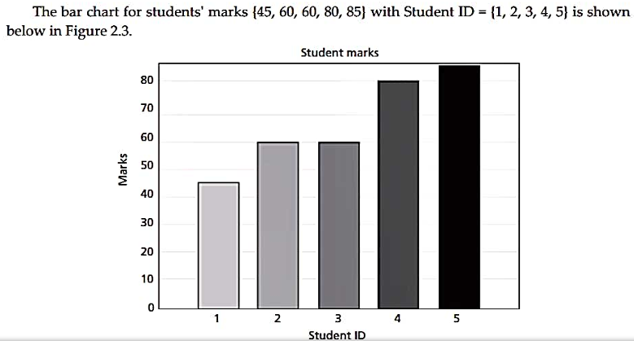
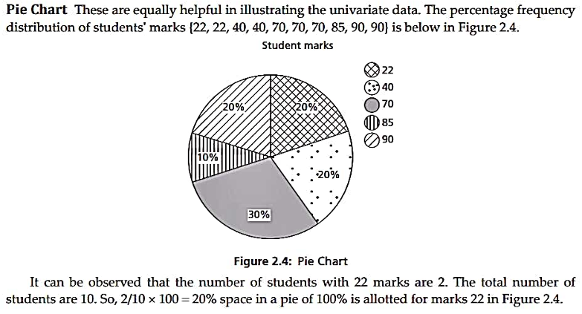
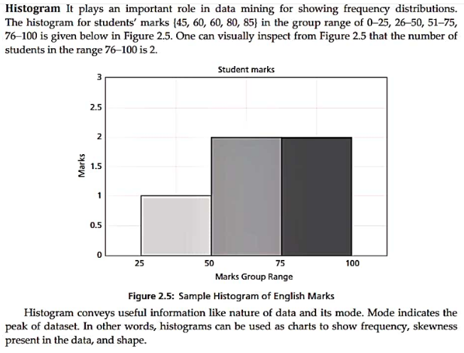
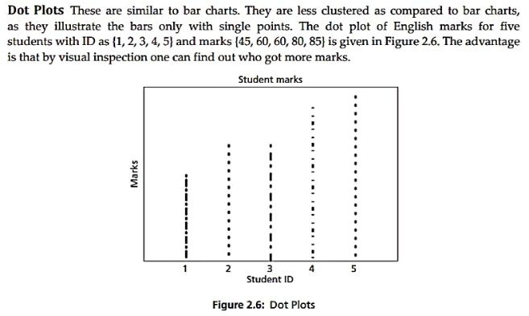

Slide 53

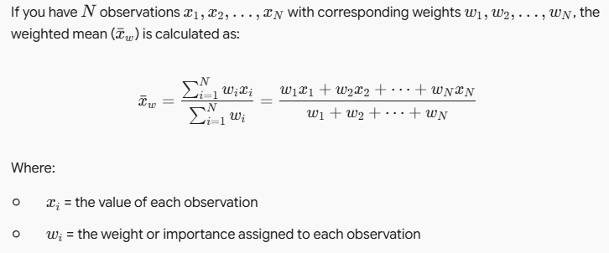
2.5.2 Central Tendency
Central Tendency Overview: Condensing or summarizing data makes analysis and comparisons easier. Mass data tends to concentrate near a central location, known as a measure of central tendency or averages (the "first order of measures"). The most popular measures are mean, median, and mode.
Arithmetic Mean:
Represents the 'center' of the dataset and is commonly used in everyday contexts (e.g., average income, average traffic).
Calculated by adding all data values and dividing the sum by the total number of observations (N).
Formula:
Weighted Mean: Unlike the standard arithmetic mean (which weights all items equally), a weighted mean assigns different levels of importance/weightage to different items depending on their relative importance.

Slide 54
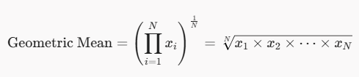
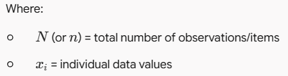
Logarithmic / Anti-log Formula (for larger datasets): Because multiplying many numbers can be difficult, the geometric mean is commonly calculated using logarithms:

Slide 55
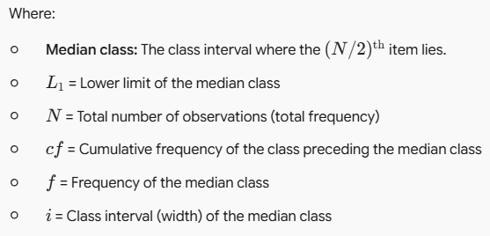

The Median is the middle value in a distribution, dividing the dataset into two equal halves where half the values are lower and half are higher.
Basic Rules (Ungrouped Data)
Odd number of items (N is odd): The median is the exact middle value.
Even number of items (N is even): The median is the average (mean) of the two central values.
Continuous / Grouped Data Formula
For continuous data grouped into classes, the median is calculated using:

Slide 56
Mode
It is the value that occurs most frequently in a dataset (the value with the highest frequency).
It applies strictly to discrete data and is not used for continuous data since continuous data lacks repeated values.
Calculate the frequencies of all individual values; the value (or values) with the highest frequency is the mode.
2.5.3 Dispersion
Dispersion is the spread of a set of data around its central tendency (mean, median, or mode).
Measures of dispersion are second-order measures. Common representations include range, variance, standard deviation, and standard error.
Range: The difference between the maximum and minimum values in a given set of data.
Standard Deviation: The average distance from the mean of the dataset to each data point. It helps measure the spread of data, which the mean alone does not capture (e.g., 10, 20, 30 and 10, 50, 0 both have a mean of 20, but different spread).

Slide 57

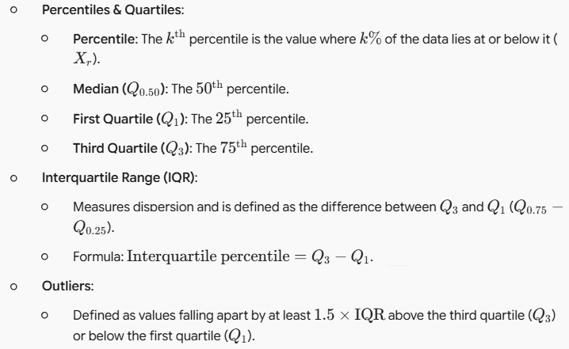
N represents the size of the population, Xi is an observation from the population, and mean is the population mean.

Slide 58
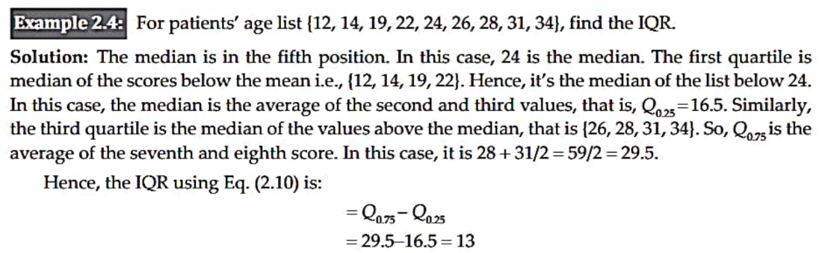
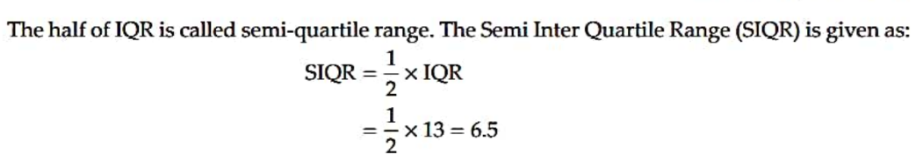

Slide 59
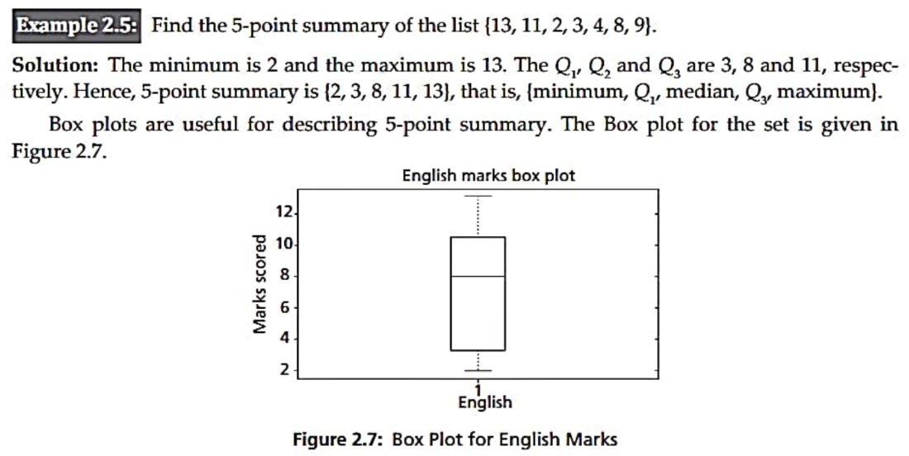

Slide 60
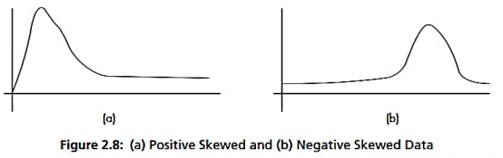
2.5.4 Shape:
Skewness and Kurtosis (referred to as moments) indicate the symmetry/asymmetry and peak location of a dataset.
Skewness:
Order: Measures of direction and degree of symmetry are called third-order measures.
Ideal Value: In an ideal normal distribution, skewness should be zero.
Symmetry in Datasets: More often than not, a given dataset does not display perfect symmetry.

Slide 61
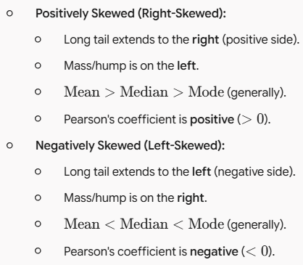

Slide 62
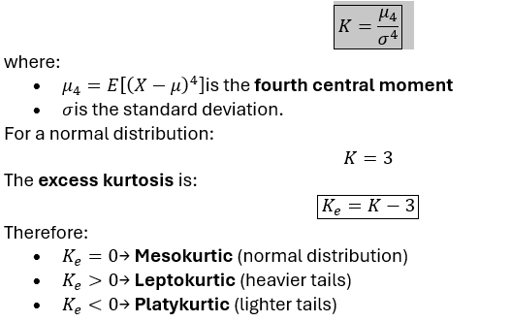
Kurtosis
The population kurtosis is given by:
Kurtosis describes the shape of a distribution by indicating the heaviness of its tails and the likelihood of extreme observations compared with a normal distribution.

Slide 63
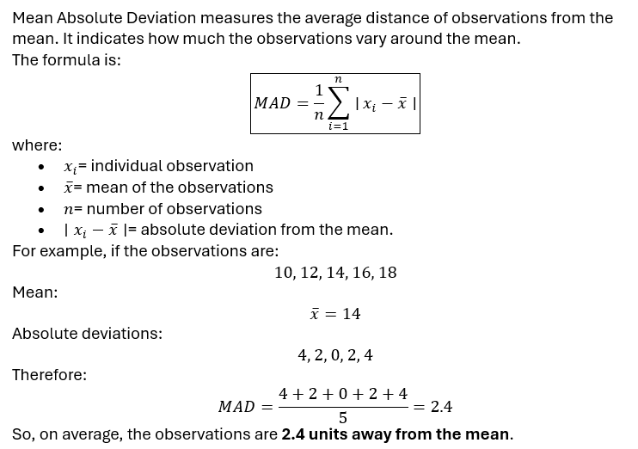
Mean Absolute Deviation (MAD)

Slide 64

Coefficient of Variation (CV)
Coefficient of Variation measures the relative variability of a dataset with respect to its mean. It is particularly useful for comparing the variability of datasets having different units or different means.

Slide 65
2.5.5 Special Univariate Plots
Univariate plots are graphical methods used to study one variable at a time. In addition to common plots such as histograms and box plots, several specialized plots are useful for understanding the distribution, spread, skewness, and unusual observations of a single variable.
Stem-and-Leaf Plot
  Displays individual numerical observations while preserving their original values.
  Useful for small or moderately sized datasets.
  Helps identify the center, spread, clusters, and outliers.
Example:
Data = 12, 13, 15, 16, 21, 22, 25
Stem-and-Leaf Plot
1 | 2 3 5 6
2 | 1 2 5

Slide 66

Q–Q Plot (Quantile–Quantile Plot)
A Q–Q plot is a special univariate plot used to determine whether a dataset follows a particular theoretical distribution, most commonly the normal distribution.
A Q–Q plot compares:
X-axis: Theoretical quantiles expected from a normal distribution
Y-axis: Observed/sample quantiles obtained from the dataset
Example
Suppose the observed data is:
10, 12, 13, 15, 16, 18, 20, 21, 23, 25
The observations are first arranged in ascending order and compared with the corresponding theoretical normal quantiles.
y=x
(-1.5,-1.4)
(-1,-1.1)
(-0.5,-0.4)
(0,0.1)
(0.5,0.6)
(1,1.0)
(1.5,1.4)
A simplified Q–Q plot may look like this:

Slide 67


2.6 Bivariate Data and Multivariate Data
Bivariate data is a type of data that consists of two variables measured for the same set of observations. It is mainly used to study the relationship or association between the two variables.
Example:
a. House area → House price
b. Study Hours —> Marks
A scatter plot and Line graph is a graphical method used to visualize bivariate data. Each observation is represented by a point:

Slide 68
Multivariate Data
Multivariate data consists of three or more variables measured or observed for the same set of individuals, objects, or observations.
It is used when we want to study the relationship between multiple variables simultaneously.
Example:
Suppose information about students is collected:
Here we have four variables:
Hours Studied
Attendance
Assignment Score
Examination Marks
Therefore, this is multivariate data.
Student | Hours Studied | Attendance (%) | Assignment Score | Marks
A | 2 | 70 | 60 | 45
B | 3 | 75 | 65 | 50
C | 4 | 80 | 72 | 60
D | 5 | 90 | 85 | 68
E | 6 | 95 | 90 | 75

Slide 69
Feature | Bivariate Data | Multivariate Data
Meaning | Data involving two variables | Data involving three or more variables
Number of variables | Exactly 2 | 3 or more
Main purpose | Study the relationship between two variables | Study relationships among multiple variables
Example | Height and weight | Height, weight, age, and blood pressure
Typical analysis | Correlation, covariance, simple linear regression | Multiple regression, PCA, clustering, multivariate analysis
Common visualization | Scatter plot | Pair plot, heatmap, 3D scatter plot, parallel coordinates
Example in ML | Hours studied → Marks | Hours studied + Attendance + Previous marks → Final marks

Slide 70



Bivariate statistics: Covariance
Covariance and correlation are examples of bivariate statistics. Covariance is a measure of the joint probability of random variables (such as X and Y) and is used to measure the variance between two dimensions.

Slide 71
Correlation:
Correlation is a statistical measure that quantifies the strength and direction of a linear relationship between two variables. While covariance indicates whether two variables change together, correlation standardizes this measure—scale-independent and bounded—making it easy to evaluate how strongly the variables are related.
1. Direction of Correlation
The direction describes how one variable changes relative to another:
Positive Correlation: As one variable increases, the other variable tends to increase as well (e.g., study time and exam scores).
Negative Correlation: As one variable increases, the other tends to decrease (e.g., speed of a car and travel time to a destination).
Zero Correlation: Changes in one variable show no linear relation to changes in the other (e.g., shoe size and intelligence quotient).

Slide 72



2. The most common measure of linear correlation is the Pearson correlation coefficient (r). It normalizes the covariance of two variables by the product of their standard deviations.
4. A foundational rule in statistics is that correlation does not imply causation:
High correlation simply means two variables move together predictably.
It does not mean that changes in one variable cause changes in the other; the relationship may be coincidental or driven by a third, unseen variable (a confounding factor).

Slide 73
Solved exercises on correlation and covarience

Slide 74
2.7 Multivariate Statistics
Multivariate statistics is a branch of statistics that deals with the simultaneous analysis of two or more variables for each observation.It helps us understand the relationships, patterns, dependencies, and combined effects among multiple variables.
Example:
We have four variables:
Study Hours
Attendance
Assignment Score
Exam Score
Since more than two variables are analyzed together, this is multivariate data, and statistical methods used to analyze it are called multivariate statistics.

Slide 75


Heatmap
Pair Plot
Combine scatter plots and distributions
Display correlations or values using intensity

Slide 76
END OF UNIT-1

