Slide 1
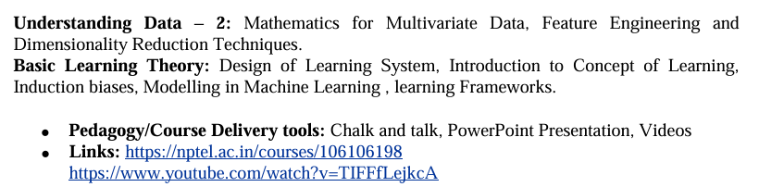
UNIT-2

Slide 2
Understanding Data – 2:
2.8 Mathematics for Multivariate Data
2.8.1 Linear Systems and Gaussian Elimination for Multivariate Data
2.8.2 Matrix Decompositions
2.8.3 Machine Learning and Importance of Probability and Statistics
Probability Distributions
Density Estimation
2.10 Feature Engineering and Dimensionality Reduction Techniques
Basic Learning Theory:
3.3 Design of Learning System
3.4 Introduction to Concept of Learning Induction biases
Modelling in Machine Learning
learning Frameworks
Topics to be covered in UNIT-2

Slide 3
2.8 ESSENTIAL MATHEMATICS FOR MULTIVARIATE DATA.
Mathematical concept | Importance in multivariate data
Vectors | Represent individual observations
Matrices | Represent complete datasets
Mean vector | Represents multivariate center
Variance | Measures individual-variable spread
Covariance | Measures joint variation
Covariance matrix | Represents variance and covariance relationships
Correlation | Measures standardized linear relationships
Standardization | Places variables on comparable scales
Distance | Measures similarity/dissimilarity
Dot product | Used for projections and linear models
Matrix operations | Support multivariate calculations
Determinant & inverse | Important for matrix-based methods
Eigenvalues/eigenvectors | Fundamental to PCA
Probability distributions | Model uncertainty and relationships
Multivariate normal distribution | Important theoretical distribution
Mathematical foundations required for handling multivariate data in machine learning:
Machine learning relies heavily on linear algebra, statistics, probability, and information theory.
Linear algebra serves as the fundamental language of data. It handles key components such as linear equations, vectors, matrices, vector spaces, and transformations, which form the bedrock of machine learning algorithms.

Slide 4
2.8.1 Linear Systems and Gaussian Elimination for Multivariate Data
If there is a unique solution, then the system is called consistent independent. If there are various solutions, then the system is called consistent dependant. If there are no solutions and if the equations are contradictory, then the system is called inconsistent.
For solving large number of system of equations, Gaussian elimination can be used. The procedure for applying Gaussian elimination is given as follows:
Gaussian elimination is a systematic method for solving a system of linear equations.
The basic idea is to transform the equations into an upper triangular form and then solve them using back substitution.
Steps
Write the equations as an augmented matrix.
Select a pivot element.
Eliminate the variables below the pivot.
Continue for the remaining rows.
Obtain an upper triangular matrix.
Use back substitution to find the unknowns.
To facilitate the application of Gaussian elimination method, the following row operations are applied:
Swapping the rows
Multiplying or dividing a row by a constant
Replacing a row by adding or subtracting a multiple of another row to it

Slide 5
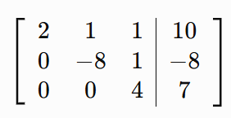

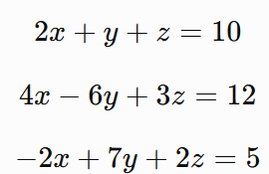



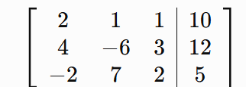
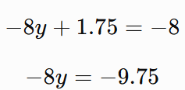

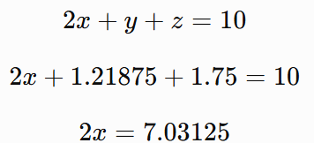
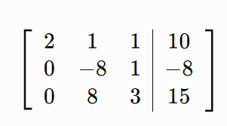
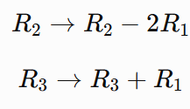
Example of Gaussian Elimination
Eliminate y
Consider:
Now the matrix is in upper triangular form.
Back Substitution
From the third equation:
Write the augmented matrix
From the second equation:
Substitute z=1.75
Eliminate x
From the first equation:
Thus, the solution is approximately:

Slide 6
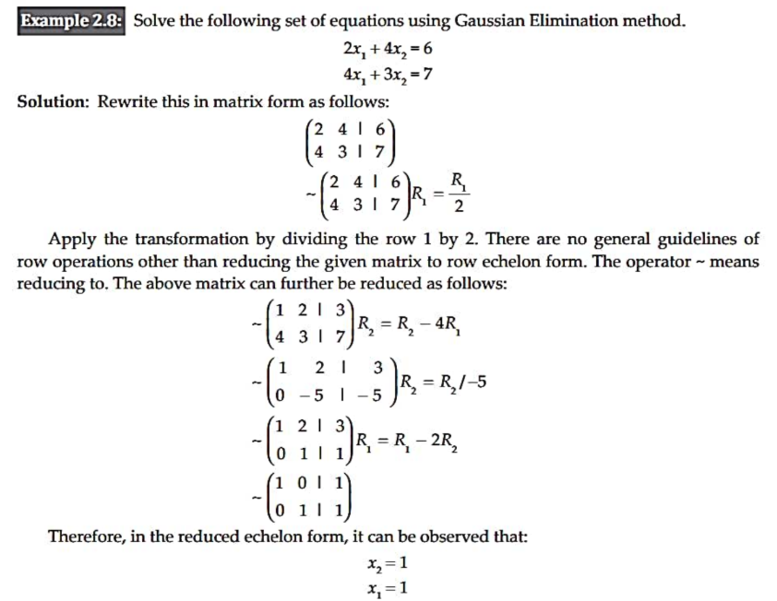

Slide 7
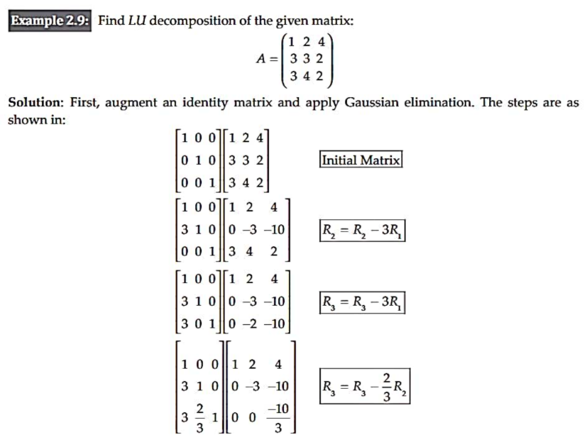
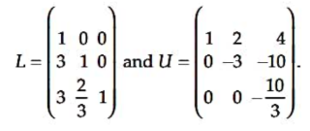
2.8.2 Matrix Decompositions
Matrix decomposition means breaking a matrix into two or more simpler matrices. These simpler matrices make it easier to solve mathematical and computational problems.
One important decomposition is LU decomposition.
It can be cross verified that the multiplication of LU yields the original matrix A

Slide 8
2.8.3 Machine Learning and Importance of Probability and Statistics
Statistics and probability form a core foundation of machine learning, serving an essential role alongside linear algebra to enable effective data analysis.
Data Modeling & Probability Distributions: Datasets in machine learning are viewed as outcomes of probability distributions. Because real-world data often stems from various overlapping distributions, understanding random variables and probability distributions is crucial for mastering machine learning models.
Hypothesis and Model Evaluation: Machine learning relies heavily on statistical concepts to formulate hypotheses, construct algorithms, assess model performance through hypothesis testing, and measure statistical significance.
Dataset Construction: Sampling theory plays a vital role in designing and building representative datasets for training and testing models.

Slide 9
Probability Distributions
A probability distribution summarizes the probabilities associated with a variable's (say X) events, acting as a parameterized mathematical function that describes relationships between observations in a sample space. Data is said to follow a distribution if it obeys the mathematical function characterizing it, which allows calculating the probability of individual observations.
Types of Probability Distributions
Discrete probability distribution
Continuous probability distribution
Probability Density Function (PDF): Summarizes continuous probability distributions, calculates the probability of observing an instance, and displays the shape of the distribution when plotted.
Cumulative Distributive Function (CDF): Computes the probability of an observation being less than or equal to a value . It is also defined by calculating the area under the curve for a small interval around a specific outcome.
Both PDF and CDF yield continuous values.
The discrete equivalent of PDF in a discrete distribution is called the Probability Mass Function (PMF).

Slide 10
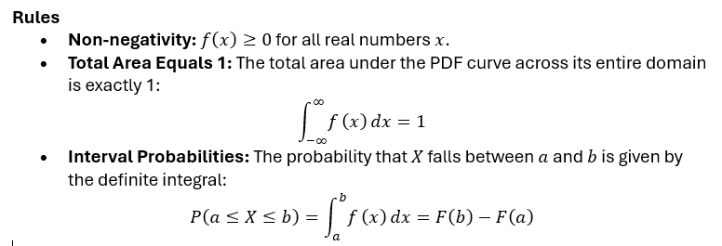

Continuous distribution:
A continuous distribution describes a random variable whose possible outcomes fall along a continuous spectrum or interval of real numbers (such as height, weight, time, or temperature), rather than isolated points.
Unlike discrete variables, the probability of a continuous random variable taking on an exact single value is always zero (P(X=c)=0). Instead, probabilities are calculated for intervals of values (e.g., P(a≤X≤b)) by finding the area under a curve.
Probability Density Function (PDF): Denoted as f(x), it describes the relative likelihood of a random variable taking on a value near x. The height of the curve does not represent probability directly—the area under the curve does.
Cumulative Distribution Function (CDF): Denoted as F(x)=P(X≤x), it measures the total accumulated probability up to x:

Slide 11
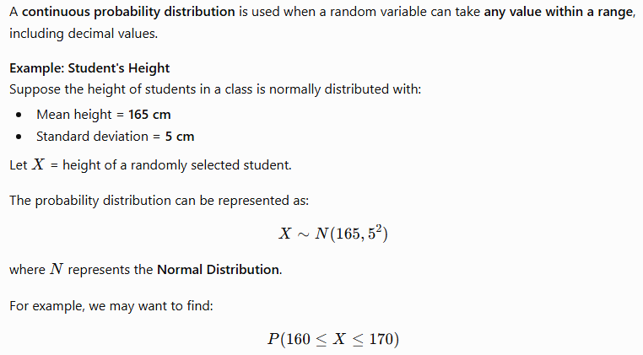
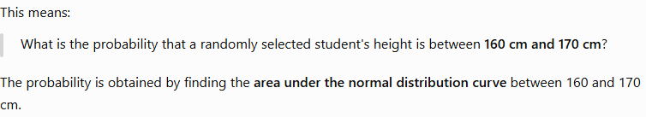

Slide 12
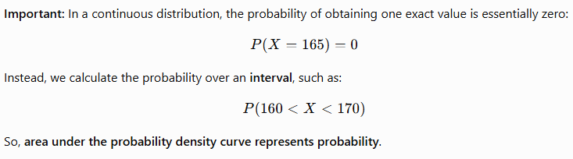
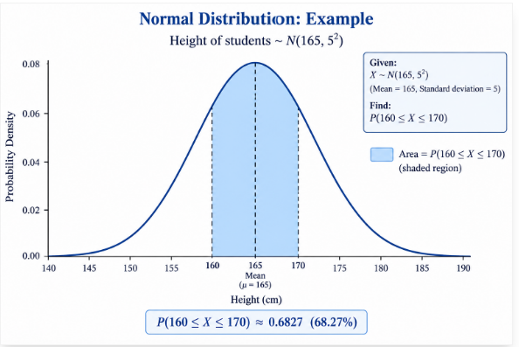

Slide 13
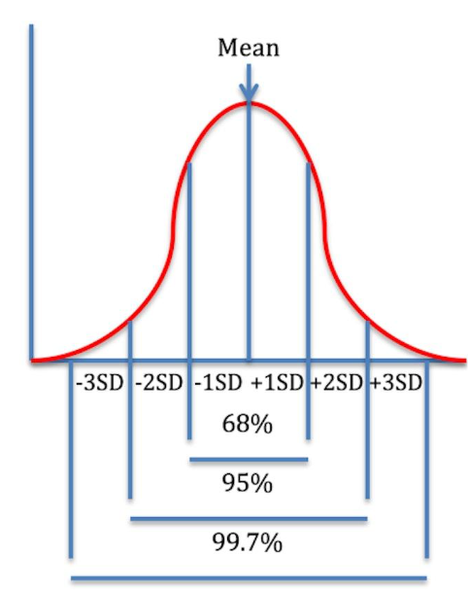
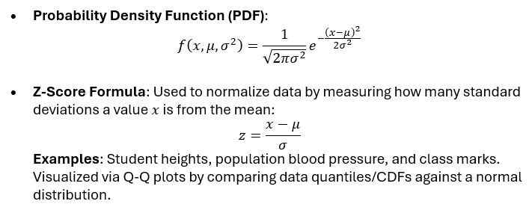
Normal Distribution:
The normal distribution is a continuous probability distribution with a symmetrical, bell-shaped curve where data centers around a central value with no bias to the left or right. In this distribution, the mean, median, and mode are equal, and the domain extends from -∞ to +∞. It is characterized by two parameters: mean (μ) and variance (σ^2) or standard deviation (σ). A standard normal distribution uses a mean of 0 and a standard deviation of 1.

Slide 14
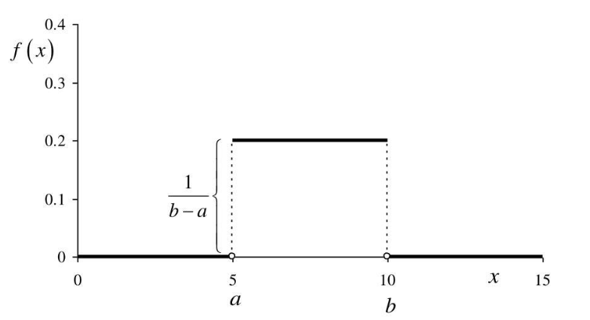


Rectangular Distribution Overview
Also known as the continuous uniform distribution, a rectangular distribution is a symmetric probability distribution where all intervals of equal length within the distribution's range have an equal probability of occurring.Its probability density function (PDF) forms a rectangle, bounded by a minimum value a and a maximum value b
Probability Density Function (PDF):
Commonly used in simulation modeling, random number generation, and scenarios where outcomes are equally likely across a bounded range (such as ideal die rolls or rounding errors).

Slide 15
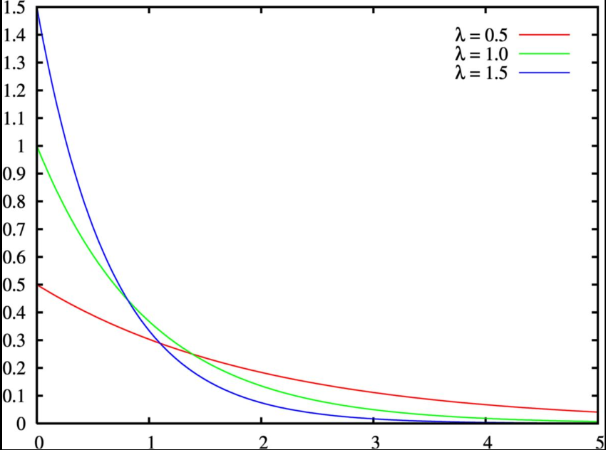
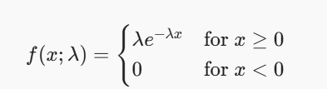
Exponential Distribution:
A continuous probability distribution used to model the time or space between Poisson point process events (events that occur continuously and independently at a constant average rate).
It is memoryless, meaning the probability of an event occurring in a future time interval depends only on the duration of that interval, not on how much time has already elapsed.
Probability Density Function (PDF):

Slide 16
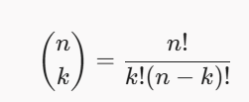

Discrete Distribution:
A discrete distribution is a probability distribution that describes a random variable whose possible outcomes are distinct, separate values (such as integers like 0, 1, 2, 3...) rather than a continuous range.
Unlike continuous variables (like height or weight) which use a Probability Density Function (PDF), discrete variables rely on two foundational mathematical functions:
Probability Mass Function (PMF): Denoted as P(X=x) or p(x), it gives the exact probability that a discrete random variable X equals a specific value x.
Cumulative Distribution Function (CDF): Denoted as F(x)=P(X≤x), it gives the sum of probabilities for all values up to and including x.
Rules
Non-negativity: For every possible value x, P(X=x)≥0.
Total Probability: The sum of all individual probabilities across the entire sample space equals 1:
Binomial Distribution
Binomial distribution is another distribution that is often encountered in machine learning. It has only two outcomes: success or failure. This is also called a Bernoulli trial.
The objective of this distribution is to find the probability of getting ksuccesses out of n trials.
The number of ways to choose k successes out of n trials is given by:
Probability Mass Function (PMF)

Slide 17
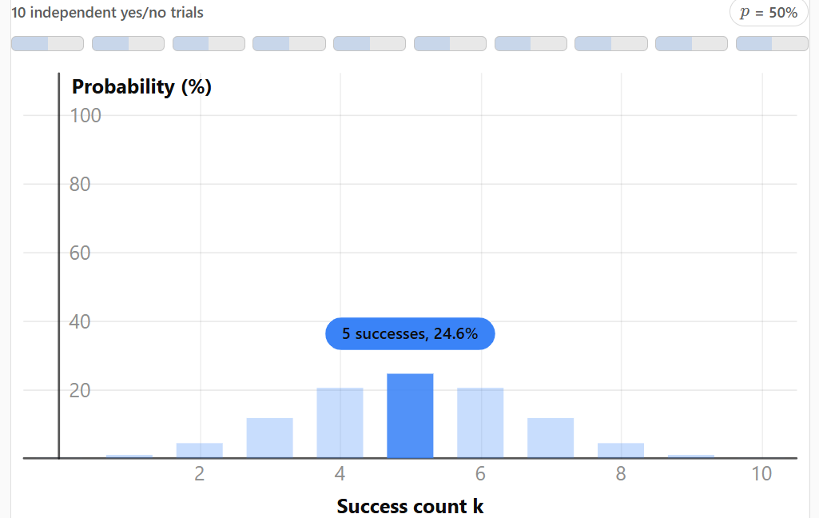

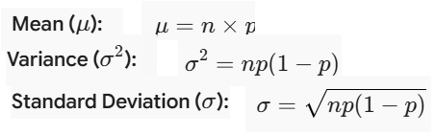
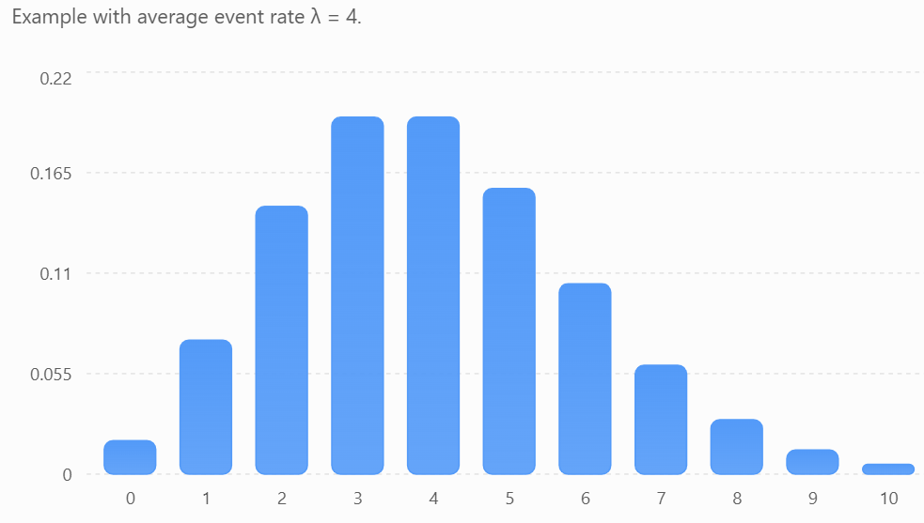

Combining both gives the probability function for a binomial distribution:
Poisson Distribution :
It is another important distribution that is quite useful. Given an interval of time, this distribution is used to model the probability of a given number of events k. The mean rule lambda is inclusive of previous events. Some of the examples of Poisson distribution are number of emails received, number of customers visiting a shop and the number of phone calls received by the office.
The PDF of Poisson distribution is given as follows:
Here, x is the number of times the event occurs and lambda is the mean number of times an event occurs.
The mean is the population mean at number of emails received and the standard deviation is sqrt(lambda)

Slide 18
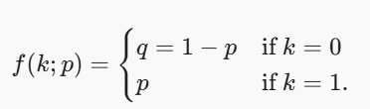
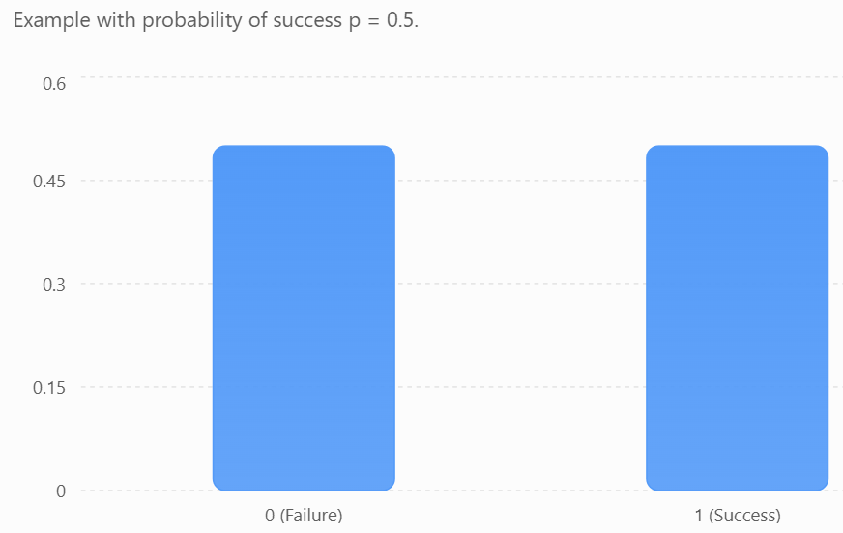
Bernoulli Distribution:
This distribution models an experiment whose outcome is binary. The outcome is positive with p and negative with 1 - p. The PMF of this distribution is given as:
The mean is p and variance is p(1 - p) = q

Slide 19
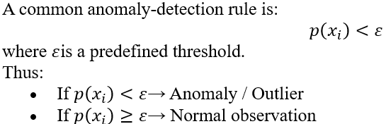
Density Estimation
Suppose we have observed data values
from a larger population whose probability distribution is unknown. Density estimation is the process of estimating the underlying probability density function (PDF) from these observed data values.
The estimated density function is represented by
There are two main approaches:
Type | Basic idea | Distribution assumption
Parametric Density Estimation | Assume a particular probability distribution and estimate its parameters | Distribution is assumed known
Non-Parametric Density Estimation | Estimate the density directly from the observed data | No specific distribution is assumed

Slide 20
Density estimation estimates how frequently or likely different data values are, and very low-density values can be identified as anomalies.
There are two main types:
Parametric Density Estimation
  Assumes that the data follows a particular distribution.
  Example: Gaussian (Normal) distribution.
  Parameters such as mean and variance are estimated from the data.
Non-Parametric Density Estimation
  Does not assume a specific distribution.
  Estimates the density directly from the observed data.
  Examples: Histogram and Kernel Density Estimation (KDE).

Slide 21
2.10 FEATURE ENGINEERING AND DIMENSIONALLY REDUCTION TECHNIQUES
PCA and LDA algorithm and problems

Slide 22
Basic Learning Theory:
Design of Learning System
Introduction to Concept of Learning
Induction biases
Modelling in Machine Learning
learning Frameworks

Slide 23
Design of Learning System:
Learning is the process of gaining knowledge and skills through study, experience, or teaching.
In Machine Learning (ML), we try to make computers learn from experience/data, similar to how humans learn.
For a computer to learn effectively, the problem should be well-defined (well-posed).
A learning problem consists of three important components:
Task (T) – What the computer has to learn or do.
Performance Measure (P) – How we measure whether the computer is performing well.
Experience (E) – The data or previous examples from which the computer learns.
Tom Mitchell's Definition of Learning
According to Tom Mitchell:
A computer program is said to learn from experience (E) with respect to a task (T) and a performance measure (P) if its performance at task T, as measured by P, improves with experience E.

Slide 24
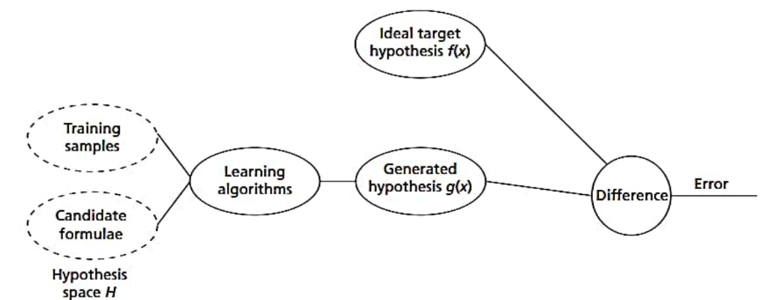

Component | Example
Task (T) | Identify whether an email is spam or not
Performance (P) | Accuracy of classification
Experience (E) | Previously labeled spam and non-spam emails

Slide 25
Some important learning types are:
No. | Learning Type | Simple Meaning | Example
1 | Learning by Memorization (Rote Learning) | Learning by remembering information through repetition, without necessarily understanding the concept. | Memorizing multiplication tables.
2 | Learning by Examples (Inductive Learning) | Learning a general rule or concept by observing several examples or past experiences. | Seeing many spam emails and learning what characteristics indicate spam.
3 | Learning by Being Taught | Learning from a teacher or expert. It can be passive or active, where the learner asks questions to obtain labels or information. | A teacher explaining how a decision tree works.
4 | Learning by Critical Thinking (Deductive Learning) | Using known facts and information to derive a new fact or conclusion. | If all humans are mortal and Ravi is human, concluding that Ravi is mortal.
5 | Self-Learning (Reinforcement Learning) | Learning independently through rewards and punishments based on actions and mistakes. | A robot learns to navigate a room by receiving rewards for reaching the target.
6 | Learning to Solve Problems (Cognitive Learning) | Learning by developing a method or sequence of steps to achieve a particular goal. | Finding the shortest route from one city to another.
7 | Learning by Generalizing Explanations (Explanation-Based Learning – EBL) | Using expert/domain knowledge to understand examples and improve the learning of concepts. | Using a medical expert's knowledge to improve a disease-classification model.

Slide 26
Design of Learning System
A learning system is a system designed around a learning algorithm so that it can learn from experience and improve its performance.
The design of a learning system generally involves four main steps:
Choosing a Training Experience
Choosing a Target Function
Representing the Target Function
Function Approximation

Slide 27
1. Choosing a Training Experience
The first step is deciding what experience or data the system will learn from.
Example: Chess Game
Suppose we want to build a machine learning system that learns to play chess.
There are two ways to provide training experience:
Direct experience
The system is directly given chess board positions and the correct moves.
Example:
Board position → Best move
Indirect experience
The system is given the sequence of moves and the final result of the game.
The system learns which moves were good or bad based on the result.
For example:
Game → Win → Learn which moves contributed to winning.
If a supervisor/expert is available, the expert can label the correct moves.
If there is no supervisor, the chess program can play against itself and learn from the results.

Slide 28
2. Choosing the Target Function
The target function specifies what the learning system should learn.
In simple words:
Target function = The desired output that the learning system tries to predict.
Chess Example
The system needs to decide:
"Is this a good move or a bad move?"
3. Determining the Target Function Representation
After deciding what to learn, we must decide how to represent the knowledge.
The target function can be represented using:
Tables
Rules
Decision trees
Neural networks
Mathematical equations
Example: Linear Representation
Suppose the chess board has three important features:
x1 = number of useful pieces
x2 = position of pieces
x3 = control of important squares

Slide 29
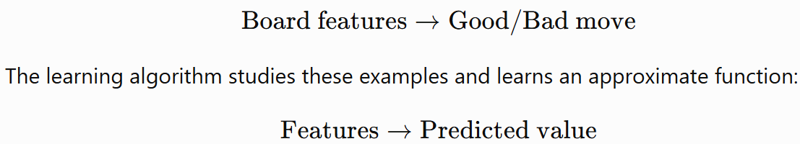
4. Function Approximation
The actual target function may be very complex and may not be known exactly.
Therefore, the learning algorithm tries to approximate the target function using the available training data.
For example:
Training data

Slide 30


Concept learning
Concept learning is an important topic in Machine Learning. It refers to the problem of inferring a Boolean-valued function from training examples.
“Concept learning is the task of learning a general rule (concept) from specific examples.”
OR
“A task of acquiring potential hypothesis(solution) that best fits the given training example.”
A concept is a function that maps an input instance to either:
Positive (Yes / True)
Negative (No / False)
Instance/sample:
An individual example described by attributes.
Example (Weather dataset): Each row = Instance

Slide 31
Hypothesis Space (H)
The set of all possible hypotheses that can be formed using.
Specific values
General value (?)
No value (Ø)
Then the hypothesis space contains all combinations.
Attribute
A property used to describe an instance.
Example:
Sky
Temperature
Humidity
Wind
Hypothesis
A candidate rule that classifies instances as positive or negative.
Example:
If Sky = Sunny AND Temp = Warm → Play = Yes
Goal of Concept Learning
Given:
A set of training examples
Each labeled as Positive or Negative
Find a hypothesis h such that:
h(x)=c(x)
for all training examples
That means:
The hypothesis should correctly classify all training data.

Slide 32
Example: Suppose we want to learn the concept: Days suitable for playing tennis”
Sky | Temp | Play
Sunny | Warm | Yes
Rainy | Cold | No
Sunny | Cold | No
Sunny | Warm | Yes
The learning task is to find a rule like:
If Sky = Sunny AND Temp = Warm → Yes
Else → No
Concept learning can be viewed as a search problem
The search space = Hypothesis Space (H)
Because:
There are many possible hypotheses in H.
We must search through H
To find the hypothesis that best fits the training data.

Slide 33
Hypotheses can be ordered from:
Most General (accepts all instances) <?, ?>
Most Specific (rejects all instances) <Ø, Ø>
The Version Space is the subset of hypotheses that are:
✔ Consistent with all training examples.
It lies between:
S boundary → Most specific hypothesis
G boundary → Most general hypothesis
Searching the Hypothesis Space
General-to-Specific Search: Start with most general hypothesis, gradually specialize it. Used in
Find-S Algorithm
Candidate Elimination Algorithm
Specific-to-General Search: Start with most specific hypothesis, gradually generalize it.

Slide 34
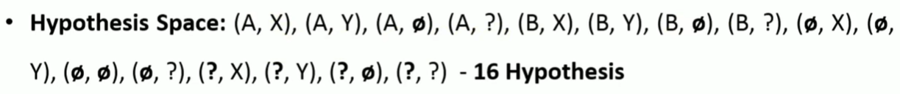
Find the following for the given example:
Consider
Feature1→A ,B
Feature2→X ,Y
Instance space=(A,X),A,Y),(B,X) (B,Y)

Slide 35
Example | Sky | Temp | Humidity | Wind | Play
1 | Sunny | Warm | Normal | Strong | Yes
2 | Sunny | Warm | High | Strong | Yes
3 | Rainy | Cold | High | Strong | No
4 | Sunny | Warm | Normal | Weak | Yes
Find-S Algorithm
Start with the most specific hypothesis:
S0​=<Ø,Ø,Ø,Ø>
This means: Reject all instances initially.
Instance1:
<Sunny, Warm, Normal, Strong>
Since hypothesis is most specific, replace
Ø with attribute values.
<S1=<Sunny,Warm,Normal,Strong>
<Sunny, Warm, High, Strong>
Updated hypothesis:
<S2=<Sunny,Warm,?,Strong>
4. <Rainy, Cold, High, Strong> is a negative sample so Find-s algorithm ignores
<S3​=<Sunny,Warm,?,Strong>
5. <Sunny, Warm, Normal, Weak>
Updated hypothesis:
<S4=<Sunny,Warm,?,?>
6. Sfinal​=<Sunny,Warm,?,?>
The learned concept is:
If Sky = Sunny AND Temperature = Warm → Play = Yes
Humidity and Wind do not matter.

Slide 36
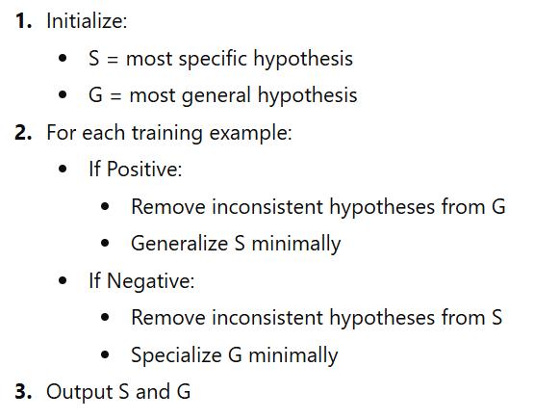
Candidate Elimination Algorithm
The Candidate Elimination Algorithm is an advanced concept learning method that finds all hypotheses consistent with the training data, not just one.
It works by maintaining the Version Space — the set of all consistent hypotheses.
Unlike Find-S (which finds only one hypothesis), Candidate Elimination:
✔ Uses both positive and negative examples
✔ Maintains two boundaries:
S (Specific boundary) → Most specific consistent hypothesis
G (General boundary) → Most general consistent hypothesis
Eliminates inconsistent hypotheses step by step

Slide 37
Candidate elimination algorithm
Example | Sky | Temp | Humidity | Wind | Play
1 | Sunny | Warm | Normal | Strong | Yes
2 | Sunny | Warm | High | Strong | Yes
3 | Rainy | Cold | High | Strong | No
4 | Sunny | Warm | Normal | Weak | Yes
Most Specific Hypothesis:
S0 = <Ø, Ø, Ø, Ø>
Most General Hypothesis:
G0=<?,?,?,?>
Instance-3:<Rainy, Cold, High, Strong>
Instance-1: <Sunny, Warm, Normal, Strong>
S0 = <Ø, Ø, Ø, Ø>
Replace Ø with values:
S1=<Sunny,Warm,Normal,Strong>
Now we update G, not S.
We must specialize G so it does NOT cover this negative example.
Current: G2=<?,?,?,?>
To exclude <Rainy, Cold, High, Strong>, we specialize attributes one by one:Possible minimal specializations:
<Sunny, ?, ?, ?>
<?, Warm, ?, ?>
<?, ?, Normal, ?>
<?, ?, ?, Weak>
G1​=<?,?,?,?> no change
2. Instance-2: <Sunny, Warm, High, Strong>
Compare with S₁:
<S2​=<Sunny,Warm,?,Strong>
Remove hypotheses inconsistent with this positive example.
Current G still consistent → No change.
G2​=<?,?,?,?>

Slide 38
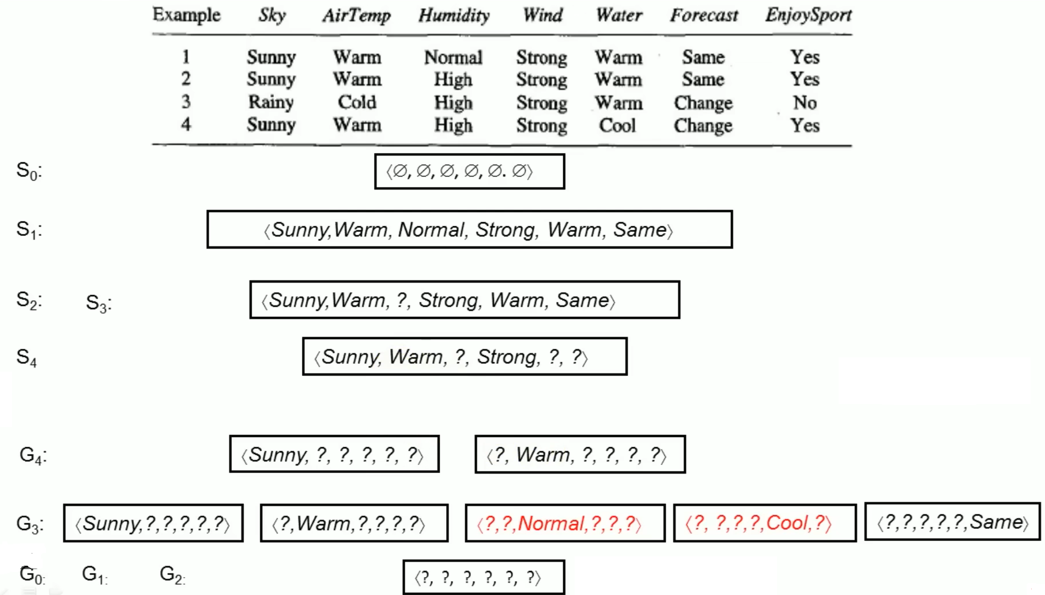
Problem-1

Slide 39
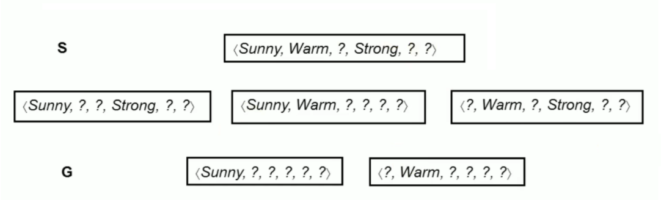

Slide 40
Induction biases
Induction is a process of learning a target function or generalizing training data into a general model.
Inductive bias is the set of prior assumptions considered by a learning algorithm beyond the training data, in order to perform induction. It is also called the bias of the algorithm and is similar to prior knowledge used for learning new concepts.

Slide 41
1. Bias
Bias is the error caused when a model is too simple and makes strong assumptions about the data.
High bias → Underfitting
The model performs poorly on both training and test data.
Example: Using a straight line (linear regression) to model a highly complex curved relationship.
Bias is the error due to a model being too simple to capture the actual pattern in the data.
2. Variance
Variance is the error caused when a model is too sensitive to the training data.
High variance → Overfitting
The model performs very well on training data but poorly on unseen/test data.
Example: A very deep decision tree that memorizes the training examples.
Variance is the error due to a model changing too much when the training data changes.

Slide 42
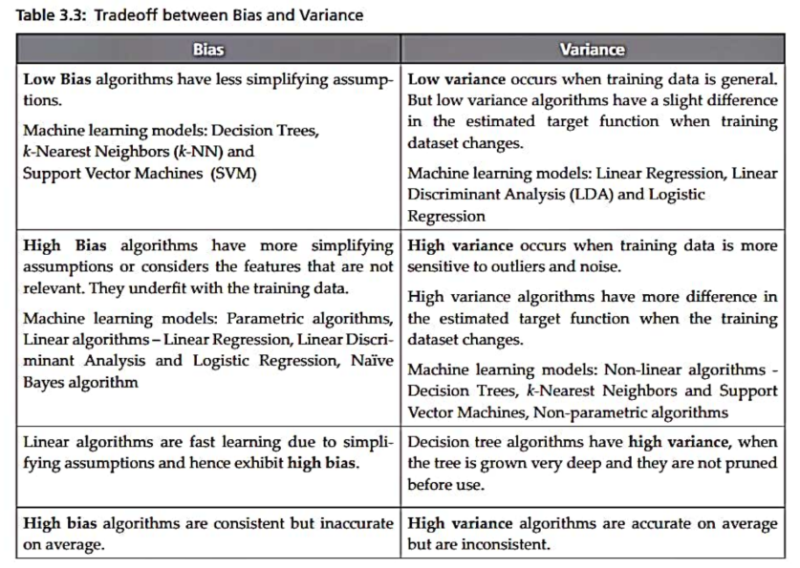
Bias variance tradeoff

Slide 43
Modelling in Machine Learning
Model selection and model evaluation
Resampling methods
The main resampling methods are:
Holdout Method
Random Subsampling
Cross-Validation
  k-Fold Cross-Validation
  Stratified k-Fold Cross-Validation
  Leave-One-Out Cross-Validation (LOOCV)
  Leave-P-Out Cross-Validation
Bootstrap Sampling
Repeated Cross-Validation

Slide 44
learning Frameworks
A learning framework is a systematic process of collecting data, preparing it, learning patterns using an algorithm, evaluating the learned model, and using it to make predictions.

Slide 45
END OF UNIT-2

