Slide 1
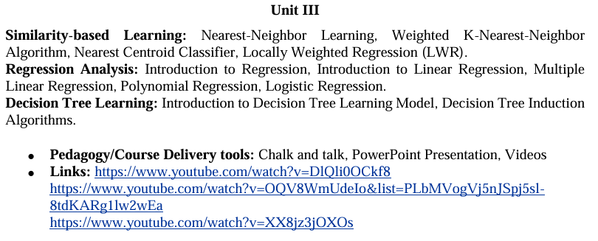
UNIT-3

Slide 2
Theory and Problems on K-Nearest neighbor

Slide 3
Theory and Problems on Linear and multiple linear

Slide 4
Theory and Problems on logistic regression and multinomial logistic regression

