Slide 1
Unit II
Research Design

Slide 2
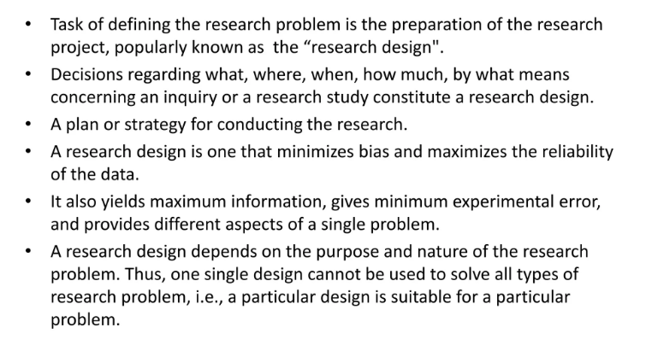
Research Design

Slide 3
Research Design
What is the study about?
Why is the study being made?
Where will the study be carried out?
What type of data is required?
Where can the required data be found?
What periods of time will the study include?
What will be the sample design?
What techniques of data collection will be used?
How will the data be analyzed?
In what style will the report be prepared?

Slide 4
Research Design
Sampling Design: Method of selecting items to be observed for the given study
Observational Design: Conditions under which observation must be made
Statistical Design: How many data items to be observed? How information / data gathered has to be analysed?
Operational Design: Techniques by which procedures specified in sampling, statistical and observational designs can be carried out.

Slide 5
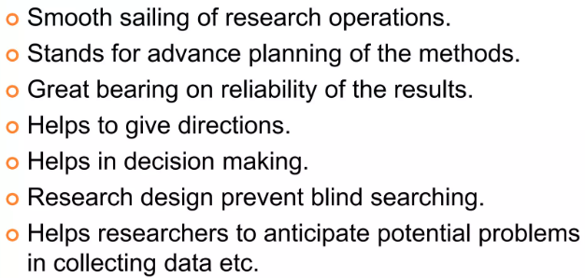
Need of research design

Slide 6
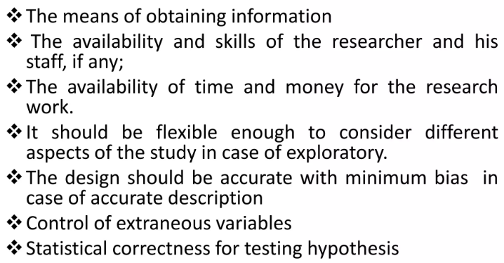
Features of a Good Design

Slide 7
Features of a Good Design
Research design involves consideration of following factors:
Means of obtaining information
Availability and skills of researcher and his staff
Objective of the problem to be studied
Nature of the problem to be studied
Availability of time and money
Exploratory / Formulative -> Research design must be flexible to permit consideration of many aspects of the phenomenon
Hypothesis > Minimization of bias and maximization of reliability.

Slide 8
Concepts relating to research design
Variables
Dependent variables and independent variables
Extraneous variables and confounded variables
Research Hypothesis
Null and Alternate hypothesis
Directional and Non directional hypothesis
Experimental and Control groups
Treatments

Slide 9
Term | Role | Example
Dependent Variable (DV) | Measured outcome | Model accuracy (%)
Independent Variable (IV) | Factor manipulated | Training dataset size
Extraneous Variable | Uncontrolled factor, may affect DV | Learning rate, data quality
Confounded Variable | Extraneous variable linked to IV | Using advanced model for larger dataset

Slide 10
Variables
Any characteristics which is subject to change and can have more than one value. They play a crucial role in formulating hypotheses, designing experiments, and interpreting results.
Example: intelligence, motivation, age, gender
Quantitative phenomena characterized by presence / absence of attributes
Continuous and discrete variables

Slide 11
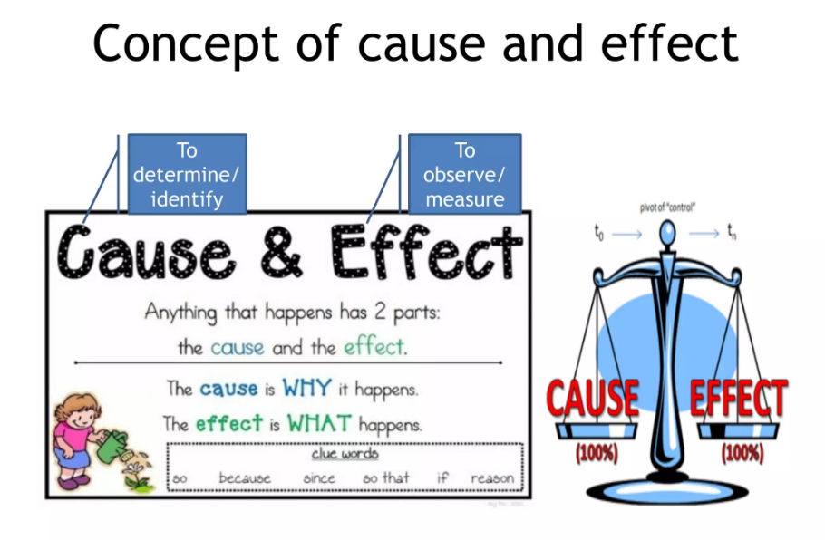

Slide 12
Types of Variables
Independent Variables
Independent variables are the factors that researchers manipulate or control in an experiment to observe their effect on the dependent variable. They are considered the "cause" in a cause-and-effect relationship.
Types:
1.Experimental Independent Variables: These are directly manipulated by the researcher (e.g., dosage of a drug).
2.Subject Variables: These are characteristics of the subjects that cannot be manipulated but can categorize participants (e.g., age, gender)
Dependent Variables
Dependent variables are the outcomes or effects that researchers measure in response to changes in the independent variable. They are considered the "effect" in a cause-and-effect relationship.
Characteristics: The values of dependent variables depend on the variations of independent variables.
Examples include test scores, growth measurements, or behavioral responses

Slide 13
Extraneous Variables
Extraneous variables are any variables other than the independent variable that could influence the dependent variable. These can introduce noise into the experiment and potentially confound results if not controlled.
Examples: Environmental factors (temperature, lighting)
Participant characteristics (mood, fatigue)
Experimental conditions (time of day when measurements are taken)
Whatever effect is noticed on dependent variable as a result of extraneous variable(s) is technically described as an ‘experimental error’. A study must always be so designed that the effect upon the dependent variable is attributed entirely to the independent variable(s), and not to some extraneous variable or variables
Confounded Variables
Confounded variables occur when two or more variables are intertwined in such a way that their individual effects on the dependent variable cannot be separated. This can lead to misleading conclusions about relationships between variables.
Characteristics: Confounding occurs when an extraneous variable correlates with both the independent and dependent variables.
Example include a study examines the effect of a new teaching method on student performance but does not control for prior knowledge, then prior knowledge becomes a confounding variable.

Slide 14
Importance of Variables in Research
Understanding variables is essential for several reasons:
Hypothesis Development: Clearly defined variables help in formulating testable hypotheses.
Experimental Design: Knowledge of how to manipulate and measure variables is crucial for designing effective experiments.
Data Analysis: Identifying variable types informs appropriate statistical analyses and interpretation of results.

Slide 15
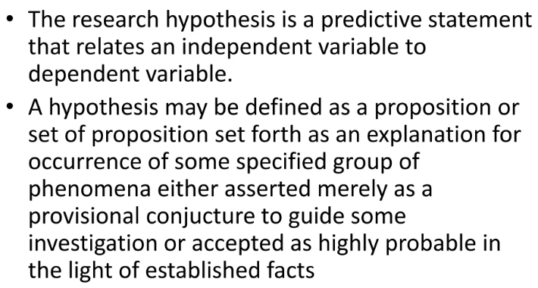
Research Hypothesis

Slide 16
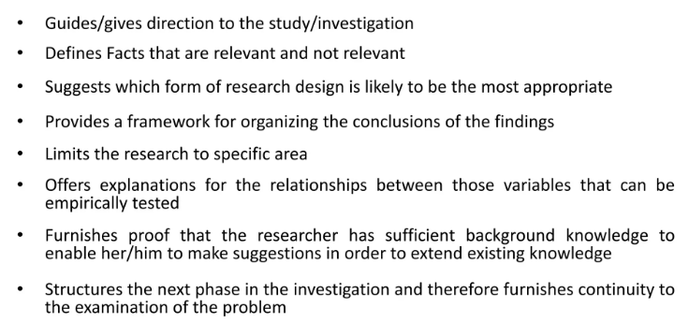
Purpose of hypothesis

Slide 17
Types of hypothesis
Based on formulation: Null and Alternate hypothesis
Based on direction: Directional and non directional hypothesis

Slide 18
Null and Alternative Hypotheses
Null Hypothesis (H₀):The null hypothesis is a statement asserting that there is no effect, no difference, or no relationship between variables in a population. It serves as a default position that researchers aim to test against.
Example: In a study examining the effect of a new drug on blood pressure, the null hypothesis might state that the mean blood pressure of patients taking the drug is equal to that of those not taking it (H₀: μ₁ = μ₂).
Alternative Hypothesis (H₁ or Hₐ):The alternative hypothesis is a statement that contradicts the null hypothesis, suggesting that there is an effect, a difference, or a relationship present. It represents what the researcher aims to support through evidence.
Example: Continuing with the drug study, the alternative hypothesis could state that the mean blood pressure of patients taking the drug is different from that of those not taking it (H₁: μ₁ ≠ μ₂).

Slide 19
Directional and Non-Directional Hypotheses
Directional Hypothesis: A directional hypothesis specifies the expected direction of the relationship or effect between variables. It indicates whether one variable is expected to be greater than or less than another.
Example: In the context of the drug study, a directional hypothesis might state that patients taking the new drug will have lower blood pressure than those not taking it (H₁: μ₁ < μ₂).
Non-Directional Hypothesis: A non-directional hypothesis does not specify a direction; it simply states that there is a difference or effect without indicating whether it is positive or negative.
Example: Using the same drug study, a non-directional hypothesis would assert that there is a difference in mean blood pressure between patients taking the drug and those not taking it (H₁: μ₁ ≠ μ₂).

Slide 20
Importance of hypothesis in Research
Understanding these hypotheses is crucial for conducting statistical tests and interpreting research findings effectively.
Null Hypothesis (H₀): Assumes no effect or relationship exists.
Alternative Hypothesis (H₁): Suggests an effect or relationship exists.
Directional Hypothesis: Predicts the direction of the effect (greater than or less than).
Non-Directional Hypothesis: Indicates there is a difference but does not specify direction.

Slide 21
Treatment
Treatment is what is administered to participants or experimental units in an experiment. It can take various forms, such as a drug, therapy, educational program, or any other intervention that is hypothesized to have an effect.
The different conditions under which experimental and control groups are put are usually referred to as ‘treatments’

Slide 22
Experimental and Control Groups
Experimental and control groups are foundational elements in research design. The experimental group allows researchers to test hypotheses by applying treatments, while the control group provides a reference point for evaluating those effects.
Together, they enable rigorous testing of theories and contribute to reliable scientific conclusions.
In an experimental hypothesis-testing research when a group is exposed to usual conditions, it is termed a ‘control group’, but when the group is exposed to some novel or special condition, it is termed an ‘experimental group’. In the above illustration, the Group A can be called a control group and the Group B an experimental group. If both groups A and B are exposed to special studies programmes, then both groups would be termed ‘experimental groups.’

Slide 23
Does a new drug reduce blood pressure?
Experimental Variable (IV): Type of drug given (new drug vs placebo).
Dependent Variable (DV): Patient’s blood pressure.
Control Variables: Patient’s diet, exercise routine, room temperature during testing, measurement method.
Does dataset size improve AI model accuracy?
Experimental Variable (IV): Dataset size (10k, 50k, 100k images).
Dependent Variable (DV): Model accuracy.
Control Variables: Same model architecture, same optimizer, same learning rate, same evaluation dataset

Slide 24
Experimental Group
The experimental group is the group of subjects that receives the treatment or intervention being tested. This group is exposed to the independent variable to observe its effects on the dependent variable.
Characteristics:
Treatment Application: Members of the experimental group experience changes or interventions that are hypothesized to affect outcomes.
Comparison Basis: The results from this group are compared against those from the control group to determine the effectiveness of the treatment.
Example: In a clinical trial testing a new medication, the experimental group would receive the actual drug being studied.

Slide 25
Control Group
The control group is a separate group that does not receive the treatment or intervention. Instead, it serves as a baseline to compare against the experimental group.
Characteristics:
No Treatment or Placebo: Members of the control group may receive a placebo or standard treatment, allowing researchers to isolate the effects of the independent variable.
Similarity to Experimental Group: Ideally, control and experimental groups should be identical in every way except for the treatment being tested. This ensures that any differences in outcomes can be attributed to the treatment.
Example: In clinical trial, the control group might receive a placebo pill that has no therapeutic effect.

Slide 26
Importance of Experimental and Control Groups
Establishing Causality: By comparing outcomes between groups, researchers can determine whether changes in the dependent variable are due to the independent variable.
Reducing Bias and Variability: Control groups help mitigate confounding variables and biases, enhancing the validity of findings.
Benchmarking Results: The control group provides a standard against which researchers can measure changes observed in the experimental group.

Slide 27
Types of Treatments
Experimental Treatments: These are the new or modified interventions being tested (e.g., a new medication).
Control Treatments: These may include standard treatments, placebos, or no treatment at all, used for comparison against the experimental treatments.
Purpose
The primary goal of applying treatments is to determine their effect on the outcome of interest (the dependent variable). By comparing the results from treatment groups to control groups, researchers can assess whether the treatment has a significant impact.

Slide 28
Design Considerations:
Researchers must carefully design the treatment conditions, including dosage, duration, and delivery method, to ensure valid and reliable results.
Random assignment of treatments helps minimize bias and confounding variables, enhancing the internal validity of the study.
Measurement:
Outcomes are typically measured before and after treatment application (pretest and posttest) to evaluate changes attributable to the treatment.

Slide 29
Example of Treatment in Research
In a clinical trial evaluating the effectiveness of a new drug for hypertension:
Treatment Group: Participants receive the new drug.
Control Group: Participants receive a placebo.
Researchers compare blood pressure readings before and after treatment in both groups to determine if the new drug is effective.

Slide 30
Experiment
The process of examining the truth of a statistical hypothesis, relating to some research problem, is known as an experiment.
Experiments can be of two types viz., absolute experiment and comparative experiment.
If we want to determine the impact of a fertilizer on the yield of a crop, it is a case of absolute experiment; but if we want to determine the impact of one fertilizer as compared to the impact of some other fertilizer, our experiment then will be termed as a comparative experiment. Often, we undertake comparative experiments when we talk of designs of experiments.

Slide 31
Experiment Units
The pre-determined plots or the blocks, where different treatments are used, are known as experimental units. Such experimental units must be selected (defined) very carefully.

Slide 32
Experimental Design
Experimental design methods allow the experimenter to understand better and evaluate the factors that influence a particular system by means of statistical approaches.
Such approaches combine theoretical knowledge of experimental designs and a working knowledge of the particular factors to be studied.

Slide 33
Principle of Randomization
Design an experiment in such a way that all variations caused by extraneous factors are combined under general heading of “chance”.
Assign variety of rice to be grown in different parts of field on basis of random sampling. This gives better estimate of experimental error.
Ex: Suppose a researcher wants to study the effect of three fertilizers (A, B, C) on crop yield. The field has different soil fertility levels — so we treat each fertility level as a block.
In each block:
Fertilizers (treatments) are assigned randomly to plots.
This controls the soil variation effect.

Slide 34
Principle of Replication
Experiment should be repeated more than once.
Each treatment is applied in many experimental units instead of one. Hence, statistical accuracy is increased.
Eg: Divide the field into several parts, grow one variety in one half of these parts and another variety in another half of the parts. Collect the data of yield of the two varieties and draw conclusion by comparing the same. The result is more reliable than that without replication.

Slide 35
Principle of Local Control
Divide the field into several homogenous parts called block and divide block into several parts (equal to number of treatments).
Blocks are the levels at which we hold extraneous factor fixed so that we can measure its contribution to total variability of data by two-way ANOVA.
It eliminates variability due to extraneous factor from experimental error.
Eg: Treatment (Different rice varieties); Extraneous factor (soil fertility)

Slide 36
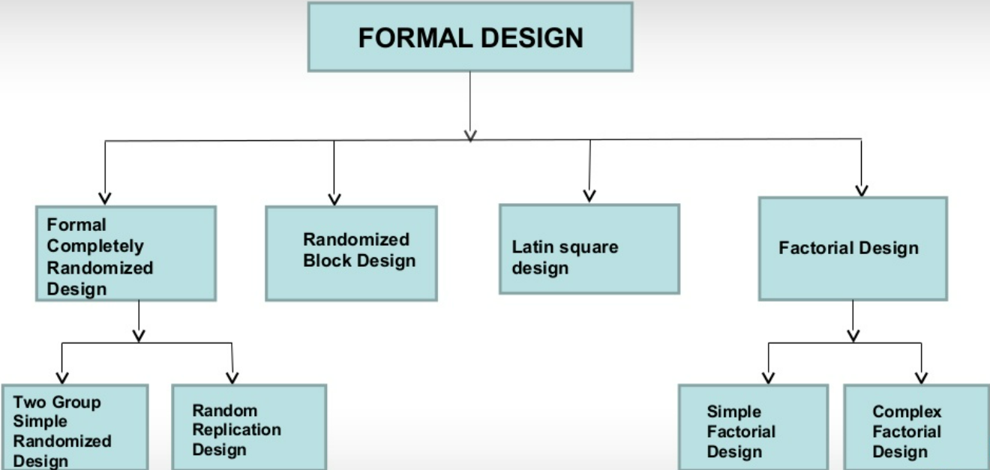
Single factor/Single independent variable
Multi factors/Multiple independent variables

Slide 37
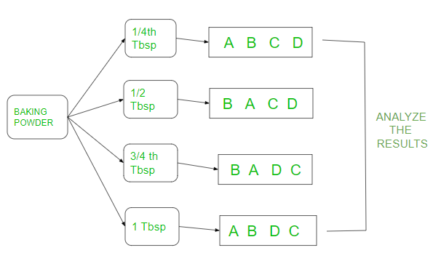
Completely Randomised Design
Completely Randomized Design (CRD) is a basic experimental design in which treatments are assigned to experimental units completely at random. This means that each unit has an equal chance of receiving any treatment, ensuring that the effects of the treatments can be assessed without bias.
Applies principles of replication and randomization
Example
Adding more baking powder to cakes increases the heights of the cake

Slide 38
Key Characteristics
Random Assignment: Treatments are allocated randomly to experimental units, which minimizes the influence of uncontrolled variables and helps in achieving homogeneity among groups.
Single Factor Focus: CRD is typically used when studying the effects of one primary factor (treatment) on a response variable.
Homogeneity Requirement: It is most effective when the experimental units are homogeneous, meaning they are similar in all respects except for the treatment being tested.
Flexibility: The design allows for any number of treatments and replications, making it adaptable to various experimental conditions.

Slide 39
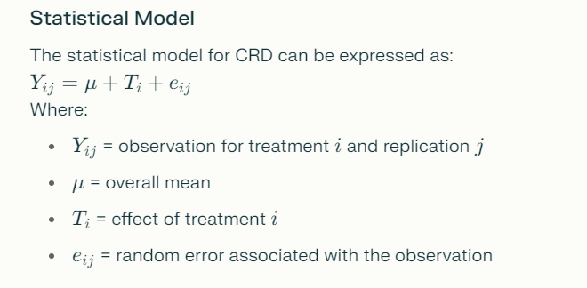

Slide 40
Advantages
Simplicity: The layout and analysis of CRD are straightforward, making it easy to implement.
Statistical Efficiency: It provides maximum degrees of freedom for error, which enhances the sensitivity of statistical tests.
Flexibility in Design: Researchers can easily modify treatment levels and replications as needed.
Limitations
Homogeneity Requirement: CRD is less effective if the experimental units are not homogeneous, as this can lead to increased variability and reduced precision.
Less Accurate in Field Experiments: Due to environmental variations, CRD may not be suitable for field experiments where conditions are not controlled.
Inability to Detect Interactions: It does not account for interactions between factors, which may limit its applicability in more complex experiments.

Slide 41
Applications
CRD is widely used in laboratory experiments where conditions can be tightly controlled, such as: Agricultural research to test different treatments on crops.
Clinical trials to assess the effectiveness of new drugs.
Basic research in biology and chemistry where randomization is crucial for unbiased results.

Slide 42
Types
Two group simple randomized experimental design: Population is defined and samples are selected. It is randomly assigned to experimental and control groups. The two groups are given different treatment of independent variable. Suitable behavioral science research. Eg: Normal vs specialized training on students.
Random replications design: Repetition for each treatment. It provides controls for differential effects of extraneous independent variables and secondly, it randomizes individual differences among those conducting the experiments.

Slide 43
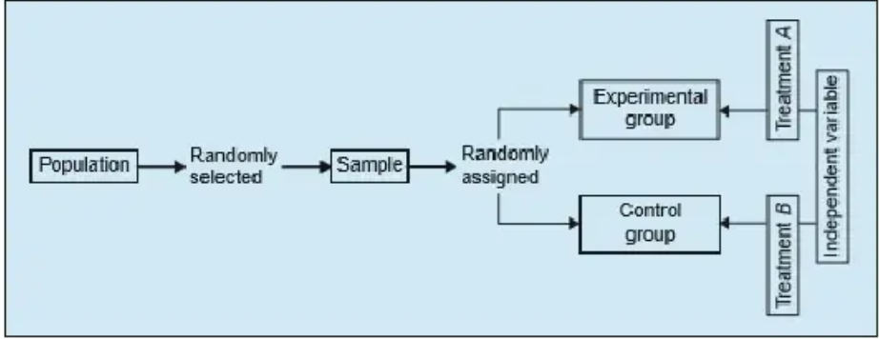
Two group simple randomized experimental design

Slide 44
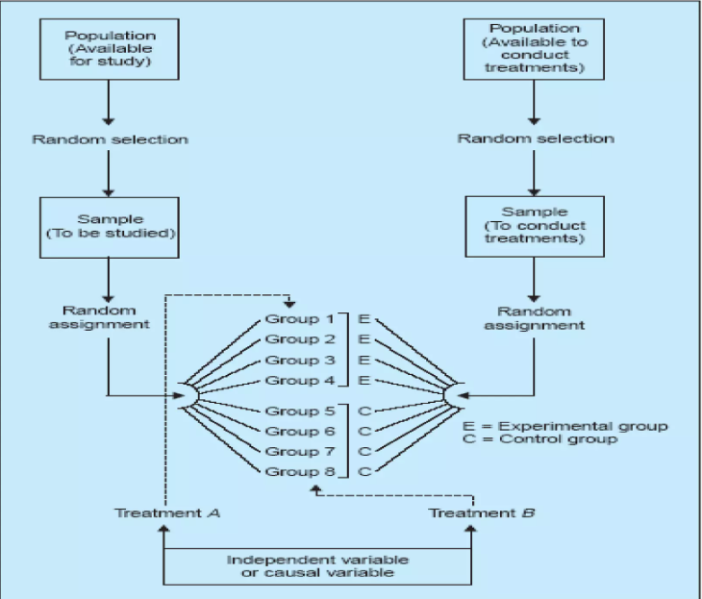
Random replications design

Slide 45
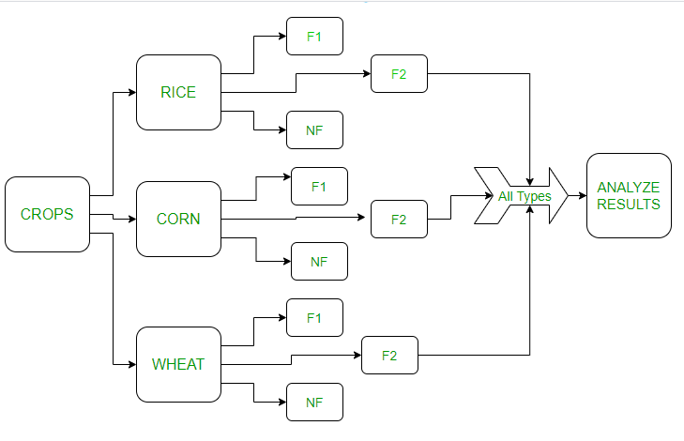
Randomized Block Design
Randomized Block Design (RBD) is an experimental design that involves grouping experimental units into blocks based on certain characteristics or factors that are expected to affect the outcome of the experiment. Within each block, treatments are assigned randomly to minimize the impact of variability between blocks.
Example
Testing new fertilizers in different types of crops. Crops are divided into 3 different types(blocks).These blocks are again divided into 3 fertilizers that are used on those crops

Slide 46
Key Features
Blocking: Experimental units are grouped into blocks that share similar characteristics (e.g., age, gender, location). This helps control for variability and reduces the experimental error associated with those nuisance factors.
Random Assignment: Treatments are randomly assigned within each block, ensuring that each treatment has an equal chance of being applied to any experimental unit in the block.
Complete Treatment Application: Each treatment is applied to all blocks, allowing for a comprehensive comparison across different conditions.

Slide 47
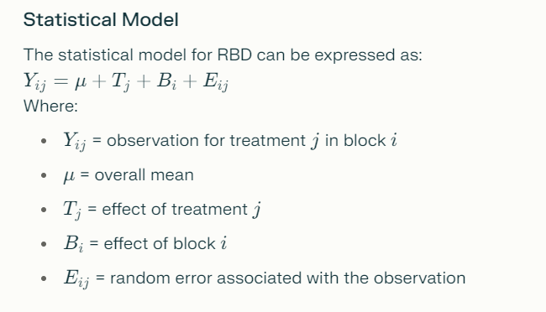

Slide 48
Advantages
Reduction of Variability: By accounting for known sources of variability, RBD increases the precision of the experiment and enhances the reliability of results.
Increased Statistical Power: The design allows for more accurate estimates of treatment effects by reducing the error variance, leading to more powerful statistical tests.
Flexibility: RBD can accommodate various types of experimental conditions and is adaptable to many fields, including agriculture, medicine, and social sciences.
Limitations
Complexity in Design: Designing an experiment with appropriate blocking factors can be complex and requires prior knowledge about potential sources of variability.
Assumption of Homogeneity: The effectiveness of blocking relies on the assumption that variability within blocks is less than between blocks. If this assumption is violated, it may lead to misleading results.
Limited to Known Factors: RBD only accounts for known nuisance factors; unknown sources of variability may still affect the results.

Slide 49
Applications
Agricultural Experiments: Used to test different fertilizers or treatments across fields with varying soil types or environmental conditions.
Clinical Trials: Employed to assess treatment effects while controlling for patient demographics or baseline characteristics.
Industrial Testing: Applied in quality control processes where variations in production conditions need to be accounted for.

Slide 50
Latin Square Design
Latin Square Design (LSD) is an experimental design used to control for two blocking factors while studying the effects of one treatment factor. It is structured as an n×n grid where each treatment appears exactly once in each row and once in each column, effectively controlling for variability due to the two blocking factors.

Slide 51
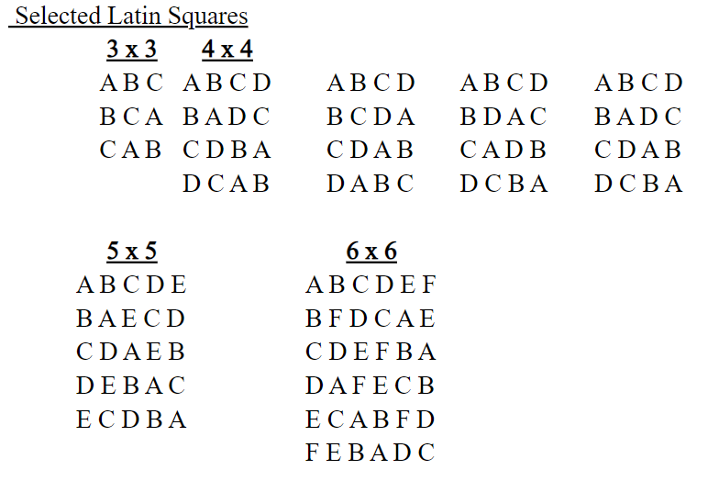

Slide 52
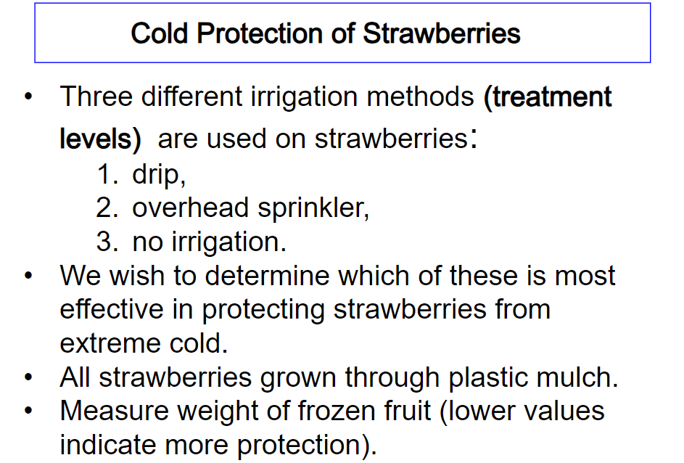
Example:

Slide 53
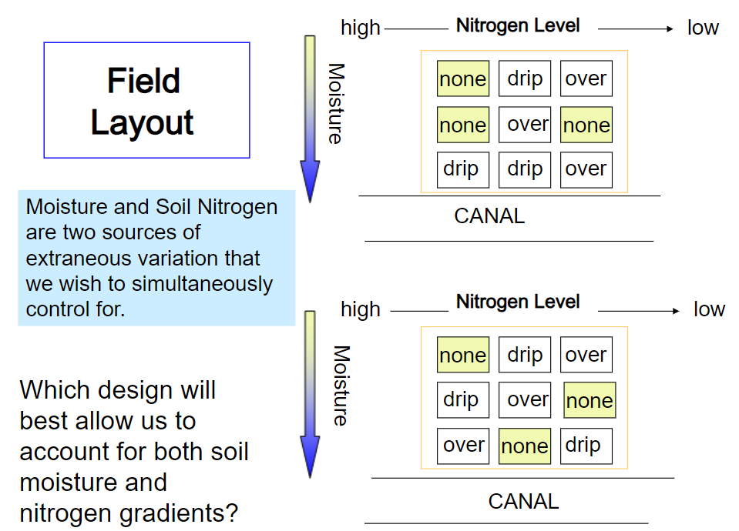

Slide 54
Key Features
Structure: The design consists of a square matrix where both rows and columns represent different blocking factors. Each cell in the matrix contains a treatment, ensuring that every treatment is tested under every combination of the blocking factors.
Blocking Factors: The two blocking factors are usually known nuisance variables that could affect the outcome of the experiment. By arranging treatments in this way, researchers can isolate the effects of the treatment from those of the blocking factors.
Equal Treatment Replication: Each treatment appears once in each row and column, allowing for balanced comparisons across all conditions.

Slide 55
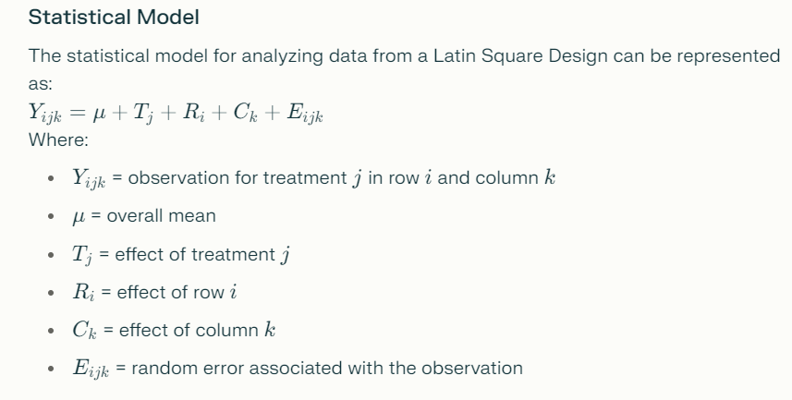

Slide 56
Advantages
Control of Variability: By accounting for two sources of variability (rows and columns), LSD reduces experimental error and increases the precision of results.
Efficient Use of Resources: The design requires fewer experimental units compared to running separate experiments for each blocking factor.
Flexibility: It can accommodate various types of treatments and is applicable in multiple fields, including agriculture, psychology, and clinical studies.
Limitations
Limited Number of Treatments: The number of treatments must equal the number of rows and columns, which can limit its applicability if there are too many treatments.
Complexity in Design: Designing a Latin square can be more complex than simpler designs, requiring careful planning to ensure that all treatments are adequately represented.
Assumption of Homogeneity: The effectiveness relies on the assumption that variations within rows and columns are minimal; significant differences may lead to biased results.

Slide 57
Applications
Agricultural Experiments: Used to evaluate different fertilizers or crop treatments while controlling for soil type (rows) and environmental conditions (columns).
Clinical Trials: Employed to study drug effects while accounting for patient demographics (rows) and treatment regimens (columns).
Psychological Studies: Applied in experiments where subjects may differ based on characteristics like age or gender, ensuring balanced representation across treatments.

Slide 58
Factorial Design
Factorial design is a statistical experimental methodology used to evaluate the effects of two or more independent variables (factors) on a dependent variable. This design allows researchers to assess not only the main effects of each factor but also the interaction effects between factors, providing a comprehensive understanding of how these variables influence outcomes.
Key Features
Multiple Factors: Factorial designs involve at least two independent variables, each with multiple levels. For example, a 2x2 factorial design includes two factors, each at two levels, resulting in four treatment combinations.
Main and Interaction Effects:
Main Effects: The individual impact of each factor on the dependent variable.
Interaction Effects: How the effect of one factor changes depending on the level of another factor.
3.Comprehensive Analysis: By manipulating multiple factors simultaneously, factorial designs allow for a nuanced analysis that can reveal complex relationships that might not be evident when studying factors in isolation.

Slide 59
Simple Factorial Design
A simple factorial design typically involves two or more factors, each with two levels. It is often represented in a format like 2x2, where the first number indicates the number of levels for the first factor and the second number indicates the levels for the second factor.
Example: In a 2x2 factorial design examining the effects of drug dosage (low vs. high) and treatment duration (short vs. long), there would be four treatment combinations:
Low dosage, short duration
Low dosage, long duration
High dosage, short duration
High dosage, long duration

Slide 60
Complex Factorial Design
Complex factorial designs involve more than two factors or factors with more than two levels. They can be represented as 2x3 or 3x2x2, indicating multiple factors and their respective levels.
Example: In a 3x2x2 factorial design examining the effects of three factors—type of therapy (Cognitive Behavioral Therapy, Psychodynamic Therapy, and Humanistic Therapy), duration (short vs. long), and therapist gender (male vs. female)—there would be 12 treatment combinations:
CBT, short duration, male
CBT, short duration, female
CBT, long duration, male
CBT, long duration, female
Psychodynamic, short duration, male
Psychodynamic, short duration, female
Psychodynamic, long duration, male
Psychodynamic, long duration, female
Humanistic, short duration, male
Humanistic, short duration, female
Humanistic, long duration, male
Humanistic, long duration, female

Slide 61
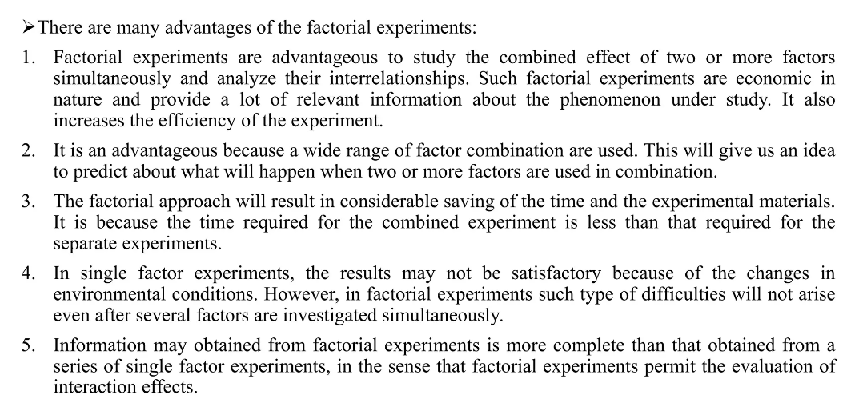
Advantages of factorial design

Slide 62
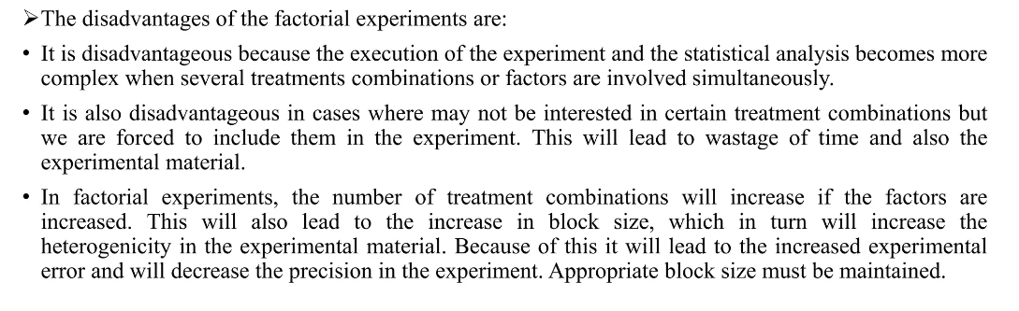
Disadvantages of factorial design

Slide 63
Thank You

