Slide 1



UNIT 2: NATURAL RESOURCES.
Forests Water Minerals Food Energy Land

Slide 2

What is Natural Resource?
The environment is everything which surrounds on organism and influences its life in many ways. It includes physical and biological components.
The physical components of the environment are soil, water, air, light and temperature (Abiotic components). The plants and animals are collectively referred to as Biotic components.
All these components work together, interact and modify the effect of one another. The basic need of life are fulfilled by minerals present in the nature. These are referred to as Natural Resources.

Slide 3
Classification of Natural Resources
1. Based on Origin:
  BIOTIC: (living organisms)
  ABIOTIC: (non living organisms)
  2. Based on Availability:
Inexhaustible: (replenishes naturally)
Exhaustible: (replenishing process is extremely slow)
3. Based on Distribution:
Omni present: (found everywhere)
Location based: (found at some specific locations only)

Slide 4
4. Based on Source:
Continue…
Water Resources
Forest Resources
Mineral Resources
Marine Resources
Based on Chemical Composition:
  organic: (vegetables, animals, bacteria, mineral oil)
  Inorganic: (Air, water, minerals)
  mixed: (land)

Slide 5

Forests
The earth’s land area where the vegetations are grown naturally in groups is known as a forest. Vegetations means trees, shrubs, creepers or any woody vegetations having a closed canopy.

Slide 6
Classification of Indian Forests
Evergreen forests
Deciduous forests
Dry forests
Mountain or Hill forests
Tidal forests

Slide 7
Tropical Forests
• Area bounded by 23.5 degree N and 23.5 degree S
• Hot and Humid climate • Temperature: 20-25 C
Rainfall : Exceeding 200 cm
Low land tropical forests: > Rain falls almost daily
(ii) Tropical cloud forests : > Higher Altitudes

Slide 8
Temperate deciduous Forests
Occurring between 30 to 60 latitudes
Temperature varying between -30 to +30 C
Soil is fertile
Rain : 75-150 cm throughout year
Deciduous forests: > Northern hemisphere
(ii) Evergreen forests : >Southern hemisphere

Slide 9
Coniferous Forests
• Called “taiga”
•Northern hemisphere (50 to 60 N)
• Low bio diversity
• Snow form (40 to 100 cm)
• Soil is thin , acidic
Grasslands: > Short period rain, more droughts
Tundra : >Frozen, extreme cold3

Slide 10
Type of Forest States
1. Rain evergreen forest: Western Ghats
2. Tropical wet evergreen forest: Kerala , Assam
3. Tropical deciduous forest: Gujarat, Rajasthan
4. Broad leaves deciduous forest: Himalaya
5. Coniferous deciduous forest: U.P, H.P , J & K 6. Mangrove forest: coastal area

Slide 11
Importance of Forests
Function
1.Protective functions: Protect against : flood, soil erosion, drought ,etc.
2. Productive functions: Produces: Katha , pulp paper , bamboos, etc.
3. Regulative function: Regulates Temperature,O2 ,CO2.
4. Accessory function: Helps in : aesthetics and habitats of flora & fauna.

Slide 12
Importance of Forest
Ecological Importance
Regulation of Global climate and temperatures
Reduction in Global warming
Production of Oxygen
Conservation of soil
Important in a fertility of soil
Control of water flow
Habitats to Wildlife
Absorption of noise
Absorption of Air Pollution

Slide 13
Importance of Forest
Economical Importance
Timber
Fuel food
Raw material for wood based industries
Bamboo
Food
Miscellaneous products

Slide 14
Deforestation
Deforestation refers to the long term or permanent loss of forest cover.
10% loss of canopy is considered as Deforestation.

Slide 15
Causes
Population explosion
Shifting Cultivation
Growing food demands
Fire foods
Raw material for wood based industries
Infrastructure Development
Forest Fires :
(i) Ground fire
(ii) Surface fire
(iii) Crown fire
(iv) human activities
Over grazing :
Mining activities
Attack of insects
Natural forces

Slide 16
Threats associated with Deforestation:
Increase in the possibilities of flash floods.
Decrease in the rain fall.
Increase in the atmospheric temperature.
Increase in the amount of soil erosion.
Migration of tribal population leads to mental frustration.
Extinction of some useful medicinal species.
Shelter problem for forest animals will increase.
Problem of urbanization will arise.
Atmosphere will become adverse.
Desertification of forests and agricultural land.
Forest dwellers will have a problem of survival.
Decrease in the population of animal species.
Increased chances of cyclone due to climate change.

Slide 17
Effects
Destruction of species habitats :Extinction of species, Loss of Bio-diversity
Reduction of vegetation: Soil erosion
Loss of soil fertility Loss of mineral nutrients
Landslides
Destructs Oxygen cycle
Pollution + Global warming
Less forest products Quality of our life

Slide 18

Need and measures of Forest Conservation
Needs:
To maintain equilibrium in Ecosystem.
To maintain Bio-diversity.
Measures:
Forest fires should be prevented.
Use of pesticides to eliminate the risk of pests.
Plantation of resistant varieties.
Replacements of trees (aforestation)
Replacing the fire woods by biogas and solar cooker.
Implementation of social forestry programmes.
Aforestation programmes should be undertaken on wastelands.
Trees of aesthetic value should be planted.
Renewal of forest crops.
Reforestation by suitable monoculture.
Unwanted felling of trees should be restricted.

Slide 19
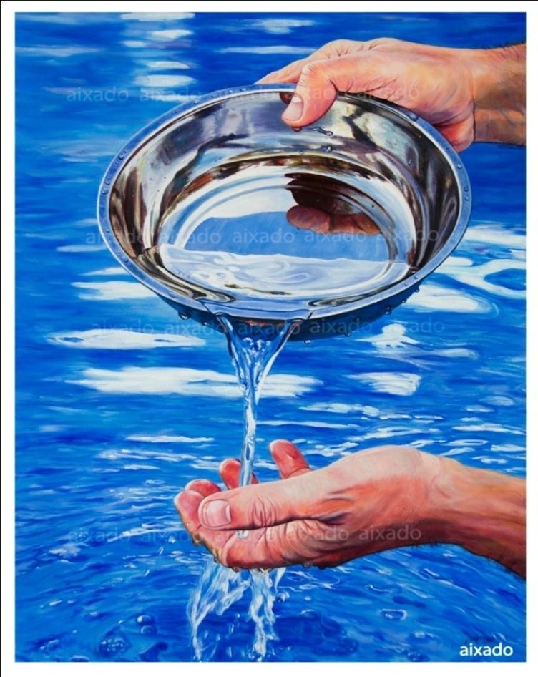
Water
Uses of Water:
Use of water in Agricultural and Industrial activities.
Drinking and Washing purposes.
Vital for Fishing Industry.
Marine transportation.
Electricity generation.

Slide 20
Sources of Water: (Water sheds)
Rain
Underground water
Surface water
Evaporation water
Stream
Artesian Stream
Gravity Stream
Surface Stream
Wells
Tanks | Sea | Rivers | Lakes | Lakes
 | or | and | and | formed
Ocean
Streams
Ponds
by collected Water
Dug Wells
Shallow Wells
Deep Wells
Tube Wells
Artesian Wells

Slide 21


Types of Wells:
Shallow wells:
  2 to 6 mts. Diameter
  Half or Full Built up (brick walls)
  7 to 15 mts. Depth
  used for household purposes
Deep Wells:
  made of cement pipes (format)
  20 to 40 mts depth
  0.6 to0.9 mts diameter
  pure water ready to supply directly

Slide 22
3. Tube Wells:
60 to 300 mts depth
0.5 to 1.3 mts diameter
40 to 50 liters per second water flow
Water used for gardening or water supply to distant place
Purification is necessary
Artesian Wells:
  Constructed in valley or hilly areas
  Water pump is not required
  Purification of water is necessary
Dug Wells:
  Similar to Shallow wells
  Digging tools and spades are used to dug these wells
  Parapet wall of 1 mt. height is constructed
  Well is surrounded by inside slope

Slide 23
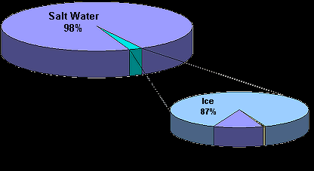
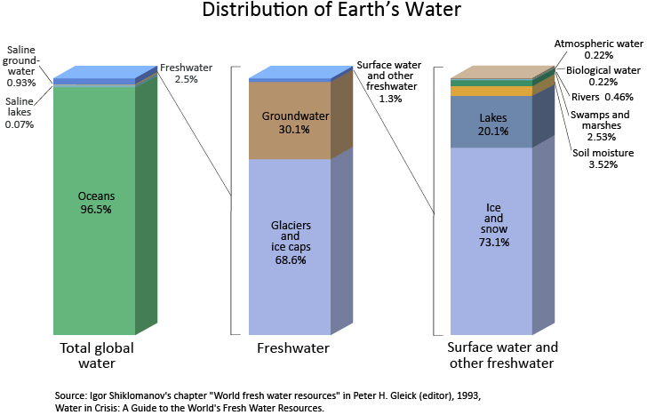

Slide 24

Dams and its Social and Environmental Impacts:
Advantages of Dams:
Helps in water supply in Summer.
Blocking the water flow towards Sea.
For forming artificial lakes to maintain daily water
supply.
Helps in irrigation and electricity generation.
Useful in creating Ecosystems for Birds and Aquatic Animals.
Useful to farmers to yield multiple crops in a year.

Slide 25
Problems Caused by Dams:
Fragmentation and Physical Transformation of rivers.
Serious impact on river-line Ecosystem.
Social consequences of large dams due to displacement of peoples.
Water logging and selinization of the surrounding land.
Dislodging animal population, damaging their habitat and cutting of their migratory routes.
Disruption of fishing and water- way traffic.
emission of green house gases due to rotting of vegetation.
Serious impact on tribal people.
failure in achieving the targeted objectives and high cost.

Slide 26
Impact of Over Utilization of Water:
Water scarcity specially in summer.
Wastage of Water may lead to blockage of drainage line, water pollution, Air pollution and Virulent disease or epidemics.
Economic loss due to over usage of Water.
It may be considered as Crime or Offence in the court of Almighty.

Slide 27
Recharging and Conservation of Water:
Construction of small Dams and artificial lakes for the water storage
purpose.
Construction of ponds for the purpose of storing rain water.
Grow more trees to increase the chances of Rain.
Economical use of water. (avoid water wastage)
Try to reuse the water. E.g:
  Water used for bathing can be reused for vegetation in the veranda.
  Reuse of water by spraying it on dusty roads to prevent small particles to mix with air.
Use based water charges for controlling water usage.
After purification of Dirty water it should be used in farms or grass lands.

Slide 28
MINERALS
A mineral is a naturally occurring substance of definite composition and identifiable physical properties.
Coal, natural gas and mineral oil
Metals like iron, copper, silver, aluminum, manganese and other valuable stones.

Slide 29
Classification of Minerals:
Energy Providing Minerals: Coal, Natural Gas and Mineral oil etc.
Valuable Minerals: Gold, Silver and Diamond.
Minerals Useful in Construction Work: Stones, Marbles, Lime etc.
Industrial Minerals: Iron, Copper, Manganese, aluminum etc.

Slide 30
Mineral Resources of India
Mineral Name | Quantity (‘000 tons) | Mineral Name | Quantity (‘000 tons)
Copper | 5393 | Fire Clay | 445
Lime stone | 66900 | Celica | 1139
Manganese | 1363 | Canite | 38
Lead- Zink | 43- 138 | Steatite | 390
Bauxite | 4773 | Dolomite | 2505
Chromite | 939 | Mica | 4
Asbestos | 26 | Gypsum | 1657
Pyrite | 94 | Iron | 53700
Gold | 1983 kg | Lignite | 13900
Diamond | 18000 carets | Magnetite | 544
Silver | 33 | Silmenite | 17
Falspar | 46837 | Barytes | 707
Salt | 3 | Tugsten | 22

Slide 31
Exploitation of Minerals:
Minerals are recovered by the process of mining. It is the physical removal of minerals from the crust of the earth.
Methods of mining:
Surface Mining:
  Open pit mining: For obtaining Lime-stone, sand stone, marble, granite, mica etc.
  Dredging: To Obtain the under water Mineral deposits.
  Strip mining: Use of big digging tools to obtain the minerals
from the ore.
Underground Mining: By making big Holes into the earth’s surface to bring out the minerals lying in the deep earth ore.

Slide 32
Impact of Mines and Minerals on Environment
Air pollution by the emission of Sulphur Dioxide and Nitrogen Monoxide (SO2 and NO) during the mining process.
Various types of diseases arises due to air pollution.
Possibility of Acid Rain due to Toxic substances in the air.
Increase in Noise pollution due to the use of Heavy machineries in mining process.
Emission of Radon and Thorone in the Uranium Mines.
When water flows from mines, there will be Water
Pollution.
Polluted water obtained from the Natural oil wells may create Land pollution.

Slide 33
Conservation of Minerals
Recycling: Reusing of useless articles by adopting proper processes for them.
Reusing: Reusing the Articles again and again.( glass bottles)
Decrease consumption: Minimizing the requirements of certain minerals and reducing the wastage.
Substitution: Try to find the Substitute of the Minerals.
Use of Waste: the Wastage of some industries can be used as Raw materials in other Industries.

Slide 34
FOOD
Any substance or thing which is able to satisfy appetite to meet the physiological needs for growth to maintain all body processes and to supply essential energy required for maintaining body temperature and activity.
Chapatti, rice, bread, butter, fruits, vegetables, milk, edible oil, etc are the routine examples of food.

Slide 35
Functions of Food
It provides energy to do day to day work and maintains body temperature.
It provides nutrients for the development and the growth of the body.
It provides substances to replace the catabolic cells by new cells or to appropriately repair the damaged cells.
It provides substances for the proper functioning of the reproductive system.
It regulates body activities to ensure longitivity of life and body.

Slide 36
Components of Food and their Functions
Element/ component | Daily requirement | Function | Sources
1. Carbohydrates | 500 gms. | Energy and Temperature of the body is maintained | Grains, potatoes, sugar, banana, carrot, honey, etc
2. Fats | 50 gms. | Important for the development of cells and building tissues. | Clarified butter, edible oil, milk, butter, eggs, etc
3. Proteins | 100 gms. | Necessary for the growth and development of body tissues. | Cereals, milk, curd, cheese, meat, fishes, and eggs.
4. Water | 2.5 liters | Essential for the bio- chemical process in the body. | Water

Slide 37
5. Salt (minerals) | 0.7 gm. | Security against damage and strengthens bones. | Grains, cereals, salt
6. Vitamins | 0.6 gm | Useful for bio chemical processes, health, growth | Milk, butter, vegetables, eggs and meat
7. Roughage | Rarely taken | It is useful for proper digestion and bowel’s movement. | Chaff of grains.

Slide 38
Modern Agriculture
Modern agriculture is an evolving approach to agricultural innovations and farming practices that help farmers increase efficiency and reduce the number of natural resources like water, land, and energy necessary to meet the world’s food, fuel, and fibre needs.

Slide 39
Effects of Modern Agriculture
Soil Erosion
Contamination of ground water
Water-logging and salinity
Eutrophication
Fertilizers

Slide 40
FERTILIZERS
The substance which brings an improvement in the productivity of the land and which is also helpful in bringing up vegetation is called fertilizer.
The Fertilizers can be divided in to two parts
Chemical or mineral Fertilizers
Biological or Natural Fertilizers

Slide 41
Chemical Fertilizers
The continuous crop yield will exhaust the level of minerals (nitrogen, phosphorus, calcium and potassium). To regain the minerals chemical fertilizers are used.
Characteristics of Chemical Fertilizers:
It is soluble in water.
It is durable.
It should not be harmful to the plans.
Types of Chemical Fertilizers:
Phosphatic
Nitrogenous
Phospho-nitrous

Slide 42

Biological Fertilizers
Classification of Biological Fertilizers:
Manures:
It is obtained by decomposition of organic substances
and bacteria.
Bio Fertilizers:
It includes the micro living organisms in the land which is used to increase the fertility of the land. It provides the nitrogenous elements to the plants and vegetation.
The main resource of bio fertilizers are; bacteria, algae and fungus.

Slide 43
Forms of Manures
Farmyard manures: Mixture of crop residues and excreta of animals. It has all maintenance elements of land and makes the land fertile.
Compost: Decomposition of organic matter by the micro- organisms: like fungi and bacteria. To prepare the compost, layers of plant materials, cattle dung and soil are arranged and water is sprinkled to keep it moisted.
Green manures: It consists of fast growing green plant materials. The leguminous and the non leguminous plants are planted on the same land. The process is called green manuring.

Slide 44
Manures v/s Bio Fertilizers
Manures | Bio Fertilizers
It is semi rotten or decayed organic substance, which is added to the soil. | It is a living formation which increases the fertility of the soil by microbial process.
This fertilizer provides nutrient elements (such as organic and inorganic) to the soil. | It provides inorganic elements to the soil. When the living species of this fertilizer are dead, it provides the organic elements in some extent.
This fertilizers keep the soil in its proper form and forms the aeration and hydration in appropriate proportion in soil. | It does not keep the soil in the proper form.
These fertilizers are not available in the sufficient necessary quantity for the agriculture. | These fertilizers are available in the sufficient necessary quantity for the agriculture.

Slide 45
Drip irrigation
Drip irrigation or trickle irrigation is an irrigation method which saves water and fertilizer by allowing water to drip slowly to the roots of plants, either on to the soil surface or directly on to the root zone, through a network of valves, pipes, tubes, and emitters.
There are certain advantages and disadvantages of this irrigation method which are

Slide 46

Advantages of drip Irrigation
Minimizes the use of fertilizers.
High water application efficiency.
Leveling of the field not necessary.
Ability to irrigate irregular shaped fields.
Moisture within the root zone can be maintained at field capacity.
Minimized soil erosion.
Highly uniform distribution of water.
Lower labour cost.

Slide 47
Disadvantages of Drip Irrigation
High initial cost.
The sun can affect the longetivity of the tubes used in the drip irrigation.
Clogging problem will arise.
Drip tape causes extra clean up costs after harvest.
If not installed properly, then it may create waste of water, time and harvest.

Slide 48
Pesticides:
Pesticides are poisons used to kill pests.
We use pesticides to kill off pests that hurts us, animals or plants. Farmers first used them to kill off bugs and weeds because they have big fields. After a while the cities and towns started using them.
Pests don’t have to be just bugs they can be weeds, diseases that kill plants, and other animals such as rats or mice.

Slide 49
At least three million people are poisoned by pesticides every year.
25 million agricultural workers are poisoned every year.
More than 200,000 people die each year from pesticides
Half of all pesticides are used on the five main crops- cereals, corn/maize, rice, cotton and soya.

Slide 50

Benefits of pesticides
It helps in increasing the yield of crop plants.
Application of pesticides may be beneficial in Public Health Programmes. (e.g. for controlling the growth of mosquitoes causing malaria, yellow fever, etc. houseflies, lice, cockroaches, poisonous insects, etc.
It helps in controlling the pests causing damage to animals, stored food, books, wooden articles, etc.
Pesticides are also used to protect stored food grains in godowns.

Slide 51

Disadvantages of Pesticides;
Along with the harmful pests, it may also damage the
crops or plants.
It may cause the damage to the bacteria which are useful for the growth of plants.
It causes the damage to the health of the person who is
spraying it in the field.
Some pesticides are able to mix with the air and may pollute the atmosphere.
The durable poisonous pesticides may cause the water pollution as it can flow with the water and mixes to the water resources.
Some types of pesticides may enter into the food chain and can harm the human health.

Slide 52
Land
Uses of Land:
  For Residential and for Construction purpose.
  For the construction of roads.
  For Agricultural and for Gardening purpose.
  For creating Forests.
  For the construction of big Industrial Units.
  For preparing canal and water resources.
Misuses of Land:
  Destruction of forests.
  Unused grass land.
  Non planned urbanization.
  Excess use of chemical fertilizers.
  Use of land for mineral industries.

Slide 53
Land slides
It refers to the sliding or dislodging of a large mas s of rocks materials , soils etc… down the side of amount a inorcliff landslides represent the most extreme hazards , especially in terms of loss of life Overpopulation and socio-economic pressures have forced some of the most vulnerable populations into areas of high risk (hill sides)

Slide 54
Causes
Climate
Earthquake
Weathering
Erosion
Volcanoes
Forest fire
Gravity
Mining

Slide 55
Effects
Lead to economic decline
Decimation of infrastructure
Loss of life
Affects beauty of landscapes
Impacts river ecosystems

Slide 56
Various Causes of Soil Erosion
1. Rain and Rainwater Runoff
2. Farming
3. The slope of the Land
4. Soil Erodibility
5. Lack of Vegetation
6. Unsheltered Distance
7. Wind

Slide 57
Effects of Soil Erosion
1. Loss of Topsoil
2. Soil Compaction
3. Reduced Organic and Fertile Matter
4. Poor Drainage
5. Issues With Plant Reproduction
7. Long Term Erosion
8. Water Pollution
9. Climate Change

Slide 58
Preventive Measures
1. Careful Tilling
2. Crop Rotation
3. Increased Structure For Plants
4. Water Control
5. Soil Conservation
6. Increased Knowledge

Slide 59

Soil protection:
Avoid Soil erosion.
Avoid Water congestion.
Water slop on the slope has to be controlled to minimum speed.
Water should be absorbed in the soil with a slow speed.
Control the wind velocity by growing more trees.
Construct the drain of such a breadth that the soil particles may be kept to stick one another.

Slide 60

THANK YOU

