Slide 1
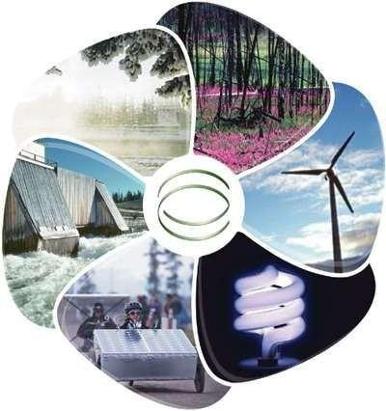
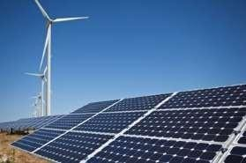
ENERGY SOURCES

Slide 2
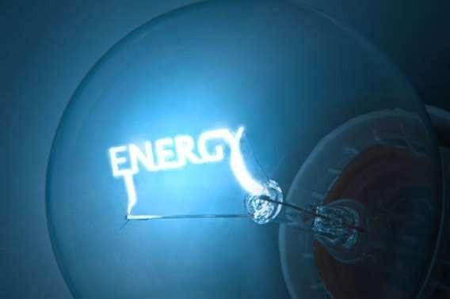
Energy
Energy is the capacity of a physical system to perform work. Energy exists in several forms such as heat, kinetic or mechanical energy, light, potential energy, electrical, or other forms.
Sources of Energy:
Conventional/Non Renewable Energy Sources
Renewable Energy Sources

Slide 3
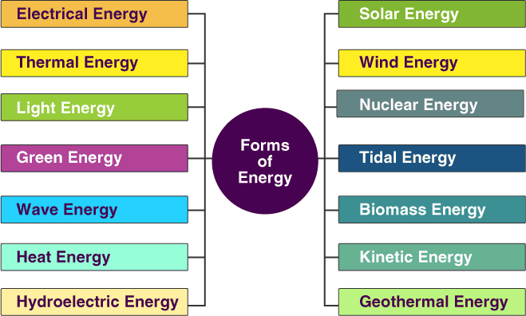

Slide 4
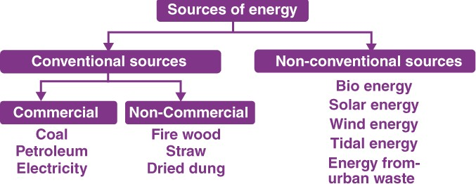

Slide 5
Conventional Energy Sources
The term "Conventional" means "not unusual or extreme or ordinary." Conventional energy sources are the traditional sources of energy like coal and petroleum. Conventional energy sources are finite. They will not last forever.
Natural Gas
Natural gas in its purest form is pure methane but before it is refined, it also contains varying amount of ethane, propane, butane and carbon dioxide. When refined, it is colorless and odorless but can be burned to release large amounts of energy.

Slide 6
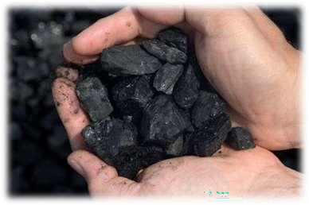
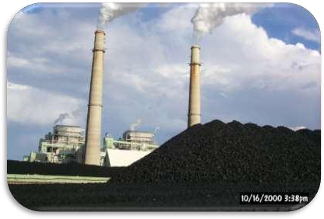
Conventional Energy Sources
Coal
Coal releases large amounts of energy when it is burned because of
the density of hydrocarbons in the material. Coal is formed by dead plants being put under significant pressure and temperature for millions of years. There are four grades of coal: lignite, subbituminous, bituminous coal and anthracite. Bituminous coal is the best for releasing energy and is the most commonly mined type of coal .

Slide 7
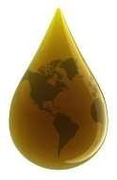
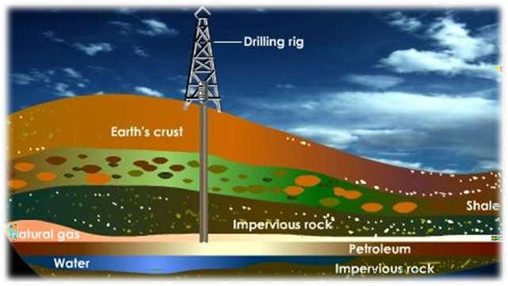
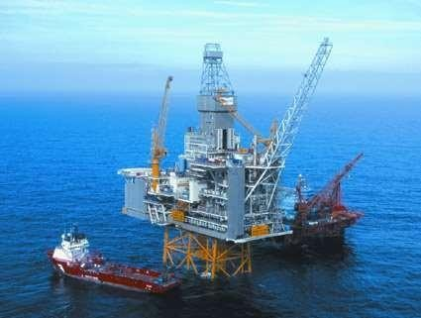
Conventional Energy Sources
Petroleum
Petroleum is formed from the compression of animal and plant remains over millions of years. Petroleum has to be drilled for because it is usually located deep below the earth's surface and is then refined to produce a number of different products including gasoline, heavy fuel oil and diesel fuel.

Slide 8
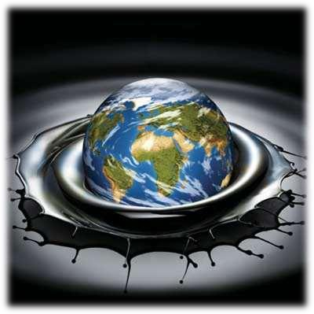
Conventional Energy Sources
Advantages of Conventional Energy Sources
Conventional energy sources are proven technologies
which can provide energy regardless of the weather conditions unlike solar and wind power which may go for days without being able to produce substantial amounts of power. Currently, the financial costs are much lower than alternative energy sources.

Slide 9


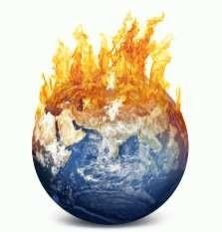
Conventional Energy Sources
Disadvantages of Conventional Energy Sources
Petroleum, gas and coal are non renewable energy sources which means that they will eventually run out.
These energy sources also release greenhouse gases like carbon dioxide into the atmosphere which contribute to global warming.
Other pollutants released include sulphur and nitrogen oxide, which can lead to acid rain and mercury, which is harmful to humans when ingested.

Slide 10
Renewable Energy Sources
Renewable energy is natural energy which does not have a limited supply. Renewable energy can be used again and again, and will never run out.
Renewable energy is energy which comes from natural resources such as sunlight, wind, rain, tides and geothermal heat, which are renewable (naturally replenished.)
Renewable energy is an alternative to fossil fuels and nuclear power, and was commonly called alternative energy.

Slide 11
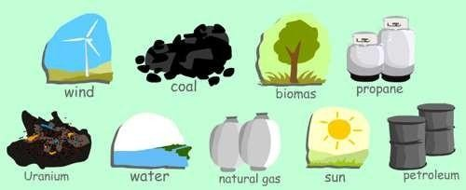
Renewable Energy Sources
A list of renewable energy sources:
Biomass
Hydro
Geothermal
Solar
Tidal
Wave
Wind
Wood
Renewable energy replaces conventional fuels in four distinct areas:
power generation,
hot water/ space heating,
transport fuels and
rural (off-grid) energy services.

Slide 12
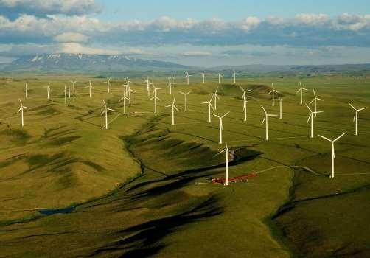
WIND ENERGY
Wind power
Airflows can be used to run wind turbines. Modern wind turbines range from around 600 kW to 5 MW of rated power, although
turbines with rated output of 1.5–3 MW have become the most common for commercial use; the power output of a turbine is a function of
the cube of the wind speed, so as wind speed increases, power output increases dramatically.

Slide 13
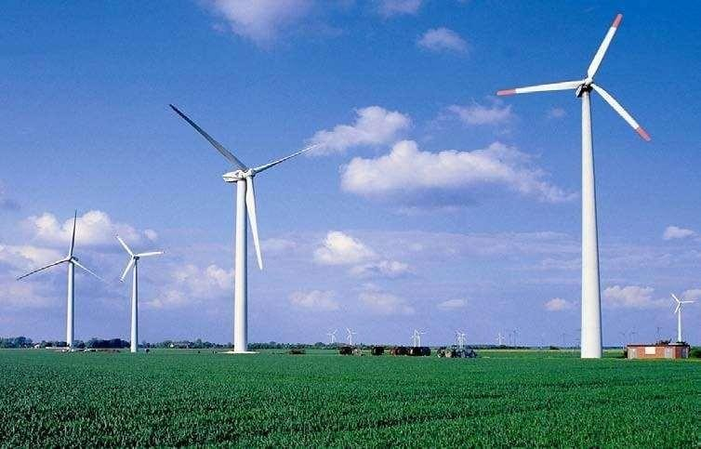
WIND ENERGY
Areas where winds are stronger and more constant, such as offshore and high altitude sites, are preferred locations for wind farms. Typical capacity factors are 20- 40%, with values at the upper end of the range in particularly favorable sites.

Slide 14
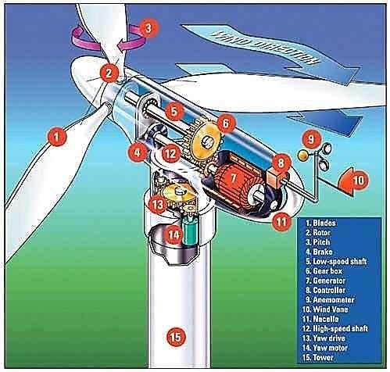
WIND ENERGY

Slide 15
WIND ENERGY
Globally, the long-term technical potential of wind energy is believed to be five times total current global energy production, or 40 times current electricity demand. This could require wind turbines to be installed over large areas, particularly in areas of higher wind
resources. Offshore resources experience mean wind speeds of
~90% greater than that of land, so offshore resources contribute substantially more energy.
could

Slide 16
Hydropower
Energy in water can be harnessed and used. Since water is about 800 times denser than air, even a slow flowing stream of water, or moderate sea swell, can yield considerable amounts of energy.
There are many forms of water energy:
Micro hydro systems are hydroelectric power installations that typically produce up to 100 kW of power. They are often used in water rich areas as a remote-area power supply (RAPS). There are many of these installations around the world, including several delivering around 50 kW in the Solomon Islands.
Damless hydro systems derive kinetic energy from rivers and oceans without using a dam. Ocean energy describes all the technologies to harness energy from the ocean and the sea. This includes marine current power, ocean thermal energy conversion, and tidal power.

Slide 17
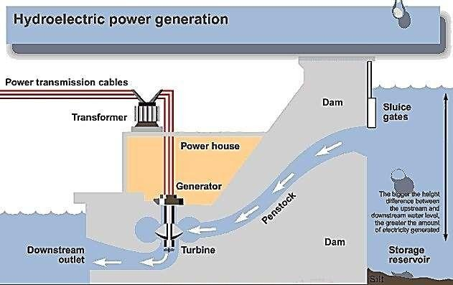
Hydropower

Slide 18
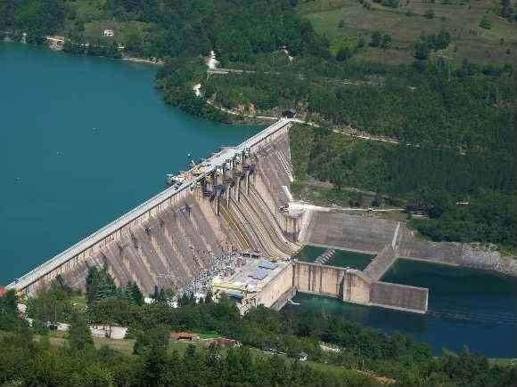
Hydropower

Slide 19
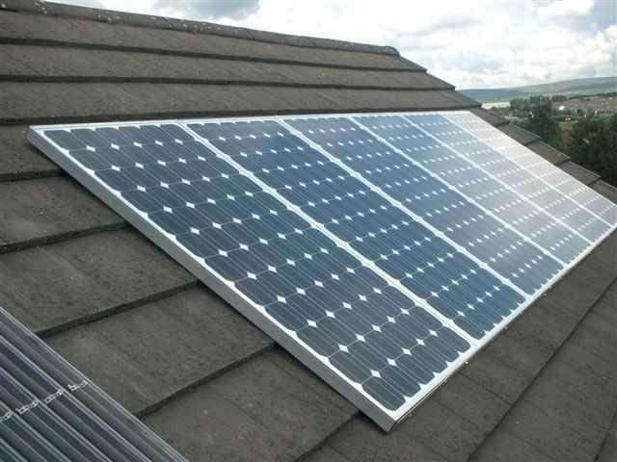
Solar energy
Solar energy is the energy derived from the sun through the form of solar radiation.
  Solar powered electrical Generation relies on photovoltaic and heat engines.
  A partial list of other solar applications includes space heating and cooling through solar architecture, day lighting, solar hot water, solar cooking, and high temperature process heat for industrial purposes.

Slide 20
Solar energy
Solar technologies are broadly characterized as either passive solar or active solar depending on the way they capture, convert and distribute solar energy.
Active solar techniques include the use of photovoltaic panels and solar thermal collectors to harness the energy.
Passive solar techniques include orienting a building to the Sun, selecting materials with favorable thermal mass or light dispersing properties, and designing spaces that naturally circulate air.

Slide 21
Biomass
Biomass (plant material) is a renewable energy source because the energy it contains comes from the sun. Through the process of photosynthesis, plants capture the sun's energy. When the plants are burned, they release the sun's energy they contain. In this way, biomass functions as a sort of natural battery for storing solar energy. As long as biomass is produced sustainably, with only as much used as is grown, the battery will last indefinitely.
In general there are two main approaches to using plants for energy production: growing plants specifically for energy use, and using the residues from plants that are used for other things. The best approaches vary from region to region according to climate, soils and geography.

Slide 22
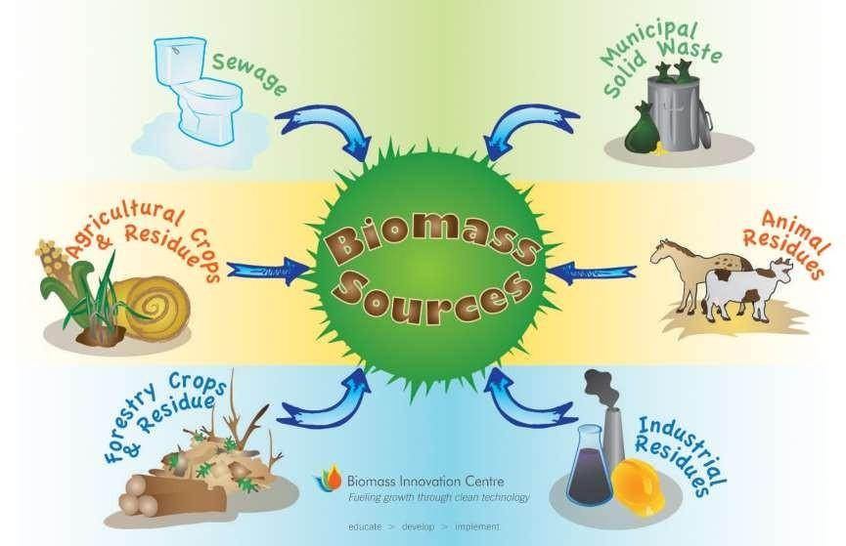
Biomass

Slide 23
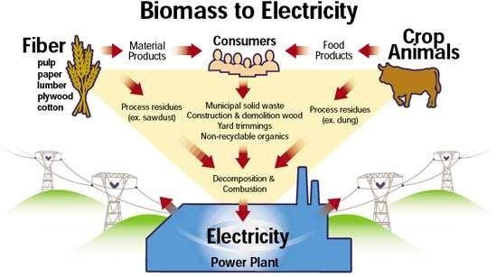
Biomass

Slide 24
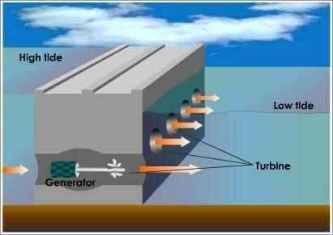
Tidal Energy
This is another unlimited and inexhaustible source of energy. The Gulfs of Kutch is preferably suited to build up electricity from the energy produced by high and lofty tides entering into slender creeks.

Slide 25
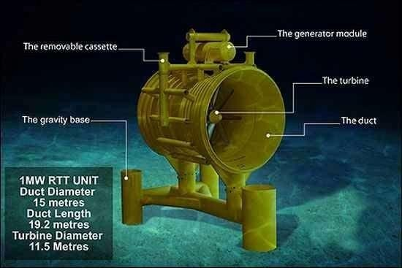
Tidal Energy

Slide 26
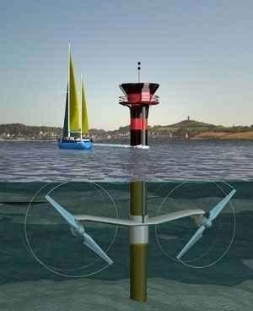
Tidal Energy

Slide 27
Biofuel
Liquid biofuel is usually either bio alcohol such as bioethanol or an oil such as biodiesel.
Bioethanol is an alcohol made by fermenting the sugar components of plant materials and it is made mostly from sugar and starch crops. With advanced technology being developed, cellulosic biomass, such as trees and grasses, are also used as feedstock for ethanol production.
Ethanol can be used as a fuel for vehicles in its pure form, but it is usually used as a gasoline additive to increase octane and improve vehicle emissions.
Biodiesel is made from vegetable oils, animal fats or recycled greases. Biodiesel can be used as a fuel for vehicles in its pure form, but it is usually used as a diesel additive to reduce levels of particulates, carbon monoxide, and hydrocarbons from diesel-powered vehicles. Biodiesel is produced from oils or fats using trans esterification.

Slide 28
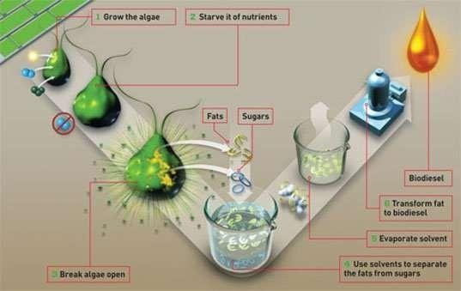
Biofuel

Slide 29
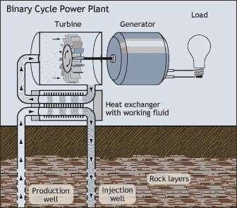
Geothermal energy
Geothermal energy is energy obtained by
tapping the heat of the from kilometers deep
earth itself, both into the Earth's
crust in volcanically active locations of the globe or from shallow depths, as in geothermal heat pumps in most locations of the planet.
It is expensive to build a power station but operating costs are low resulting in low energy costs for suitable sites. Ultimately, this energy derives from heat in the Earth's core.

Slide 30
Geothermal energy
Three types of power plants are used to generate power from geothermal energy: dry
steam, flash, and binary.
Dry steam plants take steam out of fractures in the ground and use it to directly drive a
turbine that spins a generator.
Flash plants take hot water, usually at temperatures over 200 °C, out of the ground, and allows it to boil as it rises to the surface then separates the steam phase in steam/water separators and then runs the steam through a turbine.
In binary plants, the hot water flows through heat exchangers, boiling an organic fluid that spins the turbine. The condensed steam and remaining geothermal fluid from all three types of plants are injected back into the hot rock to pick up moreheat.
The geothermal energy from the core of the Earth is closer to the surface in some areas than in others. Where hot underground steam or water can be tapped and brought to the surface it may be used to generate electricity.

Slide 31

Advantages of renewable energy sources
Renewable energy sources consist of solar, hydro, wind, geothermal, ocean and biomass. The most common advantage of each is that they are renewable and cannot be depleted.
They are clean energy, as they don't pollute the air, and they don't contribute to global warming or greenhouse effects.
Since their sources are natural the cost of operations is reduced and they also require less maintenance on their plants.

Slide 32
Disadvantages of Renewable energy sources
A common disadvantage to all is that it is difficult to produce the large quantities of electricity their counterpart the fossil fuels are able to. Since they are also new technologies, the cost of initiating them is high.
Wind : turbines are expensive. Wind doesn't blow all the time, so they have to be part of a larger plan.
Solar :panels are expensive. Governments are not all willing to buy home generated electricity. Not all climates are suitable for solar panels.
Waves : different technologies are being tried around the world. Scientists are still waiting for the killer product.
Tides : barrages (dams) across river mouths are expensive to build and disrupt shipping. Smaller turbines are cheaper and easier to install.

Slide 33
Disadvantages of Renewable energy sources
Rivers : Dams are expensive to build and disrupt the environment. They have also caused earthquakes.
Geothermal : Difficult to drill two or three kilometers down into the earth.
Biofuel : Often uses crop lands and crops (like corn) to produce the bio-alcohol. This means that more land has to be cleared to grow crops, or there is not enough food, or that food becomes more expensive.

Slide 34
Fossil Fuels
Fossil fuels are buried flammable geologic deposits of organic substances such as dead plants, and animals that got deposited under several thousand feet of silt.
These deposits decayed with the passage of time and got converted to natural gas, coal, and petroleum due to the extreme heat and pressure inside the earth’s crust. They are also known as non-renewable sources of energy as it takes a very long time for it to replenish.

Slide 35
Types of Fossil Fuels
Coal
Petroleum
Natural gas
Coal
It is a hard, black coloured substance made up of carbon, hydrogen, nitrogen, oxygen, and
sulphur.
The major types of coal are- anthracite, bituminous and lignite.
Anthracite has a higher carbon concentration and is the hardest type of coal.
Lignite has a high concentration of oxygen and hydrogen but a low concentration of
carbon.
Bituminous is a moderate form of coal.
Coal is processed industrially to obtain derivatives like coke, coal tar, and coal gas.

Slide 36
Types of Fossil Fuels
Formation of Coal
The process of formation of coal is known as coalification.
The dense forest present in the low-lying wetland got buried in the earth, millions of years ago.
Soil kept depositing over them and they got compressed.
As they went deeper and deeper, they faced high temperature and pressure.
As a result, the substances slowly got converted into coal.
Uses of Coal
Coal was used to produce steam in the railway engines initially.
It is used to cook food.
It is used to generate electricity in thermal plants.
It is used in industries as fuel.

Slide 37
Types of Fossil Fuels
Petroleum
It is a clear, oily liquid, usually green or black in colour.
It has a very strange smell and is a mixture of petroleum gas, diesel, paraffin wax, petrol, lubricating oil, etc.
It is also termed as “Black Gold” because of its wide range of uses in many industries.
Formation of Petroleum
The sea animals and plants died and their bodies settled at the bottom of the sea.
They got compressed by the layers of sand and clay.
Their encounter with high temperature and pressure converts them into petroleum.
The petroleum is separated from the crude oil by a series of processes in a refinery. This is known as petroleum refining.

Slide 38
Types of Fossil Fuels
Uses of Petroleum
It is used to power internal combustion engines in the form of petrol.
It is used in roofing, road pavements, and as a water repellent.
It is used in manufacturing detergents, plastics, fibres, polyethene, etc.
Natural gas
It is a clean and non-toxic fossil fuel.
It is colourless and odourless and can be easily transferred through pipelines.
It is stored as compressed natural gas (CNG) under high pressure.
It is a less polluting and less expensive fossil fuel.
Methane is the most important natural gas.

Slide 39
Types of Fossil Fuels
Formation of Natural Gas
The phytoplankton and zooplankton sink to the bottom of the ocean and mix with organic materials to form an organic-rich mud.
The mud buried under more sediments and lithifies to form an organic shale. This prevents its exposure to oxygen. This is done to protect the organic materials from being decomposed by bacteria.
The increasing pressure and temperature transform the shale into a waxy material known as the kerogen.
At temperatures between 90-160°C kerogen is transformed into natural gas.
Uses of Natural gas
Compressed Natural Gas is used for generating power.
It is used as fuels in automobiles.
It can be used at homes for cooking.
It is used as a starting material in chemicals and fertilizers.

Slide 40
Types of Fossil Fuels
Are Fossil Fuels Renewable?
Fossil fuels are a non-renewable source of energy. Most of the energy used by us is obtained by the burning of fossil fuels.
These fossil fuels are used up at a faster rate. They cannot be regrown at a scale compared
to their consumption.
With the increased demand for the production of various energies, fossil fuel energy is declining. It is difficult to replace them. That is why they are known as a non-renewable source of energy.

Slide 41
Advantages and Disadvantages of Fossil Fuels
Advantages:
Fossil fuels can generate a large amount of electricity at a single location.
They can be found very easily.
They are cost-effective.
Transportation of oil and gas can be done easily through pipelines.
They have become safer over time.
Despite being a finite resource, it is available in plenty.

Slide 42
Advantages and Disadvantages of Fossil Fuels
Disadvantages:
Fossil fuels emit carbon dioxide when burnt which is a major greenhouse gas and the primary source of pollution. This has contributed to global warming.
They are a non-renewable resource, i.e., once used they cannot be replaced.
Combustion of fossil fuels makes the environment more acidic. This has led to unpredictable and negative changes in the environment.
Harvesting of fossil fuels also causes fatal diseases among the people. For eg., the coal miners often suffer from Black Lung Disease. The natural gas drillers are constantly exposed to chemicals and silica which is dangerous for their health.

Slide 43
Environmental Impact of Fossil Fuel Use
Carbon fuels
Release of carbon monoxide gas into the atmosphere.
Global warming
Releases sulphur dioxide gas

Slide 44
Alternative to Fossil Fuels
Bio Fuels
Bio mass
Algae based Fuels
Bio Diesels
Alcohol fuels
Hydrogen Fuels

Slide 45
Merits and Demerits of Alternative Fuels
Merits
Environmental benefit
Increased energy security
Sustainability
Massive job creator
Demerits
High Cost
Low Efficiency
Issue with the stability of the system
Logistic problem for Installations.

Slide 46
Growing Energy Needs
Coal, Oil, Gas, Water constitute main sources of energy in India
Commercial consumption of energy from coal (56%) & Petroleum (32%) other
sources as Natural Gas, Water
Traditional Sources of energy : wood, agriculture waste & animal residue
Industrial sectors consuming about 50% of total commercial energy
Industrial energy consumption sources: fertilizer, aluminum, textiles, cement, iron and steel and paper
Farm sector energy consumption increased from 3.9% in 1951 to 32.5% in 1997

Slide 47
Renewable Energy Sources
Wind Energy: In 2014, world can produce 3% of total electricity, now it is 10%
Hydropower: In 2015, Hydropower generated 16.6% of world electricity & 70% of all renewal electricity…..now it is 38.7 %
Solar Energy: In 2014, less 1% of world total grid electricity, now it is 3.6%
Geothermal Energy: Heat to earth around 4600km down with 5000 degree temperature, estimated energy is 10000MW
Bio Energy: Energy from living organism, bio- fuels provided 2.7% of world’s transport fuels in 2010,,,now it is 32%

Slide 48
Fuel Cells
Hydrogen Fuel Cell
A fuel cell combines hydrogen and oxygen to produce electricity, heat, and water. Fuel cells are often compared to batteries. Both convert the energy produced by a chemical reaction into usable electric power.

Slide 49
Nuclear Energy
Nuclear Energy
Nuclear energy is the energy in the nucleus, or core, of an atom.

Slide 50
ENVIRONMENTAL IMPACT ASSESSMENT
Environmental Impact Assessment (EIA) is a process which ensures that all environmental matters are taken into account quite early in the project at planning process itself.
It takes into consideration not only technical and economic considerations but also, traditional aspects like impact on local people, biodiversity etc.

Slide 51
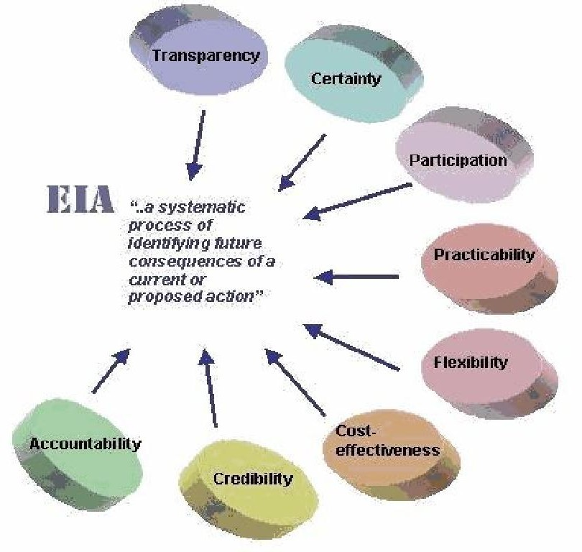

Slide 52



WHY EIA?
EIA is intended to prevent or minimize potentially
adverse environmental
impacts and enhance the overall quality of a project. The main benefits and advantages of EIAare:
Lower project costs in thelong-term Increased project acceptance Improved project design

Slide 53
HISTORY OF EIA IN
INDIA
Started in 1976-77, when Planning Commission asked Department of Science & Technology toexamine River Valley Projects from environmentalangle
Till 1994, Environmental Clearance from Central Government was an administrative decision which lacked legislative support.
On 27th January 1994, Union Ministry of Environment & Forests, GOI under Environment (Protection) Act 1986, promulgated EIAnotification making Environment clearance mandatory for expansion or modernization of any activity or for setting up new projects listed in Schedule one of the notification, which have been amended more than 12times.

Slide 54
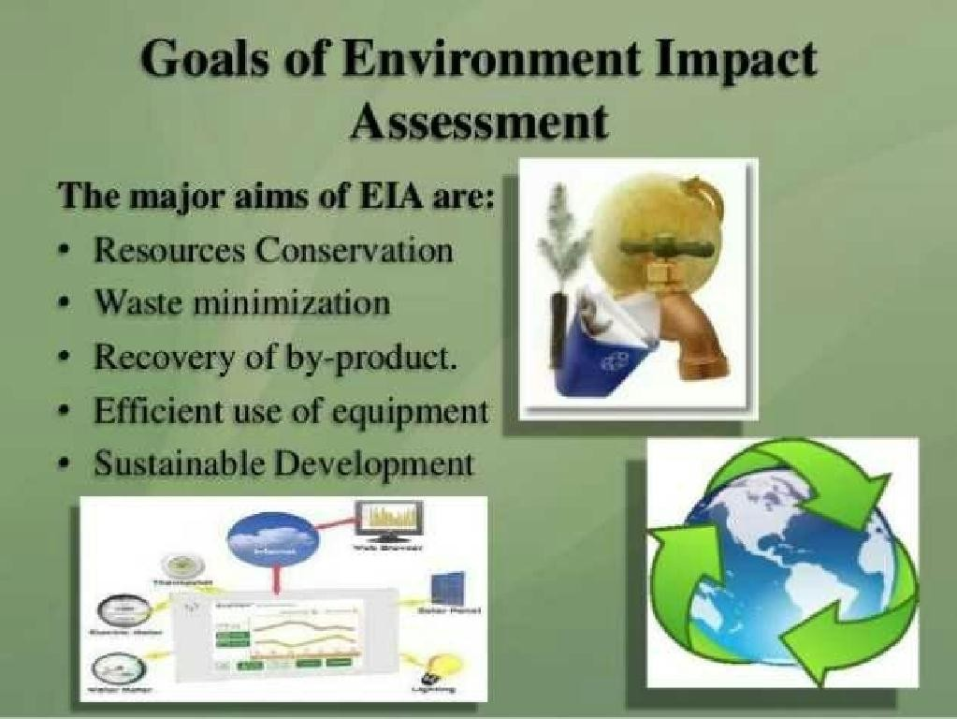
9

Slide 55

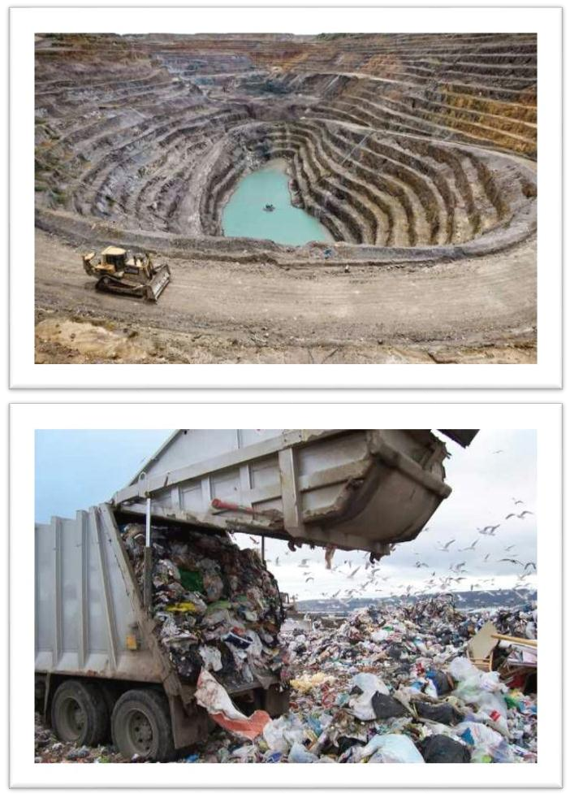
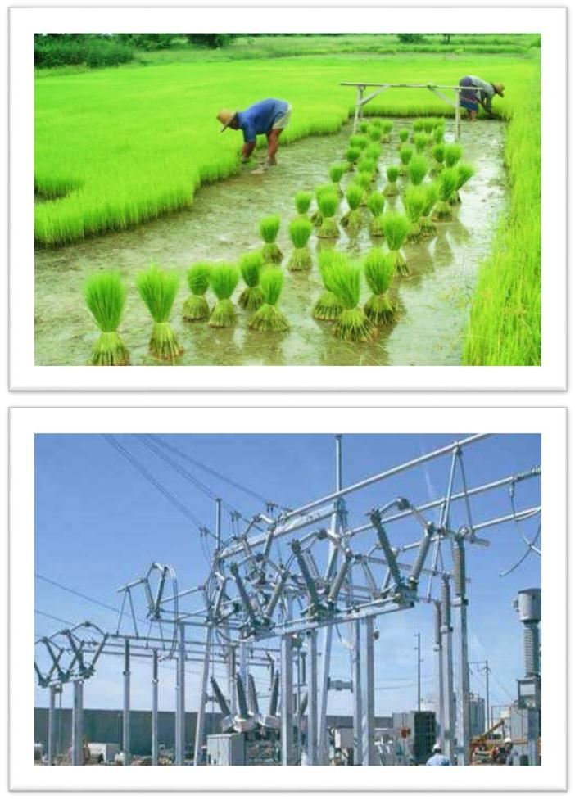
PROJECTS UNDERGOING EIA

Slide 56
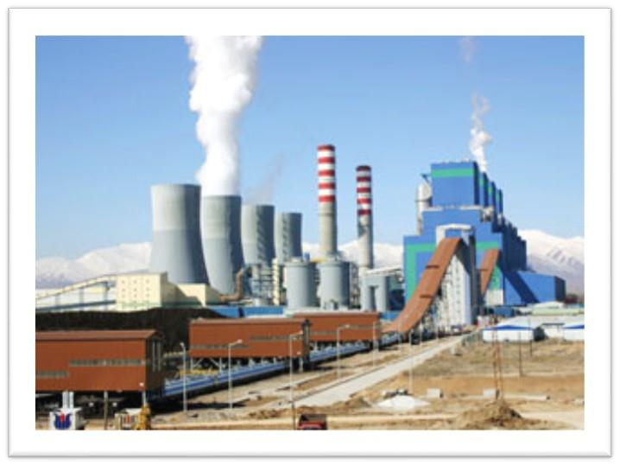
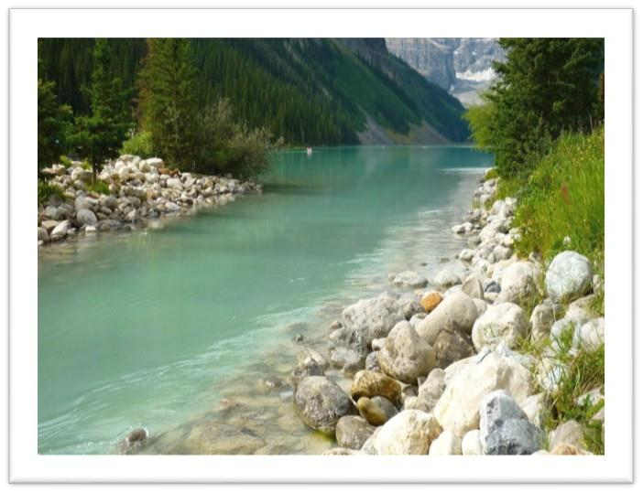
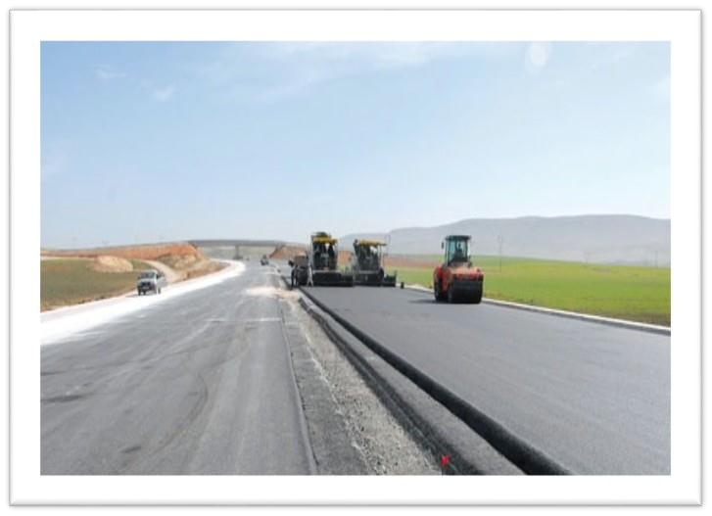


Slide 57
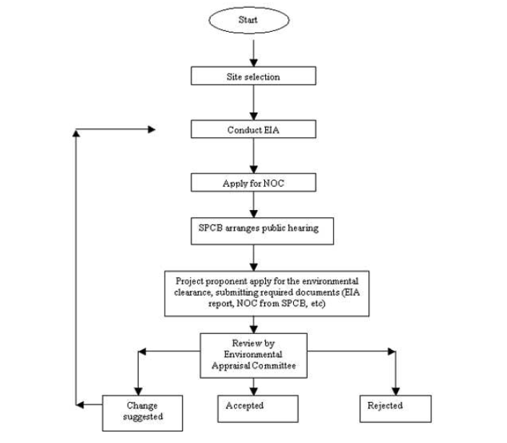

Slide 58
Flow chart representing the process of EIA
Initial Environmental Examination (IEE)
IEE
Review
Screening
EIA
Required
Scoping/ Terms Reference
EIA Not
Required
of
Full-Scale EIA
EIA
Approved
EIA
Review
Decision
Making
Monitoring
EIA Audit and Evaluation
EIA Not Approved
Evaluate Options

Slide 59
Screening
It would be time consuming and a, waste projects and activities to undergo EIA
of resources for all proposed
Not all development projects require an EIA, as some projects may not pose an environmental threat
Screening is the process used to determine whether a proposed project, or activity requires an EIA and, if so, what levelof environmental review is necessary.
14

Slide 60
Screening Flow Chart
Project type on project screening checklist?
Project scale above the screening threshold?
Project located in a critical area?
IAA funding, or any other special circumstances?
Will the project be funded
by an IAA?
NO
Get specific IAA
requirements
No initial environmental examination required (IEE)
Prepare the work plan for the initial environmental
examination (IEE)

Slide 61
Initial Environment Examination
Initial environmental examination (IEE) is intended as a low-cost environmental evaluation that makes use of information already available.
It boost assistance.
up the process
of EIA and lead the
matter to further

Slide 62
IEE in the Overall EIA Process
Initial Environmental Examination
1. Identifies potential significant environmental issues associated
Project Screening
Identifies projects that
with a
project
effects and identifies actual Significant
typically contain potential
significant issues
2. Grades
Environmental Issues (SEIs)
Resolves simple SEIs
Recommends further action for resolving outstanding SEIs
Full-Scale EIA or Other Additional Study Resolves any remaining significant environmental issues

Slide 63

Scoping
A process proponents
of interaction
between
government
agencies and project
Identifies:
spatial and temporal boundaries for the EIA
important issues and concern
information necessary for decision making
significant effects and factors to be considered
Establishes terms for reference of
full
scale EIA

Slide 64
Scoping
IEE Review: All potential SEIs resolved
Project Proceeds according to terms of IEE
IEE
Terms of Reference
Background
Impact Issues Significant Issues
Relevant Resources Report Formatting
Work Plan
When/Who/How of Task Completion
Full-Scale
EIA

Slide 65
Decision Making
The challenge of making the final decision on observed.
implementing a project is
Decision are taken at all stages during the EIA process and the outcome will be based on these decisions.
If a large scale project falls under the jurisdiction of countries with comparable national EIA procedures,it should be feasible to be more ambitious in organising EIATransboundary.

Slide 66

Monitoring
In legislation there is a often demand for environmental reporting when treating permits to activities with large EIA.
This stage involves improvement and mitigational measures to put forward EIA. It also involves elements of assessing risks and hazard management.

Slide 67
Audit and Evaluation
This is the final stage of EIA.
Audit consists opinions and corrections of the report which are submitted in front of decision making committee.
It also reveals that whether EIA is necessary or not for the report submitted,if necessary what are the measures taken in order to overcome the drawbacks and hazards.

Slide 68
Uses of EIA
Systematic evaluation of a eco friendly project.
Risk and hazard assessment. Impact identification.
Monitoring of impact and advice. Development control
Project development
SEA(strategic environmental assessment) and permit.

Slide 69
CONCLUSION
EIA is an important tool in assuring that projects and plans will not give adverse impact on the environment.
The use of EIA has developed throughout the world and may different applications exists.
EIA process thus could not only prevent costs due to environmental aspects but also prevent possible public opinions and protest against a project.

