Slide 1
The Foundation of React
React is a frontend JavaScript library for building interactive user interfaces using components.
Created by Facebook (2011): Initially built for Facebook’s newsfeed and Instagram.
Open Source (2013): First public release.
Adoption: Now widely used by major companies like Facebook, Instagram, Netflix, Reddit, Dropbox, Airbnb, and many more.

Slide 2
1. Why it’s called React
React reacts to changes in data and updates the UI efficiently.
You don’t need to manually update the page—React does it automatically.
Example: when count changes, React re-renders only the <p> part, not the whole page.
2. What a Virtual DOM does
The Virtual DOM is like a copy of the real DOM kept in memory.
React compares the Virtual DOM with the previous version (“diffing”) and updates only what’s changed.
// Imperative DOM update (Vanilla JS)
document.getElementById("title").innerText = "Hello World";

Slide 3
// Declarative update (React)
function App() {
return <h1>Hello World</h1>;
}
React figures out what exactly changed and updates only that in the real DOM.
3. Composition vs. Inheritance
Instead of inheritance (extending classes), React uses composition (combining components).
Example: The Card component is reused to “wrap” other UI parts.

Slide 4
4. Declarative vs. Imperative Programming
Declarative (React way): You describe the UI for a given state.
Imperative (traditional JS): You manually tell the DOM how to change step by step.
Imperative Example:
const btn = document.createElement("button");
btn.innerText = "Click Me";
btn.onclick = () => alert("Clicked!");
document.body.appendChild(btn);

Slide 5
Declarative Example (React):
function App() {
return <button onClick={() => alert("Clicked!")}>Click Me</button>;
}
In React, you just declare the UI, and React handles the DOM updates.

Slide 6
5. Idiomatic React
Writing code in the “React way” means following its principles:
  Use components.
  Use state and props for data flow.
  Keep data unidirectional (parent → child).

Slide 7
Why “React”?
Facebook built React to handle frequent UI updates efficiently.
Web applications need to update in response to events such as:
User input (typing, clicking, scrolling)
New data from APIs or servers (e.g., live chat messages, news feed updates)
Sensor data (e.g., GPS location changes)
Traditionally, web apps used a refresh or polling model:
The page refreshes every few seconds to check for new data (pull model).
React introduced a reactive model:
Instead of refreshing blindly, the UI reacts immediately to actual data changes (push model).
This style of updating UIs based on data changes is called Reactive Programming.

Slide 8
1. User Input
Whenever a user types, clicks, or scrolls, the website needs to react immediately.
Example: When you type in a search box, results show up instantly.
Example: When you click a “Like” button, it turns blue without refreshing the whole page.
React updates only the part of the page that changed (the search results or the button), not the entire website.

Slide 9
2. New Data from APIs or Servers
Websites often need to fetch new data from the internet.
Example: In WhatsApp Web, new chat messages appear automatically.
Example: On Facebook/Instagram, the news feed updates when new posts arrive.
React makes sure the new data is displayed instantly without reloading the whole page.

Slide 10
3. Sensor Data (like GPS)
Some apps depend on data from your device’s sensors.
Example: Google Maps updates your location in real time when you move.
Example: A weather app changes to show weather for your current city.
React reacts to this incoming sensor data and updates only what’s needed on the screen.

Slide 11
In short:
User input → "I did something" → Update the UI.
API/server data → "New info came in" → Update the UI.
Sensor data → "Device data changed" → Update the UI.

Slide 12
React and the UI Layer
Web applications are often structured using the MVC (Model–View–Controller) pattern:
Model → Data layer
View → What the user sees (UI)
Controller → Connects View ↔ Model
React only cares about the “View”.
It takes data (state/props) as input.
It renders that data as UI.

Slide 13
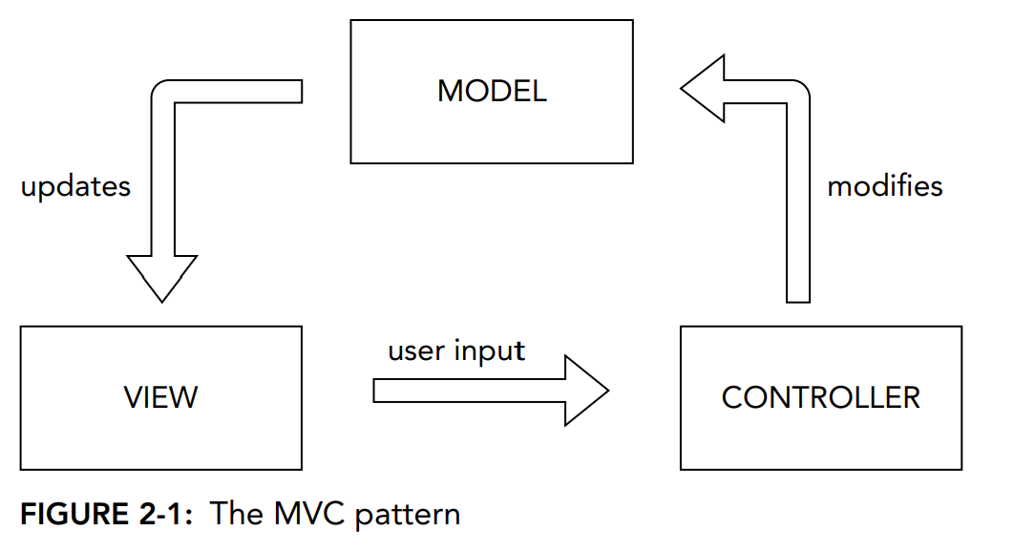
In an MVC application, the View sends input to the Controller, which passes data between the data layer and the View. React is only concerned with the V in MVC. It takes data as input and presents it to the user in some form.

Slide 14
React itself doesn’t care whether the user is using a mobile phone, a tablet, a desktop web browser, a screen reader, a command-line interface, or any other kind of device or interface that may be invented in the future.
React just renders components. How those components get presented to the user is up to a separate library.
The library that handles rendering of React components in web browsers is called ReactDOM. If you want to render React elements to native mobile apps, you use React Native. If you want to render React components to static HTML, you can use ReactDOMServer.

Slide 15
What is ReactDOM?
React by itself just describes what the UI should look like.
But React doesn’t know where to put that UI — it needs help to connect with the actual browser DOM.
That’s the job of ReactDOM.
Think of React as the architect (designing components) and ReactDOM as the builder (actually putting them into the house = browser).

Slide 16
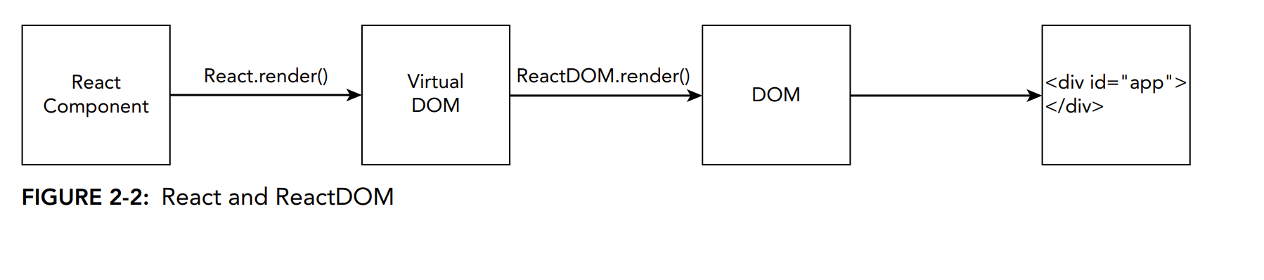
ReactDOM has a number of functions for interfacing between React and web browsers, but the one that every React application makes use of is called ReactDOM.render

Slide 17
React Component
You write UI as React components (functions or classes).
Example:
function App() {
return <h1>Hello, React!</h1>;
}

Slide 18
2. React.render() → Virtual DOM
React takes the component and creates a Virtual DOM (a lightweight, in-memory copy of the actual DOM).
This Virtual DOM is just a JavaScript object representation of what the UI should look like.
Example (conceptually, not exact code):
{
type: "h1",
props: { children: "Hello, React!" }
}

Slide 19
ReactDOM.render() → DOM
  ReactDOM compares the Virtual DOM with the real DOM.
  It then updates only the parts of the real DOM that need changes.
  This makes updates fast and efficient (instead of reloading the whole page).
DOM → <div id="app"></div>
  Finally, ReactDOM renders the component into the actual HTML page.
  Typically, you have an empty <div id="app"></div> (or "root") in your HTML file.
  React fills this div with your components.

Slide 20
Example:
<body>
<div id="app"></div>
<script src="bundle.js"></script>
</body>
After ReactDOM.render(<App />, document.getElementById("app"));, the <div> will now contain:
<div id="app">
<h1>Hello, React!</h1>
</div>

Slide 21
In Short
React Component → Written by developer.
Virtual DOM → Internal React representation.
ReactDOM.render() → Syncs Virtual DOM with Real DOM.
Real DOM → Browser updates only what changed.
Result → Efficient, dynamic UI inside <div id="app">.

Slide 22
Example
function Counter() {
const [count, setCount] = React.useState(0);
return (
<div>
<h1>Count: {count}</h1>
<button onClick={() => setCount(count + 1)}>Increase</button>
</div>
);
}

Slide 23
React Creates a Virtual DOM
{
type: "div",
children: [
{ type: "h1", children: "Count: 0" },
{ type: "button", children: "Increase" }
]
}

Slide 24
You click Increase.
The count state changes from 0 → 1.
React re-renders the Virtual DOM with the new data.
{
type: "div",
children: [
{ type: "h1", children: "Count: 1" }, // only this part changed
{ type: "button", children: "Increase" }
]
}

Slide 25
ReactDOM Updates the Real DOM
React compares the old Virtual DOM with the new Virtual DOM.
It finds that only the text in <h1> changed (Count: 0 → Count: 1).
ReactDOM updates just that part in the real DOM.

Slide 26
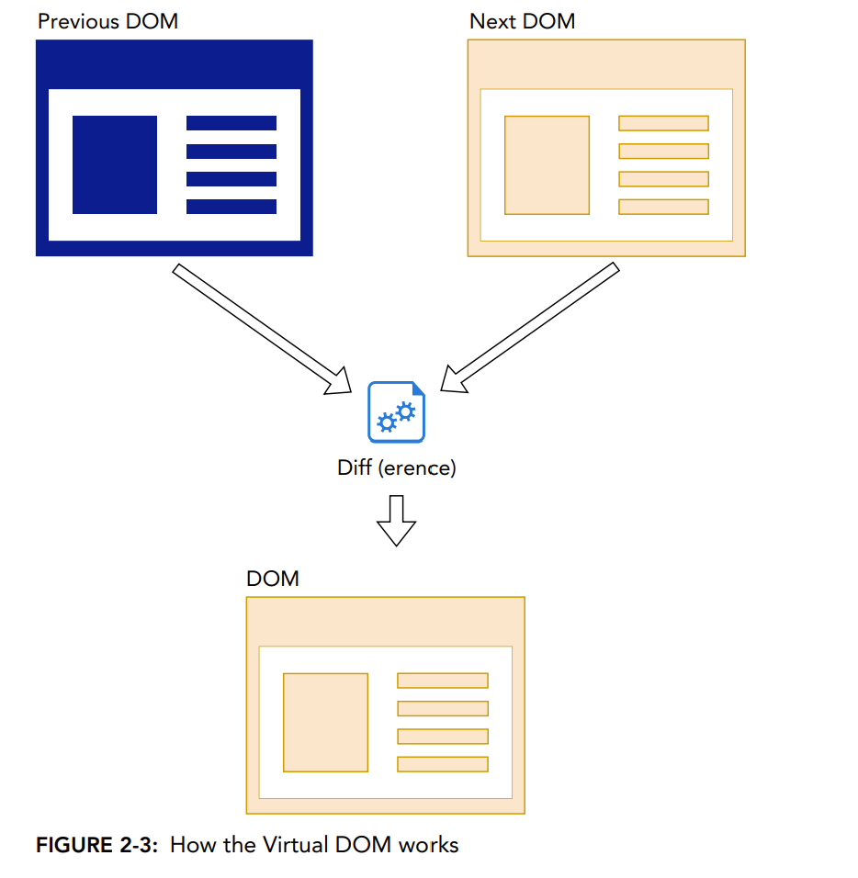

Slide 27
THE PHILOSOPHY OF REACT
1. Thinking in Components
React apps are built from components (small reusable pieces of UI).
Each component should have one responsibility (Single Responsibility Principle).

Slide 28
// A general Button component
function Button(props) {
return <button onClick={props.handleClick}>{props.label}</button>;
}
// A Submit button (special case, using the same Button)
function SubmitButton() {
return <Button label="Submit" handleClick={() => alert("Form Submitted!")} />;
}

Slide 29
Button is a reusable component.
It takes props (parameters) from outside:
  props.label → what text should appear inside the button.
  props.handleClick → what function should run when the button is clicked.
Example:
<Button label="Cancel" handleClick={() => alert("Cancelled!")} />
This would create a button that says Cancel and shows an alert when clicked.

Slide 30
Submit Button Component
function SubmitButton() {
return <Button label="Submit" handleClick={() => alert("Form Submitted!")} />;
}
Here, instead of writing a new button from scratch, we reuse the Button component.
We pass specific props:
label="Submit" → text on the button is Submit.
handleClick={() => alert("Form Submitted!")} → when clicked, it shows “Form Submitted!”

Slide 31
Without React, you’d probably write a new <button> every time with its own logic.
With React, you make one general Button → then reuse it by passing different props.
This follows the composition philosophy → build specific components by reusing general ones.

Slide 32
Composition vs. Inheritance
In Object-Oriented Programming (OOP), we often use inheritance.
Example in pseudo-code (Java / C++ style):
class Button {
void render() {
System.out.println("General Button");
}
}
class SubmitButton extends Button {
void render() {
System.out.println("Submit Button");
}
}

Slide 33
Imagine you are building a website with many types of buttons:
Submit button
Cancel button
Login button
Logout button
You have to make a new child class for every different type of button.
If you want to add one more (e.g., “Download Button”), you must create another class.
This becomes too many files, too much repetition, and is hard to maintain.

Slide 34
The React Way (Composition + Props)
React avoids this problem. Instead of creating a new child class every time, you just make one general Button and customize it using props.

Slide 35
function Button(props) {
return <button onClick={props.handleClick}>{props.label}</button>;
}
// Specific cases using the same Button
function App() {
return (
<div>
<Button label="Submit" handleClick={() => alert("Form Submitted!")} />
<Button label="Cancel" handleClick={() => alert("Cancelled!")} />
<Button label="Login" handleClick={() => alert("Logged In!")} />
<Button label="Logout" handleClick={() => alert("Logged Out!")} />
</div>
);
}
Only one Button component exists.
Different types (Submit, Cancel, Login, Logout) are created by changing props.
No duplicate classes. No huge inheritance tree. Easy to maintain.

Slide 36
React Is Declarative
Imperative Programming (Step by Step Instructions)
In imperative programming, you tell the computer exactly how to do something, step by step.
Example with jQuery:
<p id="para1">Old text</p>
<script>
// Imperative approach
$('#para1').html('<p>This is the new paragraph.</p>');
</script>

Slide 37
Explanation:
You tell the browser:
  Go find the element with id="para1".
  Replace its inner HTML with new text.
You (the programmer) are in charge of how the DOM changes.
This is like telling a robot:
Walk to the bread.
Open the bag.
Take out two slices.
Find a knife… etc.

Slide 38
Declarative Programming (Describe the End Result)
In declarative programming, you just describe what you want, not how to do it.
The system (React in this case) figures out the steps.
Example with React:
function App() {
return <p>This is the new paragraph.</p>;
}

Slide 39
Explanation:
You don’t manually find the paragraph or replace text.
You just say: “The UI should look like this.”
React compares old UI vs new UI using the Virtual DOM and updates only what’s changed.
This is like telling a robot:
“Make me a peanut butter sandwich.”
The robot already knows the steps, so you don’t have to explain them.

Slide 40
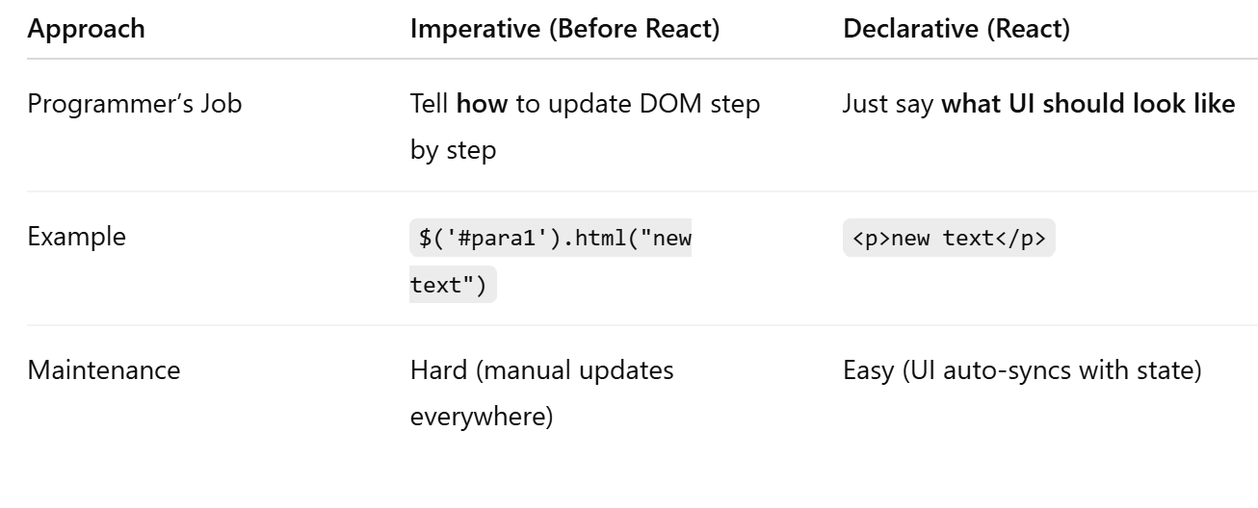

Slide 41
React Is Idiomatic
React is just JavaScript with a small set of extra tools.
If you already know JavaScript, React won’t feel alien — it uses familiar patterns.
The more JavaScript features you learn (functions, objects, ES6+, arrow functions, destructuring, classes), the better you get at React.

Slide 42
Javascript
function greet(name) {
return "Hello, " + name;
}
console.log(greet(“Anitha")); // Hello, Anitha
React component (same idea, just returns JSX):
function Greet(props) {
return <h1>Hello, {props.name}</h1>;
}

Slide 43
Both are functions.
One returns a string ("Hello, Shruti") → normal JS.
One returns JSX (<h1>Hello, Shruti</h1>) → React.
So, React components are just functions in JavaScript.
That’s why it’s called idiomatic → looks natural if you already know JS.

Slide 44
React vs Angular
1. Library vs Framework
React: Just a library (a tool) for building UI with components.
Like Lego blocks — you choose what other tools you need.
Angular: A framework (full system) with everything built-in (routing, forms, HTTP, etc.).
Like a full Lego kit — you get everything, but it’s heavier and has rules.

Slide 45
2. Learning Curve
React: Easier to start (just JavaScript + JSX).
Angular: Harder to start → you must also learn TypeScript and Angular’s rules.
3. DOM Handling
React: Uses Virtual DOM (makes updates fast).
Angular: Uses Real DOM + Change Detection (updates directly but can be slower).

Slide 46
With Angular (Real DOM + Change Detection):
Angular makes this automatic using two-way data binding ([(ngModel)]).
<input [(ngModel)]="username" placeholder="Type your name">
<p>Hello {{username}}</p>
And in Angular’s component code:
export class AppComponent {
username: string = "";
}
Angular watches (detects changes) in the username variable.
If the model changes (username = “Anitha"), Angular updates the <p> automatically.
If the user types in the input, Angular updates the variable username.
This is called Change Detection. Angular checks the real DOM for changes and keeps the UI + data in sync.

Slide 47
4. Data Flow
React: One-way data flow
  Data goes one direction: from parent → child.
  Example:
function Child({ message }) {
return <p>{message}</p>;
}
function Parent() {
return <Child message="Hello from Parent!" />;
}
Child gets data from Parent. If Parent changes, Child updates.
But Child cannot directly change Parent’s data.

Slide 48
Angular: Two-way data binding
  Data flows both ways: View ↔ Model.
Example (Angular style with [(ngModel)]):
<input [(ngModel)]="username">
<p>Hello {{username}}</p>
  If user types in the input, the username variable changes.
  If the code changes username, the input updates automatically.

Slide 49
React (one-way data flow):
Like giving instructions to your assistant:
You tell them what to do → they do it.
If you change your mind, you give new instructions.
The assistant never changes your mind on their own.
Angular (two-way binding):
Like a walkie-talkie conversation:
You talk, and they reply at the same time.
Both sides can change the situation directly.

Slide 50
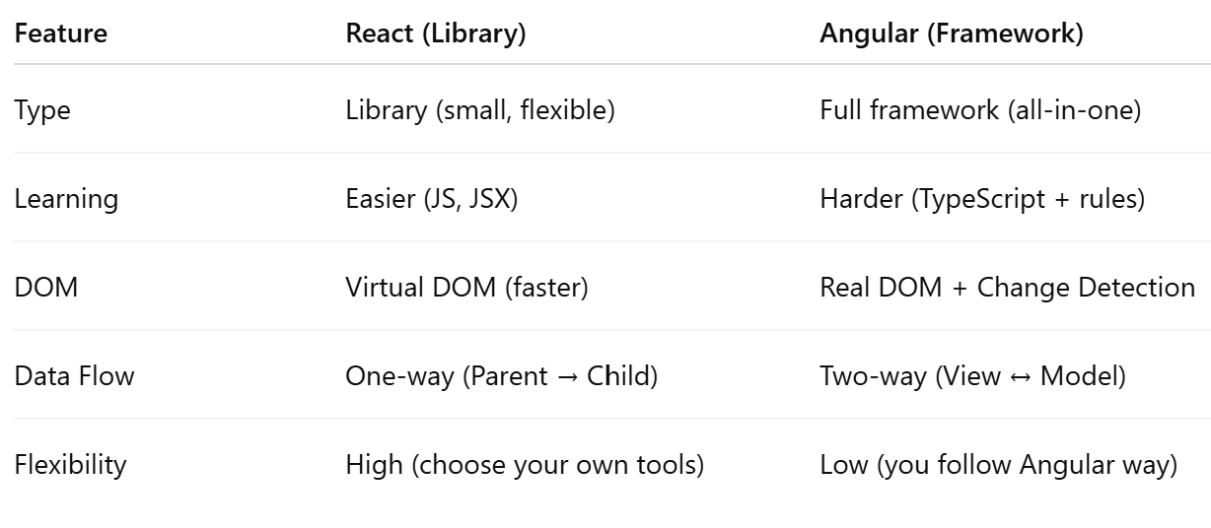

Slide 51
Similarities (React & Vue)
Both are used to build modern, dynamic user interfaces.
Both use components (small reusable UI pieces).
Both support props (data passing) and state (data storage).
Both are fast, thanks to Virtual DOM.

Slide 52
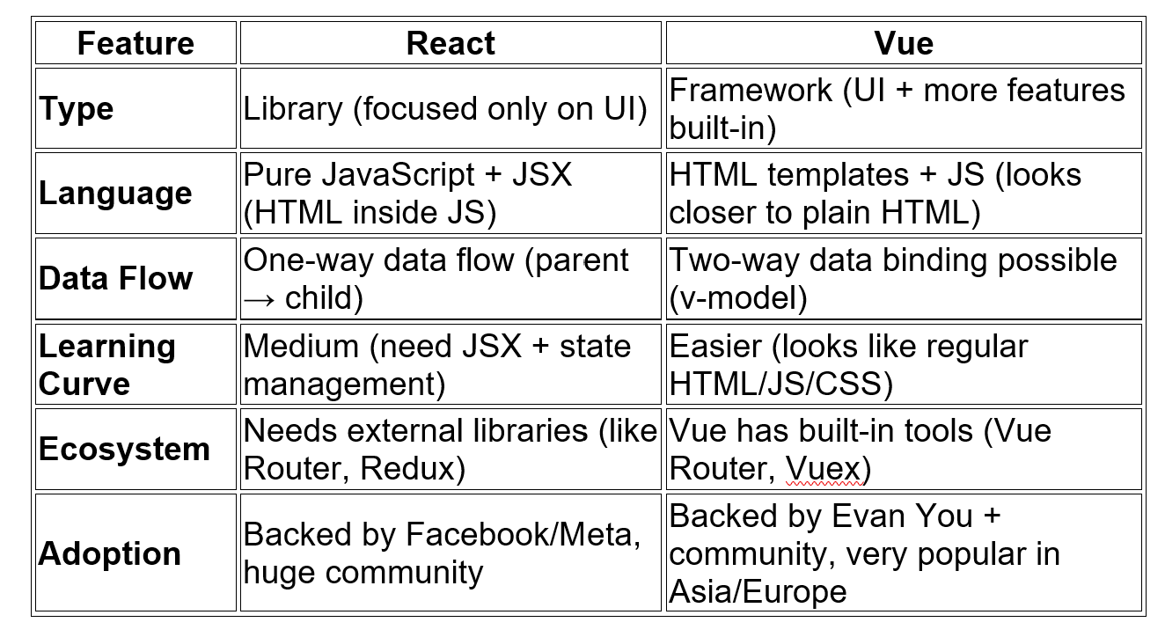

Slide 53
What React Is Not
React is a front-end library for building user interfaces, running entirely in the browser. It does not replace servers, databases, or development tools, and it is not a one-size-fits-all solution.

Slide 54
React Is Not a Web Server
React cannot handle HTTP requests or serve web pages.
A web server sends React (and other JS/CSS/HTML files) to the browser, but React itself cannot act as the server.
React only runs in the browser and interacts with it via JavaScript APIs.

Slide 55
Example
Suppose you visit www.example.com.
The web server sends you:
index.html (the structure)
style.css (the styling)
app.js (React library and your React code)
Your browser opens these files.
React runs in the browser and dynamically updates the page:
Shows a list of products
Changes the content when you click a button
But React cannot serve new pages to other people on its own; that’s the server’s job.

Slide 56
React Is Not a Programming Language
React is a JavaScript library, not a language.
It’s a collection of pre-written JavaScript functions to simplify creating dynamic user interfaces.
You could, in theory, write React functionality yourself purely in JavaScript, but the library saves you time.
React Is Not a Database Server
React cannot store data permanently or securely.
Dynamic data in a React UI (like session data) is temporary.
Persistent data must be handled via server-side databases, APIs, or browser storage (cookies/local storage).

Slide 57
React Is Not a Development Environment
React does not require any specific tools or IDEs.
You can write React code with any text editor or toolchain.
Common tools (like Node.js, npm, or Vite) are optional; they just make development easier.
React is just a library. You can run it in a plain HTML file or use modern tools to improve development speed and workflow.
React Is Not the Perfect Solution for Everything
React is great for many applications, but it’s not ideal for all situations(Simple, Static Websites, Heavy Backend Processing Apps, Non-Web Applications,etc)
Knowing other languages and libraries helps you choose the best tool for the job rather than defaulting to React.

Slide 58
JSX is not HTML
function Login(){
const handleSubmit = (e) => {
e.preventDefault();
console.log(`logging in ${e.target[0].value}`);
// do something else here
}

Slide 59
return (
<form id="login-form" onSubmit={handleSubmit}>
<input type="email" id="email" placeholder="E-Mail Address"/>
<input type="password" id="password"/>
<button>Login</button>
</form>
);
}
export default Login;

Slide 60
The function Login() is a React component.
Inside the return, it looks like you’re returning HTML, but it’s actually JSX.
JSX allows you to write XML-like syntax in JavaScript, which React then compiles into regular JavaScript (calls to React.createElement) under the hood.

Slide 61
What is JSX?
JSX stands for JavaScript XML.
It is an XML-like syntax that you can write inside JavaScript.
It allows you to describe what your UI should look like in a syntax that resembles HTML.

Slide 62
Why it’s not HTML
Even though it looks like HTML:
It’s embedded in JavaScript, so you can’t just paste raw HTML in a JS file.
Every JSX element must be closed, even <input /> or <br />.
Some attribute names are different:
  class → className
  for → htmlFor
You can embed JavaScript expressions inside JSX using {} braces.

Slide 63
For example:
const username = “React";
return <p>Hello, {username}!</p>;
This will render: Hello, React!

Slide 64
The JSX you wrote:
<form id="login-form" onSubmit={handleSubmit}>
<input type="email" id="email" placeholder="E-Mail Address"/>
<input type="password" id="password"/>
<button>Login</button>
</form>

Slide 65
Gets compiled by React into something like this:
React.createElement(
"form",
{ id: "login-form", onSubmit: handleSubmit },
React.createElement("input", { type: "email", id: "email", placeholder: "E-Mail Address" }),
React.createElement("input", { type: "password", id: "password" }),
React.createElement("button", null, "Login")
);
So, it becomes pure JavaScript, which the browser can execute.

Slide 66
JSX = JavaScript + HTML-like syntax.
It cannot run directly as HTML, but React transforms it into JavaScript that manipulates the DOM.
This makes React components declarative and readable, letting you visualize UI while staying in JavaScript.

Slide 67
JSX Syntax
JSX ≠ HTML
JSX looks like HTML but it's actually JavaScript XML — which means it has stricter rules than HTML.
XML-Like Rules in JSX
All elements must be closed
<br /> ✅ <br> ❌ Since JSX is JavaScript, every tag needs to be properly closed. This ensures that the code is syntactically correct when it's converted to JavaScript.
Empty elements need a self-closing slash- Certain HTML elements don’t have children, and these are known as "empty elements." Examples include <img>, <br>, <input>, <link>, etc. In HTML, you might write them without a closing tag (e.g., <br>), but in JSX, they must be self-closed with a slash (/).<img src="image.jpg" alt="description" />

Slide 68
Non-empty elements
<div>
<h1>Welcome to my site</h1>
<p>This is a paragraph inside a div.</p>
</div>
<p>This is a paragraph.</p>
<h1>This is a main heading</h1>
<a href="https://www.example.com">Click here to visit Example</a>

Slide 69
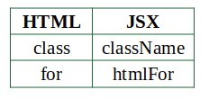
3. String attributes must be in quotes
<input type="text" name="username" />
4. HTML tags must be lowercase
<div></div> ✅ <Div></Div> ❌
5. Reserved HTML Attribute Names (due to JS conflicts)
<label htmlFor="username">Username</label>
JS:
<label for="username">Username</label>

Slide 70
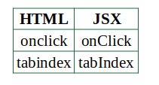
6. camelCase for Multi-Word Attributes
In JSX, multi-word HTML attributes are camelCased:
7. Custom Attributes
For Built-in DOM Elements
Before React 16: Use data- prefix. <div data-color="blue" data-size="large">My Item</div>
React 16+: Can use any attribute name (though still not best practice).
<div color="blue" size="large">My Item</div>

Slide 71
For User-Defined Components
Custom attributes = props for components:
<MyWidget widgetSize="large" color="blue" />
8. Boolean Attributes
You can omit the value or pass true:
<input disabled /> // ✅
<input disabled={true} /> // ✅

Slide 72
9. Embedding JavaScript: Use {}
For values that are dynamic (like variables or functions), wrap in curly braces:
<input value={props.term} onChange={(e) => props.onChange(e.target.value)} />
10. Object Literals = Double Curly Braces
Use double braces for inline style objects:
<h1 style={{ fontSize: "24px", color: "blue" }}>Hello</h1>
The first pair of curly braces {} is for JSX to evaluate the JavaScript expression. The second pair {} is for the object literal.
11. Comments in JSX
Use JavaScript block comments, wrapped in {}:
{/* This is a comment */}

Slide 73
function MyComponent(props) {
return (
<div className="container">
{/* This is a header */}
<h1 style={{ fontSize: "20px", color: "green" }}>
Hello, {props.username}
</h1>

Slide 74
<input
type="text"
name="search"
value={props.searchTerm}
onChange={(e) => props.onChange(e.target.value)}
disabled
/>
</div>
);
}

Slide 75
Install Node.js (if you don’t already have it). - https://nodejs.org/en/download
npx create-react-app my-app
# OR (faster)
npm create vite@latest my-app
cd my-app
npm install

Slide 76
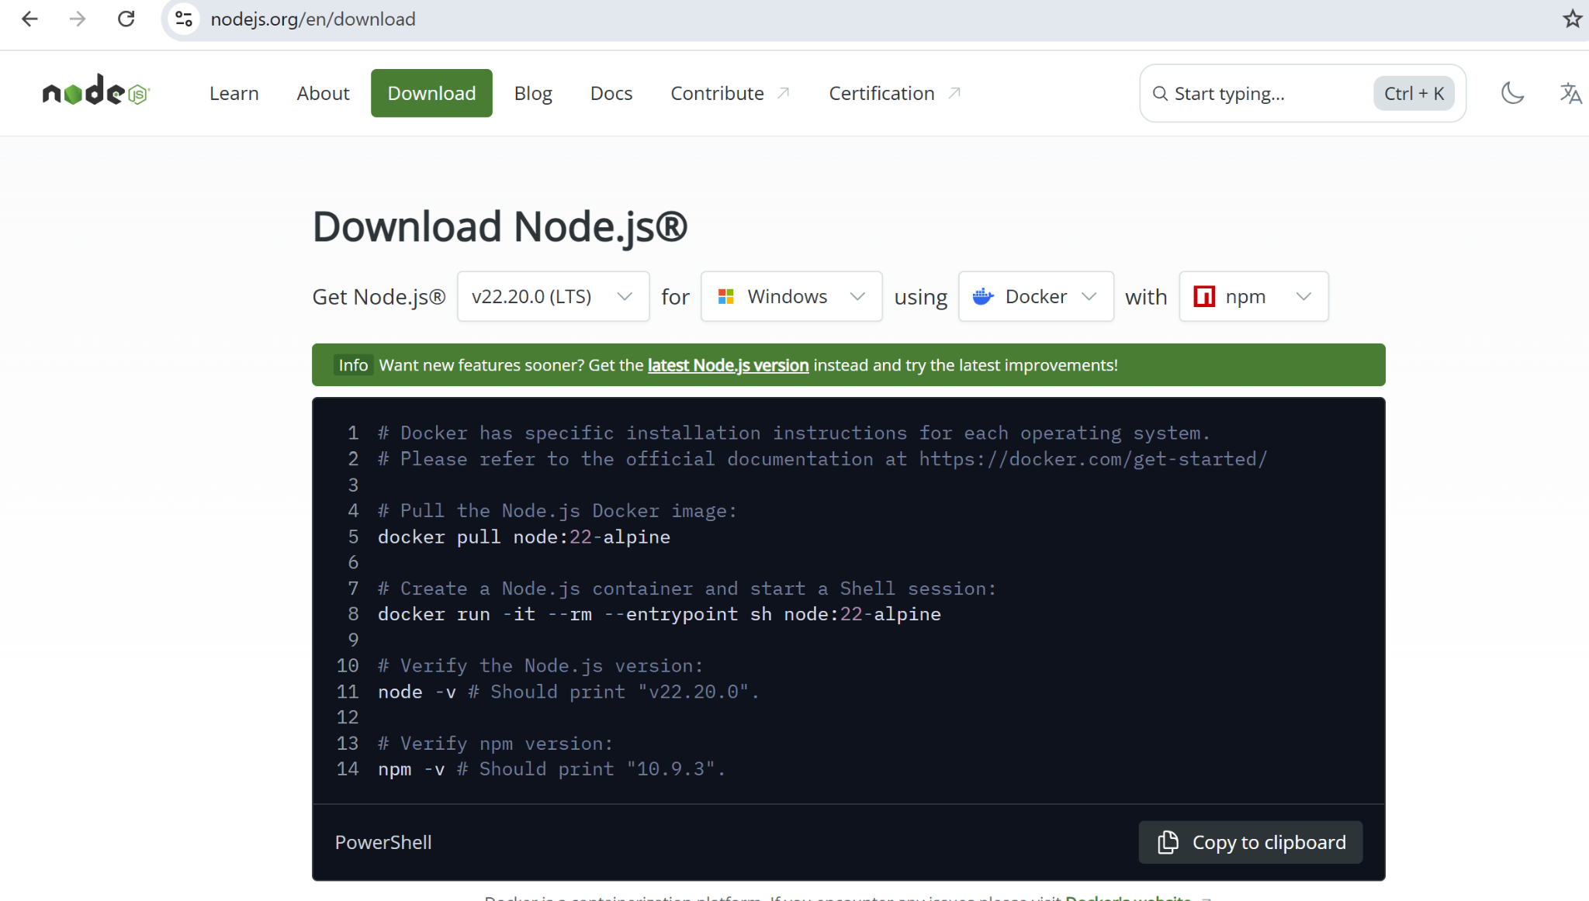

Slide 77
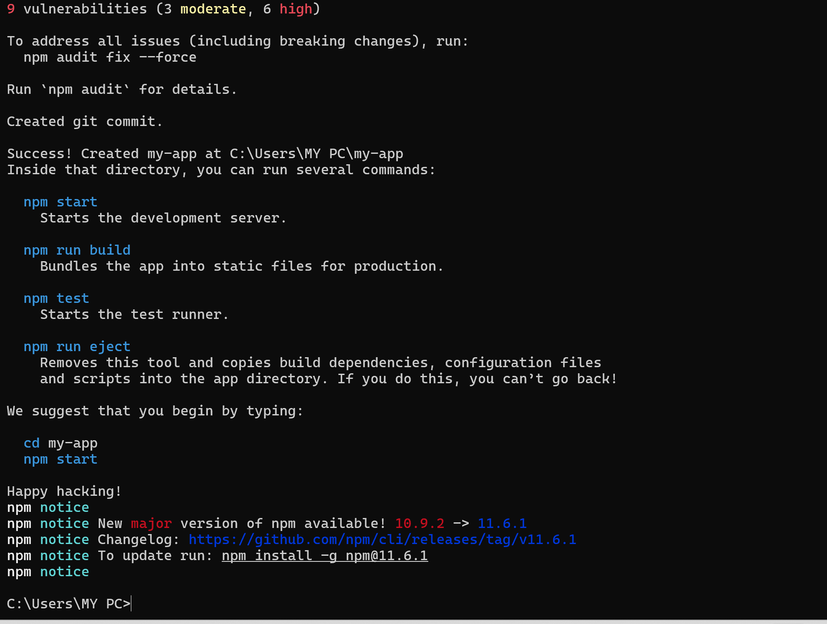

Slide 78
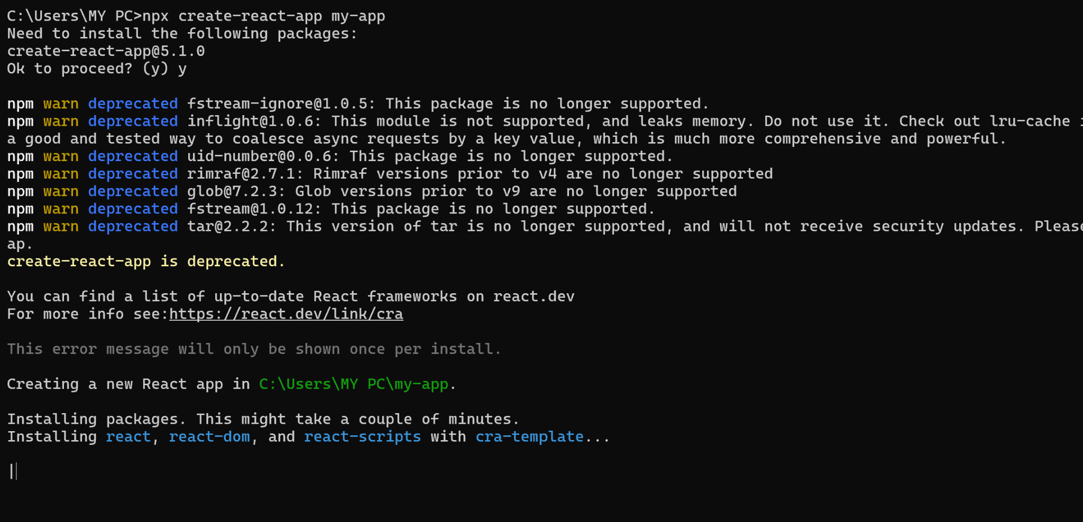

Slide 79
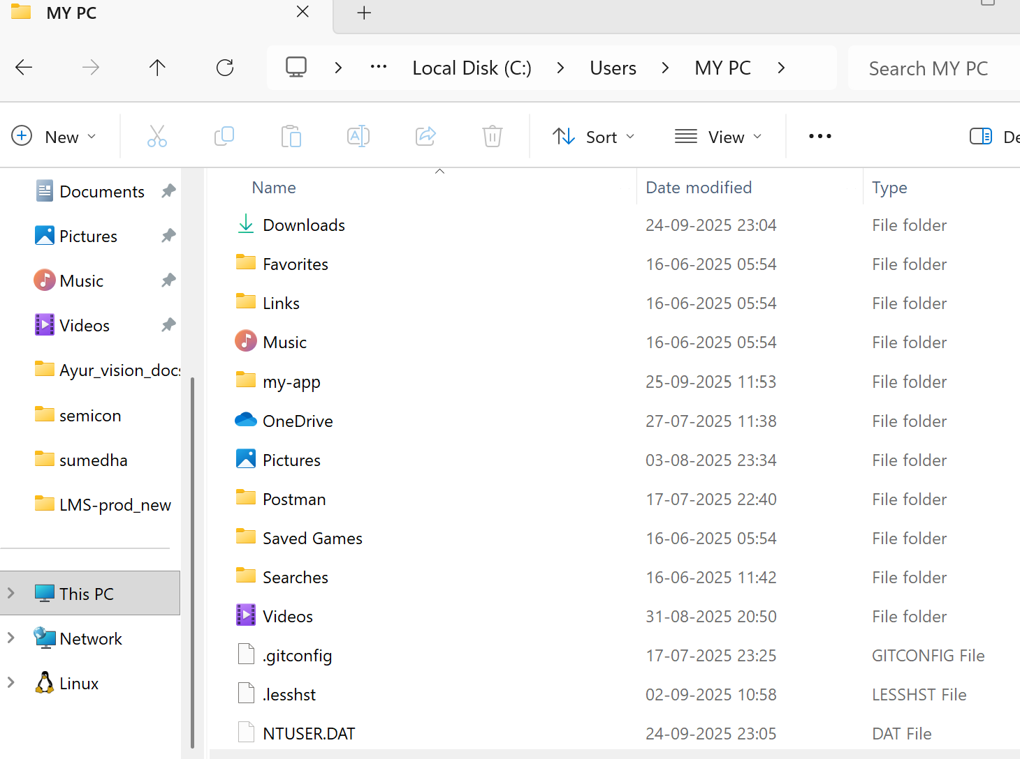

Slide 80
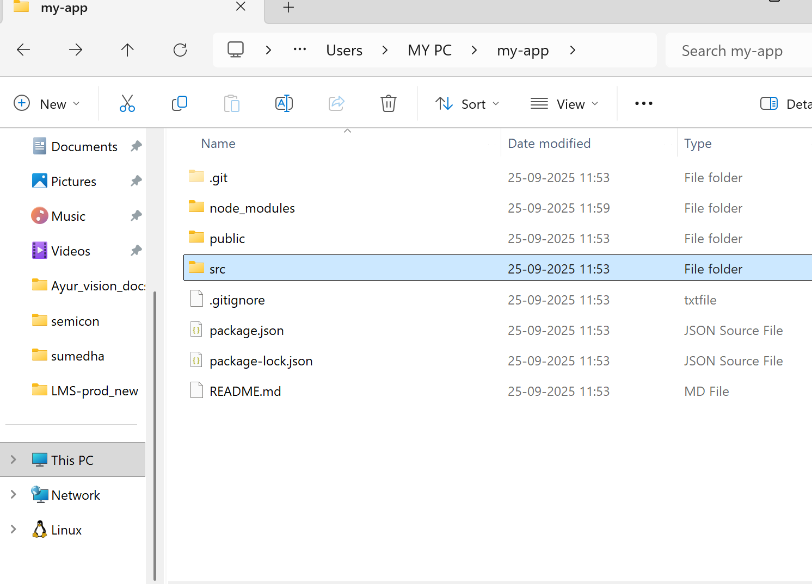

Slide 81
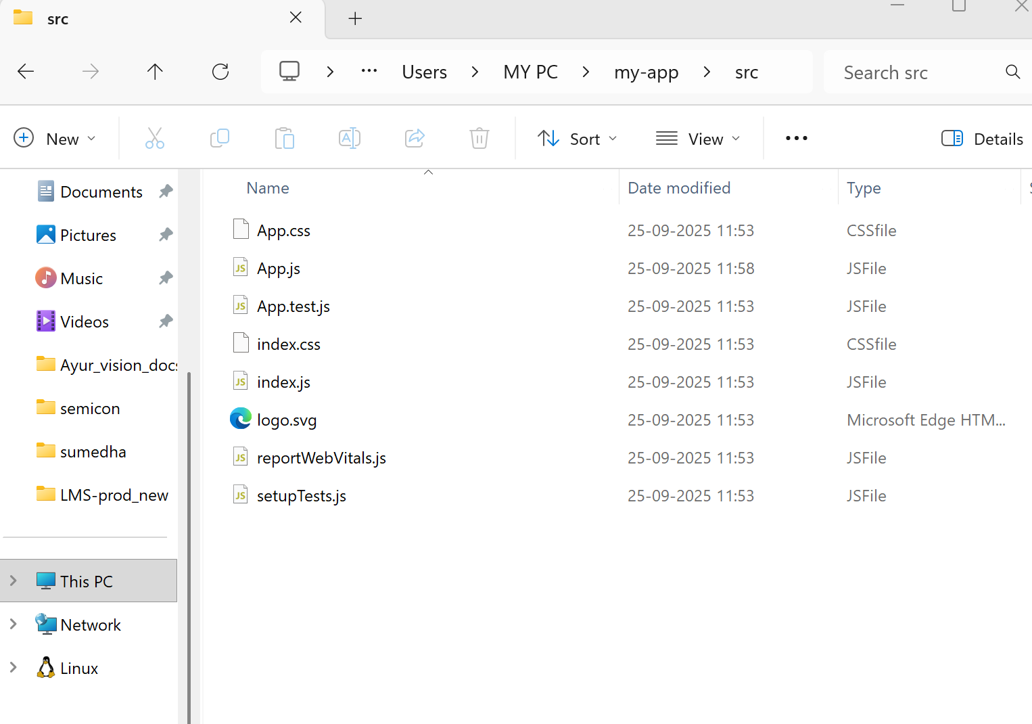

Slide 82
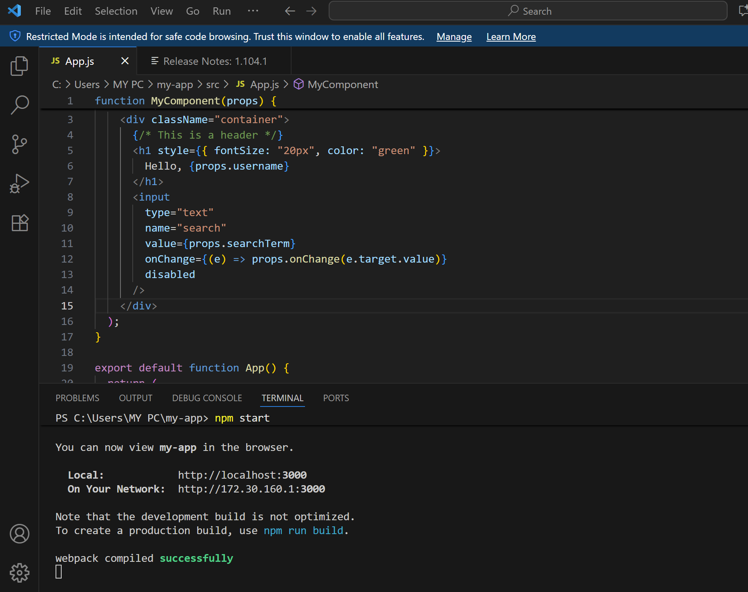

Slide 83
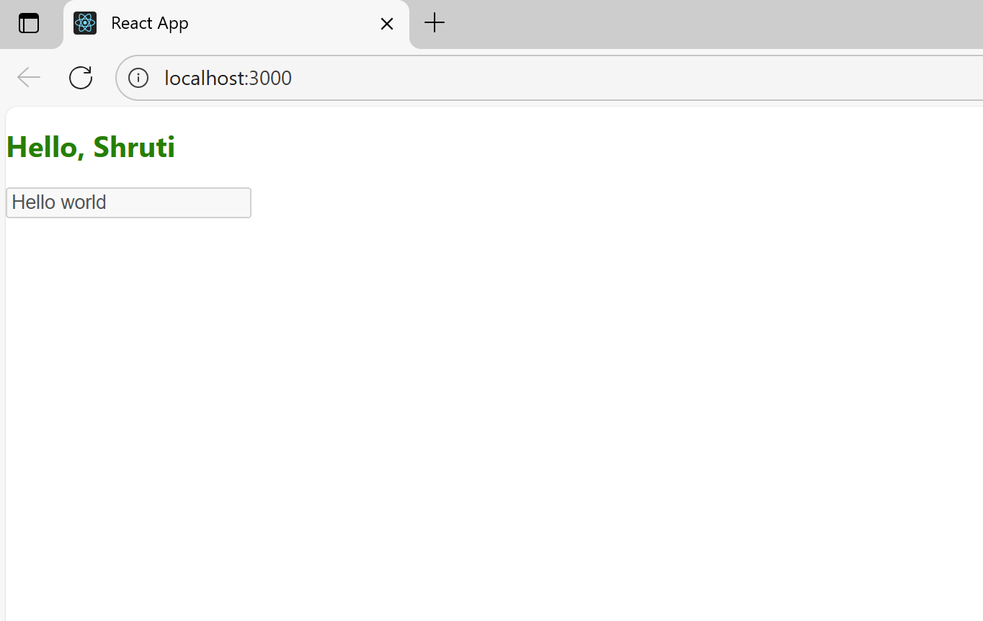

Slide 84
What is Conditional Rendering?
It means:
“Show this only if some condition is true.”
Or: “Show A if condition is true, otherwise show B.”
In React, we often need this when showing different UI for logged in vs logged out users, error messages, loading screens, etc.

Slide 85
1. Conditional Rendering with if/else + element variables
import Header from './Header';
import Login from './Login';
function Welcome({ loggedIn }) {
let content;
if (loggedIn) {
content = <Header />;
} else {
content = <Login />;
}

Slide 86
return (
<div>
{content}
</div>
);
}
export default Welcome;
What happens:
If loggedIn = true → <Header /> is shown.
If loggedIn = false → <Login /> is shown.

Slide 87
function Welcome({ loggedIn }) {
let message;
if (loggedIn) {
message = <h2>Welcome back!</h2>;
} else {
message = <h2>Please log in</h2>;
}

Slide 88
return (
<div>
{message}
</div>
);
}

Slide 89
function App() {
let isLoggedIn = true;
if (isLoggedIn) {
return <h1>Welcome, User!</h1>;
}
else {
return <h1>Please Login</h1>;
}
}
export default App;

Slide 90
2. Conditional Rendering with && (logical AND)
import Header from './Header';
function Welcome({ loggedIn }) {
return (
<div>
{loggedIn && <Header />}
Note: if you don't see the header, you're not logged in.
</div>
);
}
export default Welcome;
How it works:
loggedIn && <Header /> means:
  If loggedIn = true → show <Header />.
  If loggedIn = false → show nothing.

Slide 91
3. Conditional Rendering with ? : (Ternary Operator)
import Header from './Header';
import Login from './Login';
function Welcome({ loggedIn }) {
return (
<div>
{loggedIn ? <Header /> : <Login />}
</div>
);
}
export default Welcome;
How it works:
If loggedIn = true → show <Header />.
If loggedIn = false → show <Login />.

Slide 92
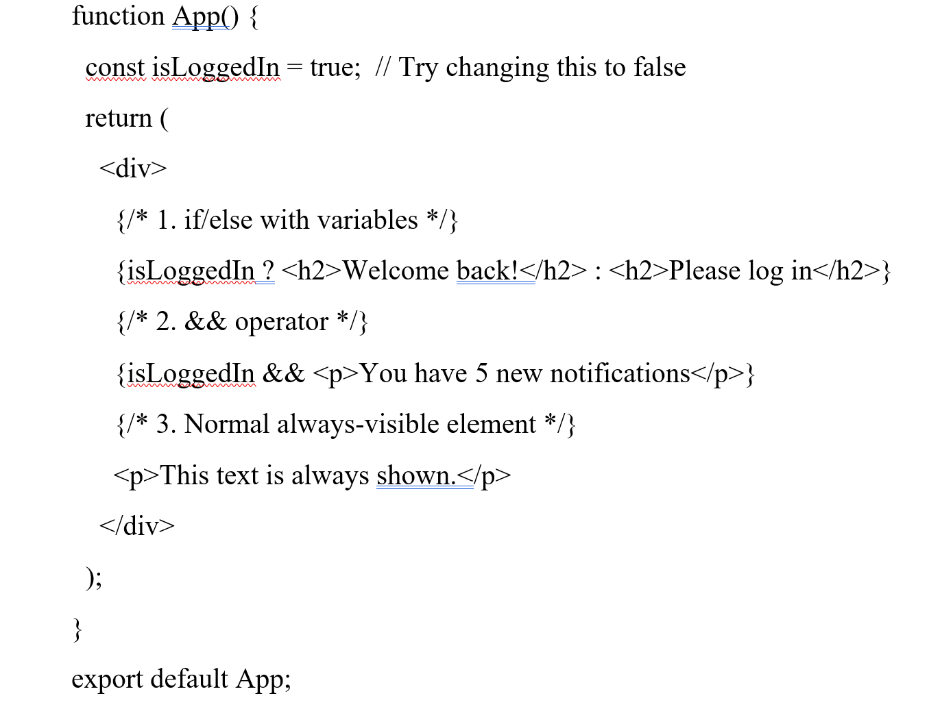

Slide 93
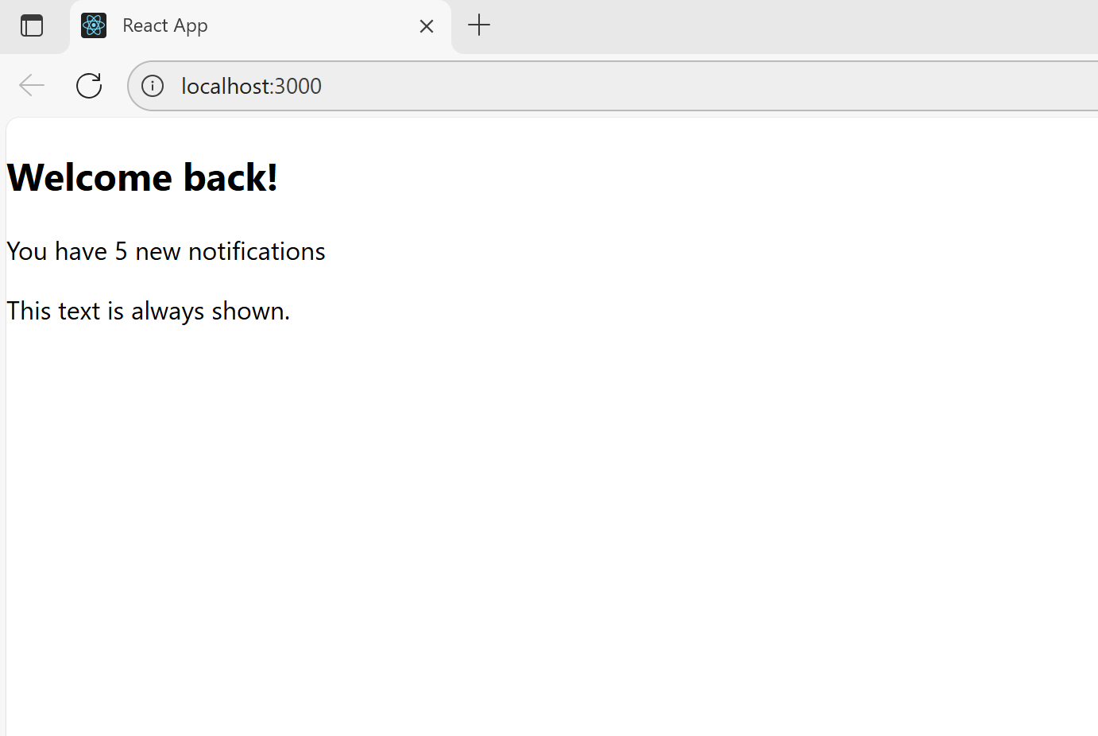

Slide 94
Expressions in JSX
What can go inside { }?
Numbers: {1+1} → shows 2
Strings: {"Hello " + "World"} → shows Hello World
Variables: {username}
Function calls: {myFunction()}
Immediately invoked functions: {(() => "value")()}

Slide 95
What cannot go directly inside { }?
if statements
for loops
Function declarations
These don’t produce a value directly, so you must run them outside JSX.

Slide 96
Examples:
<h1>{1 + 1}</h1>
function App() {
return (
<div>
<h1>{1 + 1}</h1>
<h1>{10 * 5}</h1>
<h1>{100 / 4}</h1>
</div> ); }
export default App;
3. <p>My age is {20 + 5}</p>
4. <h1>{"Hello " + "World"}</h1>

Slide 97
import { useState } from "react";
function CountUp() {
const [count, setCount] = useState(0);
return (
<div>
{/* Button calls a function (expression) on click */}
<button onClick={() => setCount(count + 1)}>Add One</button>
{/* Expression: shows the value of count */}
{count}
</div>
);
}
export default CountUp;
Here:
onClick={() => setCount(count+1)} is an arrow function (expression).
{count} is also an expression (value of the variable count).

Slide 98
Example 2: Immediately Invoked Function
function ImmediateInvoke() {
return (
<div>
{(() => <h1>The Header</h1>)()}
</div>
);
}
export default ImmediateInvoke;
Here:
Inside { }, we create a function:
() => <h1>The Header</h1>
Then immediately call it with ().
So it returns <h1>The Header</h1> which JSX can render.

Slide 99
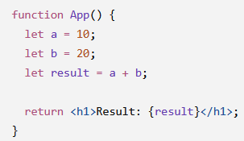
Why would we use an IIFE in JSX?
It can be useful when you need several JavaScript statements or a small calculation inside JSX.
function App() {
return (
<div>
{(() => {
let a = 10;
let b = 20;
let result = a + b;
return <h1>Result: {result}</h1>;
})()}
</div>
);
}
export default App;

Slide 100
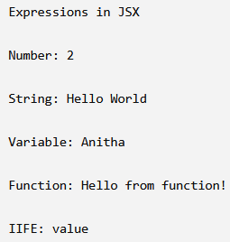
Using all five together: output:
function myFunction() {
return "Hello from function!";
}
function App() {
let username = "Anitha";
return (
<div>
<h1>Expressions in JSX</h1>
<p>Number: {1 + 1}</p>
<p>String: {"Hello " + "World"}</p>
<p>Variable: {username}</p>
<p>Function: {myFunction()}</p>
<p>IIFE: {(() => "value")()}</p>
</div>
);
}
export default App;

Slide 101
Using Children in JSX
The rule
A React component’s return statement must return only one “thing”.
That “thing” can be:
  A string: "Hello"
  A number: 123
  A Boolean: true or false
  An array: [<A />, <B />]
  A single JSX element
Even if you want to show multiple elements, they must be inside a single parent element.

Slide 102
Example of invalid JSX
return(
<MyComponent />
<MyOtherComponent />
);
This is wrong because there are two sibling elements at the top level.
React doesn’t know which one to return.

Slide 103
Fix: Wrap with a parent element
return(
<div>
<MyComponent />
<MyOtherComponent />
</div>
);
Now it’s valid JSX because:
There is one parent <div> wrapping the children.
React sees one element being returned, but inside it can have many children.

Slide 104
Alternative: Using React Fragments
If you don’t want an extra <div>, you can use React Fragment:
return(
<>
<MyComponent />
<MyOtherComponent />
</>
);
<> ... </> is a special tag that won’t render extra HTML.
It still allows multiple children to be returned.

Slide 105
What are React Fragments?
When you return multiple JSX elements from a component, React requires one parent element.
Sometimes people wrap them in <div>…</div> just to satisfy this rule.
But adding extra <div>s creates unnecessary HTML, which can make your HTML messy and affect styling or accessibility.
React Fragment solves this problem:
It wraps multiple elements into a single JSX element
But doesn’t create extra HTML in the DOM

Slide 106
How to use React.Fragment : Using <React.Fragment>
import React from "react";
function MyComponent() {
return (
<React.Fragment>
<h1>The heading</h1>
<h2>The subheading</h2>
</React.Fragment>
);
}
export default MyComponent;
Here <h1> and <h2> are children of <React.Fragment>.
No extra <div> is added in the HTML.

Slide 107
Using Fragment from React
import { Fragment } from "react";
function MyComponent() {
return (
<Fragment>
<h1>The heading</h1>
<h2>The subheading</h2>
</Fragment>
);
}
export default MyComponent;

Slide 108
Short syntax: <> </>
function MyComponent() {
return (
<>
<h1>The heading</h1>
<h2>The subheading</h2>
</>
);
}
export default MyComponent;
Shortest and cleanest way.
No import needed.
Works exactly the same as <Fragment>

Slide 109
What is JSX Transform?
JSX is not valid JavaScript on its own. Browsers cannot understand it.
The JSX transform is the process of converting JSX into plain JavaScript that browsers can run.
🔹 Example
JSX code:
const element = <h1 className="title">Hello, React!</h1>;

Slide 110
After JSX transform (by Babel):
const element = React.createElement(
"h1",
{ className: "title" },
"Hello, React!"
);
<h1> → "h1" (type)
className="title" → { className: "title" } (props)
"Hello, React!" → child of the element
This is plain JavaScript, which the browser can execute.

Slide 111
Why JSX Transform is needed
JSX looks like HTML but is not JavaScript.
React needs React.createElement calls to build elements.
Babel or another compiler transforms JSX → JS automatically.

Slide 112
What is Babel?
Babel is a JavaScript compiler.
It allows you to write modern JavaScript and JSX and converts it into browser-compatible JavaScript.
Browsers cannot understand JSX directly. Babel turns JSX into plain JavaScript.

Slide 113
Why we need Babel with React
React code often looks like this:
function App() {
return <h1>Hello, World!</h1>;
}
<h1>Hello, World!</h1> is JSX, not valid JavaScript.
Browsers don’t understand JSX.
Babel compiles it to this:

Slide 114
function App() {
return React.createElement("h1", null, "Hello, World!");
}
Now the browser can run it because it’s plain JS.

Slide 115
Example with JSX and Babel
Input (JSX):
const element = <h1>Hello React!</h1>;
Compiled by Babel (JavaScript):
const element = React.createElement("h1", null, "Hello React!");
React.createElement → React’s way to create DOM elements.
Every JSX tag is converted to a React.createElement call.

