Slide 1
Image Super Resolution
Using GANs
P. Anantha Rohan K. Bhargav Ram
(160116737034) (160116737036)

Slide 2
Super Resolution:
What is IMAGE RESOLUTION?
Resolution refers to the number of pixels in an image.
Super-resolution imaging (SR) is a class of techniques that enhance the resolution of an imaging system.

Slide 3
Generative Adversarial Networks:
GANs or Generative Adversarial Networks are a class of artificial intelligence algorithms used in unsupervised machine learning.
GANs can be grouped into three buckets:
Given a label, they predict the associated features.
Given a hidden representation, they predict the associated features.
Given some of the features, they predict the rest.

Slide 4
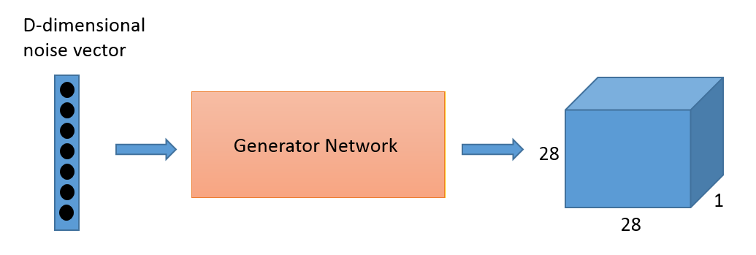
“Generative” Part:
Called the Generator.
Given a certain label, tries to predict features.
Ex: Given an email is marked as spam, predicts (generates) the text of the email.

Slide 5
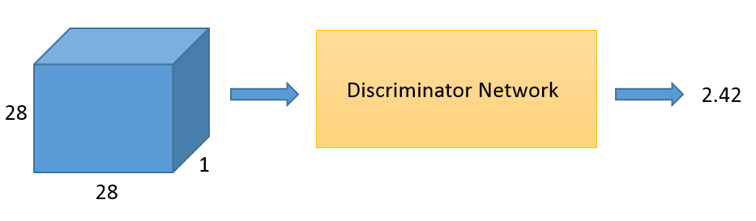
“Adversarial” Part:
Called the Discriminator.
Given the features, tries to predict the label.
Ex : Given the text of an email, predicts (discriminates) whether spam or not-spam.

Slide 6
Purpose and Prerequisites:
The purpose of this project is Super Resolution of images using Super Resolution Generative Adversarial Network or SRGAN.
Software Specifications:
Languages - Python
Frameworks - TensorFlow and TensorLayer (for neural networks)
SciPy and NumPy (image manipulation)

Slide 7
Datasets & Working Environment:
Div2k dataset:
1000 2K resolution images.
800 images for training.
100 images for validation & 100 images for testing.
Google Colaboratory:
Free-to-use cloud service with jupyter notebook env.
Xeon Processors & K80 cuda core GPU
12GB DDR4 RAM & 33GB Disk Space

Slide 8
Working of SRGAN:
A GAN typically consists of two CNNs. So operations like Convolution, BatchNormalization & Pooling are predominant.
Apart from the above the training parameters for a Generator include calculating losses from discriminator and VGG19 network.
Initially discriminator easily knocks-off the fake HR images generated by the Generator part.
Over a period of training, HR images generated by generator will be able to fool the discriminator.

Slide 9
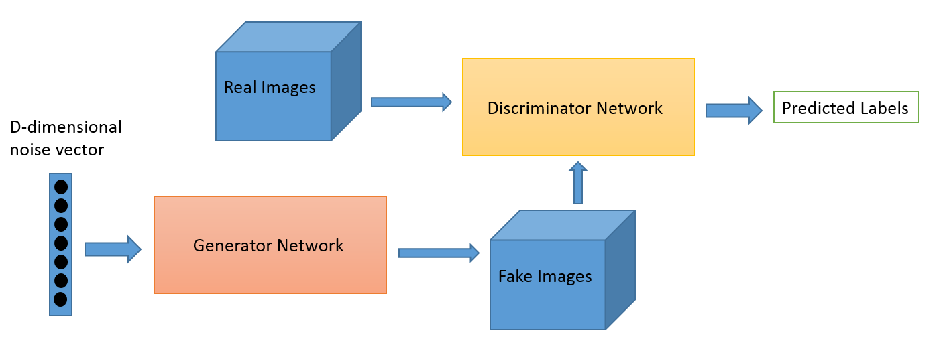
Schema of SRGAN:

Slide 10
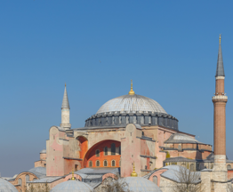
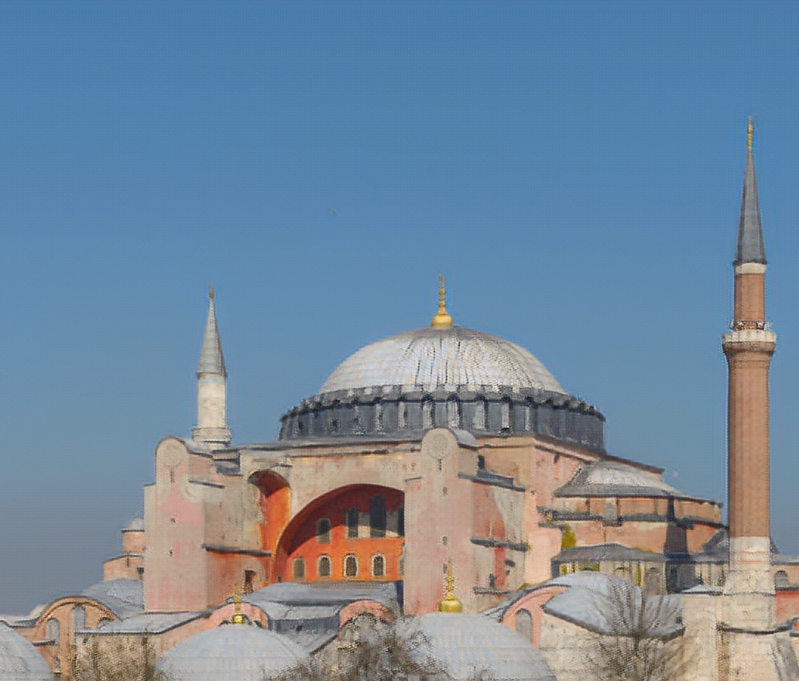
RESULT
Low Resolution Image
High Resolution Image

Slide 11
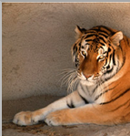
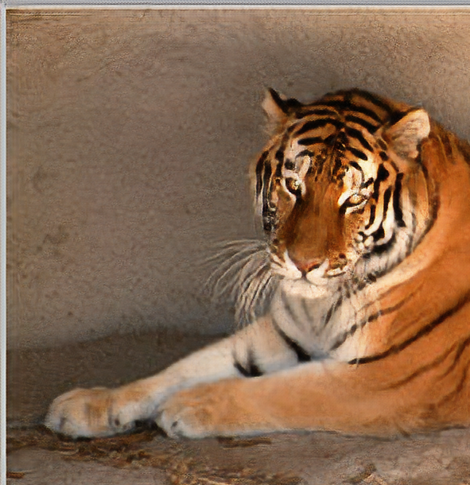
RESULT
Low Resolution Image
(input)
High Resolution Image
(output)

Slide 12
Conclusion and Future Scope:
GANs is one of the trending fields in Machine Learning and a wide range of research is being done.
SRGAN is one of the many applications of GAN. Training a GAN with a proper dataset yields a better SRGAN.
Create a user accessible application with the model extracted from SRGAN.

Slide 13
Bibliography:
Photo-Realistic Single Image Super-Resolution Using a Generative Adversarial Network by Christian Ledig, Lucas Theis, Ferenc Huszar etc; The IEEE Conference on Computer Vision and Pattern Recognition (CVPR), 2017.
Tensor Layer: https://github.com/tensorlayer/srgan
DIV2K dataset: https://data.vision.ee.ethz.ch/cvl/DIV2K/
Medium Article : An Intuitive Introduction to Generative Adversarial Networks, SRGAN by Jonathan Hui

Slide 14
THANK YOU!
We’re open to questions & queries

