Slide 1
SAFEHER
A Smart Travel Companion for Women
Presented by: Ananthalakshmy R
Register No: MLM25MCA2019
Department: Department of Computer Applications
Course: MCA
College: Mangalam College Of Engineering
Academic Year: 2026 – 2027
Guide: Mrs Anju John, Assistant Professor

Slide 2
Introduction
SafeHer is a web-based travel companion that brings emergency alerts, safe stays, nearby help and AI guidance into one platform for women travellers.
Women travelling alone face real risks, yet safety tools are scattered across separate apps for maps, bookings, reviews and emergency calls.
To give women a fast, reliable way to ask for help, find verified women-friendly stays and travel with confidence.
A single trusted platform shortens response time in emergencies and lets the community share safety experiences that guide others.
2

Slide 3
Abstract
SafeHer is a smart web platform that enhances the safety and confidence of women while travelling.
Women travelling alone lack one dependable place for instant emergency alerts, verified stays, nearby help and trusted guidance.
One-tap SOS with live location sharing, wearable and voice-triggered alerts, verified women-friendly stays, community reviews, an AI safety chatbot and an admin panel.
React.js, Node.js with Express, MySQL, JWT authentication, Socket.IO, OpenStreetMap with OSRM, Fast2SMS and a Gemini / OpenAI chatbot.
A working platform that helps women reach trusted contacts quickly, choose safer places to stay and travel with greater confidence.
3

Slide 4
Problem Definition
Women travellers face challenges such as finding safe routes, accessing nearby emergency services, receiving timely SOS alerts with live location, verifying women-friendly accommodations, obtaining real-time safety warnings and AI guidance, and accessing hands-free wearable SOS support through a single reliable platform.
4

Slide 5
Objectives
To develop a secure, integrated web platform that enhances women's travel safety through instant SOS alerts, safe accommodation discovery, and AI-powered guidance.
Provide secure user registration, profile management, and emergency contact management.
Enable one-tap SOS alerts with live location sharing and faster notifications to trusted contacts.
Help women find verified, women-friendly hotels and PG accommodations.
Provide community reviews, safety ratings, and AI-powered travel safety guidance.
Integrate wearable technology for hands-free emergency assistance.
Offer trusted, community-backed safety information through one easy-to-use platform.
Improve women's confidence, convenience, and peace of mind while travelling.
5

Slide 6
Existing System
Women must search for accommodation on booking websites and check nearby emergency services separately.
Reviews and accommodation listings may be unverified, making it difficult to identify safe places.
Safety tools are scattered across multiple applications, with no single integrated platform.
Emergency assistance often requires manual calls or messages, delaying help during critical situations.
Live location sharing and emergency contact notifications are limited or unavailable.
Nearby police stations, hospitals, and other emergency services are not displayed in one place.
Hands-free emergency alerts through wearable devices are often unavailable.
Review verification and moderation by administrators may be lacking.
Safety-focused travel guidance and AI-powered assistance are limited or unavailable.
6

Slide 7
Proposed System
SafeHer integrates emergency alerts, safe places, community reviews, and AI guidance into one secure web platform.
Provides one-tap SOS alerts with live location sharing to trusted contacts.
Enables faster, automated emergency notifications instead of manual calls or messages.
Supports wearable and voice-based SOS for hands-free emergency assistance.
Helps users find verified women-friendly accommodations with CCTV, security guards, and women-only facilities.
Displays nearby police stations and hospitals on a map.
Provides community reviews and 1–5-star safety ratings for informed decisions.
Offers an AI chatbot for travel safety tips and emergency guidance.
Ensures verified listings, moderated reviews, and trusted safety information in one easy-to-use platform.
7

Slide 8
Scope of the Project
SafeHer supports women travelling alone or in groups, business travellers, and students.
It manages user accounts, emergency contacts, SOS alerts, and live location sharing.
It provides wearable SOS, voice assistance, safe accommodations, reviews, and an AI chatbot.
It supports tourism, business travel, daily commuting, and relocation.
It is a React and Node.js web platform with six modules, including an admin panel.
It helps users locate nearby police stations and hospitals.
Future enhancements include mobile app development and crime hotspot prediction.
It aims to provide hotspot alerts, evidence capture, and adoption by tour operators and educational campuses.
8

Slide 9
Literature Review
Title & Year | Author & Publication | Algorithm Used in the Base Paper | Feature Extracted / Methodology | Performance Metric | Result / Findings
1. Women Travel Safety Companion (2026) | B. Dhanalakshmi, U. Pavithra, S. Hema and Mrs. Angayarkanni; International Journal of Research Publication and Reviews. | GPS-based route monitoring and route-deviation detection; no named ML algorithm verified. | GPS tracking, geofencing, route monitoring and SOS alerts. | Numerical metrics not verified. | Supports real-time travel monitoring and emergency notifications.
2. Safety for HER (2021) | Logesh Rajendran and Shyam Shankaran R.; IEEE CONECCT 2021. | Two-level SOS alert and responder-coordination logic; no named ML algorithm identified. | Emergency alerts, GPS sharing, registered responders and police coordination. | Numerical metrics not verified. | Connects users in distress with community responders and emergency services.
3. Android-Based Women Safety Application with Real-Time Alerts and Location Tracking (2025) | Jaydip Bengare, Ravindra Jadhav, Gaurav Kapale and Rushikesh Chandan; International Journal of Sciences and Innovation Engineering. | GPS-based tracking and event-triggered SOS messaging; no named ML algorithm reported. | Android, GPS, Google Maps API, SQLite, WhatsApp and SMS alerts. | Reported alert delivery: 2–3 seconds; location accuracy: 5–10 metres. | Enables rapid emergency alerts and location tracking.
4. Safarion: An AI-Driven Safety and Travel Companion for Solo Explorers (2026) | Sruthy Ravi, Meya Maria Tony, Sreeya Menon P. T., Nikhil Raju and Jisha Mariam Jacob; IJERT, 2026. | Voice-triggered SOS, geofencing and offline alert-handling logic; specific ML model not verified. | Voice SOS, live GPS, geofencing, offline alerts, QR codes and community safety information. | Numerical metrics not verified. | Integrates travel assistance with emergency alerts and offline support.
9

Slide 10
Technologies Used
Category | Component | Version
Backend | Node.js | 18.x LTS or later
Frontend | React.js | 18.x
Database | MySQL | 8.0 or later
Maps & Routing | OpenStreetMap + OSRM | Current
Authentication | JSON Web Tokens (JWT), bcrypt | Current stable
Real-time Communication | Socket.IO | 4.x
SMS Alert Notification | Fast2SMS API | Current
Version Control | Git | Current release
10

Slide 11
Software Requirements
Category | Specification
Operating system | Windows 10/11, Linux or macOS
Runtime | Node.js 18.x LTS or later
Frontend | React.js 18.x
Backend | Express.js 4.x
Database | MySQL 8.0 or later
Tools | Git, VS Code, Postman
Browser | Latest Chrome or Edge
11

Slide 12
Hardware Requirements
Category | Specification
Processor | Intel Core i3 or above (i5 recommended)
RAM | 4 GB minimum, 8 GB recommended
Storage | 20 GB free disk space
Display | 1366 × 768 or higher
Network | Stable internet connection
Wearable | Bluetooth device for SOS trigger

Slide 13
System Architecture
Layer | Component | Description
User interaction | Traveller / Admin | Travellers and admins use the browser; wearable triggers SOS
Application layer | React.js | React.js screens, forms, map view and chatbot window
Business logic | Node.js + Express | Express APIs for auth, SOS, listings and reviews; Socket.IO live updates
Database layer | MySQL | MySQL via Sequelize / Prisma stores users, contacts and alerts
External services | OpenStreetMap + OSRM, Fast2SMS, Gemini / OpenAI chatbot, Wearable device | Maps and routing, SMS delivery and AI chatbot APIs
12

Slide 14
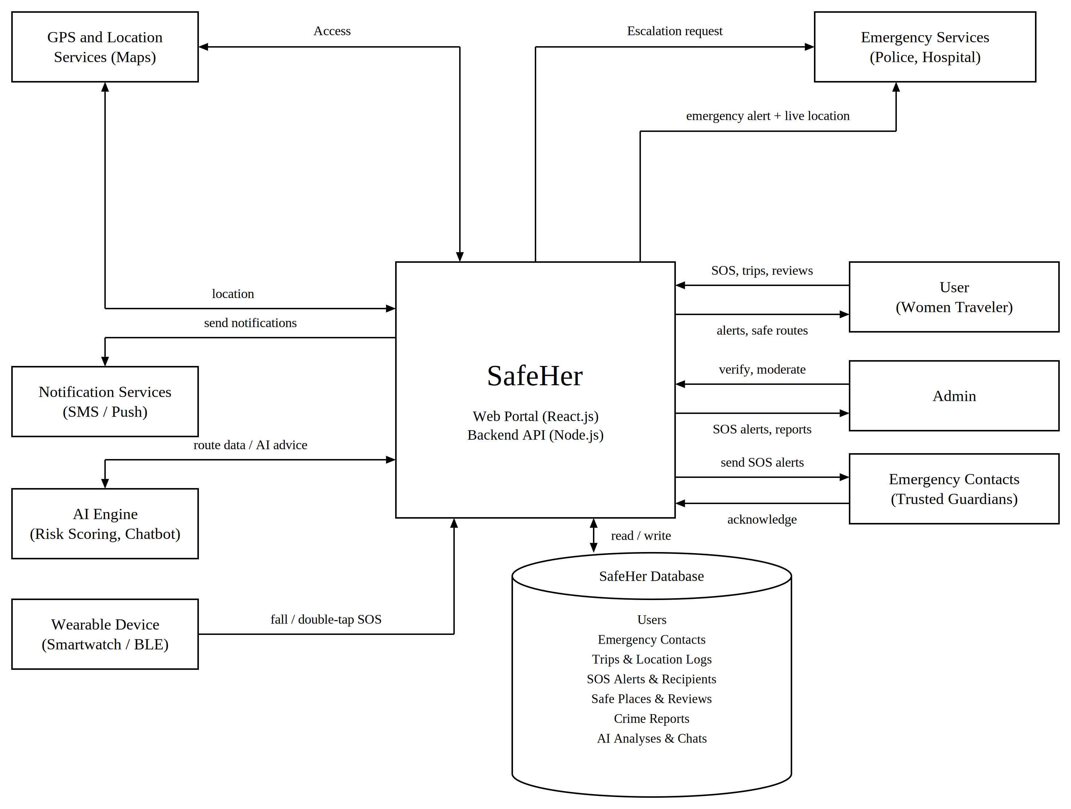
System Architecture Diagram
System Architecture
13

Slide 15
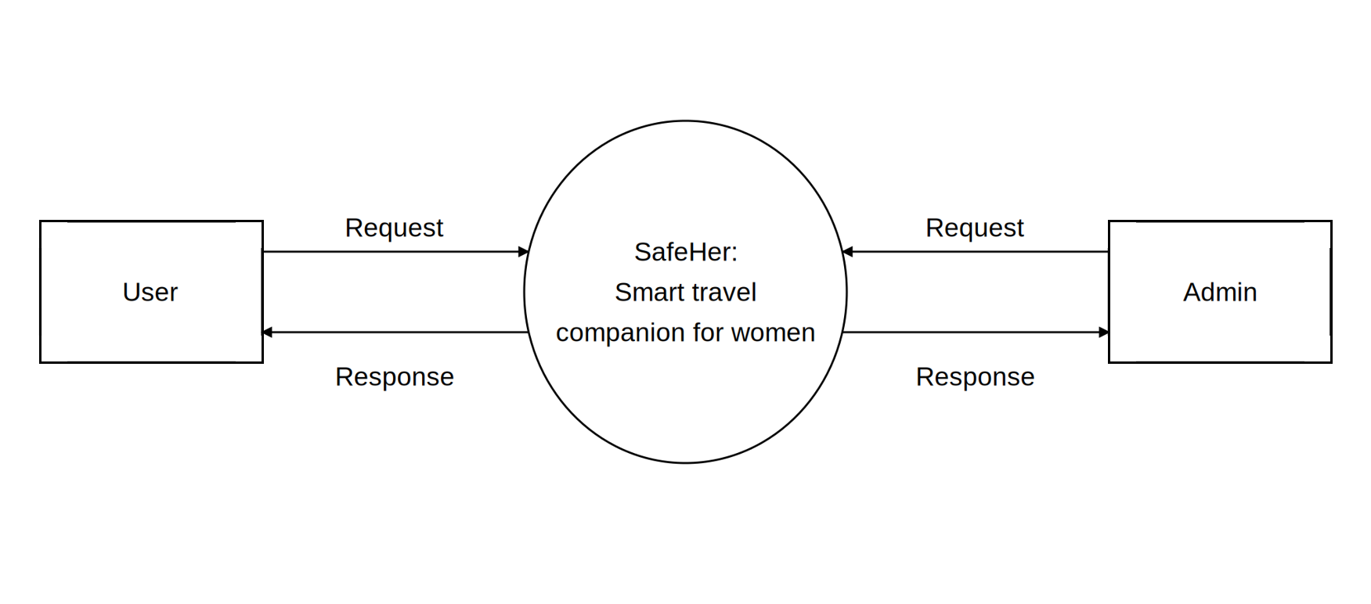
DFD Context Diagram
Context Diagram (Level 0)
14

Slide 16
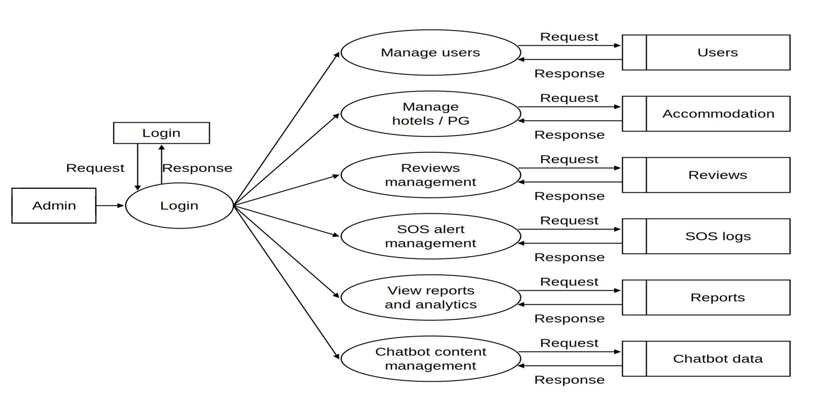
DFD Level 1 -Admin
Level 1 DFD – Admin
15

Slide 17
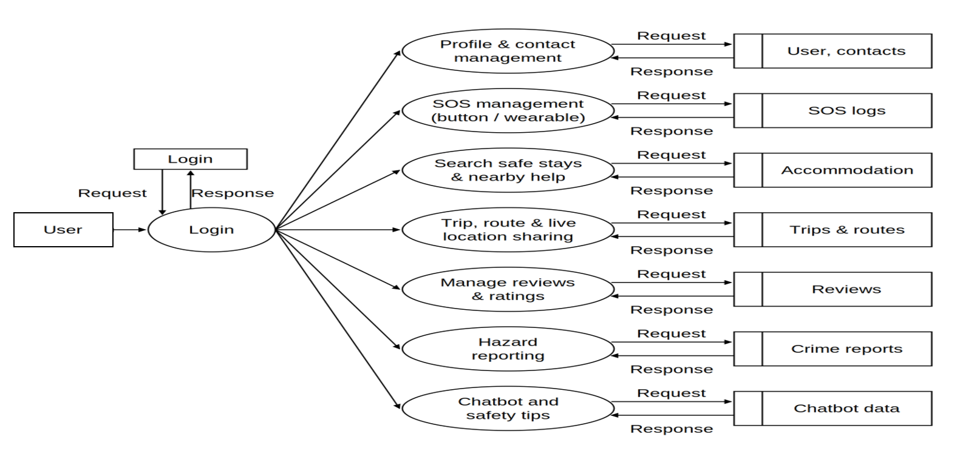
DFD Level 1- User
Level 1 DFD – User
16

Slide 18
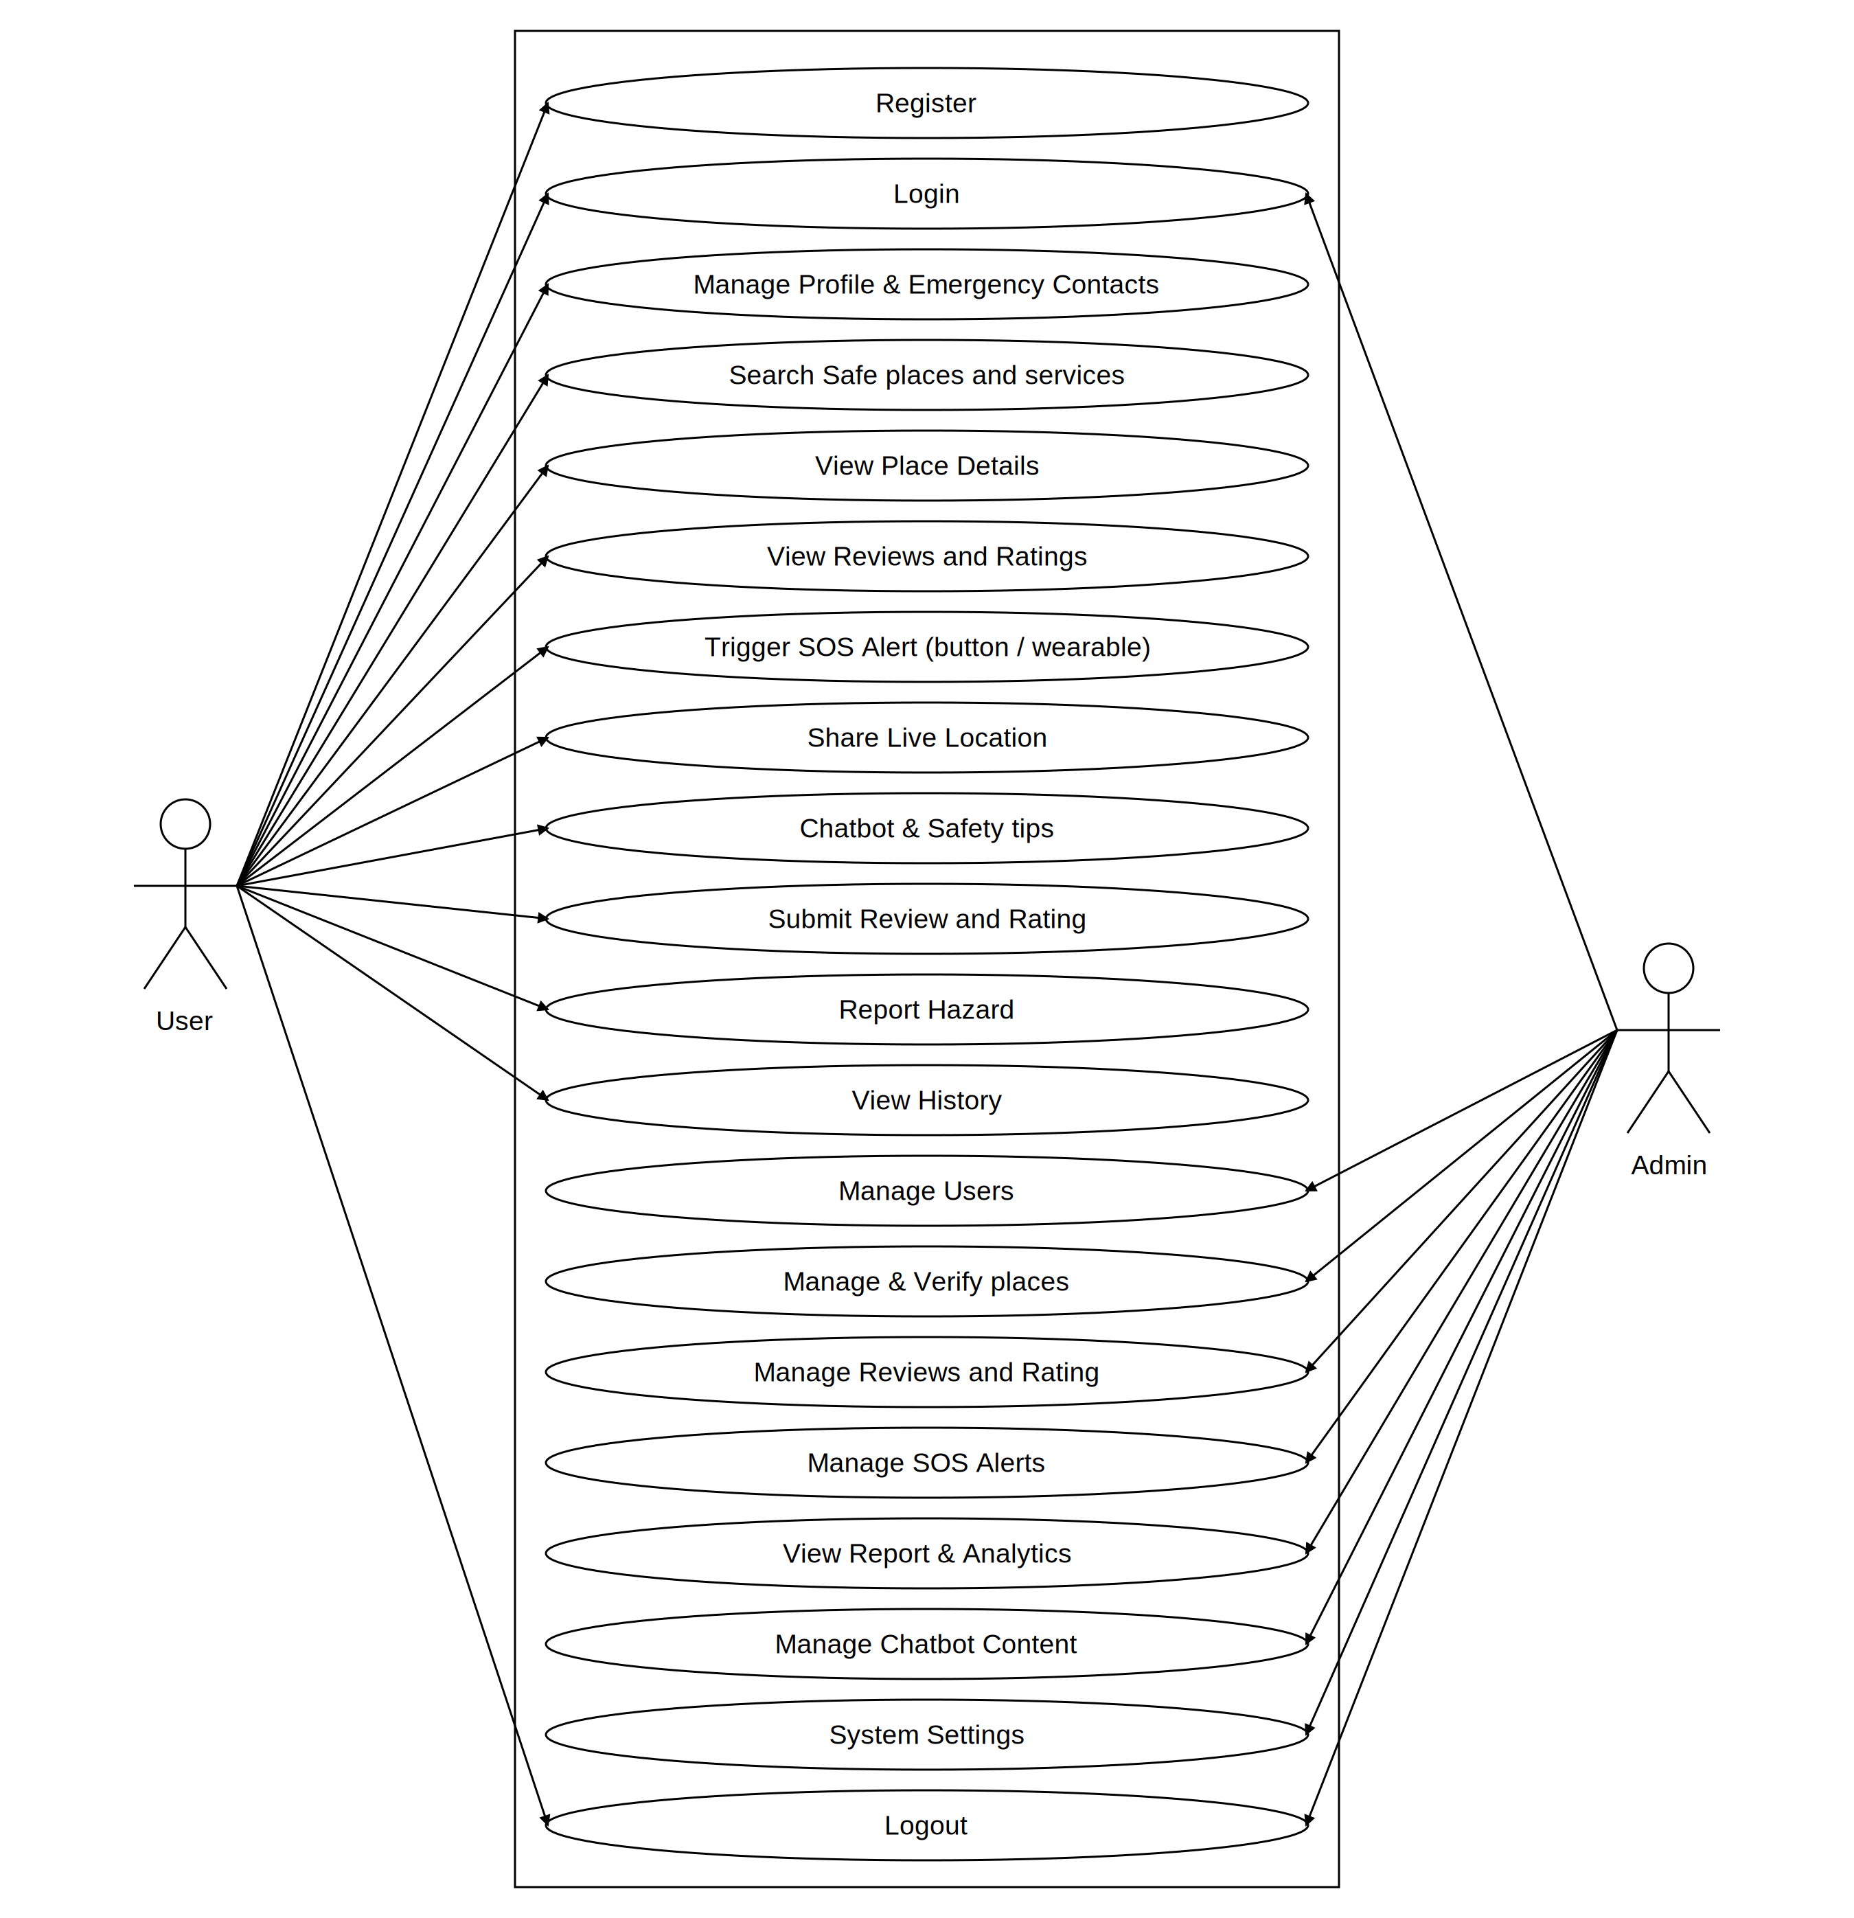
Usecase Diagram
17

Slide 19
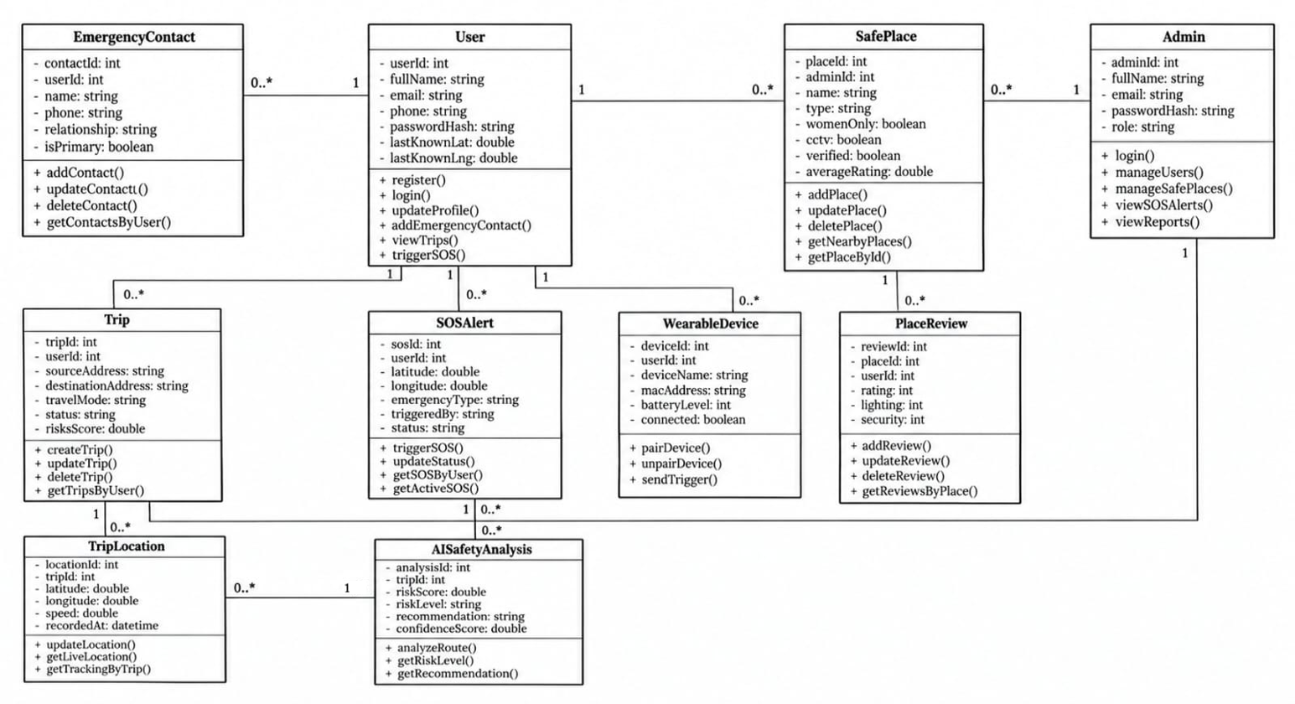
Class Diagram
18

Slide 20
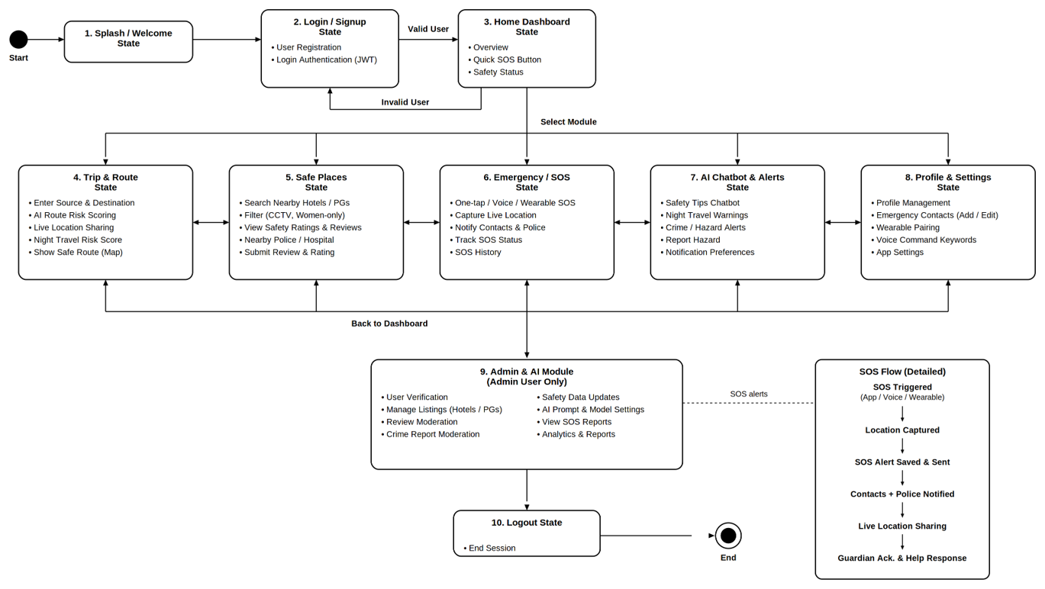
State Diagram
19

Slide 21
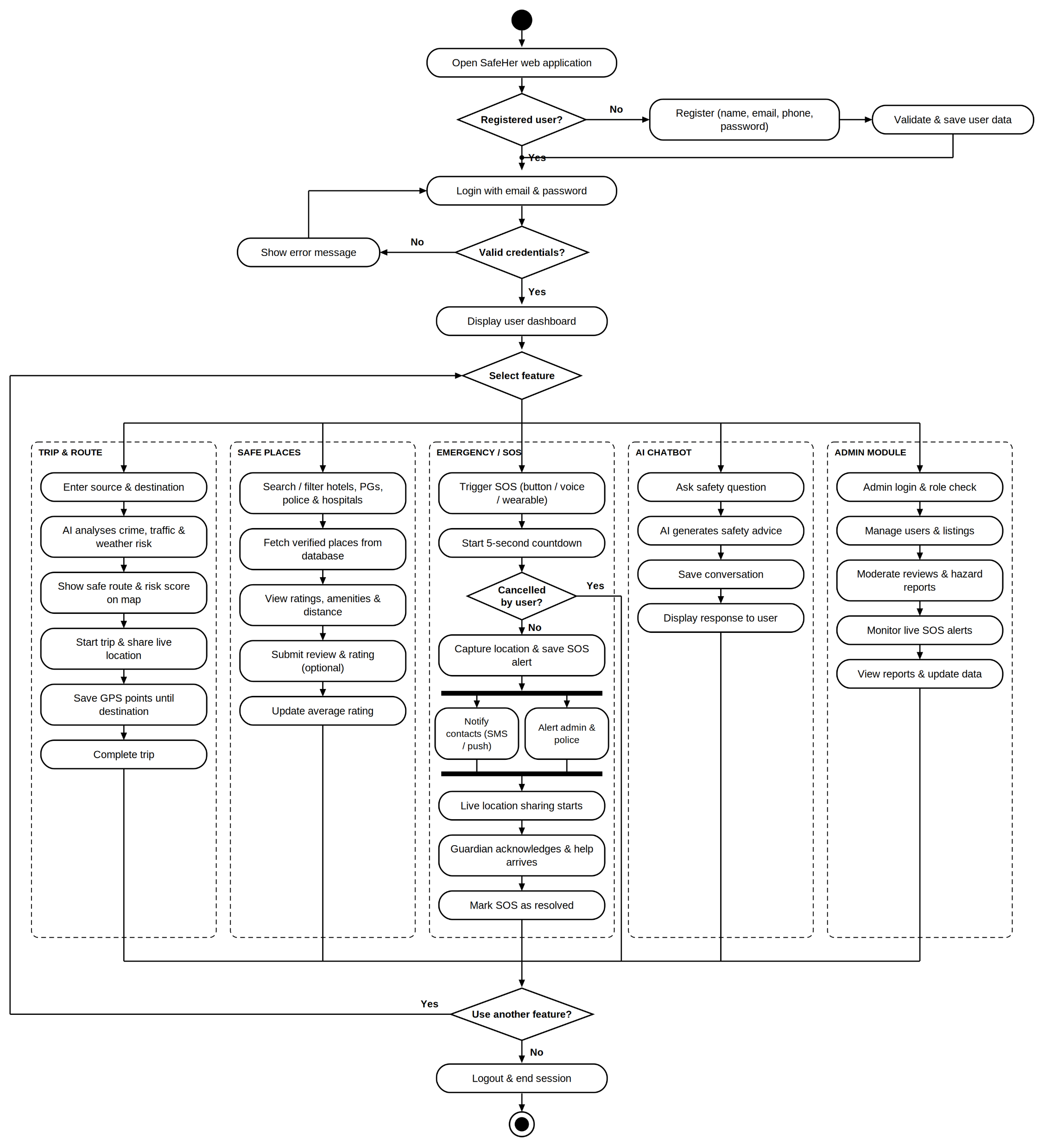
Activity Diagram
20

Slide 22
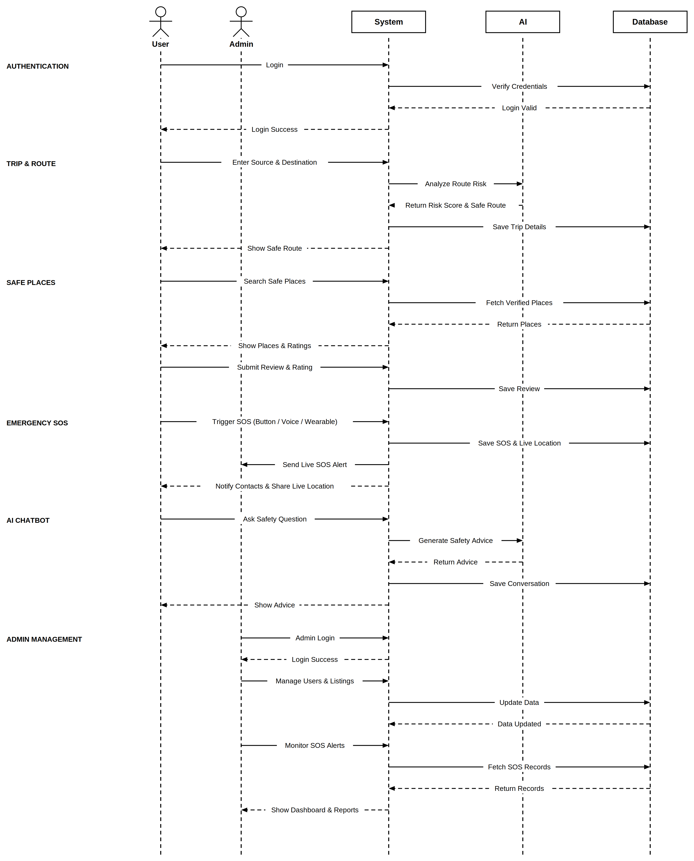
Sequence Diagram
21

Slide 23
Module Description
No. | Module | Functions
1 | User Authentication & Profile | Register, login and logout; forgot password; profile management; up to 5 emergency contacts
2 | Trip & Safe Places | Search hotels and PGs; view CCTV, guard, women-only; nearby hospitals and police; map view and trip management
3 | Emergency SOS & Wearable | One-tap SOS button; live location sharing; wearable and voice SOS; SOS history and helplines
4 | Community Reviews & Ratings | Review accommodations; 1–5 star safety ratings; comments and feedback; report inappropriate reviews
5 | AI Safety Assistant | AI chatbot (Gemini / OpenAI); personal safety tips; travel advice and FAQs; emergency guidance
6 | Admin | Manage users; approve or remove listings; moderate community reviews; monitor SOS reports
22

Slide 24
Methodology
Trigger – SOS button, wearable or voice
Capture – live GPS location
Record – alert saved with recipients
Notify – SMS via Fast2SMS, live updates via Socket.IO
Retry – resend if delivery fails
Agile, iterative cycles of requirements, design, build and test for each module.
OSRM routes are compared using safety data, an approach inspired by SafeRoutes.
Passwords hashed with bcrypt and JWT tokens guard private routes. Safety rating is the average of 1–5 star reviews.
23

Slide 25
Implementation
React.js 18 single-page app
Screens for SOS, stays, reviews, chatbot, admin
Live updates through Socket.IO
Express.js 4 REST APIs on Node.js 18
JWT and bcrypt for secure login
Services for SOS, listings, reviews, chatbot
MySQL 8 through Sequelize / Prisma
Users, Contacts, SOSAlerts, SOSRecipients
Accommodations, Reviews and Trips
OpenStreetMap + OSRM for maps and routes
Fast2SMS for SMS emergency alerts
Gemini or OpenAI API for the chatbot
24

Slide 26
Results / Analysis
Module tested | Tests | Passed | Result
Authentication & contacts | 3 | 3 | Pass
SOS (button, wearable, voice) | 2 | 2 | Pass
Community reviews | 1 | 1 | Pass
Admin panel | 1 | 1 | Pass
Observations
7 / 7 test cases passed across 6 integrated modules
SOS can be raised by button, wearable or voice, and reaches every saved contact with live location
Admin verification and review moderation keep listings trustworthy
25

Slide 27
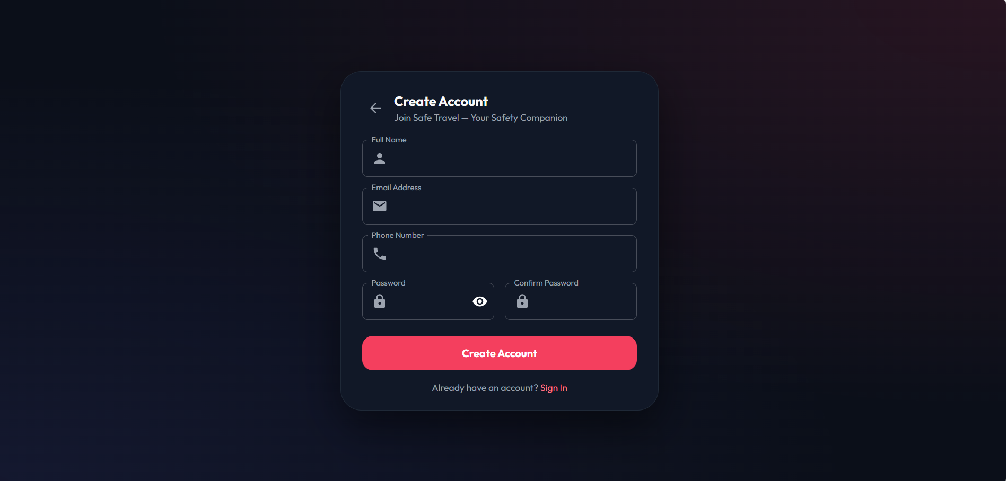
Screenshots / Output
Registration page
26

Slide 28
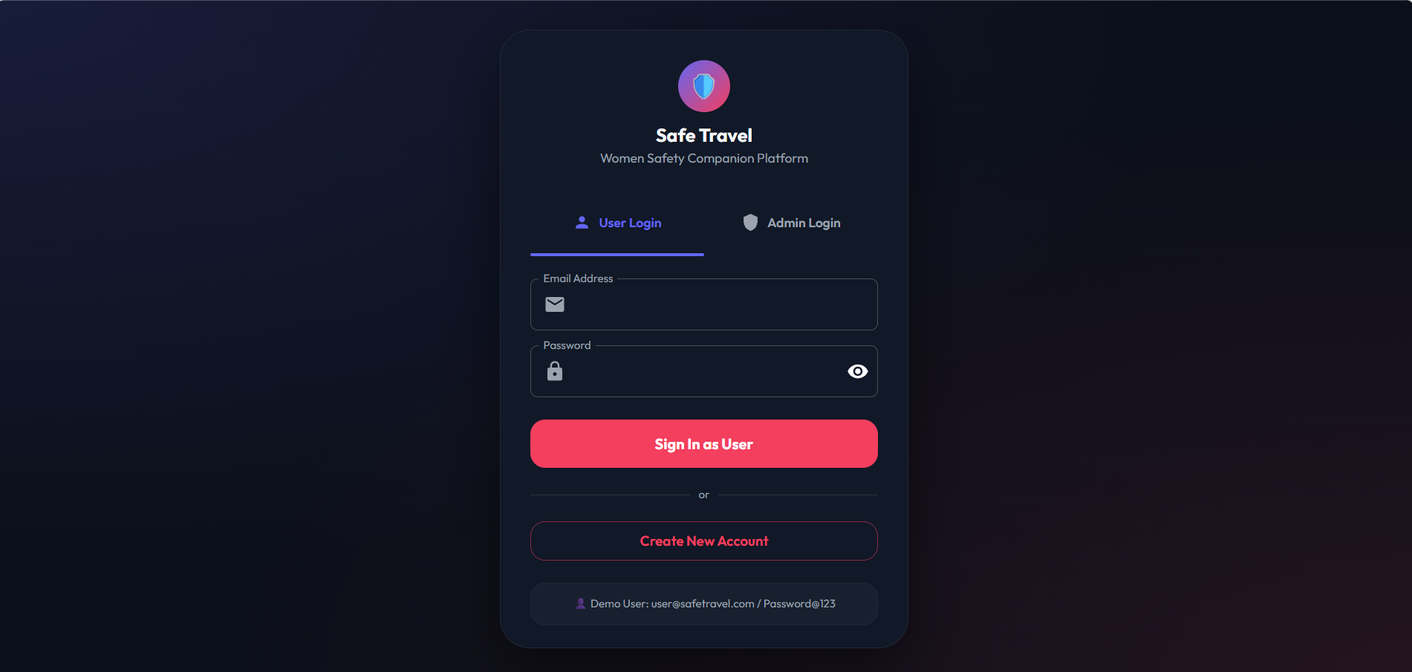
Screenshots / Output
Login page
27

Slide 29
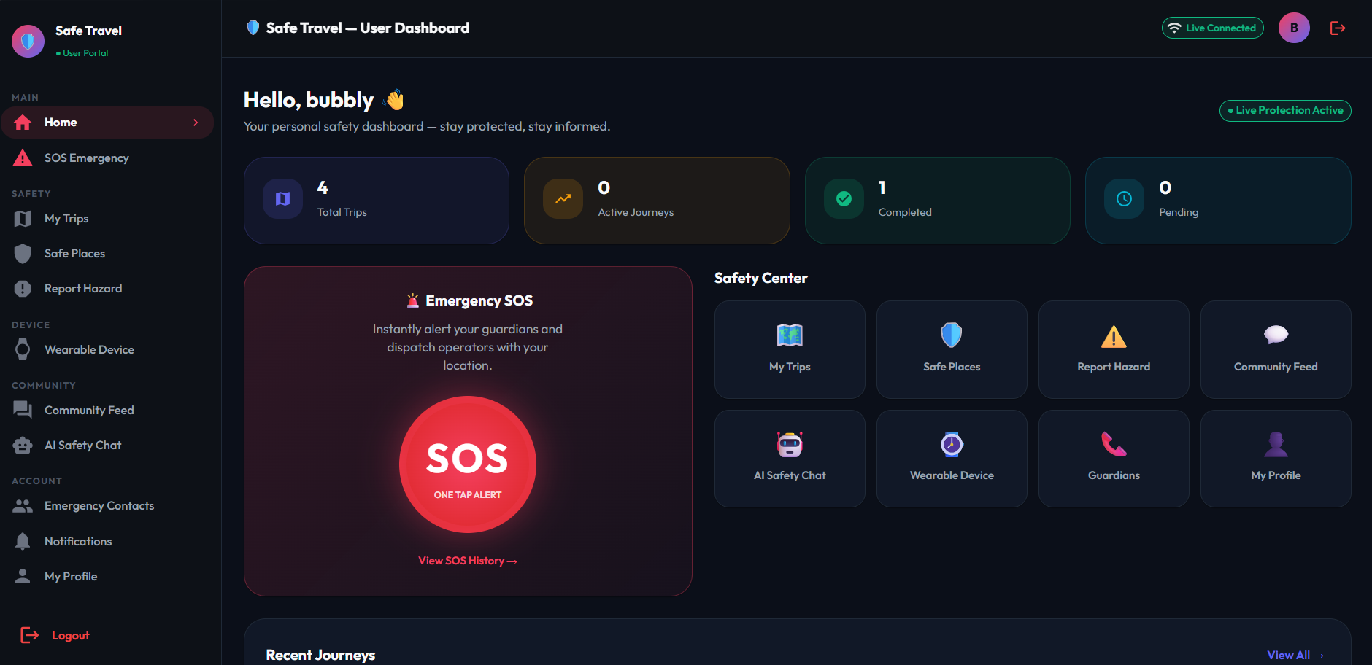
Screenshots / Output
User Dashboard
28

Slide 30
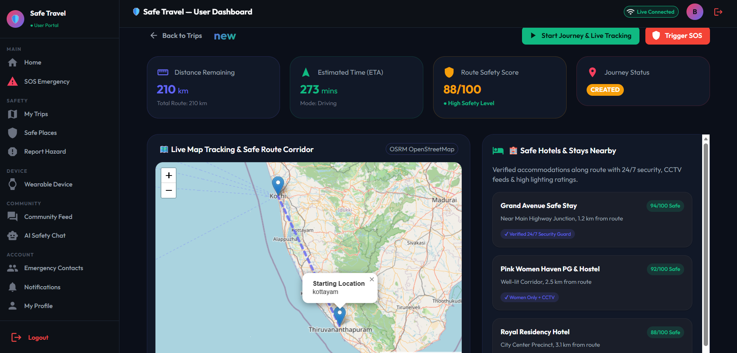
Screenshots / Output
Main functionality (SOS)
29

Slide 31
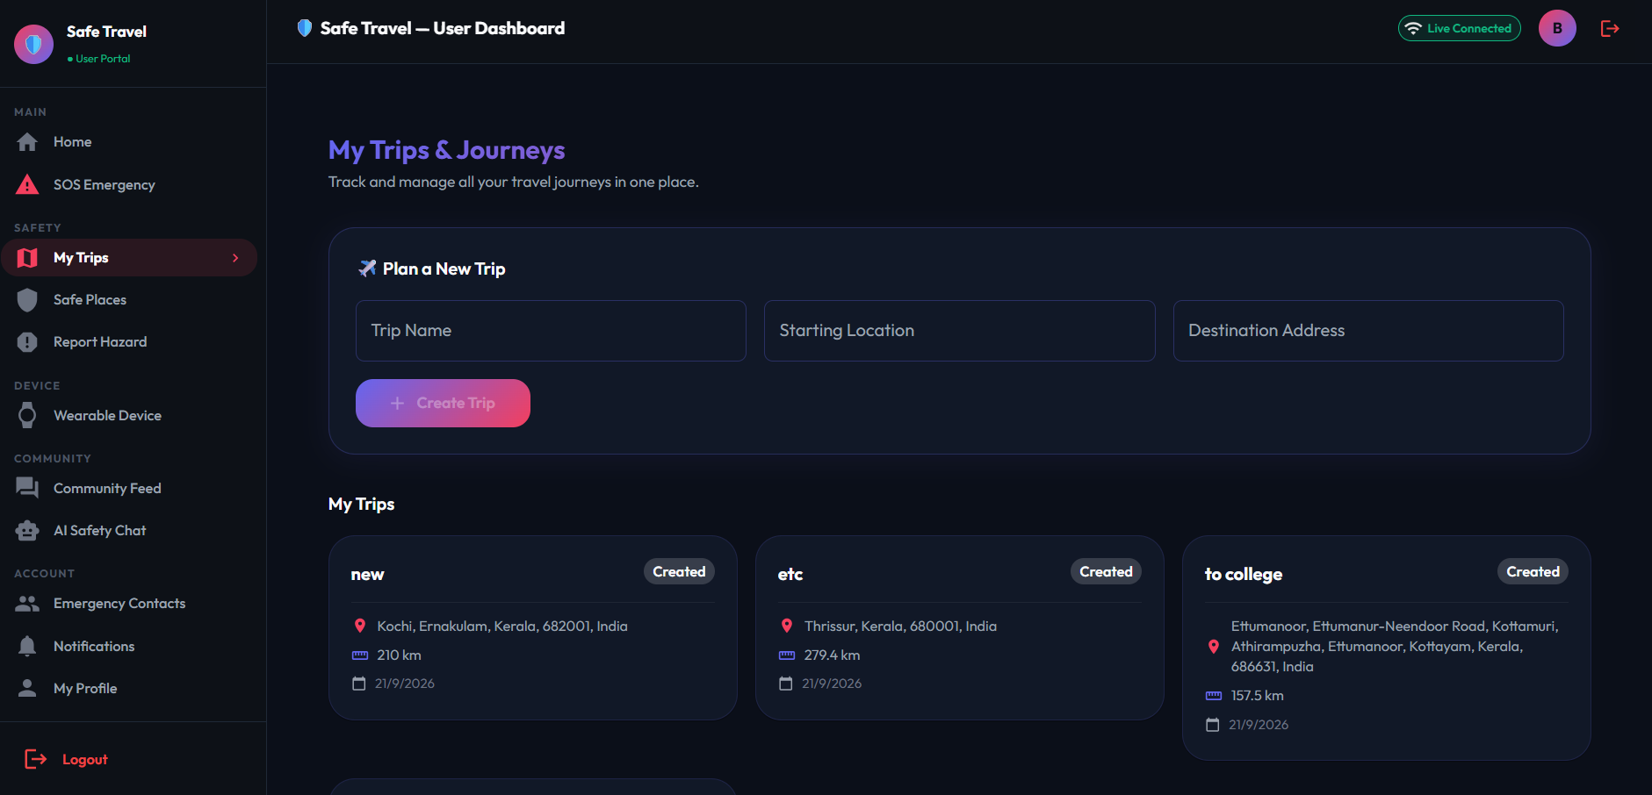
Screenshots / Output
Safe travel
30

Slide 32
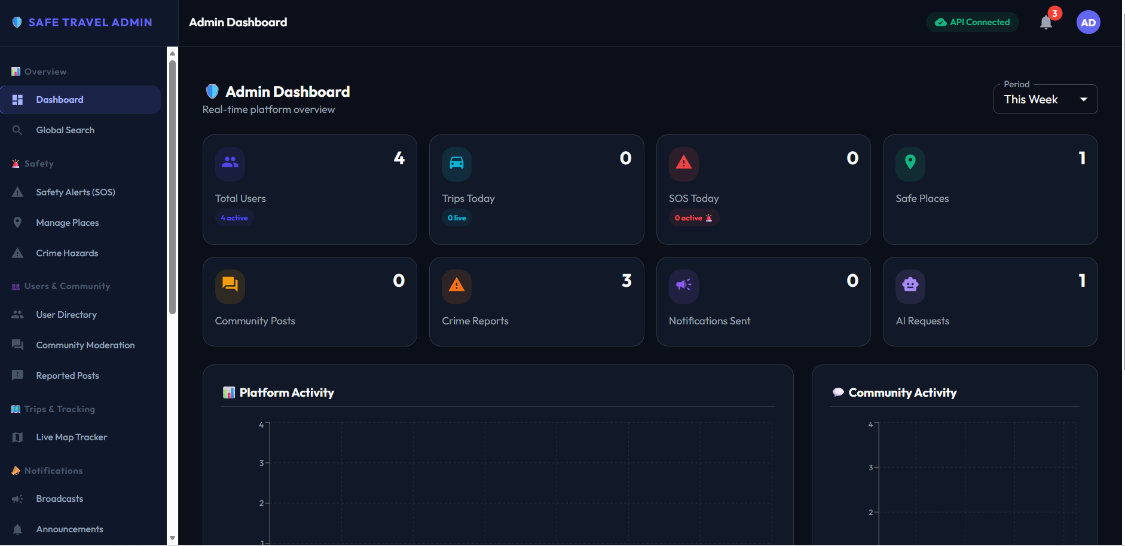
Screenshots / Output
Admin interface
31

Slide 33
Comparison with Existing System
Feature | Existing System | Proposed System (SafeHer)
Processing | Separate apps; manual calling and searching | Single integrated, automated platform
Accuracy | Unverified listings and reviews | Admin-verified listings, moderated reviews
Time | Several steps to reach help | One-tap SOS with live location
Security | Contact data handled loosely | JWT sessions, bcrypt-hashed passwords
Accessibility | Needs phone in hand during an emergency | Web access plus hands-free wearable SOS
Reporting | No consolidated safety reports | Admin SOS reports and platform analytics
32

Slide 34
Testing
Types of testing: Unit testing • Integration testing • System testing • User acceptance
Test Case | Expected Result | Actual Result | Status
Valid login | Login successful | Login successful | Pass
Invalid login | Error message shown | Error displayed | Pass
Add a 6th emergency contact | Blocked, limit is 5 | Limit message shown | Pass
One-tap SOS | Alert with live location sent | Alert delivered to contacts | Pass
Wearable / voice SOS | SOS raised hands-free | SOS triggered | Pass
Submit 1–5 star review | Review saved, rating updated | Saved and rating updated | Pass
Admin approves listing | Listing visible to users | Listing published | Pass
33

Slide 35
Advantages
One tap sends live location to trusted contacts.
Wearable and voice triggers work when the phone is out of reach.
Verified listings show CCTV, guards and women-only facilities.
Ratings and reviews help travellers decide.
The AI chatbot gives tips and emergency advice any time.
The admin panel verifies listings and monitors SOS reports.
35

Slide 36
Limitations
SOS alerts and live location need an internet connection to reach contacts.
Hands-free SOS needs a connected wearable or a working microphone for voice.
Accommodation information depends on listings and community reviews.
AI answers are guidance only and do not replace emergency services.
Currently a web application; there is no dedicated mobile app yet.
36

Slide 37
Conclusion
SafeHer brings emergency alerts, safe-stay discovery, community feedback and AI guidance into one secure platform. It reduces the effort of asking for help and supports women in travelling with greater confidence.
One-tap SOS – live location reaches trusted contacts with a single tap.
Verified stays – women-friendly hotels and PGs with visible safety amenities.
AI guidance – safety tips and emergency advice whenever needed.
37

Slide 38
Future Scope
Native Android and iOS versions of SafeHer.
Time-aware hotspot prediction to warn users about risky zones.
Deep graph convolutional models for higher precision.
SMS-based alerts when the internet is unavailable.
Photo or video attached to alerts through an ESP32 camera.
Regional-language chatbot and voice commands.
38

Slide 39
References
B. Dhanalakshmi, U. Pavithra, S. Hema, and Angayarkanni, “Women Travel Safety Companion: A Real-Time Monitoring and Alert System,” International Journal of Research Publication and Reviews, 2026.
L. Rajendran and S. Shankaran R., “Safety for HER: A Systematic Approach with Coalescence of Technology and Citizens,” in Proc. IEEE Int. Conf. Electronics, Computing and Communication Technologies (CONECCT), 2021.
J. Bengare, R. Jadhav, G. Kapale, and R. Chandan, “Android-Based Women Safety Application with Real-Time Alerts and Location Tracking,” International Journal of Sciences and Innovation Engineering, 2025.
S. Ravi, M. M. Tony, S. Menon P. T., N. Raju, and J. M. Jacob, “Safarion: An AI-Driven Safety and Travel Companion for Solo Explorers,” International Journal of Engineering Research & Technology (IJERT), 2026.
M. Kohale, D. Sharma, R. Bobade, et al., “Virangana: Advanced Women’s Safety Application,” in Proc. 2026 3rd Int. Conf. Emerging Trends in Engineering and Medical Sciences (ICETEMS), 2026.
39

Slide 40
S. Potturi, S. Thota, P. Kandukuru, et al., “An SOS Women Safety Device: Automatic Emergency Alerts and Geo-location Sharing with GSM/GPS Integration,” in Proc. 2026 Int. Conf. Intelligent Computing, Networks, and Security (IC-ICNS), 2026.
“AuraAlert: An AI-Powered Real-Time Women’s Safety Platform with Geospatial Crime Analytics,” in Proc. 2026 2nd Int. Conf. Computing, Communication and Green Engineering (CCGE), 2026.
“Smart Safety Handbag: An IoT-Enabled Machine Learning and GIS-Based Framework for Real-Time Women Safety,” in Proc. 2026 1st Int. Conf. Innovation & Growth in Next-Gen Intelligent Technology & Engineering (IGNITE), 2026.
“Real-Time Distress Detection and Location Tracking using a Voice-Activated System,” in Proc. IEEE Conference.
Development of Women’s Safety System Using IoT and Taser Technology,” in Proc. 2024 4th Asian Conf. Innovation in Technology (ASIANCON), 2024.

Slide 41
Thank You
40

