Slide 1



(Automated attendance system using facial recognition)
DRISHTI

Slide 2
What is Drishti?
An Automated Attendance Management System that tracks and records attendance for Students/Employees by adapting facial recognition algorithm.
This system is intended to become an efficient alternative to the traditional and manual way of recording attendance.

Slide 3

How Drishti ?
We have implemented a facial recognition algorithm using OpenCV which maps the RGB colors of a person’s face on camera to the same face that is saved in our database.
We have also designed an algorithm to find the distance of the user from the camera to avoid giving unintentional attendance / proxies.
Two cameras are placed opposite to each other in such an angle that one camera records the entry of a person and another camera records the exit. The difference is calculated for each slot and attendance is marked.

Slide 4

How Drishti ?
Upon researching on few of the other facial recognition methods such as Eigenfaces, 3D – Facial recognition, R- CNN, Holistic matching, etc. We chose Google’s library called OpenCV which contains models trained on their neural network.
The parallel approach in thought was to build a customized neural network but due to time constraints the project was limited to a model using the OpenCV library.

Slide 5
Why Drishti ?
Drishti is an attendance management system that uses facial recognition to detect the presence of students
The current system is prone to malpractice, requires human effort and results in a very time-consuming process
Drishti is a product of AI/ML, Computer Vision and Deep learning and makes the manual - automatic

Slide 6

Equipment / Requirements
High Resolution Cameras (Resolution 2k HD and above)
Base level i5 processor machines to run the ML algorithm
Servers or API services for data manipulation

Slide 7

Innovations
Integration of Facial recognition along with Face mesh technology
Detection of phones to avoid intentional proxies
Constant communication with a customized application for additional functionalities
Features
Real time face tracking
Constant data manipulation (load, store, delete)
Measure of distance from the cameras which can be further utilized

Slide 8

Limitations
Hard to avoid situations of severe malpractices such as covering camera lens, showing printed cutouts of a person, etc.
Power Failures cause the system to shut down completely without a backup
Future Scope
To integrate face-mask detection
To track body movements for additional functionalities such as tracking anomalies, exam malpractices, etc.
Implementing Embedded Systems to increase the scope to CCTV cameras.
To utilize the benefit of higher resolution cameras including night vision for dimmer circumstances

Slide 9

Application System (Drishti)
Front-end User interface design
Back-end User database with login and sign up
Students can view and request attendance
Faculties can view and approve attendance requests

Slide 10
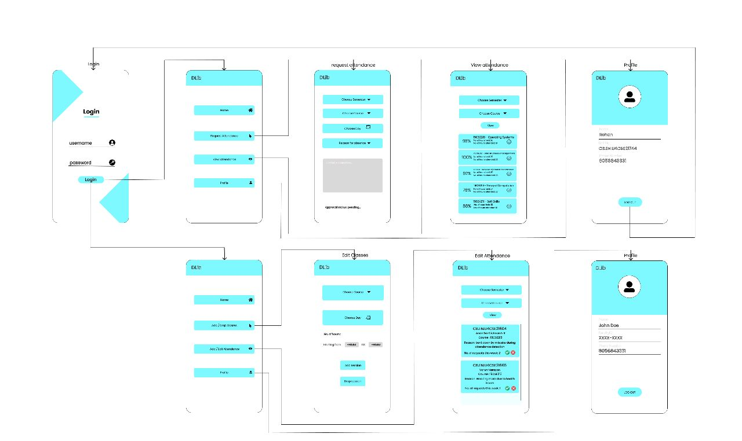
Wireframe

Slide 11

Beneficial conclusion
Near zero human intervention - fully autonomous
Constant communication with a customized application for additional functionalities
Cost – effective system involving major one time investments of two cameras
App support
Proof of concept: https://amritavishwavidyapeetham-my.sharepoint.com/:w:/g/personal/cb_en_u4cse21665_cb_students_amrita_edu/Ebd0ymG1qedHqNknSyJWua4BwRgz6FrKFHOF4cyRDqfUgw?rtime=w1aNVElG20g

