Slide 1
Title:
Intelligent Document Extraction, Validation & API Platform
AI Engineer Internship – Technical Case Study
Candidate: Ananthi R
Document Intelligence Solution
Python / FastAPI / OCR / Gemini / PostgreSQL / SQLite

Slide 2
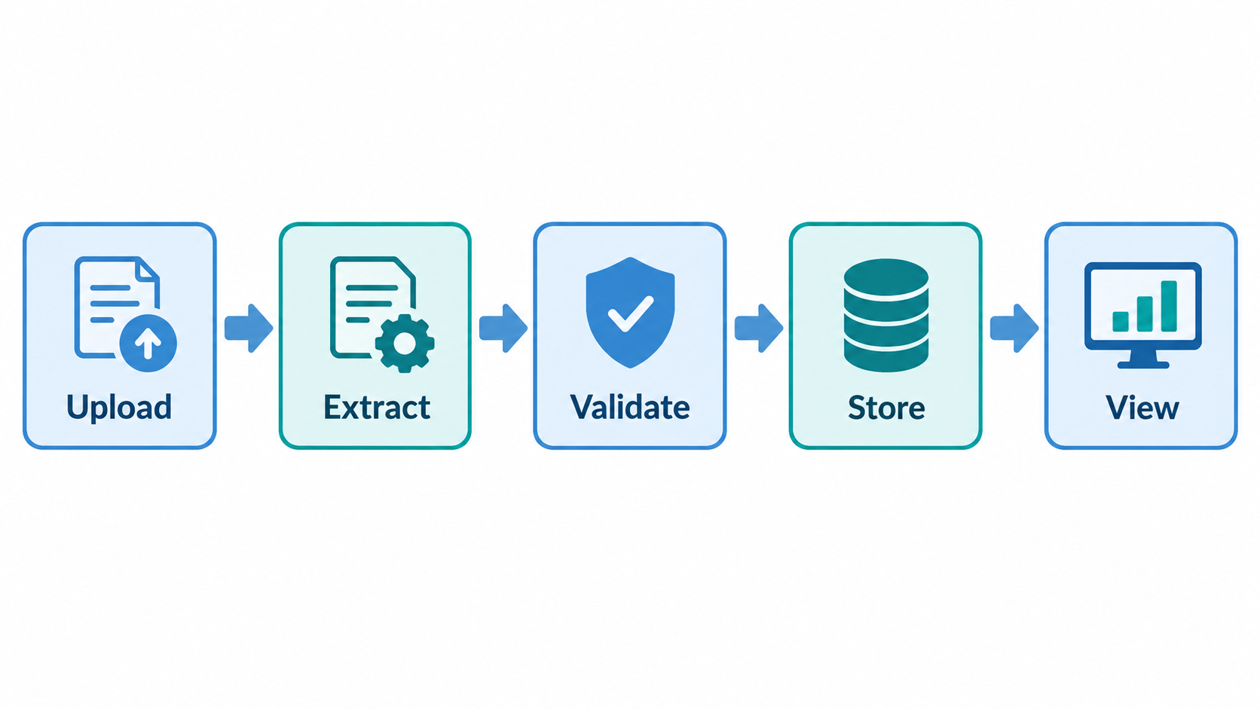
Problem Statement & Objective
Financial documents arrive in different layouts and formats.
Documents may be native PDFs or scanned PDF/JPG/PNG images.
OCR errors and varying financial tables make manual extraction difficult.
The solution must extract all meaningful document information into structured JSON.
Financial relationships must be validated using deterministic calculations.
Processed results must be stored and accessible through REST APIs and a dashboard.

Slide 3
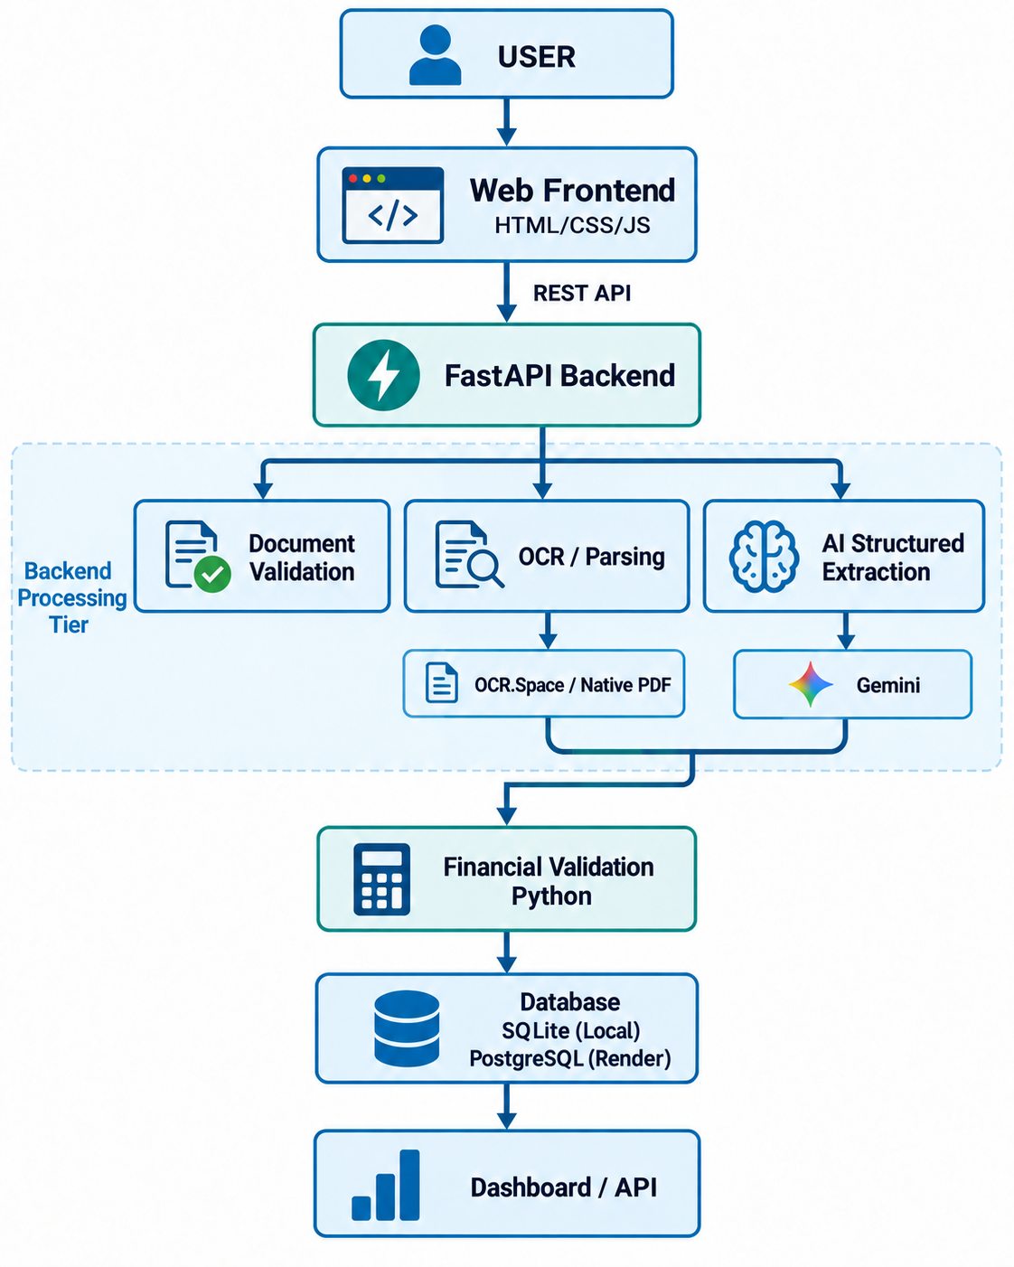
Solution Architecture
Modular architecture with separate validation, OCR, extraction, validation, repository and API layers.
PostgreSQL stores deployed results on Render. SQLite is used locally
AI is used for extraction; deterministic Python is used for financial calculations.

Slide 4
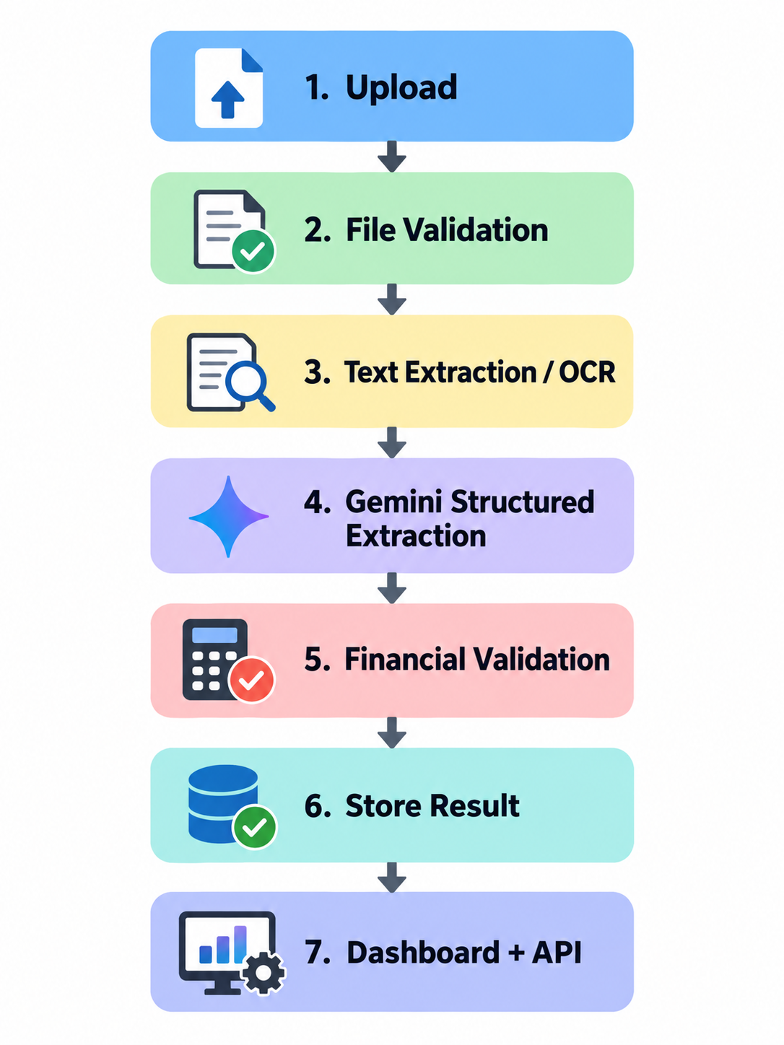
Processing Pipeline
File Validation
PDF / JPG / PNG only
Maximum 3 pages
Empty/corrupted file handling
Basic file integrity check
OCR Strategy
Native PDF text extraction first
OCR.Space for scanned/image documents
Gemini Vision fallback when required

Slide 5
Supported Documents & Structured Extraction
Invoice
Invoice details
Vendor / customer
Currency and totals
Line items
Discount / tax / rounding
Evidence
Balance Sheet
Statement headers
Reporting periods
Assets
Liabilities
Equity
Complete line items
Profit & Loss
Income
Expenses
Profit values
Comparative periods
Appropriation information
Cash Flow
Operating activities
Investing activities
Financing activities
Opening / closing cash
FX / adjustments
Missing or unsupported values → null
No guessing or invented values.

Slide 6
Financial Validation
Financial calculations are performed using Python, not the LLM.
Invoice
Balance Sheet
Profit & Loss
Cash Flow
Quantity × Unit Price ≈ Line Amount
Sum(Line Amounts) ≈ Subtotal
Taxable Amount + Tax + Round Off ≈ Total
Cash Paid − Total ≈ Change
Interest Earned + Other Income ≈ Total Income
Total Income − Total Expenditure
≈ Net Profit before Minority Interest
OCF + ICF + FCF + FX
≈ Net Change in Cash
Opening Cash + Net Change + Adjustments ≈ Closing Cash
Capital & Liabilities ≈ Total Assets

Slide 7
Financial Validation – PASS & FAIL Examples
Successful validation -PASS Case – Invoice 20251118_000612.jpg
Real failure detected
FAIL Case – Invoice batch2-0499.jpg
Validation Check | Result
Line-item calculations | PASS
Discount handling | PASS
Line items → Subtotal | PASS
Taxable Amount + Tax + Round Off | PASS
Invoice Total | PASS
Sum of line-item amounts = 145.00
Reported subtotal = 135.00
Variance = 10.00
Result = FAIL ❌
The system does not force documents to PASS.
It reports genuine financial inconsistencies found in the source document.
Taxable Amount = 5,815.17
Tax Amount = 1,046.72
Round Off = 0.11
5,815.17 + 1,046.72 + 0.11
= 6,862.00
Result: PASS ✅

Slide 8
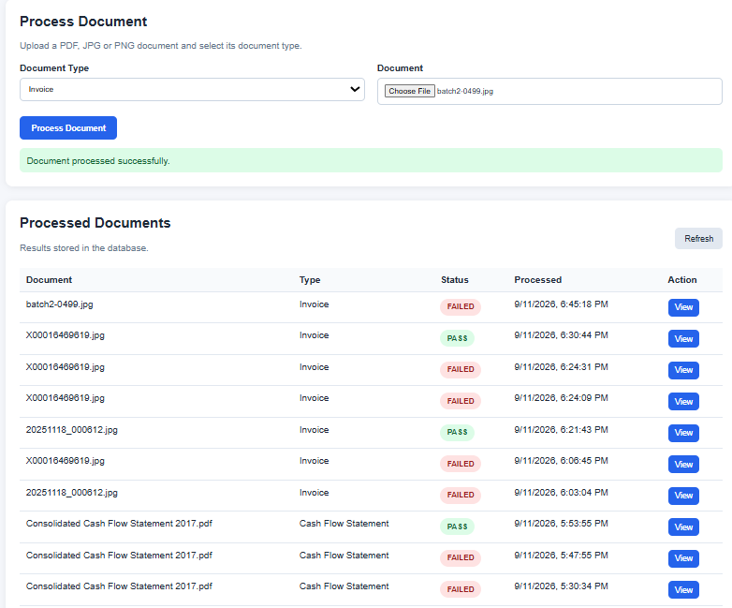
APIs, Dashboard & Persistence
API’S
POST /api/v1/documents/process
GET /api/v1/documents/{document_name}
GET /api/v1/documents
GET /api/v1/health
Dashboard
Document type selection
PDF/JPG/PNG upload
Processing status
Extracted key-value fields
Line-item tables
Financial validation results
Raw JSON viewer
Database-backed processed-document list
FastAPI automatically provides Swagger/OpenAPI documentation at /docs.

Slide 9
Technology Stack & Engineering Decisions
Component | Technology
Backend | FastAPI / Python
Structured schemas | Pydantic
AI extraction | Gemini
OCR | OCR.Space + Gemini Vision fallback
PDF handling | PyPDF / PyMuPDF
Database | PostgreSQL + SQLite + SQLAlchemy
Frontend | HTML / CSS / JavaScript
API documentation | Swagger / OpenAPI
Version control | GitHub
Deployment | Render
Key Design Decisions
User selects document type — no unnecessary auto-classifier.
LLM handles unstructured extraction.
Python handles deterministic arithmetic.
Evidence/source text improves traceability.
Modular services improve maintainability.
Environment variables protect API keys.

Slide 10
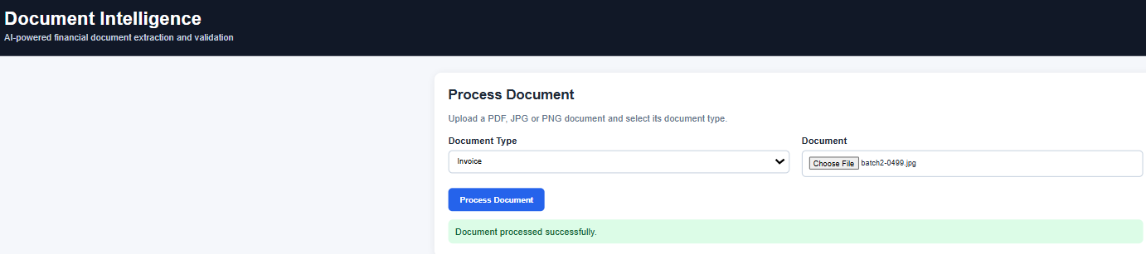
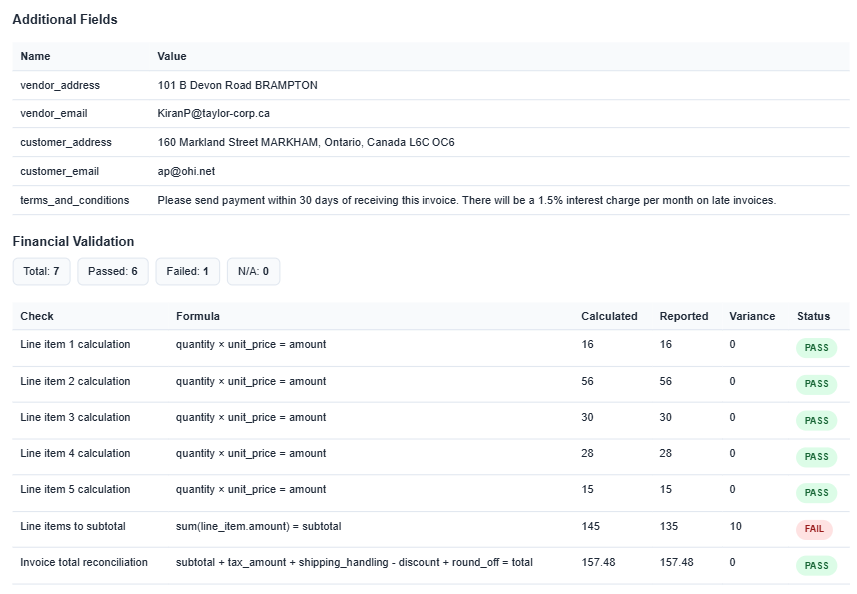

Slide 11
Testing, Limitations & Deployment
Testing
Tested all four document types.
Tested scanned/image invoices.
Tested valid financial reconciliation.
Tested real financial validation failure.
Tested missing values.
Tested OCR fallback.
Invalid/unsupported file test.
Basic automated tests
Current Limitations
OCR accuracy depends on source image quality.
Free-tier API/model quotas may affect availability.
Some complex table layouts can produce row alignment issues.
SQLite is used locally; deployed persistence uses PostgreSQL on Render.
Confidence scoring not implemented.

Slide 12
Production Improvements
PostgreSQL / managed database
Background task queue
More robust table extraction
Authentication / authorization
Monitoring and metrics
Automated evaluation dataset
Containerized deployment
GitHub:
https://github.com/Ananthi0207/document-intelligence
Frontend:
https://document-intelligence-fchk.onrender.com/
API:
https://document-intelligence-fchk.onrender.com
Swagger:
https://document-intelligence-fchk.onrender.com/docs

Slide 13
Conclusion
Built an end-to-end document intelligence prototype supporting four financial document types.
Combined OCR + LLM extraction with deterministic financial validation and evidence-grounded structured output.
Delivered results through REST APIs, persistent storage and a web dashboard.
Implemented source-grounded extraction with evidence text and page references to improve traceability.
Added database-backed persistence so processed documents can be retrieved later and viewed through the dashboard.
Designed the solution in a modular way so OCR, AI extraction, financial validation, API, and database layers can be improved independently.

