Slide 1
Employee Promotion Prediction

Slide 2
Problem Statement
The objective of this project is to predict whether an employee will be promoted by leveraging historical employee performance and demographic data using machine learning models.

Slide 3
Approach
Analyzed employee performance data, applied preprocessing and feature engineering to improve data quality, built a robust XGBoost prediction model, and delivered the solution through a REST API and an interactive web interface

Slide 4
Model & Evaluation
Model: Extreme Gradient Boosting (XGBoost) Classifier
Evaluation Metric: Area Under the ROC Curve (AUC), achieving strong predictive performance on the validation dataset.

Slide 5
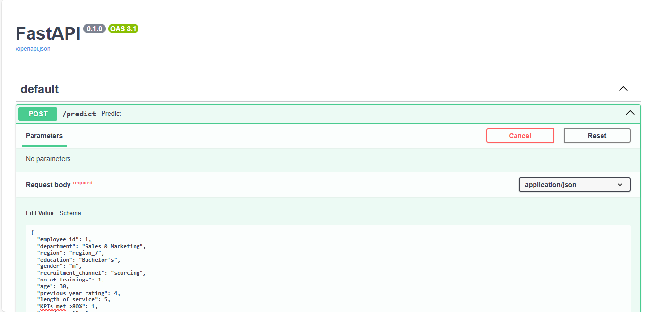
API Output
FastAPI endpoint returning promotion probability

Slide 6
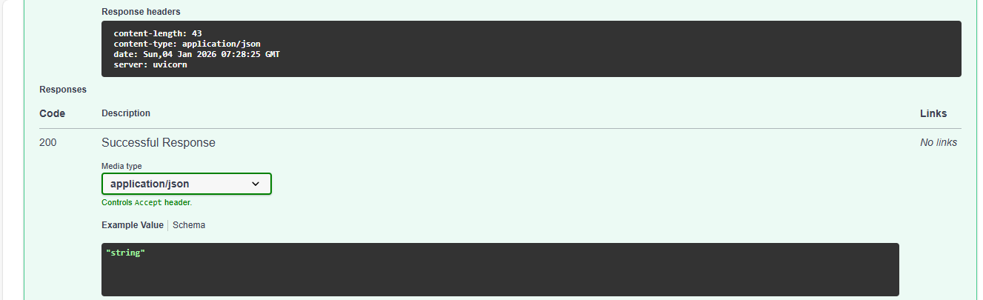
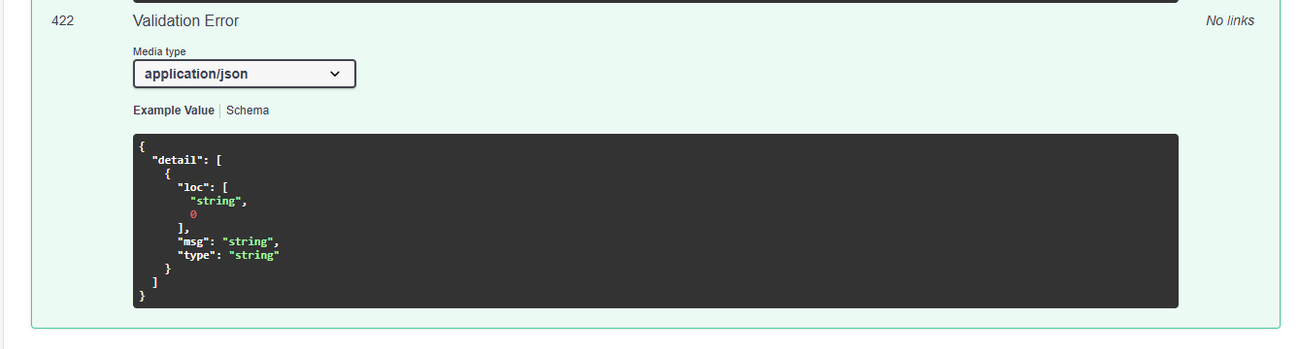

Slide 7
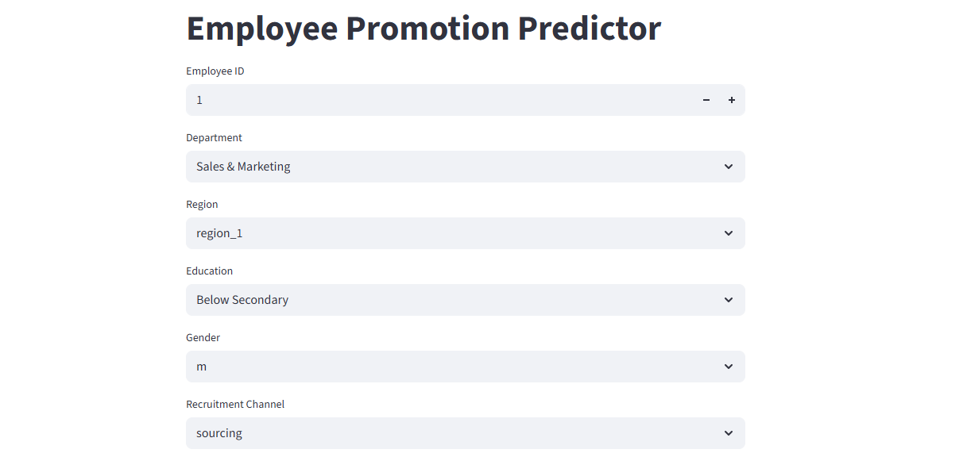
Streamlit UI
Streamlit UI for user input and prediction

Slide 8
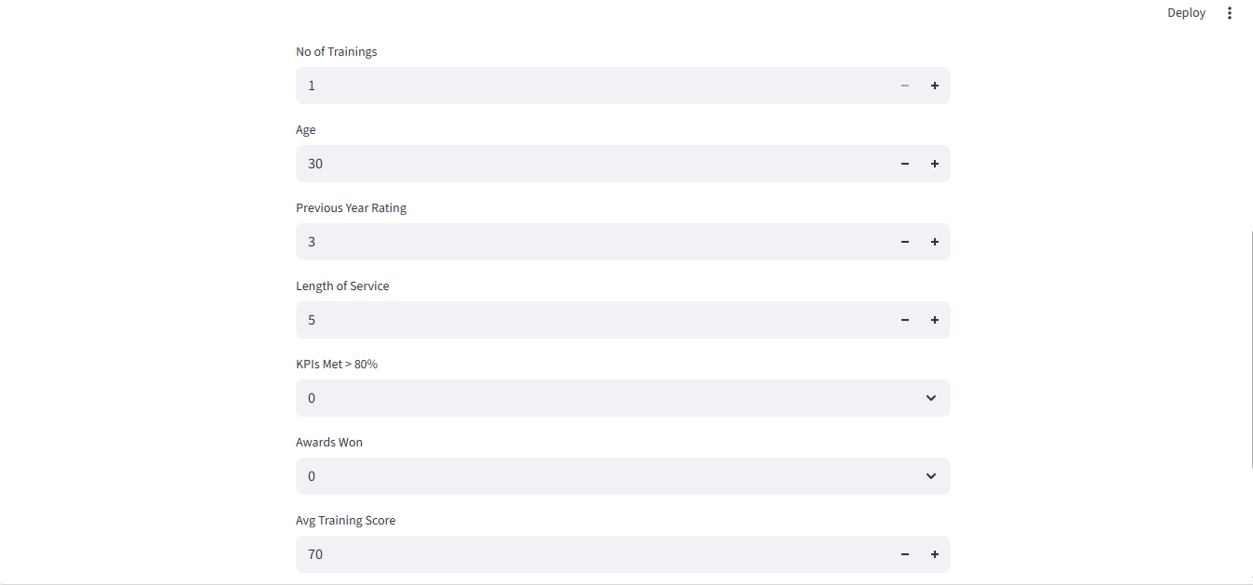
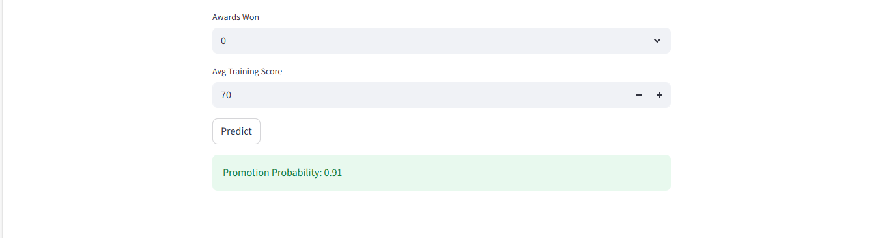

Slide 9
Conclusion
An end-to-end machine learning solution was successfully designed, implemented, and demonstrated, covering data processing, model development, and deployment through a scalable API and web interface

