Slide 1
Brain Stroke Predictor
Presented By:
Ananthu S
TKM23MCA-2016
Guided By:
Prof. Natheera Beevi M

Slide 2
INTRODUCTION
Overview: Stroke is a leading cause of disability and death globally.
Importance: Early stroke detection can significantly improve recovery outcomes.
Objective: Develop a deep learning-based web application to detect strokes in brain CT images.

Slide 3
PROBLEM STATEMENT
Challenge: Timely and accurate detection of stroke is critical, yet current manual analysis methods can be time-consuming and may vary in accuracy.
Impact: Delayed detection can lead to worsened outcomes, increasing the risk of severe disability or death.

Slide 4
LITERATURE REVIEW
TITLE | AUTHORS | PUBLISHED YEAR | PUBLISHER | ALGORITHM USED
Brain Stroke Prediction Using Deep Learning: A CNN Approach | Dr. Reddy Madhavi K, Dr. Karthik Kovuri, Dr. Avanija J, Dr.Sakthivel | 2022 | IEEE | MobileNet ResNet50 VGG16
Analysis of Brain Stroke Prediction Using Machine Learning and Deep Learning | Rajani M. Mandhare, D. B. Kshirsagar | 2024 | IEEE | Random forest Decision Tree CNN VGG16

Slide 5
Gap Identification(Existing System)
Traditional Methods: Manual evaluation of CT images by radiologists, which is resource-intensive and subject to human error.
Limitations:
Time-consuming and labor-intensive.
Potential for diagnostic errors due to visual fatigue or lack of experience.
User Access: Existing systems often require users to register or provide login details before accessing the tool, which can delay quick access for urgent cases.

Slide 6
Proposed System
Solution Overview: A web-based deep learning model to classify brain CT images as 'Stroke Detected' or 'No Stroke Detected.'
Advantages:
Automated, fast, and user-friendly interface, accessible without the need for login details.
Provides reliable support for preliminary diagnosis, especially useful in remote or under-resourced areas.
Scalable for broader healthcare applications without additional access barriers.

Slide 7
Methodology
Dataset: Brain stroke CT images, categorized as 'Normal' and 'Stroke.'
Models Used: CNN, VGG16, and MobileNet for effective classification.
Process:
Data Preprocessing: Image resizing, normalization, and augmentation.
Model Training: Training CNN, VGG16, and MobileNet with augmented data to improve model accuracy.
Evaluation: Validation and testing of models on separate datasets.
Prediction Interface: Flask-based application for users to upload CT images and receive predictions.

Slide 8
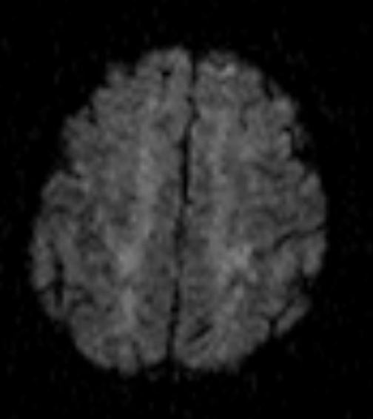
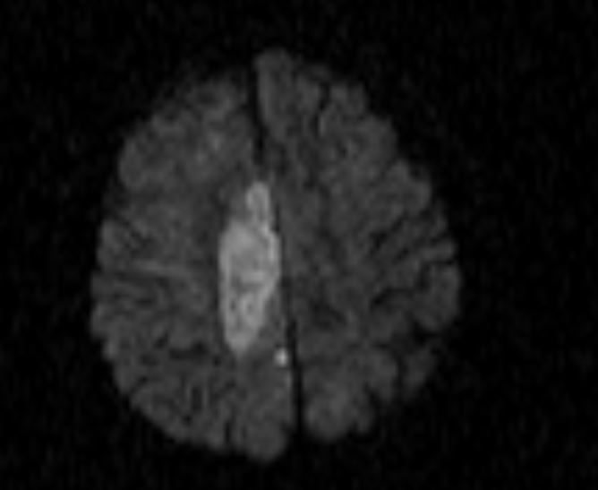
Dataset
Normal
Stroke

Slide 9
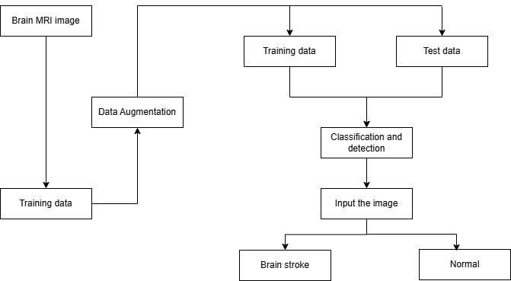
Block Diagram

Slide 10
Results
 | CNN | MobileNet | VGG16
Validation Accuracy | 93.14% | 88.18% | 78.13%
Training Accuracy | 93.75% | 90.45% | 80.49%

Slide 11
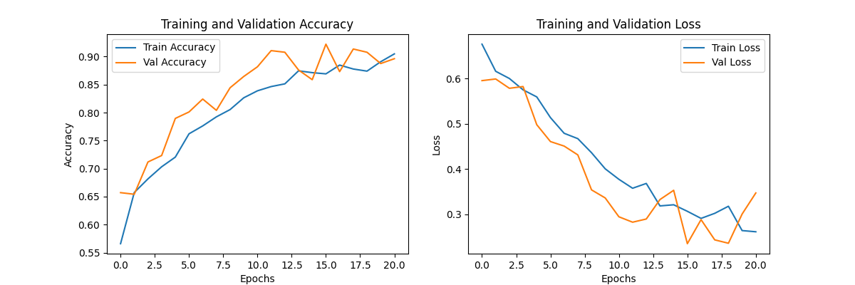
Results (CNN)

Slide 12
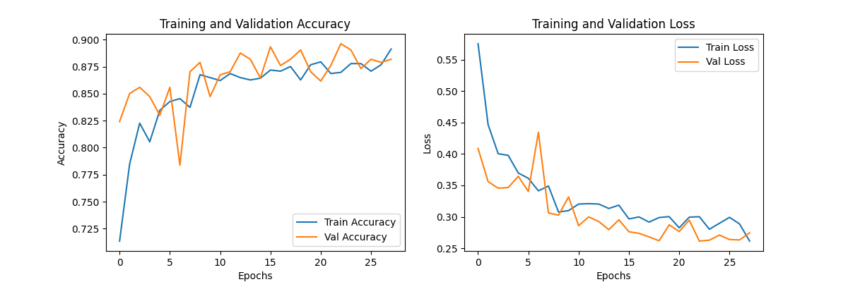
Results (MobileNet)

Slide 13
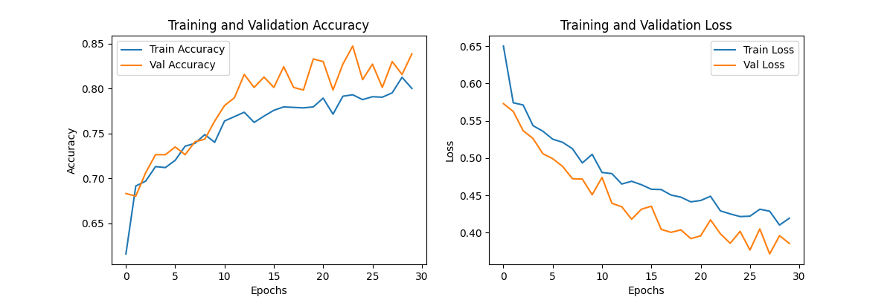
Results (VGG16)

Slide 14
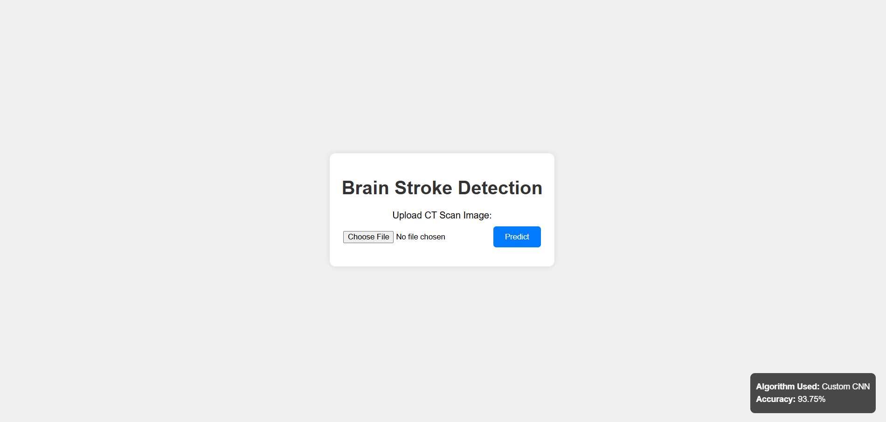
Screenshots

Slide 15
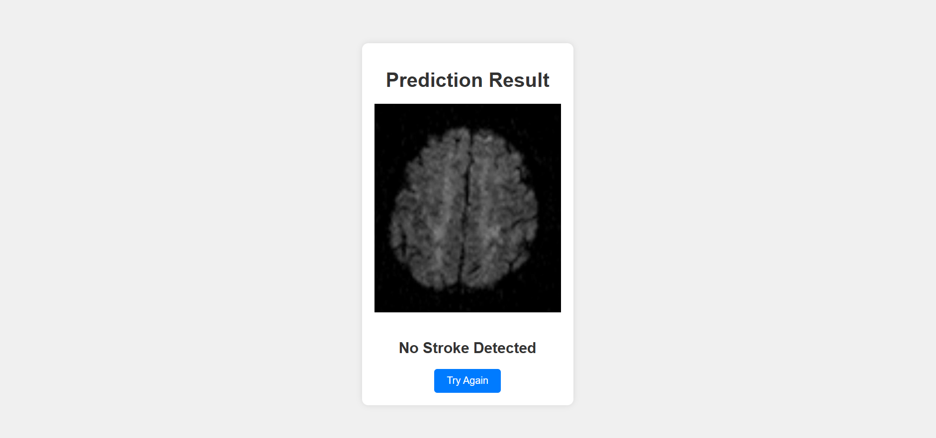

Slide 16
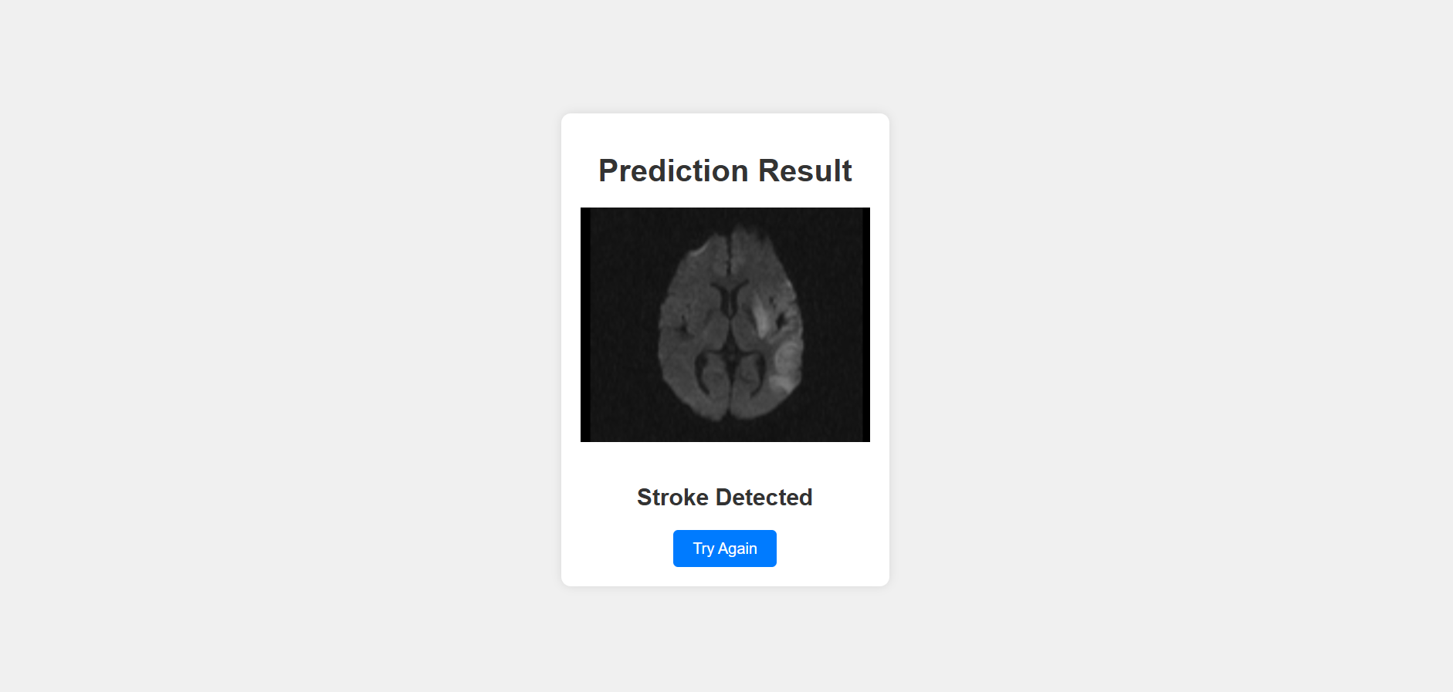

Slide 17
Future Enhancements
Model Improvement: Integrate additional data for improved accuracy and resilience to variations in image quality.
Enhanced Features: Add detailed analysis or severity scoring for detected strokes.
Deployment: Optimize for deployment in clinical environments and improve accessibility through mobile platforms.
Expansion: Adapt system to identify other conditions from CT or MRI scans.

Slide 18
Thank you!

