Slide 1
Demystifying Pregnancy Health prediction and Monitoring

Slide 2
Project Development Model: Scrum
Product Owner | Asst. Prof. Vincy Devi V.K
Scrum Master | Dr. Anoopkumar M
Sprint Start Date | 2022 August 15
Sprint End Date | 2022 November 9
Total Hours | 48
Total Number of Sprint | 6

Slide 3
Introduction
The journey of motherhood is a life-time experience for any women, where they feel plethora of emotions of love, care and at times worry for the safety of their baby
Rapport is mobile Application provide users to easily access all pregnancy-related information like daily health tips, weekly baby updates, GDM prediction, Risk analysis, prediction of fetal wellbeing and a lot more.

Slide 4
Features
01
02
03
04
GDM Prediction
Maternal Health Risk level Prediction
Fetal Health Wellbeing Prediction
Monitoring and filtering Maternal Attributes

Slide 5
Existing System
There are few apps available in the market but none of them are designed and developed according to the need of a mother.
It is not feasible for a mother to interact with the doctor every time with each and every minute details and help.
The post-pregnancy phase is also as essential as the pregnancy phase and needs special assistance for the mother and her child's overall development.
The parents in rural areas usually are not aware of the basic information regarding pregnancy and parenting phase.

Slide 6
Proposed System
The app will predict overall Risk level of pregnancy and can provide basic pre-caution and suggestions
Detection of (Gestational diabetes mellitus)
Classify fetal health in order to prevent child and maternal mortality using Cardiotocograms (CTGs) data.
The app will notify about the daily development of the child. According to the expected delivery date, it will generate the whole timeline.
The workout tutorials suitable for the mother according to the pregnancy risk level

Slide 7
Feasibility Study
Technical
Social
Economic

Slide 8
Development Requirements
Flutter
Java
VS Code
AVM
Android Studio
Python
Heroku
GitHub

Slide 9
Product Backlog
ID | Story | Estimation Time (Hours) | Priority
1 | As a user I want to login into the system | 5 | 1
2 | As a user I want to manage my account | 5 | 2
3 | As a user I want to see my predicted maternal health risk level | 8 | 3
4 | As a user I want to check whether I have GDM or not | 10 | 4
5 | As a user I want to see my predicted wellbeing of fetal | 10 | 5
6 | As a user I want to monitor and filter progression and health parameters | 10 | 6

Slide 10
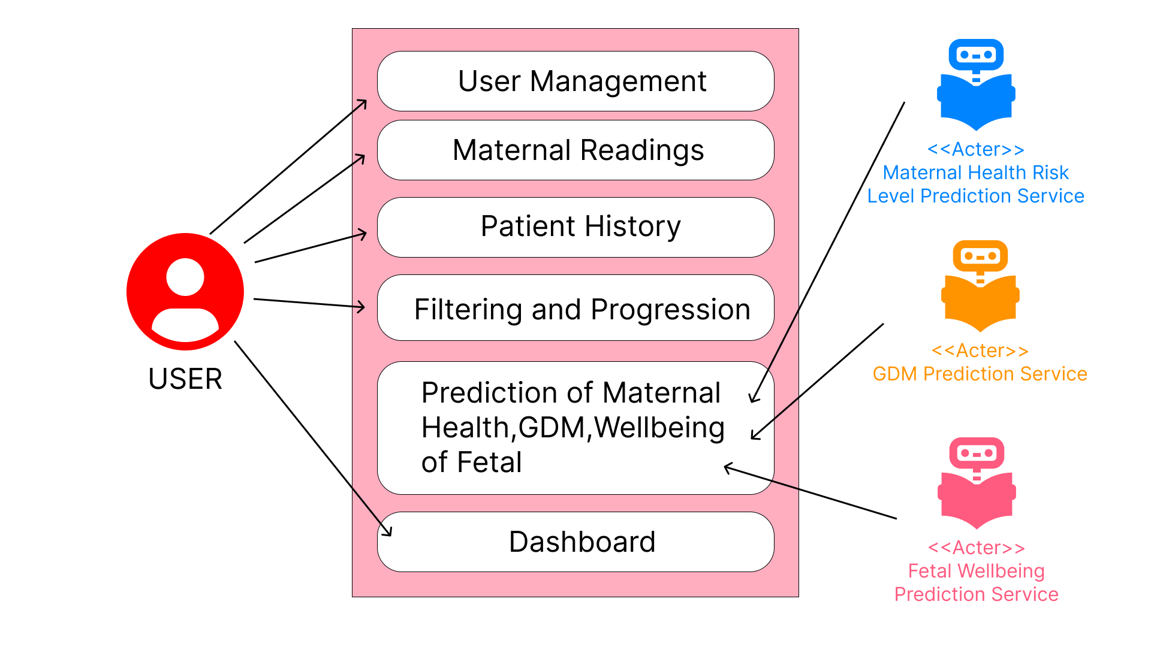
Use Case Diagram

Slide 11
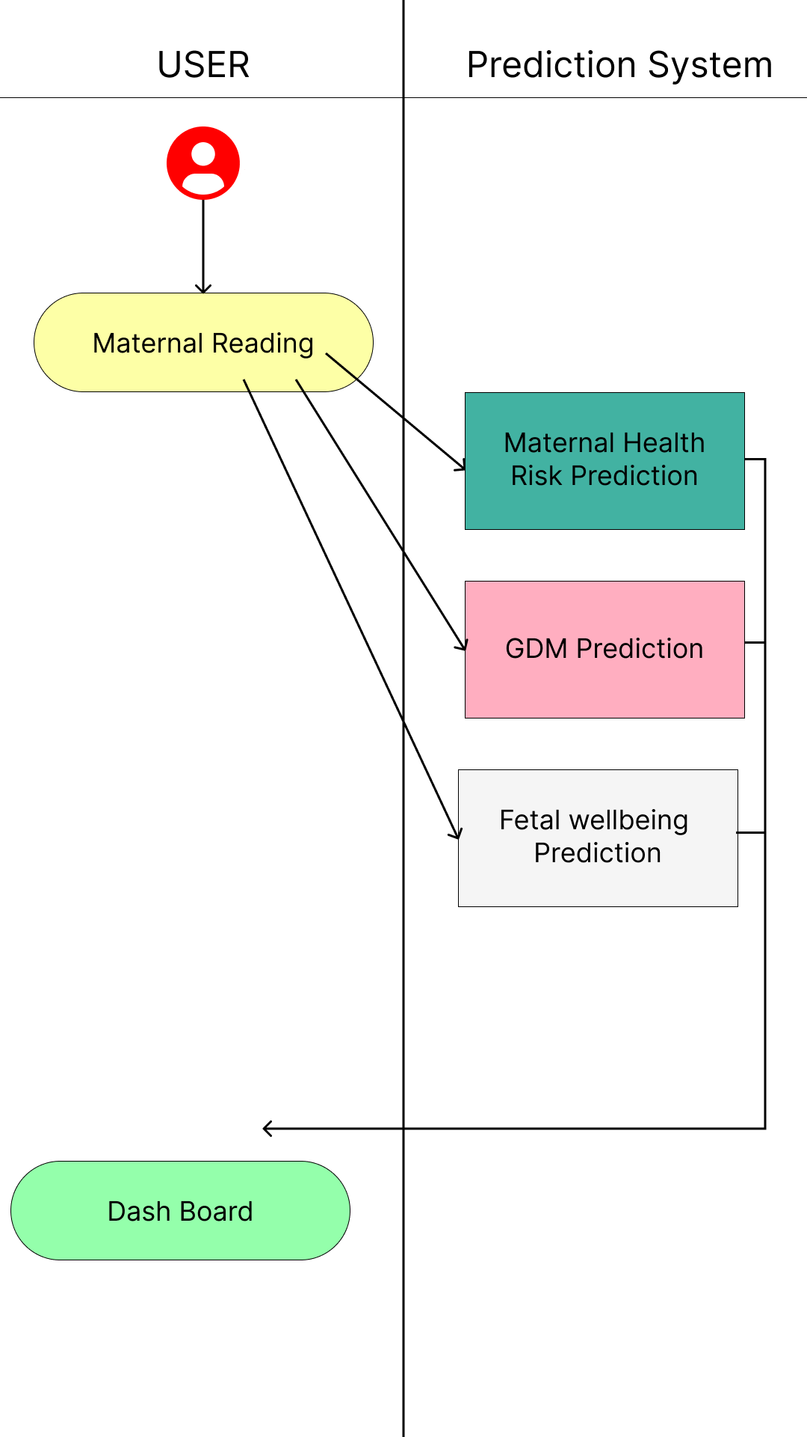
Activity Diagram

Slide 12
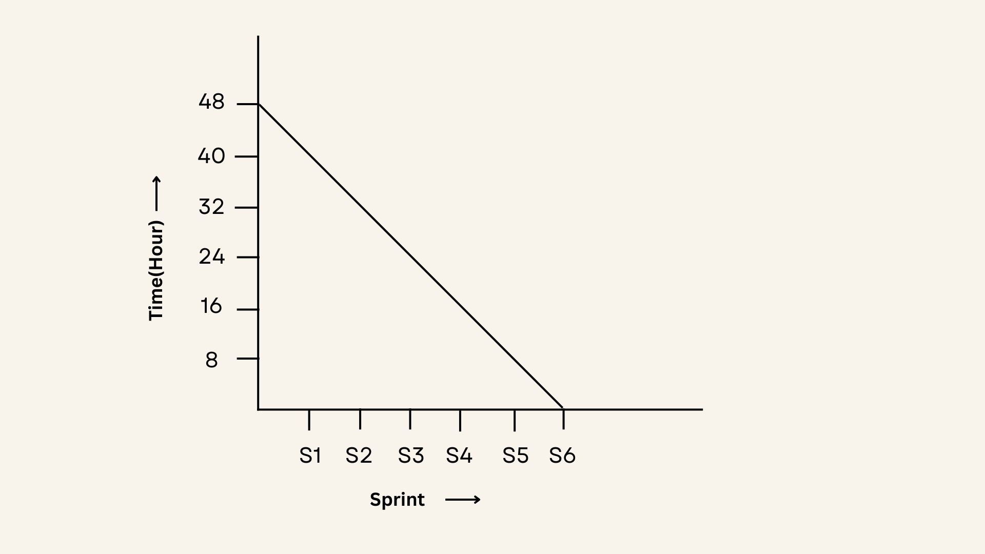
Ideal Burn down Chart

Slide 13
Thanks!

