Slide 1
ONLINE PIZZA SHOP
GRAB YOUR PIZZA NOW

Slide 2
WELCOME
2ND REVIEW
Guide: Rajalakshmi K.R.
Group Number: 3
Submitted by:
Ananthu Suresh Blessin Mathew Eldho M.S. Abhijith P.R. Abijith Anil

Slide 3
INTRODUCTION
Online pizza shop: efficient, accurate,time saving
We developed database and dfd for our project.
User friendly and Safe
Our goal is to make better tomorrow

Slide 4
MODULES
ADMINISTRATION
USER MANAGEMENT

Slide 5
DATABASE DESIGN
Done using tables
Total of 8 tables
3 for Admin
5 for User

Slide 6
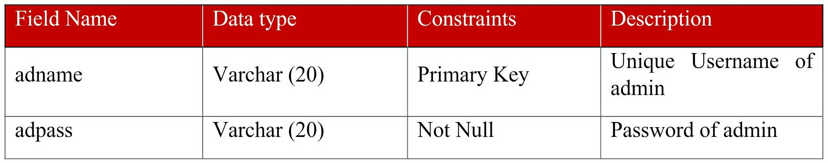
ADMINLOGIN

Slide 7
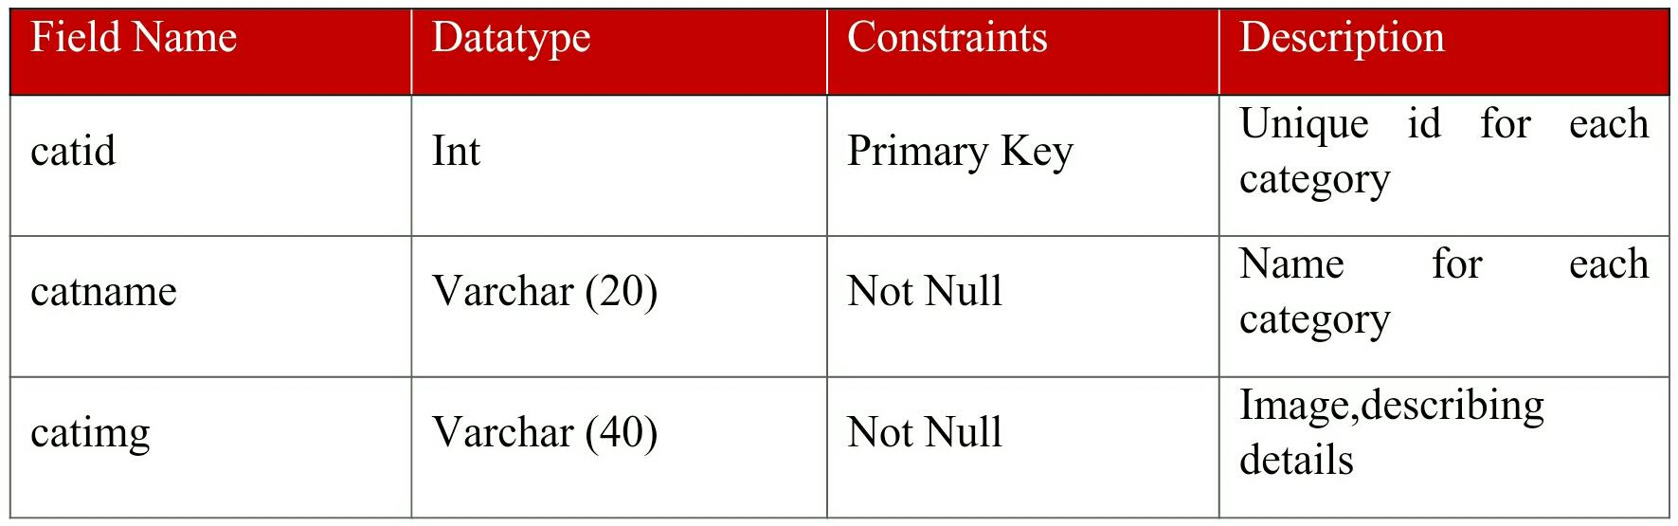
CATEGORIES

Slide 8
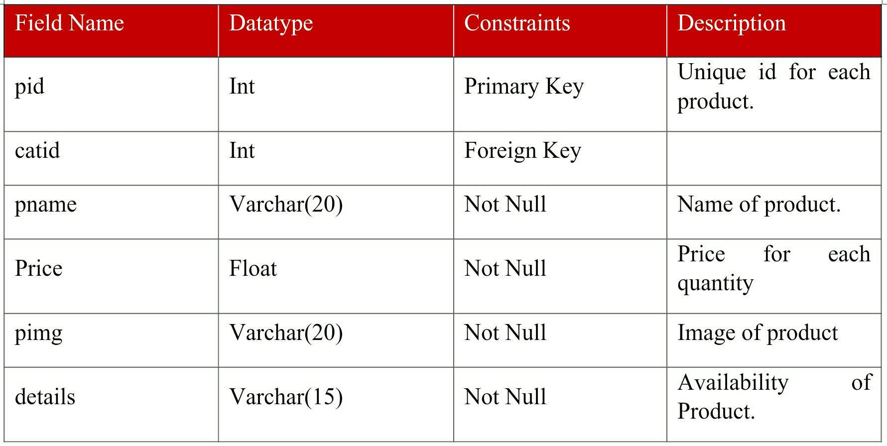
PRODUCTS

Slide 9
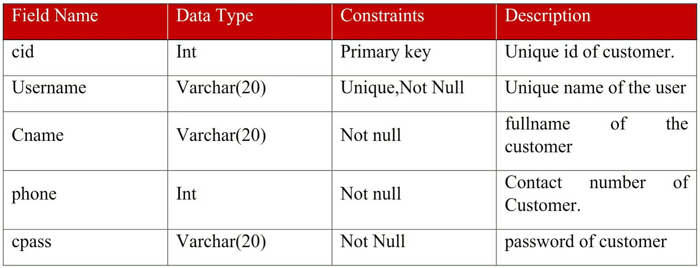
CUSTOMERDETAILS

Slide 10
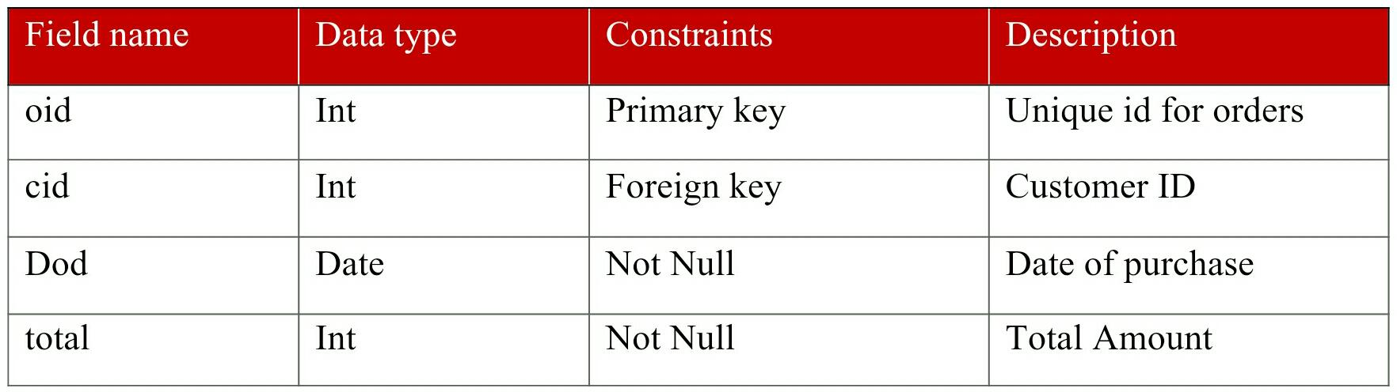
ORDERS

Slide 11
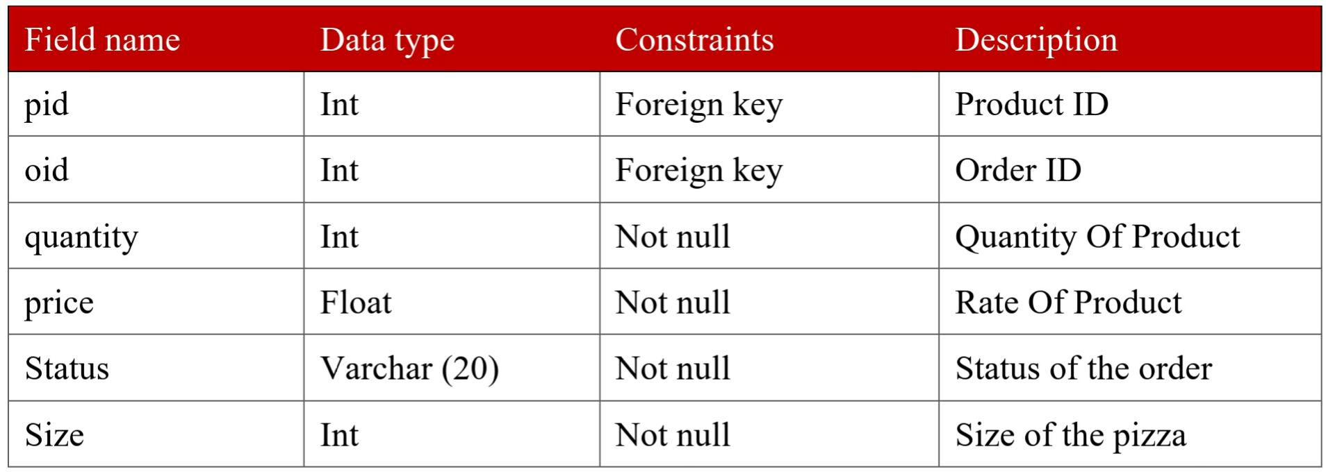
ORDERDETAILS

Slide 12
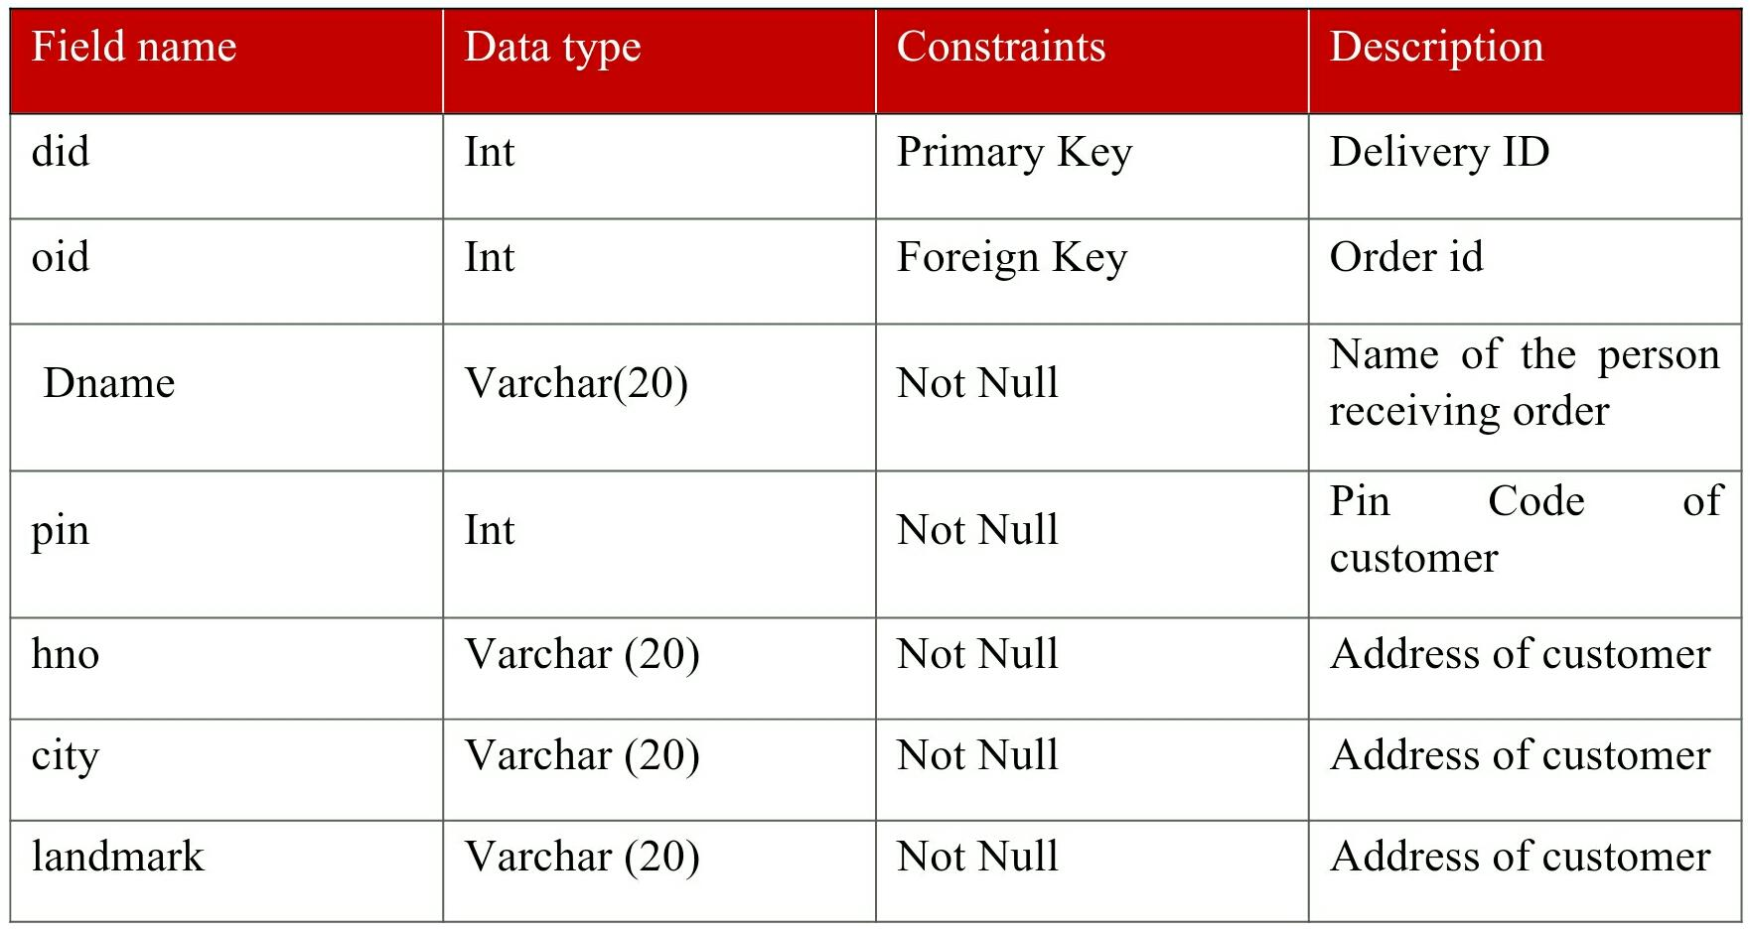
DELIVERYDETAILS

Slide 13
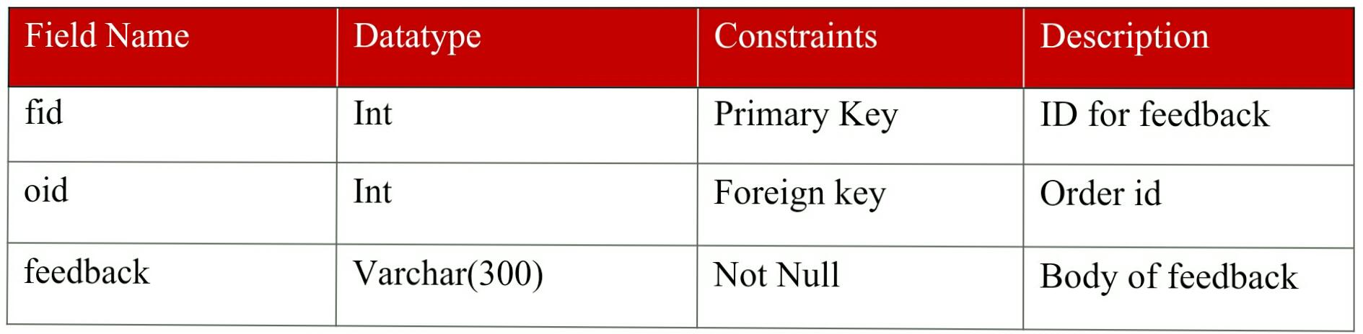
FEEDBACK

Slide 14
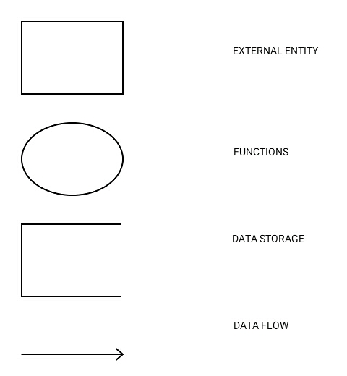
DATA FLOW DIAGRAM

Slide 15
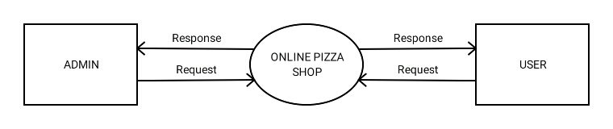
CONTEXT DIAGRAM

Slide 16
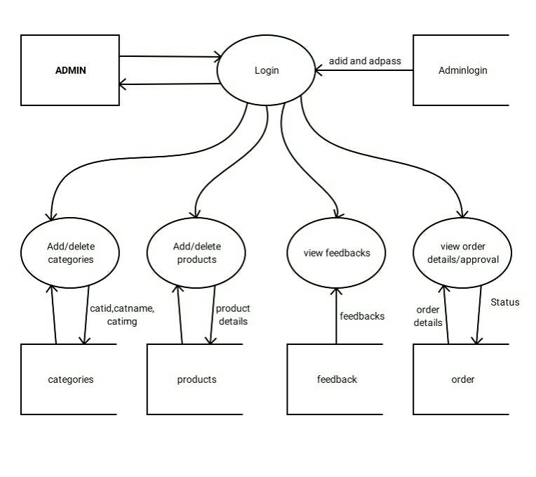
DFD FOR ADMINISTRATION

Slide 17
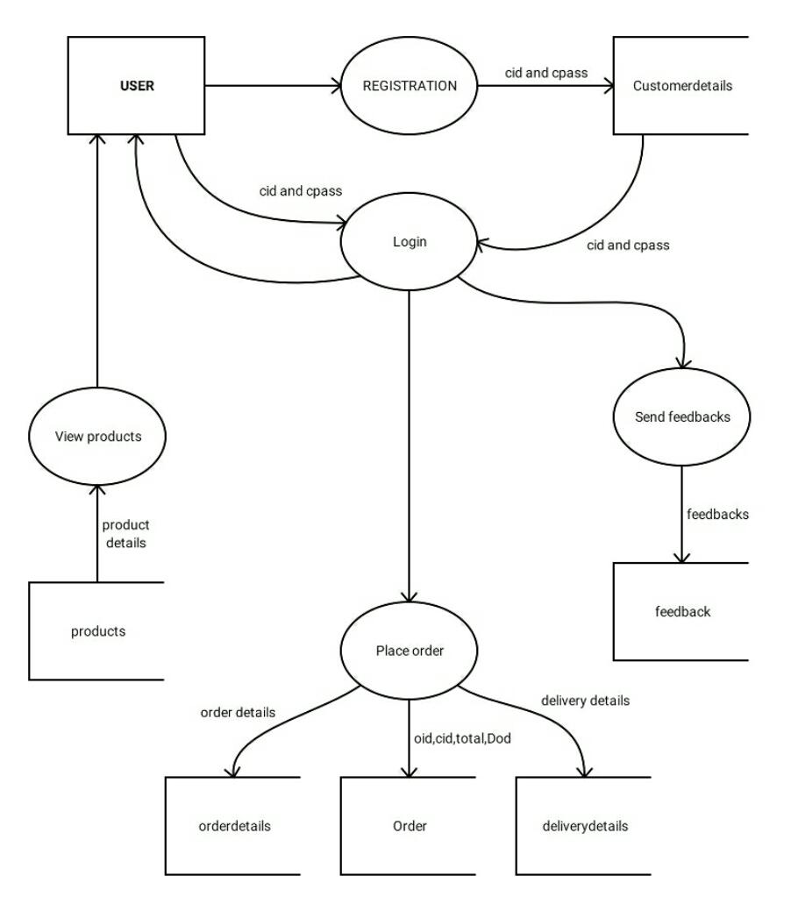
DFD FOR USER MANAGEMENT

Slide 18
CONCLUSION
The application for online pizza shop is easily accessible, informative and helpful .
The application is user friendly and very simple there by common man can easily access it.
Our database and DFD are well made and managed

Slide 19
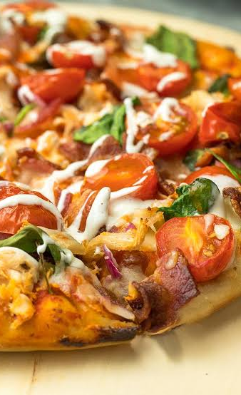
REFERENCE
Database design concept(Henry korth) Software Engineering (K.K Aggarwal and Yogesh Singh) System analysis and design (Elias M award) https://www.freeprojectz.com

Slide 20
THANK YOU
GRAB YOUR PIZZA NOW

