Slide 1
Graphical password authentication system
Review – II & III
CSE3502 – Information Security Management( J Component )

Slide 2
team members
Wilson Vidyut Doloy [19BCE1603]
Rishank Pratik [19BCE1606]
Prakrit Raj [19BCE1865]

Slide 3
index
ABSTRACT
INTRODUCTION
FLOWCHART
PROPOSED WORK
SYSTEM SPECIFICATIONS
BASE PAPER
IMPROVEMENTS
SCREENSHOTS

Slide 4
Abstract
It is a Django project demonstrating Graphical Password Authentication system. It uses combination of images as password. Functions include password reset, Block account on failed attempts, Notification when failed attempt occurs.

Slide 5
INTRODUCTION
A Graphical Password Authentication system is an authentication system that uses some combination of graphical images replacing the regular passwords. Graphical passwords may offer better security than text-based passwords because most of the people use regular, popular passwords everywhere and are prone to social engineering attacks. So graphical passwords can put stop to many attacks of this kind.

Slide 6
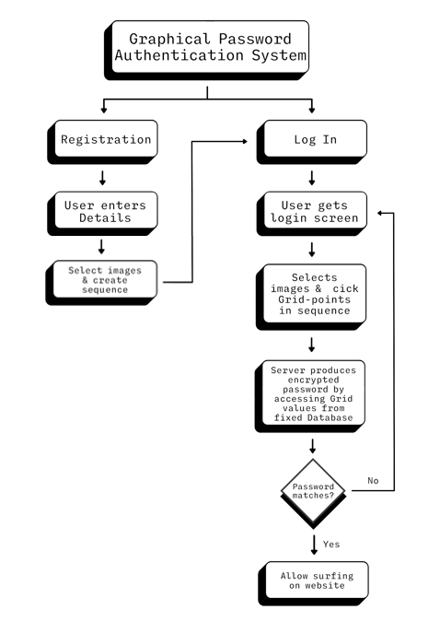
FLOWCHART

Slide 7
PROPOSED WORK
The system we propose includes certain concepts from captcha and pass points and tries to combine them in a new approach to address various security concerns related to the login modules. It takes the concept of pass points to form a grid of images which are not necessarily part of one image and are fragments of multiple images or vectors shuffled.
When one registers, they select the images based on their position inside the grid and remember the sequence of grid and not the images themselves. It eases the burden of remembering the various images and also enhances security of the login module. It incorporates the pass point concepts in creating the grid and validation of the sequence. It also uses the captcha concept to utilize various vector and stock images to materialize the grid and create random patterns difficult for attackers to crack. The system works as in the sequence of coordinates(x,y) chosen by the user on grid is analyzed. If it matches with the pre-set sequence then the access is given else not given. This is how the User is authenticated by the system.

Slide 8
SYSTEM SPECIFICATIONS
Browser Requirements: Google Chrome (latest or version 56), Firefox (latest or version 51) or Safari (version 11.1.2 or above). We do NOT recommend Internet Explorer (all versions)
Django, Flask, Python,
Image APIs

Slide 9
BASE PAPER
Graphical Image Based Password Authentication System- Dr. Sathish Kumar, R. Kalpana, R. Rajkumar. 2019
This research paper discusses various shortcomings of text based password authentication systems. It discusses various approaches to achieve the goal. These approaches include Pass position approach and Captcha approach and discusses the system for a File storage system. The system works as in the sequence of coordinates(x,y) chosen by the user on a Captcha is analyzed. If it matches with the pre-set sequence then the access is given else not given. This is how the User is authenticated by the system.

Slide 10
IMPROVEMENTS (SECURITY)
Bruteforce: After reaching max tries, the user will be notified via message through email. And the further authentication through the generic URL/website is disabled for that user account, instead, they have to use the link that will be sent by the company in the notification email. This also lets the legitimate user know about the adversary.
Shoulder Surfing: Shoulder surfing is a type of social engineering technique used to obtain information such as personal identification numbers (PINs), passwords and other confidential data by looking over the victim's shoulder. The system we adopt is similar to the Phone pattern system. The pattern is invisible on the screen when the users draw it. This makes it incredibly tough for the adversary to see the images on the grid that the user clicks.
Spyware: Graphical password systems resist spyware more easily than regular passwords. Key-loggers secretly capture keystrokes and transfer, but if the spyware wants to track the mouse movements, it can be tracked, but the adversary wouldn’t know which part of the mouse event is actually the graphical password. The timeline vs mouse-event graph is too difficult to get the pattern

Slide 11
IMPROVEMENTS (SECURITY)
Hidden Camera: There will be a camera in front of the user which identifies a face while authentication i.e., the number of pixels the face occupies should be 80-90% of the total pixels in the current frame and if this condition is not satisfied then the screen does not show the graphical password. It alerts the user to cover the screen with a proper posture. But this will be a costly operation.
Phishing: Since the adversary is made to believe that the password is a set of images, it’s not possible to make a fake page, since the adversary thinks he doesn’t know the images. Moreover, we restrict the user to one attempt and suggest the user to give a fake password every time so that he triggers the server to send and URL in email so that he can log in through the legitimate login page, and the adversary cannot send the URL to users from a legitimate server. However, when the adversary knows the technique this attack might be still possible.

Slide 12
SCREENSHOTS

Slide 13
deployment

Slide 14
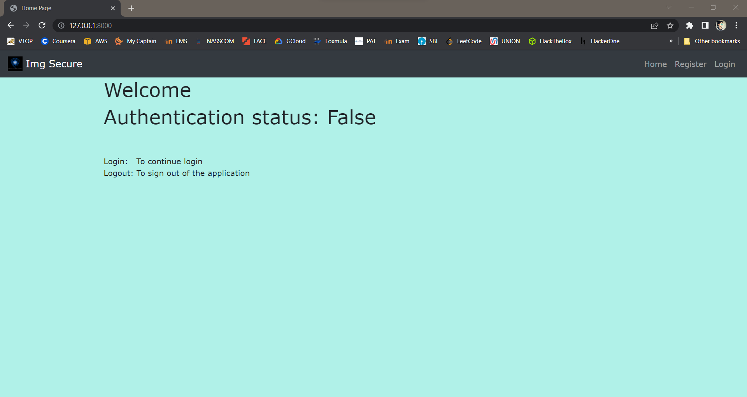

Slide 15
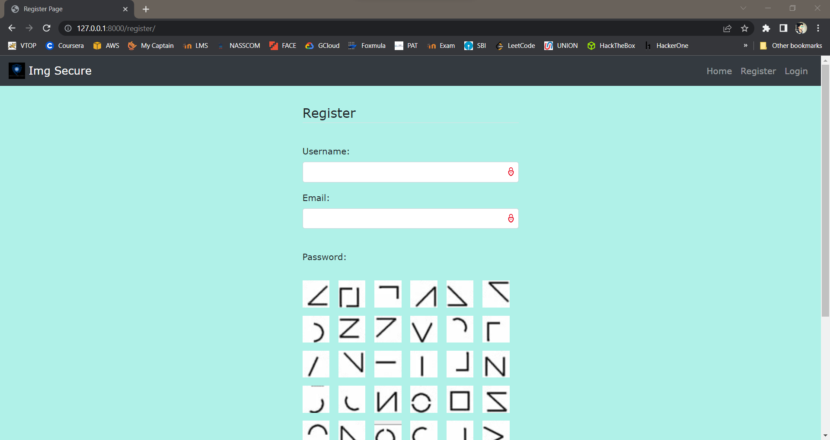

Slide 16
