Slide 1
HACKATHON PITCH
Every unit. Every bin.
One screen.
Inventory Management System: a secure, role-based web platform that replaces warehouse spreadsheets.
Ananthu C S · Easwari Engineering College, CSE · October 2026

Slide 2
Warehouses still run on guesswork
Registers and spreadsheets break down as stock grows
Wrong numbers
Lost time
No control
Manual entry and delayed updates mean recorded stock differs from what is on the shelf.
Finding a product, a bin or a damaged item means searching several files.
Shared sheets have no roles, no history and no single view of operations.
Result: stock-outs, mis-shipments and hours lost to manual reconciliation.
Inventory Management System · Hackathon Pitch
2

Slide 3
Our solution
One platform from receiving to dispatch
1
2
3
4
Know your stock
Move it safely
Fulfil orders
Stay in control
Products, warehouses and bin locations linked in one live ledger.
Transfers and dispatches are blocked if stock is insufficient.
Orders flow Pending → Confirmed → Picking → Ready → Dispatched.
JWT login with Admin, Manager and Staff roles; live dashboard.
Built with React · TypeScript · Node/Express · MongoDB
Inventory Management System · Hackathon Pitch
3

Slide 4
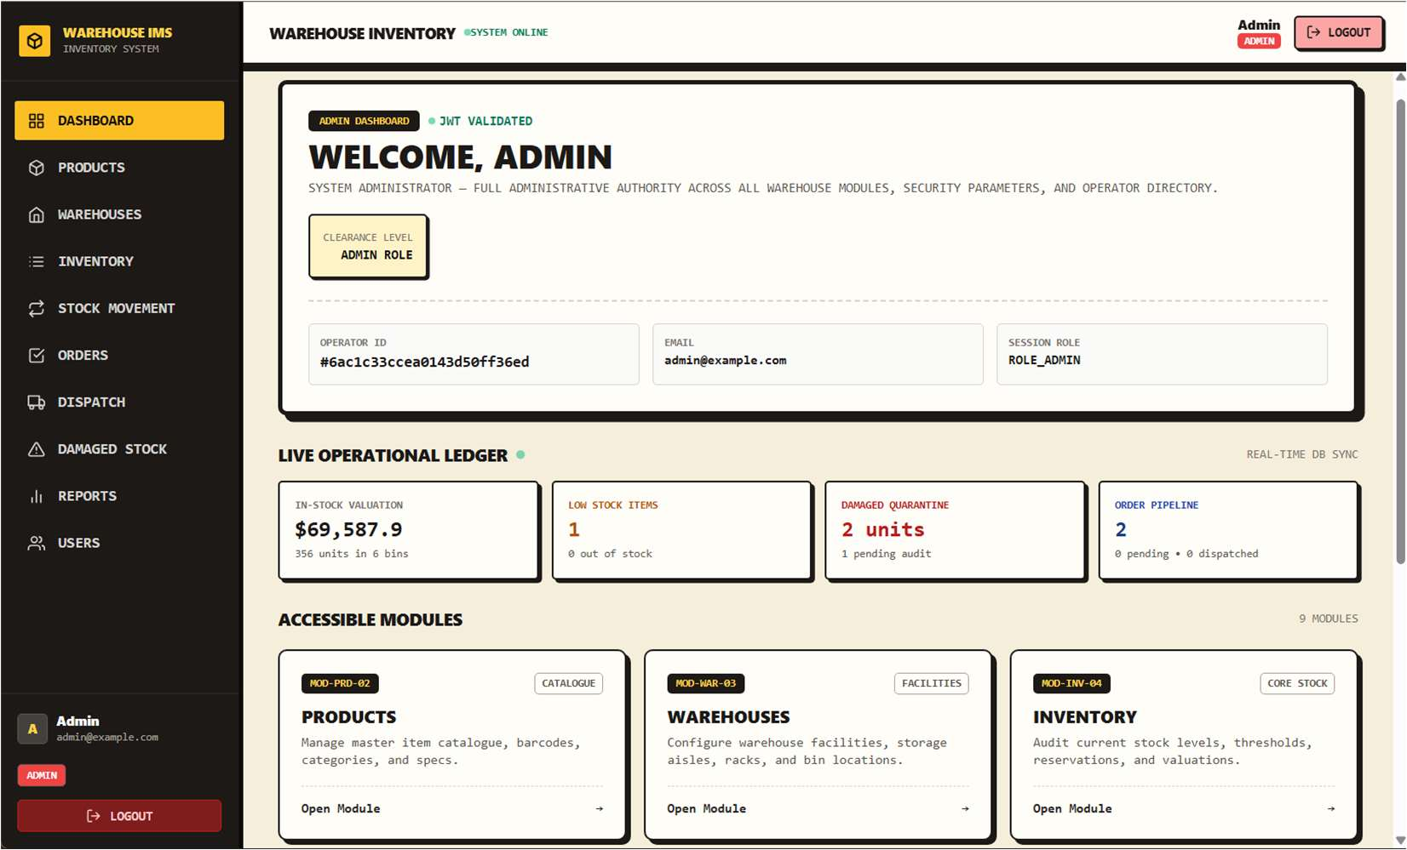
See it live
Dashboard: valuation, low stock, damaged items and order pipeline at a glance
Total stock valuation in real time
Low-stock and out-of-stock counts
Damaged stock awaiting resolution
Orders pending vs dispatched
One click into every module
Inventory Management System · Hackathon Pitch
4

Slide 5
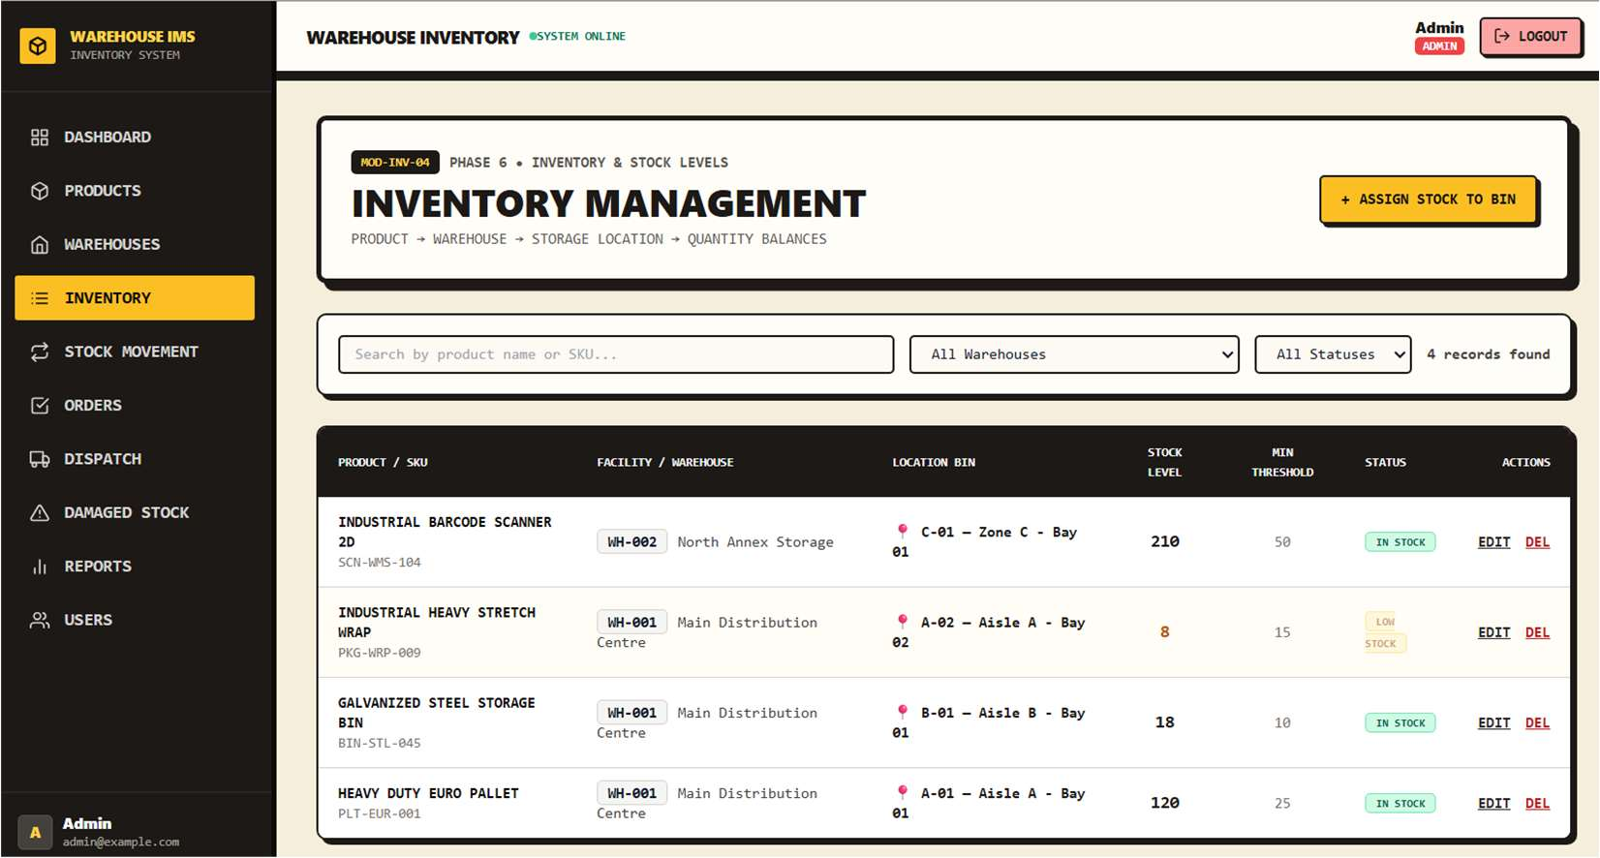
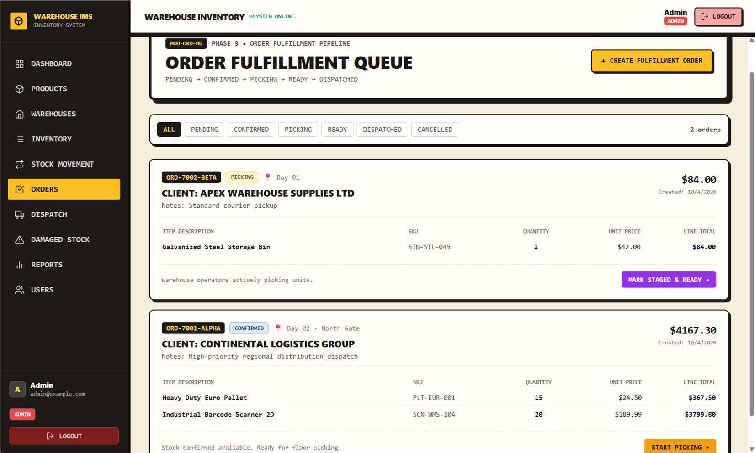
Built for daily warehouse work
Products, bins and stock levels, each with a clear status
Inventory by bin
Order fulfilment queue
Quantity, minimum threshold and an automatic IN / LOW / OUT status.
Stage-by-stage picking and dispatch with client and item detail.
Inventory Management System · Hackathon Pitch
5

Slide 6
What makes it different
Rules live in the system, not in people's heads
Self-updating status
Safe stock moves
A save hook sets IN / LOW / OUT STOCK from quantity and threshold, so status never drifts.
Transfers and dispatches are rejected when the source bin cannot cover them.
Order guardrails
Role-based access
An order cannot be confirmed unless stock across all locations covers every item.
JWT plus role middleware: each user sees and does only what their role allows.
Inventory Management System · Hackathon Pitch
6

Slide 7
Before and after
Same warehouse, one connected system
 | Spreadsheets / registers | Our system
Stock records | Manual, delayed | Centralised, always current
Finding items | Search separate files | Warehouse and bin linked to stock
Low stock | Spotted by manual checks | Automatic status and dashboard count
Movement history | Hand-written or missing | Logged IN / OUT / TRANSFER
Damaged goods | Separate lists | Reported with resolution status
Access | Anyone with the file | Admin / Manager / Staff roles
Inventory Management System · Hackathon Pitch
7

Slide 8
Who it's for
Teams that outgrow spreadsheets but do not need a full ERP
Small warehouses
Retail and e-commerce
Distributors and SMEs
Single or multi-site stores that need bins and stock visibility.
Sellers managing stock, orders and dispatch together.
Teams with several staff roles who need controlled access.
Impact: fewer stock errors, faster order handling, and one source of truth for every role.
Effect sizes will be reported once measured in a pilot.
Inventory Management System · Hackathon Pitch
8

Slide 9
Roadmap
From working prototype to a deployable product
Now
Next
Later
Core platform: products, bins, inventory, movements, damaged stock, orders, dispatch, dashboard, 14/14 tests passed.
Barcode / QR scanning, automatic low-stock alerts, mobile-friendly UI.
Supplier and purchase orders, audit trail, demand forecasting, ERP and shipping integration.
Inventory Management System · Hackathon Pitch
9

Slide 10
Thank you
Inventory Management System
Ananthu C S (310624104022) · Guide: Ms. Nagamani Segalla
Easwari Engineering College, CSE
github.com/Ananthu2006-cse/FSD-Project

