Slide 1


SMART INDIA HACKATHON 2026
TITLE PAGE
Problem Statement ID- 26099
Problem Statement Title- AI-Driven
Standardization and Harmonization
of Material Codes Across CPSEs.
Theme- Smart Automation
PS Category- Software
Team ID-
Team Name - Localhost3700

Slide 2
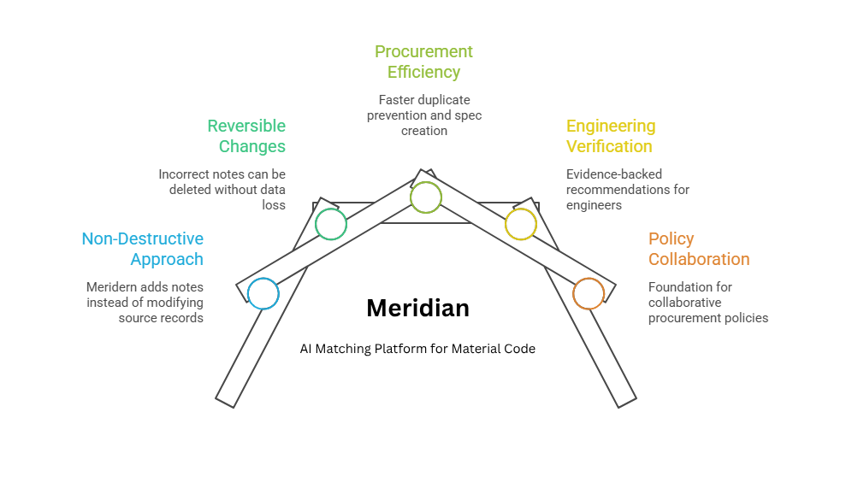
Meridian: The Convergence Point for India's Material Codes.
Local Host:
3712
Idea/Solution:
Evidence-Based AI Matching Platform for Material Code Harmonization Across CPSEs
Key Features:
Typed Attribute Extraction: Regex + LLM extraction with an evidence span per field; never guesses unknowns.
Four-Way Verdict: Same / Possible Alternative / Different / Insufficient Evidence, never a forced binary.
Deterministic Conflict Gates: Auditable rules outside the AI that can veto any match verdict.
Matching Cascade: Identity to attribute rules to model, only on ambiguous pairs: 99.4% of pairs cut.
Canonical ID Registry: One national code per material, additive mapping to every source CPSE code.
Duplicate-Prevention Check: Flags an existing match before a new material code is ever created.
Innovativeness & Uniqueness
•Evidence-First: every verdict traces to real evidence, not a score
•Deterministic Override: conflict gates make refusals auditable
•Non-Destructive: never edits a CPSE's code, only adds a note
•Benchmarked: 173x fewer false merges than fuzzy matching

Slide 3













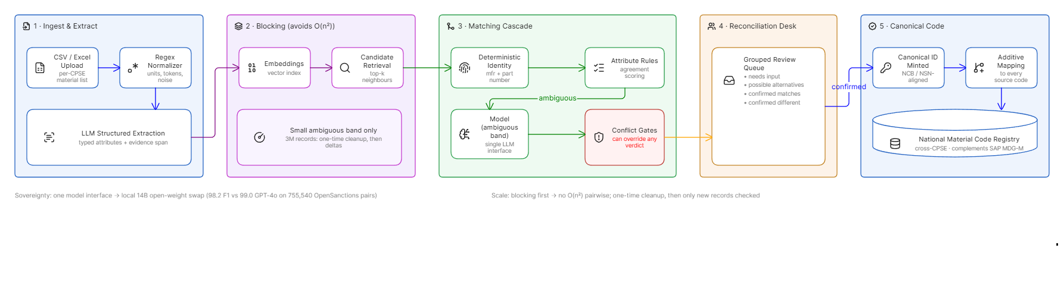


TECHNICAL APPROACH
Local Host:
3712
Frontend
Backend
AI /ML
React 19, Vite, TypeScript, TanStack Query, Tailwind CSS 4, Recharts, Axios
Python, REST APIs, FastAPI, SQLAlchemy, SQLite (Postgres-ready), Pydantic, pytest (75)
Hugging Face [BGE-base], Qwen2.5-7B (Ollama), NumPy, PyYAML, Azure OpenAI
Data Flow Diagram

Slide 4
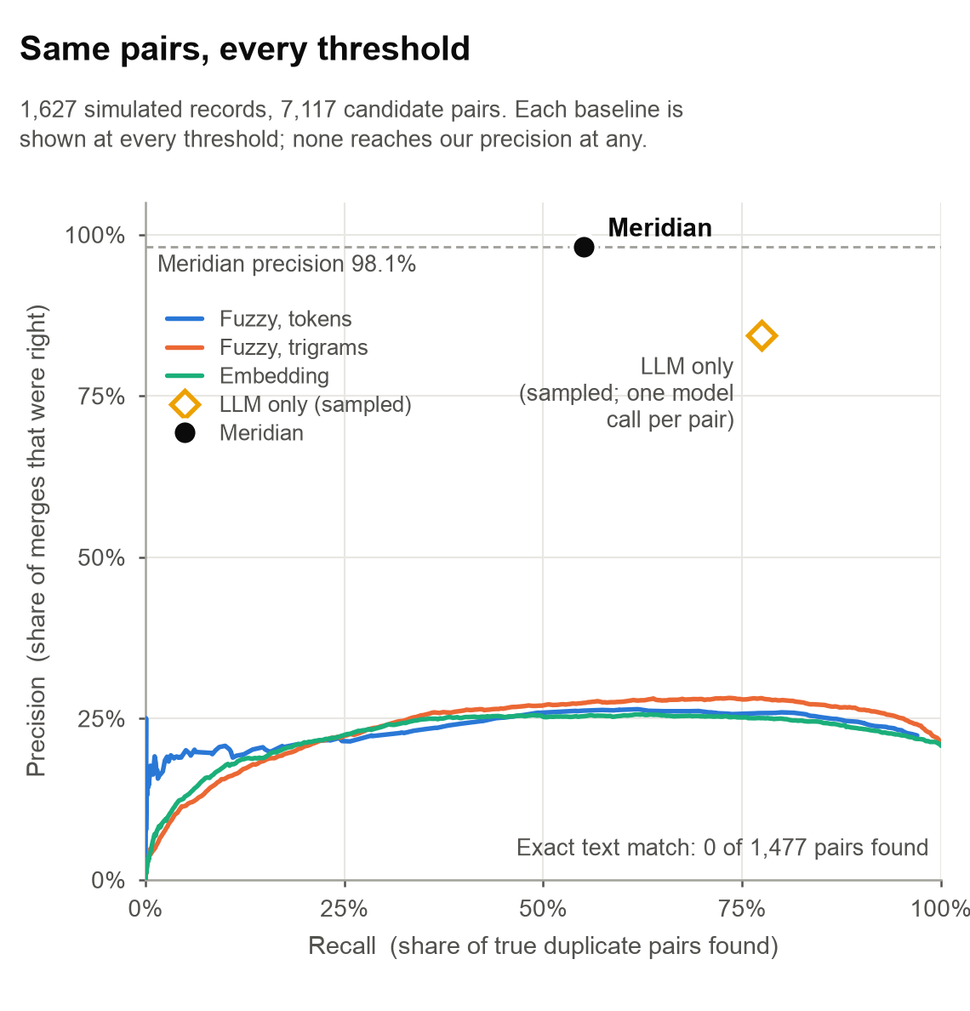
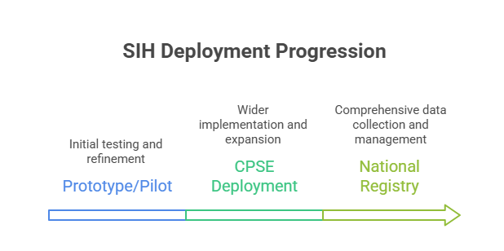
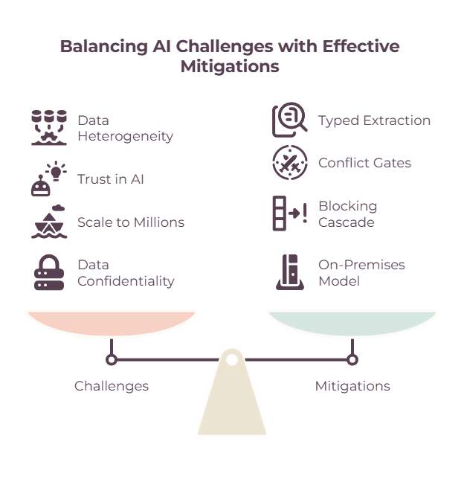
FEASIBILITY AND VIABILITY
Local Host:
3712
Feasibility:
Technical feasibility - All 7,117 pairs decided offline, zero model calls.
Scale feasibility - Blocking cuts 99.4% of comparisons, missing no true pair.
Sovereignty feasibility - The model can run inside the CPSE's own network.
Reversibility feasibility - Dry run on a CPSE master: 0 existing fields altered.
Safety feasibility - Gates outside the AI: 0.0028 false-merge rate on hard pairs.
Generalisation feasibility - 4 families, each added as YAML with no code change.
Evidence feasibility - Fuzzy makes 2,764 false merges at our recall; we make 16.
Viability:
Adoption viability - Works alongside SAP via a MATMAS05 IDoc export, so no CPSE replaces what it already runs.
Cost viability - The deterministic path needs no model call, so most decisions cost nothing to run.
Market viability - Incumbents clean one company's data; none reconcile identity across organisations.

Slide 5
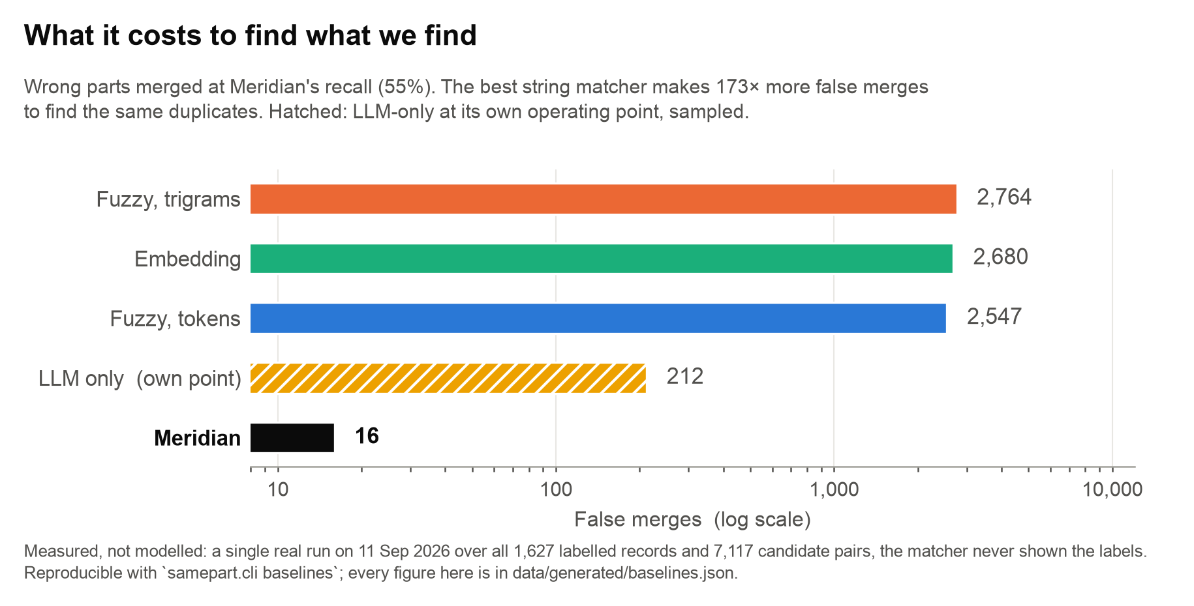
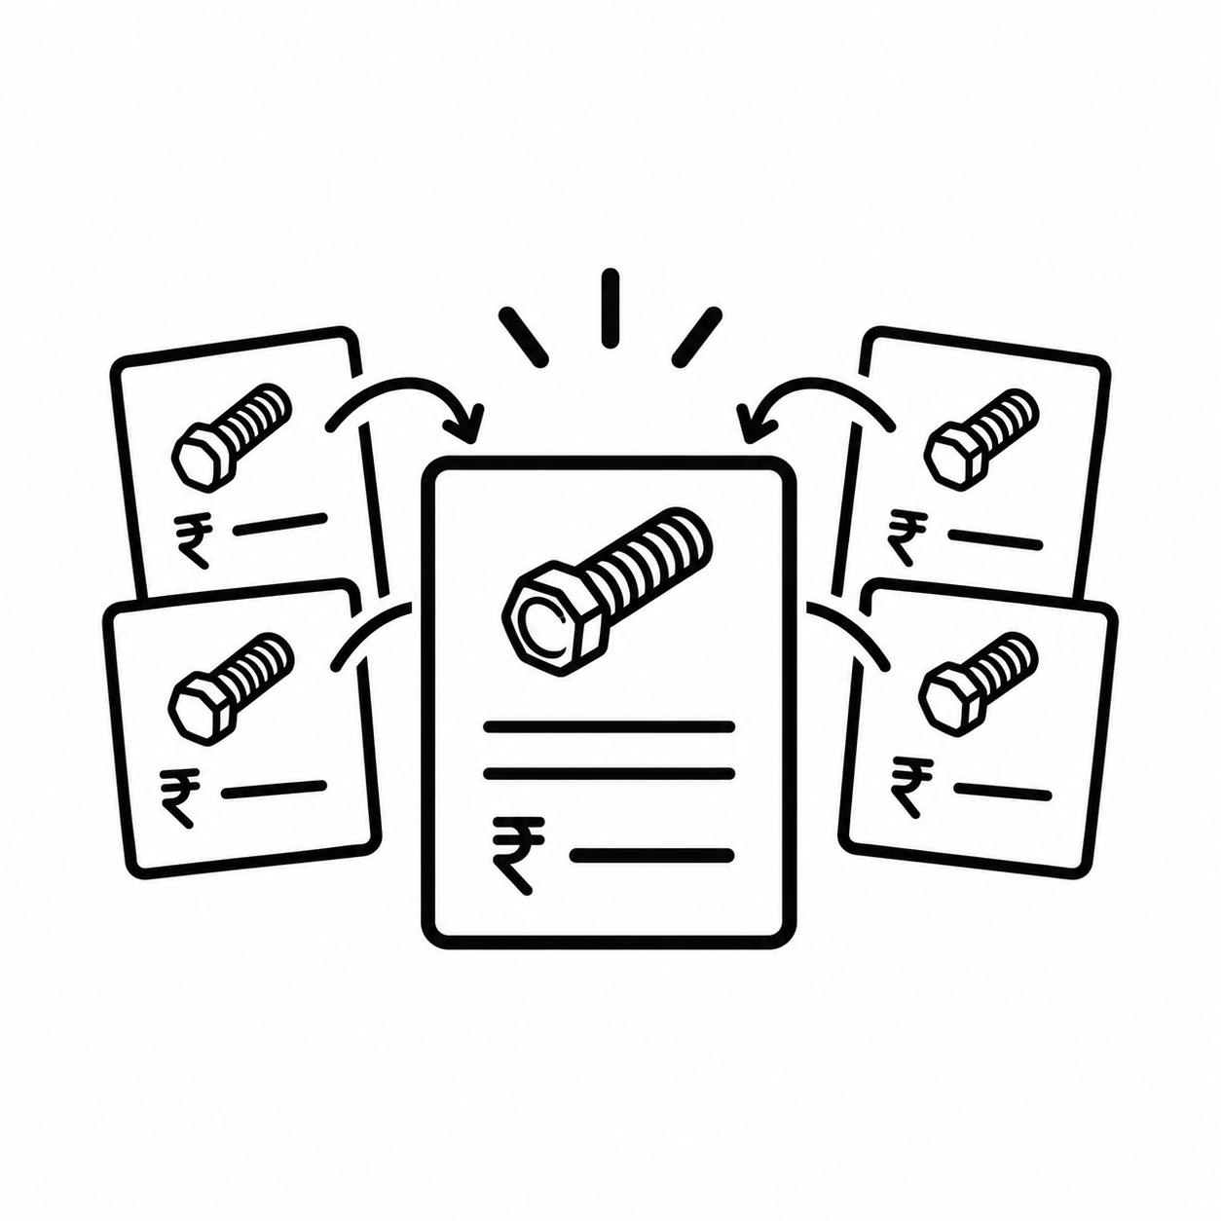
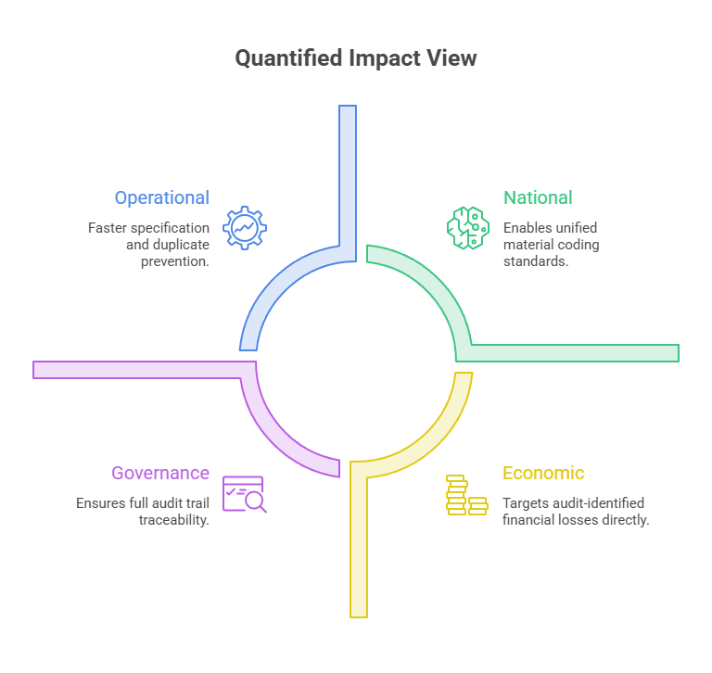
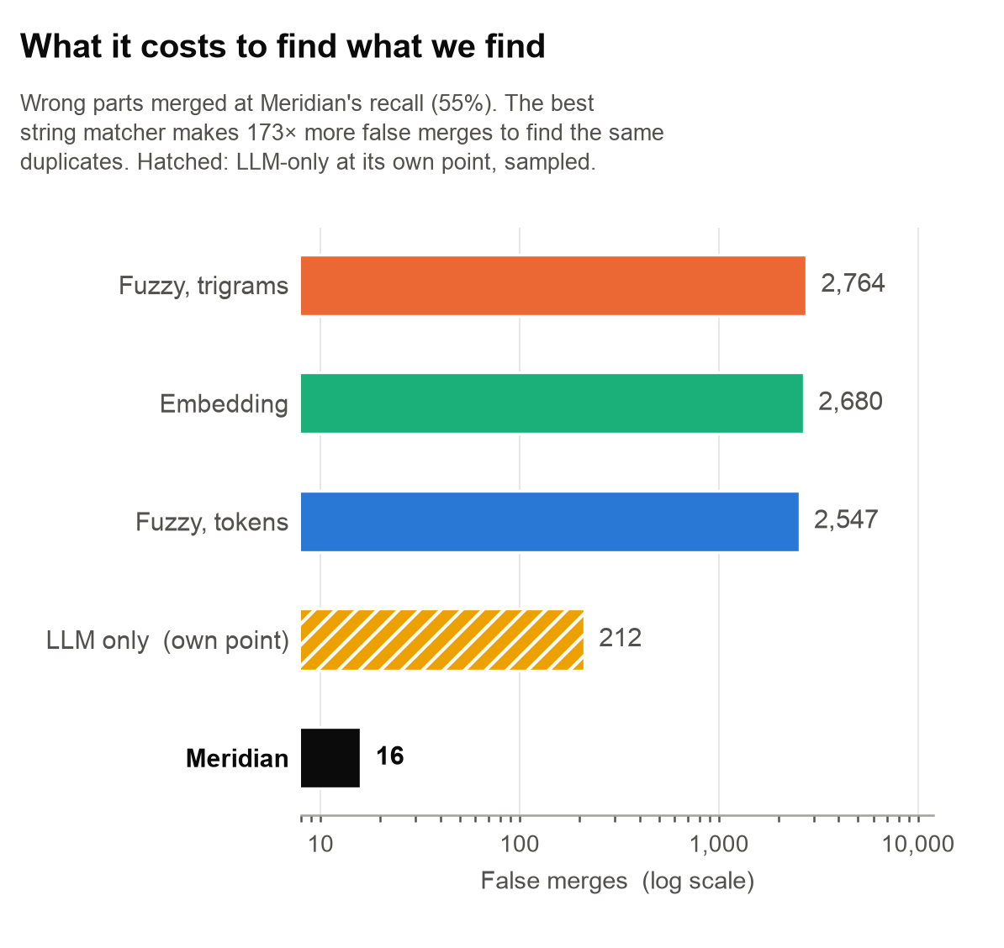
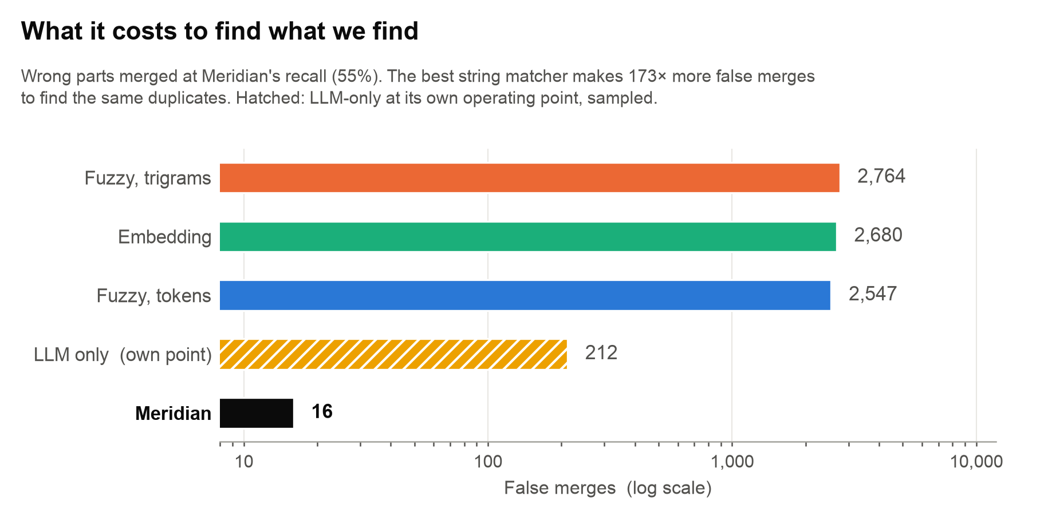
IMPACT AND BENEFITS
Local Host:
3712
Strategic Benefits:
Economic: One identity per material lets CPSEs aggregate demand and compare prices.
Governance: SHA-256 hash-chained audit trail; 1,935 events, tamper-evident.
Safety: Never edits or deletes a source code, only adds a note - so a wrong merge costs nothing to undo.
Impact:
Procurement Teams: Confident duplicate prevention and faster specification finalization, before a new code is ever created.
Plant Engineers / Reviewers: Evidence-backed recommendations they can verify, not a black-box similarity score.
Policy Makers: A working foundation for collaborative procurement and strategic sourcing across CPSEs.
One Part, One Price
Same bolt, different CPSEs, different prices
Once Meridian confirms these are the same part, price and quantity per cluster becomes a single grouping query.
Reference scale: CAG found Rs 12,743 crore in procurement & inventory losses at SAIL alone over 7 years.

Slide 6
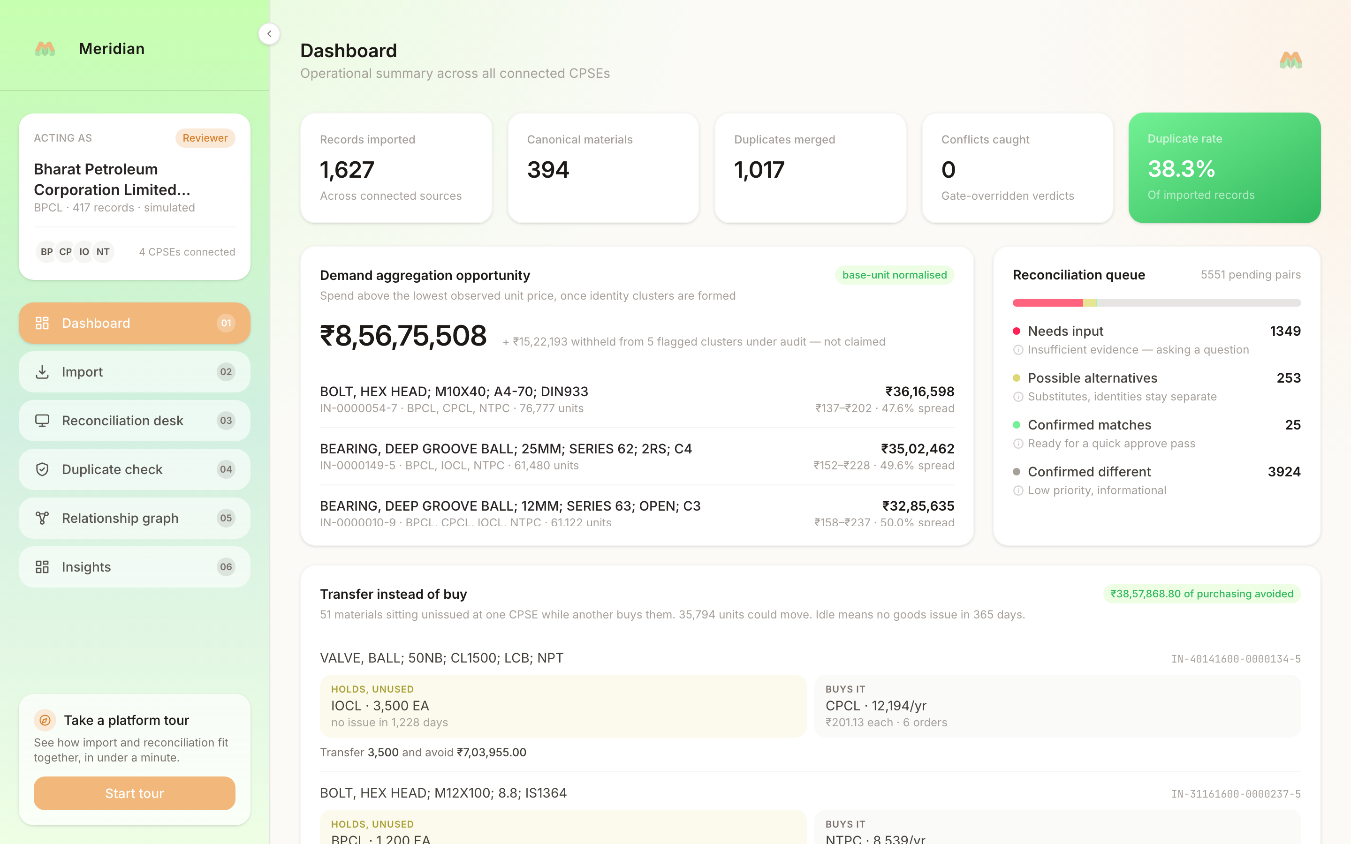
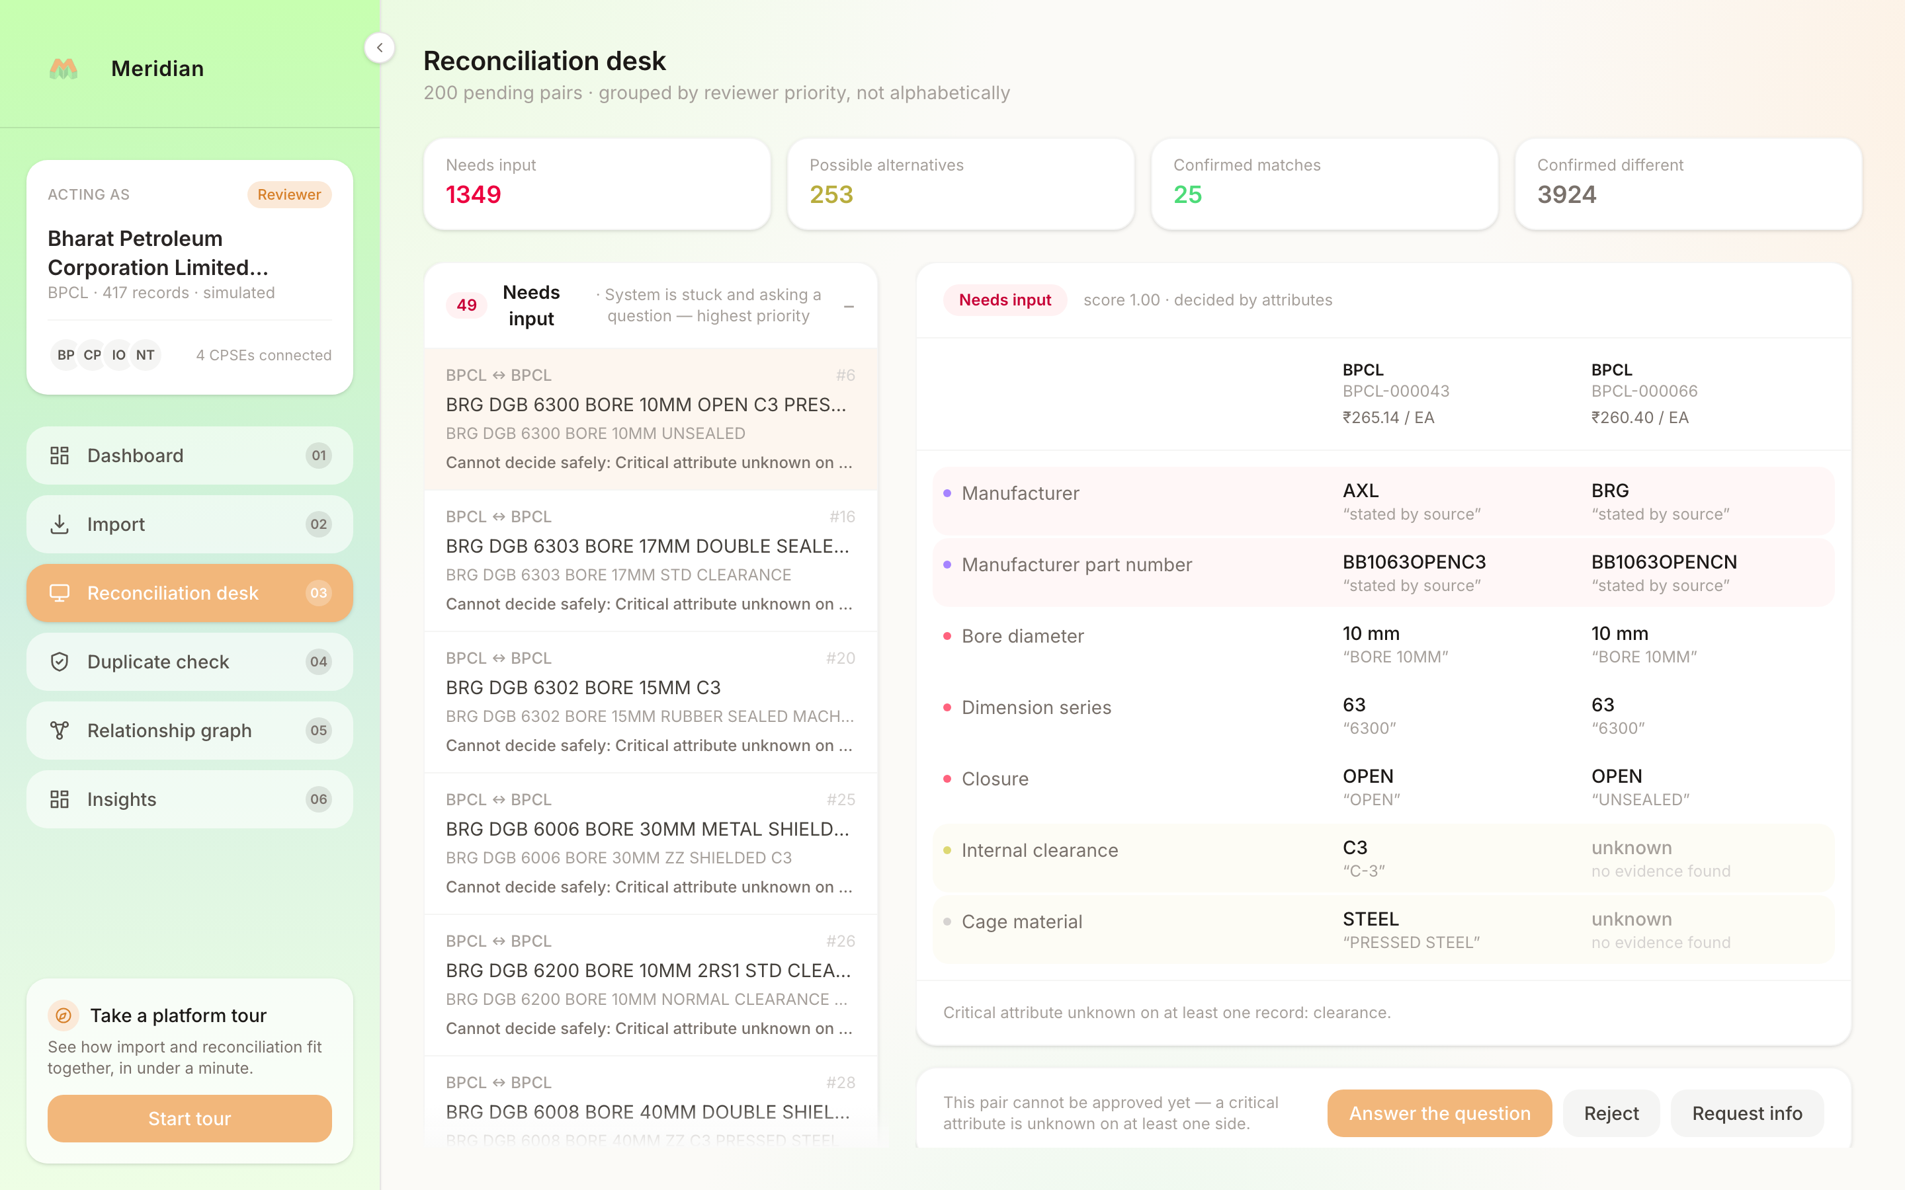
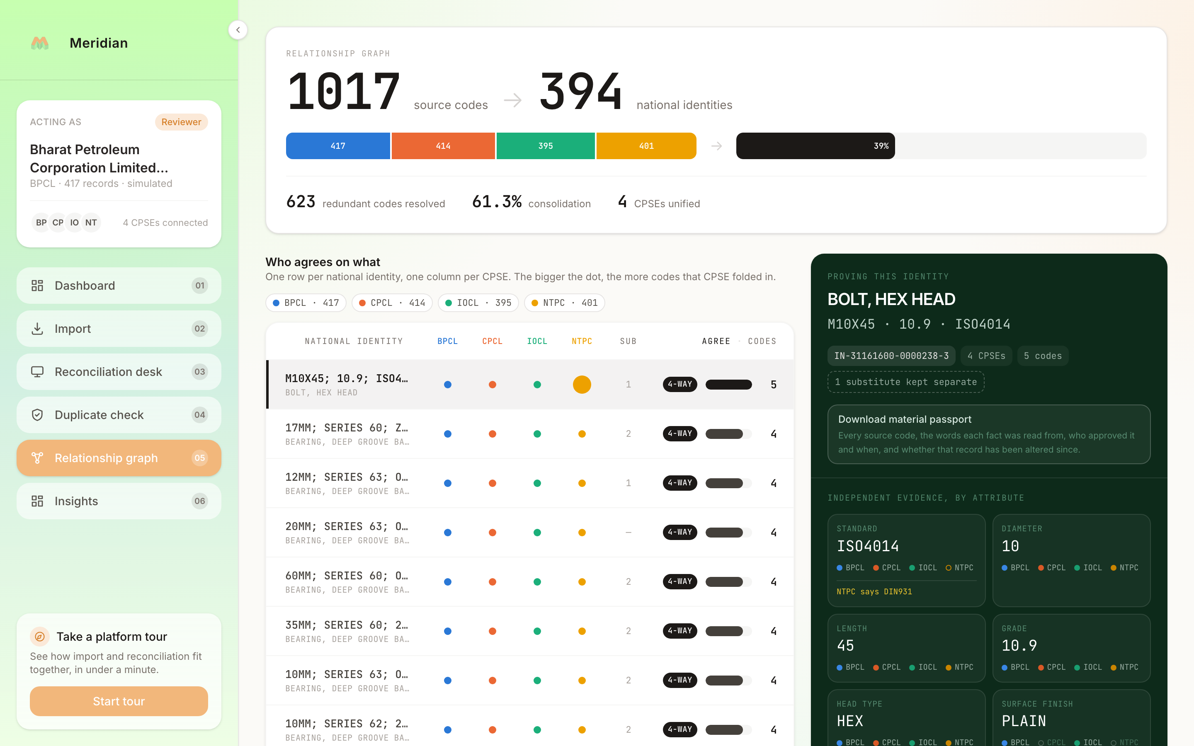
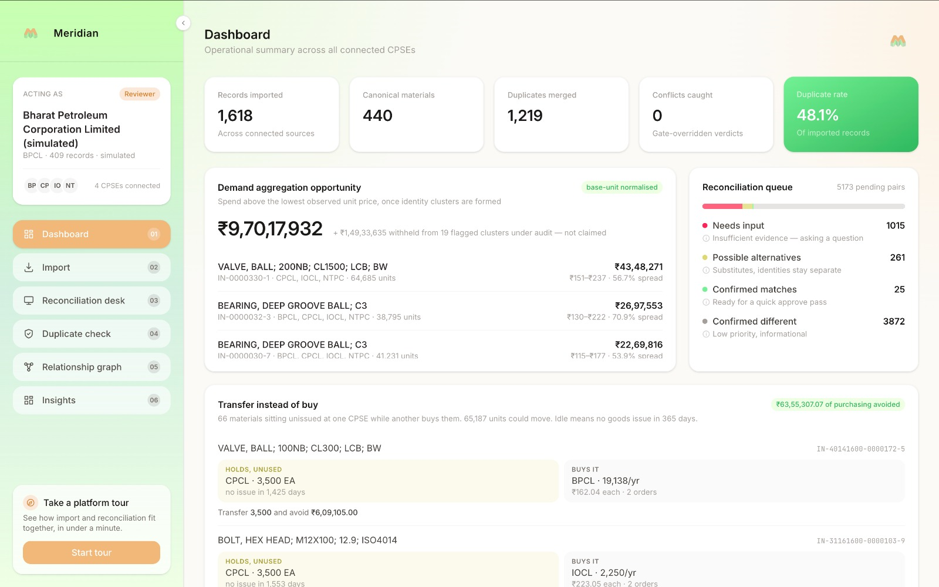
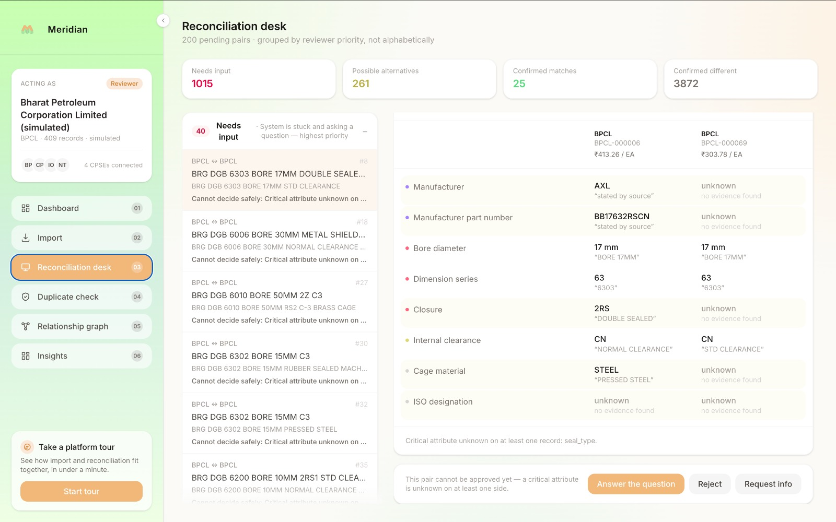
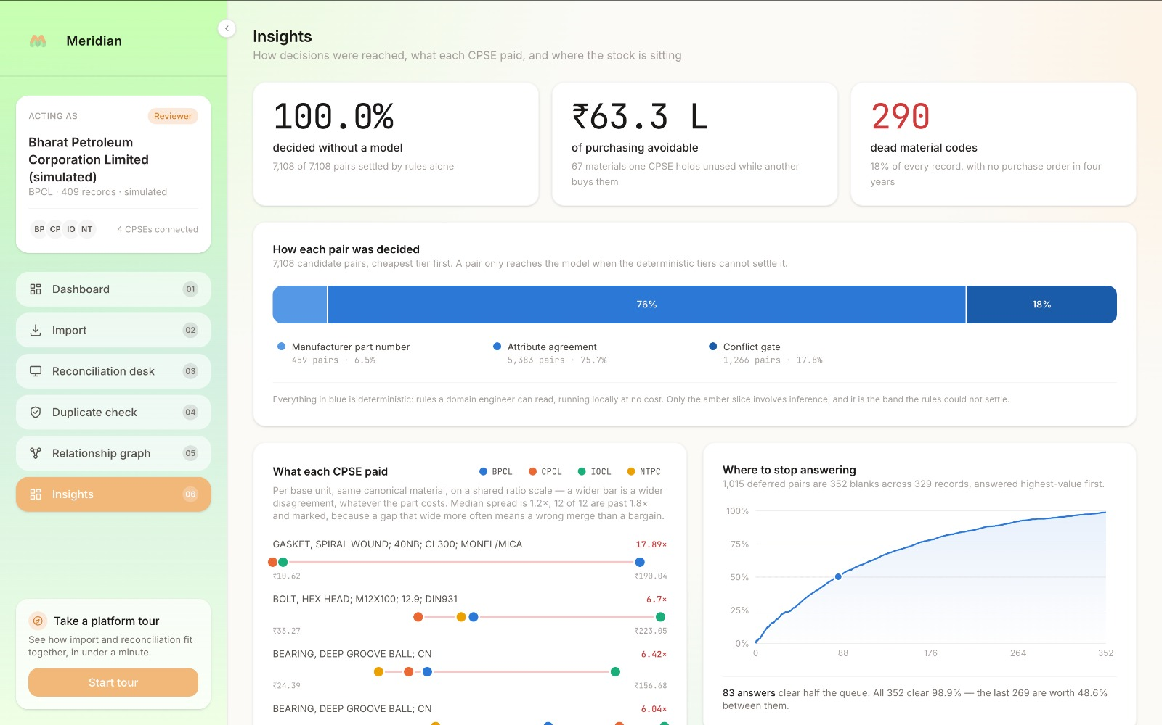
RESEARCH AND REFERENCES
Local Host:
3712
Fellegi & Sunter, A Theory for Record Linkage (JASA, 1969): https://www.jstor.org/stable/2286061
Peeters, Steiner & Bizer, LLMs for Entity Matching (EDBT 2025): https://arxiv.org/abs/2310.11244
OpenSanctions Pairs benchmark (on-prem vs hosted model F1): https://arxiv.org/abs/2603.11051
Splink - UK Ministry of Justice entity resolution toolkit: https://github.com/moj-analytical-services/splink
NCB-India / NATO Codification System: https://ddpdos.gov.in/about-us
CAG Report No. 10 of 2025, SAIL inventory losses: https://cag.gov.in
Ditto - deep entity matching (VLDB 2021): https://arxiv.org/abs/2004.00584

