Slide 1


SMART INDIA HACKATHON 2026
TITLE PAGE
Problem Statement ID- 26099
Problem Statement Title- AI-Driven
Standardization and Harmonization
of Material Codes Across CPSEs.
Theme- Smart Automation
PS Category- Software
Team ID-
Team Name - Localhost3700

Slide 2
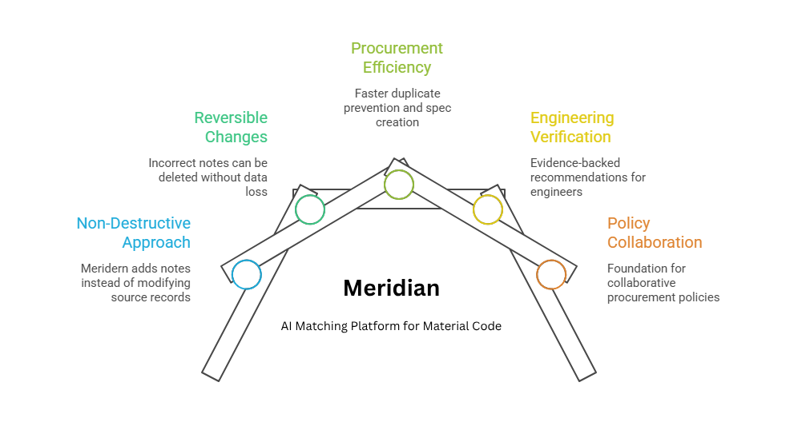
Meridian: The Convergence Point for India's Material Codes.
Local Host:
3712
Idea/Solution:
Evidence-Based AI Matching Platform for Material Code Harmonization Across CPSEs
Key Features:
Typed Attribute Extraction: Regex + LLM extraction with an evidence span per field; never guesses unknowns.
Four-Way Verdict: Same / Possible Alternative / Different / Insufficient Evidence, never a forced binary.
Deterministic Conflict Gates: Auditable rules outside the AI that can veto any match verdict.
Matching Cascade: Deterministic identity to attribute rules to model, only on ambiguous pairs, so it scales.
Canonical ID Registry: One national code per material, additive mapping to every source CPSE code.
Duplicate-Prevention Check: Flags an existing match before a new material code is ever created.
Innovativeness & Uniqueness
•Evidence-First: every verdict traces to real evidence, not a score
•Deterministic Override: conflict gates make refusals auditable
•Non-Destructive: never edits a CPSE's code, only adds a note

Slide 3















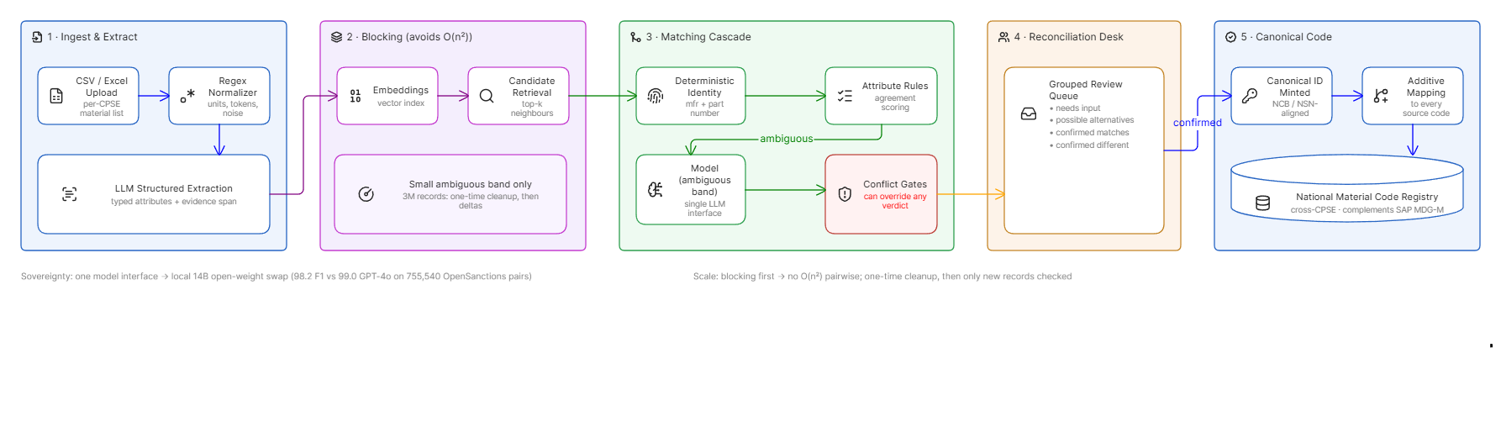
TECHNICAL APPROACH
Local Host:
3712
Frontend
Backend
AI /ML
React 19, vite, TypeScript, TanStack Query, Tailwind CSS 4, Recharts, @xyflow/react, Axios
Python, REST APIs, FastAPI, SQLAlchemy, SQLite (dev), Postgres (prod), Pydantic (validation), pytest (testing)
Hugging Face[Qwen 14B], numpy, Pandas, yaml, scikit-learn, Azure OpenAI
Data Flow Diagram

Slide 4
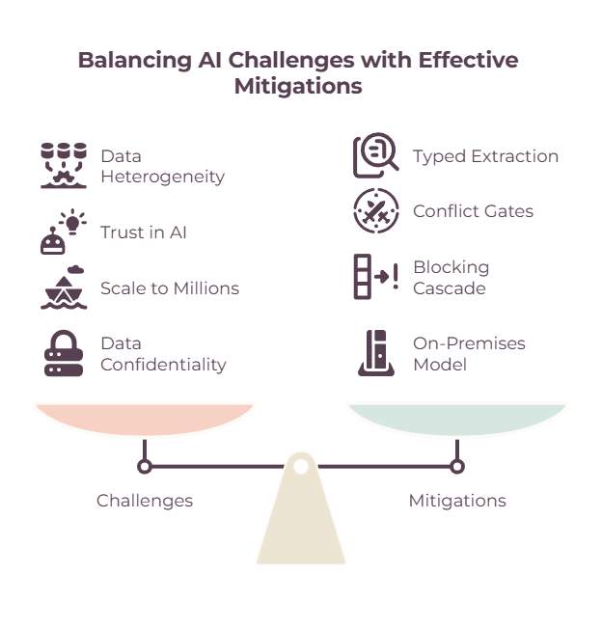
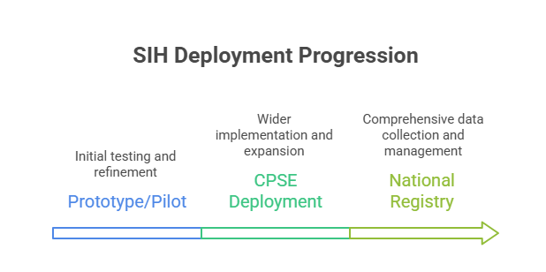
FEASIBILITY AND VIABILITY
Local Host:
Feasibility:
Technical feasibility - Core matching works offline, with zero model calls.
Scale feasibility - A staged cascade avoids comparing every record to every other.
Sovereignty feasibility - The model can run inside the CPSE's own network.
Reversibility feasibility - Wrong matches are undone by deleting a note, nothing is lost.
Safety feasibility - Conflict rules sit outside the AI and can overrule it.
Generalisation feasibility - New material families can be added live, with no code change.
Viability:
Adoption viability - Works alongside SAP, not instead of it, so no CPSE has to rip out what they already run.
Cost viability - Audited government losses (₹12,743 crore, SAIL, CAG 2025) prove the problem is real and expensive.
Market viability - Incumbents clean one company's data; none reconcile identity across organisations.

Slide 5
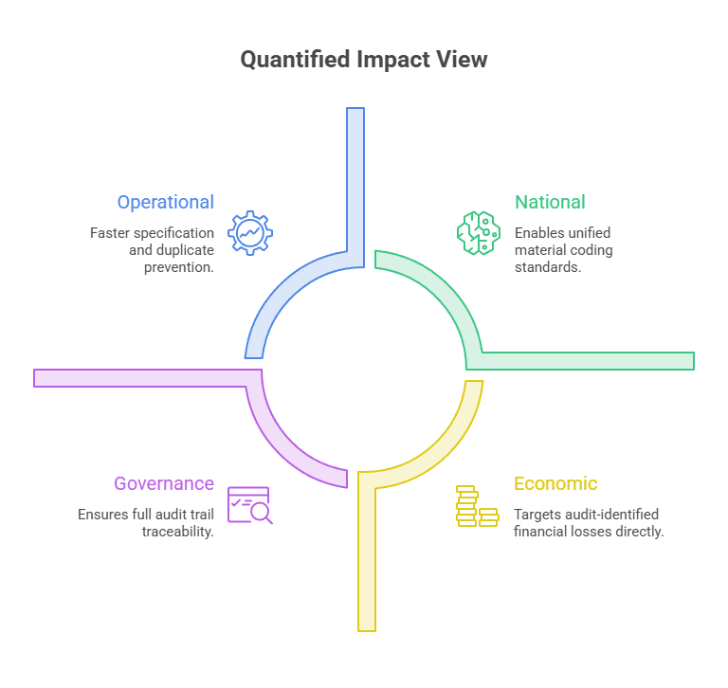
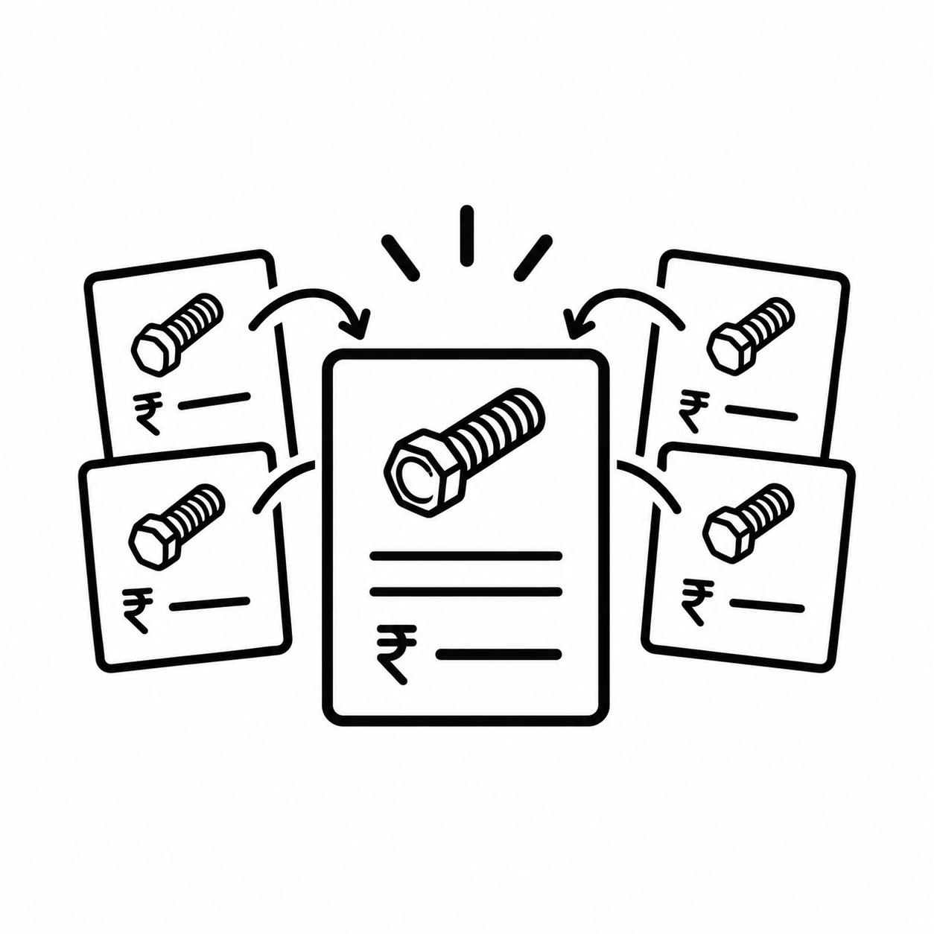
IMPACT AND BENEFITS
Local Host
Strategic Benefits:
Economic: Targets losses like the Rs 12,743 crore CAG found at SAIL alone; demand aggregation cuts duplicate spend.
Governance: Full append-only audit trail; every mapping traceable to its source evidence.
Safety: Never edits or deletes a source code, only adds a note - so a wrong merge costs nothing to undo.
Impact:
Procurement Teams: Confident duplicate prevention and faster specification finalization, before a new code is ever created.
Plant Engineers / Reviewers: Evidence-backed recommendations they can verify, not a black-box similarity score.
Policy Makers: A working foundation for collaborative procurement and strategic sourcing across CPSEs.
One Part, One Price
Same bolt, different CPSEs, different prices
Once Meridian confirms these are the same part, price and quantity per cluster becomes one grouping query — the number a judge remembers.
Reference scale: CAG found Rs 12,743 crore in procurement & inventory losses at SAIL alone over 7 years.

Slide 6
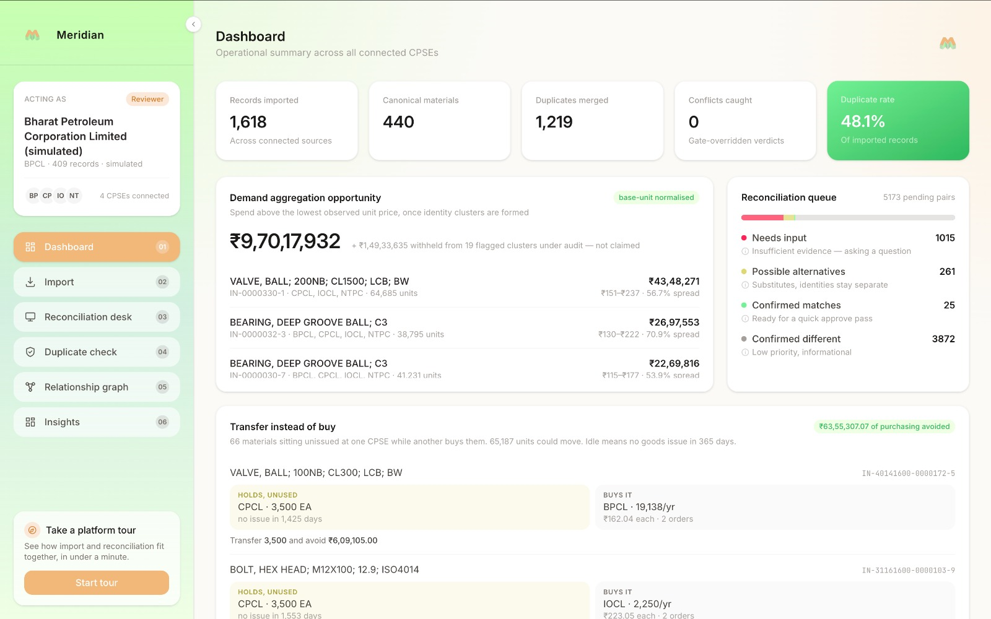
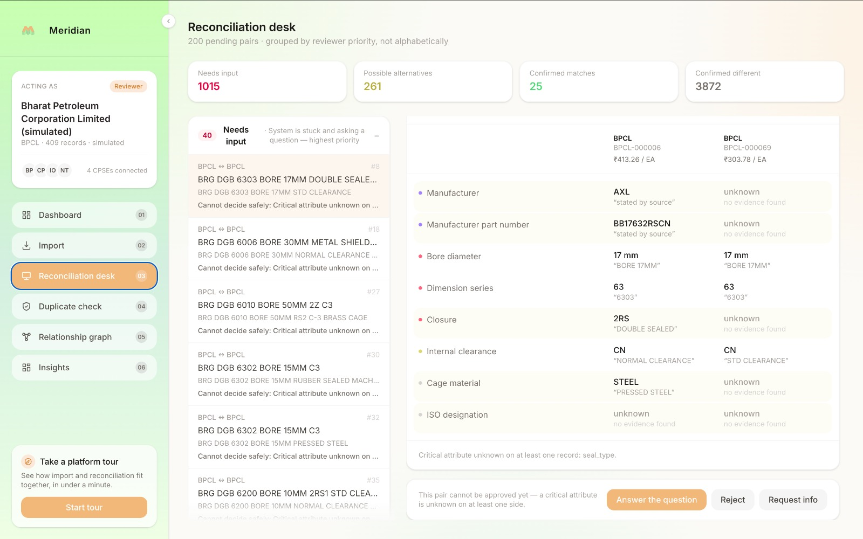
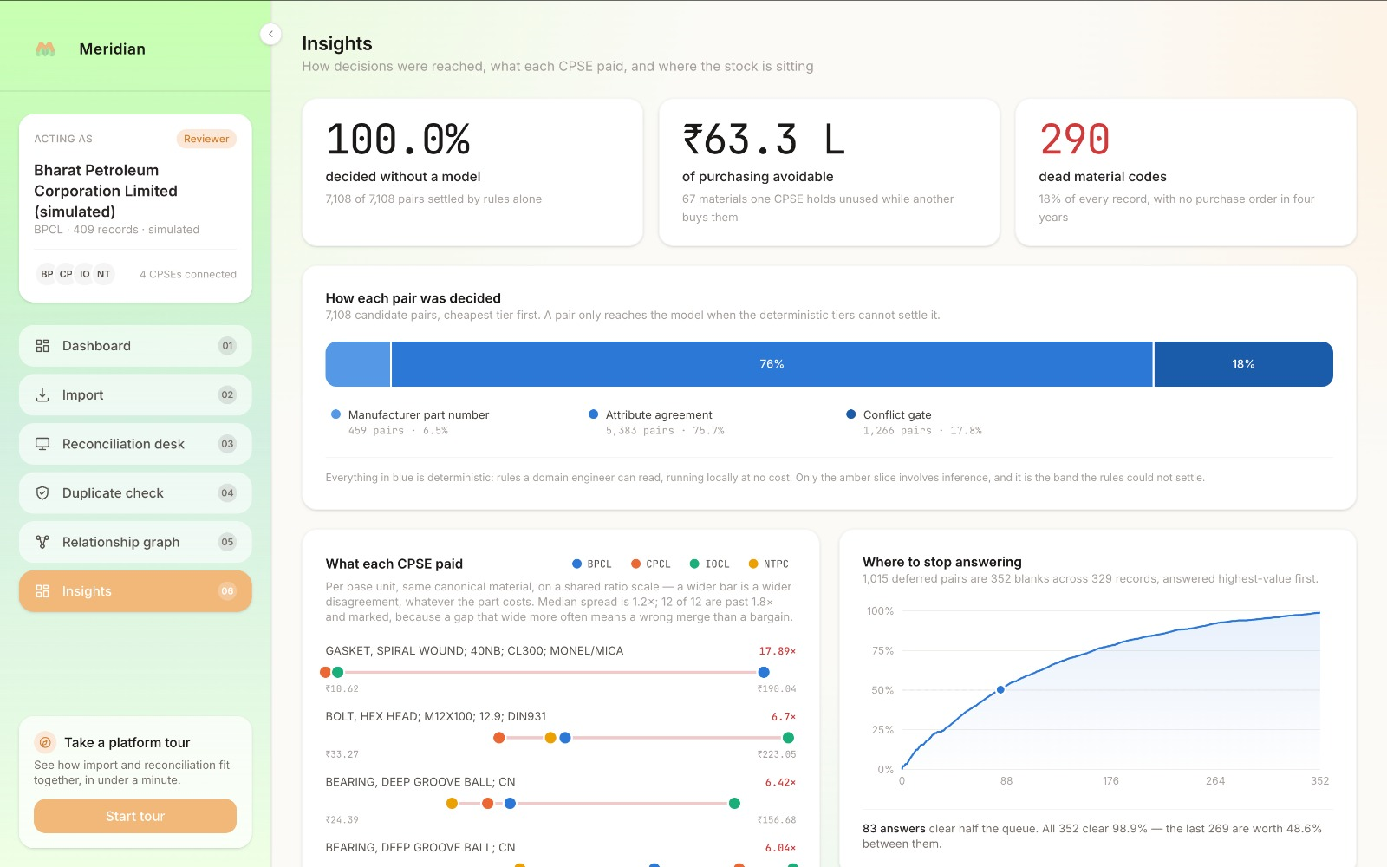
RESEARCH AND REFERENCES
Local Host
Fellegi & Sunter, A Theory for Record Linkage (JASA, 1969): https://www.jstor.org/stable/2286061
Peeters, Steiner & Bizer, LLMs for Entity Matching (EDBT 2025): https://arxiv.org/abs/2310.11244
OpenSanctions Pairs benchmark (on-prem vs hosted model F1): https://arxiv.org/abs/2603.11051
Splink - UK Ministry of Justice entity resolution toolkit: https://github.com/moj-analytical-services/splink
NCB-India / NATO Codification System: https://ddpdos.gov.in/about-us
CAG Report No. 10 of 2025, SAIL inventory losses: https://cag.gov.in
Ditto - deep entity matching (VLDB 2021): https://arxiv.org/abs/2004.00584

