Slide 1
Optus Data Breach 2022
Done By: Ananthu Krishna Vadakkeppatt
Student ID: 154290217
Course ID: SPR600

Slide 2
Table of Contents
01
02
03
04
Organization Background Information
Breach Timeline
Technical Details
05
Actions taken by the organization post-incident
References

Slide 3

Background Information
Optus is a telecommunication company that offers wide range of services all the way from your mobile to the setting up of business networks.
It is the second largest telecommunication organization in Australia and is owned by Singtel (Singapore Telecommunications Limited).
Optus was founded by Paul O'Sullivan in 1991.
Following its privatization, AUSSAT changed its name to Optus, and it made its first public sale of long-distance calls at a lower cost than its rival Telstra.

Slide 4
Breach Timeline
Wednesday 21 September 2022 - The Data Breach takes place.
Thursday 22 September 2022 - Optus releases a statement acknowledging the cyberattack.
Tuesday 27 September 2022 - 10,000 records were released with a threat to continue.
Tuesday 27 September 2022 – Four hours after posting the 10,000 records the attacker backed out from the ransom and deleted the entire dataset.
Tuesday 11 October 2022 – The OAIC and ACMA organized an investigation that was related to the personal information handling practices of Singtel Optus Pty Ltd in regard to the data breach.

Slide 5

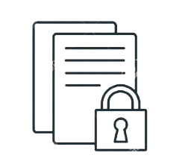
Technical Details
The Australian government and an Optus insider confirmed that a human error was most likely the weakness that led to the attack, despite the organization's assertion that it was an extremely complex attack.
The root cause of this attack was an API that was left completely unprotected and exposed to the public. Furthermore, this API lacked any user authentication measures that may have prevented or at least lessened the likelihood that this attack would have occurred in the first place.
This vulnerability exposed different sensitive data like driver's license numbers, phone numbers, dates of birth and home address.

Slide 6
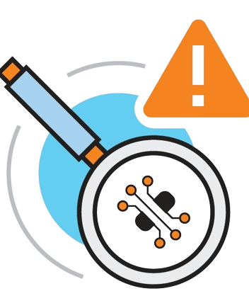
Actions Taken
After this incident, Optus appointed Deloitte to conduct an independent external review of the data breach.
Optus guaranteed its most affected customers who were badly exposed during the data breach to get a 12-month subscription to credit monitoring service Equifax Protect.
Optus also made sure that they pay for the replacement of various passports that were likely compromised during the breach.

Slide 7
References
How did the Optus data breach happen? | UpGuard. (n.d.). https://www.upguard.com/blog/how-did-the-optus-data-breach-happen
Wikipedia contributors. (2024, January 3). 2022 Optus data breach. Wikipedia. https://en.wikipedia.org/wiki/2022_Optus_data_breach
Cyberknow. (2022, September 28). OPTUS Data breach timeline. Current as of Wednesday 28th September. . . | By Cyberknow | Medium | Medium. Medium. https://cyberknow.medium.com/optus-data-breach-timeline-c02d8c5298c

Slide 8
Thank You!

