Slide 1
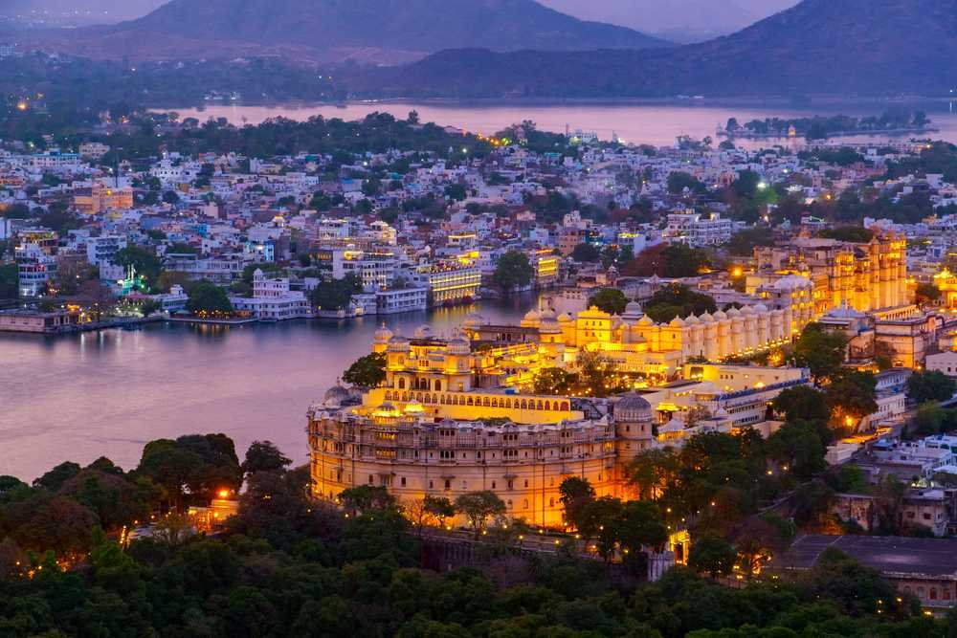
TOUROPIA
PRESENTS

Slide 2
Best tourist places in india
India, known for the vast number of tourist places across its expanse, has a mix of everything, from cultures to natural beauty and adventure activities to beautiful beaches.
So if you are planning to visit the country, you should definitely not miss the places listed below (well, at least not all of them). We have covered all of our favourites, from hill stations to beaches to cities, showcasing the culture and much more to get you to experience the best of tourism in India.

Slide 3
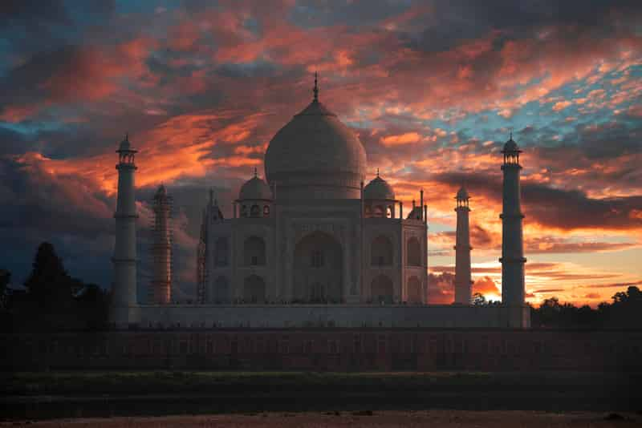
1.Agra
Agra is home to several historic monuments, making it one of the most visited places in India. Of course, top of this list of places to see in Agra is the Taj Mahal, one of the most famous buildings in the world.
This beautiful building, finished in white marble, is a perfect example of Mughal architecture, as are the Agra Fort, Akbar’s Tomb and Fatehpur Sikri. Also a great place to gorge on wonderful Mughlai food.

Slide 4
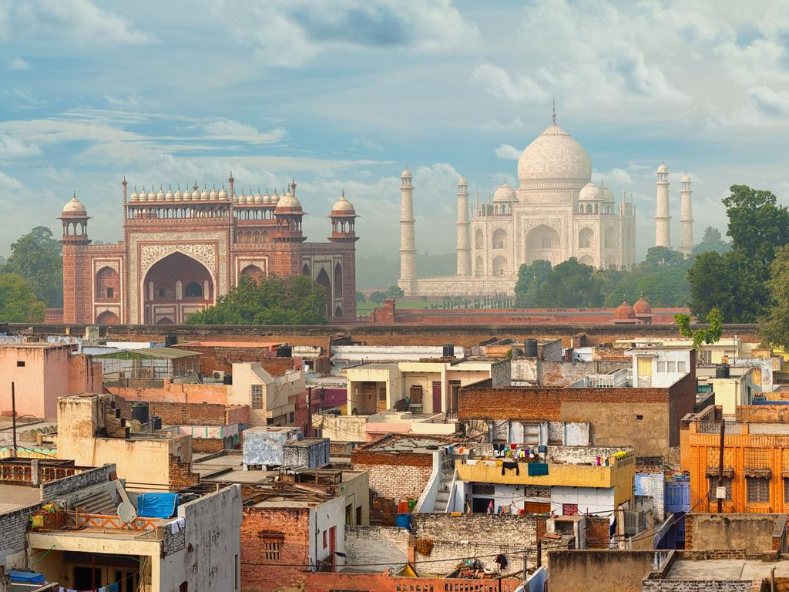
View of Agra city
TAJ-MAHAL

Slide 5
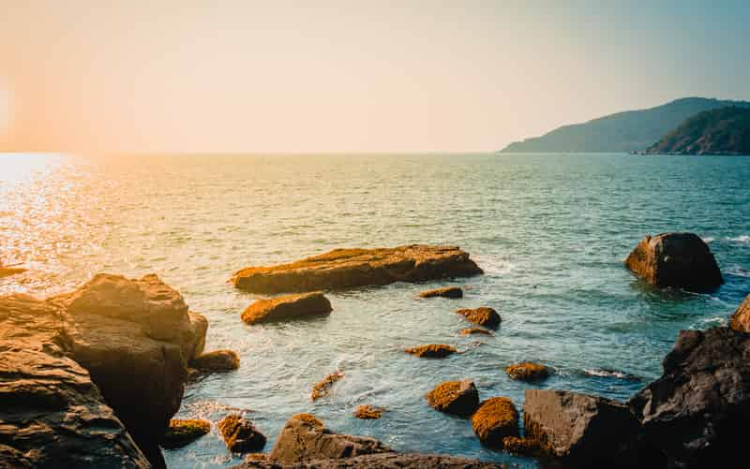
2.Goa
With 51 beaches along the coastline, Goa is considered one of the best tourist places to visit in India. Its white sandy beaches, palm trees, low tax rate, amazing coastal cuisine and laid-back attitude make it a wonderful tourist place in India.
The best time to visit this place is the winter, as the weather is just perfect (though this is when it can get expensive, too). Apart from the beach, its nightlife is surely not something you should miss.

