Slide 1
WELCOME
Group members:
Ananthu S Nair
Godson sunny
Sanu sam joseph
Abhilash kaimal

Slide 2
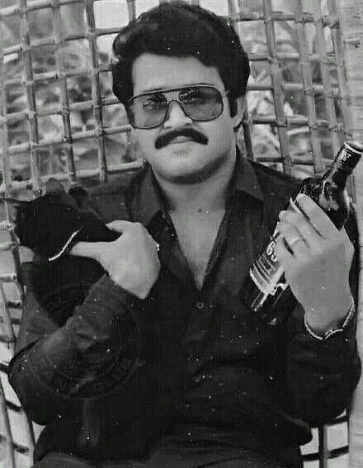
Drugs are not cool! Just say no.

Slide 3


