Slide 1

IBM
HACK CHALLENGE 2020

Slide 2

Team Name: EXCAVATORS
TEAM LEADER : RAJAT KUMAR
TEAM MEMBERS : ANANY GUPTA
TARUSHI KAPOOR
RISHABH GUPTA

Slide 3
Predicting the energy output of wind turbine based on weather condition
ZEPHYR

Slide 4

objective
Develop a time series model to Predict the power output of wind farm based on the weather condition in the site (1Hr prediction to 72Hrs. prediction) Build an application to recommend the Power Grid to suggest the best time to utilize the energy from wind farm

Slide 5
Proposed Solution
Our approach was to use a time series forecasting model that would generate point forecasts of wind generation for the upcoming three days, for a wind turbine. We used publicly available historical weather data of a wind plant to train model and learn the changing weather patterns. We also used it to find the correlations among different weather attributes and their effect on energy output.
We have used a VAR (Vector Autoregressive) model, a multivariate time-series model to handle multiple time series of different weather attributes. We have presented our results in an Android application in user-friendly graphs and tables

Slide 6
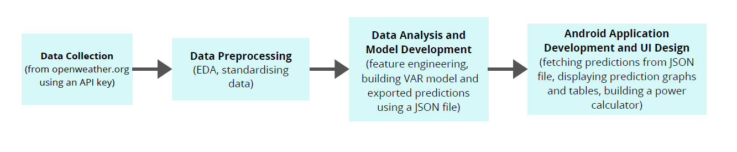
Project Flow

Slide 7
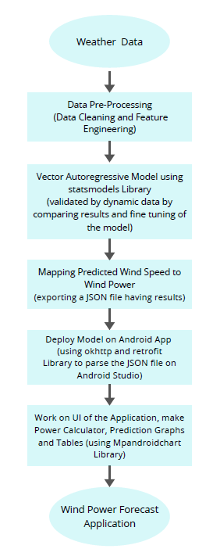
Model development
Our approach involved using an Autoregression model, that used observations from previous time steps as input to a regression equation to predict the value at the next time step, to predict wind speed and other weather attributes. We then used these predicted values we calculate the wind power. Since we were handling time series of different weather variables all of which affect one another, we used a Vector Autoregressive (VAR) model. The VAR helped us to capture the linear interdependencies among multiple time series.

Slide 8
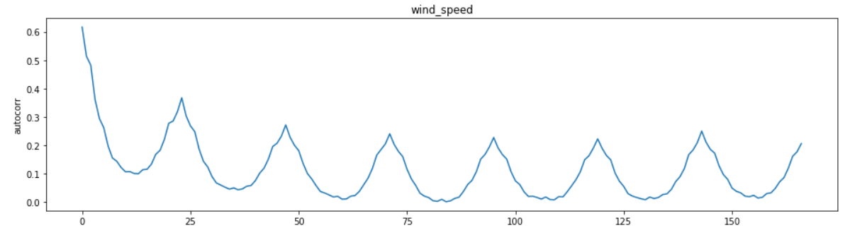
To fit the VAR model onto our data, we needed to make sure that our data is stationary. For that we had to remove the seasonality and trends from our data.
From the correlation plots we saw that all the time series have a seasonality of 24-hour time lag. So, we performed a 24- hour lag differencing on our data to make it stationary. This stabilized the mean and variance of our time series.
Further, to help the model understand the cyclic nature of the weather we introduced cyclic variables in our data using sin and cosine series on the day and year of the date label.

Slide 9
Forecasting wind power
Wind power depends on a number of factors like:
Radius of the rotor(r)
Air density(ρ)
Wind Speed(v)
The wind speed refers to one point in time, not to an average speed. Air density, which is the mass of air per space, depends on air pressure, temperature and humidity. The efficiency factor(η) tells which part of wind blowing through the area spanned by the rotor blades is converted into electric energy. The theoretic maximum for the efficiency factor is 16/27, respectively 59,26 %. The power is given by:
P = π/2 * r² * v³ * ρ * η
The weather variables forecasted using the trained VAR model transformed into the wind power using the above formula.

Slide 10
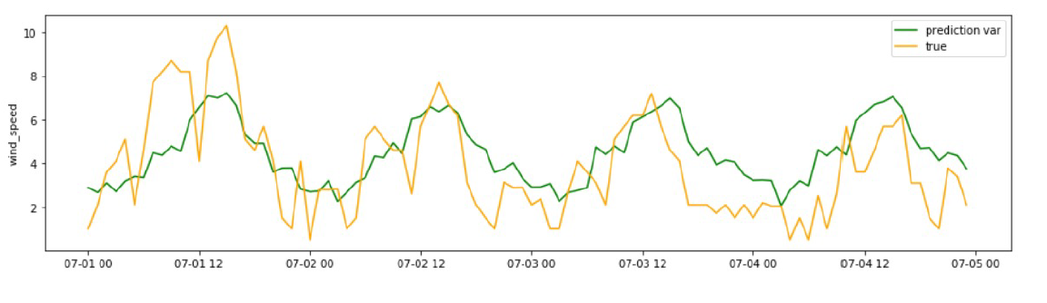
RESULT & Conclusion
We have shown how wind energy output can be predicted from publicly available weather data for a wind turbine. The applied model can be easily extended to predict outputs for an entire wind farm. Using these forecasted power outputs, we have suggested the power plants the time to best harness wind energy in our android application. These predictions will help the wind energy suppliers to efficiently coordinate collaborative production with other energy suppliers in the power grid.

Slide 11
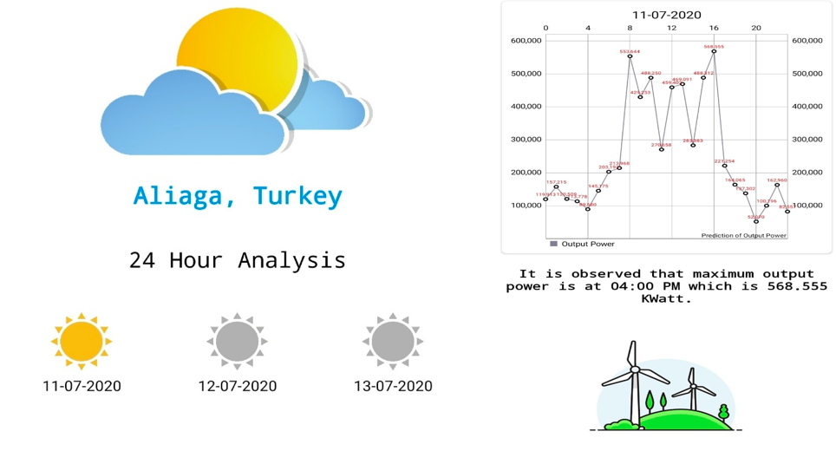
For presentation purposes we have developed an Android Application in Android Studio using Kotlin. Working with some libraries like Retrofit, OkHttp (for importing JSON files and requesting API’s), MPAndroidChart (used for displaying graph) and Recycler View, etc. For the 72 hour prediction we have displayed output for 3 days in form of graph while also providing the time of the day when the plant would get the maximum output and also the wind speed analysis for the day.

Slide 12
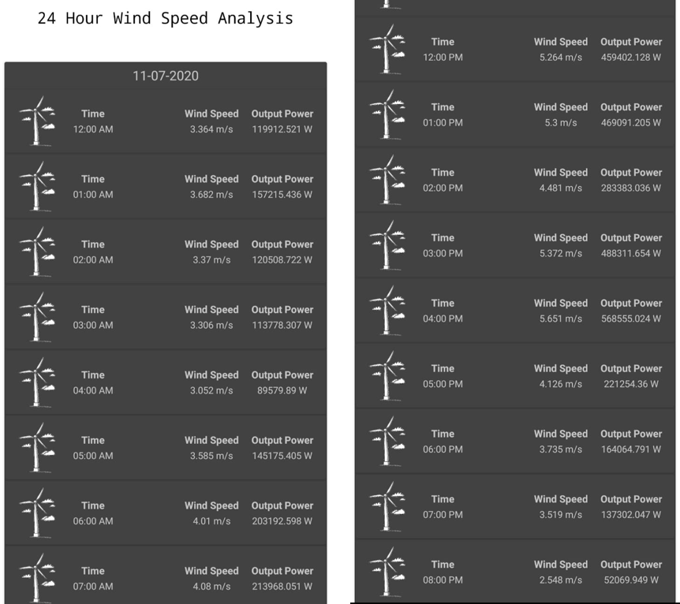
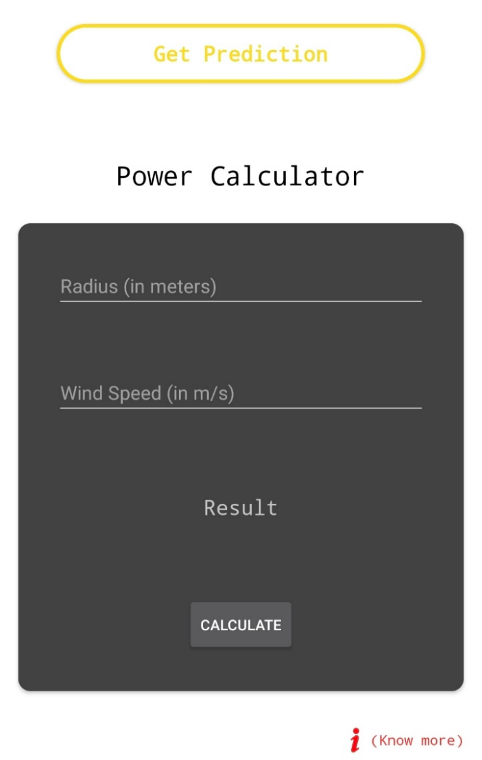
We have also presented the forecasted power values along with the corresponding wind speed to better understand it. We have also provided user with a wind power calculator to calculate wind power by providing the turbine radius and wind speed.

Slide 13
Advantages
The model not only uses a 3 year historical weather data but also saves in the updates of daily weather training itself everyday hence getting better every day.
Since the model uses a huge amount of data the results generated are accurate and reliable.
The model also helps in avoiding the damage to the turbine when the wind speed is below cut-in speed or above cut-off speed as wind speed is forecasted in advance.
The interface is user friendly and easy to use and understand even to a person who has very little/no knowledge for the same.

Slide 14
Disadvantages
The unsteadiness and the turbulence of the wind may vary the wind speed predictions hence pose a threat to the wind turbine from cut-off speed
The power output does not take into consideration the power loses due to wire cables or other resistance offering components.
Wind gusts are not taken into the consideration while generating the predictions due to their unpredictability and lack of proper data.
The model generates theoretical power forecasts close enough to the active power, thus the results cannot be taken as accurate point forecasts of the power values.

Slide 15
Applications
This model helps the farm to plan ahead of time for the unit commitments to the power grid. Hence relaxing the conventional sources of energy
It also helps in scheduling and dispatch by system operators, and maximize profit by electricity traders
This model can further be used to analyze suitability of a location to setup a wind farm. Hence increasing the market of wind power.
This model can also be developed to provide the wind direction hence enabling the farm rotate the turbines in given direction to get better output.

Slide 16
Future Scope
The results are quite promising, but there is still a room for further improvement. With the availability of daily wind turbine output data for a minimum of 3-4 years, we can use neural networks to understand the mapping of the calculated power into the active power due to the weather variables.
Wind power generation is directly linked to weather conditions and thus the first aspect of wind power forecasting is the prediction of future values of the necessary weather variables at the level of the wind farm. However, even by better understanding and modelling both the meteorological and power conversion processes, there will always be an inherent and irreducible uncertainty in every prediction.
This internal uncertainty corresponds to the incomplete knowledge one has of the processes that influence future events. Thus, rather than generating point forecasts of power outputs for consecutive hours, we should predict maximum power outputs for a day.

