Slide 1
ALERT : Adapting Language Models to Reasoning Tasks
Ananya Joshi

Slide 2
Overview
Current large language models can perform reasonably well on complex tasks that require step-by-step reasoning with few-shot learning.
Is that these models are applying reasoning skills they have learnt during pre-training and reason outside of their training context, or are they simply memorising their training corpus at finer granularity and have learnt to better understand their context?
To tease apart these possibilities, ALERT, a benchmark and suite of analyses for assessing language models’ reasoning ability comparing pre-trained and fine-tuned models on complex tasks that require reasoning skills to solve is introduced and we will talk about it in this presentation.

Slide 3
What is ALERT
Large language models (LLMs) have shown increasing in-context learning capabilities with scaling up the model and data size. Despite this progress, even the largest of these models still struggle with tasks such as common sense reasoning (West et al., 2022), and math word problems (Hendrycks et al., 2021b) which require arithmetic reasoning or symbolic manipulation
ALERT provides a test bed to assess any language model on fine-grained reasoning skills, which spans over 20 datasets and covers 10 different reasoning skills. ALERT in this paper is leveraged to further investigate the role of fine tuning.

Slide 4
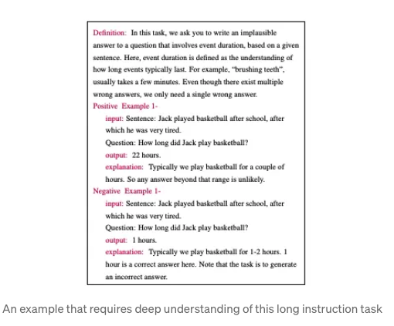
ALERT, a new pipeline to benchmark different LLMs on various reasoning skills is introduced.Unlike existing commonly used benchmarks, ALERT evaluates LLMs on fine-grained reasoning skills. It spans over 20 datasets and covers 10 different reasoning skills including logistic, causal, common sense, abductive, spatial, analogical, argument and deductive reasoning as well as textual entailment and mathematics ALERT enables easy benchmarking of any LM (e.g., pre-trained, fine tuned, CoT-fine tuned) on a rich set of new inference methods including zero-shot, few-shot and chain-of-thought (CoT).

Slide 5
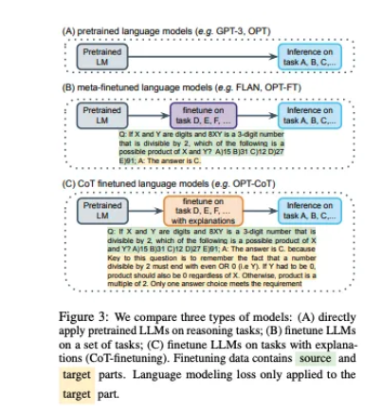
To perform a controlled comparison across training and prompting methods, three different models are focused: pre-trained, fine tuned, and rationale-based fine tuned (CoT-fine tuned) models.

Slide 6
Evaluation
Evaluation metrics on this benchmark contains both classification and generation tasks, Its not desired to use classification accuracy to evaluate all the tasks. Following FLAN , classification choices at the end of prompts are appended and models are asked to generate answers. Thus, classification tasks can be treated as a special case of generation tasks. Accordingly, ROUGE-L is used to measure the performance of both classification and generation tasks and report the aggregated score. Exact-match score which is more suitable for tasks with short answers is used. Additionally, relaxed-match score which is a relaxed version of exact-match is computed. Specifically, ground truth answers and predictions are normalised to have all text in lowercase and remove punctuation and extra white spaces

Slide 7
Reasoning skills transfer
LLMs showed improved reasoning abilities on textual entailment, abductive reasoning, and analogical reasoning tasks.
We find that these three skills can not be easily obtained during the pre-training stage since pre training stage only contains plain text.
On the contrary, for example, common sense reasoning or spatial reasoning can be learned during pre training, while the benefits of fine tuning are not prominent.

Slide 8
Conclusion
Using this benchmark, It is possible to further explore what is the meaning of fine tuning for these complex tasks.
The above experiments reveal that LLMs do not rely on memorising training data, but are capable to learn diverse reasoning skills, such as textual entailment, abductive reasoning and analogical reasoning. While it was found that in general fine tuning yields performance improvement, It also showed some side effects. LLMs memorise the data template representation and templates seen during fine tuning, thus reducing the robustness of the model to generalized settings.
CoT-fine tuning alleviates this problem to a certain extent, but it is still less robust compared to the pre-trained model.

