Slide 1

Theme 1- Create an appication to promote Aspire for HER’s outreach and Member acquisition

Slide 2
Content
1
Introduction
2
Concerned Areas
3
Idea/Solution
4
Conclusion

Slide 3
1.
Introduction

Slide 4

Introduction
Education is one of the most critical areas of empowerment for women.
Offering girls basic education is one sure way of giving them much greater power -- of enabling them to make genuine choices over the kinds of lives they wish to lead.
An educated woman will also be more productive at work -- and better paid.
An educated woman has the skills, information and self-confidence that she needs to be a better parent, worker and citizen.

Slide 5
2.
Concerned Areas

Slide 6
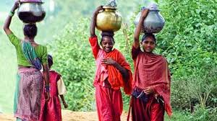
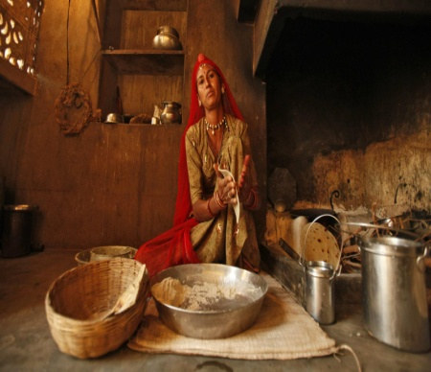
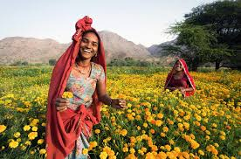
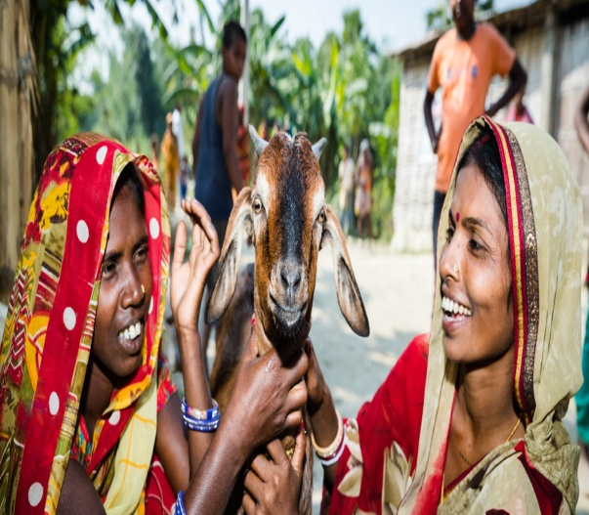
Concerned Area 1
Social economic and political status of women specifically in the rural parts is atrocious, hence empowerment of women is staggeringly low and is a neccisity as this would help women to get rid of social voilence and atrocities against her.
Women typically in rural areas face constraints in engaging in economic activities becuase of gender base discrimination and social norms, dispropotionate environment in upaid work, and enequal access to education, healthcare, propert and financial and other services.

Slide 7
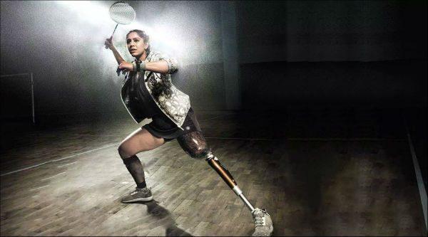
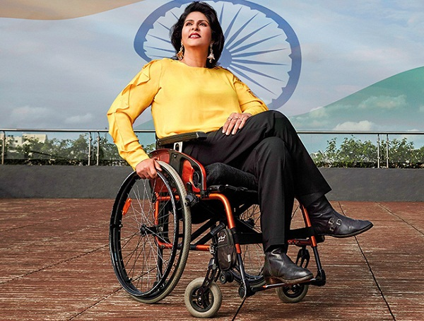
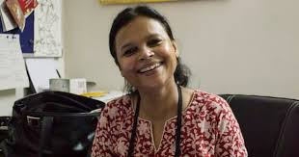
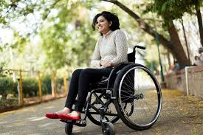
Concerned Area 2
Deepa Malik
There is a need to take into account and address the concerns of women and girls with disabilities in order to make them empowered.
The differently able are poorest, there are issues like low access, low availiblity, overlapping and many others that needs to get resolved in order to make the disabled women empowered more effectively. But with a single ray of hope they are nothing less than superwoman.
Manasi Joshi
Rajalakshmi SJ
Ruma Roka

Slide 8
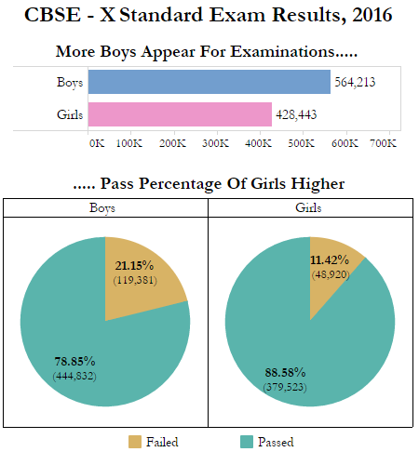
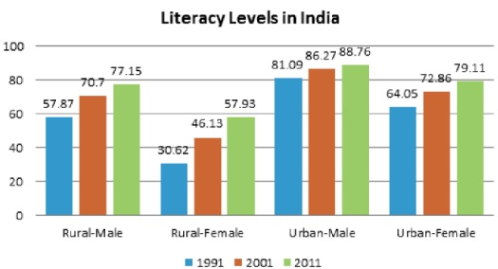
Statistics
Bar Graph picturing the literacy rate of Urban and Rural men and women
Pie chart of number of girls appearing for examinations

Slide 9
3
Ideas/Solutions

Slide 10

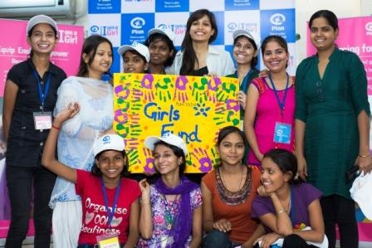
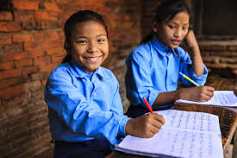
Defining the target audience
A target audience is the demographic of people most likely to be interested in a company's product or service.
Targeting the right audience means better results in your activities, so for marketers, it is one of the crucial steps.
Referal Schemes
On ground teams
Resource providing

Slide 11
Blogger
Bloggers can be a great source for starting the conversation online, and targeted well, they can also become ongoing partners to assist with future development and promotional opportunities. Below are some helpful tools for blogging purpose.
Tool 1.
Tool 2.
Tool 3.
FindThatLead – This tool helps you find the bloggers’ emails so you don’t have to manually search for them.
Gmass – This Chrome extension can help you bulk send personalized emails in minutes.
Dux Soup – This Chrome extension help you automate your LinkedIn outreach on top of emails to help you increase the rate of return.
.

Slide 12



Estabilishing an application
Sharing thoughts, expressions
Helping Womenship
Developing Community
General Platform
User Friendly
1
2
3
4
5

Slide 13
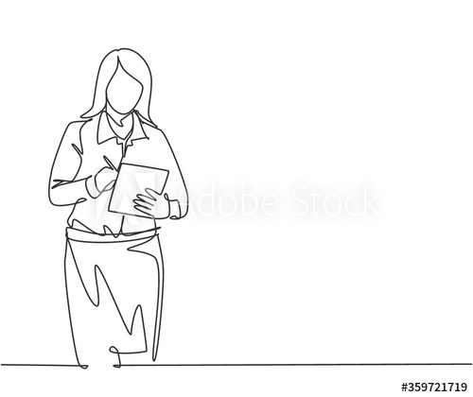
Social Media Influencing
Sharing insipiring real life stories
Having a dynamic interaction with the followers
Increase in number of video content

Slide 14
4
Conclusion

Slide 15
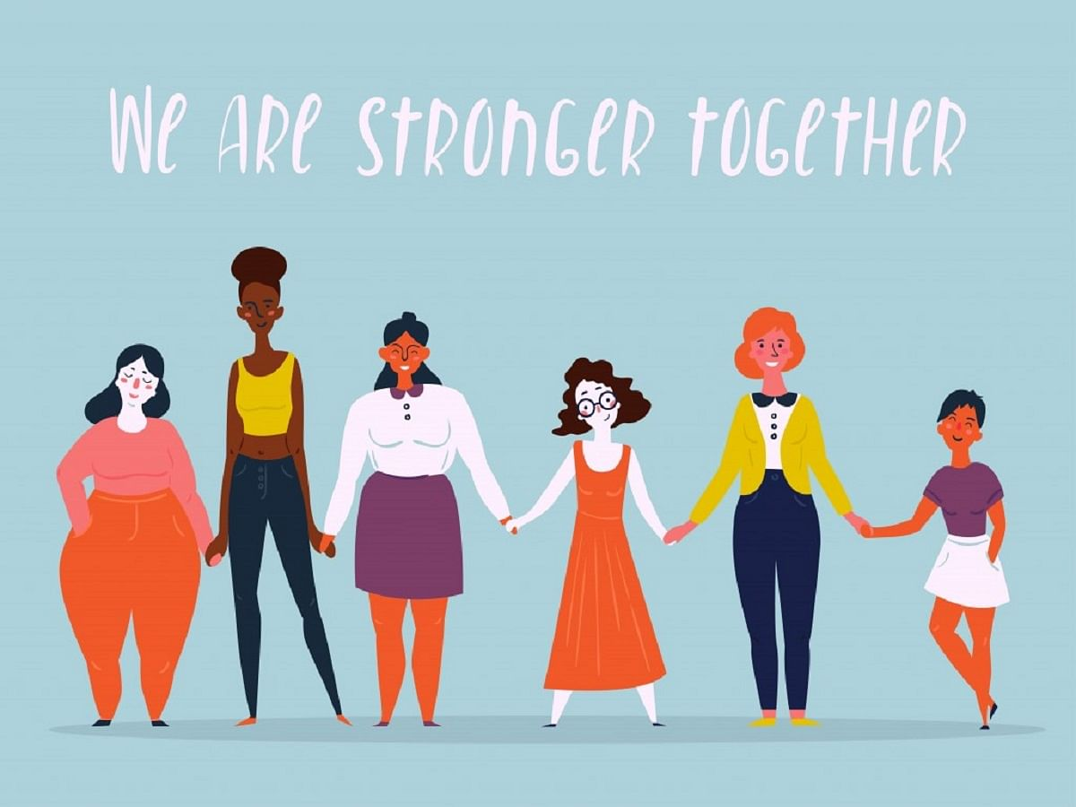

Conclusion
Generally speaking the women of India are relatively disempowered and they enjoy somewhat lower status than that of men.
Mere access to education and employment can only help in the process of empowerment. These are the tools or the enabling factors through which the process gets speeded up.
However, achievement towards this goal depends more on attitude. Unless the attitude towards the acceptance of unequal gender role by the society and even the women themselves changed women can not grab the opportunity provided to them through constitutional provision, law etc. Till then we can not say that women are empowered in India in its real sense.

Slide 16
THANKS
-Team Firebirds
Ananya Singh
Shubhi Jha

