Slide 1

Applied Internet of Things(CSE 2198) Project Presentation on Enhancing Attendance Monitoring through an Advanced Facial RecognitionSystem Powered by Raspberry Pi.
Presented by
Ms. Ananya Satapathy
(2241019330)
Ms. Nikita Acharya
(2241001022)
Ms. Anushka Rana
(2241018049)
Ms. Blooma Prusty
(2241016484)
Supervisor
Dr. Biswaranjan Swain
Department of Computer Science and Engineering (IOT)
Institute of Technical Education & Research (FET)
Siksha ‘O’ Anusandhan Deemed to be University, Bhubaneswar
May, 2024

Slide 2
Contents
Introduction
Literature Survey
Design Scheme
Testing, Analysis, And Evaluation
Socio-economic Issues Associated With The Project
Engineering Tools And Standards
Conclusion

Slide 3
Introduction
The project aims to enhance attendance monitoring through the implementation of an advanced facial recognition system powered by Raspberry Pi technology.
By leveraging Raspberry Pi and sophisticated face recognition algorithms, the system automates attendance management in diverse environments, including classrooms, offices, and events.
This innovative solution eliminates the need for manual attendance marking and offers a reliable, secure, and efficient method for tracking attendance.

Slide 4
Literature Survey
Real-Time Face Recognition Using Raspberry Pi Reference: "Real-Time Face Recognition Using Raspberry Pi" by P. Viola and M. Jones.
Smart Attendance System Using Face Recognition:
Reference: "Smart Attendance System using Face Recognition" by V. Singh, A. Parnami, and N. Nair.
Automated Classroom Attendance System Using Facial Recognition:
Reference: "Automated Classroom Attendance System Using Facial Recognition" by K. Priya and D. Dhivya.

Slide 5
Design Scheme
System Architecture: Raspberry Pi as the main controller. Camera module for capturing facial images.
Various sensors for environment monitoring (e.g., PIR motion sensor, temperature sensor).
Facial Recognition Algorithm: Use OpenCV library for facial recognition.
Train the algorithm with reference images of individuals.
User Interface: Display attendance status or other information on a connected display (optional).
Provide feedback to users (e.g., audio or visual cues).

Slide 6
DESIGN SCHEME
Data Logging and Analysis: Log attendance data, including timestamps and recognized individuals. Store data locally or send it to a remote server for further analysis.
Integration: Integrate software components with hardware components. Establish communication between Raspberry Pi and Arduino Uno (if used).
Power Management: Use a power management system to ensure efficient use of power and battery life (if applicable).
Security and Privacy: Implement security measures to protect attendance data. Ensure compliance with relevant data protection regulations.

Slide 7
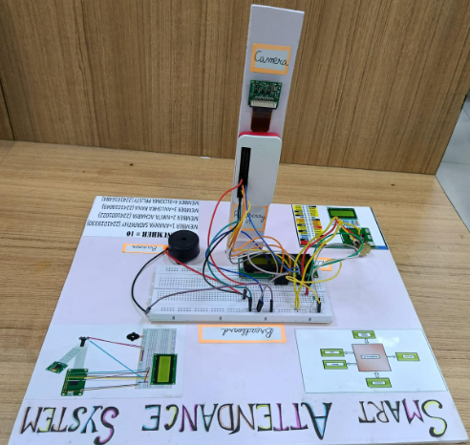
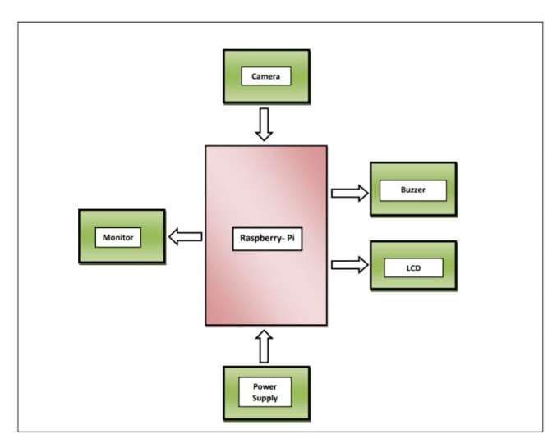
DESIGN SCHEME

Slide 8
Testing (Breadboard Implementation)
Unit Testing: Test individual components (e.g., facial recognition algorithm, sensor interfacing code) to ensure they work correctly. Use mock data or simulated inputs to test different scenarios.
Integration Testing: Test the integration of hardware and software components to ensure they communicate and work together as expected.
Verify that sensor inputs trigger the correct actions in the system (e.g., capturing facial images, logging attendance).

Slide 9
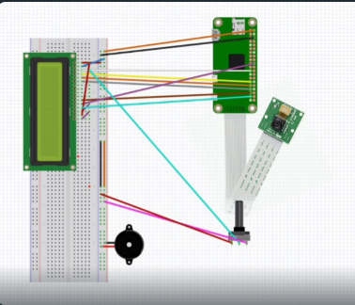
Testing(Breadboard Implementation):

Slide 10
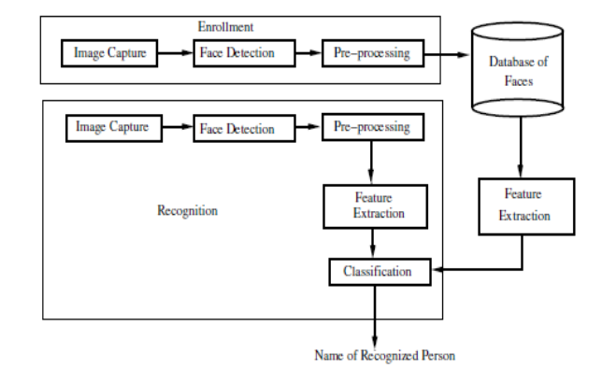
Flowchart :

Slide 11
Requirements:
Raspberry Pi: Choose a suitable model (e.g., Raspberry Pi 4) with sufficient processing power for facial recognition tasks.
Camera Module: High-quality camera modules, such as the Raspberry Pi Camera Module v2, for clear and accurate image capture.
Breadboard and Jumper Wires: For prototyping and connecting components.
LCD Module: To display some messages regarding the person whose attendance is being taken.
OpenCV: A library for real-time computer vision and image processing.
Python: For scripting and implementing the facial recognition logic.
Development Tools: IDE (Integrated Development Environment)Thonny for Python development.
Version Control: Git for source code management and collaboration.
Database: Excel file in LibreOffice for storing attendance records

Slide 12
Results, Analysis and Evaluation
Improved Efficiency: Automates attendance management processes, saving time and effort for administrators. .
✓ Enhanced Security: Increases security by accurately identifying individuals and preventing attendance fraud. .
✓ Real-Time Monitoring: Provides real-time updates on attendance status, enabling prompt intervention and decision-making. .
✓ Cost-Effectiveness: Reduces costs associated with manual attendance tracking methods and eliminates the need for physical attendance registers. .
✓ Enhanced User Experience: Offers a seamless and convenient attendance monitoring experience for administrators and users

Slide 13
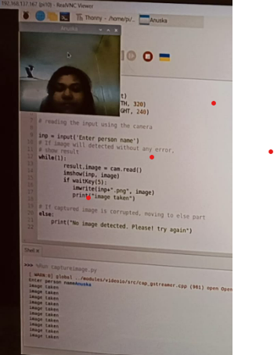
Results, Analysis and Evaluation
STEP 1:THE IMAGE IS CAPURED USING capture.py

Slide 14
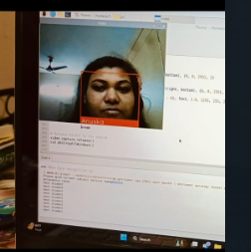
Results, Analysis and Evaluation
STEP 2:THE FACE IS RECOGNISED USING face-recognition.py

Slide 15
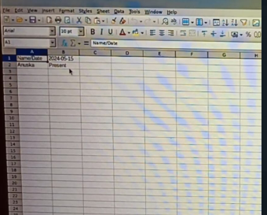
Results, Analysis and Evaluation
STEP 3:THE ATTENDANCE HAS BEEN RECORDED IN THE EXCEL SHEET.

Slide 16
Socio-economic Issues Associated With The Project
Privacy Concerns: The use of facial recognition technology raises privacy concerns, as it involves the collection and processing of biometric data. Individuals may be concerned about how their facial data is being used, stored, and protected.
Data Security: Ensuring the security of attendance data is crucial to prevent unauthorized access or data breaches. Robust security measures need to be in place to protect sensitive information.
Ethical Considerations: There are ethical considerations surrounding the use of facial recognition technology, such as ensuring consent is obtained from individuals before their facial data is collected and used.
Digital Divide: The implementation of advanced technology like facial recognition may widen the digital divide, as not everyone may have access to or be comfortable with using such technology.
Cost: The cost of implementing and maintaining the system may be a barrier for some organizations, particularly smaller ones with limited resources.
Job Displacement: The automation of attendance monitoring processes through technology could potentially lead to job displacement for individuals involved in manual attendance tracking.
Reliability and Bias: Facial recognition technology may not be 100% accurate and may exhibit biases, particularly against certain demographic groups. This could lead to inaccuracies in attendance tracking.

Slide 17
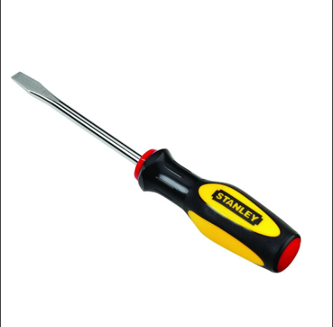
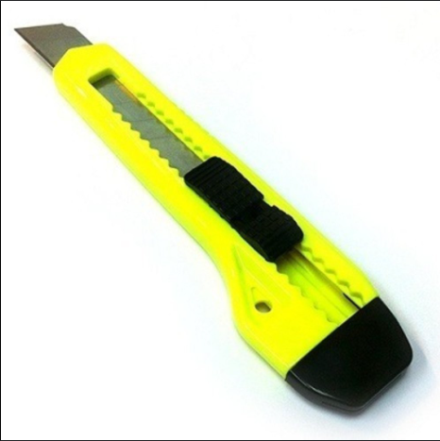
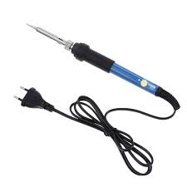
Engineering Tools And Standards
Soldering Machine: It helps us soldering the metal pins of LCD in to the motherboard.
Paper Cutter : To cut out and make the physical prototype.
Screw Driver : To turn the potentiometer for increasing or decreasing intensity of LCD light.

Slide 18
Engineering Tools And Standards
- Standards and Guidelines:
ISO 27001 (Information Security):This family of standards concerns information technology to improve security and protect company assets.
IEEE 802.15.2: Bluetooth and Wi-Fi coexistence mechanism.
IEEE 802.11 : Wireless Networking – "WiFi“.
JTAG (Joint Test Action Group): Used for debugging and programming microcontrollers. It typically uses a standardized pinout for debugging interfaces.
ACPI (Advanced Configuration and Power Interface): Defines power management for devices and can include GPIO specifications for power states.
LPC (Low Pin Count) Interface: Used in legacy systems for communication between the CPU and peripheral devices, involving GPIO configurations.

Slide 19
Conclusion
Existing methods may suffer from inaccuracies due to manual entry errors or barcode scanning issues. The facial recognition system must achieve high accuracy in identifying individuals to ensure reliable attendance tracking.
This project showcases the potential of Raspberry Pi technology and facial recognition algorithms to revolutionize attendance monitoring in various ways.
The project aims to enhance attendance monitoring by implementing an advanced facial recognition system powered by Raspberry Pi.

Slide 20
References
Python Programming For IOT – by Gary Smart
Raspberry Pi Cookbook – by Simon Monk
https://www.geeksforgeeks.org/python-programming-language/
✓ https://www.youtube.com/watch?v=Ag_NWssyI50&list=PLZbNfIz7zVFArBDOCODU30EA4nvZ2-jf&index=9
✓https://realpython.com/face-recognition-with-python/

Slide 21


Slide 22


