Slide 1


Shri Dharmasthala Manjunatheshwara College of Engineering & Technology, Dharwad
Automatic
Car Parking System
Course Subject professor
Deepa Bendigeri
TEAM MEMBERS
ANANYA R UPADHYA
PRIYA MANNUR
VAISHNAVI HEGDE
01

Slide 2

INTRODUCTION
02
Automatic Car Parking System
PROBLEM
1.
Insufficient parking spaces in large complexes lead to chaos and uncertainty for drivers searching for available spots.
Hence, it is very much important to develop a parking system that is efficient and provides more organized parking experiences.

Slide 3
INTRODUCTION
03
Automatic Car Parking System
SOLUTION
2.
Keep track of the total number of cars inside the parking area by subtracting the number of exiting cars from the number of entering cars.
To implement this utilize an Arduino Uno microcontroller board as the central control unit for the parking system and Install IR sensors at the entrance and exit points of the parking area to detect cars entering and exiting

Slide 4
Flow Chart
IR Proximity
sensor 1
Arduino
Servo Motor
LCD
IR Proximity
sensor 11
Automatic Car Parking System
04

Slide 5
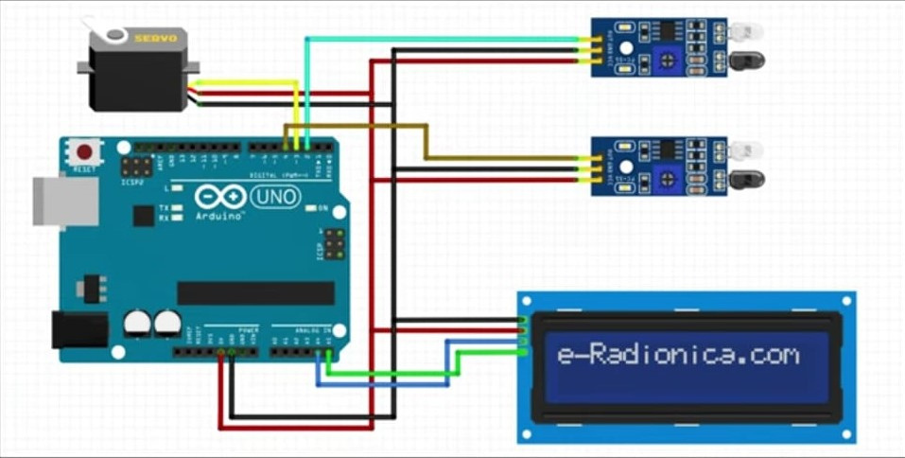
CIRCUIT
Automatic Car Parking System
05

Slide 6
INTRODUCTION
06
Automatic Car Parking System
APPLICATION
3.
This can be directly implemented in various locations such as
Malls
Offices
Parks
Complexes
& more.

Slide 7
Automatic Car Parking System
07
Components
Budget
Jumpers -Rs 250
23.8%
Arduino Uno -Rs 300
28.6%
Arduino Uno
IR proximity sensor
16*2 LCD i2c display
Servo motor
Jumpers
Servo motor -Rs 100
9.5%
IR proximity sensor -Rs50*2
9.5%
16*2 LCD i2c display -Rs 300
28.6%
Total = Rs 1050

Slide 8


THANK YOU
Automatic Car Parking System
08

