Slide 1
Advance Database management System Module 2
Atul Kumar uttam
atul.uttam@gla.ac.in
Assistant Professor CEA, GLA University, Mathura

Slide 2
Syllabus (Module -2)
Introduction of Transaction Processing Concepts:
Transactions, Properties & States of Transactions, Read and Write Operations, System Log, Commit Point of a Transaction, Desirable Properties of Transactions, Need of Concurrency Control.
Schedule:
Serial, Non-Serial and Conflict Serializable Schedules, Uses of Serializabilty, View Equivalence and View Serializability.
Concurrency Control Techniques:
Two Phase Locking Techniques for Concurrency Control, Concurrency Control Based on Timestamp Ordering.
Deadlock:
Deadlock Handling, Deadlock Prevention, Deadlock Detection and Deadlock Recovery Techniques.
Recovery System:
Failure Classification, Storage Structure, Data Access.

Slide 3
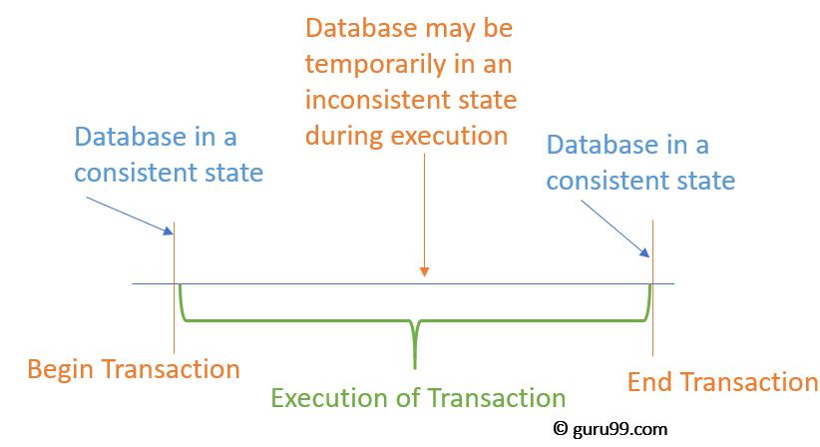
Transaction
“Transaction is a set of operations which are all logically related.”
OR
“Transaction is a single logical unit of work formed by a set of operations.”

Slide 4
Operations in Transaction
The main operations in a transaction are-
Read Operation
Write Operation

Slide 5
1. Read Operation
Read operation reads the data from the database and then stores it in the buffer in main memory.
Example- Read(A) instruction will read the value of A from the database and will store it in the buffer in main memory.

Slide 6
2. Write Operation
Write operation writes the updated data value back to the database from the buffer.
Example- Write(A) will write the updated value of A from the buffer to the database.

Slide 7
Transaction States
A transaction goes through many different states throughout its life cycle.
Active state
Partially committed state
Committed state
Failed state
Aborted state
Terminated state

Slide 8
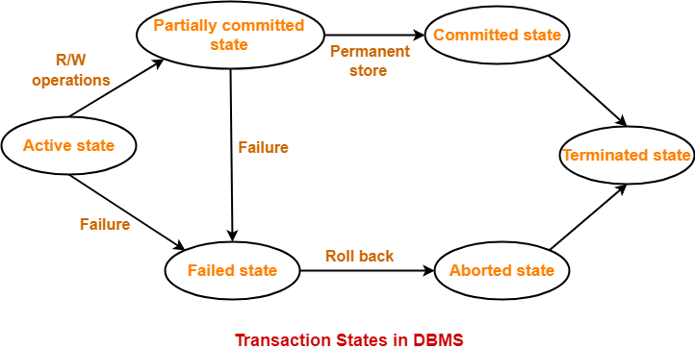

Slide 9
1. Active State-
A transaction is called in an active state as long as its instructions are getting executed.
All the changes made by the transaction now are stored in the buffer in main memory.

Slide 10
2. Partially Committed State-
After the last instruction of transaction has executed, it enters into a partially committed state.
It is not considered fully committed because all the changes made by the transaction are still stored in the buffer in main memory.

Slide 11
3. Committed State-
After all the changes made by the transaction have been successfully stored into the database, it enters into a committed state.
Now, the transaction is considered to be fully committed.

Slide 12
NOTE-
After a transaction has entered the committed state, it is not possible to roll back the transaction.
This is because the system is updated into a new consistent state.
The only way to undo the changes is by carrying out another transaction called as compensating transaction that performs the reverse operations.

Slide 13
4. Failed State-
When a transaction is getting executed in the active state or partially committed state and some failure occurs due to which it becomes impossible to continue the execution, it enters into a failed state.

Slide 14
5. Aborted State-
After the transaction has failed and entered into a failed state, all the changes made by it have to be undone.
To undo the changes made by the transaction, it becomes necessary to roll back the transaction.
After the transaction has rolled back completely, it enters into an aborted state.

Slide 15
6. Terminated State-
This is the last state in the life cycle of a transaction.
After entering the committed state or aborted state, the transaction finally enters into a terminated state where its life cycle finally comes to an end.

Slide 16
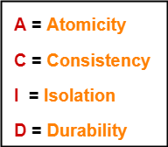
ACID Properties
It is important to ensure that the database remains consistent before and after the transaction.
To ensure the consistency of database, certain properties are followed by all the transactions occurring in the system.
These properties are called as ACID Properties of a transaction.

Slide 17
Atomicity
This property ensures that either the transaction occurs completely or it does not occur at all.
In other words, it ensures that no transaction occurs partially.
That is why, it is also referred to as “All or nothing rule“.
It is the responsibility of Transaction Control Manager to ensure atomicity of the transactions

Slide 18
2. Consistency
This property ensures that integrity constraints are maintained.
In other words, it ensures that the database remains consistent before and after the transaction.
It is the responsibility of DBMS and application programmer to ensure consistency of the database.

Slide 19
3. Isolation
Ensures that multiple transactions can occur simultaneously without causing any inconsistency.
During execution, each transaction feels as if it is getting executed alone in the system.
Changes made by a transaction becomes visible to other transactions only after they are written in the memory.
The resultant state of the system after executing all the transactions is same as the state that would be achieved if the transactions were executed serially one after the other.
It is the responsibility of concurrency control manager to ensure isolation for all the transactions.

Slide 20
4. Durability
This property ensures that all the changes made by a transaction after its successful execution are written successfully to the disk.
It also ensures that these changes exist permanently and are never lost even if there occurs a failure of any kind.
It is the responsibility of recovery manager to ensure durability in the database.

Slide 21
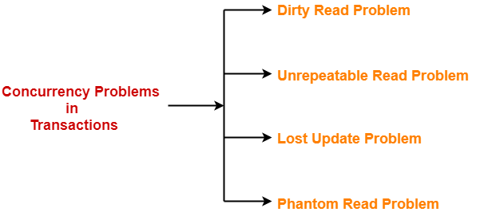
Concurrency Problems in DBMS
When multiple transactions execute concurrently in an uncontrolled or unrestricted manner, then it might lead to several problems.
Such problems are called as concurrency problems.

Slide 22
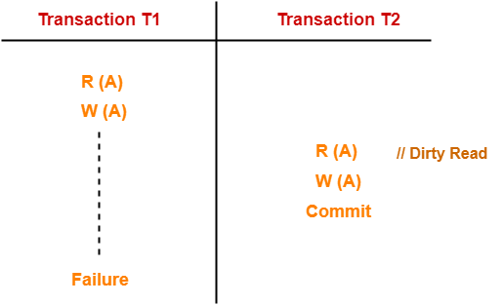
1. Dirty Read Problem
Reading the data written by an uncommitted transaction is called as dirty read.
Notes:
There were two students one has copied from

Slide 23
In the previous example,
T2 reads the dirty value of A written by the uncommitted transaction T1.
T1 fails in later stages and roll backs.
Thus, the value that T2 read now stands to be incorrect.
Therefore, database becomes inconsistent.

Slide 24
This read is called as dirty read because:
There is always a chance that the uncommitted transaction might roll back later.
Thus, uncommitted transaction might make other transactions read a value that does not even exist.
This leads to inconsistency of the database.

Slide 25
NOTE
Dirty read does not lead to inconsistency always.
It becomes problematic only when the uncommitted transaction fails and roll backs later due to some reason.

Slide 26
Here,
T1 reads the value of A.
T1 updates the value of A in the buffer.
T2 reads the value of A from the buffer.
T2 writes the updated the value of A.
T2 commits.
T1 fails in later stages and rolls back.

Slide 27
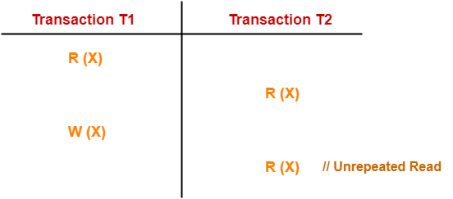
2. Unrepeatable Read Problem
This problem occurs when a transaction gets to read unrepeated
That is, different values of the same variable in its different read operations even when it has not updated its value.

Slide 28
Here:
T1 reads the value of X (= 10 say).
T2 reads the value of X (= 10).
T1 updates the value of X (from 10 to 15 say) in the buffer.
T2 again reads the value of X (but = 15).

Slide 29
In this example,
T2 gets to read a different value of X in its second reading.
T2 wonders how the value of X got changed because according to it, it is running in isolation.

Slide 30
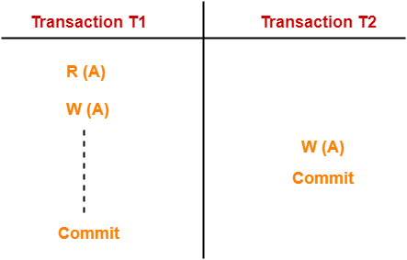
3. Lost Update Problem
This problem occurs when multiple transactions execute concurrently and updates from one or more transactions get lost.

Slide 31
Here,
T1 reads the value of A (= 10 say).
T1 updates the value to A (= 15 say) in the buffer.
T2 does blind write A = 25 (write without read) in the buffer.
T2 commits, (it means in buffer A=25)
When T1 commits, it writes A = 25 in the database (as the value of A in buffer is 25).
Hence value updated by T1 is lost.

Slide 32
In this example,
T1 writes the over written value of X in the database.
Thus, update from T1 gets lost.

Slide 33
NOTE-
This problem occurs whenever there is a write-write conflict.
In write-write conflict, there are two writes one by each transaction on the same data item without any read in the middle.

Slide 34
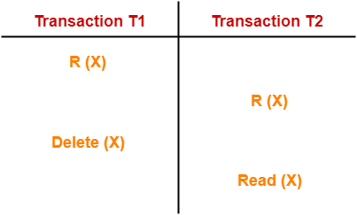
4. Phantom Read Problem
This problem occurs when a transaction reads some variable from the buffer and when it reads the same variable later, it finds that the variable does not exist.

Slide 35
Here,
T1 reads X.
T2 reads X.
T1 deletes X.
T2 tries reading X but does not find it.
In this example,
T2 finds that there does not exist any variable X when it tries reading X again.
T2 wonders who deleted the variable X because according to it, it is running in isolation.

Slide 36
Avoiding Concurrency Problems
To ensure consistency of the database, it is very important to prevent the occurrence of above problems.
Concurrency Control Protocols help to prevent the occurrence of above problems and maintain the consistency of the database.

Slide 37
Schedules in DBMS
The order in which the operations of multiple transactions appear for execution is called as a schedule.
T₁ | T₂
R(A)
W(A)
R(B)
 | W(B)
 | R(A)
 | R(B)
T₁ | T₂
R(A)
 | W(B)
W(A)
R(B)
 | R(A)
 | R(B)

Slide 38
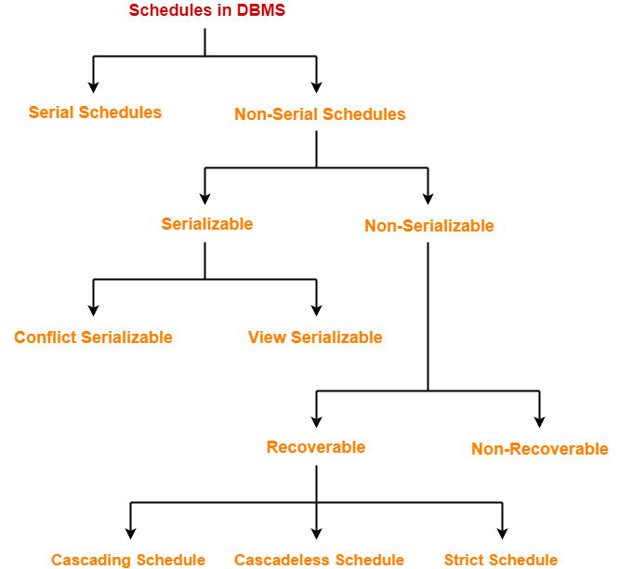

Slide 39
Serial Schedules
In serial schedules,
All the transactions execute serially one after the other.
When one transaction executes, no other transaction is allowed to execute.
Characteristics
Serial schedules are always
Consistent
Recoverable
Cascadeless
Strict

Slide 40
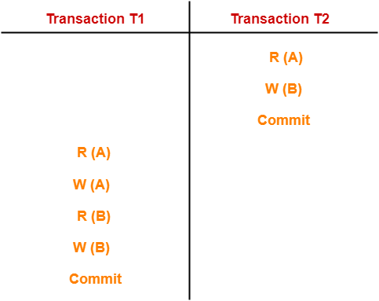
Example

Slide 41
Non-Serial Schedules
In non-serial schedules,
Multiple transactions execute concurrently.
Operations of all the transactions are inter leaved or mixed with each other.

Slide 42
Characteristics-
Non-serial schedules are NOT always
Consistent
Recoverable
Cascadeless
Strict

Slide 43
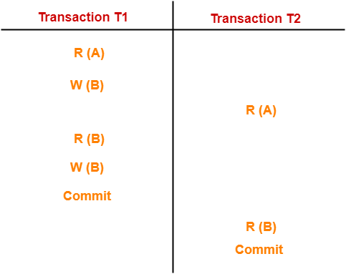

Slide 44

Finding Number Of Schedules
Consider there are n number of transactions T1, T2, T3 …. , Tn with N1, N2, N3 ….Nn , number of operations respectively.
Total Number of Schedules
Total number of possible schedules (serial + non-serial) is given by:
( )!

Slide 45
Total Number of Serial Schedules
Total number of serial schedules
= Number of different ways of arranging n transactions
= n!

Slide 46
Total Number of Non-Serial Schedules
Total number of non-serial schedules
= Total number of schedules – Total number of serial schedules

Slide 47
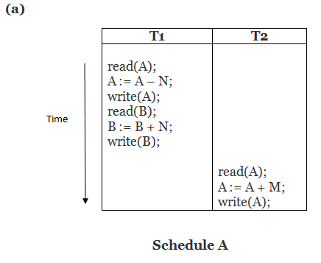
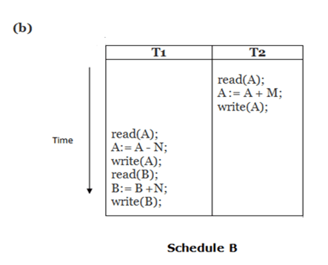
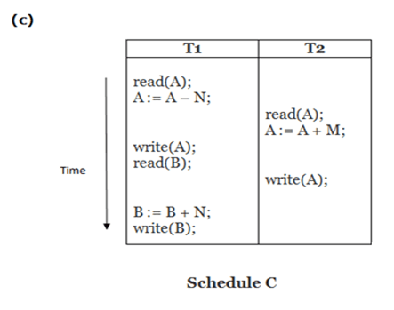
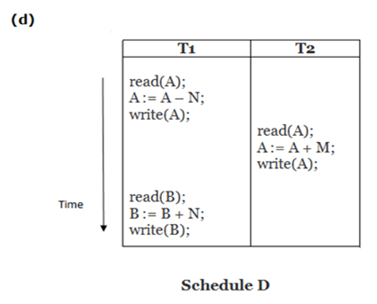
Find Out serial and Non serial Schedule

Slide 48
Problem
Consider there are three transactions with 2, 3, 4 operations respectively, find:
How many total number of schedules are possible?
How many total number of serial schedules are possible?
How many total number of non-serial schedules are possible?

Slide 49
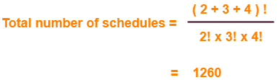
Solution
Total Number of Schedules-

Slide 50
Total Number of Serial Schedules:
Total number of serial schedules
= Number of different ways of arranging 3 transactions
= 3!
= 6

Slide 51
Total Number of Non-Serial Schedules
Total number of non-serial schedules
= Total number of schedules – Total number of serial schedules
= 1260 – 6
= 1254

Slide 52
Serializability in DBMS
Some non-serial schedules may lead to inconsistency of the database.
Serializability is a concept that helps to identify which non-serial schedules are correct and will maintain the consistency of the database.

Slide 53
Serializable Schedules
If a given non-serial schedule of ‘n’ transactions is equivalent to some serial schedule of ‘n’ transactions, then it is called as a serializable schedule.

Slide 54
Characteristics
Serializable schedules behave exactly same as serial schedules.
Thus, serializable schedules are always-
Consistent
Recoverable
Casacadeless
Strict

Slide 55
Serial Schedules Vs Serializable Schedules
Serial Schedules | Serializable Schedules
No concurrency is allowed. Thus, all the transactions necessarily execute serially one after the other. | Concurrency is allowed. Thus, multiple transactions can execute concurrently.
Serial schedules lead to less resource utilization and CPU throughput. | Serializable schedules improve both resource utilization and CPU throughput.
Serial Schedules are less efficient as compared to serializable schedules. (due to above reason) | Serializable Schedules are always better than serial schedules. (due to above reason)

Slide 56
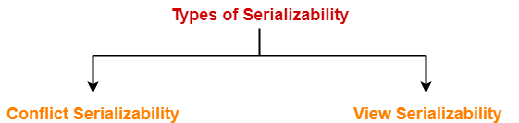
Types of Serializability

Slide 57
Conflict Serializability
If a given non-serial schedule can be converted into a serial schedule by swapping its non-conflicting operations, then it is called as a conflict serializable schedule.
Conflicting Operations
Two operations are called as conflicting operations if all the following conditions hold true for them-
Both the operations belong to different transactions
Both the operations are on the same data item
At least one of the two operations is a write operation

Slide 58
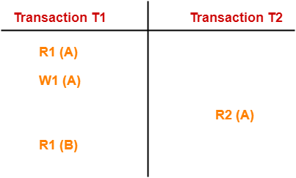
In this schedule, W1 (A) and R2 (A) are called as conflicting operations.
This is because all the above conditions hold true for them.

Slide 59
Checking Whether a Schedule is Conflict Serializable Or Not
Step-01:
Find and list all the conflicting operations.
Step-02:
Start creating a precedence graph by drawing one node for each transaction.
Step-03:
Draw an edge for each conflict pair such that if X_{i} (V) and Y_{j} (V) forms a conflict pair then draw an edge from T_{i} to T_{j}. This ensures that T_{i} gets executed before T_{j}.
Step-04:
Check if there is any cycle formed in the graph.
If there is no cycle found, then the schedule is conflict serializable otherwise not.

Slide 60
NOTE
By performing the Topological Sort of the Directed Acyclic Graph so obtained, the corresponding serial schedule(s) can be found.
Such schedules can be more than 1.

Slide 61
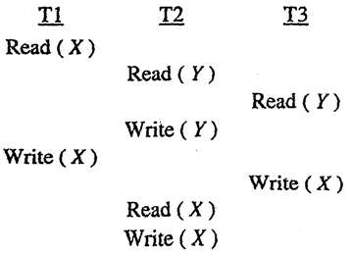
Example
Consider the following schedule for transactions T1, T2 and T3:

Slide 62
PROBLEMS BASED ON CONFLICT SERIALIZABILITY
Problem-01
Check whether the given schedule S is conflict serializable or not-
S : R₁(A) , R₂(A) , R₁(B) , R₂(B) , R₃(B) , W₁(A) , W₂(B)

Slide 63
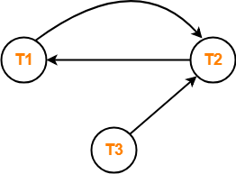
Solution:
S : R₁(A) , R₂(A) , R₁(B) , R₂(B) , R₃(B) , W₁(A) , W₂(B)
Step-01:
List all the conflicting operations and determine the dependency between the transactions-
R₂(A) , W₁(A) (T₂ → T₁)
R₁(B) , W₂(B) (T₁ → T₂)
R₃(B) , W₂(B) (T₃ → T₂)
Step-02:
Draw the precedence graph
Clearly, there exists a cycle in the precedence graph.
Therefore, the given schedule S is not conflict serializable

Slide 64
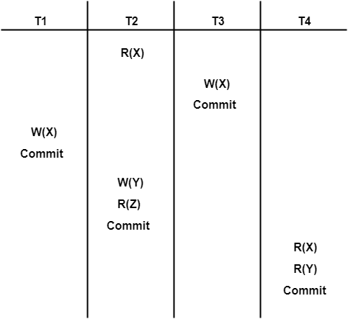
Problem-02
Check whether the given schedule S is conflict serializable and recoverable or not:

Slide 65
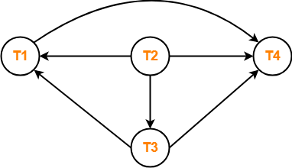
Solution
Step-01:
List all the conflicting operations and determine the dependency between the transactions-
R₂(X) , W₃(X) (T₂ → T₃)
R₂(X) , W₁(X) (T₂ → T₁)
W₃(X) , W₁(X) (T₃ → T₁)
W₃(X) , R₄(X) (T₃ → T₄)
W₁(X) , R₄(X) (T₁ → T₄)
W₂(Y) , R₄(Y) (T₂ → T₄)
Step-02:
Draw the precedence graph
Therefore, the given schedule S is
conflict serializable.

Slide 66
Checking Whether S is Recoverable Or Not………
Conflict serializable schedules are always recoverable.
Therefore, the given schedule S is recoverable.
Alternatively,
There exists no dirty read operation.
This is because all the transactions which update the values commits immediately.
Therefore, the given schedule S is recoverable.
Also, S is a Cascadeless Schedule.

Slide 67
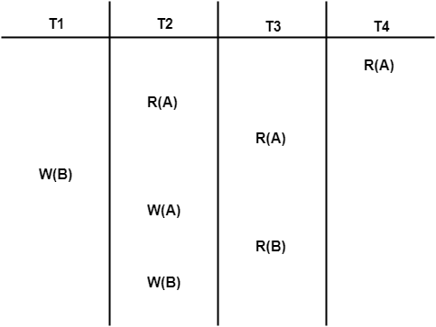
Problem-03
Check whether the given schedule S is conflict serializable or not. If yes, then determine all the possible serialized schedules:

Slide 68
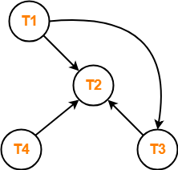
Solution
Step-01:
List all the conflicting operations and determine the dependency between the transactions-
R₄(A) , W₂(A) (T₄ → T₂)
R₃(A) , W₂(A) (T₃ → T₂)
W₁(B) , R₃(B) (T₁ → T₃)
W₁(B) , W₂(B) (T₁ → T₂)
R₃(B) , W₂(B) (T₃ → T₂)
Step-02:
Draw the precedence graph-
Clearly, there exists no cycle in the precedence graph.
Therefore, the given schedule S is conflict serializable.

Slide 69
Finding the Serialized Schedules
All the possible topological orderings of the above precedence graph will be the possible serialized schedules.
The topological orderings can be found by performing the Topological Sort of the above precedence graph.
After performing the topological sort, the possible serialized schedules are:
T₁ → T₃ → T₄ → T₂
T₁ → T₄ → T₃ → T₂
T₄ → T₁ → T₃ → T₂
R₄(A) , W₂(A) (T₄ → T₂)
R₃(A) , W₂(A) (T₃ → T₂)
W₁(B) , R₃(B) (T₁ → T₃)
W₁(B) , W₂(B) (T₁ → T₂)
R₃(B) , W₂(B) (T₃ → T₂)

Slide 70
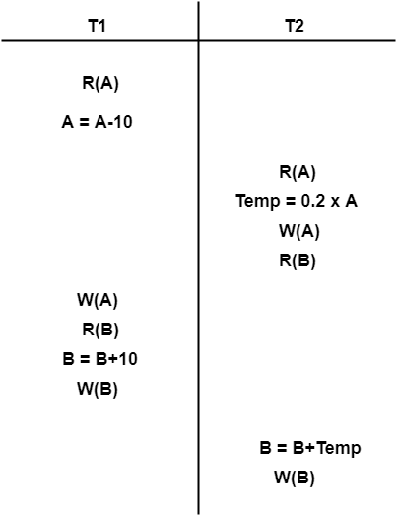
Problem-04
Determine all the possible serialized schedules for the given schedule:

Slide 71
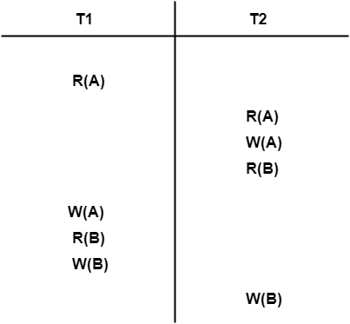
Solution
The given schedule S can be rewritten as:

Slide 72
Step-01:
List all the conflicting operations and determine the dependency between the transactions-
R₁(A) , W₂(A) (T₁ → T₂)
R₂(A) , W₁(A) (T₂ → T₁)
W₂(A) , W₁(A) (T₂ → T₁)
R₂(B) , W₁(B) (T₂ → T₁)
R₁(B) , W₂(B) (T₁ → T₂)
W₁(B) , W₂(B) (T₁ → T₂)

Slide 73
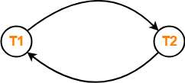
Step-02:
Draw the precedence graph-

Slide 74
View Serializability in DBMS
If a given schedule is found to be view equivalent to some serial schedule, then it is called as a view serializable schedule.

Slide 75
View Equivalent Schedules
Consider two schedules S1 and S2 each consisting of two transactions T1 and T2.
Schedules S1 and S2 are called view equivalent if the following three conditions hold true for them-
Condition-01:
For each data item X,
if transaction T_{i} reads X from the database initially in schedule S1,
then in schedule S2 also, T_{i} must perform the initial read of X from the database.

Slide 76
Condition-02
If transaction T_{i} reads a data item that has been updated by the transaction T_{j} in schedule S1,
then in schedule S2 also, transaction T_{i} must read the same data item that has been updated by the transaction T_{j.}

Slide 77
Condition-03:
For each data item X,
if X has been updated at last by transaction T_{i} in schedule S1,
then in schedule S2 also, X must be updated at last by transaction T_{i}.

Slide 78
Summary of View Equivalent
Initial readers must be same for all the data items.
Write-read sequence must be same.
Final writers must be same for all the data items.

Slide 79
Schedule is View Serializable Or Not…?
Method-01:
Check whether the given schedule is conflict serializable or not.
If the given schedule is conflict serializable, then it is surely view serializable. Stop and report your answer.
If the given schedule is not conflict serializable, then it may or may not be view serializable. Go and check using other methods.
Thumb Rules
All conflict serializable schedules are view serializable.
All view serializable schedules may or may not be conflict serializable.

Slide 80
Method-02:
Check if there exists any blind write operation.
If there does not exist any blind write, then the schedule is surely not view serializable. Stop and report your answer.
If there exists any blind write, then the schedule may or may not be view serializable. Go and check using other methods.
Thumb Rule
No blind write means not a view serializable schedule.

Slide 81
Method-03:
In this method, try finding a view equivalent serial schedule.
By using the above three conditions, write all the dependencies.
Then, draw a graph using those dependencies.
If there exists no cycle in the graph, then the schedule is view serializable otherwise not.

Slide 82
SUMMARY
if (Schedule(S) == ConflictSerializable)
{
then, Schedule(S) == View Serializable
}
else if(Schedule(S) has no blind write)
{
then, Schedule(S) == NOT View Serializable
}
else if(Schedule(S) == ViewEquivalentSchedule)
{
Draw dependency graph
If graph has no cycle View Serializable
}
else Not View Serializable

Slide 83
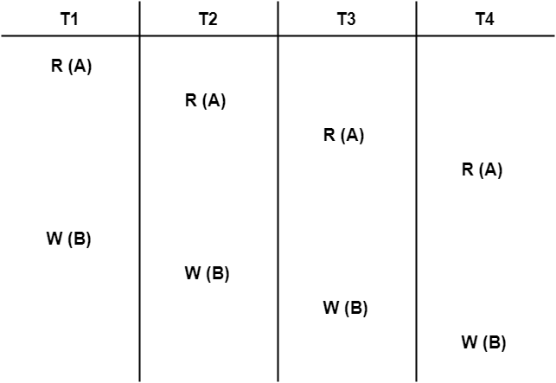
PROBLEMS BASED ON VIEW SERIALIZABILITY
Problem-01: Check whether the given schedule S is view serializable or not-

Slide 84
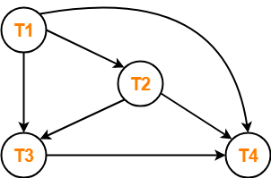
Solution
Checking Whether S is Conflict Serializable Or Not-
conflicting operations
W₁(B) , W₂(B) (T₁ → T₂)
W₁(B) , W₃(B) (T₁ → T₃)
W₁(B) , W₄(B) (T₁ → T₄)
W₂(B) , W₃(B) (T₂ → T₃)
W₂(B) , W₄(B) (T₂ → T₄)
W₃(B) , W₄(B) (T₃ → T₄)
Clearly, there exists no cycle in the precedence graph.
Therefore, the given schedule S is conflict serializable.
Thus, we conclude that the given schedule is also view serializable.

Slide 85
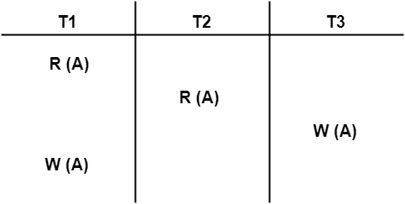
Problem-02

Slide 86
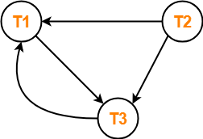
R₁(A) , W₃(A) (T₁ → T₃)
R₂(A) , W₃(A) (T₂ → T₃)
R₂(A) , W₁(A) (T₂ → T₁)
W₃(A) , W₁(A) (T₃ → T₁)
Clearly, there exists a cycle in the precedence graph.
Therefore, the given schedule S is not conflict serializable.

Slide 87
Checking for Blind Writes
There exists a blind write W₃ (A) in the given schedule S.
Therefore, the given schedule S may or may not be view serializable.

Slide 88
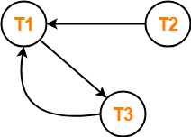
Drawing a Dependency Graph
T1 firstly reads A and T3 firstly updates A.
So, T1 must execute before T3.
Thus, we get the dependency T1 → T3.
Final updation on A is made by the transaction T1.
So, T1 must execute after all other transactions.
Thus, we get the dependency (T2, T3) → T1.
There exists no write-read sequence.
Clearly, there exists a cycle in the dependency graph.
Thus, we conclude that the given schedule S is not view serializable.

Slide 89
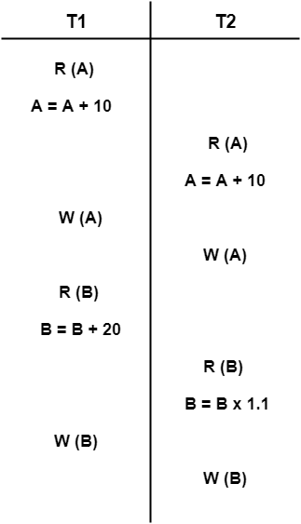
Problem-03

Slide 90
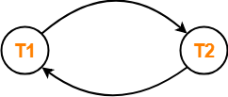
Solution
conflicting operations
R₁(A) , W₂(A) (T₁ → T₂)
R₂(A) , W₁(A) (T₂ → T₁)
W₁(A) , W₂(A) (T₁ → T₂)
R₁(B) , W₂(B) (T₁ → T₂)
R₂(B) , W₁(B) (T₂ → T₁)
Therefore, the given schedule S is not conflict serializable.
Checking for Blind Writes-
There exists no blind write in the given schedule S.
Therefore, it is surely not view serializable.

Slide 91
Problem-04
Check whether the given schedule S is view serializable or not. If yes, then give the serial schedule.
S : R₁(A) , W₂(A) , R₃(A) , W₁(A) , W₃(A)

Slide 92
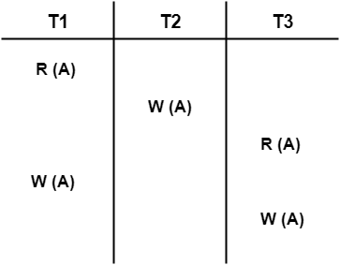
Solution

Slide 93
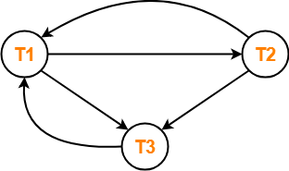
R₁(A) , W₂(A) (T₁ → T₂)
R₁(A) , W₃(A) (T₁ → T₃)
W₂(A) , R₃(A) (T₂ → T₃)
W₂(A) , W₁(A) (T₂ → T₁)
W₂(A) , W₃(A) (T₂ → T₃)
R₃(A) , W₁(A) (T₃ → T₁)
W₁(A) , W₃(A) (T₁ → T₃)

Slide 94
Checking for Blind Writes
There exists a blind write W₂ (A) in the given schedule S.
Therefore, the given schedule S may or may not be view serializable.

Slide 95
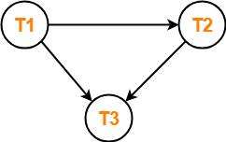
Drawing a Dependency Graph
T1 firstly reads A and T2 firstly updates A.
So, T1 must execute before T2.
Thus, we get the dependency T1 → T2.
Final updation on A is made by the transaction T3.
So, T3 must execute after all other transactions.
Thus, we get the dependency (T1, T2) → T3.
From write-read sequence, we get the dependency T2 → T3

Slide 96
Recoverability in DBMS

Slide 97
Non-Serializable Schedules
A non-serial schedule which is not serializable is called as a non-serializable schedule.
A non-serializable schedule is not guaranteed to produce the same effect as produced by some serial schedule on any consistent database.
Characteristics
Non-serializable schedules-
may or may not be consistent
may or may not be recoverable

Slide 98
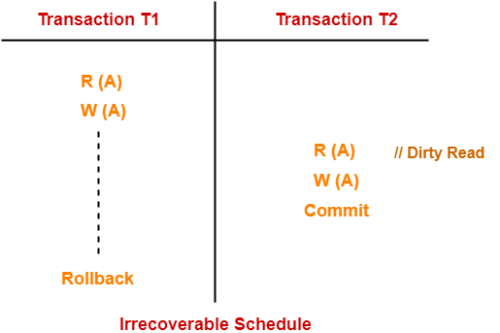
Irrecoverable Schedules
If in a schedule,
A transaction performs a dirty read operation from an uncommitted transaction
And commits before the transaction from which it has read the value
then such a schedule is known as an Irrecoverable Schedule.

Slide 99
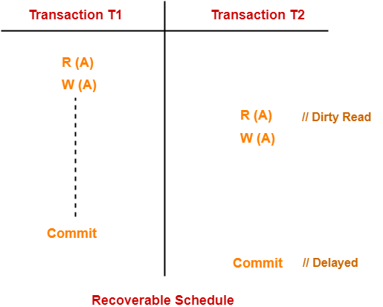
Recoverable Schedules
If in a schedule,
A transaction performs a dirty read operation from an uncommitted transaction
And its commit operation is delayed till the uncommitted transaction either commits or roll backs
then such a schedule is known as a Recoverable Schedule.

Slide 100
A Schedule is Recoverable or Irrecoverable
Method-01
Check whether the given schedule is conflict serializable or not.
If the given schedule is conflict serializable,
then it is surely recoverable.
If the given schedule is not conflict serializable,
then it may or may not be recoverable. Go and check using other methods.

Slide 101
Method-02
Check if there exists any dirty read operation.
If there does not exist any dirty read operation,
then the schedule is surely recoverable
If there exists any dirty read operation,
then the schedule may or may not be recoverable.

Slide 102
If there exists a dirty read operation, then follow the following cases
Case-01:
If the commit operation of the transaction performing the dirty read
occurs before the commit or abort operation of the transaction which updated the value,
then the schedule is irrecoverable.

Slide 103
Case-02:
If the commit operation of the transaction performing the dirty read is
delayed till the commit or abort operation of the transaction which updated the value,
then the schedule is recoverable.

Slide 104
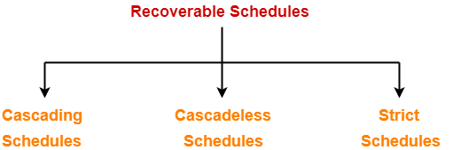
Types of Recoverable Schedules

Slide 105
Cascading Schedule
If in a schedule, failure of one transaction causes several other dependent transactions to rollback or abort, then such a schedule is called as a Cascading Schedule or Cascading Rollback or Cascading Abort.
It simply leads to the wastage of CPU time.

Slide 106
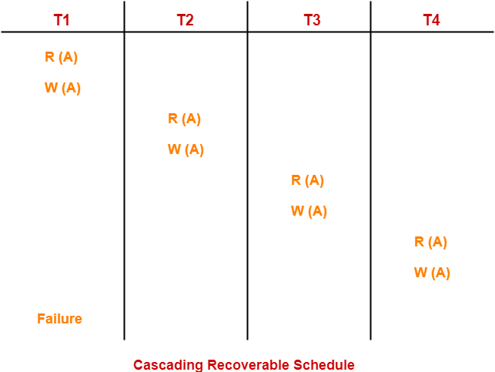
NOTE- If the transactions T2, T3 and T4 would have committed before the failure of transaction T1, then the schedule would have been irrecoverable.

Slide 107
Cascadeless Schedule
If in a schedule, a transaction is not allowed to read a data item until the last transaction that has written it is committed or aborted, then such a schedule is called as a Cascadeless Schedule.
In other words,
Cascadeless schedule allows only committed read operations.
Therefore, it avoids cascading roll back and thus saves CPU time.

Slide 108
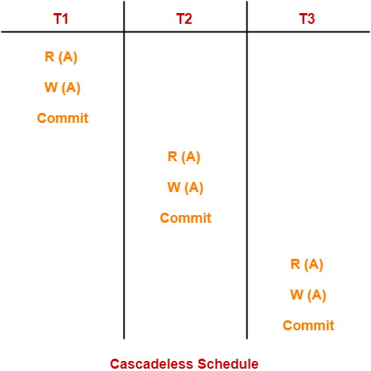

Slide 109
Strict Schedule
If in a schedule, a transaction is neither allowed to read nor write a data item until the last transaction that has written it is committed or aborted, then such a schedule is called as a Strict Schedule.
In other words,
Strict schedule allows only committed read and write operations.
Clearly, strict schedule implements more restrictions than cascadeless schedule.

Slide 110
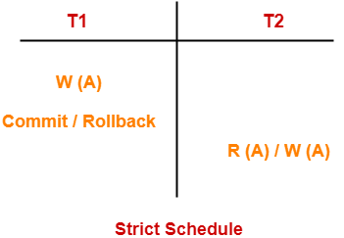

Slide 111
