Slide 1
DevOps

Slide 2
DevOps
DevOps is the combination of cultural philosophies, practices, and tools that increases an organization's ability to deliver applications and services at high velocity.
DevOps is a methodology in the software development and IT industry . DevOps is a set of practices , tools, and a cultural philosophy that automate and integrate the processes between software development and IT teams.

Slide 3
What Led to DevOps
The motivations for what has become modern DevOps and several standard DevOps practices such as automated build and test, continuous integration, and continuous delivery originated in the Agile world, which dates (informally) to the 1990s, and formally to 2001.
Scrum emerged as the dominant Agile framework in the early 2000s and it omitted the engineering practices that were part of many Agile teams, the movement to automate operations / infrastructure functions splintered from Agile and expanded into what has become modern DevOps.

Slide 4
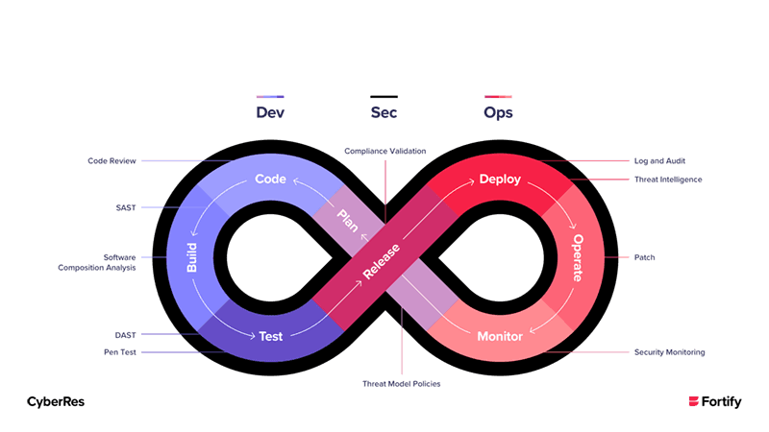

Slide 5
Dev
Writing code for robust applications using best methods.
Maintaining Standard and Quality of Code.
Writing Practical unit tests and utilizing test-driven development.
Verifying Behaviour of an Application.

Slide 6
Ops
Automated provisioning and de provisioning of environments.
Scaling UP/ Scaling Down /Scaling Out
Managing Infrastructure using IaaC(Infrastructure as a Code) to maintain version and visibility.
Configuration Management , Monitoring and Measurement.

Slide 7
Benefits of Devops
Faster, better product delivery
Faster issue resolution and reduced complexity
Greater scalability and availability
More stable operating environments
Better resource utilization
Greater automation
Greater visibility into system outcomes
Greater innovation

Slide 8
Benefits of DevOps
Early Detection of Failure
Stable and consistent environment
Easy Rollback
Single-click Deployment

Slide 9
History of DevOps
2007: It all started in 2007 when Patrick Debois started working on a robust data-centre migration where he was responsible for testing. He experienced many frustrations during the course of this project, starting from the continuous switching back and forth from the development side of the problem and the bevy of operations that waited on the other side. He realized that a large chunk of the effort and time was spent (or rather wasted) in navigating the project from development to operations. However, it wasn’t possible to bridge the significantly wide gap between the two worlds.

Slide 10
History of DevOps
2008: It was in 2008 at an Agile conference conducted in Toronto, Canada, when a man named Andrew Shafer attempted to arrange a meetup session that was called “Agile Infrastructure.” Patrick was seemingly the only person who had attended this session. Andrew, after receiving a huge amount of negative feedback regarding this said that even he did not show up to his own session. However, Patrick was quite excited finally come across a like-minded person. He hunted Shafer down at the conference and talked to him in the hallway. They later went on to form a discussion group for various people who wanted to post their ideas that would help bring a relevant solution to the wide gap between development and operations.

Slide 11
History of DevOps
2009: During the initial stages, not a lot came forth with their ideas with this perspective. However, things started looking up in the June of 2009, Paul Hammond and John Allspaw conducted a lecture entitled “10+ Deploys a Day: Dev and Ops Cooperation at Flickr.” Patrick ended up watching the streaming video of that presentation when he was home in Belgium. Its views highly resonated with him making him realize that this was exactly the solution he had been looking for. Motivated by this lecture, he arranged a gathering of system administrators and developers to sit together and discuss the most ideal ways to begin bridging the gap between these two heterogeneous fields. This event was named DevOpsDays, and was held during the final week of October 2009.

Slide 12
History of DevOps
2010: With the significant amount of attention that this event gathered from experts in both fields, there are lively debates held over Twitter where users used the hashtag #DevOps. This was all that was needed for smaller tech enterprises to make an effort in amalgamating the DevOps practices and the tools built to help new teams that are forming. By this time, DevOps managed to acquire a grassroots following where members began extensively pushing their respective ideas.

Slide 13
History of DevOps
2011: It was in March 2011 when Cameron Haight of Gartner offered his predictions for DevOps to take a course in the following few years. With his positive outlook, many other members and users came and began implementing DevOps with wide ideas. Soon enough, enterprises regardless of how small or big scale they are started adopting DevOps. DevOps is one of the most internal frameworks in the workspace and were beginning to adopt these new practices. With DevOps earning more and more fame, it is a thing similar to Agile.

Slide 14
History of DevOps
2015: DevOps incorporated into SAFe. SAFe is rapidly gaining traction in the enterprise arena, where DevOps is adopted and scaled across.
2016: DevOps is the new norm for high-performing companies “Clearly, what was state of-the-art three years ago is just not good enough for today’s business environment.”
2018: State of Devops report defines 5- stage approach From level 0 to 5, a descriptive, pragmatic approach is introduced to guide teams and mature DevOps initiatives, a report sponsored by Deloitte.
2019: Enterprises embed more IT functions in their teams next to ‘Dev’ and ‘Ops’ “organizations are embedding security (DevSecOps), privacy, policy, data (DataOps) and controls into their DevOps culture and processes.”

Slide 15
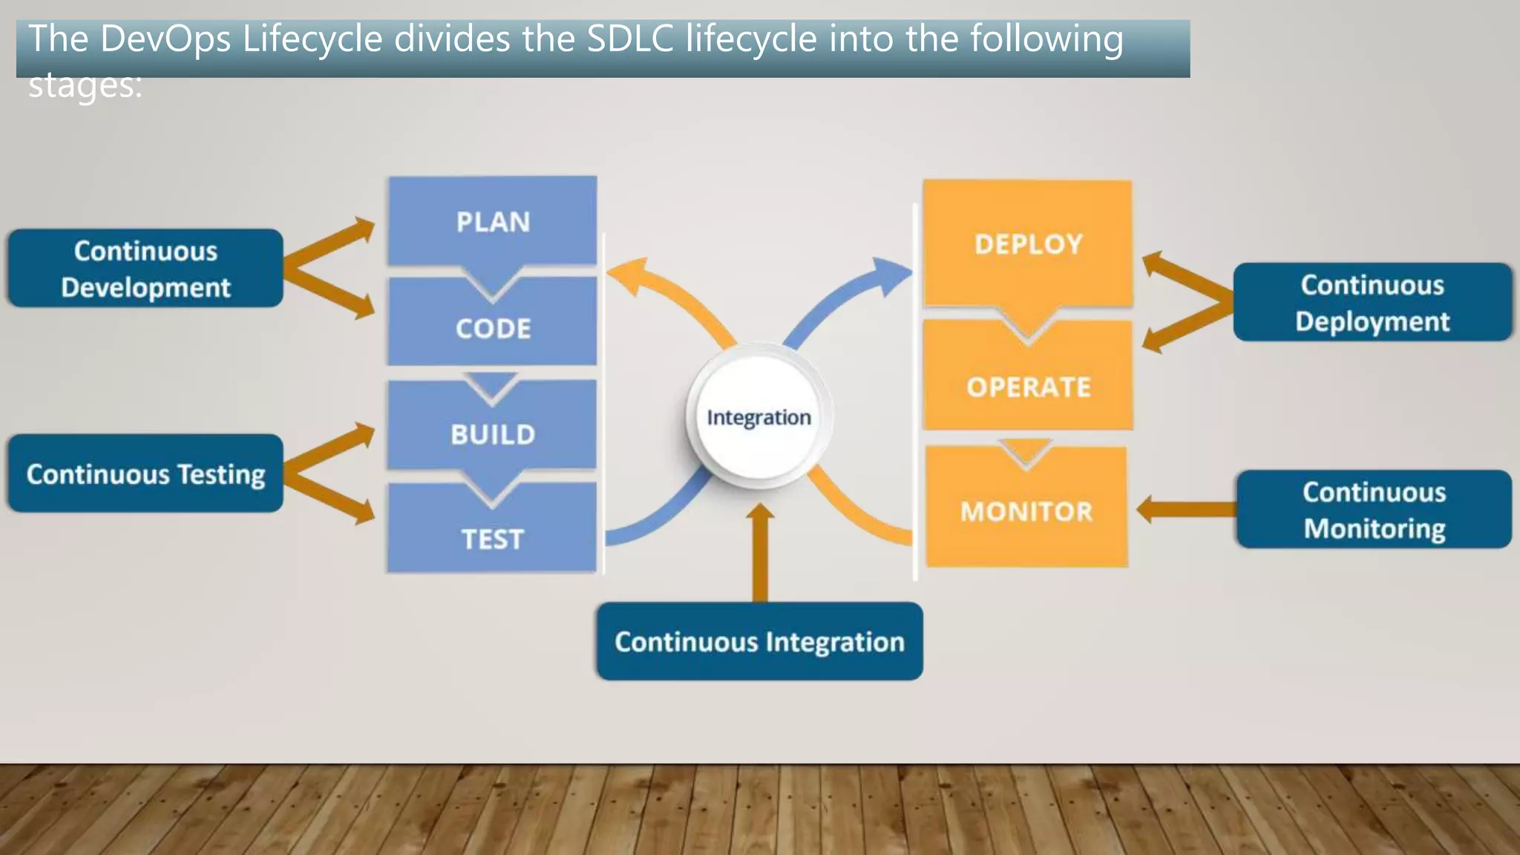

Slide 16
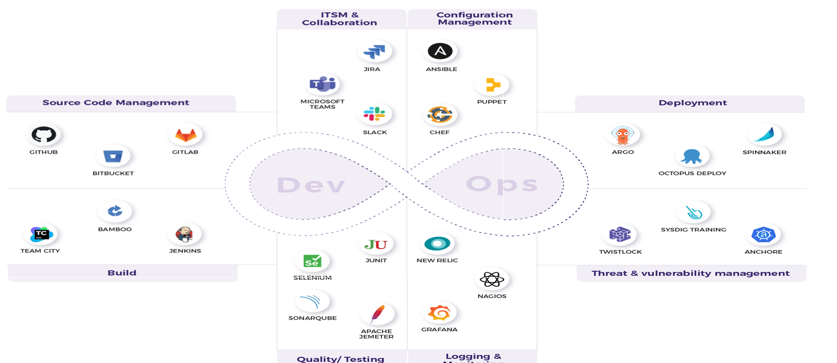

Slide 17
Continuous Code Inspection
Continuous code inspection allows you to perform static code analysis and highlight bugs, vulnerabilities, and other code issues related to standards. Quality profiles and quality gates can be integrated with a continuous integration server. In short static code analysis (SCA) helps to analyse the code without running it.

Slide 18
Objectives
To maintain code quality.
To identify potential code quality issues during the development phase.
To cultivate the habit to write better quality of code with continuous improvement.
To fix programming errors , finding bugs, or ensuring conformance to coding guidelines.

Slide 19
Benefits
SCA tools are affordable open-source or available with SDK’s.
Automated Code Analysis
Repeatable
Details analysis on AS-IS scenario of code
Customizable
No human intervention except initial configuration for code analysis
Huge rule set and efficient scanning of a large codebase

Slide 20
Challenges
To integrate the code using development tools to get the result as and when code is written.
To cultivate the mindset to avoid the issues in the code that have already occurred in past code inspections.
To develop a habit to write code that matches industry and technical standard.
To fix the benchmark for code quality in different programming languages and different domains.

Slide 21
Tools
SonarQube
Android Lint
Swift Lint
CheckStyle

Slide 22
Outcome
Priority based bugs-code issues, security vulnerabilities
Maintainability related issues
Quality gate results

Slide 23
Continuous Integration
Continuous integration is the DevOps practise to integrate the new feature implementation or bug fix in existing distributed version control systems such as git that triggers code quality checks , unit test execution and build . Continuous integration ids easy to implement and hence for DevOps starters, it works as a solid base on which the rest of practices can stand.

Slide 24
Objectives
To fail fast and recover fasts
Compilation and unit test execution
Publishing test and code coverage reports on the Jenkins dashboard
To create a package or artifact

Slide 25
Benefits
Improved quality-increased confidence
Faster detection of failures
Fewer effects in the resolution of errors in the early stages of issue
Focus on new feature implementations and bug fixes
Transparency and visibility across stakeholders
Improved communication and collaboration
A solid base of culture transformation movement
Collective responsibility , accountability and ownership
Reduced risks
Reduced repetitive manual processes

Slide 26
Challenges
Build automation to compile source code files to execute unit tests and to create a package file
Expertise to build automation tools such as Ant , Maven or Gradle is required
Unit test implementation- to develop a mindset in the team so the team can understand the importance of test-driven development

Slide 27
Tools
Jenkins
Microsoft Azure DevOps
Atlassian Bamboo
TeamCity

Slide 28
Outcome
Code quality reports
Codec quality gate verification
Unit tests reports
Code coverage reports based on unit tests
Package creation for distribution or deployment

Slide 29
Artifact Management
An artifact repository supports the artifact lifecycle and allows you to manage DevOps practices more efficiently by managing the version of different artifacts . It manages packages ready for deployment for dependencies that can be used to create packages itself.
Objective : To manage application packages such as WAR,APK,IPA file or Maven dependencies such as-Jar files.

Slide 30
Benefits
Integration with CI server such as Jenkins or Automation tool such as IBM Urban code Deploy helps to maintain multiple versions of files.
Rollback is easier while using the artifact repository as multiple versions are available.
Integration with tools available for automation such as Jenkins , NPM , Docker and others.
It serves as a shared library for artifact.
Compliance control for all dependencies used by the team in applications and complete control of in-house developed libraries within an organization.

Slide 31
Challenges for Organization
The learning curve is medium to difficult.
Downtime management if the repository is not as a Service.
Tools
Artifactory
Nexus Repository

Slide 32
Outcome
Versioned Artifact
Shared Dependencies

Slide 33
Continuous Delivery
The objective of continued delivery and continuous deployment is to deploy an application in Dev , test , UAT , production environment in an automated manner.
It helps in incremental release after short spans of development or sprint in the agile term.

Slide 34
Challenges : Faced by Organizations
To write scripts or use plugins or deploy an application in the specific environment.
To set an approval process for governance.
Proper access to the remote system to deploy an application.

Slide 35
Tools
Plugins
Shell Script
Batch Script
App Centre
TestFlight
Other tools

Slide 36
Outcome
Automated deployment of artifacts
Governance
Approval or review process before deployment

Slide 37
Continuous Testing
Continuous testing helps to verify the functional aspects of an application in an automated manner and to keep application production-ready after all verifications.
Objectives
To verify the functional and non-functional aspects of an application in an automated manner and to keep application production-ready after all verifications.

Slide 38
Benefits
Brings quality and improvement as a part of a continuos process or pipeline.
Helps to detect issues in early stages.
Accelerate application Delivery.
Faster time to market with continuous feedback.
Improve test coverage
Transparency

Slide 39
Challenges
Understanding requirements
Trained resource to write functional test cases
Testing framework and reusability
Software licences
Running the same test case multiple time
Testing for multiple platform/device models is time consuming
Testing application on the different models , screen sizes ,screen resolutions , OS

Slide 40
Tools
Selenium
Appium
Apache JMeter
OWASP ZAP
Cucumber
Mob SF

Slide 41
Continuous Deployment
Continuous Deployment is about confidence and capabilities that every change is deployed in the production environment

Slide 42
Agile Methodology
Agile software development is a set of principles for software development in which requirement and solutions evolve through collaboration between self-organizing , cross-functional teams.

Slide 43
Principles
Customer satisfaction by early and continuous delivery of valuable software.
Welcome changing requirements, even in late deployments.
Working software is delivered frequently(Weeks rather than months)
Close daily, co-operation between business people and developers.
Projects are built around motivated people who should be trusted.
Face to Face communication is the best form of communication(co-location).
Working software is the principal measure of progress.

Slide 44
Principles
Sustainable development , able to maintain constant pace.
Continuous attention to technical excellence and good design.
Simplicity- the art of maximizing the amount of work not done-is essential.
Best architectures , requirements and design from self-organizing team.
Regularly the team reflects on how to become more effective and adjust accordingly

Slide 45
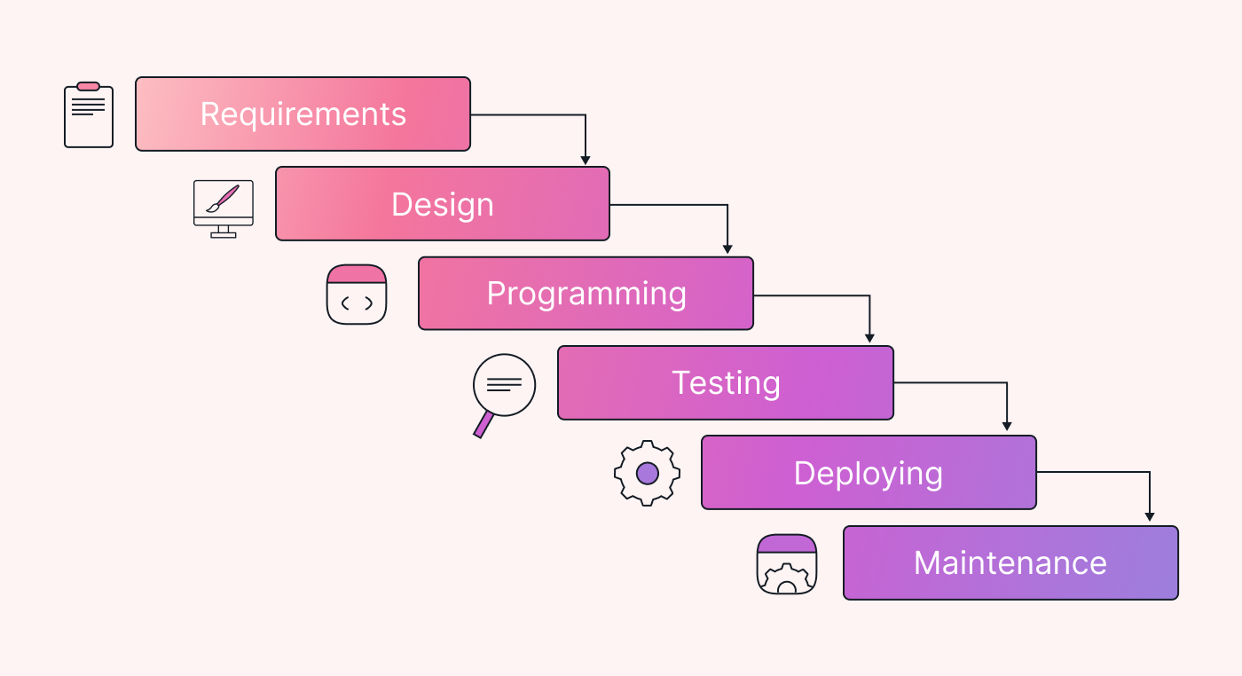
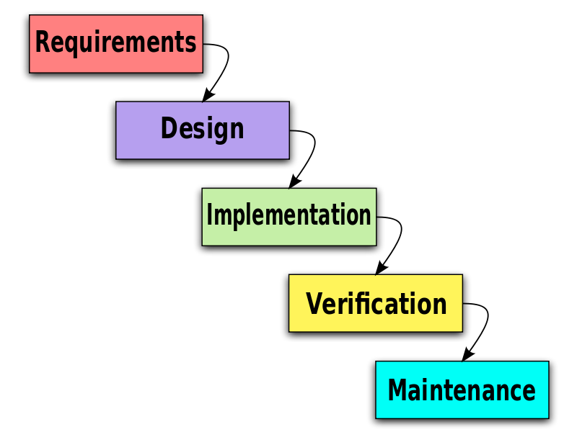
Traditional Waterfall Model

Slide 46
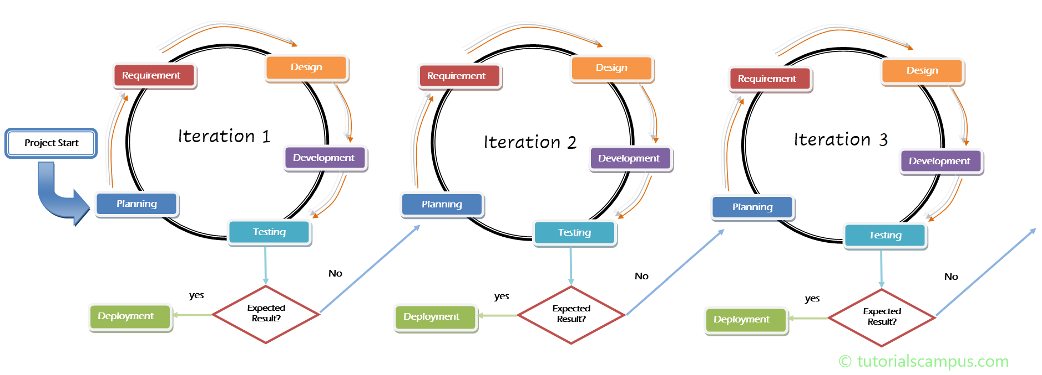
Agile Model

