Slide 1
Discrete Mathematics BCSC0010
Module 1
Functions (Lecture 6)

Slide 2
Types of Function
One-to-One Function (Injective)
Onto Function (Surjective)
One-to-one correspondence (bijective)

Slide 3
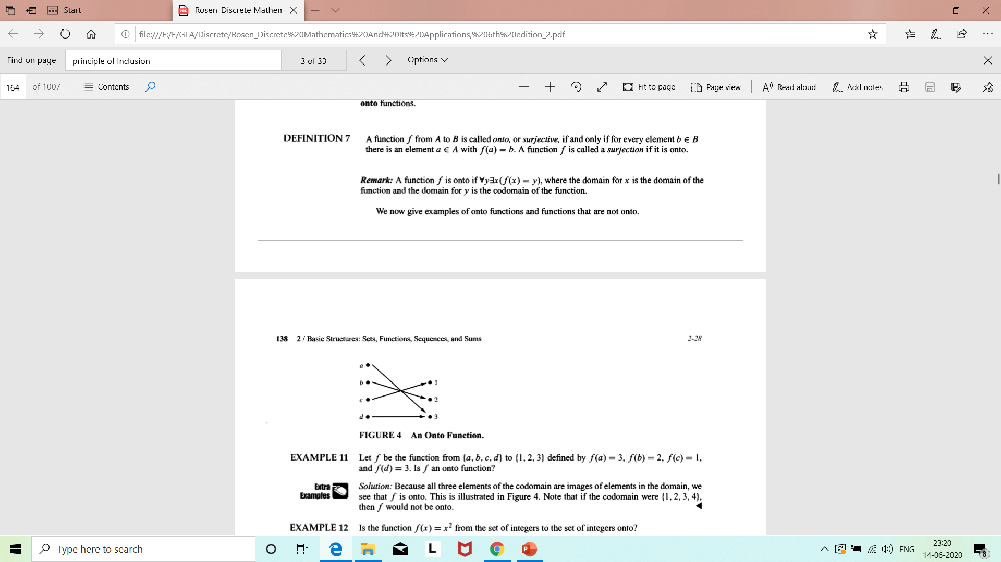
Onto Function
A function f is onto if ∀b∃a(f(a) = b)

Slide 4
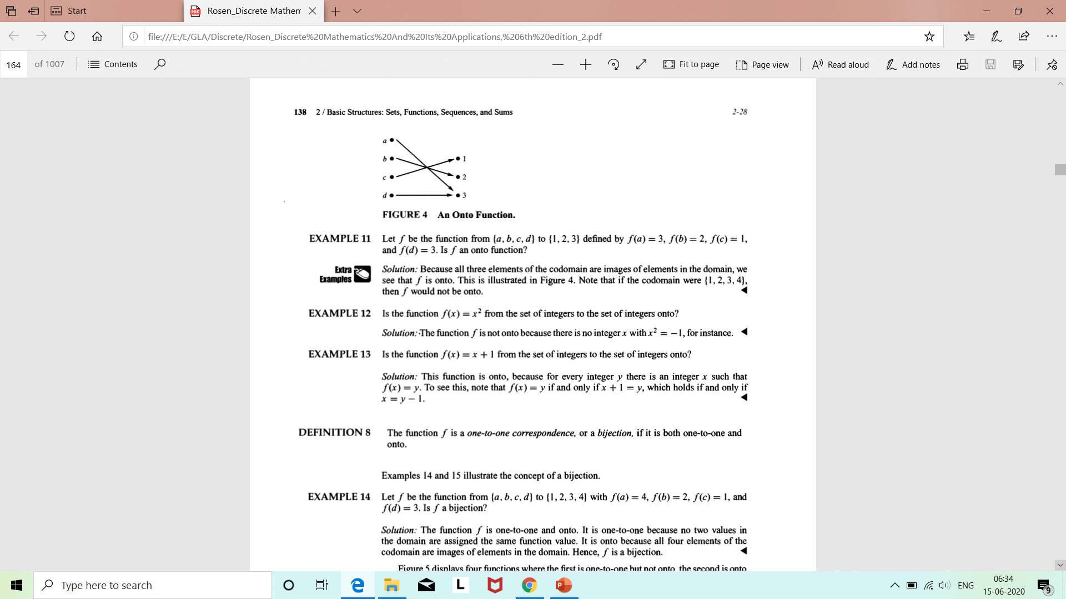
Example

Slide 5
Example

Slide 6
Example

Slide 7
One-to-One Correspondence
The function f is a one-to-one correspondence, or a bijection, if it is both one-to-one and onto.

Slide 8
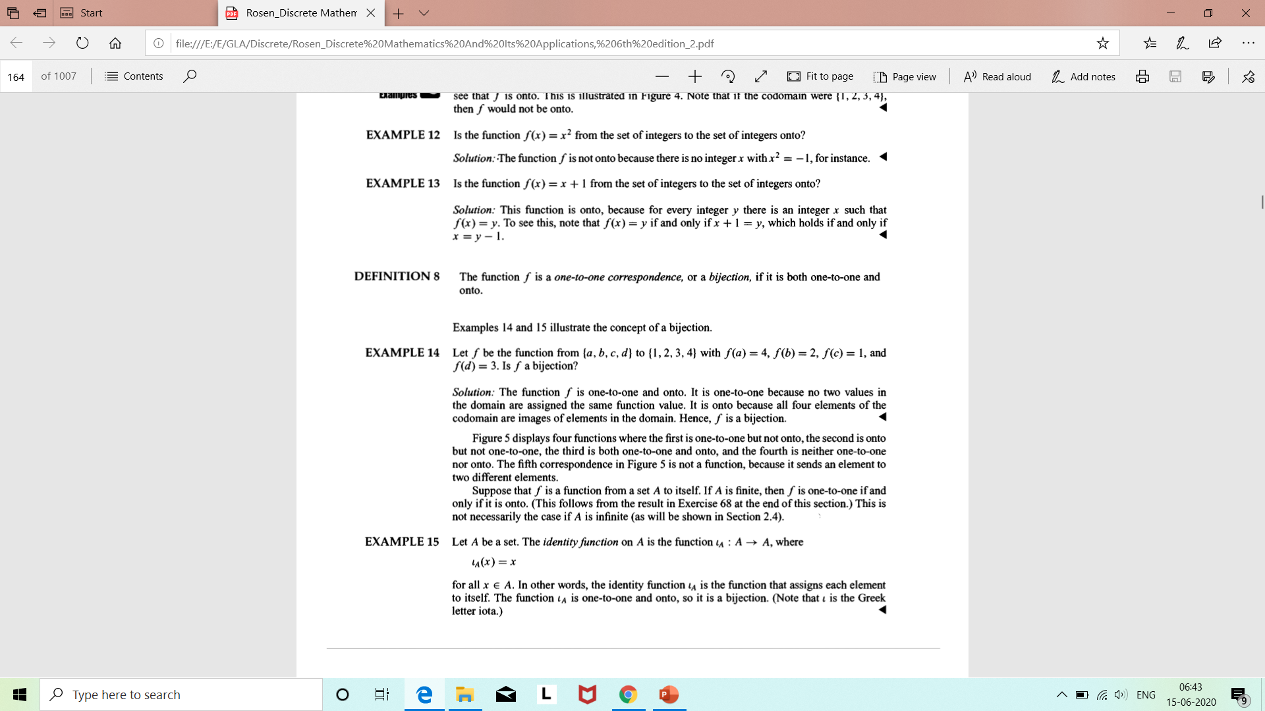
Example

Slide 9
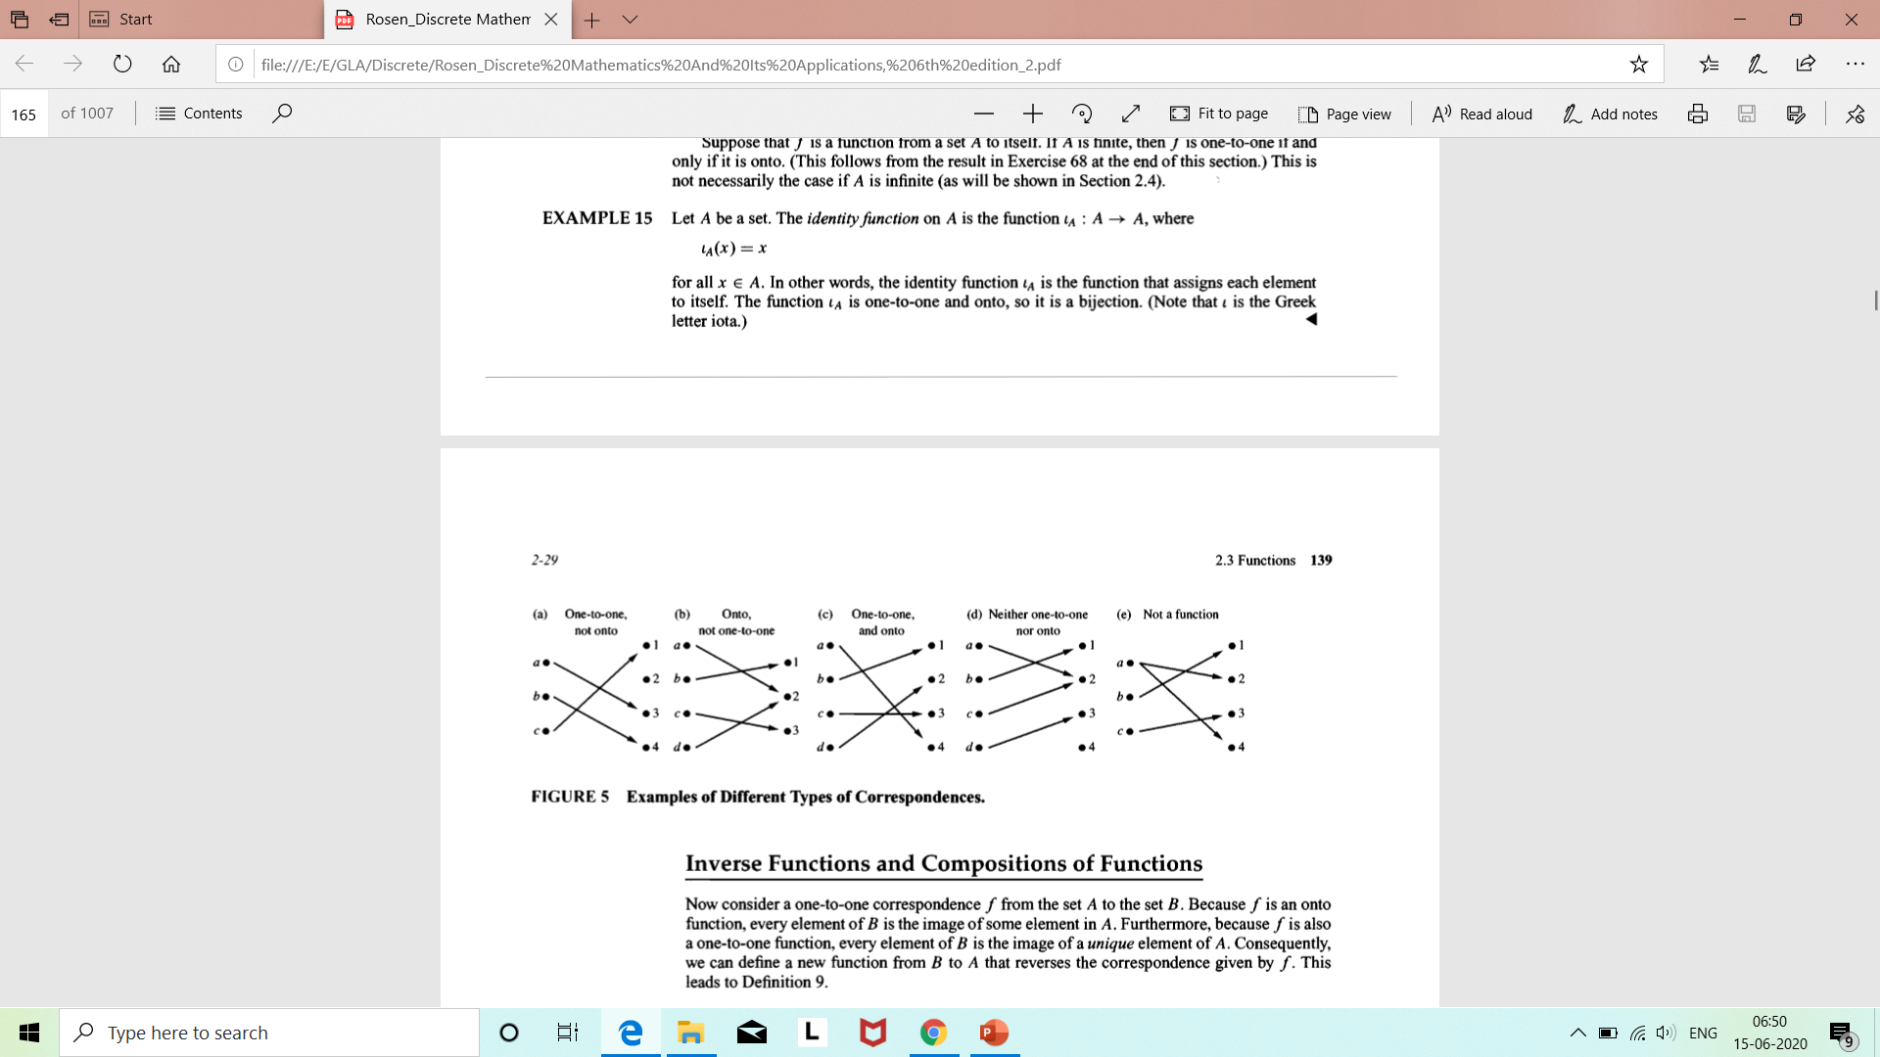
Different Types of Correspondences

Slide 10
Next topic..
Relations

