Slide 1
Discrete Mathematics BCSC0010
Module 1
Functions (Lecture 5)

Slide 2
Function
Let A and B be nonempty sets.
A function f from A to B is an assignment of exactly one element of B to each element of A.
We write f(a) = b if b is the unique element of B assigned by the function f to the element a of A.
If f is a function from A to B, we write f:A → B.
Functions are sometimes also called mappings or transformations.

Slide 3
Function
f : A → B
function
domain
Co-domain

Slide 4
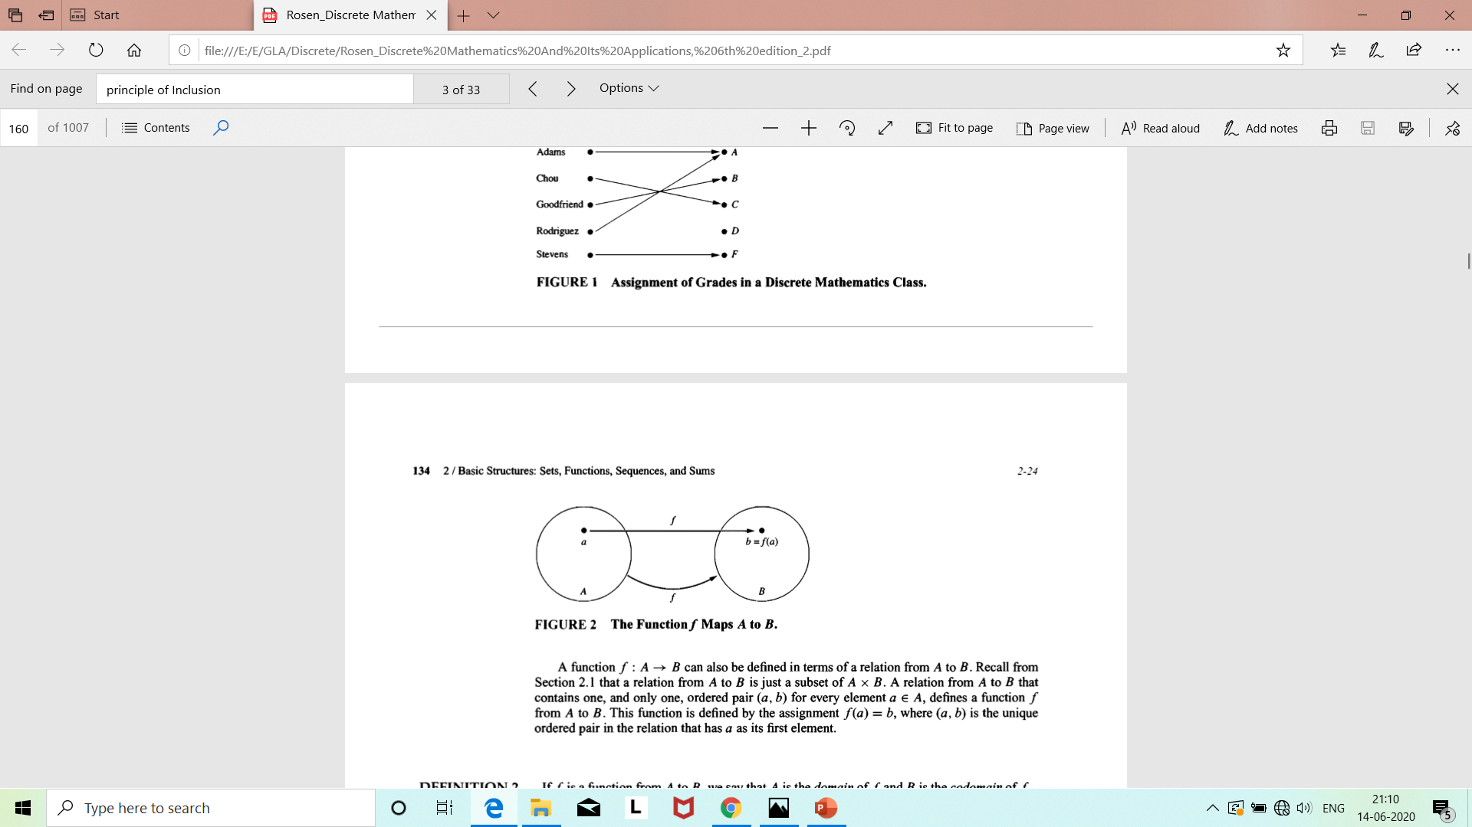

Slide 5
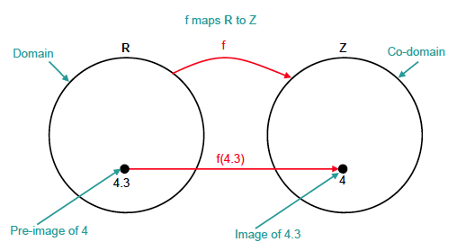
Terminology
Example of the floor function

Slide 6
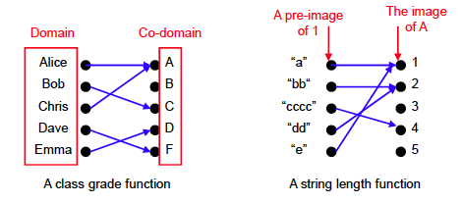
Examples

Slide 7
Exercises
Why is f not a function from R to R if
f(x) = x ^{½}
f(x) = ±(x² + 1) ^{½}

Slide 8
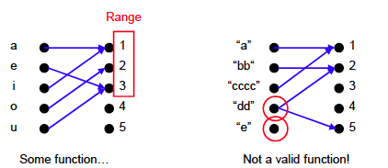
More examples
What is the difference between co-domain and range?

Slide 9
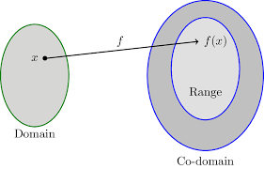
Function
If f is a function from A to B,
we say that A is the domain of f and
B is the codomain of f.
If f(a) = b, we say that b is the image
of a and a is a preimage of b.
The range of f is the set of all images of elements of A.
Also, if f is a function from A to B, we say that f maps A to B.

Slide 10
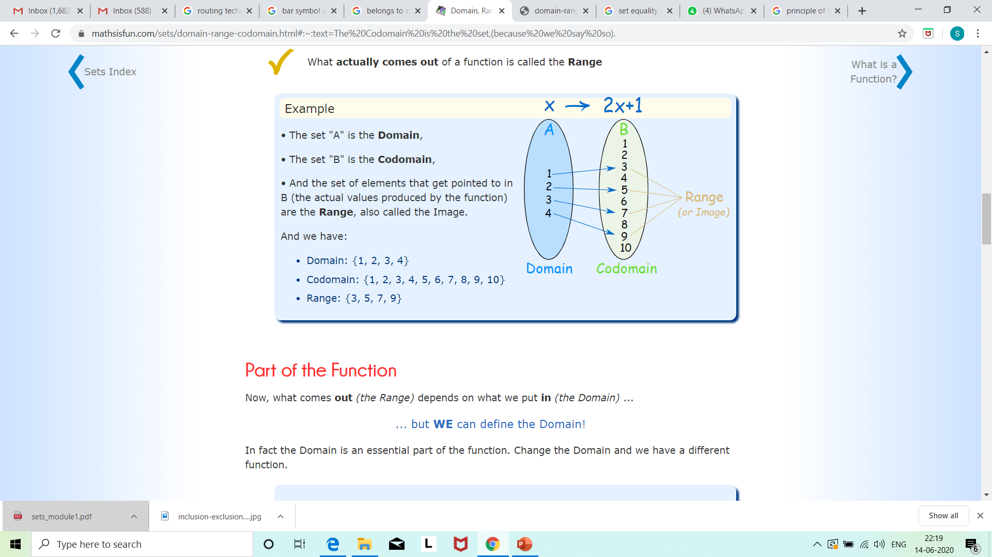
Ref: https://www.mathsisfun.com/sets/domain-range-codomain.html#:~:text=The%20 Codomain%20is% 20the%20set, (because%20we%20say%20so).

Slide 11
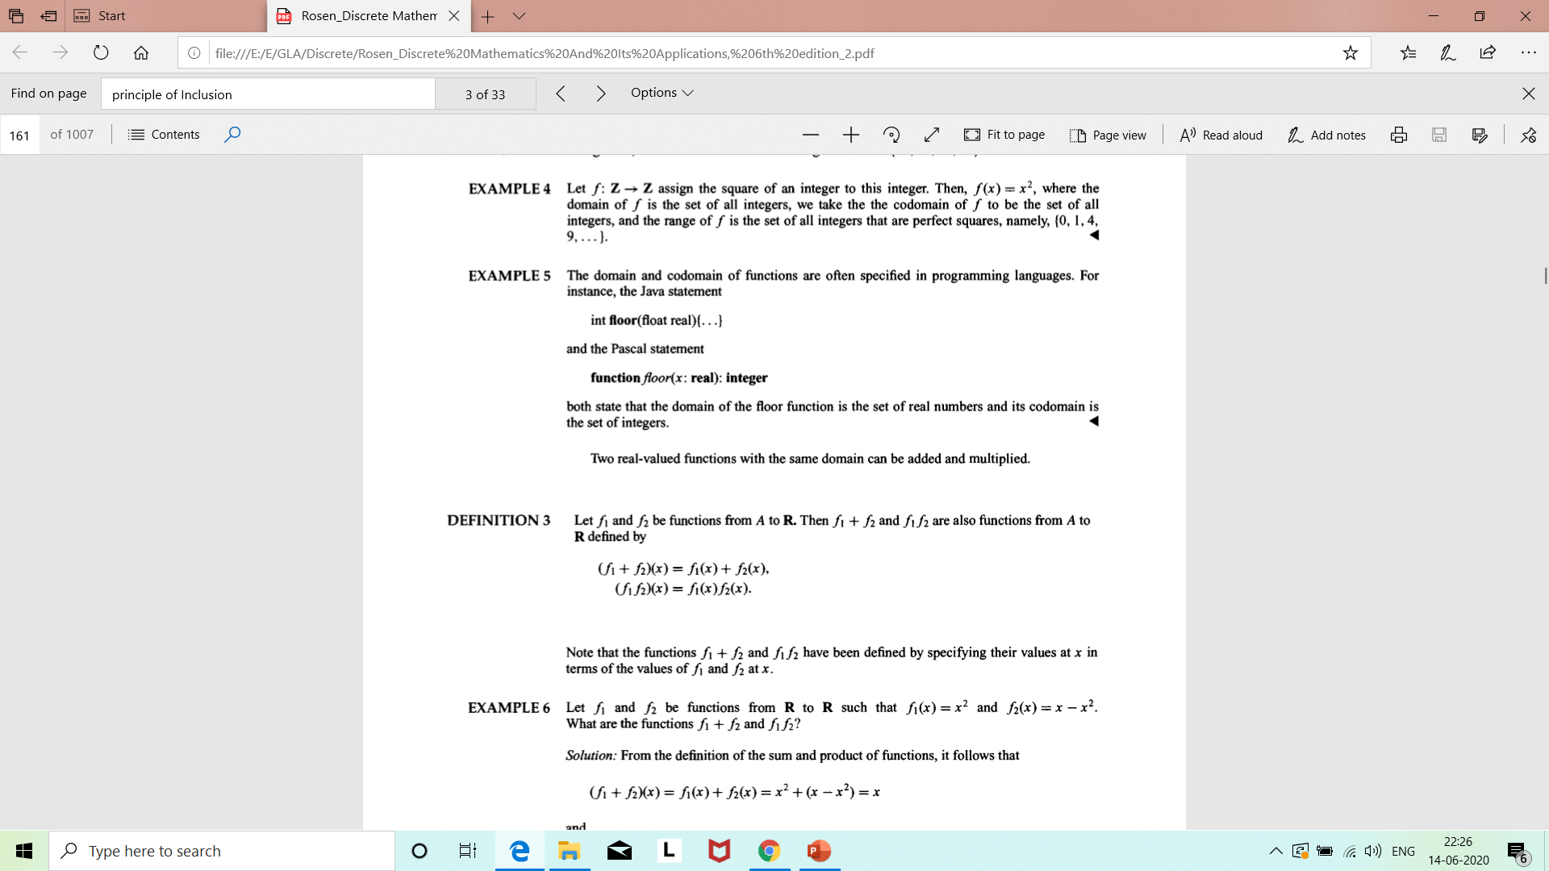
Function

Slide 12
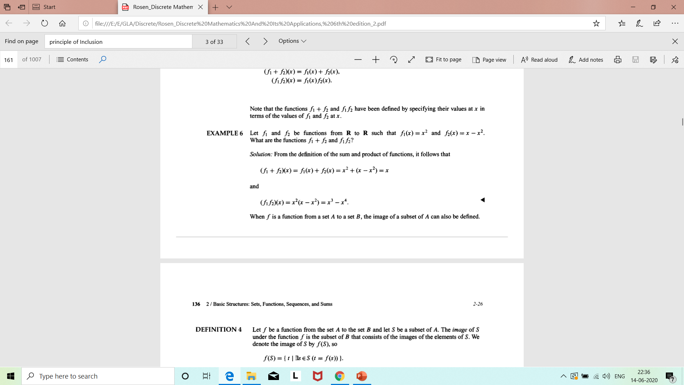
Example

Slide 13
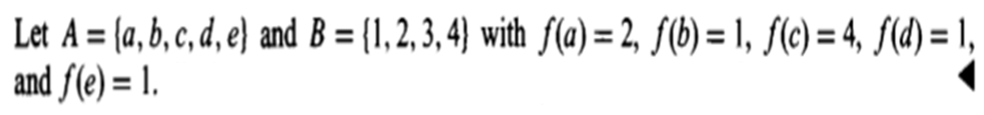
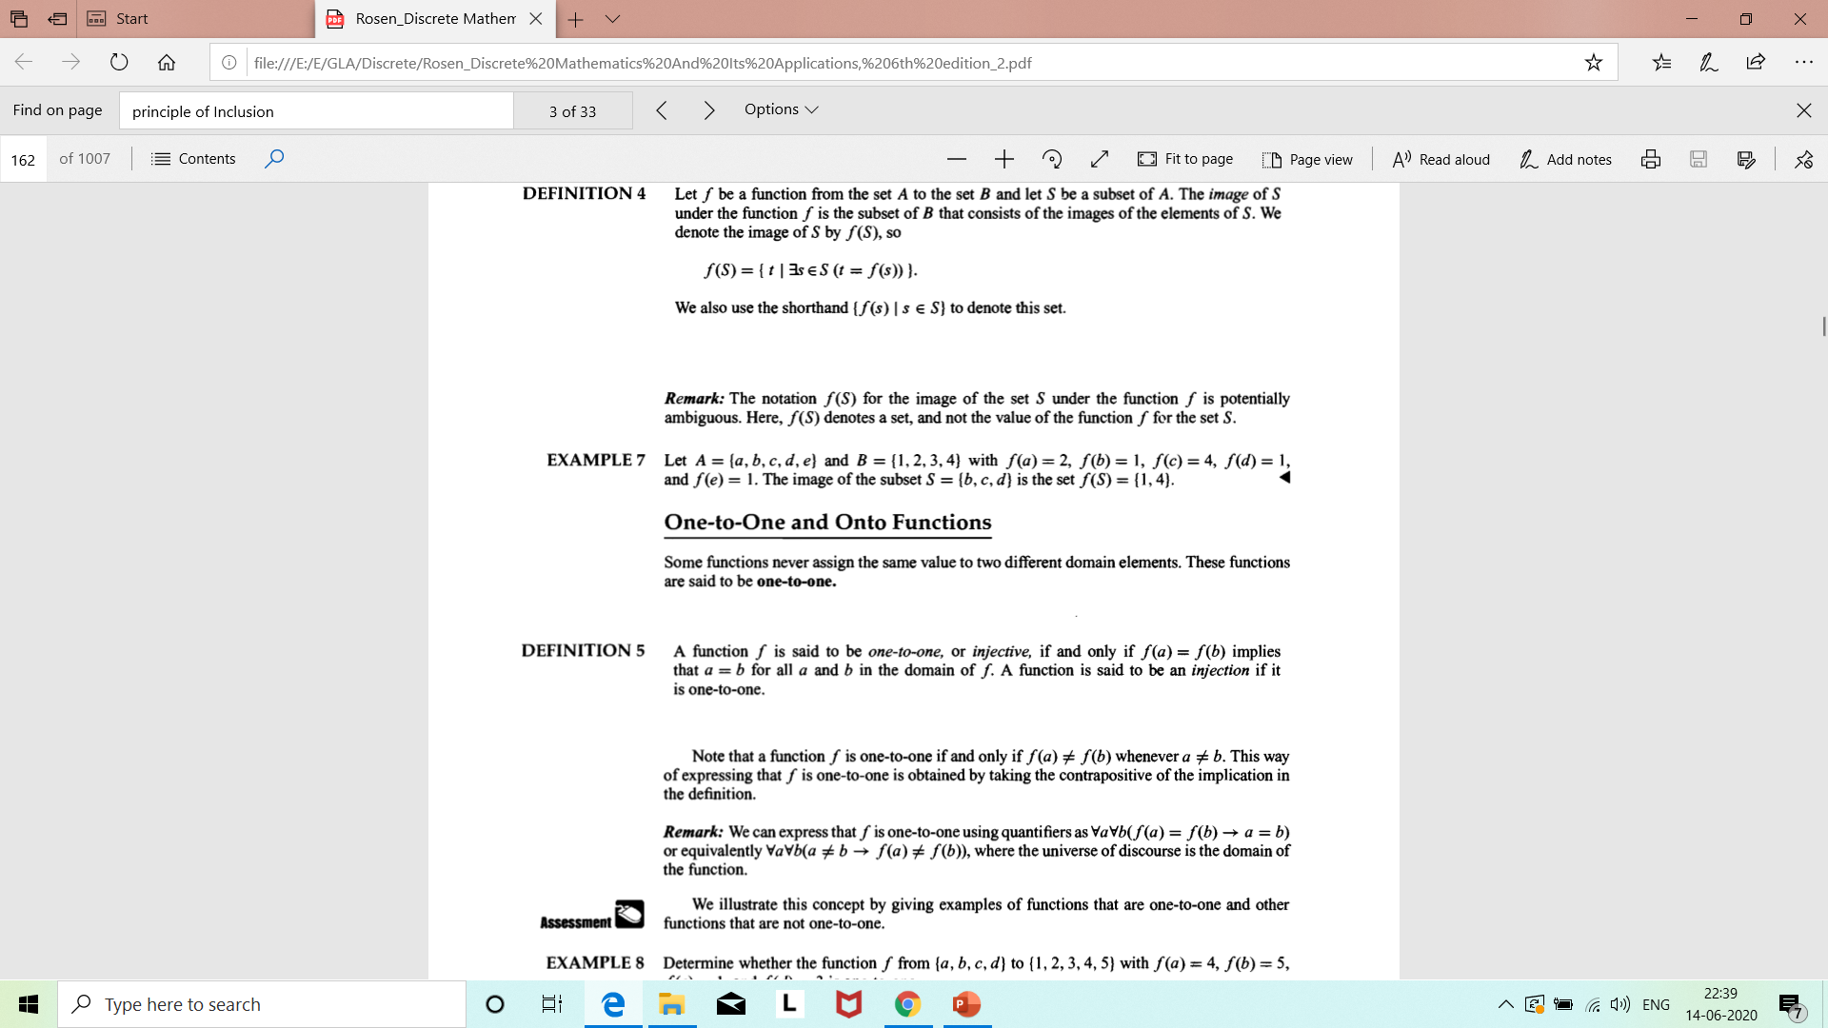
Example

Slide 14
Types of Function
One-to-One Function (Injective)
Onto Function (Surjective)
One-to-one correspondence (bijective)

Slide 15
One-to-One Function
Some functions never assign the same value to two different domain elements. These functions are said to be one-to-one.
A function f is said to be one-to-one, or injective, if and only if f(a) = f(b) implies that a = b for all a and b in the domain of f.
∀a∀b(f(a) = f(b) ⇒ a = b) or
∀a∀b(a ≠ b ⇒ f(a) ≠ f(b))

Slide 16
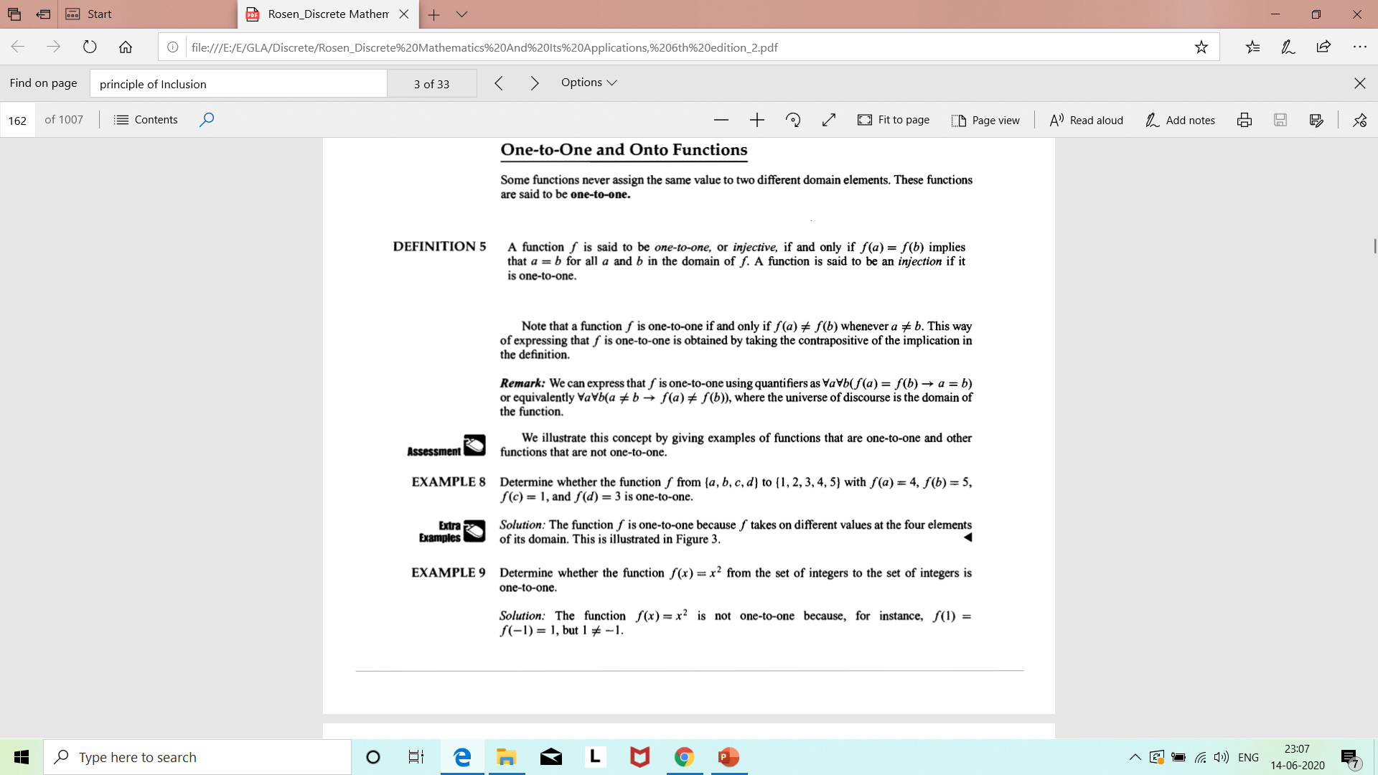
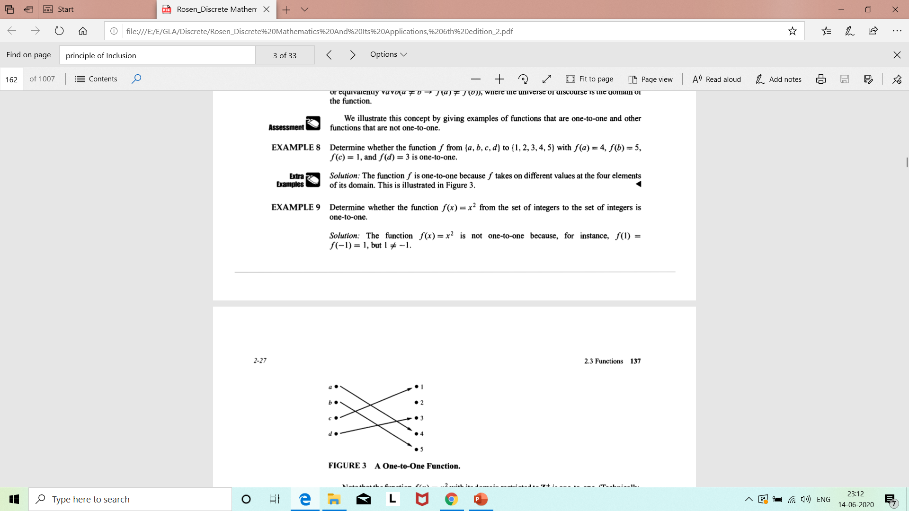
Example

Slide 17
Example

Slide 18
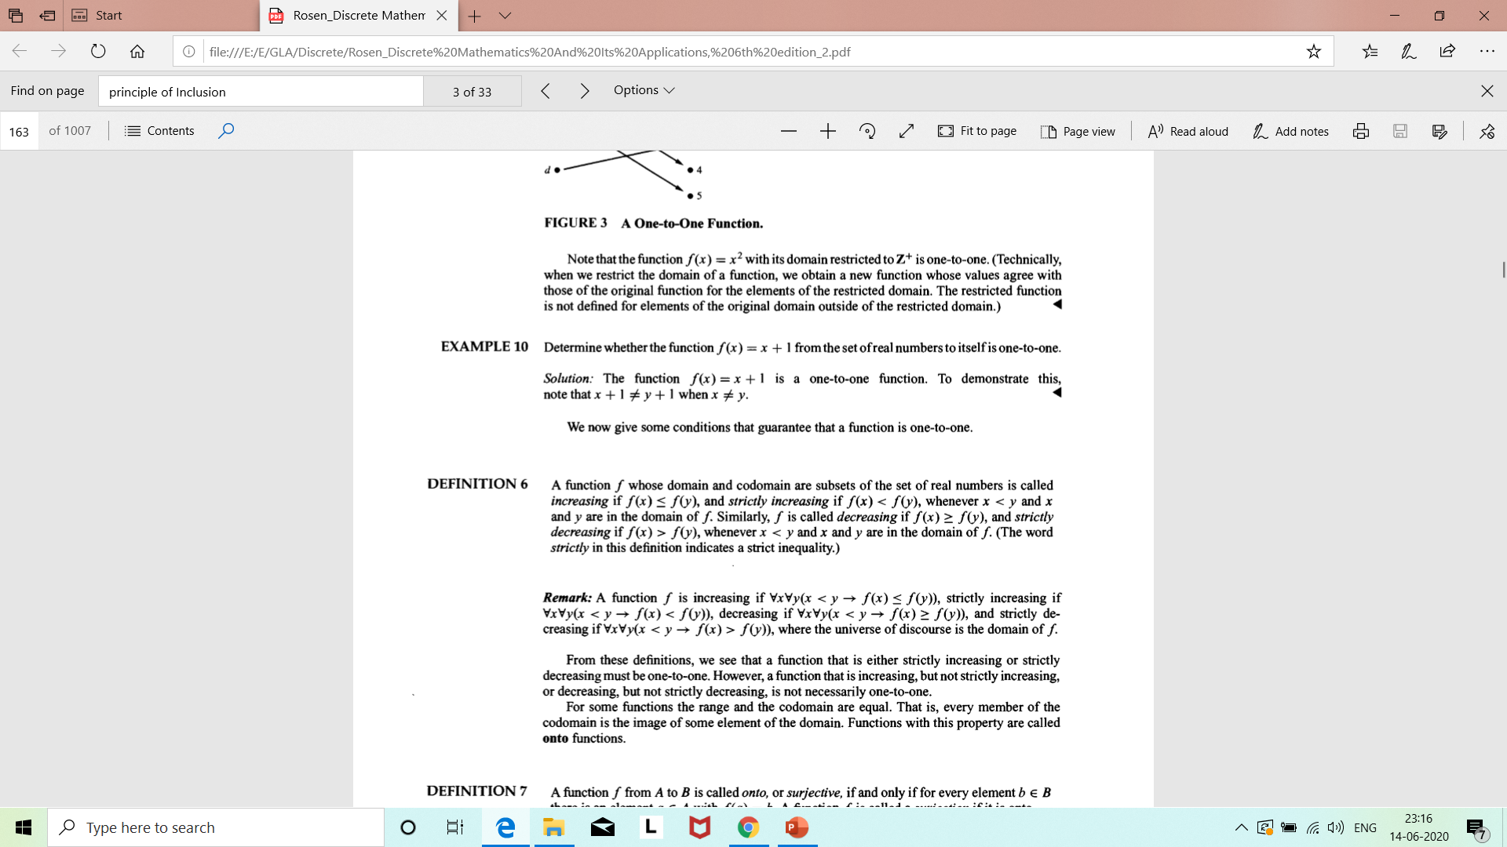
Example

Slide 19
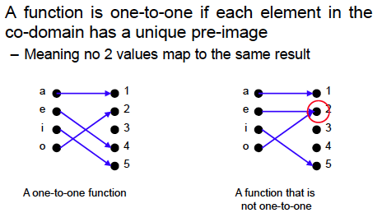
One-to-one functions
The term injective is synonymous with one-to-one

Slide 20
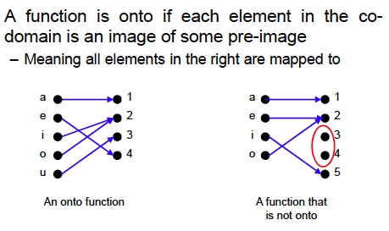
Onto Functions
The term surjective is synonymous with onto.

Slide 21
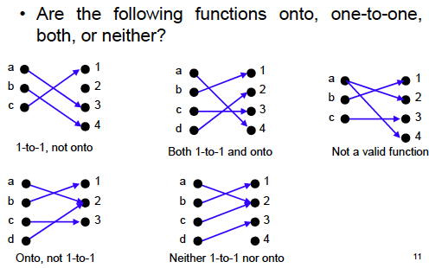
Exercise
1-to-1 and onto function are called bijective.

