Slide 1
Natural Language Processing
Dr. Gourav Bathla

Slide 2
Corpus
Corpus is collections of Natural Language text which is machine-readable and authentic.
The application of linguistic corpus is collection, structure and rules of grammar

Slide 3
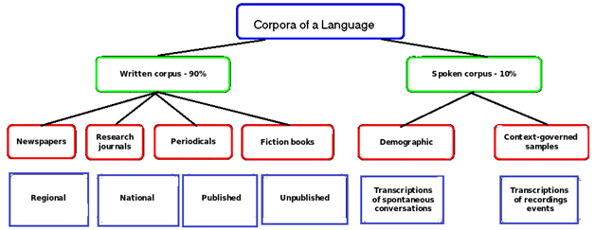

Slide 4
Example
Brown Corpus (1 million words)
Bank of English Corpus(524 million)
BNC Corpus (British National Corpus- 100 million words)
Google N-gram

Slide 5
Corpus v/s Archive
The main difference between corpus and archive is in representation. Corpus have specific representation for specific use.

Slide 6
Source
www.english-corpora.org

Slide 7
Corpus characteristics
Representative
Large-size
Authentic

Slide 8
Corpus types
Plain Text v/s Annotated Text
General v/s Specialized
Single v/s parallel

Slide 9
Use
Word Frequency Information
Collocation
Set Phrase

Slide 10
Good Text Corpus
Depth
Recent
Clean

Slide 11
Annotations
Annotations are used to represent document in better way.
Inline
Single line
Multi-line

Slide 12
Treebank
Treebank is annotated tree using dependency and constituent parse tree.

Slide 13
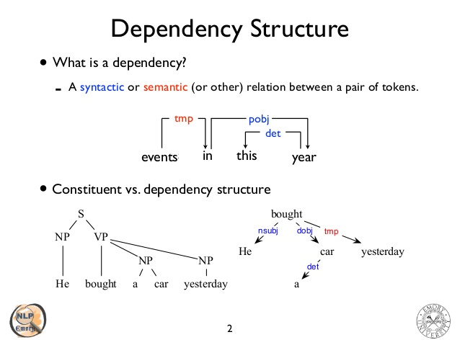
Source : https://www.slideshare.net/jchoi7s/cs571-dependency-parsing

Slide 14
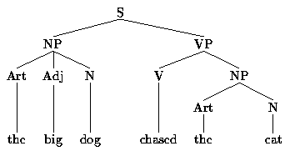

Slide 15
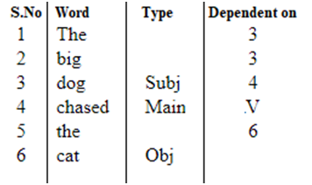

Slide 16
Examples
Penn treebank
OntoNotes

Slide 17
Penn Treebank
It was designed at University of Pennsylvania in 1990s by (Marcus,Santroni and Marcinkiewicz).
It contains 40000 training sentences and 2400 sentences

