Slide 1
WORD SENSE DISAMBIGUATION
By
Mitesh M. Khapra
Under the guidance of
Prof. Pushpak Bhattacharyya

Slide 2
MOTIVATION
One of the central challenges in NLP.
Ubiquitous across all languages.
Needed in:
  Machine Translation: For correct lexical choice.
  Information Retrieval: Resolving ambiguity in queries.
  Information Extraction: For accurate analysis of text.
Computationally determining which sense of a word is activated by its use in a particular context.
      E.g. I am going to withdraw money from the bank.
A classification problem:
      Senses → Classes
      Context → Evidence
CFILT - IITB

Slide 3
ROADMAP
Knowledge Based Approaches
  WSD using Selectional Preferences (or restrictions)
  Overlap Based Approaches
Machine Learning Based Approaches
  Supervised Approaches
  Semi-supervised Algorithms
  Unsupervised Algorithms
Hybrid Approaches
Reducing Knowledge Acquisition Bottleneck
WSD and MT
Summary
Future Work
CFILT - IITB

Slide 4
KNOWLEDEGE BASED v/s MACHINE LEARNING BASED v/s HYBRID APPROACHES
Knowledge Based Approaches
  Rely on knowledge resources like WordNet, Thesaurus etc.
  May use grammar rules for disambiguation.
  May use hand coded rules for disambiguation.
Machine Learning Based Approaches
  Rely on corpus evidence.
  Train a model using tagged or untagged corpus.
  Probabilistic/Statistical models.
Hybrid Approaches
    Use corpus evidence as well as semantic relations form WordNet.

Slide 5
ROADMAP
Knowledge Based Approaches
  WSD using Selectional Preferences (or restrictions)
  Overlap Based Approaches
Machine Learning Based Approaches
  Supervised Approaches
  Semi-supervised Algorithms
  Unsupervised Algorithms
Hybrid Approaches
Reducing Knowledge Acquisition Bottleneck
WSD and MT
Summary
Future Work
CFILT - IITB

Slide 6
WSD USING SELECTIONAL PREFERENCES AND ARGUMENTS
Sense 1
Sense 2
This airlines serves dinner in the evening flight.
serve (Verb)
  agent
  object – edible
This airlines serves the sector between Agra & Delhi.
serve (Verb)
  agent
  object – sector
Requires exhaustive enumeration of:
  Argument-structure of verbs.
  Selectional preferences of arguments.
  Description of properties of words such that meeting the selectional preference criteria can be decided.
    E.g. This flight serves the “region” between Mumbai and Delhi
    How do you decide if “region” is compatible with “sector”
CFILT - IITB

Slide 7
ROADMAP
Knowledge Based Approaches
  WSD using Selectional Preferences (or restrictions)
  Overlap Based Approaches
Machine Learning Based Approaches
  Supervised Approaches
  Semi-supervised Algorithms
  Unsupervised Algorithms
Hybrid Approaches
Reducing Knowledge Acquisition Bottleneck
WSD and MT
Summary
Future Work
CFILT - IITB

Slide 8
OVERLAP BASED APPROACHES
Require a Machine Readable Dictionary (MRD).
Find the overlap between the features of different senses of an ambiguous word (sense bag) and the features of the words in its context (context bag).
These features could be sense definitions, example sentences, hypernyms etc.
The features could also be given weights.
The sense which has the maximum overlap is selected as the contextually appropriate sense.
CFILT - IITB

Slide 9
LESK’S ALGORITHM
Sense Bag: contains the words in the definition of a candidate sense of the ambiguous word.
Context Bag: contains the words in the definition of each sense of each context word.
E.g. “On burning coal we get ash.”
Ash
Coal
Sense 1
Trees of the olive family with pinnate leaves, thin furrowed bark and gray branches.
Sense 2
The solid residue left when combustible material is thoroughly burned or oxidized.
Sense 3
To convert into ash
Sense 1
A piece of glowing carbon or burnt wood.
Sense 2
charcoal.
Sense 3
A black solid combustible substance formed by the partial decomposition of vegetable matter without free access to air and under the influence of moisture and often increased pressure and temperature that is widely used as a fuel for burning
CFILT - IITB
In this case Sense 2 of ash would be the winner sense.

Slide 10
WALKER’S ALGORITHM
A Thesaurus Based approach.
Step 1: For each sense of the target word find the thesaurus category to which that sense belongs.
Step 2: Calculate the score for each sense by using the context words. A context words will add 1 to the score of the sense if the thesaurus category of the word matches that of the sense.
  E.g. The money in this bank fetches an interest of 8% per annum
  Target word: bank
  Clue words from the context: money, interest, annum, fetch
 | Sense1: Finance | Sense2: Location
Money | +1 | 0
Interest | +1 | 0
Fetch | 0 | 0
Annum | +1 | 0
Total | 3 | 0
Context words
add 1 to the
sense when
the topic of the
word matches that
of the sense

Slide 11
WSD USING CONCEPTUAL DENSITY
Select a sense based on the relatedness of that word-sense to the context.
Relatedness is measured in terms of conceptual distance
  (i.e. how close the concept represented by the word and the concept represented by its context words are)
This approach uses a structured hierarchical semantic net (WordNet) for finding the conceptual distance.
Smaller the conceptual distance higher will be the conceptual density.
  (i.e. if all words in the context are strong indicators of a particular concept then that concept will have a higher density.)
CFILT - IITB

Slide 12
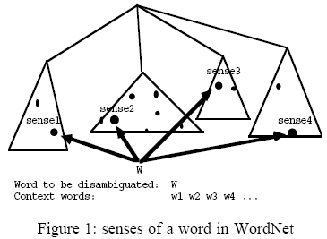
CONCEPTUAL DENSITY (EXAMPLE)
The dots in the figure represent the senses of the word to be disambiguated or the senses of the words in context.
The CD formula will yield highest density for the sub-hierarchy containing more senses.
The sense of W contained in the sub-hierarchy with the highest CD will be chosen.
CFILT - IITB

Slide 13
CONCEPTUAL DENSITY (EXAMPLE)
administrative_unit
body
division
CD = 0.256
CD = 0.062
committee
department
government department
local department
CFILT - IITB
jury
operation
police department
jury
administration
The jury(2) praised the administration(3) and operation (8) of Atlanta Police Department(1)
Step 1: Make a lattice of the nouns in the context, their senses and hypernyms.
Step 2: Compute the conceptual density of resultant concepts (sub-hierarchies).
Step 3: The concept with highest CD is selected.
Step 4: Select the senses below the selected concept as the correct sense for the respective words.

Slide 14
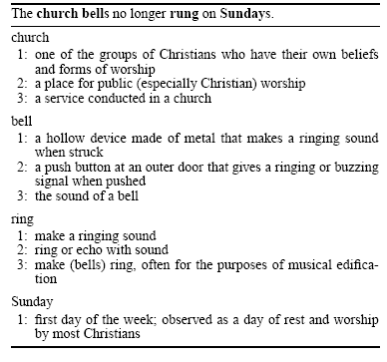
WSD USING RANDOM WALK ALGORITHM
0.46
0.97
0.42
S3
a
S3
S3
b
a
c
0.49
e
S2
S2
0.35
S2
0.63
f
g
k
h
CFILT - IITB
0.92
i
0.56
0.58
l
0.67
S1
j
S1
S1
S1
Bell ring church Sunday
Step 1: Add a vertex for each possible sense of each word in the text.
Step 2: Add weighted edges using definition based semantic similarity (Lesk’s method).
Step 3: Apply graph based ranking algorithm to find score of each vertex (i.e. for each word sense).
Step 4: Select the vertex (sense) which has the highest score.

Slide 15
KB APPROACHES – COMPARISONS
Algorithm | Accuracy
WSD using Selectional Restrictions | 44% on Brown Corpus
Lesk’s algorithm | 50-60% on short samples of “Pride and Prejudice” and some “news stories”.
WSD using conceptual density | 54% on Brown corpus.
WSD using Random Walk Algorithms | 54% accuracy on SEMCOR corpus which has a baseline accuracy of 37%.
Walker’s algorithm | 50% when tested on 10 highly polysemous English words.
CFILT - IITB

Slide 16
KB APPROACHES –CONCLUSIONS
Drawbacks of WSD using Selectional Restrictions
  Needs exhaustive Knowledge Base.
Drawbacks of Overlap based approaches
  Dictionary definitions are generally very small.
  Dictionary entries rarely take into account the distributional constraints of different word senses (e.g. selectional preferences, kinds of prepositions, etc. → cigarette and ash never co-occur in a dictionary).
  Suffer from the problem of sparse match.
  Proper nouns are not present in a MRD. Hence these approaches fail to capture the strong clues provided by proper nouns.
E.g. “Sachin Tendulkar” will be a strong indicator of the category “sports”.
Sachin Tendulkar plays cricket.
CFILT - IITB

Slide 17
ROADMAP
Knowledge Based Approaches
  WSD using Selectional Preferences (or restrictions)
  Overlap Based Approaches
Machine Learning Based Approaches
  Supervised Approaches
  Semi-supervised Algorithms
  Unsupervised Algorithms
Hybrid Approaches
Reducing Knowledge Acquisition Bottleneck
WSD and MT
Summary
Future Work
CFILT - IITB

Slide 18
NAÏVE BAYES
sˆ= argmax _{s ε senses} Pr(s|V_{w})
‘V_{w}’ is a feature vector consisting of:
  POS of w
  Semantic & Syntactic features of w
  Collocation vector (set of words around it) → typically consists of next word(+1), next-to-next word(+2), -2, -1 & their POS's
  Co-occurrence vector (number of times w occurs in bag of words around it)
Applying Bayes rule and naive independence assumption
sˆ= argmax _{s ε senses} Pr(s).Π_{i=1}^{n}Pr(V_{w}^{i}|s)
CFILT - IITB

Slide 19
DECISION LIST ALGORITHM
Based on ‘One sense per collocation’ property.
  Nearby words provide strong and consistent clues as to the sense of a target word.
Collect a large set of collocations for the ambiguous word.
Calculate word-sense probability distributions for all such collocations.
Calculate the log-likelihood ratio
Higher log-likelihood = more predictive evidence
Collocations are ordered in a decision list, with most predictive collocations ranked highest.
Assuming there are only
two senses for the word.
Of course, this can easily
be extended to ‘k’ senses.
CFILT - IITB
CFILT - IITB
Pr(Sense-A| Collocation_{i})
Pr(Sense-B| Collocation_{i})
Log( )

Slide 20
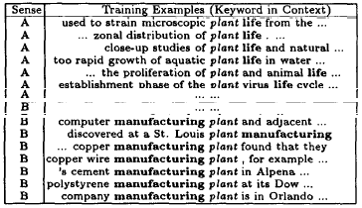
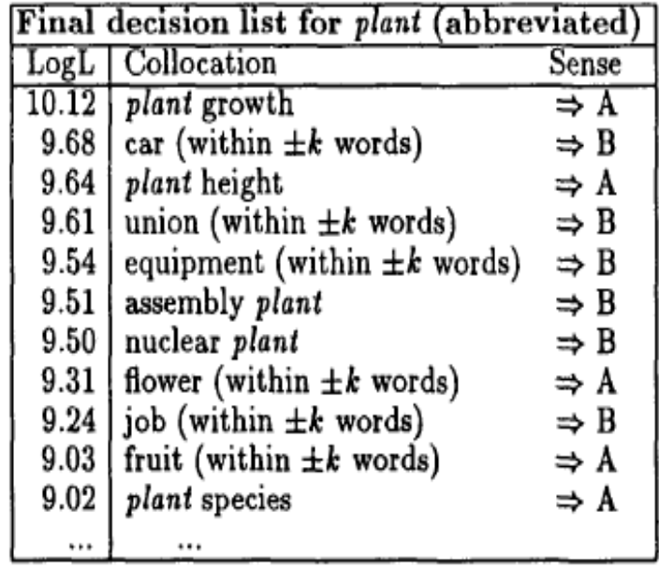
DECISION LIST ALGORITHM (CONTD.)
Training Data | Resultant Decision List
CFILT - IITB
Classification of a test sentence is based on the highest ranking collocation found in the test sentence.
E.g.
…plucking flowers affects plant growth…

Slide 21
EXEMPLAR BASED WSD (K-NN)
An exemplar based classifier is constructed for each word to be disambiguated.
Step1: From each sense marked sentence containing the ambiguous word , a training example is constructed using:
  POS of w as well as POS of neighboring words.
  Local collocations
  Co-occurrence vector
  Morphological features
  Subject-verb syntactic dependencies
Step2: Given a test sentence containing the ambiguous word, a test example is similarly constructed.
Step3: The test example is then compared to all training examples and the k-closest training examples are selected.
Step4: The sense which is most prevalent amongst these “k” examples is then selected as the correct sense.
CFILT - IITB

Slide 22
WSD USING SVMS
SVM is a binary classifier which finds a hyperplane with the largest margin that separates training examples into 2 classes.
As SVMs are binary classifiers, a separate classifier is built for each sense of the word
Training Phase: Using a tagged corpus, f or every sense of the word a SVM is trained using the following features:
  POS of w as well as POS of neighboring words.
  Local collocations
  Co-occurrence vector
  Features based on syntactic relations (e.g. headword, POS of headword, voice of head word etc.)
Testing Phase: Given a test sentence, a test example is constructed using the above features and fed as input to each binary classifier.
The correct sense is selected based on the label returned by each classifier.
CFILT - IITB

Slide 23
WSD USING PERCEPTRON TRAINED HMM
WSD is treated as a sequence labeling task.
The class space is reduced by using WordNet’s super senses instead of actual senses.
A discriminative HMM is trained using the following features:
  POS of w as well as POS of neighboring words.
  Local collocations
  Shape of the word and neighboring words
    E.g. for s = “Merrill Lynch & Co shape(s) =Xx*Xx*&Xx
Lends itself well to NER as labels like “person”, location”, "time” etc are included in the super sense tag set.
CFILT - IITB

Slide 24
SUPERVISED APPROACHES – COMPARISONS
Approach | Average Precision | Average Recall | Corpus | Average Baseline Accuracy
Naïve Bayes | 64.13% | Not reported | Senseval3 – All Words Task | 60.90%
Decision Lists | 96% | Not applicable | Tested on a set of 12 highly polysemous English words | 63.9%
Exemplar Based disambiguation (k-NN) | 68.6% | Not reported | WSJ6 containing 191 content words | 63.7%
SVM | 72.4% | 72.4% | Senseval 3 – Lexical sample task (Used for disambiguation of 57 words) | 55.2%
Perceptron trained HMM | 67.60 | 73.74% | Senseval3 – All Words Task | 60.90%
CFILT - IITB

Slide 25
SUPERVISED APPROACHES –CONCLUSIONS
General Comments
    Use corpus evidence instead of relying of dictionary defined senses.
    Can capture important clues provided by proper nouns because proper nouns do appear in a corpus.
Naïve Bayes
  Suffers from data sparseness.
  Since the scores are a product of probabilities, some weak features might pull down the overall score for a sense.
  A large number of parameters need to be trained.
Decision Lists
  A word-specific classifier. A separate classifier needs to be trained for each word.
  Uses the single most predictive feature which eliminates the drawback of Naïve Bayes.
CFILT - IITB

Slide 26
SUPERVISED APPROACHES –CONCLUSIONS
Exemplar Based K-NN
  A word-specific classifier.
  Will not work for unknown words which do not appear in the corpus.
  Uses a diverse set of features (including morphological and noun-subject-verb pairs)
SVM
  A word-sense specific classifier.
  Gives the highest improvement over the baseline accuracy.
  Uses a diverse set of features.
HMM
  Significant in lieu of the fact that a fine distinction between the various senses of a word is not needed in tasks like MT.
  A broad coverage classifier as the same knowledge sources can be used for all words belonging to super sense.
  Even though the polysemy was reduced significantly there was not a comparable significant improvement in the performance.
CFILT - IITB

Slide 27
ROADMAP
Knowledge Based Approaches
  WSD using Selectional Preferences (or restrictions)
  Overlap Based Approaches
Machine Learning Based Approaches
  Supervised Approaches
  Semi-supervised Algorithms
  Unsupervised Algorithms
Hybrid Approaches
Reducing Knowledge Acquisition Bottleneck
WSD and MT
Summary
Future Work
CFILT - IITB

Slide 28
SEMI-SUPERVISED DECISION LIST ALGORITHM
Based on Yarowsky’s supervised algorithm that uses Decision Lists.
Step1: Train the Decision List algorithm using a small amount of seed data.
Step2: Classify the entire sample set using the trained classifier.
Step3: Create new seed data by adding those members which are tagged as Sense-A or Sense-B with high probability.
Step4: Retrain the classifier using the increased seed data.
Exploits “One sense per discourse” property
  Identify words that are tagged with low confidence and label them with the sense which is dominant for that document
CFILT - IITB

Slide 29
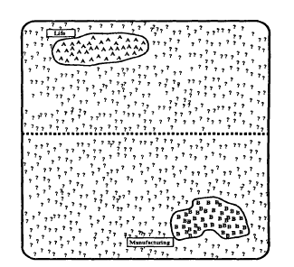
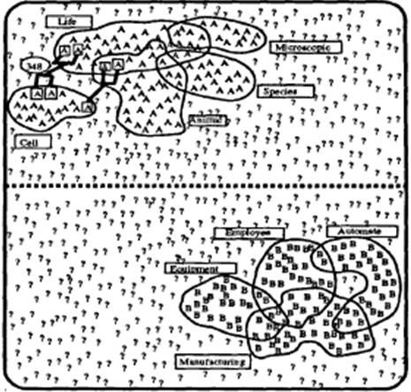
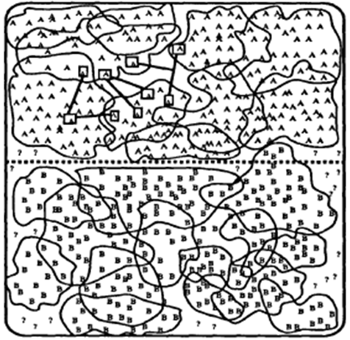
INITIALIZATION, PROGRESS AND CONVERGENCE
Residual data
Life
Manufacturing
Seed set grows | Stop when residual set stabilizes
CFILT - IITB

Slide 30
SEMI-SUPERVISED APPROACHES – COMPARISONS & CONCLUSIONS
Approach | Average Precision | Corpus | Average Baseline Accuracy
Supervised Decision Lists | 96.1% | Tested on a set of 12 highly polysemous English words | 63.9%
Semi-Supervised Decision Lists | 96.1% | Tested on a set of 12 highly polysemous English words | 63.9%
CFILT - IITB
Works at par with its supervised version even though it needs significantly less amount of tagged data.
Has all the advantages and disadvantaged of its supervised version.

Slide 31
ROADMAP
Knowledge Based Approaches
  WSD using Selectional Preferences (or restrictions)
  Overlap Based Approaches
Machine Learning Based Approaches
  Supervised Approaches
  Semi-supervised Algorithms
  Unsupervised Algorithms
Hybrid Approaches
Reducing Knowledge Acquisition Bottleneck
WSD and MT
Summary
Future Work
CFILT - IITB

Slide 32
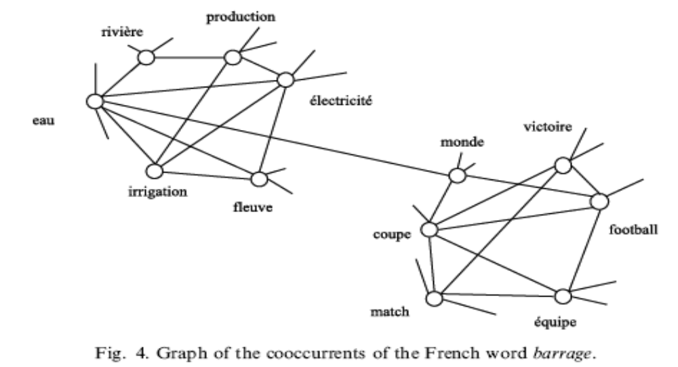
HYPERLEX
KEY IDEA
  Instead of using “dictionary defined senses” extract the “senses from the corpus” itself
  These “corpus senses” or “uses” correspond to clusters of similar contexts for a word.
(river)
(victory)
CFILT - IITB
(electricity)
(world)
(water)
(flow)
(cup)
(team)

Slide 33
DETECTING ROOT HUBS
Different uses of a target word form highly interconnected bundles (or high density components)
In each high density component one of the nodes (hub) has a higher degree than the others.
Step 1:
    Construct co-occurrence graph, G.
Step 2:
    Arrange nodes in G in decreasing order of in-degree.
Step 3:
    Select the node from G which has the highest frequency. This node will be the hub of the first high density component.
Step 4:
    Delete this hub and all its neighbors from G.
Step 5:
    Repeat Step 3 and 4 to detect the hubs of other high density components
CFILT - IITB

Slide 34
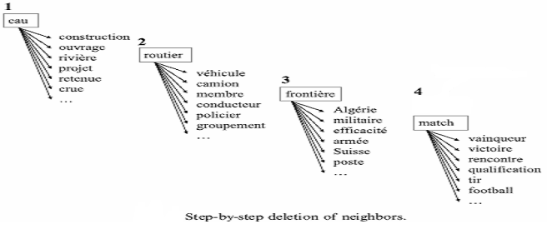
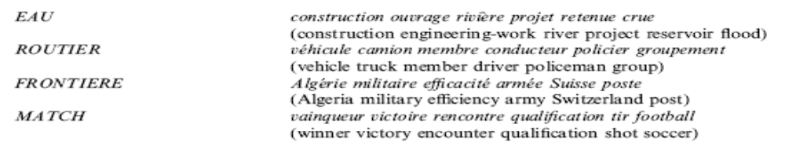
DETECTING ROOT HUBS (CONTD.)
CFILT - IITB
The four components for “barrage” can be characterized as:

Slide 35
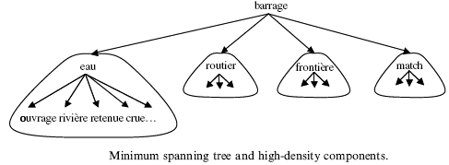
DELINEATING COMPONENTS
Attach each node to the root hub closest to it.
The distance between two nodes is measured as the smallest sum of the weights of the edges on the paths linking them.
Step 1:
    Add the target word to the graph G.
Step 2:
    Compute a Minimum Spanning Tree (MST) over G taking the target word as the root.
CFILT - IITB

Slide 36

DISAMBIGUATION
Each node in the MST is assigned a score vector with as many dimensions as there are components.
E.g. pluei(rain) belongs to the component EAU(water) and d(eau, pluie) = 0.82, s_{pluei} = (0.55, 0, 0, 0)
Step 1:
    For a given context, add the score vectors of all words in that context.
Step 2:
    Select the component that receives the highest weight.
CFILT - IITB

Slide 37
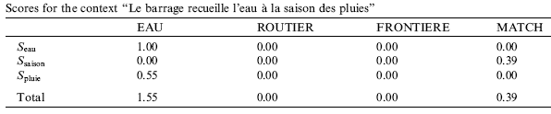
DISAMBIGUATION (EXAMPLE)
Le barrage recueille l’eau a la saison des plueis.
The dam collects water during the rainy season.
EAU is the winner in this case.
A reliability coefficient (ρ) can be calculated as the difference (δ) between the best score and the second best score.
ρ = 1 – (1/(1+ δ))
CFILT - IITB

Slide 38

YAROWSKY’S ALGORITHM
(WSD USING ROGET’S THESAURUS CATEGORIES)
Based on the following 3 observations:
  Different conceptual classes of words (say ANIMALS and MACHINES) tend to appear in recognizably different contexts.
  Different word senses belong to different conceptual classes (E.g. crane).
  A context based discriminator for the conceptual classes can serve as a context based discriminator for the members of those classes.
Identify salient words in the collective context of the thesaurus category and weigh appropriately.
        Weight(word) = Salience(Word) =
CFILT - IITB
ANIMAL/INSECT
species (2.3), family(1.7), bird(2.6), fish(2.4), egg(2.2), coat(2.5), female(2.0), eat (2.2), nest(2.5), wild
TOOLS/MACHINERY
tool (3.1), machine(2.7), engine(2.6), blade(3.8), cut(2.2), saw(2.5), lever(2.0), wheel (2.2), piston(2.5)

Slide 39

DISAMBIGUATION
Predict the appropriate category for an ambiguous word using the weights of words in its context.
ARGMAX
RCat
…lift water and to grind grain. Treadmills attached to cranes were used to lift heavy objects from Roman times, ….
TOOLS/MACHINE | Weight | ANIMAL/INSECT | Weight
lift | 2.44 | Water | 0.76
grain | 1.68
used | 1.32
heavy | 1.28
Treadmills | 1.16
attached | 0.58
grind | 0.29
Water | 0.11
TOTAL | 11.30 | TOTAL | 0.76
CFILT - IITB

Slide 40
LIN’S APPROACH
Two different words are likely to have similar meanings if they occur in identical local contexts.
E.g. The facility will employ 500 new employees.
Senses of facility
Subjects of “employ”
installation
proficiency
adeptness
readiness
toilet/bathroom
Word | Freq | Log Likelihood
ORG | 64 | 50.4
Plant | 14 | 31.0
Company | 27 | 28.6
Industry | 9 | 14.6
Unit | 9 | 9.32
Aerospace | 2 | 5.81
Memory device | 1 | 5.79
Pilot | 2 | 5.37
CFILT - IITB
In this case Sense 1 of installation would be the winner sense.

Slide 41

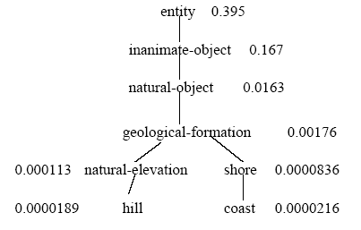

SIMILARITY AND HYPERNYMY
sim(A,B) =
If A is a “Hill” and B is a “Coast” then the commonality between A and B is that “A is a GeoForm and B is a GeoForm”.
sim(Hill, Coast) =
In general, similarity is directly proportional to the probability that the two words have the same super class (Hypernym)
CFILT - IITB
To maximize similarity select that sense which has the same hypernym as most of the Selector words.

Slide 42
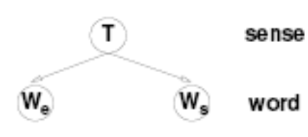

WSD USING PARALLEL CORPORA
A word having multiple senses in one language will have distinct translations in another language, based on the context in which it is used.
The translations can thus be considered as contextual indicators of the sense of the word.
Sense Model
Concept Model
CFILT - IITB

Slide 43
UNSUPERVISED APPROACHES – COMPARISONS
Approach | Precision | Average Recall | Corpus | Baseline
Lin’s Algorithm | 68.5%. The result was considered to be correct if the similarity between the predicted sense and actual sense was greater than 0.27 | Not reported | Trained using WSJ corpus containing 25 million words. Tested on 7 SemCor files containing 2832 polysemous nouns. | 64.2%
Hyperlex | 97% | 82% (words which were not tagged with confidence>threshold were left untagged) | Tested on a set of 10 highly polysemous French words | 73%
WSD using Roget’s Thesaurus categories | 92% (average degree of polysemy was 3) | Not reported | Tested on a set of 12 highly polysemous English words | Not reported
WSD using parallel corpora | SM: 62.4% CM: 67.2% | SM: 61.6% CM: 65.1% | Trained using a English Spanish parallel corpus Tested using Senseval 2 – All Words task (only nouns were considered) | Not reported
CFILT - IITB

Slide 44
UNSUPERVISED APPROACHES –CONCLUSIONS
General Comments
    Combine the advantages of supervised and knowledge based approaches.
    Just as supervised approaches they extract evidence from corpus.
    Just as knowledge based approaches they do not need tagged corpus.
Lin’s Algorithm
  A general purpose broad coverage approach.
  Can even work for words which do not appear in the corpus.
Hyperlex
  Use of small world properties was a first of its kind approach for automatically extracting corpus evidence.
  A word-specific classifier.
  The algorithm would fail to distinguish between finer senses of a word (e.g. the medicinal and narcotic senses of “drug”)
CFILT - IITB

Slide 45
UNSUPERVISED APPROACHES –CONCLUSIONS
Yarowsky’s Algorithm
  A broad coverage classifier.
  Can be used for words which do not appear in the corpus. But it was not tested on an “all word corpus”.
WSD using Parallel Corpora
  Can distinguish even between finer senses of a word because even finer senses of a word get translated as distinct words.
  Needs a word aligned parallel corpora which is difficult to get.
  An exceptionally large number of parameters need to be trained.
CFILT - IITB

Slide 46
ROADMAP
Knowledge Based Approaches
  WSD using Selectional Preferences (or restrictions)
  Overlap Based Approaches
Machine Learning Based Approaches
  Supervised Approaches
  Semi-supervised Algorithms
  Unsupervised Algorithms
Hybrid Approaches
Reducing Knowledge Acquisition Bottleneck
WSD and MT
Summary
Future Work
CFILT - IITB

Slide 47
AN ITERATIVE APPROACH TO WSD
Uses semantic relations (synonymy and hypernymy) form WordNet.
Extracts collocational and contextual information form WordNet (gloss) and a small amount of tagged data.
Monosemic words in the context serve as a seed set of disambiguated words.
In each iteration new words are disambiguated based on their semantic distance from already disambiguated words.
It would be interesting to exploit other semantic relations available in WordNet.
CFILT - IITB

Slide 48
SENSELEARNER
Uses some tagged data to build a semantic language model for words seen in the training corpus.
Uses WordNet to derive semantic generalizations for words which are not observed in the corpus.
Semantic Language Model
For each POS tag, using the corpus, a training set is constructed.
Each training example is represented as a feature vector and a class label which is word#sense
In the testing phase, for each test sentence, a similar feature vector is constructed.
The trained classifier is used to predict the word and the sense.
If the predicted word is same as the observed word then the predicted sense is selected as the correct sense.
CFILT - IITB

Slide 49
SENSELEARNER (CONTD.)
Semantic Generalizations
Improvises Lin’s algorithm by using semantic dependencies form the WordNet.
E.g.
if “drink water” is observed in the corpus then using the hypernymy tree we can derive the syntactic dependency “take-in liquid”
“take-in liquid” can then be used to disambiguate an instance of the word tea as in “take tea”, by using the hypernymy-hyponymy relations.
CFILT - IITB

Slide 50
STRUCTURAL SEMANTIC INTERCONNECTIONS (SSI)
An iterative approach.
Uses the following relations
  hypernymy (car#1 is a kind of vehicle#1) denoted by (kind-of )
  hyponymy (the inverse of hypernymy) denoted by (has-kind)
  meronymy (room#1 has-part wall#1) denoted by (has-part )
  holonymy (the inverse of meronymy) denoted by (part-of )
  pertainymy (dental#1 pertains-to tooth#1) denoted by (pert)
  attribute (dry#1 value-of wetness#1) denoted by (attr)
  similarity (beautiful#1 similar-to pretty#1) denoted by (sim)
  gloss denoted by (gloss)
  context denoted by (context)
  domain denoted by (dl)
Monosemic words serve as the seed set for disambiguation.
CFILT - IITB

Slide 51
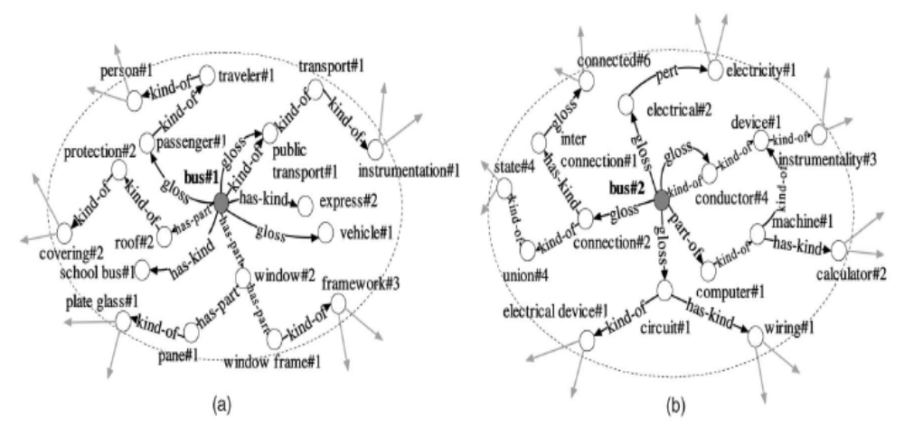
STRUCTURAL SEMANTIC INTERCONNECTIONS (SSI) CONTD.
A semantic relations graph for the two senses of the word bus (i.e. vehicle and connector)
CFILT - IITB

Slide 52
HYBRID APPROACHES – COMPARISONS & CONCLUSIONS
Approach | Precision | Average Recall | Corpus | Baseline
An Iterative Approach to WSD | 92.2% | 55% | Trained using 179 texts from SemCor. Tested using 52 texts created from 6 SemCor files | Not reported
SenseLearner | 64.6% | 64.6% | SenseEval-3 All Words Task | 60.9%
SSI | 68.5% | 68.4% | SenseEval-3 Gloss Disambiguation Task | Not reported
CFILT - IITB
General Comments
Combine information obtained from multiple knowledge sources
Use a very small amount of tagged data.

Slide 53
ROADMAP
Knowledge Based Approaches
  WSD using Selectional Preferences (or restrictions)
  Overlap Based Approaches
Machine Learning Based Approaches
  Supervised Approaches
  Semi-supervised Algorithms
  Unsupervised Algorithms
Hybrid Approaches
Reducing Knowledge Acquisition Bottleneck
WSD and MT
Summary
Future Work
CFILT - IITB

Slide 54
OVERCOMING KNOWLEDGE BOTTLE-NECK
Using Search Engines
Construct search queries using monosemic words and phrases form the gloss of a synset.
Feed these queries to a search engine.
From the retrieved documents extract the sentences which contain the search queries.
Using Equivalent Pseudo Words
Use monosemic words belonging to each sense of an ambiguous word.
Use the occurrences of these words in the corpus as training examples for the ambiguous word.
CFILT - IITB

Slide 55
ROADMAP
Knowledge Based Approaches
  WSD using Selectional Preferences (or restrictions)
  Overlap Based Approaches
Machine Learning Based Approaches
  Supervised Approaches
  Semi-supervised Algorithms
  Unsupervised Algorithms
Hybrid Approaches
Reducing Knowledge Acquisition Bottleneck
WSD and MT
Summary
Future Work
CFILT - IITB

Slide 56
DOES WSD HELP MT??
Contradictory results have been published. Hence difficult to conclusively decide.
Depends on the quality of the underlying MT model.
The bias of BLEU score towards phrasal coherency often gives misleading results.
E.g. (Chinese to English translation)
Hiero (SMT model): Australian minister said that North Korea bad behavior will be more aid.
Hiero (SMT model) + WSD : Australian minister said that North Korea bad behavior will be unable to obtain more aid.
Here the second sentence is more appropriate. But since the phrase “unable to obtain” was not observed in the language model the second sentence gets a lower BLEU score
CFILT - IITB

Slide 57
ROADMAP
Knowledge Based Approaches
  WSD using Selectional Preferences (or restrictions)
  Overlap Based Approaches
Machine Learning Based Approaches
  Supervised Approaches
  Semi-supervised Algorithms
  Unsupervised Algorithms
Hybrid Approaches
Reducing Knowledge Acquisition Bottleneck
WSD and MT
Summary
Future Work
CFILT - IITB

Slide 58
SUMMARY
Dictionary defined senses do not provide enough surface cues.
Complete dependence on dictionary defined senses is the primary reason for low accuracies in Knowledge Based approaches.
Extracting “sense definitions” or “usage patterns” from the corpus greatly improves the accuracy.
Word-specific classifiers are able to attain extremely good accuracies but suffer from the problem of non-reusability.
Unsupervised algorithms are capable of performing at par with supervised algorithms.
Relying on single most predictive evidence increases the accuracy.
CFILT - IITB

Slide 59
SUMMARY (CONTD.)
Classifiers that exploit syntactic dependencies between words are able to perform large scale disambiguation (generic classifiers) and at the same time give reasonably good accuracies.
Using a diverse set of features improves WSD accuracy.
WSD results are better when the degree of polysemy is reduced.
Hyperlex (unsupervised corpus based), Lin’s algorithm (unsupervised corpus based) and SSI (hybrid) look promising for resource-poor Indian languages.
CFILT - IITB

Slide 60
ROADMAP
Knowledge Based Approaches
  WSD using Selectional Preferences (or restrictions)
  Overlap Based Approaches
Machine Learning Based Approaches
  Supervised Approaches
  Semi-supervised Algorithms
  Unsupervised Algorithms
Hybrid Approaches
Reducing Knowledge Acquisition Bottleneck
WSD and MT
Summary
Future Work
CFILT - IITB

Slide 61
FUTURE WORK
Use unsupervised or hybrid approaches to develop a multilingual WSD engine. (focusing on MT)
Automatically generate sense tagged data.
Explore the possibility of using an ensemble of WSD algorithms.
Explore whether it possible to evaluate the role of WSD in MT (the evaluation should be independent of the MT model being used)
CFILT - IITB

Slide 62
REFERENCES
Michael Lesk. 1986. “Automatic sense disambiguation using machine readable dictionaries: how to tell a pine cone from an ice cream cone”, in Proceedings of the 5th annual international conference on Systems documentation, Toronto, Ontario, Canada, 1986.
Walker D. and Amsler R. 1986. "The Use of Machine Readable Dictionaries in Sublanguage Analysis", in Analyzing Language in Restricted Domains, Grishman and Kittredge (eds), LEA Press, pp. 69-83, 1986.
Yarowsky, David. 1992. "Word sense disambiguation using statistical models of Roget's categories trained on large corpora", in Proceedings of the 14th International Conference on Computational Linguistics (COLING), Nantes, France, 454-460, 1992.
Yarowsky, David. 1994. "Decision lists for lexical ambiguity resolution: Application to accent restoration in Spanish and French", in Proceedings of the 32nd Annual Meeting of the Association for Computational Linguistics (ACL), Las Cruces, U.S.A., 88-95, 1994.
Yarowsky, David. 1995. "Unsupervised word sense disambiguation rivaling supervised methods", in Proceedings of the 33rd Annual Meeting of the Association for Computational Linguistics (ACL), Cambridge, MA, 189-196, 1995.
Agirre, Eneko & German Rigau. 1996. "Word sense disambiguation using conceptual density", in Proceedings of the 16th International Conference on Computational Linguistics (COLING), Copenhagen, Denmark, 1996
CFILT - IITB

Slide 63
REFERENCES (CONTD.)
Ng, Hwee T. & Hian B. Lee. 1996. "Integrating multiple knowledge sources to disambiguate word senses: An exemplar-based approach", Proceedings of the 34th Annual Meeting of the Association for Computational Linguistics (ACL), Santa Cruz, U.S.A., 40-47.
Ng, Hwee T. 1997. "Exemplar-based word sense disambiguation: Some recent improvements", Proceedings of the 2nd Conference on Empirical Methods in Natural Language Processing (EMNLP), Providence, U.S.A., 208-213.
Lin, Dekang. 1997."Using syntactic dependency as local context to resolve word sense ambiguity", in Proceedings of the 35th Annual Meeting of the Association for Computational Linguistics (ACL), Madrid, 64-71,1997.
Rada Mihalcea, Dan I. Moldovan, 1999. "An automatic method for generating sense tagged corpora", Proceedings of the sixteenth national conference on Artificial intelligence and the eleventh Innovative applications of artificial intelligence conference innovative applications of artificial intelligence.Orlando, Florida, United States, 1999.
Philip Resnik, 1999."Semantic Similarity in a Taxonomy: An Information-Based Measure and its Application to Problems of Ambiguity in Natural Language", Journal of Artificial Intelligence Research, 1999.
CFILT - IITB

Slide 64
REFERENCES (CONTD.)
E. Agirre, J. Atserias, L. Padr, G. Rigau, 2000."Combining Supervised and Unsupervised Lexical Knowledge Methods for Word Sense Disambiguation Computers and the Humanities", Special Double Issue on SensEval. Eds. Martha Palmer and Adam Kilgarriff. 34:1,2, 2000.
Rada Mihalcea and Dan Moldovan, 2000."An Iterative Approach to Word Sense Disambiguation", in Proceedings of Florida Artificial Intelligence Research Society Conference (FLAIRS 2000), [pg.219-223] Orlando, FL, May 2000.
Agirre Eneko, Ansa Olatz, Hovy Eduard, Martinez David, 2001. "Enriching WordNet concepts with topic signatures", Proceedings of the NAACL workshop on WordNet and Other lexical Resources:Applications, Extensions and Customizations. Pittsburg, 2001.
Mona Diab and Philip Resnik, 2002."An Unsupervised Method for Word Sense Tagging Using Parallel Corpora", In Proceedings of the 40th Annual Meeting of the Association for Computational Linguistics, Philadelphia, Pennsylvania, July 2002.
VÃ©ronis, Jean. 2004."HyperLex: Lexical cartography for information retrieval", Computer Speech & Language, 18(3):223-252, 2004.
Rada Mihalcea and Ehsanul Faruque, 2004. "SenseLearner: Minimally Supervised Word Sense Disambiguation for All Words in Open Text", in Proceedings of ACL/SIGLEX Senseval-3, Barcelona, Spain, July 2004.
CFILT - IITB

Slide 65
REFERENCES (CONTD.)
Indrajit Bhattacharya, Lise Getoor, Yoshua Bengio, 2004."Unsupervised sense disambiguation using bilingual probabilistic models", In Proceedings of the 42nd Annual Meeting on Association for Computational Linguistics, Spain, 2004.
Lee, Yoong K., Hwee T. Ng & Tee K. Chia. 2004. "Supervised word sense disambiguation with support vector machines and multiple knowledge sources", Proceedings of Senseval-3: Third International Workshop on the Evaluation of Systems for the Semantic Analysis of Text, Barcelona, Spain, 137-140.
Mihalcea, Rada. 2005."Large vocabulary unsupervised word sense disambiguation with graph-based algorithms for sequence data labeling", in Proceedings of the Joint Human Language Technology and Empirical Methods in Natural Language Processing Conference (HLT/EMNLP), Vancouver, Canada, 411-418, 2005.
Marine Carpuat, Dekai Wu, 2005."Evaluating the Word Sense Disambiguation Performance of Statistical Machine Translation",
Marine Carpuat and Dekai Wu, 2005."Word sense disambiguation vs. statistical machine translation", In Proceedings of the 43rd Annual Meeting of the Association for Computational Linguistics (ACLâ€™05), pages 387-394, Ann Arbor, Michigan, June 2005.
Roberto Navigli, Paolo Velardi, 2005."Structural Semantic Interconnections: A Knowledge-Based Approach to Word Sense Disambiguation", IEEE Transactions On Pattern Analysis and Machine Intelligence, July 2005.
CFILT - IITB

Slide 66
REFERENCES (CONTD.)
M Ciaramita, Y. Altun, 2006."Broad-Coverage Sense Disambiguation and Information Extraction with a Supersense Sequence Tagger", in Proceedings of the Conference on Empirical Methods in Natural Language Processing (EMNLP 2006).
Yee Seng Chan, Hwee Tou Ng, 2006."Estimating class priors in domain adaptation for word sense disambiguation", in Proceedings of the 21st International Conference on Computational Linguistics and the 44th annual meeting of the ACL, Sydney, 2006.
Roberto Navigli, 2006."Meaningful clustering of senses helps boost word sense disambiguation performance", in Proceedings of the 21st International Conference on Computational Linguistics and the 44th annual meeting of the ACL, Sydney, 2006.
Roberto Navigli, 2006."Ensemble methods for unsupervised WSD", in Proceedings of the 21st International Conference on Computational Linguistics and the 44th annual meeting of the ACL, Sydney, 2006.
Zhimao Lu, Haifeng Wang, Jianmin Yao, Ting Liu,Sheng Li, 2006."An equivalent pseudoword solution to Chinese word sense disambiguation", in Proceedings of the 21st International Conference on Computational Linguistics and the 44th annual meeting of the ACL, Sydney, 2006.
CFILT - IITB

Slide 67
REFERENCES (CONTD.)
Yee Seng Chan, Hwee Tou Ng and David Chiang, 2007."Word Sense Disambiguation Improves Statistical Machine Translation", in Proceedings of the 45th Annual Meeting of the Association for Computational Linguistics, Prague, 2007.
CFILT - IITB

Slide 68
??
THANK YOU!
??
CFILT - IITB

Slide 69
EXTRA SLIDES

Slide 70
LESK’S ALGORITHM
Two different words are likely to have similar meanings if they occur in identical local contexts.
E.g. The facility will employ 500 new employees.
Senses of facility
Subjects of “employ”
installation
proficiency
adeptness
readiness
toilet/bathroom
Word | Freq | Log Likelihood
ORG | 64 | 50.4
Plant | 14 | 31.0
Company | 27 | 28.6
Industry | 9 | 14.6
Unit | 9 | 9.32
Aerospace | 2 | 5.81
Memory device | 1 | 5.79
Pilot | 2 | 5.37
CFILT - IITB
To maximize similarity select that sense which has the same hypernym as most of the other words in the context

Slide 71
Life
Manufacturing
All occurrences of the target word are identified
A small training set of seed data is tagged with word sense
Seed collocation should accurately distinguish the senses.
Strategies for selecting seed words:
  Use words from dictionary definitions.
  Use a single defining collocate for each class.
    E.g. “bird” and “machine” for the target “crane”
  Hand-label salient corpus collocates
CFILT - IITB

Slide 72
SELECTIONAL PREFERENCES
(INDIAN TRADITION)
“Desire” of some words in the sentence (“aakaangksha”).
    I saw the boy with long hair.
    The verb “saw” and the noun “boy” desire an object here.
“Appropriateness” of some other words in the sentence to fulfil that desire (“yogyataa”).
    I saw the boy with long hair.
    The PP “with long hair” can be appropriately connected only to “boy” and not “saw”.
In case, the ambiguity is still present, “proximity” (“sannidhi”) can determine the meaning.
    E.g. I saw the boy with a telescope.
    The PP “with a telescope” can be attached to both “boy” and “saw”, so ambiguity still present. It is then attached to “boy” using the proximity check.
CFILT - IITB

Slide 73
SELECTIONAL PREFERENCES
(RECENT LINGUISTIC THEORY)
There are words which demand arguments, like, verbs, prepositions, adjectives and sometimes nouns. These arguments are typically nouns.
Arguments must have the property to fulfil the demand. They must satisfy selectional preferences.
  Example
    Give (verb)
        agent – animate
        obj – direct
        obj – indirect
    I gave him the book
    I gave him the book (yesterday in the school) -> adjunct
How does this help in WSD?
  One type of contextual information is the information about the type of arguments that a word takes.
CFILT - IITB

Slide 74
CRITIQUE
Requires exhaustive enumeration in machine-readable form of:
  Argument-structure of verbs.
  Selectional preferences of arguments.
  Description of properties of words such that meeting the selectional preference criteria can be decided.
    E.g. This flight serves the “region” between Mumbai and Delhi
    How do you decide if “region” is compatible with “sector”
Accuracy
  44% on Brown corpus.
CFILT - IITB

Slide 75
CRITIQUE
Proper nouns in the context of an ambiguous word can act as strong disambiguators.
E.g. “Sachin Tendulkar” will be a strong indicator of the category “sports”.
Sachin Tendulkar plays cricket.
Proper nouns are not present in the thesaurus. Hence this approach fails to capture the strong clues provided by proper nouns.
Accuracy
  50% when tested on 10 highly polysemous English words.

Slide 76
CRITIQUE
Suffers from sparse match: the possibility of word overlap is very less.
Can be misled.
    E.g. As a result of the forest fire all olive trees were reduced to ash.
    Here Sense 1 of ash would be incorrectly chosen as the contextually appropriate sense.
Proper nouns in the context of an ambiguous word can act as strong disambiguators.
E.g. “Sachin Tendulkar” will be a strong indicator of the category “sports”.
Sachin Tendulkar plays cricket.
Proper nouns are not present in the Wordnet. Hence this approach fails to capture the strong clues provided by proper nouns.
Accuracy
  50-60% on short samples of “Pride and Prejudice” and some “news stories”.
CFILT - IITB

Slide 77
CRITIQUE
The Good
  A non-syntactic approach.
  Simple Implementation.
  Does not require a tagged corpus.
The Bad
  Suffers from sparse match: the possibility of word overlap is very less.
  Can be misled.
    E.g. As a result of the forest fire all olive trees were reduced to ash.
    Here Sense 1 of ash would be incorrectly chosen as the contextually appropriate sense.
  Proper nouns in the context of an ambiguous word can act as strong disambiguators.
E.g. “Sachin Tendulkar” will be a strong indicator of the category “sports”.
Sachin Tendulkar plays cricket.
  Proper nouns are not present in the Wordnet. Hence this approach fails to capture the strong clues provided by proper nouns.
Accuracy
  50-60% on short samples of “Pride and Prejudice” and some “news stories”.
CFILT - IITB

Slide 78
CRITIQUE
Resolves lexical ambiguity of nouns by finding a combination of senses that maximizes the total Conceptual Density among senses.
The Good
  Does not require a tagged corpus.
The Bad
  Fails to capture the strong clues provided by proper nouns in the context.
Accuracy
  54% on Brown corpus.
CFILT - IITB

Slide 79
CRITIQUE
The Good
  Simple Implementation.
  Independence assumption avoids complex modeling of feature dependencies.
The Bad
  May suffer from data scarcity.
  The test sentence might have some features for which the P (feature|sense) may be zero for all the senses (unable to handle unseen/unknown features).
  Some weak features might pull down the overall score i.e. they might reduce the influence of the strong features/indicators.
Accuracy
  64% using some trial and error smoothing on SEMCOR corpus where the baseline accuracy was 61.2%.
CFILT - IITB

Slide 80
CRITIQUE
The Good
  Only the single most predictive piece of evidence is used to classify the target word (contrast this with Naïve Bayes where weaker features can reduce the overall score).
  Simple implementation.
  Easy understandability of resulting decision list.
  Is able to capture the clues provided by Proper nouns from the corpus.
The Bad
  Needs a large tagged corpus.
  The classifier is word-specific.
  A new classifier needs to be trained for every word that you want to disambiguate.
Accuracy
  Average accuracy of 96% when tested on a set of 12 highly polysemous words.
CFILT - IITB

Slide 81
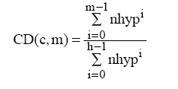
CONCEPTUAL DENSITY FORMULA
Wish list
The conceptual distance between two words should be proportional to the length of the path between the two words in the hierarchical tree (WordNet).
The conceptual distance between two words should be proportional to the depth of the concepts in the hierarchy.
entity
Sub-Tree
d (depth)
location
finance
h (height) of the
concept “location”
CFILT - IITB
bank-2
bank-1
money
where, c = concept
nhyp = mean number of hyponyms
h = height of the sub-hierarchy
m = no. of senses of the word and senses of context words contained in the sub- hierarchy
CD = Conceptual Density

Slide 82
RANDOM WALK ALGORITHM
A popular algorithm used by search engines for ranking web pages (e.g. PageRank algorithm used by Google).
Finds the importance score of a vertex in a graph.
Uses the idea of “voting” or “recommendation”.
When one vertex links to another it is basically casting a vote for that vertex. (E.g. a link from Yahoo to your home page)
Large number of votes = high importance.
The importance of the vertex casting the votes determines the importance of the vote itself. (A link from Yahoo would be more important than a link from your friend)
A vertex recommends other vertices and the strength of the recommendation is recursively computed.
CFILT - IITB

Slide 83
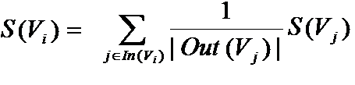
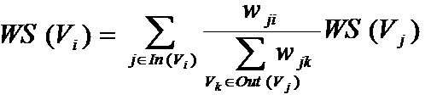
RANDOM WALK ALGORITHM - PAGERANK
Given a graph G = (V,E)
    In(V_{i}) = predecessors of V_{i}
    Out(V_{i}) = successors of V_{i}
In a weighted graph, the walker randomly selects an outgoing edge with higher probability of selecting edges with higher weight.
CFILT - IITB

Slide 84
CRITIQUE
Relies on random walks on graphs encoding label dependencies.
The Good
  Does not require any tagged data (a WordNet is sufficient).
  The weights on the edges capture the definition based semantic similarities.
  Takes into account global data recursively drawn from the entire graph.
The Bad
  Poor accuracy
Accuracy
  54% accuracy on SEMCOR corpus which has a baseline accuracy of 37%.
CFILT - IITB

Slide 85
BAYES RULE AND INDEPENDENCE ASSUMPTION
sˆ= argmax _{s ε senses} Pr(s|V_{w})
where V_{w} is the feature vector.
Apply Bayes rule:
  Pr(s|V_{w})=Pr(s).Pr(V_{w}|s)/Pr(V_{w})
Pr(V_{w}|s) can be approximated by independence assumption:
Pr(V_{w}|s) = Pr(V_{w}¹|s).Pr(V_{w}²|s,V_{w}¹)...Pr(V_{w}^{n}|s,V_{w}¹,..,V_{w}^{n-1})
  = Π_{i=1}^{n}Pr(V_{w}^{i}|s)
sˆ= argmax _{sÎsenses} Pr(s).Π_{i=1}^{n}Pr(V_{w}^{i}|s)
CFILT - IITB

Slide 86

ESTIMATING PARAMETERS
Parameters in the probabilistic WSD are:
  Pr(s)
  Pr(V_{w}^{i}|s)
Senses are marked with respect to sense repository (WORDNET)
Pr(s) = count(s,w) / count(w)
Pr(V_{w}^{i}|s) = Pr(V_{w}^{i},s)/Pr(s)
= c(V_{w}^{i},s,w)/c(s,w)
CFILT - IITB

Slide 87
ITERATIVE BOOTSTRAPPING ALGORITHM – STEP 1
Identify all contexts in which the polysemous word occurs.
For each possible sense use seed collocations to identify a relatively small number of training examples representative of that sense.
Seed collocation should accurately distinguish the senses.
        E.g. “life” and “manufacturing” for the target “plant”
Residual data
CFILT - IITB
Life
Manufacturing

Slide 88
ITERATIVE BOOTSTRAPPING ALGORITHM – STEP 2
Train the Decision List algorithm on the seed data.
Classify the entire sample set using the trained classifier.
Create new seed data by adding those members which are tagged as Sense-A or Sense-B with high probability.
Retrain the classifier using the new seed data.
These additions will contribute new collocations that are reliably indicative of the 2 senses.
CFILT - IITB

Slide 89
ONE SENSE PER DISCOURSE
The accuracy of the algorithm can be improved by using the “One sense per discourse” property.
After algorithm has converged
  Identify words that are tagged with low confidence and label them with the sense which is dominant for that document.
After each iteration
  If there is substantial disagreement concerning which is the dominant sense, all instances in the discourse are returned to the residual set rather than merely leaving their current tags unchanged. This helps improve the purity of the training data.
CFILT - IITB

Slide 90
CRITIQUE
Harnesses powerful, empirically-observed properties of language.
The Good
  Does not require large tagged corpus. Simple implementation.
  Simple semi-supervised algorithm which builds on an existing supervised algorithm.
  Easy understandability of resulting decision list.
  Is able to capture the clues provided by Proper nouns from the corpus.
The Bad
  The classifier is word-specific.
  A new classifier needs to be trained for every word that you want to disambiguate.
Accuracy
  Average accuracy of 96% when tested on a set of 12 highly polysemous words.
CFILT - IITB

Slide 91
SMALL LEXICAL WORLDS
Construct a graph for each word to be disambiguated.
Nodes are the words which co-occur with the target word.
An edge connects two nodes if the corresponding words co-occur with each other.
Such a graph has all the properties of small world graphs.
(river)
(victory)
CFILT - IITB
(electricity)
(world)
(water)
(flow)
(cup)
(team)

Slide 92
ADDING WEIGHTS TO THE EDGES
Each edge is assigned a weight that decreases as the association frequency of the words increases.
w_{A,B} = 1 – max[P(A|B), P(B|A)]
P(A|B) = f_{A,B}/f_{B}, P(B|A) = f_{B,A}/f_{A}
P(eau|ouverage) = 183/479 0.38, P(ouverage|eau) = 183/1057 = 0.17, w = 1 – 0.38 = 0.62
 | EAU (Water) | ~EAU
OUVRAGE (Work) | 183 | 296
~OUVRAGE | 874 | 5556
Total | 1057 | 5852
POTABLE (drinkable) | 63 | 0
~POTABLE | 994 | 5852
Total | 1057 | 5852
Total
479
6430
6909
63
6846
6909
CFILT - IITB

Slide 93
STEP 1 – COLLECTING CONTEXTS
Collect contexts which are representative of the Roget category.
  Extract concordances of 100 surrounding words for each occurrence of each member of the category in the corpus
  The level of noise introduced due to polysemy is substantial but can be tolerated as the spurious senses get distributed over the 1041 other categories whereas the signal is concentrated in just one.
Words in Context of the category TOOLS
equipment such as a hydraulic shovel capable of lifting 26 cubic…. ………….Resembling a power shovel mounted on a floating hul… .equipment, valves for nuclear generators, oil refinery turbines.... …………...flint-edged wooden sickles were used to gather wild…. ....penetrating carbide-tipped drills forced manufacturers to….. ………... heightens the colors Drills live in the forests of equa….. .traditional ABC method and drill were unchanged and dissa….. …..center of rotation A tower crane is an assembly of fabricat….. …marshy areas The crowned crane however occasionally…….
CFILT - IITB

Slide 94
STEP 2 – IDENTIFY SALIENT WORDS
Identify salient words in the collective context and weight appropriately.
        Weight(word) = Salience(Word) =
This list of words includes a broad set of relations like :
        Hyponymy (e.g. bird, engine)
        Typical functions (e.g. eat, cut)
        Typical modifiers (e.g. wild, sharp)
ANIMAL/INSECT
species (2.3), family(1.7), bird(2.6), fish(2.4), egg(2.2), coat(2.5), female(2.0), eat (2.2), nest(2.5), wild
TOOLS/MACHINERY
tool (3.1), machine(2.7), engine(2.6), blade(3.8), cut(2.2), saw(2.5), lever(2.0), wheel (2.2), piston(2.5)
CFILT - IITB

Slide 95
LOCAL CONTEXTS DATABASE
Local context is defined in terms of the syntactic dependencies between the words and other words in the sentence.
The local context is a triple that corresponds to a dependency relationship in which W is the head or the modifier. (type, word, position)
E.g. the boy chased a brown dog
The corpus is parsed to construct a Lexical Context Database. Each entry in the DB is a pair (lc, C(lc))
CFILT - IITB
Word | Local Contexts
Boy | (subject, chase, head)
Dog | (adjn, brown, modifier) (comp1, chase, head)
lc | C(lc)
(subject, employ, head) | ((ORG 64 50.4) (plant 14 31.0) .....(pilot 2 5.3))

Slide 96
DISAMBIGUATION
Step1
Parse the input text and extract local contexts of the ambiguous word w.
Step 2
Search the Local Context DB and find words that appeared in an identical local context as w. These are called selectors of w.
Step 3
Select a sense s of w that maximizes the similarity between w and Selectors(w).
Step 4
Assign this sense to all occurrences of w in the input text.
CFILT - IITB

Slide 97
CRITIQUE
Makes use of the “small world” structure of co-occurrence graphs.
The Good
  Does not require any tagged data
  Automatically extracts a “use” list of words in a corpus.
  Does not rely on dictionary defined word senses.
The Bad
  The classifier is word-specific.
  A new classifier needs to be trained for every word that you want to disambiguate.
Accuracy
  Average accuracy of 96% when tested on a set of 10 highly polysemous words.
CFILT - IITB

Slide 98
CRITIQUE
The Good
  Lexical Network (thesaurus) + Corpus based.
  Is able to capture the clues provided by Proper nouns from the corpus.
    E.g. “Sachin Tendulkar” will have a strong salience value in the category “sports”
  The classifier is not word-specific. Will work even for unseen/rare words.
The Bad
  Performance is weaker for:
    Minor sense distinctions within a category.
      E.g. the two senses of drug in medical domain.
    Idioms
      E.g. the word “hand” in “on the other hand” and “close at hand”.
Accuracy
  Average accuracy of 92% when tested on a set of 12 highly polysemous words.
CFILT - IITB

Slide 99
CRITIQUE
The Good
  The same knowledge sources are used for all words.
  Can deal with words that are infrequent or do not even appear in the corpus.
  The classifier is not word-specific.
The Bad
  Syntactic dependencies need to be identified from the corpus.
  This requires an efficient broad coverage parser.
Accuracy
  74% on Wall Street Journal Corpus.
CFILT - IITB

