Slide 1
D-Drive: Decentralized Storage Space
~using Blockchain and IPFS protocol
Submitted in the partial fulfillment for the award of the degree of
BACHELOR OF ENGINEERING
IN
B.E – CSE (Internet of Things)
Submitted by:
ANANYA SINGH
20BCS4585
Under the Supervision of:
SUPERVISORS NAME :
MR. PIYUSH SAMANT
Department of AIT-CSE
DISCOVER . LEARN . EMPOWER

Slide 2
Outline
Introduction to Project
Problem Formulation
Objectives of the work
Methodology used
Results and Outputs
Conclusion
Future Scope
References

Slide 3
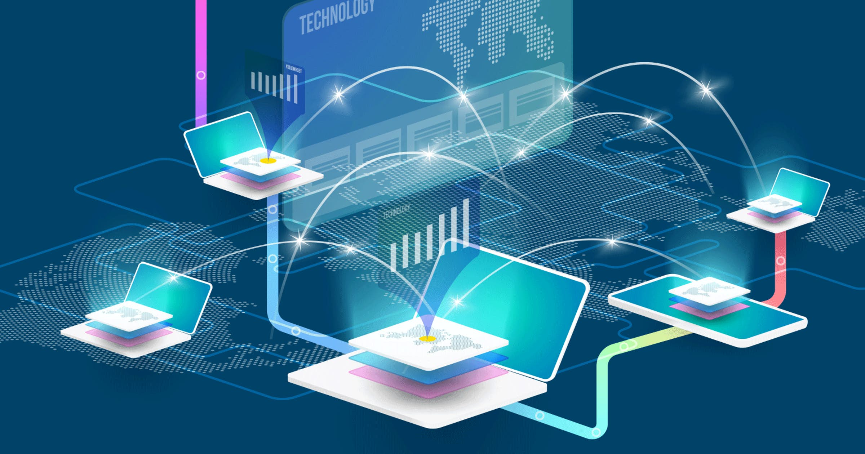
Introduction to Project
Blockchain is becoming one of the fastest-growing technologies and has been adopted by many people worldwide.
Nowadays, huge amounts of data are produced every day. To meet the increasing demand for data storage space, cloud-based centralized storage systems have been widely used in terms of data storage and sharing.
Centralized cloud storage has a lot of disadvantages including data leaking or breaching by malware during the process and a proprietorship of data by a single entity that increases the chances of personal data being used by third parties for their analysis or personal use.
Decentralized storage is the storage system where data is stored on a peer-to-peer network.

Slide 4
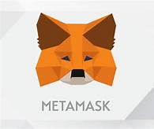


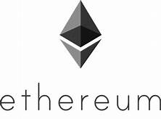
Problem Formulation
Centralized cloud-based storage has received great attention and has been extensively used by many companies in the recent years. However, these cloud-based storage are not secure because of the involvement of a centralized entity or a third party.
Hence, in order to maximize data privacy and security, there is a need for blockchain-based decentralized system.
This proposed D-drive, an IPFS-based decentralized storage space to solve the problem.
Decentralized storage using blockchain and IPFS will allow us to upload file in a decentralized way, allowing us to share in a trust less censorship resistant fashion.

Slide 5
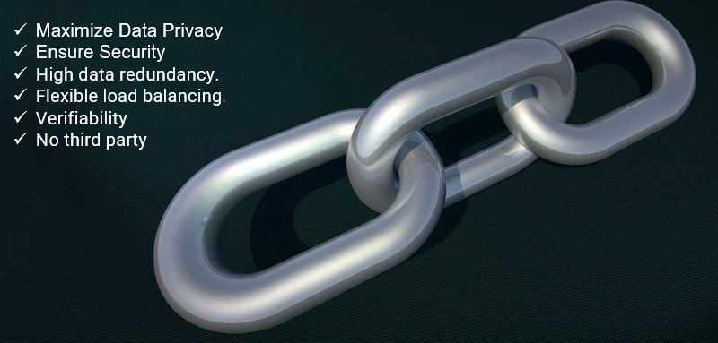
Objectives of the Work

Slide 6
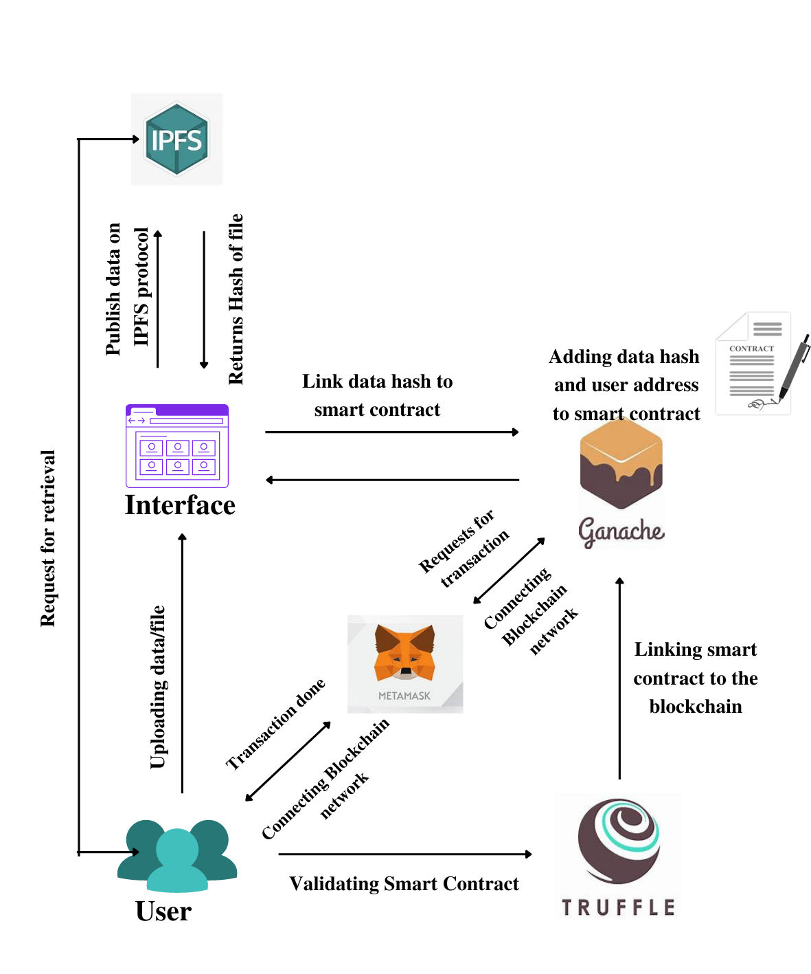
Methodology used

Slide 7
Technology used
Truffle: Framework for creating Ethereum smart contracts (solidity programming language)
Ganache: It is the blockchain that will run on our computer to run transactions and deploy smart contracts without having to pay real money.
Metamask: Browser extension to connect the browser to the blockchain. It is Ethereum wallet to turn our browser to Blockchain browser.
Web3.js: Collection of libraries that allows you to interact with a local or remote Ethereum node using HTTP, IPC, WebSocket (connects our application to the blockchain)
ReactJS: JavaScript library used for frontend.
Solidity: Solidity is an object-oriented programming language for implementing smart contracts
IPFS: The Inter Planetary File System is a protocol and peer-to-peer network for storing and sharing data in a distributed file system.

Slide 8
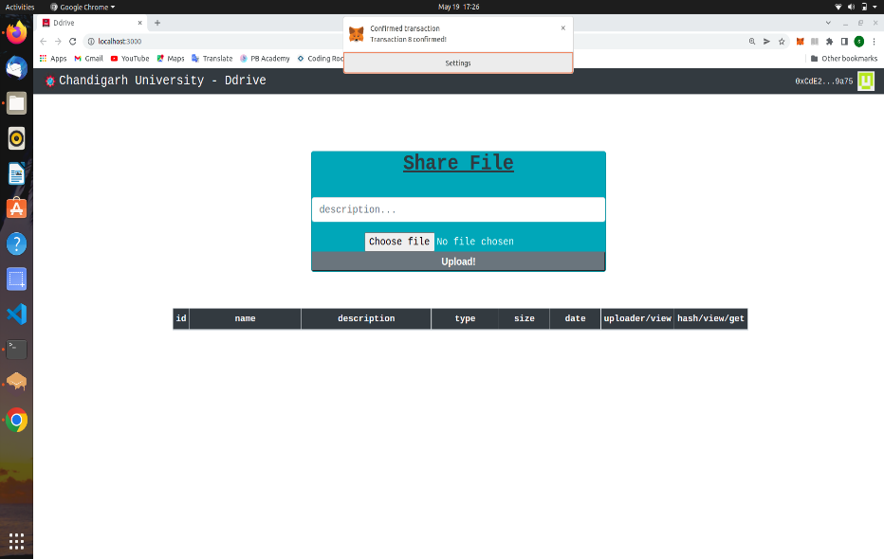
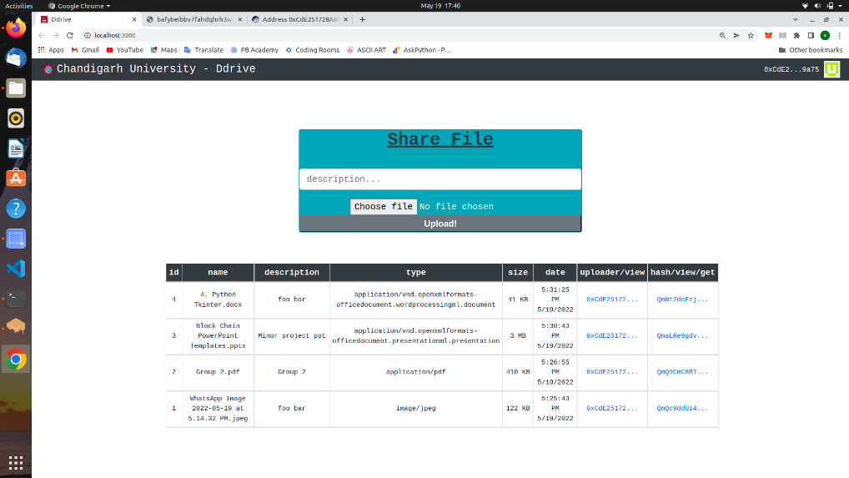
Results and Outputs

Slide 9
Future Scope
Network transparency: This basically refers to the freedom for the user from the operational details of the network. These are of two types Location and naming transparency.
Replication transparencies: It basically made user unaware of the existence of copies as we know that copies of data may be stored at multiple sites for better availability performance and reliability.
Fragmentation transparency: It basically made user unaware about the existence of fragments it may be the vertical fragment or horizontal fragmentation.
Increased Reliability and availability Reliability is basically defined as the probability that a system is running at a certain time whereas Availability is defined as the probability that the system is continuously available during a time interval.

Slide 10
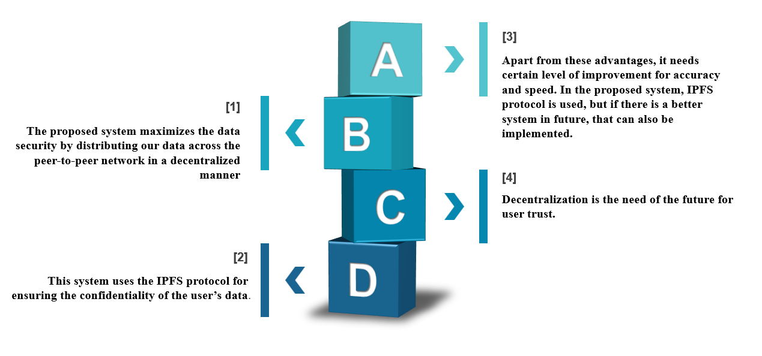
CONCLUSION

Slide 11
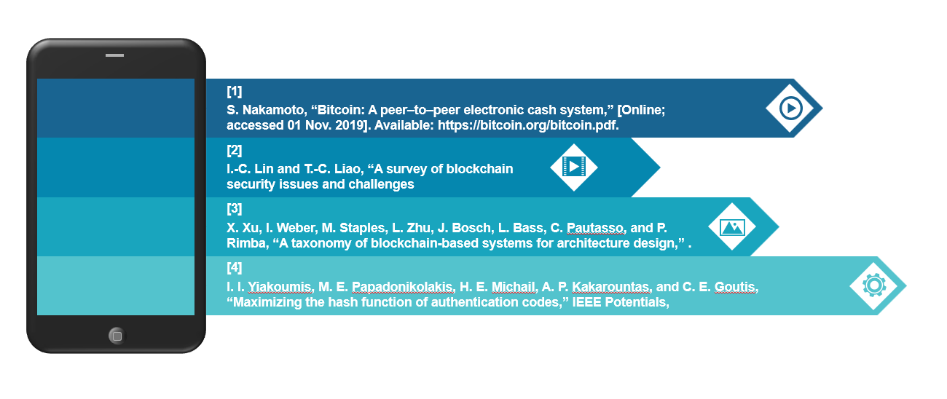
References

Slide 12


