Slide 1
IntelliHome : The Automated household Infrastructure
Submitted in the partial fulfillment for the award of the degree of
BACHELOR OF ENGINEERING
IN
COMPUTER SCIENCE ENGINEERING
WITH
SPECIALIZATION IN INTERNET OF THINGS
Under the Supervision of:
Mrs. Geeta Rani
Submitted by:
SIDDHARTH SINGH
ANANYA SINGH
Department of AIT-CSE
DISCOVER . LEARN . EMPOWER

Slide 2
Outline
Scope of the Project
Hardware Used
Software used
Objectives of the work
Methodology
References

Slide 3
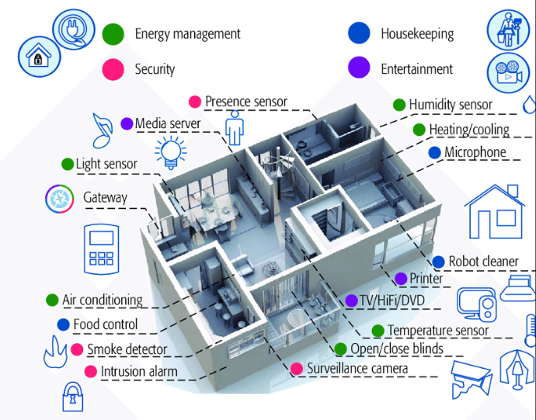
Scope of the Project
The project aims to enhance convenience, efficiency and control through integration of various technologies. This includes automated and controlled lighting, temperature, security and more using different sensors.
The main highlight of the project is the use of OpenCV for object detection to implement smart inventory management, automated cleaning systems and face recognition systems for enhanced security and privacy.
The project further includes implementation of convertible kitchen, smart humidifier, path finder and energy management as per homeowner’s requirements.

Slide 4
Hardware Requirements
ESP32-CAM Module
PIR Motion Sensor
DHT11 Humidity/ Temperature Sensor
Bending Beam Weight Sensors
LDR Sensors
Power Meter/Power Meter
Breadboard
Thermostat
Transistor
Smoke Sensors

Slide 5
Software Requirements
Python IDE
Arduino IDE
IFTTT Webhooks Services
ThingSpeak
Android Studio
Home Assistants

Slide 6
Objectives of the Work
Home Automation
Energy Management
Appliance Control
Smart Inventory Management
Smart Path Finder
Convertible Kitchen
Automated Cleaning System
Smart Humidifier Implementation
Security and Surveillance

Slide 7
Methodology used
Planning and Design: Define the scope of the project, create a detailed blueprint for the automated infrastructure, and select the appropriate technologies and devices.
Integration and Development: Integrate smart devices, sensors, and systems according to the design plan, and develop the central control platform and mobile application.
Smart Inventory Management Implementation: The ESP32 and CAM Module will be used with OpenCV for detection of objects. Then the microcontroller will be used to compare the prices online and send the notification to the user to order according to the best price.
Automated Cleaning system Implementation: To implement a system using OpenCV that will automatically detect the dirt in the house and deploy the required device for cleaning.
Energy Management Implementation: Implement energy optimization algorithms and automated routines for efficient resource utilization.
.

Slide 8
Methodology used
Smart Path Finder Implementation: To implement path finder, LED lights and triggers generated by user will be integrated via IFTTT services. ESP32 Microcontroller will be used to control the LEDs
Convertible Kitchen: In order to implement convertible kitchen, DC motors will be deployed along with the microcontroller that can slide the wall of the kitchen as per instructions provided by the user.
Smart Humidifier Implementation: This system can be implemented by deploying DHT11 humidity/Temperature Sensors to detect the Outdoor temperature and humidity levels and set the Indoor temperature relatively. For example, For humidity level of 35 % outside, a temperature of +20 Degree Fahrenheit will be maintained indoor.

Slide 9
Methodology used
Security and Safety Setup: Install security devices such as cameras, motion sensors, and smart locks, and develop the security management system.
User Interface Development: Design and develop an intuitive user interface for the mobile application, enabling residents to control and monitor the automated systems.
Data Collection and Insights: Set up data collection mechanisms and implement data analytics to provide residents with insights into their energy usage and occupancy patterns.
Testing and Quality Assurance: Thoroughly test the entire automated infrastructure for reliability, security, and seamless integration
Deployment and Launch: Deploy the fully functional automated infrastructure within the household and launch the project to enhance the residents' living experience.

Slide 10
Feature Identification/Analysis
Home Automation
Energy Management
Appliance Control
Smart Inventory Management
Smart Path Finder
Convertible Kitchen
Automated Cleaning System
Smart Humidifier Implementation
Security and Surveillance

Slide 11
Constraint Identification
Technical Constraints:
Interoperability: Different smart devices and platforms may use different communication protocols. Ensuring that devices can work together seamlessly can be a challenge.
Security: Smart homes are susceptible to cybersecurity threats.
Reliability: The technology used in smart homes must be reliable to avoid system failures.
Scalability: The system must be able to handle the addition of new devices and features without significant performance degradation.
Economic Constraints:
Cost: The cost of implementing smart home technology can be a major constraint. It includes the cost of devices, installation, and ongoing maintenance.
Return on Investment (ROI): Homeowners must weigh the benefits of smart home technology against its cost. The ROI must be compelling to justify the investment.

Slide 12
Constraint Identification
3. Ethical Constraints:
Privacy: Smart home devices often collect and transmit data. Balancing the convenience of these systems with privacy concerns is a significant ethical challenge.
Data Usage: The ethical use of data collected by smart devices is a growing concern. Data should be used responsibly and in compliance with privacy regulations.

Slide 13
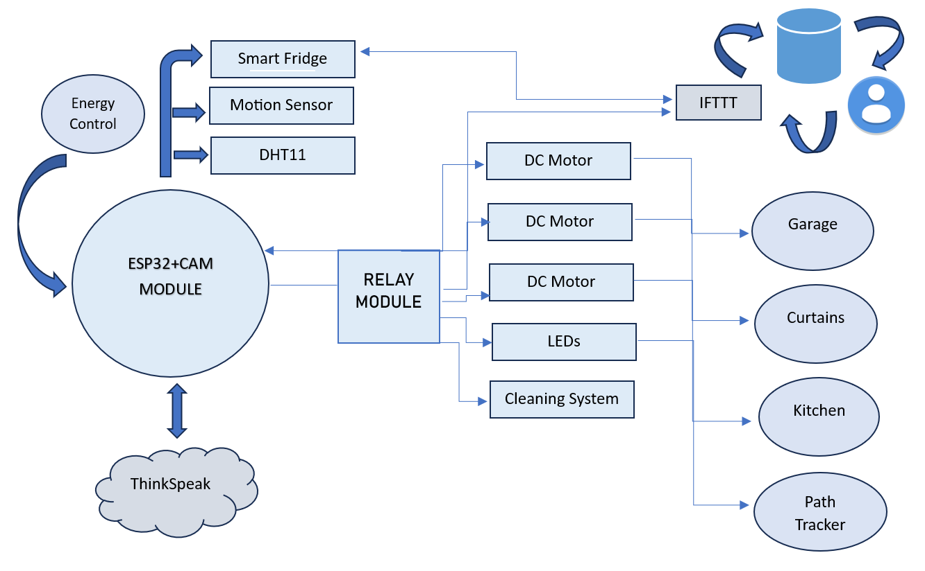
Design Selection

Slide 14
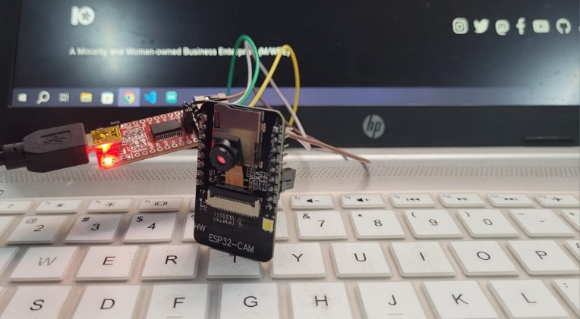
HARDWARE IMPLEMENTION
Object Detection Via ESP32 CAM Module

Slide 15
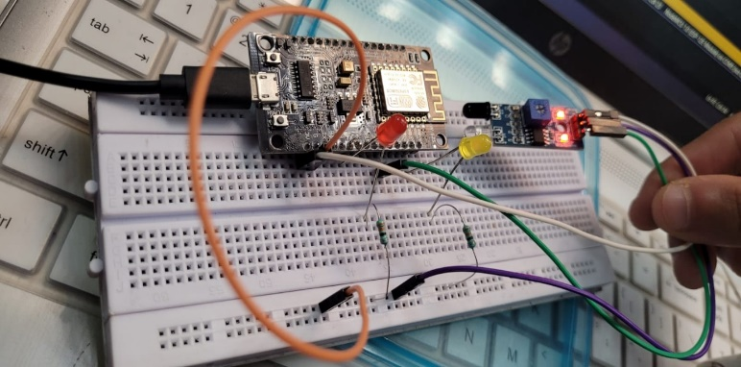
HARDWARE IMPLEMENTION
IOT-Enabled Smart Lighting

Slide 16
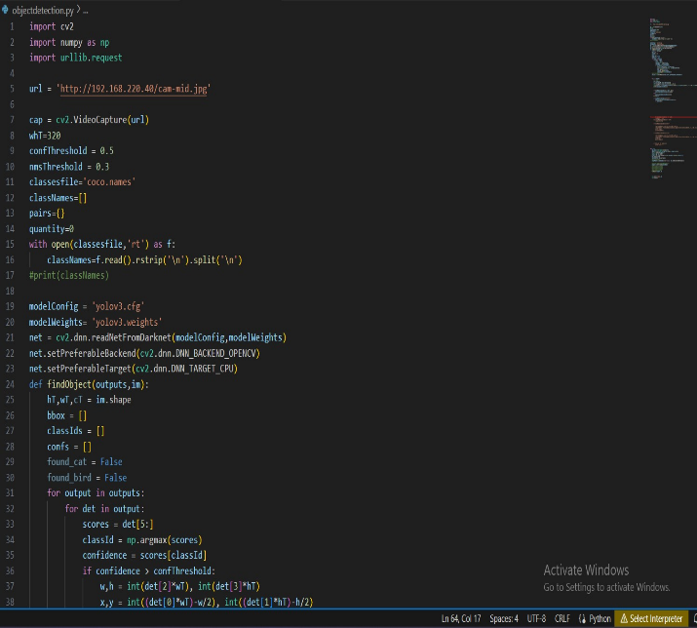

RESULTS PHASE 1: Smart Inventory Management
Object detection using yolo on visual studio code
OPENCV Source Code for Object Detection

Slide 17
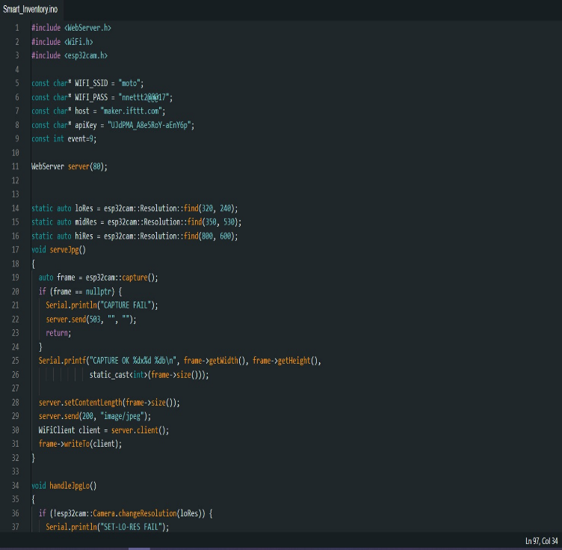
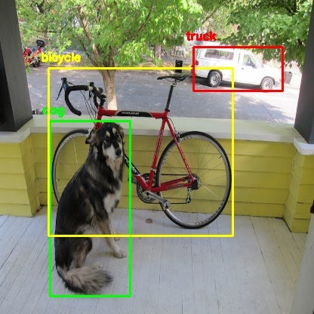
RESULTS
Arduino code for ESP8266 Module
Object detection Using Yolo

Slide 18

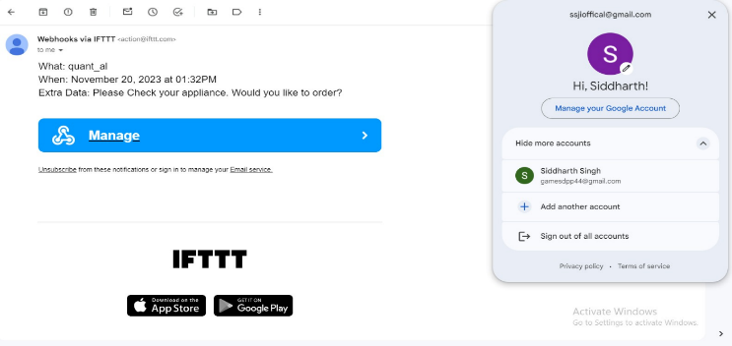
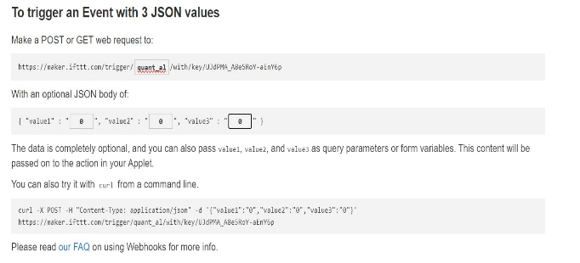
RESULTS
Mails generated via IFTTT Webhooks services using Triggers
IFTTT WEBHOOKS Interface

Slide 19

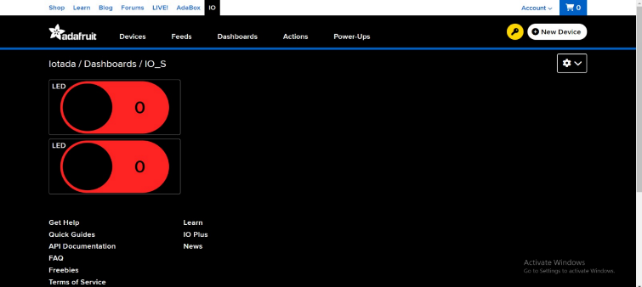
RESULTS PHASE 2: Smart Home Functionality Implementation
IoT- Enabled smart lighting
Adafruit dashboard for Smart lighting

Slide 20
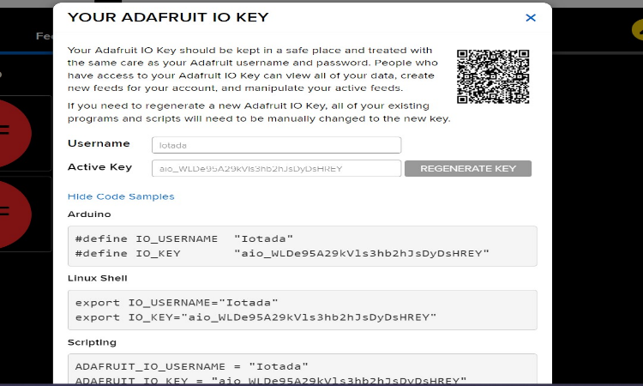
RESULTS PHASE 2: Smart Home Functionality Implementation
Adafruit Key for Smart lighting

Slide 21
References
"Smart Home Automation: A Literature Review" by Anitha Juliette Albert and Dr. M. Sangeetha - This paper reviews the various aspects of smart home automation, including its architecture, technologies, challenges, and applications. Yar H, Imran AS, Khan ZA, Sajjad M, Kastrati Z. Towards smart home automation using IoT-enabled edge-computing paradigm. Sensors. 2021 Jul 20
P. Suesaowaluk, "Home Automation System Based Mobile Application," 2020 2nd World Symposium on Artificial Intelligence (WSAI), Guangzhou, China, 2020
Garg S, Yadav A, Jamloki S, Sadana A, Tharani K. IoT based home automation. Journal of Information and Optimization Sciences. 2020 Jan 2.
Malagi M. Voice control personal assistant using Raspberry PI. 2019
Majeed R, Abdullah NA, Ashraf I, Zikria YB, Mushtaq MF, Umer M. An intelligent, secure, and smart home automation system. Scientific Programming. 2020 Oct 29
Alam T, Salem AA, Alsharif AO, Alhejaili AM. Smart home automation towards the development of smart cities. APTIKOM Journal on Computer Science and Information Technologies. 2020 Mar,5
Agarwal K, Agarwal A, Misra G. Review and performance analysis on wireless smart home and home automation using iot. In2019 Third International conference on I-SMAC (IoT in Social, Mobile, Analytics and Cloud)(I-SMAC) 2019 Dec 12 (pp. 629-633) . IEEE.

