Slide 1
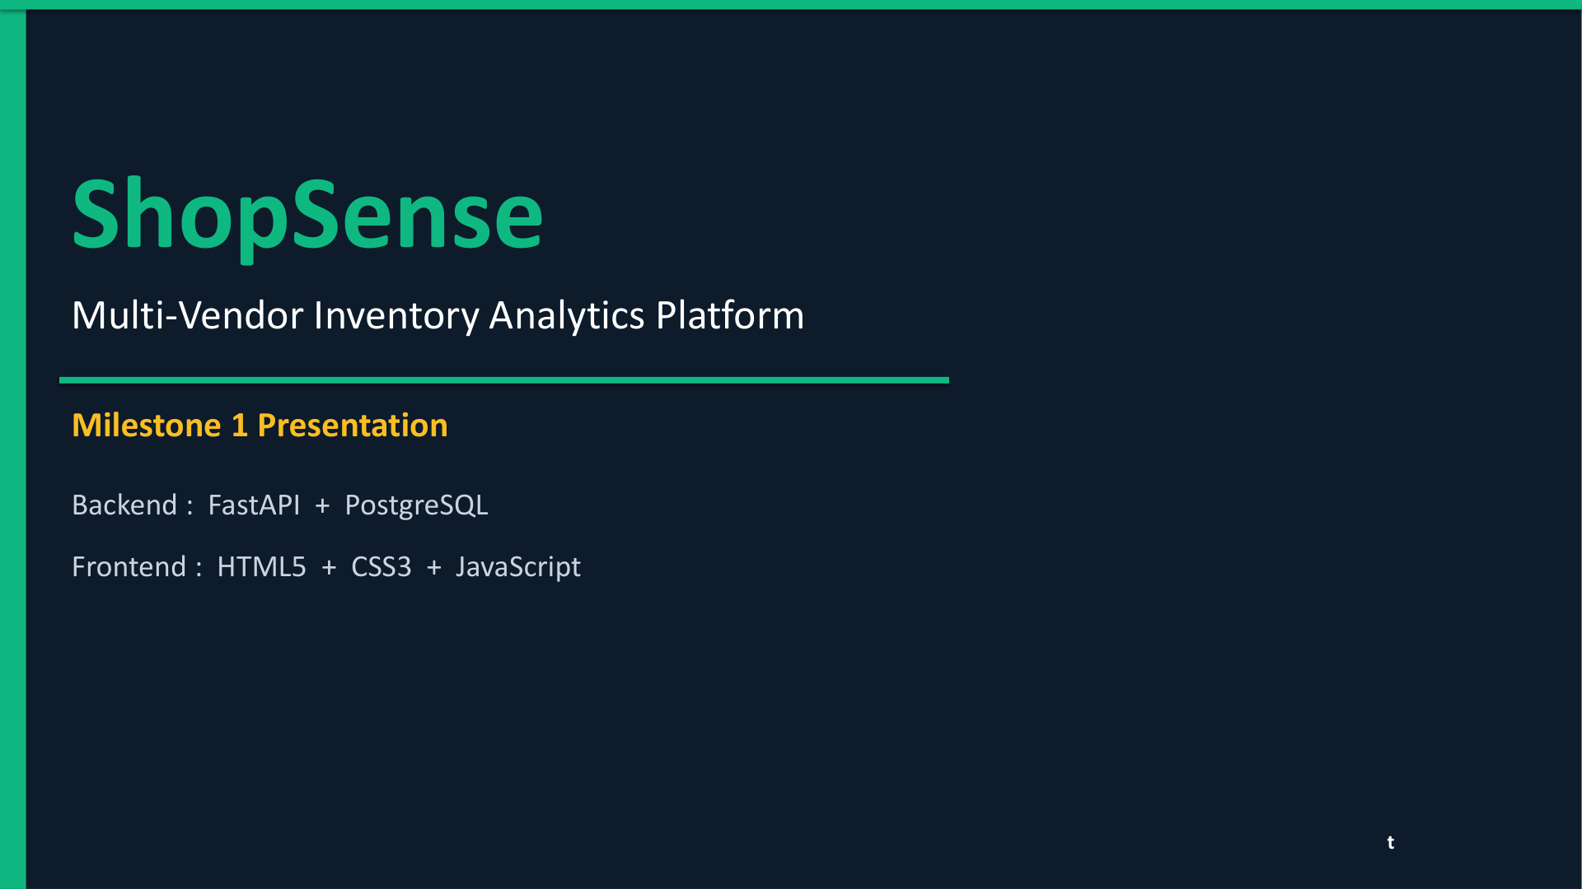

Slide 2
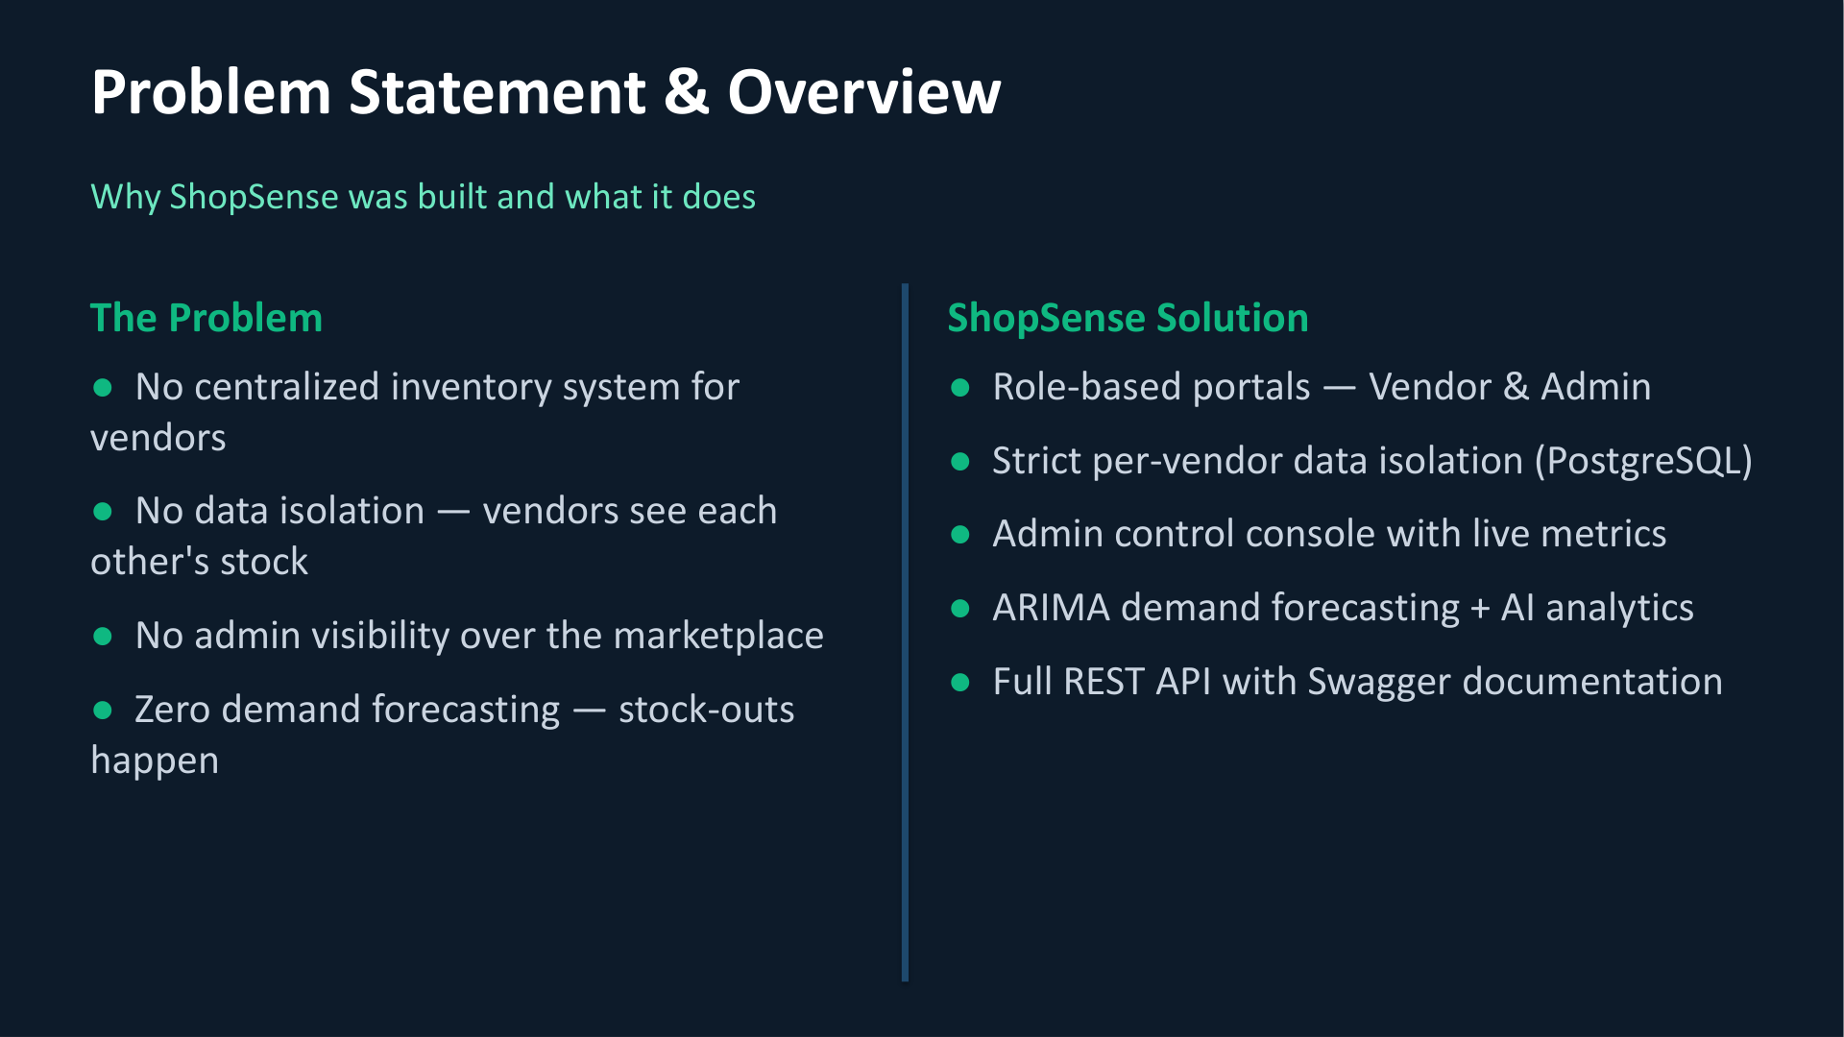

Slide 3
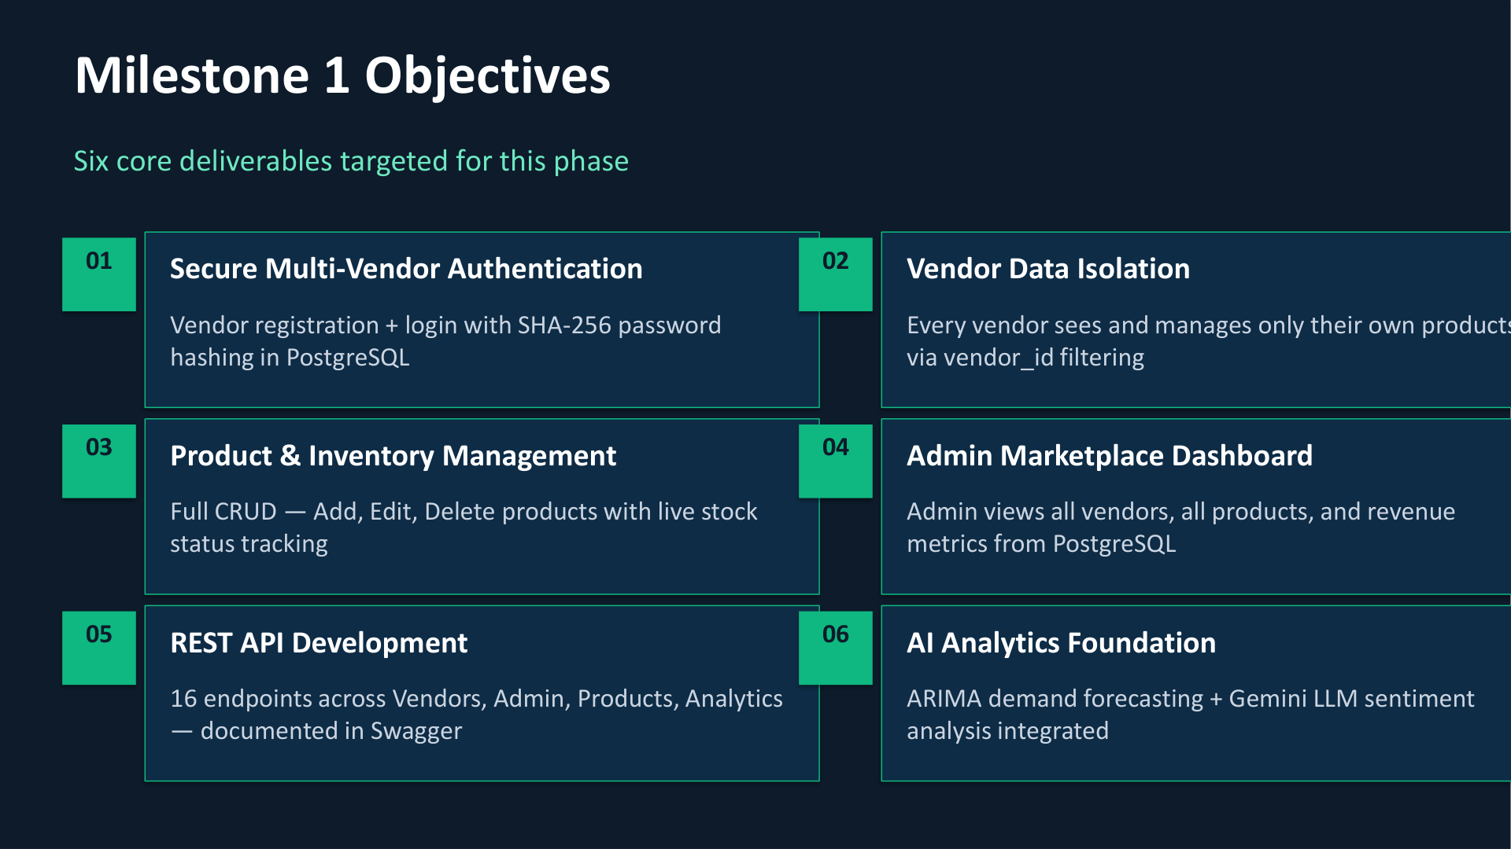

Slide 4
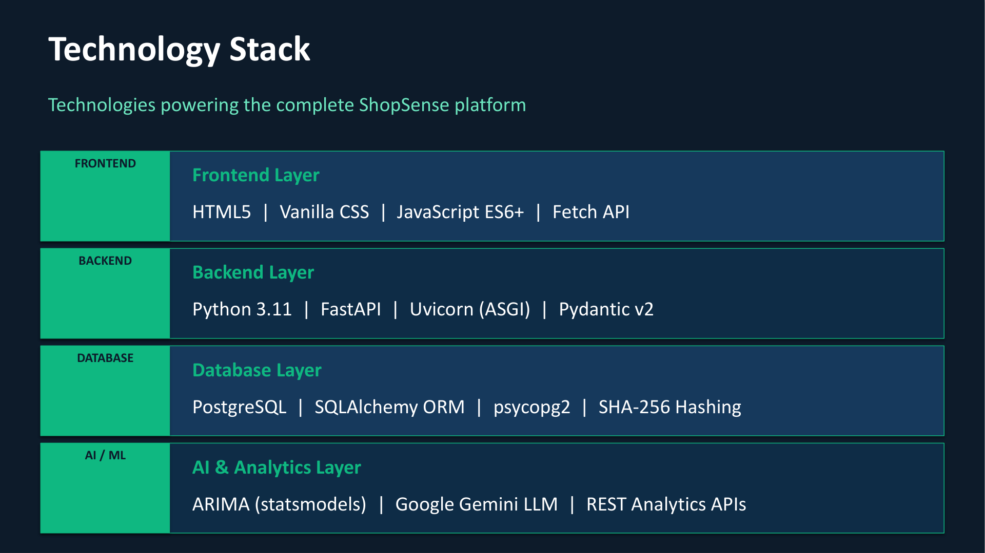

Slide 5
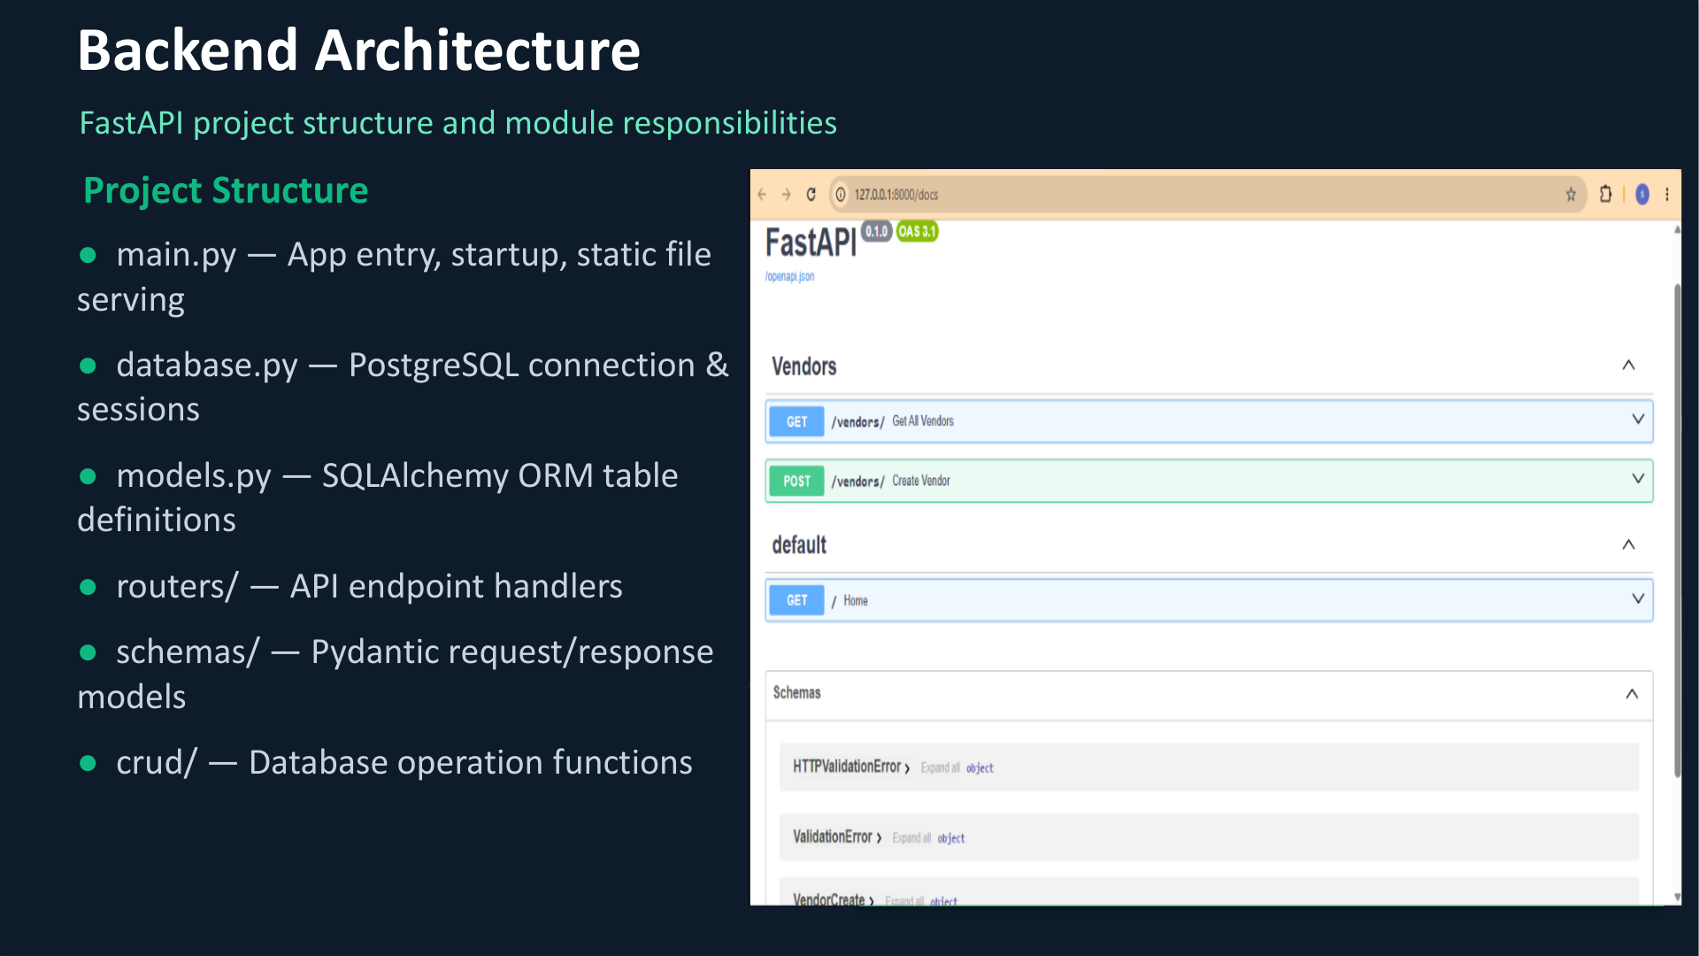

Slide 6
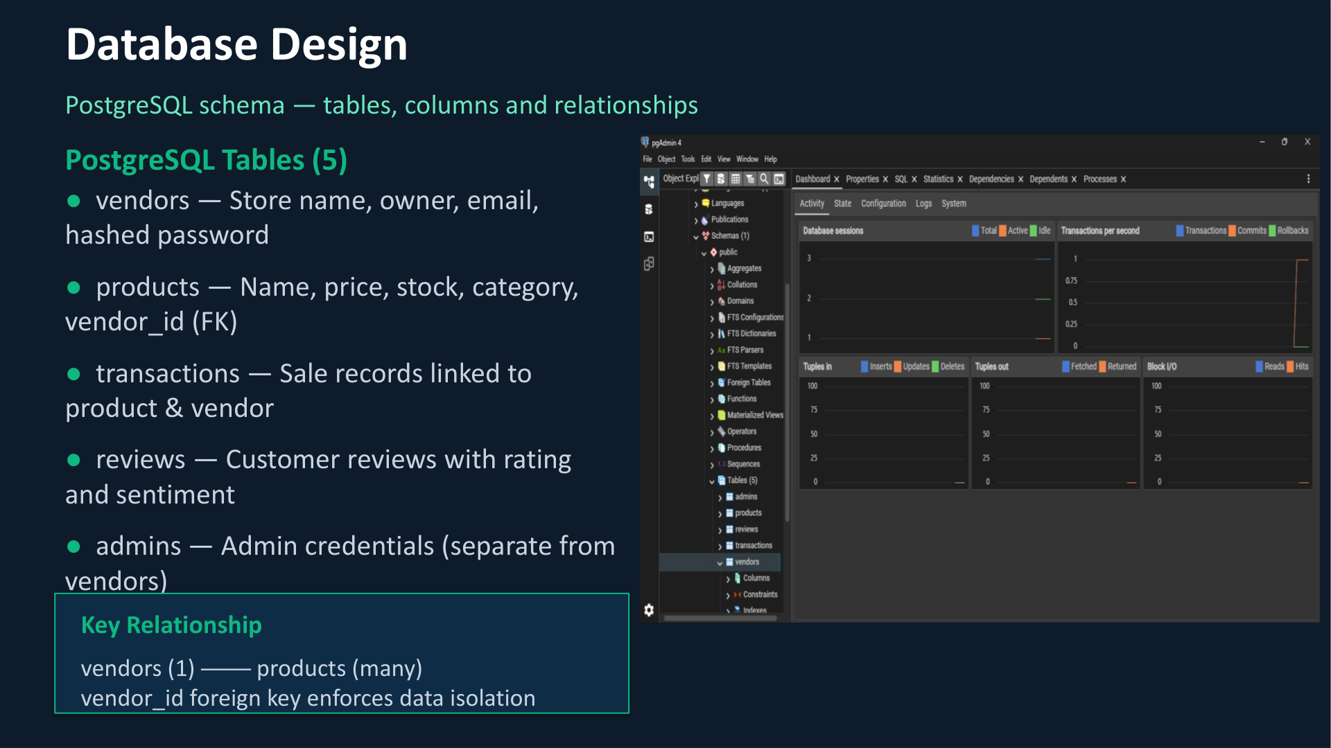

Slide 7
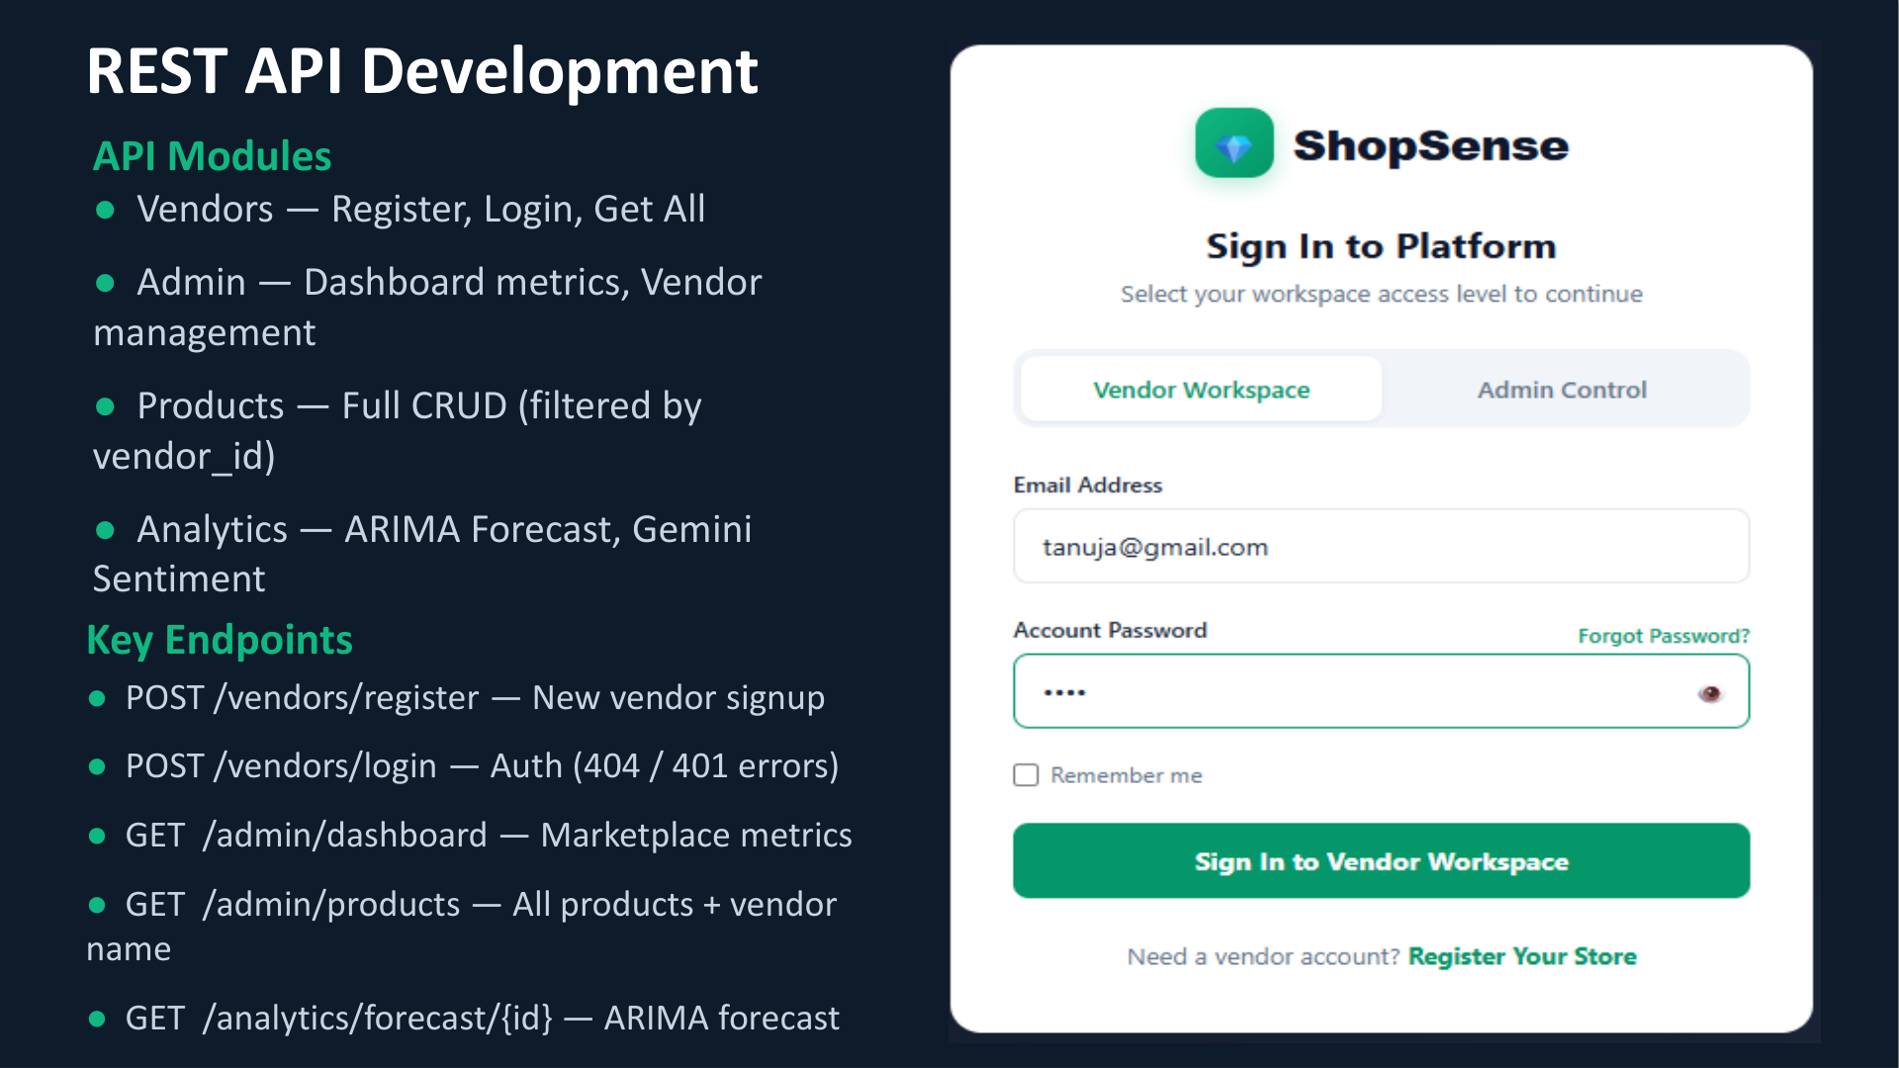

Slide 8
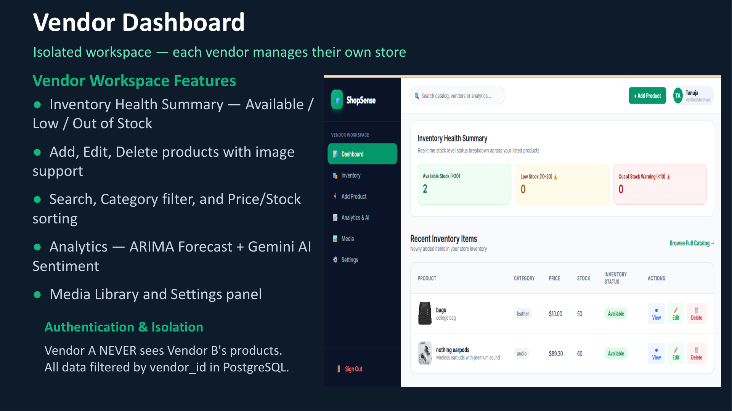

Slide 9
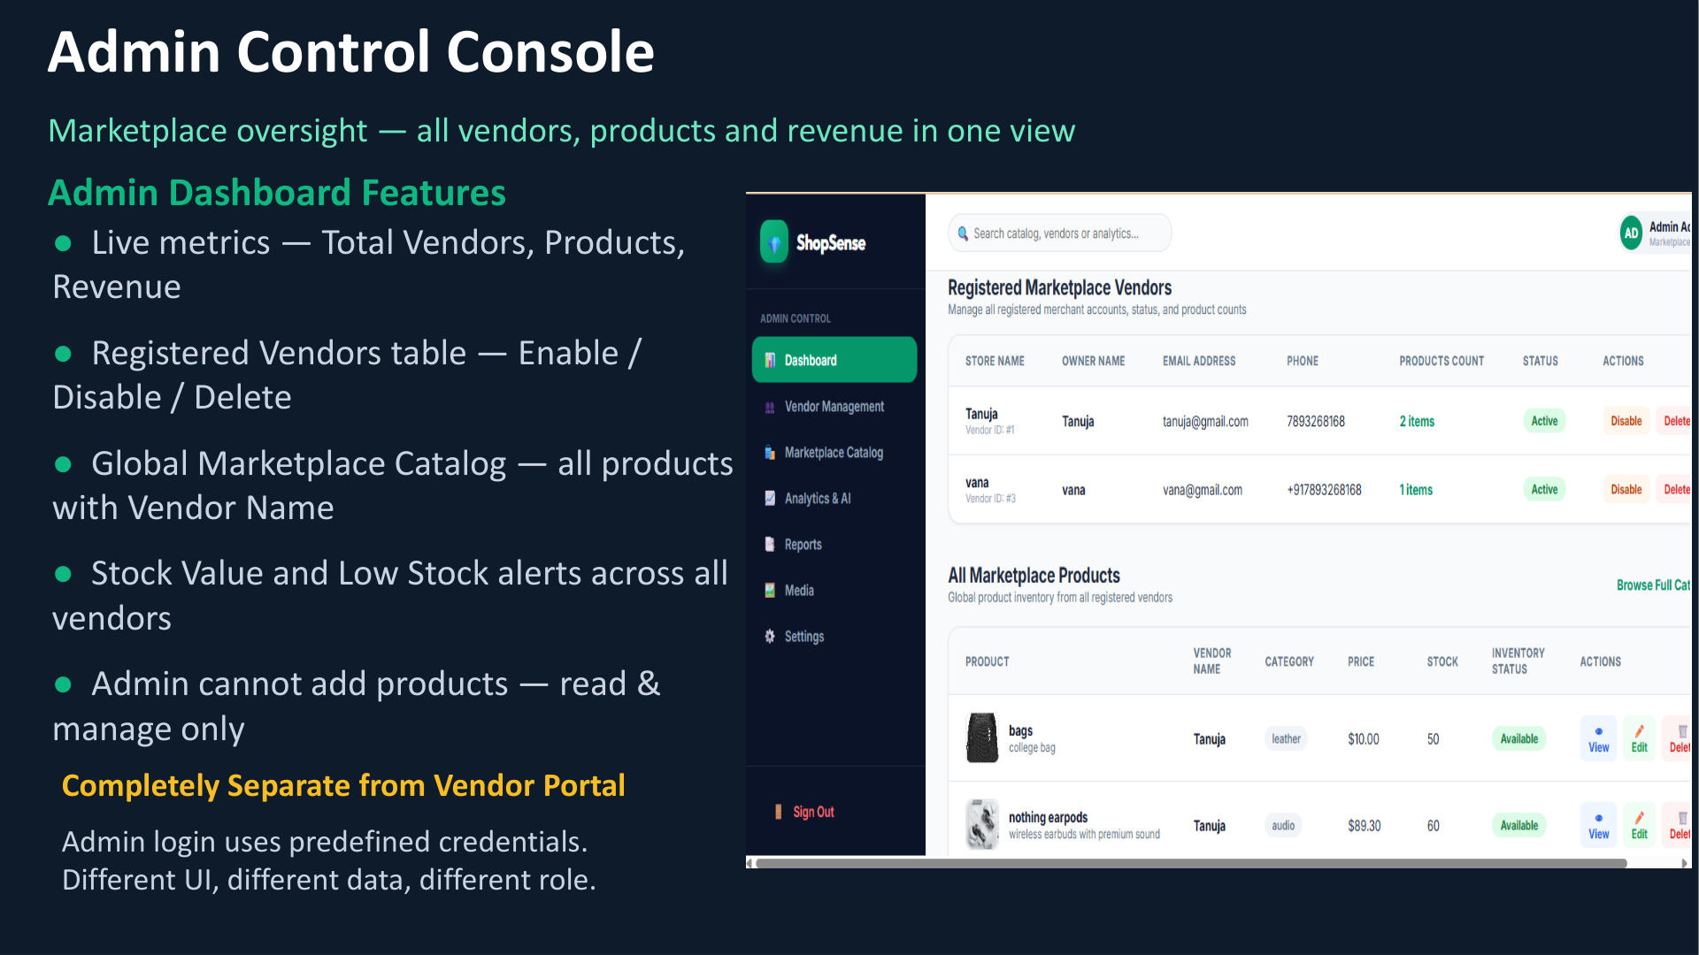

Slide 10
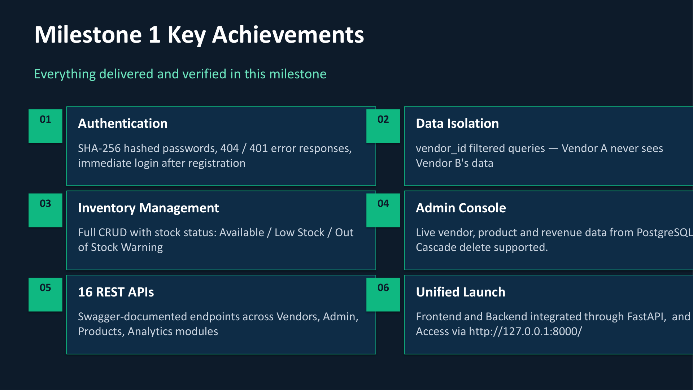

Slide 11
Milestone 2: Inventory Intelligence & Customer Analytics
Milestone 2 extends the marketplace with real customer transactions and data-driven analytics.
Extended ShopSense with a customer-facing marketplace and real order flow.
Connected customer purchases with transaction and inventory data.
Added customer segmentation and sales-based product recommendations.
Added AI features for demand forecasting and review sentiment analysis.

Slide 12
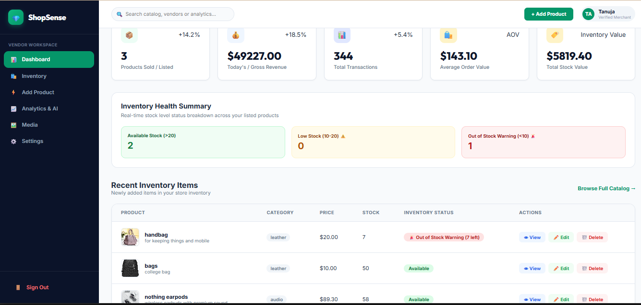
Vendor Dashboard

Slide 13
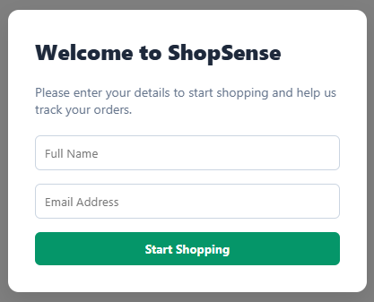
Customer Portal & Transactions
Customer enters basic details to start shopping.
Browses the marketplace and places an order.
The system stores the transaction automatically.
Product stock is instantly reduced in the PostgreSQL database.

Slide 14
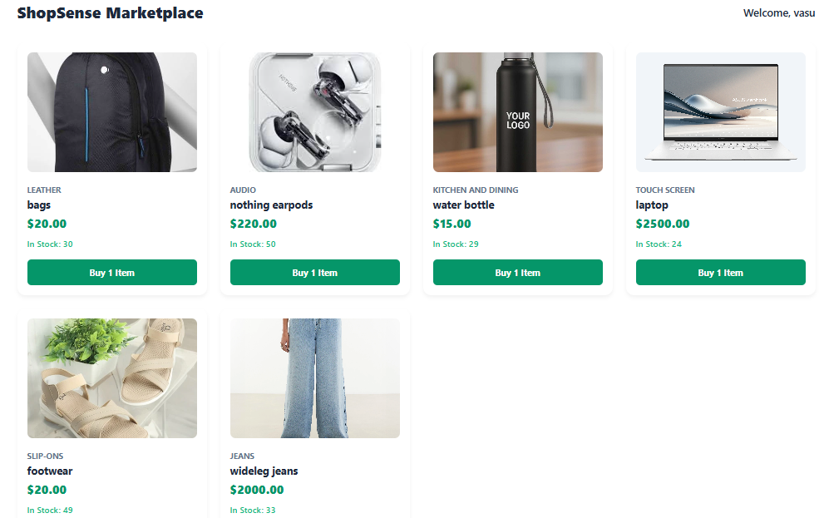

Slide 15
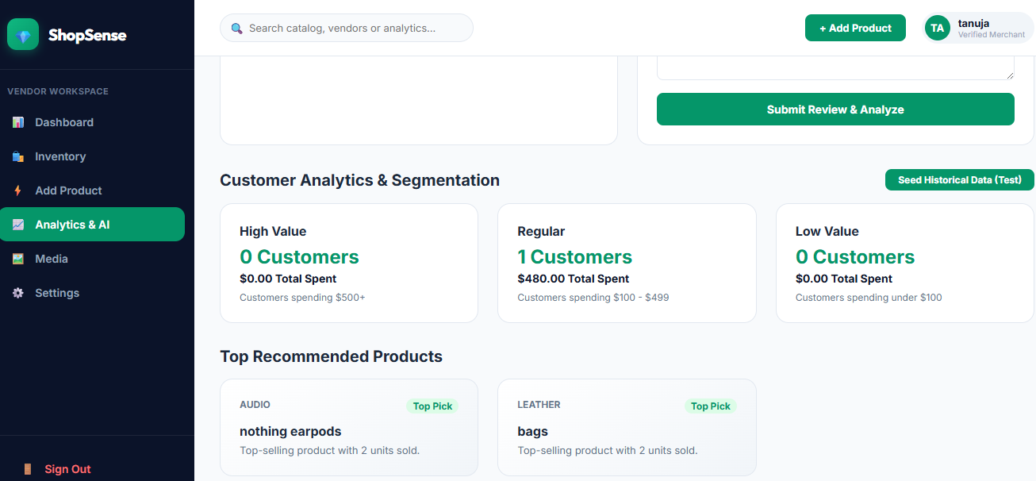
Customer Analytics & Segmentation
Customer spending is calculated from transaction history and customers are grouped into:
  High Value: $500+
  Regular: $100–$499
  Low Value: below $100
Analytics are calculated directly from actual transaction records.

Slide 16
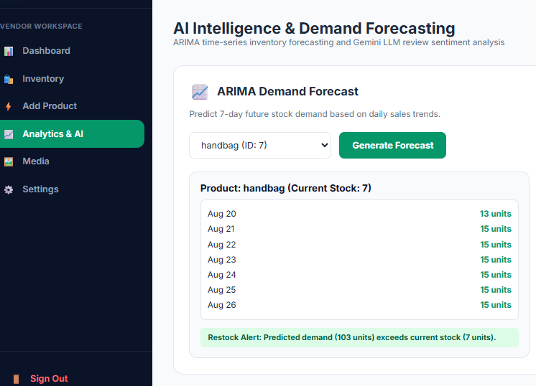
ARIMA Demand Forecasting
Historical sales data is used to identify demand patterns.
The vendor selects a product.
ARIMA generates a 7-day demand forecast.
The forecast is compared with current inventory.
A restock alert is shown when expected demand is higher than available stock.

Slide 17
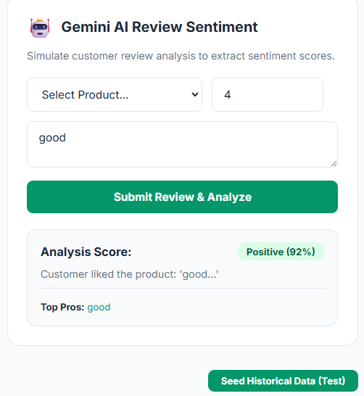
Gemini Review Sentiment Analysis
Vendor selects a product.
Enters rating and customer review text.
Gemini AI analyzes the review.
The system returns a sentiment score and identifies positive feedback and pros.
This helps the vendor quickly understand customer opinions.

Slide 18
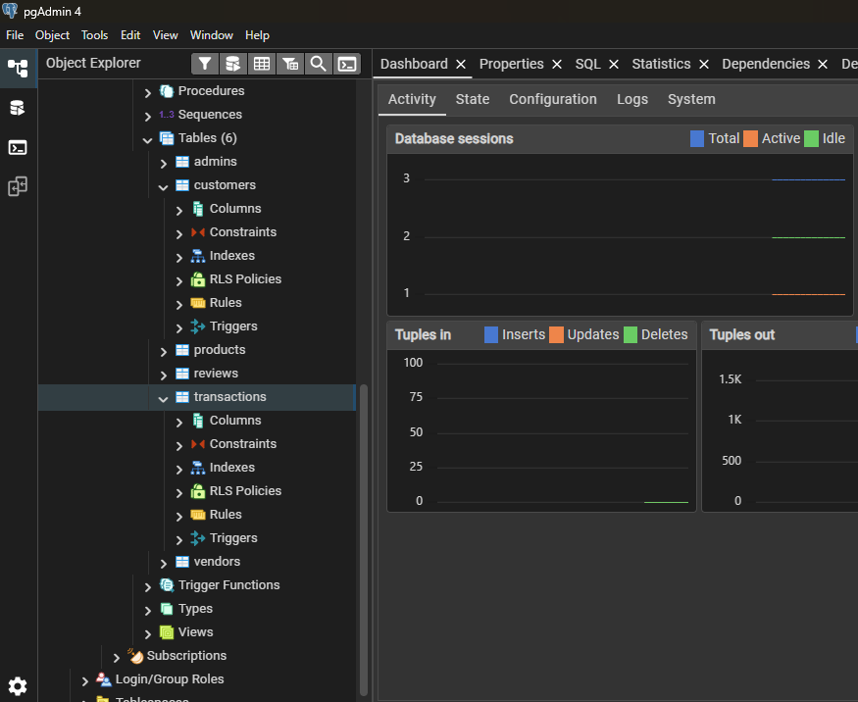
Rule-Based Recommendations & Historical Validation
Product sales are calculated from recorded transaction data.
Products are ranked based on the quantity sold.
The highest-selling products are shown as recommendations.
Historical/test transaction data was used to verify that the analytics produce the expected results.

Slide 19
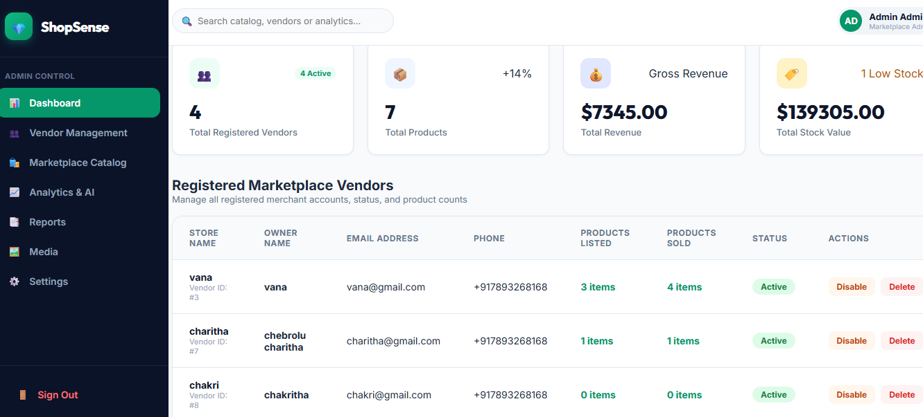

Slide 20
Milestone - 2 Outcome
Customer purchases now generate real transaction data, which feeds the analytics layer. This data is used for customer segmentation, product recommendations, demand forecasting, and review sentiment analysis.
Real customer ordering and transaction tracking
Data-driven customer segmentation and recommendations
7-day inventory demand forecasting with ARIMA
Gemini-powered review sentiment analysis

