Slide 1
11
Information Systems within the Organization

Slide 2
Transaction Processing Systems
Functional Area Information Systems
Enterprise Resource Planning (ERP) Systems
ERP Support for Business Processes

Slide 3
Explain the purpose of transaction processing systems.
Explain the types of support that information systems can provide for each functional area of the organization.
Identify advantages and drawbacks to businesses implementing an enterprise resource planning system.

Slide 4
Describe the three main business processes supported by ERP systems.

Slide 5

The Lion King
Roars Back
  Why are yield
  management systems
  so important to the
  producers of Broadway
  shows? Hint: What is the value of an unsold seat once the curtain goes up?
  Describe potential disadvantages of Disney’s yield management system.

Slide 6
11.1
Transaction Processing Systems
Transaction
Transaction Processing System (TPS)
Batch Processing
Online Transaction Processing (OLTP)
Notes:
Transaction: any business event that generates data worthy of being captured and stored in a database (e.g., product manufactured, a service sold, a person hired, and a payroll check generated)
Transaction Processing System (TPS): supports the monitoring, collection, storage, and processing of data from the organization’s basic business transactions, each of which generates and collects data continuously, in real time.
Source Data Automation: a process in which organizations try to automate the TPS data entry as much as possible because of the large volume involved.
Batch Processing: the firm collects data from transactions as they occur, placing them in groups or batches then prepares and processes the batches periodically.
Online Transaction Processing (OLTP): business transactions are processed online as soon as they occur and system performs these tasks in real time by means of online technologies.

Slide 7
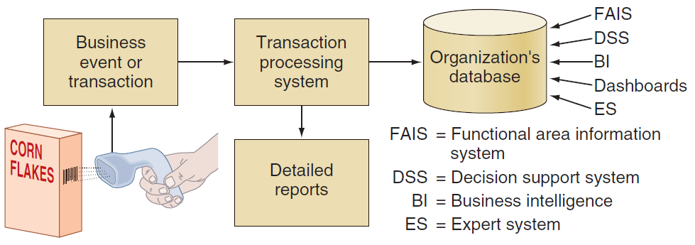
Figure 11.1: How TPS Manage Data

Slide 8
11.2
Functional Area Information Systems
IS for Accounting and Finance
IS for Marketing
IS for Production/Operations Management
IS for Human Resource Management
Reports
Notes:
Information Systems for Marketing: Any successful organization must understand its customers’ needs and wants and then develop its marketing and advertising strategies around them.

Slide 9
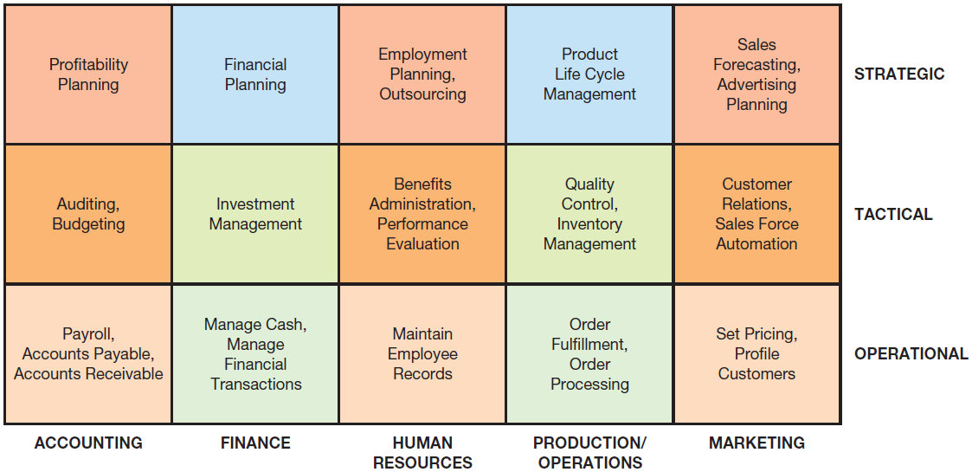
Figure 11.2: Systems supporting functional Areas

Slide 10
IS for Accounting and Finance
Financial Planning and Budgeting
Managing Financial Transactions
Investment Management
Control and Auditing
Notes:
Financial Planning and Budgeting: Appropriate management of financial assets and is an important part of managerial planning for both acquiring and utilizing resources.
Managing Financial Transactions: accounting/finance software packages that are integrated with other functional areas (e.g., Peachtree offers a sales ledger, a purchase ledger, a cash book, sales order processing, invoicing, stock control, a fixed assets register, etc.). Organizations, business processes, and business activities operate with, and manage, financial transactions.
Investment Management: Systems for managing organization investments in in stocks, bonds, real estate, and other assets that are subject to complex regulations and tax laws, which vary from one location to another.
Control and Auditing: effectively control their finances and financial statements. Let us examine some of the most common forms of financial control.

Slide 11
Financial Planning and Budgeting
Financial and economic forecasting
Budgeting
Notes:
Financial Planning and Budgeting: Appropriate management of financial assets and is an important part of managerial planning for both acquiring and utilizing resources.
Financial and Economic Forecasting: Knowledge about the availability and cost of money a key ingredient for successful financial planning including flow projections which inform organizations what funds they need, when they need them, and how they will acquire them.
Budgeting: allocates the organization’s financial resources among participants and activities allowing management to distribute resources in the way that best supports the organization’s mission and goals.

Slide 12
Managing Financial Transactions
Global stock exchanges
Managing multiple currencies
Virtual close
Expense management automation (EMA)
Notes:
Managing Financial Transactions: accounting/finance software packages that are integrated with other functional areas (e.g., Peachtree offers a sales ledger, a purchase ledger, a cash book, sales order processing, invoicing, stock control, a fixed assets register, etc.). Organizations, business processes, and business activities operate with, and manage, financial transactions.
Global stock exchanges: Financial markets operate in global, 24/7/365, distributed electronic stock exchanges that use the Internet both to buy and sell stocks and to broadcast real-time stock prices
Managing multiple currencies: Financial and accounting systems utilize financial data from different countries to convert currencies (with conversion ratios that constantly flux) in seconds.
Virtual close: the ability the books quickly at any time, on very short notice (rather than quarterly) which provides almost real-time information on the organization’s financial health.
Expense management automation (EMA): systems that automate the data entry and processing of travel and entertainment expenses through Web-based applications that enable companies to quickly and consistently collect expense information, enforce company policies and contracts, and reduce unplanned purchases as well as airline and hotel expenses.

Slide 13
Control and Auditing
Budgetary control
Auditing
Financial ratio analysis
Notes:
Control and Auditing: effectively control their finances and financial statements. Let us examine some of the most common forms of financial control.
Budgetary control: managers at various levels monitor departmental expenditures and compare them against the budget and the operational progress of corporate plans.
Auditing: monitoring how the organization’s monies are being spent and assessing the organization’s financial health.
Financial ratio analysis: monitoring the company’s financial health by assessing a set of fi nancial ratios including liquidity ratios (the availability of cash to pay debt), activity ratios (how quickly a firm converts noncash assets to cash assets), debt ratios (measure thefi rm’s ability to repay long-term debt), and profitability ratios (measure the fi rm’s use of its assets and control of its expenses to generate an acceptable rate of return).

Slide 14
IS for Production/Operations Management (POM)
In-House Logistics and Materials Management
Inventory Management
Quality Control
Planning Production and Operations Management
Computer-Integrated Manufacturing
Product Lifecycle Management

Slide 15
IS for Human Resource Management
Recruitment
Human Resources Development
Human Resources Planning and Management
Notes:
Recruitment: systems that assist human resource personnel in finding potential employees, evaluating them, and deciding which ones to hire.
Human Resources Development: IS that assist human resource personnel in helping new hires become part of the corporate human resources pool through evaluation and development.
Human Resources Planning and Management: Managing human resources in large organizations requires extensive planning and detailed strategy.

Slide 16
Three Areas of IT support in HR Planning and Management
Payroll and employees’ records
Benefits administration
Employee relationship management
Notes:
Human Resources Planning and Management: Managing human resources in large organizations requires extensive planning and detailed strategy.
Three Areas of IT support in HR Planning and Management:
Payroll and employees’ records
Benefits administration
Employee relationship management

Slide 17
Reports
Routine Reports
Ad-hoc (On-Demand) Reports
  Drill-down reports
  Key indicator reports
  Comparative reports
  Exception reports
Notes:
Routine Reports: reports produced at scheduled intervals.
Ad-hoc Reports: out-of-the routine reports.
Drill-Down Reports: display a greater level of detail.
Key Indicator Reports: summarize the performance of critical activities.
Comparative Reports: compare and contrast the performances of different business units or of a single unit during different time periods.
Exception Reports: include only information that falls outside certain threshold standards.

Slide 18
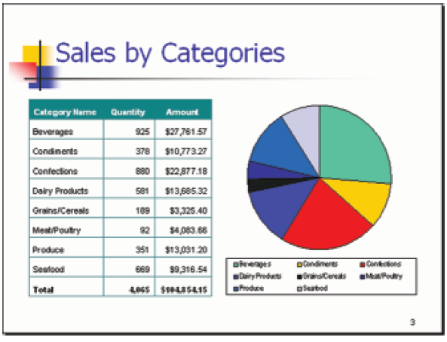
Monthly Sales Report

Slide 19
11.3
Enterprise Resource Planning (ERP) Systems
ERP II Systems
Benefits and Limitations of ERP Systems
Implementing ERP Systems
Enterprise Application Integration
Notes:
Enterprise Resource Planning (ERP) Systems: systems designed to correct a lack of communication among the functional area IS and they adopt a business process view of the overall organization to integrate the planning, management, and use of all of an organization’s resources, employing a common software platform and database.
ERP II Systems: interorganizational ERP systems that provide Web-enabled links among a company’s key business systems—such as inventory and production—and its customers, suppliers, distributors, and other relevant parties.
Enterprise Application Integration (EAI) System: integrates existing systems by providing software, called middleware, that connects multiple applications allowing existing applications to communicate and share data.

Slide 20
ERP II
SYSTEM
Core ERP Modules
Manufacturing
& Production
Module
Accounting and Financial Module
Human Resources Module
Suppliers
Customers
Supply Chain Management Module
ERP Platform & Database
Customer Relationship Management Module
Business
Intelligence
Module
E-Business Module
Extended ERP Modules

Slide 21
ERP Systems: Benefits
Organizational Flexibility and Agility
Decision Support
Quality and Efficiency
Notes:
Organizational Flexibility and Agility: ERP systems break down many former departmental and functional silos of business processes, information systems, and information resources making organizations more flexible, agile, and adaptive.
Decision Support: provide essential information on business performance across functional areas which significantly improves managers’ ability to make better, more timely decisions.
Quality and Efficiency: ERP systems integrate and improve an organization’s business processes, generating signifi cant improvements in the quality of production, distribution, and customer service.

Slide 22
ERP Systems: Limitations
Business Processes Predefined by Best Practices
Difficult to Implement
Potential for Failure
Notes:
Business Processes Predefined by Best Practices: may require companies need to change their existing business processes to fit the predefined business processes incorporated into the ERP software.
Difficult to Implement: ERP systems can be extremely complex, expensive, and time consuming to implement.
Potential for Failure

Slide 23
Major Causes of ERP Implementation Failure
Failure to involve affected employees in planning and development
Attempting too much too fast
Insufficient training
Failure to perform proper data conversion and testing
Notes:
Major Causes of ERP Implementation Failure:
Failure to involve affected employees in the planning and development phases and in change management processes
Trying to accomplish too much too fast in the conversion process
Insufficient training in the new work tasks required by the ERP system
Failure to perform proper data conversion and testing for the new system

Slide 24
Implementing ERP Systems
On-Premise ERP Implementation
Software-as-a-Service (SaaS) ERP Implementation
Notes:
ERP Software-as-a-Service (SaaS): a cloud based solution in which the company rents the software from an ERP vendor who offers its products over the Internet, manages software updates, and is responsible for the system’s security and availability.

Slide 25
On-Premise ERP Implementation
Vanilla Approach
Custom Approach
Best of Breed Approach
Notes:
Vanilla Approach: a company implements a standard ERP package, using the package’s built-in configuration options.
Custom Approach: a company implements a more customized ERP system by developing new ERP functions designed specifically for that firm.
Best of Breed Approach: combines the benefits of the vanilla and customized systems while avoiding the extensive costs and risks associated with complete customization.

Slide 26
’S ABOUT BUSINESS 11.1
GEA Group Uses SAP for Financial Reporting
  Discuss the reasons why financial reports must be timely.
  Explain how SAP enabled the GEA Group to produce their financial reports in an efficient, timely manner.
  What are the advantages of the SAP solution to the GEA Group?

Slide 27
11.4
ERP Support for Business Processes
The Procurement, Fulfillment, and Production Processes
Interorganizational Processes: ERP with SCM and CRM

Slide 28
The Procurement, Fulfillment, and Production Processes
Procurement Process
Order Fulfillment Process
Production Process
Notes:
Procurement Process: originates when a company needs to acquire goods or services from external sources, and it concludes when the company receives and pays for them.
Order Fulfillment Process: (order-to-cash process) process in which the company sells goods to a customer originating when the company receives a customer order, and concluding when the company receives a payment from the customer.
Production Process: occurring only in companies that produce physical goods, this process follows one of two strategies: make-to-stock and make-to-order.

Slide 29
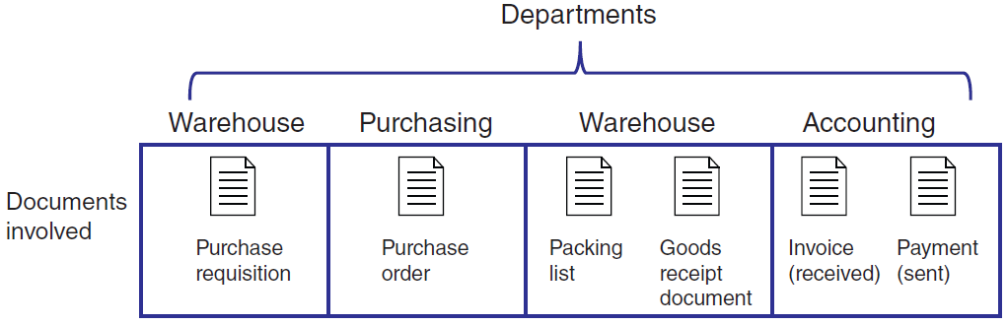
Figure 11.4: Departments & Documents Flow in Procurement

Slide 30
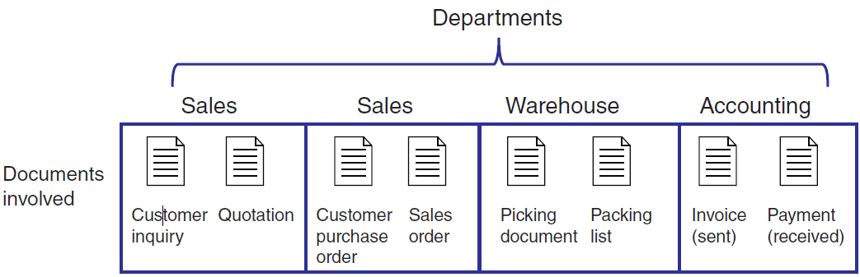
Figure 11.5: Departments & Documents Flow in Fulfillment

Slide 31
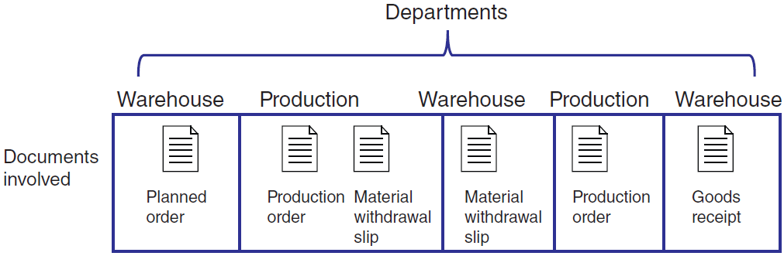
Figure 11.6: Departments & Documents Flow in Production

Slide 32
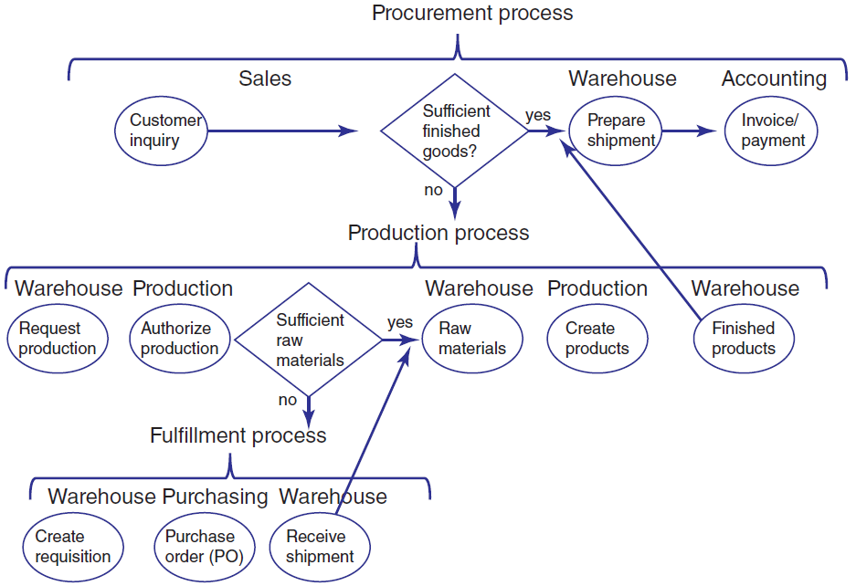
Figure 11.7: Integrated Processes with ERP Systems

Slide 33
Interorganizational Processes: ERP with SCM and CRM
Enterprise Resource Planning (ERP) Supply Chain Management (SCM) Systems
Enterprise Resource Planning (ERP) Customer Relationship Management (CRM) Systems
Notes:
SCM and CRM Processes: help multiple firms in an industry coordinate activities such as the production-to-sale of goods and services.
ERP SCM Systems: have the capability to place automatic requests to replinish raw materials/goods based on established criteria (e.g., below minimum quantity, expiration dates on perishable goods, etc.).
ERP CRM Systems: generate forecasting analyses of product consumption based on critical variables such as geographical area, season, day of the week, and type of customer; and, identify particular customer needs and then utilize this information to suggest specific product campaigns.

