Slide 1
13
Supply Chain Management

Slide 2
Supply Chains
Supply Chain Management
Information Technology Support for Supply Chain Management

Slide 3
Describe the three components and the three flows of a supply chain.
Identify popular strategies to solving different challenges of supply chains.
Explain the utility of each of the three major technologies that support supply chain management.

Slide 4

Coca Cola Enterprises
  Describe why new supply
  chain management
  technology is so important
  to CCE.
  Describe the advantages of
  the new system to CCE.
  Refer to Chapter 2. Is the
  new supply chain management system at CCE a strategic information system? Why or why not?

Slide 5
13.1
Supply Chains
The Structure and Components of Supply Chains
Notes:
Supply Chain: the flow of materials, information, money, and services from raw material suppliers, through factories and warehouses, to the end customers.
Supply Chain Visibility: the ability of all organizations within a supply chain to access or view relevant data on purchased materials as these materials move through their suppliers’ production processes and transportation networks to their receiving docks.
Inventory Velocity: the speed at which a company can deliver products and services after receiving the materials required to make them.

Slide 6
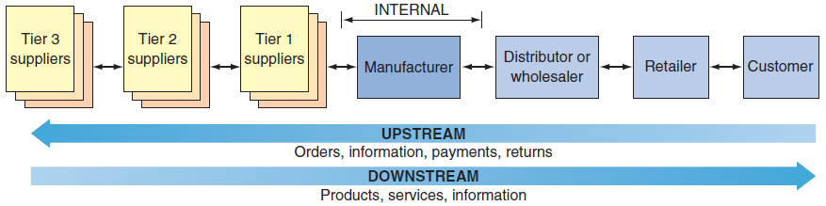
Figure 13.1:
Generic Supply Chain

Slide 7
The Structure and Components of Supply Chains
Three Segments of the Supply Chain
Tiers of Suppliers
Three Flows of the Supply Chain
Notes:
The Supply Chain Involves Three Segments:
Upstream: where sourcing or procurement from external suppliers occurs.
Internal: where packaging, assembly, or manufacturing takes place.
Downstream: where distribution takes place, frequently by external distributors.
-------------------
Tiers of Suppliers: a supplier may have one or more subsuppliers, a subsupplier may have its own subsupplier(s), and so on. For an automobile manufacturer, for example, Tier 3 suppliers produce basic products such as glass, plastic, and rubber; Tier 2 suppliers use these inputs to make windshields, tires, and plastic moldings; and Tier 1 suppliers produce integrated components such as dashboards and seat assemblies.
-------------------
Material Flows: the physical products, raw materials, supplies, and so forth that flow along the chain. Material flows also include the reverse flows.
Reverse Flows (or reverse logistics): returned products that are damaged, unwanted, or in need of recycling.
Information Flows: data related to demand, shipments, orders, returns, and schedules, as well as changes in any of these data.
Financial Flows: involve money transfers, payments, credit card information and authorization, payment schedules, e-payments, and credit-related data.
-------------------

Slide 8
Three Segments of the Supply Chain
Upstream
Internal
Downstream
Notes:
The Supply Chain Involves Three Segments:
Upstream: where sourcing or procurement from external suppliers occurs.
Internal: where packaging, assembly, or manufacturing takes place.
Downstream: where distribution takes place, frequently by external distributors.

Slide 9
Three Flows of the Supply Chain
Material Flows
  Reverse Flows
Information Flows
Financial Flows
Notes:
Material Flows: the physical products, raw materials, supplies, and so forth that flow along the chain. Material flows also include the reverse flows.
Reverse Flows (or reverse logistics): returned products that are damaged, unwanted, or in need of recycling.
Information Flows: data related to demand, shipments, orders, returns, and schedules, as well as changes in any of these data.
Financial Flows: involve money transfers, payments, credit card information and authorization, payment schedules, e-payments, and credit-related data.

Slide 10
13.2
Supply Chain Management (SCM)
Five Basic Components of SCM
Supply Chain Management Systems
The Push Model Versus the Pull Model
Problems Along the Supply Chain
Solutions to Supply Chain Problems
Notes:
Five Basic Components of SCM: Plan, Source, Make, Deliver, Return
Supply Chain Management Systems: a type of interorganizational information system (IOS) in which information flows among two or more organizations.
Push Model: In this model, also known as make-to-stock, the production process begins with a forecast, which is simply an educated guess as to customer demand.
Pull Model: In this model, also known as make-to-stock, the production process begins with a forecast, which is simply an educated guess as to customer demand.

Slide 11
Five Basic Components of SCM
Plan
Source
Make
Deliver
Return
Notes:
Five Basic Components of SCM:
Plan: Planning is the strategic component of SCM that involves developing a set of metrics (measurable deliverables) to monitor the organization’s supply chain to ensure that it is efficient and it delivers high quality and value to customers for the lowest cost.
Source: organizations choose suppliers to deliver the goods and services they need to create their product or service.
Make: the manufacturing component in which managers schedule the activities necessary for production, testing, packaging, and preparation for delivery. This is the most metric-intensive part of the supply chain, where organizations measure quality levels, production output, and worker productivity.
Deliver: (or logistics) is where organizations coordinate the receipt of customer orders, develop a network of warehouses, select carriers to transport their products to their customers, and create an invoicing system to receive payments.
Return: a responsive and flexible network for receiving defective, returned, or excess products back from their customers, as well as for supporting customers who have problems with delivered products.

Slide 12
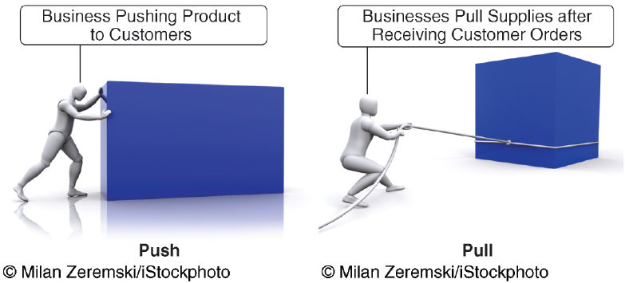
Push versus Pull Model

Slide 13
’S ABOUT BUSINESS 13.1
Crate & Barrel Increases Its Supply Chain Visibility
  Discuss the advantages of supply chain visibility for any organization.
  Explain how an increase in shipping costs can actually generate higher revenues for Crate & Barrel.

Slide 14
Problems Along the Supply Chain
Two Primary Sources of Problems Along the Supply Chain:
  Uncertainties
  The need to coordinate multiple activities, internal units, and business partners.
Demand Forecast
Bullwhip Effect
Notes:
Two Primary Sources of Problems Along the Supply Chain:
Uncertainties
The need to coordinate multiple activities, internal units, and business partners.
Demand Forecast: Demand for a product can be influenced by numerous factors such as competition, price, weather conditions, technological developments, overall economic conditions, and customers’ general confidence.
Bullwhip Effect: erratic shifts in orders up and down the supply chain.

Slide 15

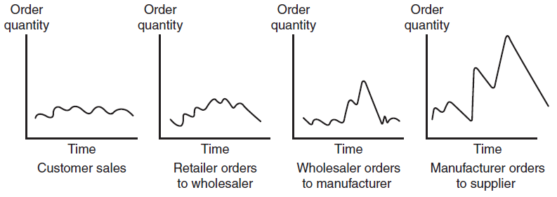
Figure 13.2: The Bullwhip Effect

Slide 16
Solutions to Supply Chain Problems
Using Inventories to Solve Supply Chain Problems
  Vertical Integration
  Just-In-Time Inventory
  Information Sharing
  Vendor-Managed Inventory (VMI)
Notes:
Vertical Integration: a business strategy in which a company purchases its upstream suppliers to ensure that its essential supplies are available as soon as the company needs them.
Just-In-Time (JIT) Inventory: a strategy to minimize inventories deliver the precise number of parts, called work-in-process inventory, to be assembled into a finished product at precisely the right time.
Information Sharing: facilitated by electronic data interchange and extranets, it helps to improve demand forecasts.
Vendor-Managed Inventory (VMI): occurs when the supplier, rather than the retailer, manages the entire inventory process for a particular product or group of products.

Slide 17
13.3
IT Support for Supply Chain Management
Electronic Data Interchange (EDI)
Extranets
Portals and Exchanges
Notes:
Electronic Data Interchange (EDI): a communication standard that enables business partners to exchange routine documents, such as purchasing orders, electronically. EDI formats these documents according to agreed-upon standards (e.g., data formats). It then transmits messages over the Internet using a converter, called translator.
Extranets: link business partners over the Internet by providing them access to certain areas of each other’s corporate intranets
Industry Extranet: a network used for mission-critical business transactions by leading international organizations in aerospace, automotive, chemical, electronics, financial services, healthcare, logistics, manufacturing, transportation, and related industries.

Slide 18
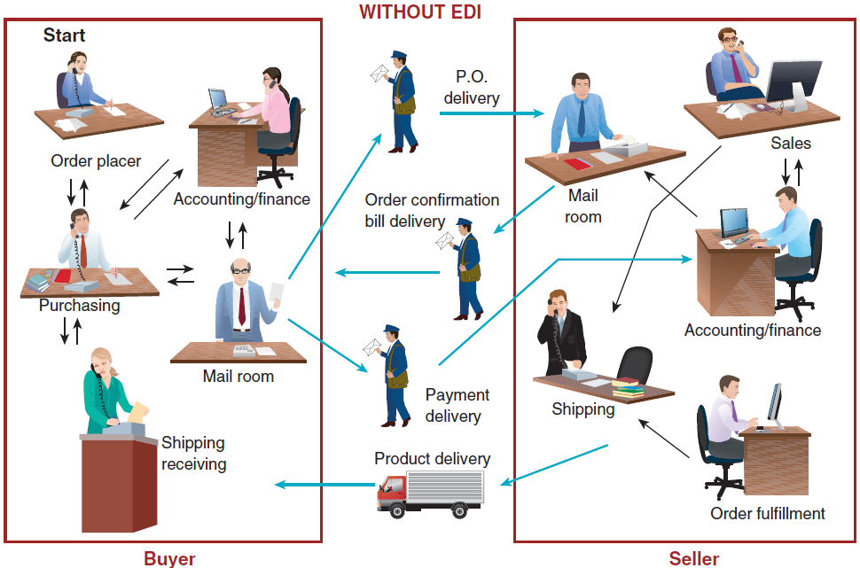
Figure 13.3: Purchase Order Fulfillment without EDI

Slide 19
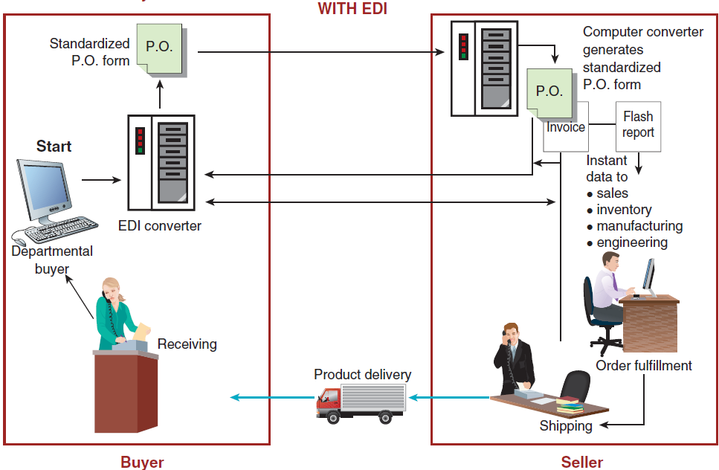
Figure 13.3: Purchase Order Fulfillment with EDI

Slide 20
Electronic Data Interchange (EDI): Benefits
Minimizes data entry errors
Length of the message can be shorter
Messages are secured
Reduces cycle time
Increases productivity
Enhances customer service
Minimizes paper usage and storage
Notes:
Electronic Data Interchange (EDI): a communication standard that enables business partners to exchange routine documents, such as purchasing orders, electronically. EDI formats these documents according to agreed-upon standards (e.g., data formats). It then transmits messages over the Internet using a converter, called translator.
-------------------
EDI Benefits:
Minimizes data entry errors
Length of the message can be shorter
Messages are secured
Reduces cycle time
Increases productivity
Enhances customer service
Minimizes paper usage and storage

Slide 21
Electronic Data Interchange (EDI): Disadvantages
Business processes sometimes must be restructured to fit EDI requirements
Many EDI standards in use today
Notes:
Electronic Data Interchange (EDI): a communication standard that enables business partners to exchange routine documents, such as purchasing orders, electronically. EDI formats these documents according to agreed-upon standards (e.g., data formats). It then transmits messages over the Internet using a converter, called translator.
EDI Disadvantages:
Business processes sometimes must be restructured to fit EDI requirements
Many EDI standards in use today

Slide 22
Extranet
A Company and Its Dealers, Customers, or Suppliers
Industry Extranet
Joint Ventures and Other Business Partnerships
Notes:
Extranets: link business partners over the Internet by providing them access to certain areas of each other’s corporate intranets
A Company and Its Dealers, Customers, or Suppliers: This type of extranet centers on a single company.
Industry Extranet: a network used for mission-critical business transactions by leading international organizations in aerospace, automotive, chemical, electronics, financial services, healthcare, logistics, manufacturing, transportation, and related industries.
Joint Ventures and Other Business Partnerships: In this type of extranet, business partners use the extranet as a vehicle for communication and collaboration.

Slide 23
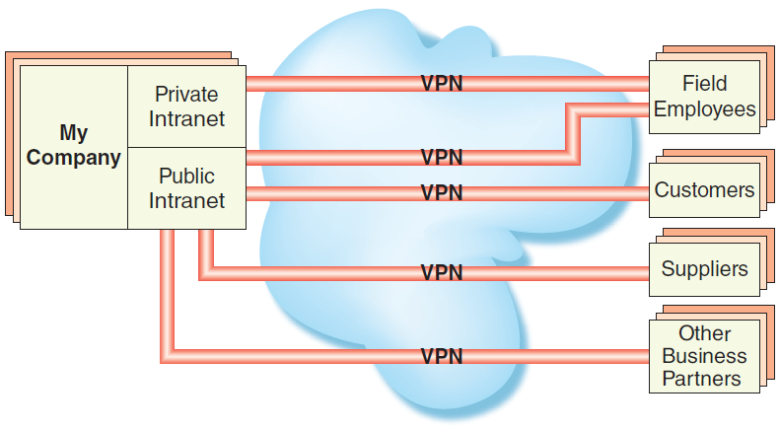
Figure 13.4: Structure of an Extranet

Slide 24
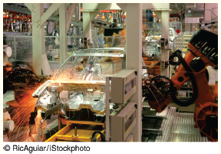
’S ABOUT BUSINESS 13.2
India’s New
Automotive Supply
Chain Extranet
  Discuss the difficulties
  involved in implementing Auto DX.
  Describe the advantages of Auto DX to the Indian automotive supply chain.

Slide 25
Portals and Exchanges
Procurement Portal
Distribution Portal
Notes:
Procurement Portal: for a company’s suppliers (upstream in the supply chain) this type of portal automates the business processes involved in purchasing or procuring products between a single buyer and multiple suppliers.
Distribution Portal: for a company’s customers (downstream in the supply chain) automate the business processes involved in selling or distributing products from a single supplier to multiple buyers.

