Slide 1
Business Insights
Sales Funnel Analysis

Slide 2
01
Introduction
02
Brief Insight Analysis of Sales Funnel
TABLE OF CONTENTS
Brief Insight Analysis from Number of Leads Onboarded in Different Cities
03
04
Brief Insight Analysis from Number of active Leads from March-April 2023
05
Conclusion

Slide 3
Introduction
This sales funnel analysis provides insights into the performance of a hostel booking platform.
The analysis looks at the number of leads generated, the conversion rates at each stage of the funnel, and the regional variations in demand.
The analysis also highlights the regional variations in hostel demand.
The lead trend and seasonal patterns highlight the need for strategic lead management and targeted marketing efforts.

Slide 4
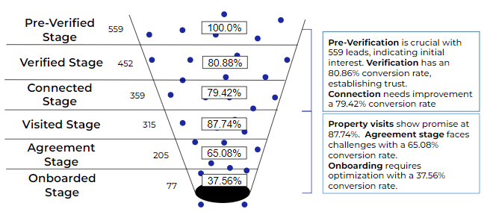
Sales Funnel Analysis

Slide 5
Brief Insight Analysis Using Sales Funnel
Pre-Verification is an essential step in the process which saw the highest number of leads with a total of 559.
The "Verified" stage demonstrated a conversion rate of 80.86%, indicating that the verification measures taken were successful in creating trust.
The "Connected" stage shows a slightly lower conversion rate of 79.42%, suggesting that this stage could be improved.
The "Visited" stage saw a conversion rate of 87.74%, indicating a positive response to property visits.
However, the "Agreement" stage had a lower conversion rate of 65.08%, suggesting potential issues in the negotiation and agreement process.
Lastly, the "Onboarded" stage had the lowest conversion rate of 37.56%, suggesting that the onboarding process might need to be optimized.

Slide 6
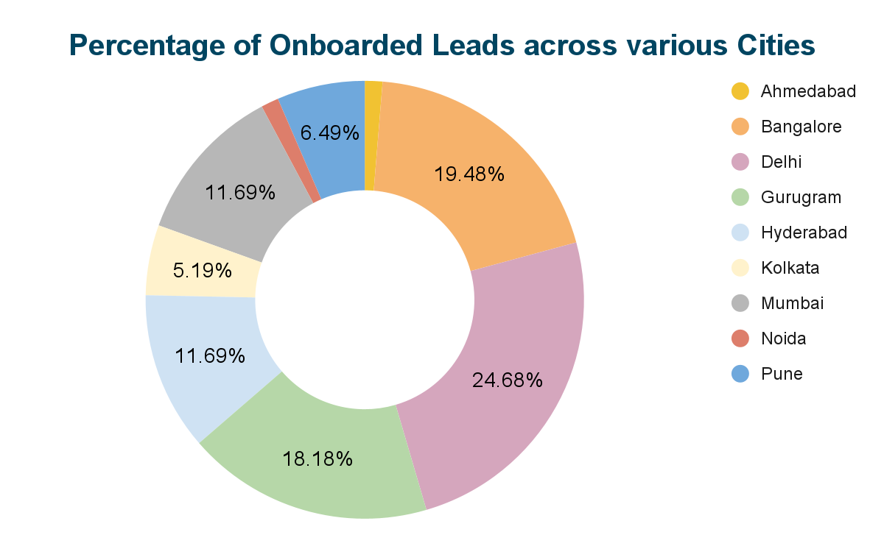

Slide 7
Brief Insight Analysis from No of Leads Onboarded in Different Cities
Delhi has the highest number of onboarded students, indicating a strong demand for hostels in the city.
Bangalore and Gurugram also show significant conversion rates, suggesting a thriving student population in those cities.
Chandigarh has no onboarded students, indicating a potential untapped market or lower demand for hostels.
Other cities, such as Hyderabad, Kolkata, Mumbai, Pune, and Noida, have moderate conversion rates, indicating a decent market for hostels.
Ahmedabad and Noida have the lowest conversion rates, suggesting potential areas for improvement in attracting and converting leads.
Overall, the data highlights the regional variations in hostel demand and the need for targeted marketing strategies in each city.

Slide 8
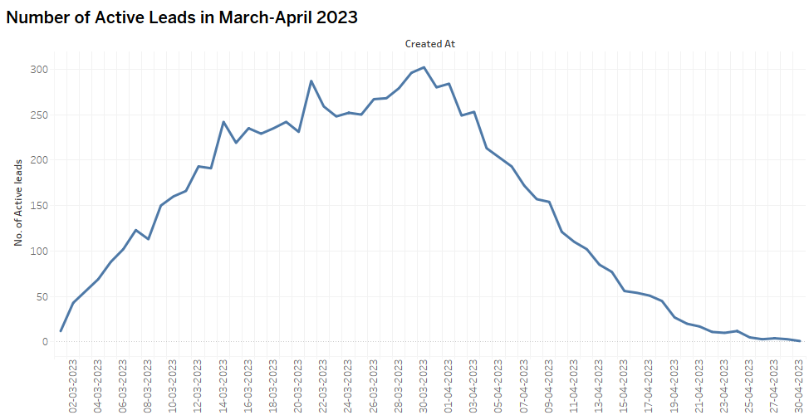

Slide 9
Brief Insight Analysis from Number of Active Leads from March-April 2023
The graph shows a clear increasing trend in the number of leads from March 1st to March 21st, reaching a peak at 287 leads.
After that, the lead count starts to decline until April 30th. A seasonal pattern is also visible in the graph, suggesting the influence of certain factors on lead generation.
By comparing the data with other metrics, such as conversion rates or sales, it becomes possible to measure the effectiveness of lead generation efforts.
The graph can also help identify any impact of marketing campaigns and initiatives on lead generation.
Furthermore, the declining trend after March 21st indicates the need for lead nurturing strategies.
Finally, any unexpected variations in lead counts can be identified and further investigated.

Slide 10
Conclusions
The pre-verification stage is essential for lead generation, with verification establishing trust and authenticity and high conversion rates. Improvements can be made in connection and agreement stages to optimize lead conversion.
Regional variations exist with Delhi, Bangalore, and Gurugram having strong conversion rates, and Chandigarh presenting untapped potential.
Lead trends and seasonal patterns suggest the need for strategic lead management and targeted marketing efforts.
Further analysis is needed to identify data anomalies and address any issues.

Slide 11
Thank You

