Slide 1

ADVENTURE WORKS
Sales Analysis

Slide 2
AGENDA
Analytics Team
Project recap
Task
Flow of work
Insights
Conclusion

Slide 3

Analysis Team
1
Suhas K S, Data Analyst Project Trainee.
2
Mounika Gangavath, Data Analyst Project Trainee.
3
Revathi RC, Data Analyst Project Trainee.
4
U Ananya Data Analyst Project Trainee.

Slide 4

Project Recap
Adventure Works Cycles is a multinational bicycle manufacturing company catering to North American, European, and Asian commercial markets.
Need for analysis:
Adventure Works Cycles is looking to
Broaden its market share by targeting its sales to its best customers.
Extending their product availability through an external Website.
Reducing their cost of sales through lower production costs.

Slide 5
Task
1
To identify the target customers.
2
To help in reducing production cost by analyzing market trends.
3
To analyze the effect of extending business through external website.

Slide 6
Flow of Work
1
Data Gathering
2
Understanding of Data
3
Data Cleaning
4
Data modelling
5
Insight Generation

Slide 7
Insights
Performance analysis of CY 2013
$16.35 M
$6.77 M
179.96%
1
Sales
Contributes 55.69% to the overall sales(29.36 M).
2
Profit
Contributes 56.04% to the overall profit(12.08 M).
3
YOY growth
Almost 3X performance than previous year(5.84 M)

Slide 8
Market Analysis

Slide 9
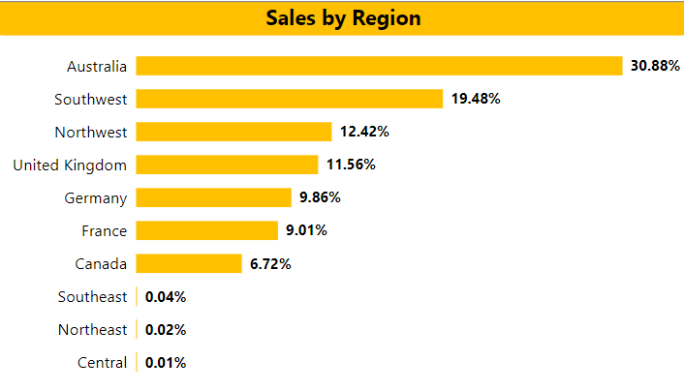
Insights
Top 2 regions are accounting more than 50% of the sales.
Australia and USA(west) are the potential market, each contributing over 30% of overall sales.
Central and East regions of USA has negligible contribution in Sales.

Slide 10
Sales Trend

Slide 11
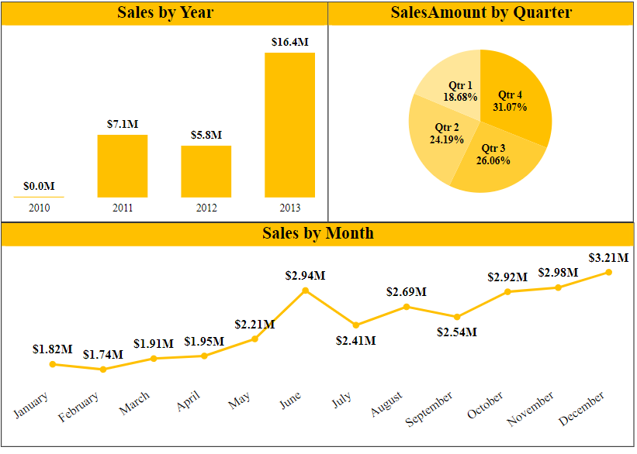
Insights
Positive growth trend in YOY Sales.
Significant growth in CY2013.
Festive season in Q4 accounts highest sales.
Sales spike in June represents seasonal demand in the market.

Slide 12
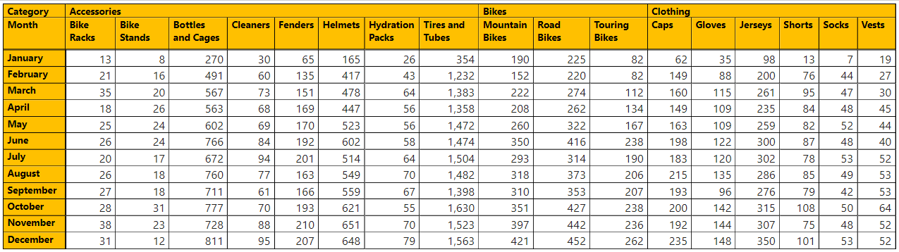
Insights
Market demand for Products in CY2013

Slide 13
Effect of E-Commerce

Slide 14
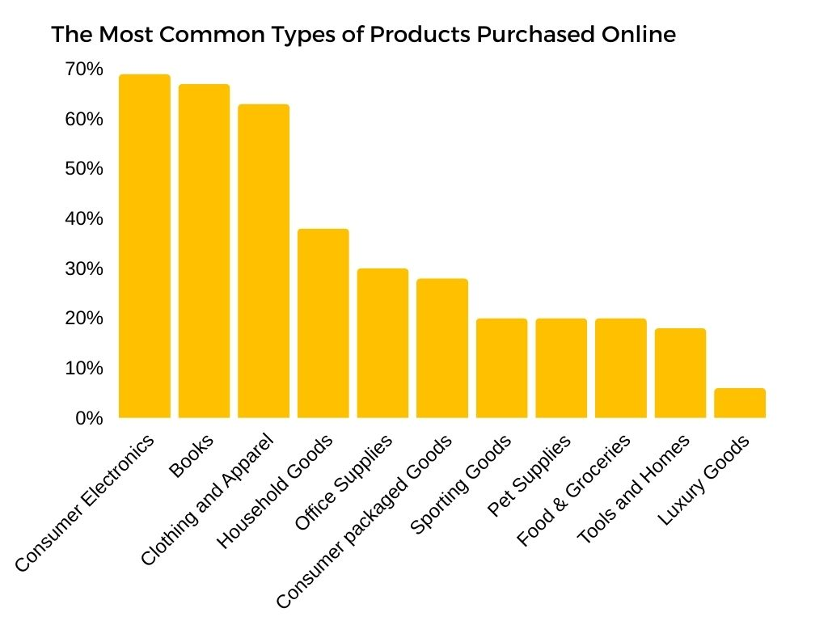
Insights
Expanding business through external website contributes 20% of overall revenue
Easy access to customers, Increase in customer base
Reduction in brokerage to dealer accounts in reduction in marketing and operational expenses.
20%

Slide 15
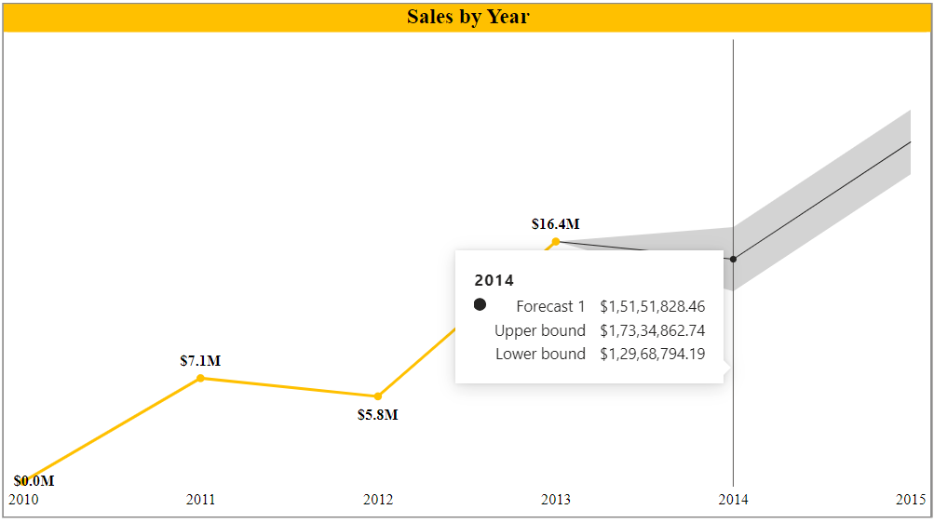
Insights
From past sales figures, considering positive growth trend and business expansion through website we can forecast the sales of CY 2014 around $15M – $17M.

Slide 16
Conclusion
1
Potential customers are based in USA (west) and Australia regions.
2
Planning production activities based on market demand, results in reduction of overall production cost by reducing the cost of overstocking and increasing production efficiency.
3
Business expansion through website contributes in 20% of overall sales.

Slide 17

Any Questions ?

Slide 18


